Slide 1
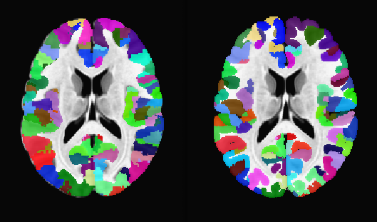
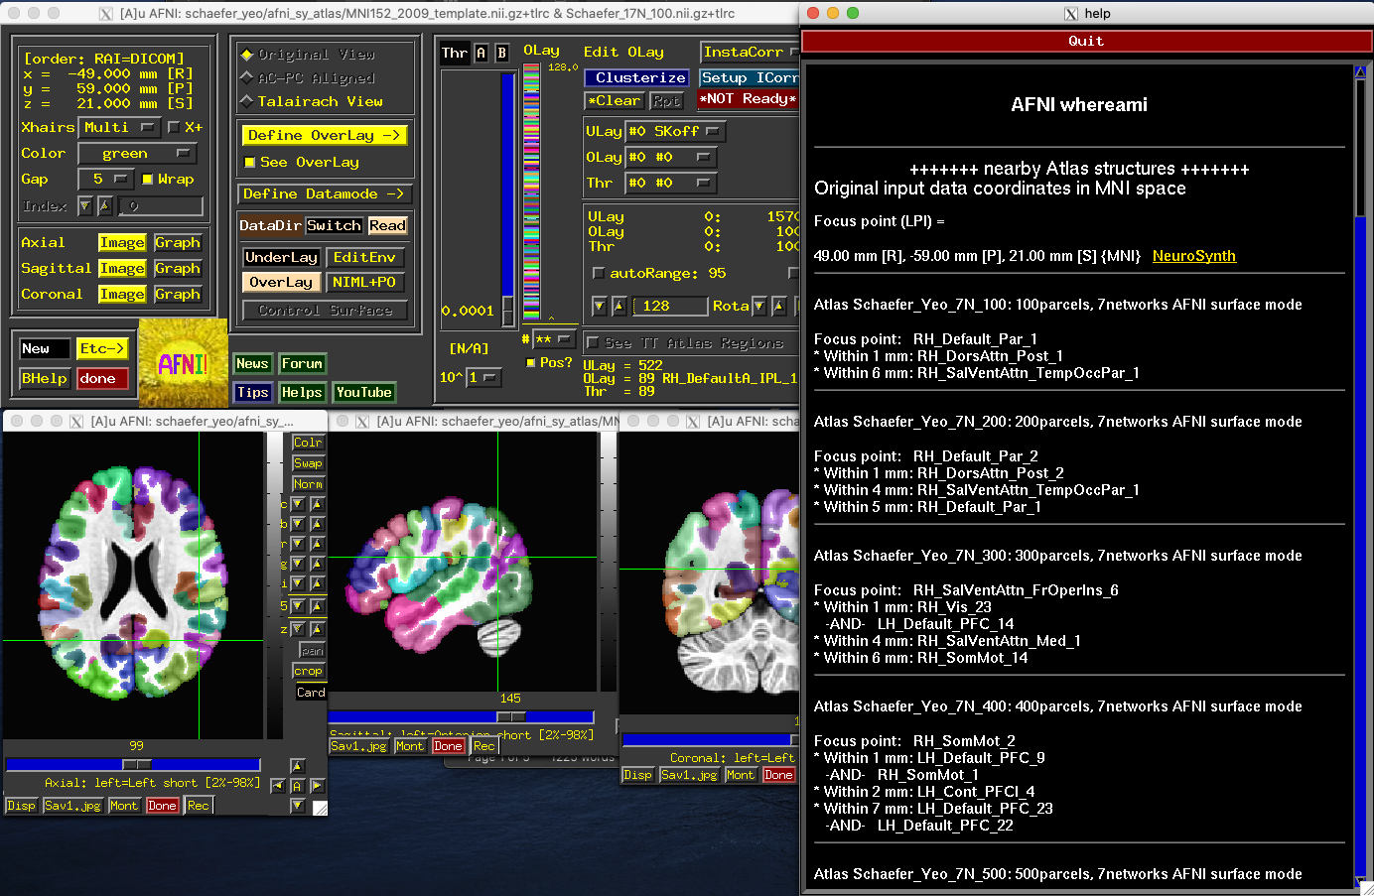
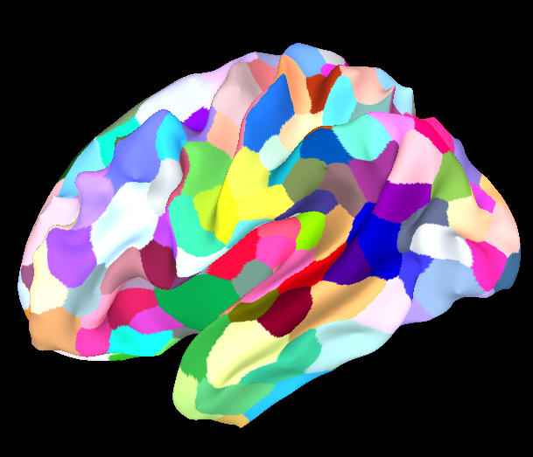
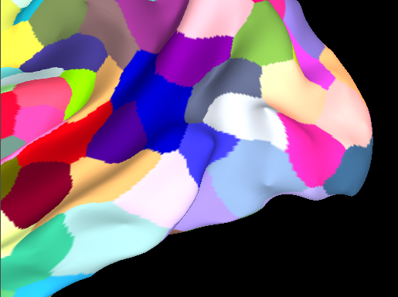
Schaefer-Yeo-AFNI-2021 Atlases: Improved ROIs with AFNI+SUMA Processing
Daniel Glen¹, Richard Reynolds¹, Paul Taylor¹, Xiaozhen You², Ruby Kong³, Aihuiping Xue³, Xiaoxuan Yan³, B.T. Thomas Yeo³ ¹NIMH, ²Childrens National Medical Center, ³National University of Singapore
Introduction:
The original set of Schaefer-Yeo atlases [1] was created from resting-state FMRI activity, with a variable number of regions (100-1000) and two sizes of network groups (7 or 17). Since its introduction, the atlas has seen wide usage in the neuroscience community partly because the multi-scale resolution of this atlas has made it flexible for a variety of studies and for its ready usage for network analysis. Here, we introduce some important updates to this atlas, namely regions matching the MNI 2009c template, contiguous regions and standard mesh versions. The processing here was completed using AFNI/SUMA tools [2,3] together with FreeSurfer [4].
a
b
Results:
The resulting volumetric (Figure 1) and surface versions (Figure 2) of the Schaefer-Yeo atlases are improved by the spatial contiguity of the atlas regions, removal of the jagged edges of the original regions, placement on the higher resolution grid and better correspondence to the improved template space of the MNI 2009c volume. Furthermore, the standard mesh versions of the surface atlases allow for propagation into subject-specific native space via each subject's FreeSurfer registration and SUMA by enforcing spatial correspondence across subjects.
Figure 1. Volumetric Atlases
a. Original Shaefer FSL MNI – 400 region, 17 networks on MNI152 2009c template
b. Projected to dilated ribbon mask on same template
Methods:
First, the original volumetric version of this atlas was made based on alignment to the MNI 2006 asymmetric template. In this release, we instead create atlas datasets that are aligned to the MNI 2009c template, which has improved structural contrast and provides a better target for nonlinear alignment, thus increasing correspondence across subjects. Furthermore, we enhance the contiguity of regions by a modal smoothing method, where every node vertex on the surface is replaced by the most common voxel in its local neighborhood. The surface mapping is projected into the volume to fill a cortical ribbon mask. Centers are computed for every region, and the atlas is available to AFNI's whereami GUI and command line for atlas queries. The original Schaefer-Yeo atlases are distributed as both volume and surface datasets. Here we use the surfaces and the FreeSurfer [4] registration (sphere.reg) to the fsaverage space to create high resolution standard mesh surfaces (where node indices are anatomically consistent across subjects)[5]. We apply modal smoothing on the surface using the new program, SurfLocalstats, with a radius of 3mm. We then project the atlas from the surface to the MNI 2009c volume, using a volumetric form of modal smoothing to fill a dilated cortical ribbon mask (@surf_to_vol_spackle)..
AFNI whereami interface
c
Modal smoothing on the surface – original, 1, 2, 2.5, 3, 4, 5 mm. Top-400 parcels, Bottom-1000 parcels 3mm neighborhood mode used for these atlases.
d
Conclusions:
An improved version of the Schaefer-Yeo atlases is provided with better spatial contiguity, a more relevant anatomical template and better surface based parcellations on a standard mesh. The scripts, atlases and intermediate datasets are all made available on the AFNI website https://afni.nimh.nih.gov/pub/dist/atlases/SchaeferYeo
References
[1] Schaefer A, Kong R,Gordon EM, Laumann TO, Zuo XN, Holmes AJ, Eickhoff SB, Yeo BT. Local-Global Parcellation of the Human Cerebral Cortex from Intrinsic Functional Connectivity MRI, Cerebral Cortex, Volume 28, Issue 9, September 2018, Pages 3095–3114, https://doi.org/10.1093/cercor/bhx179 [2] Cox RW. AFNI: Software for analysis and visualization of functional magnetic resonance neuroimages. Computers and Biomedical Research, 29:162-173, 1996. [3] Saad ZS, Reynolds RC, Argall B, Japee S, Cox RW. SUMA: An Interface For Surface-Based Intra- And Inter-Subject Analysis With AFNI. 2004 IEEE International Symposium on Biomedical Imaging: From Nano to Macro. IEEE, Arlington, VA, pp. 1510-1513 (2004). [4] Fischl B, et al. “Whole brain segmentation: automated labeling of neuroanatomical structures in the human brain.” Neuron vol. 33,3 (2002): 341-55. doi:10.1016/s0896-6273(02)00569 [5] Argall, Brenna D et al. “Simplified intersubject averaging on the cortical surface using SUMA.” Human brain mapping vol. 27,1 (2006): 14-27. doi:10.1002/hbm.20158
Figure 2. Surface Atlases, smooth white matter surface from MNI 2009c template, 400 regions, 17 networks
a,b - Original Schaefer annotation, zoomed version
c,d – Modally smoothed (3mm) labels, zoomed version

