Slide 1
FMRI Task-Based Data Analysis at the Individual Level
SSCC/NIMH/NIH/DHHS/USA/Earth

Slide 2
Overview
Basics of linear models for data analysis
FMRI data decomposition: three components
Baseline + slow drift + effects of no interest; Effects of interest; Noise
Effects of interest – understanding BOLD vs. stimulus
IRF and HRF and HDR
Three modeling strategies
Fixed-shape HRF
Variable HRF shape
Fixed major HRF shape plus a little shape adjustment
Other issues
Multicollinearity
Run catenation
Percent signal change

Slide 3
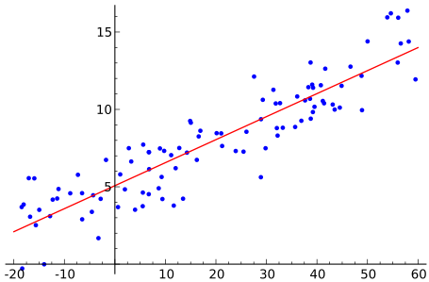
Basics of Linear Modeling
Regression: finding a relationship between a response/outcome (dependent) variable and one or more explanatory (independent) variables (regressors)
Also called linear model or linear regression
Equations
i=index of data = 0, 1, 2 … N-1 (total of N data points)
x_{i}=explanatory model (known value) for data point number i
y_{i}=data value for data point number i
y_{i} = β₀ + β₁x_{i} + ε_{i} or y_{i} ≈ β₀ + β₁x_{i}
β₀ and β₁ are model fit parameters
to be calculated from the x_{i} and y_{i}
ε_{i} are the residuals
what are left after the regression
assumed to be random noise

Slide 4
y_{i} = β₀ + β₁x_{i} + ε_{i} or y_{i} ≈ β₀ + β₁x_{i}
y
β₀ is the intercept
ε_{i}
β₁ is the slope
x

Slide 5
Modeling with Vectors and Matrices
Write the model y_{i} ≈ β₀ + β₁x_{i} out in columns (vectors)
In vector-matrix form (bold letters for vectors and matrices)
y ≈ X β or with residual vector y = X β + ε
By writing it out this way, the equations become more compact and easier to look at and easier to understand
Each column of X matrix is a regressor or model component
We assume the columns of X are known, and that data vector y is known (measured)
Goal is to compute parameter vector β (and statistics about β)
Most of this talk: where do we get X for FMRI task analysis?
y₀
y₁
y₂
…
1
1
1
…
x₀
x₁
x₂
…
1
1
1
…
x₀
x₁
x₂
…
β₀
β₁
≈
β₀ +
β₁ =
data vector
N×2 matrix

Slide 6
Solving a Linear Model
Vector y is sum of matrix X times vector β plus residuals ε
Solution for linear regression y = Xβ + ε
“Project” data y onto the space of explanatory variables (X)
OLS formula for solution:
Columns of X are the model for data vector y
Meaning of coefficient: β_{k} value is slope, marginal effect, or effect size associated with regressor number k [column k in X]
β_{k} value says how much of regressor number k is needed to fit the data “best” – in the Ordinary Least Squares sense
That is, the sum of the squares of ε_{i} is made as small as possible
If we don’t care about regressor number k, then we don’t care about the value of β_{k}
But we included regressor number k in the model because it was needed to fit some part of the data
Regressors of no interest make up the global Null Hypothesis in the model – in AFNI, we call these regressors the baseline model

Slide 7
Statistics in a Linear Model
Various statistical tests carried out after solving for β vector
Some examples, with particular null hypotheses H₀
Student t-test for each β_{i} of interest
H₀: β₃ = 0
Student t-test for linear combination of some β_{i} values = general linear test (GLT)
H₀: β₃ – β₅ = 0
H₀: 0.5*(β₃ + β₄) – β₅ = 0
F-test for composite null hypothesis
H₀: β₃ = β₄ = β₅
H₀: β₃ = β₄ = β₅ = 0
Omnibus or Full F-test for the entire model
H₀: all β_{i} values of interest are 0

Slide 8
Linear Model with FMRI
Time series regression: data vector y is time series = all values from one voxel throughout multiple image acquisitions (TRs)
Regressors: idealized BOLD response curves
We can only find what we’re looking for
Regression will miss something if we do not look for it
So we must include regressors of no interest, so we can model things like baseline drifting up or down
Regressor construction requires decisions
Don’t want to over-fit or under-fit data
Same model matrix X for all voxels in the brain
Simultaneously solve all the models (1 for each voxel)
Voxel-wise analysis = massively univariate method
y₀
y₁
y₂
…
time

Slide 9
FMRI Experiment Terminology
Experiment setup
Number of subjects
Number of conditions [tasks, stimulus (trial, event) types]: Factorial design?
Sample size (repetitions) per condition
Block, event-related, or mixed?
Inter-stimulus interval (ISI) – regular, random?
Scanning parameters: TR, voxel size, data points (volumes), slice sequence (sequential or interleaved), slice thickness, removing first few TRs
Scanning terms
Run: continuous scanning; a brief break between runs
Session: subjects come back after a long period of time
Experiment or study

Slide 10
Types of FMRI Experiments
Two classical types of experiment design
Block (boxcar) design
Each stimulus block lasts for more than one TR (e.g., 4 to 20s)
Each block is under one condition (e.g., watch a video clip), or a series of multiple trials (e.g., 10 consecutive blur images)
BOLD response is often visible in time series
SNR: noise magnitude about same as BOLD response
Event-related design
Each event or trial lasts for one TR or shorter
Events are randomly spaced and/or sequenced in time
BOLD response to stimulus tends to be weaker, since fewer nearby-in-time “activations” have overlapping signal changes
SNR: data looks more like noise (to the pitiful human eye)
Mixed designs
Containing both events and blocks, e.g., cue + video watching
Continuous stimulation (e.g., movie watching)
Not covered here – more like resting state analysis

Slide 11
FMRI Data
Data partition: Data = Signal + Noise
Data = acquisition from scanner (voxel-wise time series)
Signal = BOLD response to stimulus; effects of interest + no interest
We don’t actually know the real signal shape to look for!!!
Look for idealized task responses by assuming a fixed shape for BOLD effect (FMRI response) for each task trial
Or search for signal shape via repeated trials and basis functions
Of interest: effect size (response amplitude) for each task: beta
Of no interest: baseline, slow drifts, head motion effects, …
Noise = components in data that interfere with signal
Practically: the part of the data we can’t explain with the model
Will have to make some assumptions about its probability distribution – to be able to carry out the statistical tests
Data = baseline + slow drift + other effects of no interest + response₁ + … + response_{k} + noise
How to construct the regressors of interest (responses)?

Slide 12
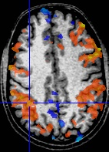
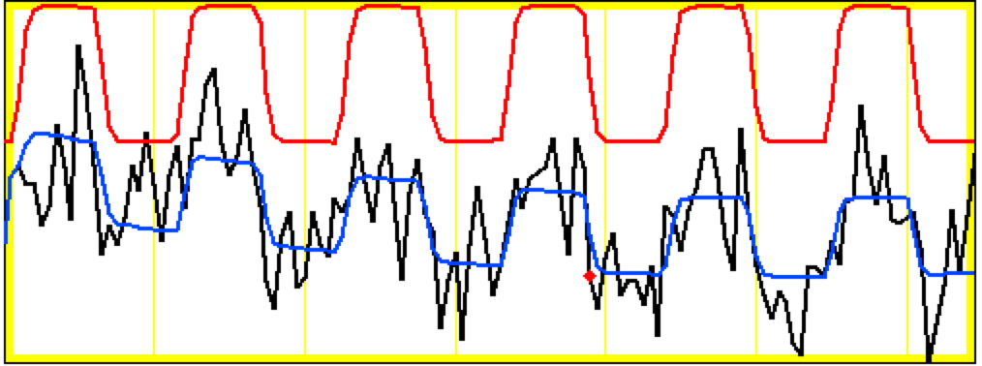
Block data of one run at a voxel
model regressor
model fitted to data
Noise ~ same size as signal change
data
Block: 27 s “on” / 27 s “off”; TR=2.5 s; 130 time points
This is “best” voxel; most voxels are not fitted as well as this
Data drifts downwards – this effect is captured in the model fit by baseline drift regressors
If we did not model for drift, our fit would not be as good
Activation amplitude and shape vary across blocks
Reasons why? We can only guess
Habituation? Attention? Noise?

Slide 13
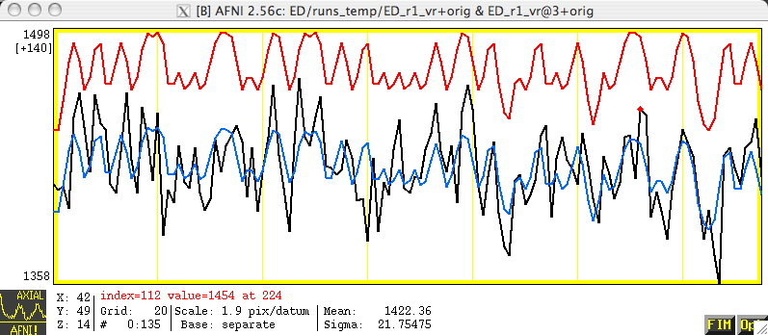
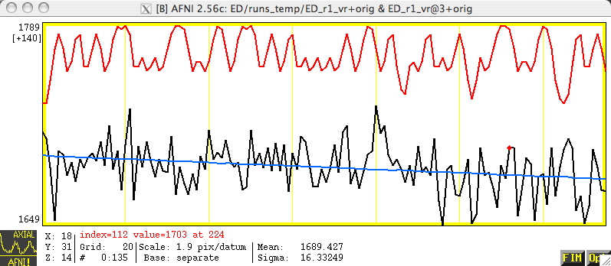
Event-Related Data at 2 Voxels
correlation with ideal = 0.56
Voxel activated
Voxel not activated
correlation with ideal = – 0.01
Lesson: ER-FMRI activation is not obvious via casual inspection

Slide 14
BOLD Response
Hemodynamic response (HDR)
Brain+FMRI response to stimulus/task/condition
Indirect measure of neural response: brain activation➔ changes in blood oxygen➔changes in FMRI signal
Hemodynamic response function (HRF)
Mathematical formulation/idealization of HDR for one full stimulus interval
HRF bridges between neural response (what we like) and BOLD signal (what we measure)
How to build the bridge?
Most simple: Assume a fixed-shape (idealized) HRF
Most complex: No assumption about HDR shape
Basis function expansion of HRF shape and size
In the middle: 1 major fixed shape + a little space for shape adjustment

Slide 15
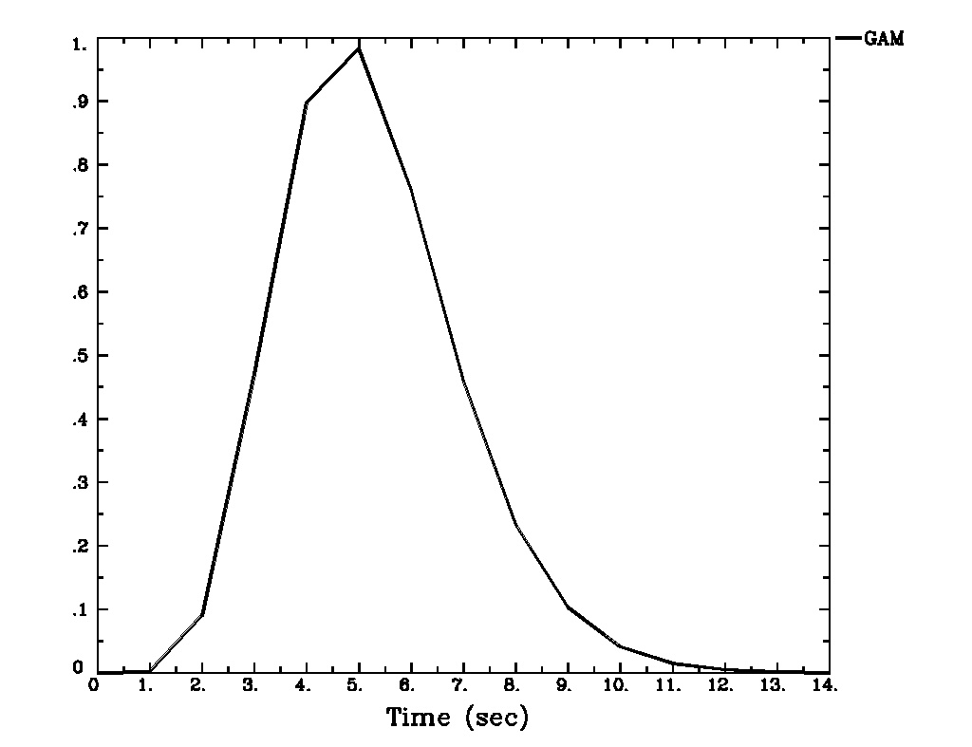
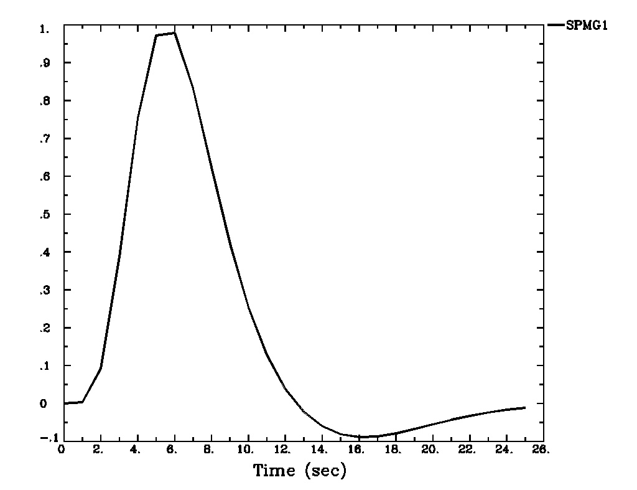
Fixed-Shape HRF – 1 s Stimulus
Assume a fixed shape h(t) for HRF to an instantaneous (very short) stimulus: impulse response function (IRF)
GAM(p,q): h(t) = t ^{p} exp(t/q) for power p and time q
Sample IRF: h(t) = t ^{8.6} exp(-t/0.547) [MS Cohen, 1997]
A variation: SPMG1 (undershoot is added in)
Build HRF based on presumed IRF through convolution
Combine IRF h(t) with stimulus timing S(t):
GAM
SPMG1
Short
Stimulus
(≤ 1s)

Slide 16
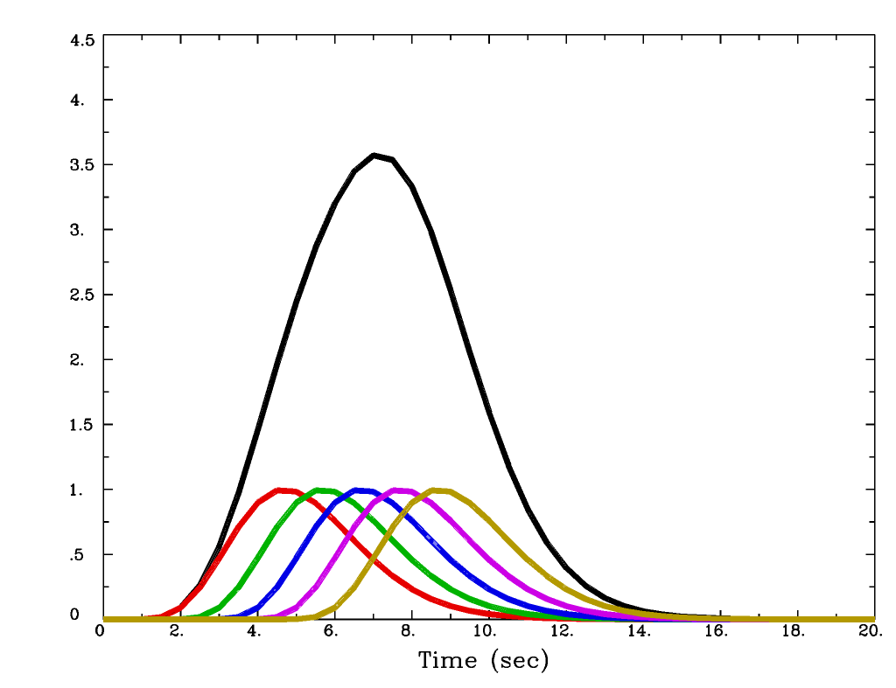
Fixed-Shape HRF – 5 s Stimulus
Combine IRF h(t) with stimulus timing S(t):
Cannot distinguish individual responses to nearby stimuli with FMRI
Sum of 5 copies of GAM
Copies of GAM
= h(t) 1 s apart

Slide 17
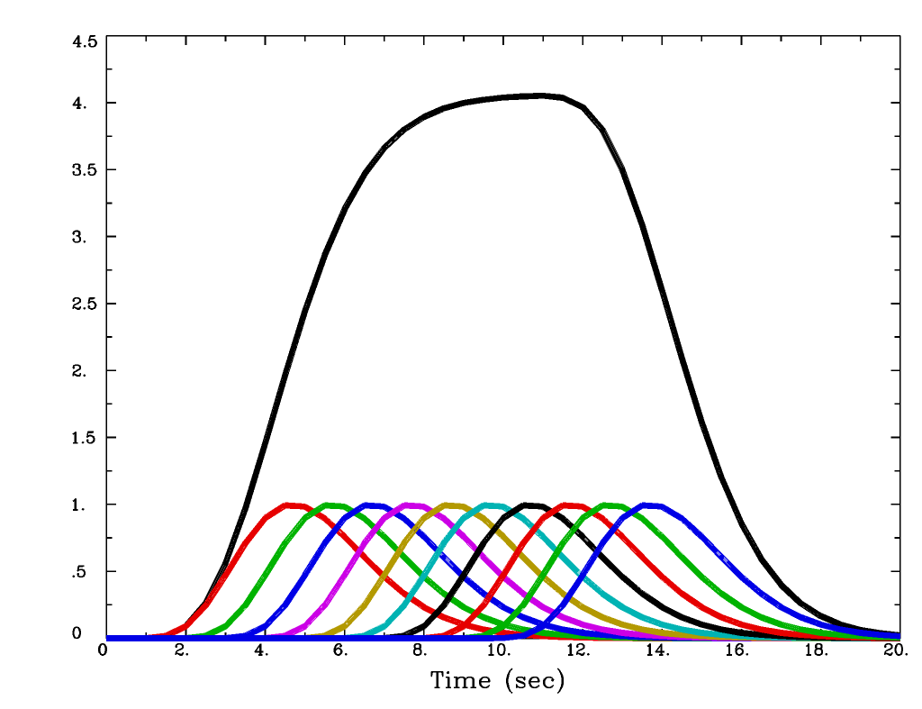
Fixed-Shape HRF – 10 s Stimulus
Combine IRF h(t) with stimulus timing S(t):
Stimulus duration
longer than 10 s is
Block Design
Sum of 10
copies of GAM

Slide 18
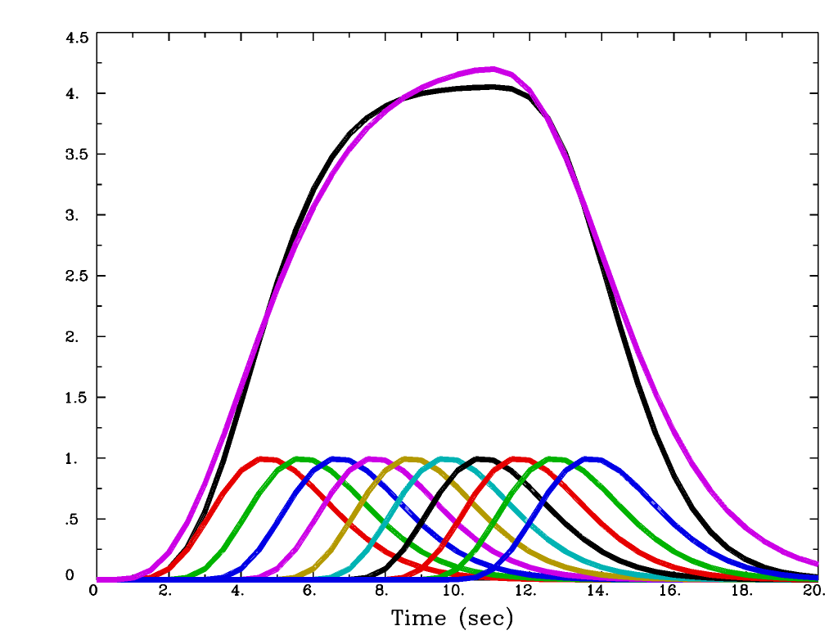
Fixed-Shape HRF – 10 s Stimulus
With the ‘BLOCK(10)’ function in AFNI
BLOCK(d) function is used to specify HRF for individual responses to stimuli with duration d
HRF = BLOCK(10)

Slide 19
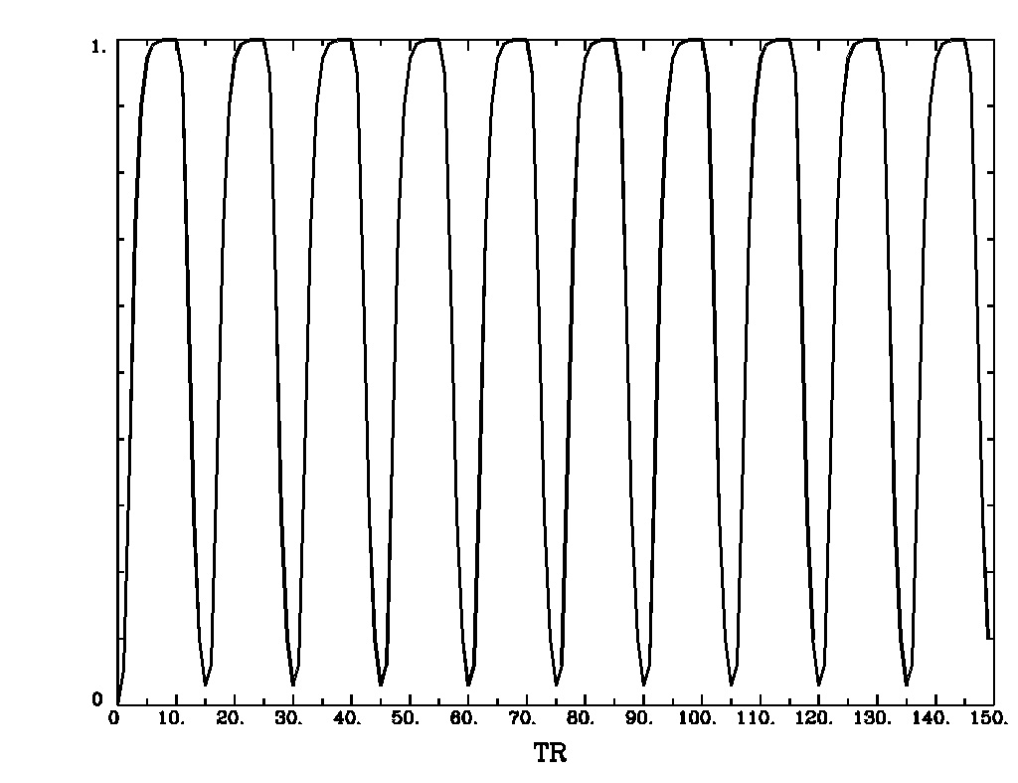
Fixed-Shape HRF for Block Design
Assuming a fixed shape h(t) for IRF to an instantaneous (very short) stimulus
For each block, h(t) is convolved with stimulus timing and duration (d) to get idealized response (temporal pattern) as an explanatory variable (regressor): HRF = BLOCK(d,p)
Equivalent to adding up a series of consecutive events
scale HRF to p=1 for easy interpretation of β
HRF = BLOCK(20,1)
Start times for each block
Block: 20 s on and 10 s off; TR=2 s; 150 time points

Slide 20
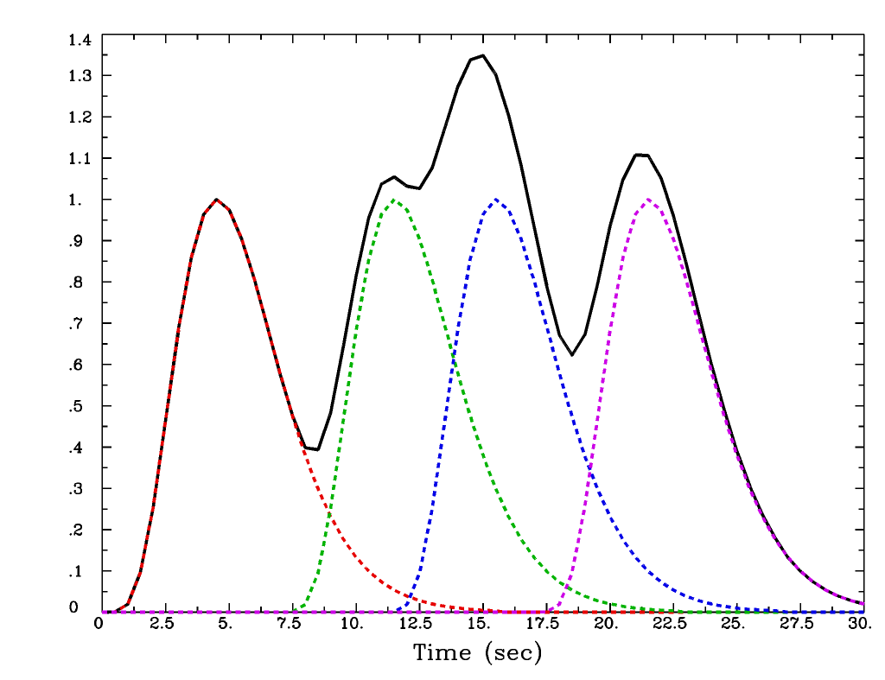
Fixed-Shape HRF for Event-Related Design
The BLOCK HRF shape is useful with event-related experiment designs
Just use a short duration, such as 1 second
Real experiments have more than 4 task repetitions!
Start times for each 1 s event
HRF = BLOCK(1,1)
Sum of 4 individual HRFs gives the regressor for this task

Slide 21
Linear Model with Fixed-Shape HRF
FMRI data = baseline + drift + other effects of no interest + response₁ + … + response_{k} + noise
‘baseline’ = baseline + drift + other effects of no interest
Drift: physiological effect, tiny motions, scanner fluctuations
Data = ‘baseline‘ + effects of interest + noise
Baseline condition (and drift) is treated in AFNI as baseline model, an additive effect, not an effect of interest (cf. SPM/FSL)!
Baseline+drift+… also need parameters in the model fit
y_{i} = α₀ + α₁ t_{i} + α₂ t_{i}² + β₁x_{1i} +… + β_{k}x_{ki} +…+ ε_{i} [i = time]
y = Xβ + ε, X = [1, t, t², x₁, x₂, …, x_{k}, …] [vector format]
In AFNI baseline + slow drift is modeled with polynomials
A longer run needs a higher order of polynomials
One polynomial order per 150 sec is the default in AFNI
With m>1 runs, m sets of polynomials needed to allow for temporal discontinuities across runs
m(p+1) columns for baseline+slow drift with p-order polynomials
Other effects of no interest: head movement estimates

Slide 22
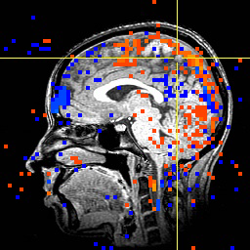
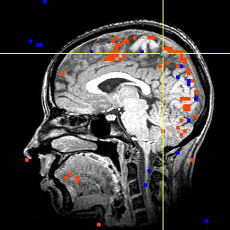
Stimulus Correlated Motion = Bad
Activation map with image registration but without using movement estimates as regressors
Activation map when also using movement estimates as regressors

Slide 23
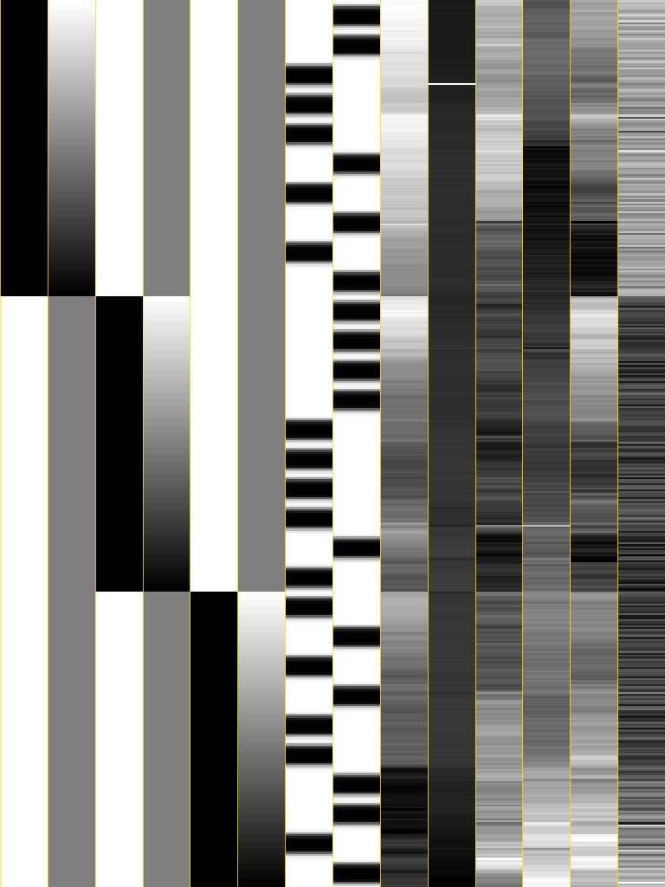
Design Matrix with Fixed-Shape HRF
Voxel-wise (massively univariate) linear model: y = Xβ+ε
X: explanatory variables (regressors) – same across voxels
y: data (time series) at a voxel – different across voxels
β: regression coefficients (effects) – different across voxels
ε: anything we can’t account for – different across voxels
Visualizing design matrix X = [1, t, x₁, x₂, …, x_{k}, …] in grayscale image
}
}
baseline + drift
stimuli
head motion
}
6 drift effect regressors
linear baseline
3 runs x 2 parameters/run
2 regressors of interest
that is, relevant to brain activity
6 head motion regressors
3 rotations + 3 shifts
Black = bigger numbers
White = smaller numbers
Each column of X scaled separately

Slide 24
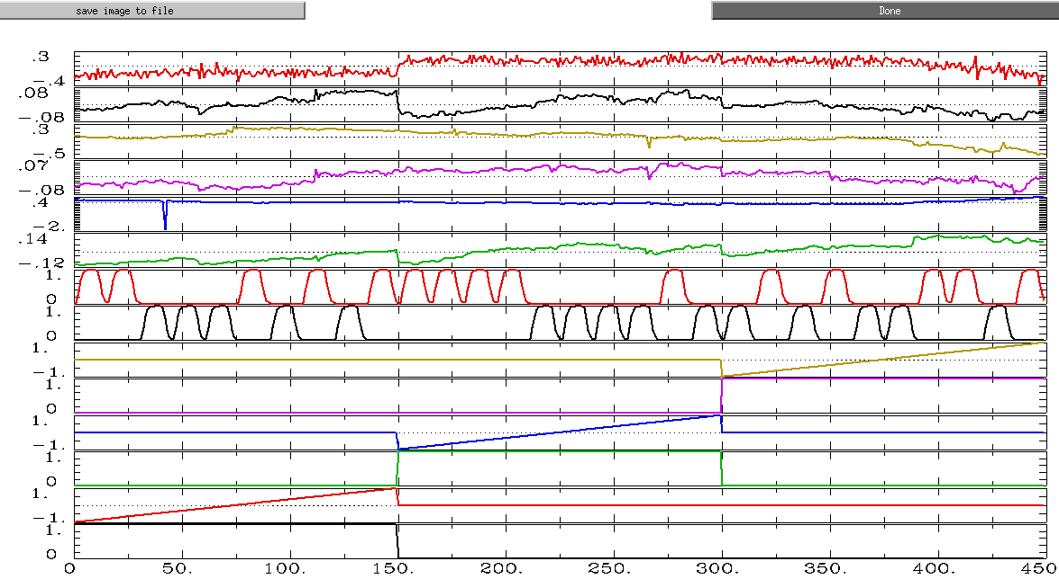
Design Matrix with Fixed-Shape HRF
Visualizing same design matrix X = [1, t, x₁, x₂, …, x_{k}, …] in graphs

Slide 25
Model Quality Check
First thing to do!
Unfortunately most users in FMRI simply jump to specific effects of interest, their contrasts and their significance. They simply don’t pay any attention (or lip service) to overall model performance at all!
Approaches to judge your model
Design matrix report from 3dDeconvolve
Full F-statistic (automatically provided in AFNI); testing
Data = ‘baseline‘ + effects of interest + noise versus
Data = ‘baseline‘ + noise
or, Determination coefficient R² at activated regions (-rout in 3dDeconvolve):
Block design: ~50%
Event-related experiments: 10-20%
Modeled vs. not modeled: –fitts and –errts in 3dDeconvolve
Fitted curve = ‘baseline‘ + effects of interest
Residuals = noise = components we have no idea about
This message is usually due to setup mistakes

Slide 26
Statistical Testing
Everything is about contrast!
Effects (regression coefficients) of interest
β: effect relative to baseline condition (by default in AFNI)
β_{A} = Effect_{A} - β_{base}
t-statistic: statistical significance of a β
Pairwise comparisons (contrasts)
Conditions β_{A} vs. β_{B} (e.g., house vs. face)
β_{A} – β_{B} = (Effect_{A} - β_{base}) – (Effect_{B} - β_{base}) = Effect_{A} - Effect_{B}
t-statistic: statistical significance of this difference
General linear test – linear combination of multiple effects
t-statistic of 0.5*happy + 0.5*sad – neutral
Composite tests
F-statistic for composite (multi-part) null hypotheses: happy = sad = neutral = 0 [3 parts]; or, happy = sad = neutral [2 parts]

Slide 27
Assessing Fixed-Shape HRF Approach
Used 99% of time: Why is it popular?
Assume brain responds with same shape across 4 levels: subjects, activated regions, stimulus conditions/tasks, trials
Difference in magnitude β in different conditions or different subjects (and its significance) is what we focus on
Strong assumption about four levels of shape information?
Easy to handle and think about: one value per effect/task
Works relatively well
Block design: shape usually not important due to accumulating effects (modeled via convolution) of consecutive events
Really plateau? Same magnitude across blocks?
Event-related experiment: OK most of time
Linearity when responses overlap? Same effect across events?
Not what you want if you
Care/worry about shape difference across subjects, across regions, across conditions, and across trials
Improved modeling

Slide 28
Alternative: No Constraint on HRF Shape
TENT expansion of HRF
Set multiple tents at various equally-spaced locations to cover the potential BOLD response period
Each TENT is a basis function
HRF is a sum of multiple basis functions, each with its own β
BOLD response measured by TENT heights (βs) at all locations
TENTs are also known as ‘piecewise linear splines’
TENT with unit height
at location 3•TR
h
Formula for standardized TENT centered at x=0, width=±1
time
Cubic splines (CSPLIN)
are also available in AFNI
t = 0
t =TR
t = 2•TR
t = 3•TR
t = 4•TR
t = 5•TR

Slide 29
Σ Tent Functions = Linear Interpolation
5 equally-spaced TENT functions = linear interpolation between “knots” with TENTzero(b,c,n) = TENTzero(0,12,7)
TENT parameters are easily interpreted as function values (e.g., L: TENT radius; β₂ = response (TENT height) at time t = 2L after stimulus onset)
Relationship of TENT spacing L and TR (L ≥ TR), e.g., with TR=2s, L=2, 4s
In uber_subject.py or 3dDeconvolve with TENTzero(0, D, n), specify duration (D) of HRF and number (n): radius L = D/(n-1) with (n-2) full tents, each TENT overlaps half tent with two neighboring ones.
In above example, D=12s, then L=2s n=7; covering 12s; TENTzero(0,12,7)
h
β₂
β₃
6 intervals = 5 β weights
stimulus onset
β₁
β₄
β₅
“knot” times
time
0
L
2L
3L
4L
5L
6L

Slide 30
Tent Functions Create the HRF
And then the HRF is repeated for all stimuli of the same type
In the example on the last slide, the HRF has 5 parameters (βs) to be estimated
The βs determine the amplitude (percent signal change) and the shape of the HRF
Each voxel in each subject gets a separate HRF shape now, not just a separate amplitude
And if there are multiple types of tasks, each task gets a separate shape
Stimulus times do not have to be exactly on the TR grid

Slide 31
Modeling with TENTs - Example
Event-related study (Beauchamp et al., J Cogn Neurosci 15:991-1001)
10 runs, 136 time points per run, TR=2 s
Two factors
Object type: human vs. tool
Object form in videos: real image vs. points
4 types (2x2 design) of stimuli (short videos)
Tools moving (e.g., a hammer pounding) - ToolMovie
People moving (e.g., jumping jacks) - HumanMovie
Points outlining tools moving (no objects, just points) - ToolPoint
Points outlining people moving - HumanPoint
Goal: find brain area that distinguishes natural motions (HumanMovie and HumanPoint) from simpler rigid motions (ToolMovie and ToolPoint)

Slide 32
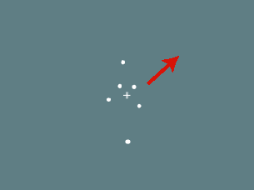
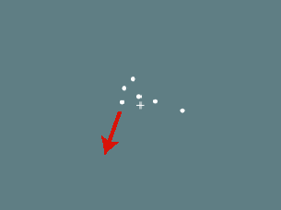
Experiment: 2 x 2 design
Human whole-body motion (HM)
Tool motion (TM)
Human point motion (HP)
Tool point motion (TP)
From Figure 1
Beauchamp et al. 2003
Hypotheses to test:
Which areas are differentially activated by any of these stimuli (main effect)?
point motion versus natural motion? (type of image)
human-like versus tool-like motion? (type of motion)
Interaction effects?
Point: human-like versus tool-like? Natural: human-like versus tool-like?
Human: point versus natural? Tool: point versus natural?

Slide 33
Tool motion (TM)
Human point motion (HP)
Tool point motion (TP)
From Figure 1
Beauchamp et al. 03
Each video is only shown once (2 seconds)

Slide 34
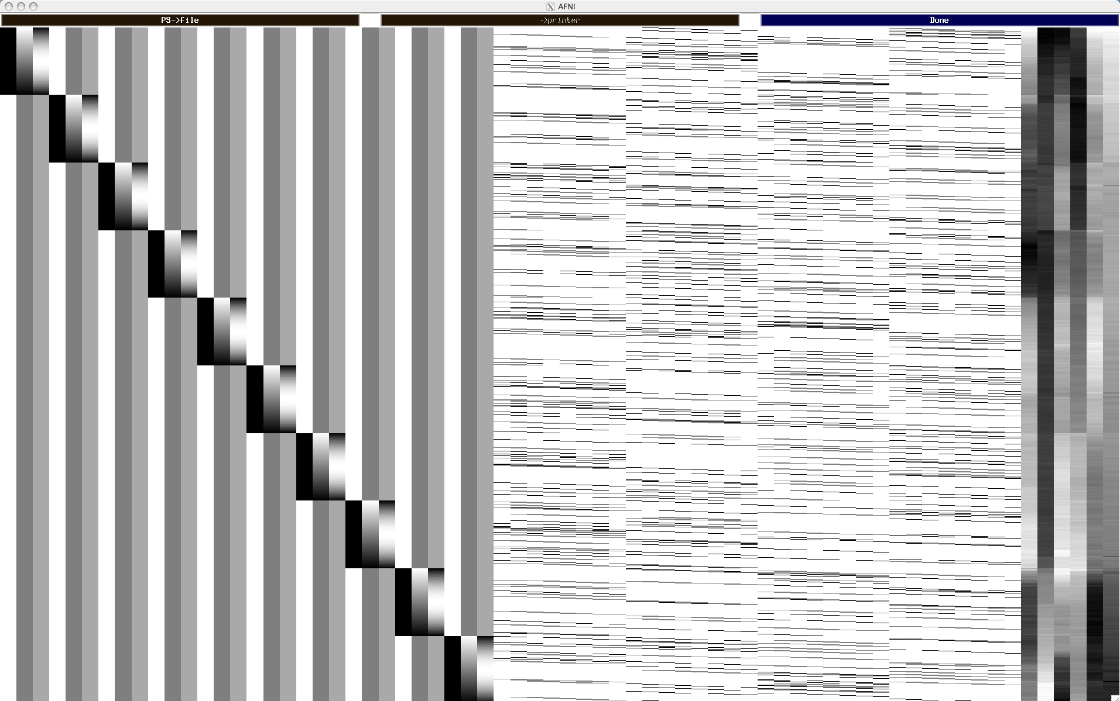
Design Matrix with TENTzero(0,16,9)
Baseline + quadratic trend for 10 runs
7 tents per condition × 4 conditions
head motion

Slide 35
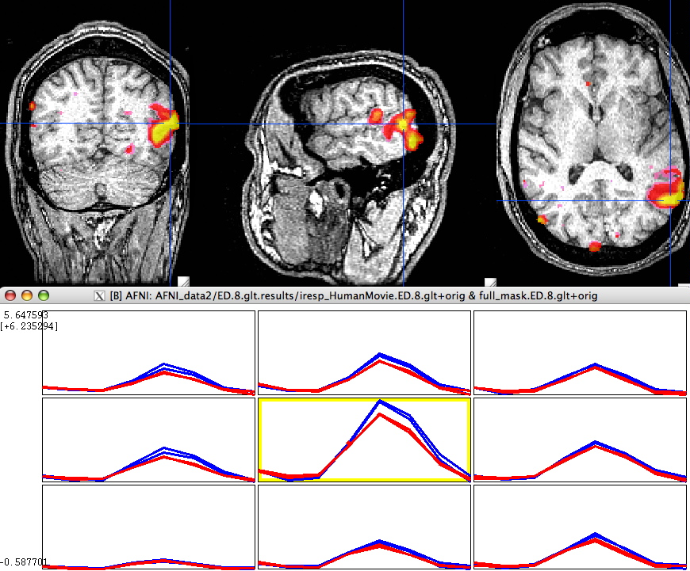
Results: Humans vs. Tools
Color overlay: Human vs Tool
(β_{HM}+β_{HP}−β_{TM}−β_{TP})
Blue (upper) : Human
Red (lower) : Tool

Slide 36
No Constraint on HRF Shape = Deconvolution
Deconvolution perspectives: inverse process of convolution
HRF stimulus = unit BOLD response
Like multiplication, we have to know two and estimate the 3rd
Fixed-shape approach: Convolution + regression
Known: HRF shape, stimulus
Use convolution to create regressors (hidden from user inside 3dDeconvolve program)
Response strength (β) estimated via linear model with programs 3dDeconvolve or 3dREMLfit
Shape estimation: Deconvolution + regression
Known: stimulus + BOLD response; unknown: impulse response
HRF stimulus = BOLD response (note: HRF, not IRF)
HDR estimated as a linear combination of multiple basis functions: TENTs
Each TENT stimulus = one regressor column
Deconvolution: HRF = a set of βs estimated via regression

Slide 37
No Constraint on HRF Shape: Pros + Cons
What is the approach good at?
Usually for event-related experiments, but can be used for BLOCK
Multiple basis functions for blocks: within-block attenuation with time
Likely to have more accurate estimate on HDR shape across
subject
conditions/tasks
brain regions
Likely to have better model fit (the goal in the sample experiment)
Likely to be statistically more powerful on test significance
For block design, may detect within-block attenuation
Cross-block attenuation?
Why is the approach not popular?
Difficult to summarize at group level [see the program 3dMVM]
Multiple parameters (βs)per task condition, instead of just one
More regressors than alternatives: DoF’s per subject
Risk of highly correlated regressors: Multicollinearity
May need to reduce the number of basis functions
Over-fitting: picking up something (head motion) unrelated to HDR

Slide 38
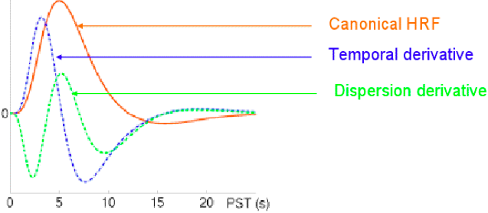
Intermediate Approach: SPMG1/2/3
Use just a few basis functions
Constrain the HDR shape with a principal basis function
SPMG1 (similar to GAM in AFNI): e^{-t}(a₁t^{p1}-a₂t^{p2}) where a₁ = 0.0083333333 p1 = 5 (main positive lobe)
a₂ = 1.274527e-13 p2 = 15 (undershoot part)
2 or 3 basis functions: parsimonious, economical
SPMG1+SPMG2+SPMG3
SPMG2: temporal derivative capturing differences in peak latency
SPMG3: dispersion derivative capturing differences in peak width

Slide 39
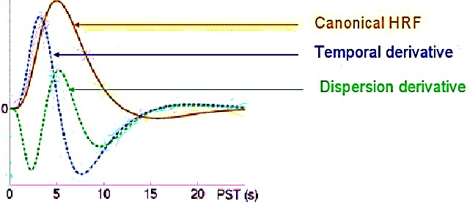
SPMG1/2/3 [Ready for their closeup, Mr. DeMille]
You can use these as basis functions in AFNI
We don’t usually recommend this
The next few talks show the details of how to choose the basis functions for the HRF

Slide 40
Multicollinearity
Voxel-wise regression model: y = Xβ+ε
Regressors in design matrix X = [1, t, t², x₁, x₂, …, x_{k}, …]
Multicollinearity problem
Two or more regressors highly correlated
Difficult or impossible to distinguish the effects among these regressors (i.e., get reliable β estimates)
Multicollearity scenarios
Collinearity - x_{i}= λx_{j} = model specification error; e.g., 2 identical regressors (mistake in stimulus timing specifications)
Exact multicollinearity: linear dependence among multiple regressors = faulty design (rare)
High degree of correlation (+ or -) among regressors = design problem (e.g., cue + movie watching)
Too many basis functions in response model
Diagnosis tools: ExamineXmat.R, timing_tool.py, xmat_tool.py

Slide 41
Serial Correlation in Residuals
Why temporal correlation?
In the residuals/noise (not the time series data)
Short-term physiological effects (breathing, heartbeat)
Other unknown reasons (scanner issues?)
What is the impact of temporal correlation?
With white noise assumption, βs are unbiased, but the statistics tend to be inflated
Little impact on group analysis – if only using βs from subjects
May affect group analysis if considering effect reliability, as in AFNI’s 3dMEMA program (where βs and ts are used)
Approach in AFNI
ARMA(1,1) noise model for residual time series correlation
Slightly different from other packages
Described in the Advanced Regression talk: 3dREMLfit

Slide 42
Dealing with Multiple Runs per Subject
Possible approaches
Analyze each run separately: AFNI, FSL
Have to have enough task repetitions per run
Can test cross-run difference (trend, habituation) at group level
Usually need to summarize multiple β’s before group analysis
Concatenate but analyze with separate regressors across runs for each condition type: AFNI, SPM
Can test cross-run difference (trend, habituation, etc.) at both individual and group level
Still need to summarize multiple β’s before group analysis
Concatenate but analyze with same regressor across runs for each condition type: default in AFNI
Assume no attenuation across runs
Cross-block (or cross-event) attenuation
Method: IM or AM regression models
cf. Advanced Regression talk

Slide 43
Percent Signal Change
Why conversion/scaling for %? Comparable across subjects
MRI and BOLD data values don’t have any useful physical/physiological meaning
Baseline is different across subjects (and possibly scaling)
It’s the relative changes that can be compared across subjects
AFNI approach
Pre-processing: data scaled by voxel-wise mean
% signal change relative to mean, not exactly to baseline
Difference is tiny: less than 5% (since BOLD effect is small)
Tied with modeling baseline as additive effects in AFNI
Sometimes baseline explicitly modeled: in SPM and FSL
Global mean scaling (multiplicative) for whole brain drift
Grand mean scaling for cross-subject comparison: not %
Global and grand mean scaling, although not usually practiced, can be performed in AFNI if desired

Slide 44
Percent Signal Change
Why not use scaled βs by real baseline???
No catenation: scale β per run by the run’s baseline
Sample size in each run could be low
Have to summarize multiple βs before group analysis
Simpler to convert to percent signal change at run level before summing over runs
Be careful when motion parameters included in model
Uber_subject.py automatically demeans the head motion regressors
Catenation: problematic
Baseline may be different across runs
Effects are not comparable across runs

Slide 45
Lackluster Performance in Modeling
Essentially, all models are wrong, but some are useful (G.E.P. Box)
Noisy data: too easy excuse!
Regressors: idealized response model
We find what we’re looking for
We may miss something when we fail to look for it
Lots of variability across trials
Amplitude Modulation if behavioral data are available
Model each trial separately (Individual Modulation)
Linearity assumptions
Data = baseline + drift + respone1 + resonse2 + … + noise
When a trial is repeated, response is assumed same
Response for a block = linearity (no attenuation)
Poor understanding of BOLD mechanism

Slide 46
Summary
Basics of linear model
FMRI data decomposition: three components
Baseline + slow drift; Effects of interest; Unknown
Effects of interest - understanding BOLD vs. stimulus: IRF
Modeling with fixed-shape IRF: GAM(p,q), BLOCK(d,p)
Modeling with no assumption about IRF shape
TENT(b,c,n) or CSPLIN(b,c,n)
Modeling with one major IRF plus shape adjustment
SPMG1/2/3
Other issues
Multicollinearity
Catenation
Percent signal change

