Slide 1
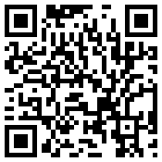


Group Analysis
File: afni24_GroupAna.pdf
Gang Chen
SSCC/NIMH/NIH/HHS

Slide 2
Preview
Introduction: basic concepts and terminology
  Why do we need to do group analysis?
  Factor, quantitative covariates, main effect, interaction, …
Group analysis approaches
  t-test: 3dttest++ (3dttest), 3dMEMA
  Regression: 3dttest++, 3dMEMA, 3RegAna
  ANOVA: 3dANOVAx, 3dMVM, GroupAna
  ANCOVA or GLM: 3dttest++, 3dMEMA, 3dMVM, 3dLME
  Impact & consequence of FSM, ASM, and ESM
Miscellaneous
  Centering for covariates
  Intra-Class Correlation (ICC)
  Nonparametric approach, fixed-effects analysis
  Inter-Subject Correlation (ISC)

Slide 3
Why Group Analysis?
Evolution of FMRI studies
  Early days [1992-1994]: no need for group analysis
    Seed-based correlation for one subject was revolutionary
  Now: torture brain/data enough, and hope nature will confess!
    Many ways to manipulate the brain (and data)
Reproducibility and generalization
  Science strives for generality: summarizing subject results
  Typically 10 or more subjects per group
  Exceptions: pre-surgical planning, lie detection, …
Why not one analysis with a giant model for all subjects?
  Computationally unmanageable and very hard to set up
  Heterogeneity in data or experiment design across subjects
  Model and data quality check at individual subject level

Slide 4
Simplest Group Analysis: One-Sample t-Test
SEM = Standard Error of the Mean = standard deviation of sample, divided by square root of number of samples
= estimate of uncertainty in sample mean
One-sample t-test determines if sample mean is large enough relative to SEM
Signal
in Voxel,
from 7
subjects
(% change)
+2 SEM
±1 SEM
−2 SEM
one data
sample =
signal from
one subject
in this voxel
in this
condition
Condition or
Contrast of 2 conditions
statistically significantly different from 0!

Slide 5
Simplest Group Analysis: Two-Sample t-Test
Group = some way to categorize subjects (e.g., sex, drug treatment, disease, …)
SEM = Standard Error of the Mean = standard deviation of sample divided by square root of number of samples
= estimate of uncertainty in sample mean
Two-sample t-test determines if sample means are “far apart” compared to size of SEM
Signal
in Voxel,
in each
condition,
from 7
subjects
(% change)
+2 SEM
±1 SEM
−2 SEM
one data
sample =
signal from
one subject
in this voxel
in this
group
Group
# 1
Group
# 2
Not statistically significantly different!

Slide 6
Simplest Group Analysis: Paired (~1-sample) t-Test
paired data
samples:
same numbers
as before
Paired means that samples in different conditions should be linked together (e.g., from same subjects)
Test determines if differences between conditions in each pair are “large” compared to SEM of the differences
Paired test can detect systematic intra-subject differences that can be hidden in inter-subject variations
Lesson: properly separating inter-subject and intra-subject signal variations can be very important!
Essentially equivalent to one-sample t-test
Signal
paired
differences
Condition
# 1
Condition
# 2
Significantly different!
Condition #2 > #1, per subject

Slide 7
Toy example of group analysis
Responses from a group of subjects under one condition
  : (β₁, β₂, …, β₁₀)=(1.13, 0.87, …, 0.72) [% signal change]
  Centroid: average (β₁+β₂+…+β₁₀)/10 = 0.92 is not enough
  Variation/reliability measure: diversity, spread, deviation
  How different is 0.92 from 0 compared to its deviation?
Model building
  Subject i‘s response = group average + deviation of subject i: simple model GLM (one-sample t-test)
  If individual responses are consistent, should be small
  How small (p-value)?
    t-test: significance measure =
2 measures: b (dimensional) and t (dimensionless)

Slide 8
Group Analysis Caveats
Results: two components (in afni GUI: OLay + Thr)
  Effect estimates: have unit and physical meaning
  Their significance (response to house significantly > face)
    Very unfortunately p-values solely focused in FMRI!
Statistical significance (p-value) becomes obsession
  Published papers: Big and tall parents (violent men, engineers) have more sons, beautiful parents (nurses) have more daughters
  Statistical signiﬁcance is not the same as practical importance
Fallacy: binarized thinking -- an effect that fails to reach statistical significance is not necessarily nonexistent
  Statistically insignificant effect might be real
  Sample size, suboptimal model, poor alignment across subjects
Notes:
How many factors, types of factor (between, within), so run to anova. But that may not be necessary since you need to get to the particular post hoc tests that can be simply done with 3dttest++ or 3dMEMA.
3dMVM or 3dLME can cover pretty much everything including one sample ttest but they are inefficient slow pigcorndogs.
Double dipping: MVM → interaction effect → extracts ROIs and then did post hoc
Better plan on these tests in the initial analysis, voxelwise tests.

Slide 9
Group Analysis Caveats
Conventional: voxel-wise (brain) or node-wise (surface)
  Prerequisite: reasonable alignment to some template
  Limitations: alignment could be suboptimal or even poor
    Different folding patterns across subjects: better alignment could help (perhaps to 5 mm accuracy?)
    Different cytoarchitectonic (or functional) locations across subjects: structural alignment of images won’t help!
    Impact on conjunction vs. selectivity
Alternative (won’t discuss): ROI-based approach
  Half data for functional localizers, and half for ROI analysis
  Easier: whole brain reduced to a few numbers per subject
  Model building and tuning possible
  Most AFNI 3d analysis programs also handle ROI input (1D files)

Slide 10
Group Analysis in NeuroImaging: why big models?
Various group analysis approaches
  Student’s t-test: one-, two-sample, and paired
  ANOVA: one or more categorical explanatory variables (factors)
  GLM: AN(C)OVA
  LME: linear mixed-effects modeling
Easy to understand: t-tests not always practical or feasible
  Tedious when layout (structure of data) is too complex
  Main effects and interactions: desirable
  Controlling for quantitative covariates
Advantages of big models: AN(C)OVA, GLM, LME
  All tests in one analysis (vs. piecemeal t-tests): omnibus F
  Controlling for covariate effects
  Power gain: combining subjects across groups for estimates of signal and noise parameters (i.e., variances and correlations)

Slide 11
Terminology: Explanatory variables
Response/Outcome variable (HDR): regression β coefficients
Factor: categorical, qualitative, descriptive, nominal, or discrete
  Categorization of conditions/tasks
    Within-subject (repeated-measures) factor
  Subject-grouping: group of subjects
    Between-subjects factor
    Gender, patients/controls, genotypes, handedness, …
  Subject: random factor measuring deviations
    Of no interest, but served as random samples from a population
Quantitative (numeric or continuous) covariate
  Three usages of ‘covariate’
    Quantitative value (rather than strict separation into groups)
    Variable of no interest: qualitative (scanner, sex, handedness) or quantitative
    Explanatory variable (regressor, independent variable, or predictor)
  Examples: age, IQ, reaction time, brain volume, …

Slide 12
Terminology: Fixed effects
Fixed-effects factor: categorical (qualitative or discrete) variable
  Treated as a fixed variable (constant to be estimated) in the model
    Categorization of conditions/tasks (modality: visual/auditory)
      Within-subject (repeated-measures) factor: 3 emotions
    Subject-grouping: Group of subjects (gender, controls/patients)
      Between-subject factor
  All factor levels are of interest: not interchangeable/replaceable
    main effect, contrasts among levels
  Fixed in the sense of statistical inferences
    Apply only to the specific levels of the factor: : replacement test
      Categories: human, tool
    Don’t extend to other potential levels that might have been included (but were not)
      Inferences from viewing human and tool categories can’t be generated to animals or clouds or Martians
Fixed-effects variable: quantitative covariate

Slide 13
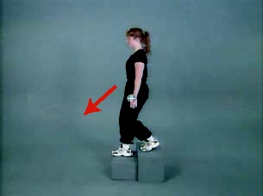
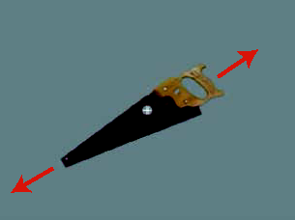
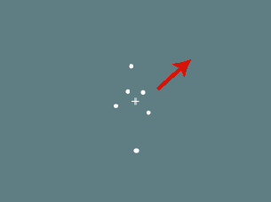
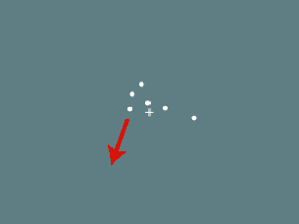
Remember This Study?
Human whole-body motion (HM)
Tool motion (TM)
Human point motion (HP)
Tool point motion (TP)
From Figure 1
Beauchamp et al. 2003
  2 Factors, each with 2 levels
  Factor A = type of object being viewed
    Levels = Human or Tool
  Factor B = type of display seen by subject
    Levels = Whole or Points
  This is repeated measures (4 βs per subject), 2 × 2 factorial

Slide 14
Terminology: Random effects
Random factor/effect
  Random variable in the model: exclusively used for subject in FMRI
    average + effects attributable to each subject: e.g. N(μ, τ²)
    Requires enough subjects to estimate properly
  Each individual subject effect is of NO interest: replacement test
    Group response = 0.92%, subject 7 = 1.13%, random effect = 0.21%
  Random in the sense
    Subjects as random samples (representations) from a population
    Inferences can be generalized to a hypothetical population
A generic group model: decomposing each subject’s response
  Fixed (population) effects: universal constants (immutable): β
  Random effects: individual subject’s deviation from the population (personality: durable for subject i): b_{i}
  Residuals: noise (evanescent): ε_{i}

Slide 15
Terminology: Omnibus tests - main effect and interaction
Main effect: any difference across levels of a factor?
Interactions: with ≥ 2 factors, interaction may exist
  2 × 2 design: F-test for interaction between A and B = t-test of
  (A1B1 - A1B2) - (A2B1 - A2B2) or (A1B1 - A2B1) - (A1B2 - A2B2)
  t stastistic is better than F : a positive t shows
  A1B1 - A1B2 > A2B1 - A2B2 and A1B1 - A2B1 > A1B2 - A2B2

Slide 16
Terminology: Interaction
Interactions: ≥ 2 factors
  May become very tedious to sort out or understand!
    ≥ 3 levels in a factor
    ≥ 3 factors
  Solutions: reduction (in complexity)
    Pairwise comparison
    Plotting: ROI averages
  Requires sophisticated modeling
    AN(C)OVA: 3dANOVAx, 3dMVM, 3dLME
Interactions: quantitative covariates
  In addition to linear effects, may have nonlinearity: y might depend on products of covariates: x₁*x₂, or x²

Slide 17
Terminology: Interaction
Interaction: between a factor and a quantitative covariate
  Using explanatory variable (Age) in a model as a nuisance regressor (additive effect) may not be enough
    Model building/tuning: Potential interactions with other explanatory variables? (as in graph on the right)
    Of scientific interest (e.g., gender differences)

Slide 18
Models at Group Level
Conventional approach: taking β (or linear combination of multiple βs) only for group analysis
  Assumption: all subjects have same precision (reliability, standard error, confidence interval) about β
  All subjects are treated equally
  Student t-test: paired, 1- and 2-sample: not random-effects models in strict sense (said to be random effects in Some other PrograM)
  AN(C)OVA, GLM, LME
More precise method: taking both effect estimates and t-stats
  t-statistic contains precision information about effect estimates
  Each subject’s β is weighted based on precision of effect estimate (more precise βs get more weight)
  Currently only available for t-test types

Slide 19
Piecemeal t-tests: 2 × 3 Mixed ANCOVA example
A relatively simple model, but challenging for neuroimaging
  Factor A (Group): 2 levels (patient and control)
  Factor B (Condition): 3 levels (pos, neg, neu)
  Factor S (Subject): 15 ASD children and 15 healthy controls
  Quantitative covariate: Age
Using Multiple t-tests for this study
  Group comparison + age effect
  Pairwise comparisons among three conditions
    Cannot control for age effect
  Effects that cannot be analyzed as t-tests
    Main effect of Condition (3 levels is beyond t-test method)
    Interaction between Group and Condition (6 levels total)
    Age effect across three conditions (just too complicated)

Slide 20
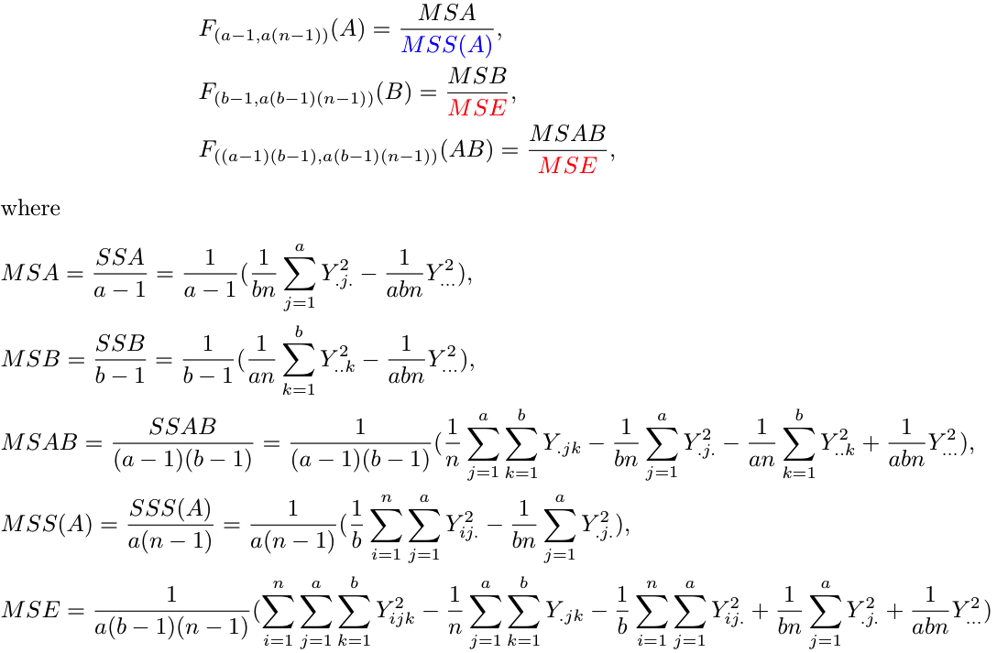
Classical ANOVA: 2 × 3 Mixed ANOVA
Factor A (Group): 2 levels (patient and control)
Factor B (Condition): 3 levels (pos, neg, neu)
Factor S (Subject): 15 ASD children and 15 healthy controls
Covariate (Age): cannot be modeled; no correction for sphericity violation
Different
denominator

Slide 21
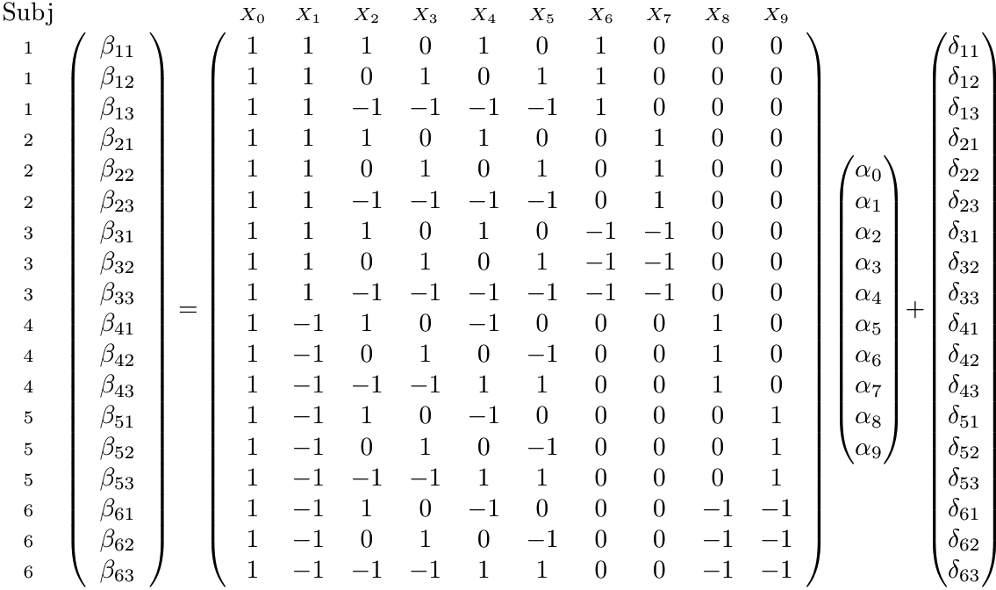
Univariate GLM: 2 x 3 mixed ANOVA
Difficult to incorporate covariates
Broken orthogonality of matrix
No correction for sphericity violation
Group: 2 levels (patient and control)
Condition: 3 levels (pos, neg, neu)
Subject: 3 ASD children and 3 healthy controls
b
a
d
X

Slide 22
Univariate GLM: popular in neuroimaging
Advantages: more flexible than the method of sums of squares
  No limit on the the number of explanatory variables (in principle)
  Easy to handle unbalanced designs
  Covariates easily modeled when no within-subject factors present
Disadvantages: costs paid for the flexibility
  Intricate dummy coding (to allow for different factors and levels)
  Tedious pairing for numerator and denominator of F-stat
    Choosing proper denominator SS is not obvious (errors in some software)
    Can’t generalize (in practice) to any number of explanatory variables
    Susceptible to invalid formulations and problematic post hoc tests
  Cannot handle covariates in the presence of within-subject factors
  No direct approach to correcting for sphericity violation
    Unrealistic assumption: same variance-covariance structure
Problems: When overall residual SS is adopted for all tests
  F-stat: valid only for highest order interaction of within-subject factors
  Most post hoc tests are inappropriate with this denominator

Slide 23
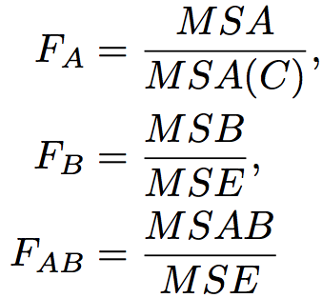
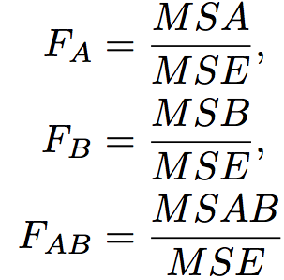
Univariate GLM: problematic implementations
Between-subjects Factor A (Group): 2 levels (patient, control)
Within-subject Factor B (Condition): 3 levels (pos, neg, neu)
A) Omnibus tests
B) Post hoc tests (contrasts)
(1) Incorrect t-tests for factor A due to incorrect denominator
(2) Incorrect t-tests for factor B or interaction effect AB when weights do
not add up to 0
C) How to handle multiple βs per effect (e.g., multiple runs)?
-- Artificially inflated DOF and assumption violation when multiple βs
are fed into program
Correct
Incorrect

Slide 24
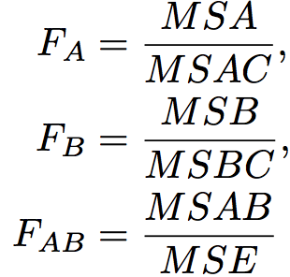
Univariate GLM: problematic implementations
Within-subjects Factor A (Object): 2 levels (house, face)
Within-subject Factor B (Condition): 3 levels (pos, neg, neu)
A) Omnibus tests
B) Post hoc tests (contrasts)
(1) Incorrect t-tests for both factors A and B due to incorrect denominator
(2) Incorrect t-tests for interaction effect AB if weights don’t add up
to 0
C) How to handle multiple βs per effect (e.g., multiple runs)?
-- Artificially inflated DOF and assumption violation when multiple βs
are fed into program
Correct
Incorrect

Slide 25
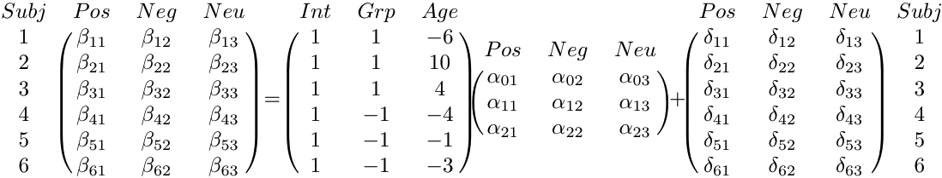
Better Approach: Multivariate GLM
Group: 2 levels (patient and control)
Condition: 3 levels (pos, neg, neu)
Subject: 3 ASD children and 3 healthy controls
Age: quantitative covariate
Β_{n×m} = X_{n×q} A_{q×m} + D_{n×m}
B
A
D
B
X

Slide 26
Why use β , not t, values for group analysis?
Why not use individual level statistics (t, F)?
  Dimensionless, no physical meaning
  Sensitive to sample size (number of trials) and to signal-to-noise ratio: may vary across subjects
    Are t-values of 4 and 100 (or p-values of 0.05 and 10⁻⁸) really informative? The HDR of the latter is not necessarily 25 times larger than the former
  Distributional considerations – not Gaussian
β values
  Have physical meaning: measure HDR magnitude = % signal change (i.e., how much BOLD effect)
Using β values and their t-statistics at the group level
  More accurate approach: 3dMEMA
  Mostly about the same as the conventional (β only) approach
  Not always practical

Slide 27
Road Map: Choosing a program for Group Analysis?
Starting with HDR estimated via shape-fixed method (SFM)
  One β per condition per subject
  It might be significantly underpowered (more later)
Two perspectives
  Data structure
  Ultimate goal: list all the tests you want to perform
    Possible to avoid a big model this way
    Use a piecemeal approach with 3dttest++ or 3dMEMA
      Perform each test on your list separately
      Difficulty: there can be many tests you might want
Most analyses can be done with 3dMVM and 3dLME
  Computationally inefficient
  Last resort: not recommended if simpler alternatives (e.g., t-tests) are available

Slide 28
Road Map: Student’s t-tests
3dttest++ (new version of 3dttest) and 3dMEMA
Not for F-tests except for ones with 1 DoF for numerator
  All factors are of two levels (at most), e.g., 2 x 2, or 2 x 2 x 2
Scenarios
  One-, two-sample, paired
  Univariate GLM
    Multiple regression: 1 group + 1 or more quantitative variables
    ANCOVA: two groups + one or more quantitative variables
    ANOVA through dummy coding: all factors (between- or within-subject) are of two levels
    AN(C)OVA: multiple between-subjects factors + one or more quantitative variables:
    https://afni.nimh.nih.gov/sscc/gangc/MEMA.html
    One group against a constant: 3dttest/3dttest++ –singletonA
      The “constant” can depend on voxel, or be fixed

Slide 29
Road Map: between-subjects ANOVA
One-way between-subjects ANOVA
  3dANOVA
  2 groups of subjects: 3dttest++, 3dMEMA (OK with > 2 groups too)
Two-way between-subjects ANOVA
  Equal #subjects across groups: 3dANOVA2 –type 1
  Unequal #subjects across groups: 3dMVM
  2 x 2 design: 3dttest++, 3dMEMA (OK with > 2 groups too)
Three-way between-subjects ANOVA
  3dANOVA3 –type 1
  Unequal #subjects across groups: 3dMVM
  2 x 2 design: 3dttest++, 3dMEMA (OK with > 2 groups too)
N-way between-subjects ANOVA
  3dMVM

Slide 30
Road Map: within-subject ANOVA
Only one group of subjects
One-way within-subject ANOVA
  3dANOVA2 –type 3
  Two conditions: 3dttest++, 3dMEMA
Two-way within-subject ANOVA
  3dANOVA3 –type 4
    (2 or more factors, 2 or more levels each)
  2 x 2 design: 3dttest++, 3dMEMA
N-way within-subject ANOVA
  3dMVM

Slide 31
Road Map: Mixed-type ANOVA and others
One between- and one within-subject factor
  Equal #subjects across groups: 3dANOVA3 –type 5
  Unequal #subjects across groups: 3dMVM
  2 x 2 design: 3dttest++, 3dMEMA
More complicated scenarios
  Multi-way ANOVA: 3dMVM
  Multi-way ANCOVA (between-subjects covariates only): 3dMVM
  HDR estimated with multiple bases: 3dANOVA3, 3dLME, 3dMVM
  Missing data: 3dLME
  Within-subject covariates: 3dLME
  Subjects genetically related: 3dLME
  Trend analysis: 3dLME

Slide 32
One-Sample Case
One group of subjects (n ≥ 10)
  One condition (visual or auditory) effect
  Linear combination of multiple effects (visual vs. auditory)
Null hypothesis H₀: average effect = 0
  Rejecting H₀ is of interest!
Results
  Average effect at group level (OLay)
  Significance: t-statistic (Thr - Two-tailed by default in AFNI)
Approaches
  uber_ttest.py (gen_group_command.py) – graphical interface
  3dttest++
  3dMEMA

Slide 33
One-Sample Case: Example
3dttest++: taking β only for group analysis
3dttest++ –prefix VisGroup -mask mask+tlrc -zskip \
-setA ‘FP+tlrc[Vrel#0_Coef]’ \
’FR+tlrc[Vrel#0_Coef]’ \
……
’GM+tlrc[Vrel#0_Coef]’
3dMEMA: taking β and t-statistic for group analysis
3dMEMA –prefix VisGroupMEMA -mask mask+tlrc -setA Vis \
FP ’FP+tlrc[Vrel#0_Coef]’ ’FP+tlrc[Vrel#0_Tstat]’ \
FR ’FR+tlrc[Vrel#0_Coef]’ ’FR+tlrc[Vrel#0_Tstat]’ \
……
GM ’GM+tlrc[Vrel#0_Coef]’ ’GM+tlrc[Vrel#0_Tstat]’ \
-missing_data 0
Voxel value = 0 ➔ treated it as missing
Voxel value = 0 ➔ treated it as missing

Slide 34
Two-Sample Case
Two groups of subjects (n ≥ 10 each): males and females
  One condition (e.g., visual or auditory) effect
  Linear combination of multiple effects (e.g., visual minus auditory)
  Example: Gender difference in emotional effect of stimulus?
Null hypothesis H₀: Group1 = Group2
  Results
    Group difference in average effect
    Significance: t-statistic - Two-tailed by default in AFNI
Approaches
  uber_ttest.py, 3dttest++, 3dMEMA
  One-way between-subjects ANOVA
    3dANOVA: can also obtain individual group t-tests

Slide 35
Paired Case
One groups of subjects (n ≥ 10)
  2 conditions (visual or auditory): no missing data allowed (3dLME)
Null hypothesis H₀: Condition1 = Condition2
  Results
    Average difference at group level
    Significance: t-statistic (two-tailed by default)
Approaches
  uber_ttest.py, gen_group_command.py, 3dttest++, 3dMEMA
  One-way within-subject (repeated-measures) ANOVA
    3dANOVA2 –type 3: can also get individual condition test
  Missing data (3dLME): only 10 of 20 subjects have both βs
Essentially same as one-sample case using contrast as input

Slide 36
Paired Case: Example
3dttest++: comparing two conditions
3dttest++ –prefix Vis_Aud \
-mask mask+tlrc –paired -zskip \
-setA ’FP+tlrc[Vrel#0_Coef]’ \
’FR+tlrc[Vrel#0_Coef]’ \
……
’GM+tlrc[Vrel#0_Coef]’ \
-setB ’FP+tlrc[Arel#0_Coef]’ \
’FR+tlrc[Arel#0_Coef]’ \
……
’GM+tlrc[Arel#0_Coef]’

Slide 37
Paired Case: Example
3dMEMA: comparing two conditions using subject-level response magnitudes and estimates of error levels
  Contrast should come from each subject
    Instead of doing contrast inside 3dMEMA itself
3dMEMA –prefix Vis_Aud_MEMA \
-mask mask+tlrc -missing_data 0 \
-setA Vis-Aud \
FP ’FP+tlrc[Vrel-Arel#0_Coef]’ ’FP+tlrc[Vrel-Arel#0_Tstat]’ \
FR ’FR+tlrc[Vrel-Arel#0_Coef]’ ’FR+tlrc[Vrel-Arel#0_Tstat]‘ \
……
GM ’GM+tlrc[Vrel-Arel#0_Coef]’’GM+tlrc[Vrel-Arel#0_Tstat]’

Slide 38
One-Way Between-Subjects ANOVA
Two or more groups of subjects (n ≥ 10)
  One condition or linear combination of multiple conditions
  Example: visual, auditory, or visual vs. auditory
Null hypothesis H₀: Group1 = Group2
  Results
    Average group difference
    Significance: t- and F-statistic (two-tailed by default)
Approaches
  3dANOVA (for more than 2 groups)
  > 2 groups: pair-group contrasts: 3dttest++, 3dMEMA
  Dummy coding: 3dttest++, 3dMEMA (hard work)
  3dMVM

Slide 39
Multiple-Way Between-Subjects ANOVA
Two or more subject-grouping factors: factorial designs
  One condition or linear combination of multiple conditions
  Examples: gender, control/patient, genotype, handedness
Testing main effects, interactions, single group, group comparisons
  Significance: t- (two-tailed by default) and F-statistic
Approaches
  Factorial design (imbalance not allowed): two-way (3dANOVA2 –type 1), three-way (3dANOVA3 –type 1)
  3dMVM: no limit on number of factors (imbalance OK)
  All factors have two levels: 3dttest++, 3dMEMA
  Using group coding (via covariates) with 3dttest++, 3dMEMA: imbalance possible

Slide 40
One-Way Within-Subject ANOVA
Also called one-way repeated-measures: one group of subjects (n ≥ 10)
  Two or more conditions: extension to paired t-test
  Example: happy, sad, neutral conditions
Main effect, simple effects, contrasts, general linear tests,
  Significance: t- (two-tailed by default) and F-statistic
Approaches
  3dANOVA2 -type 3 (2-way ANOVA w/ 1 random factor)
  With two conditions, equivalent to paired case with 3dttest++, 3dMEMA
  With more than two conditions, can break into pairwise comparisons with 3dttest++, 3dMEMA
  Univariate GLM: testing one condition is invalid

Slide 41
One-Way Within-Subject ANOVA
Example: visual vs. auditory condition
  3dANOVA2 –type 3 -alevels 2 -blevels 10 \
  -prefix Vis_Aud -mask mask+tlrc \
  -amean 1 Vis –amean 2 Aud –adiff 1 2 V-A \
-dset 1 1 ‘FP+tlrc[Vrel#0_Coef]’ \
-dset 1 2 ‘FR+tlrc[Vrel#0_Coef]’ \
……
-dset 1 10 ’GM+tlrc[Vrel#0_Coef]’ \
-dset 2 1 ‘FP+tlrc[Arel#0_Coef]’ \
-dset 2 2 ‘FR+tlrc[Arel#0_Coef]’ \
……
-dset 2 10 ’GM+tlrc[Arel#0_Coef]’

Slide 42
Two-Way Within-Subject ANOVA
Factorial design; also known as two-way repeated-measures
  2 within-subject factors
  Example: emotion (happy/sad) and category (visual/auditory)
Testing main effects, interactions, simple effects, contrasts
  Significance: t- (two-tailed by default) and F-statistic
Approaches
  3dANOVA3 –type 4 (three-way ANOVA with one random factor)
  All factors have 2 levels (2x2): 3dttest++, 3dMEMA
  Missing data?
    Break into t-tests: 3dttest++, 3dMEMA
    3dLME

Slide 43
Two-Way Mixed ANOVA
Factorial design
  One between-subjects and one within-subject factor
  Example: between-subject factor = gender (male and female) and within-subject factor = emotion (happy, sad, neutral)
Testing main effects, interactions, simple effects, contrasts
  Significance: t- (two-tailed by default) and F-statistic
Approaches
  3dANOVA3 –type 5 (three-way ANOVA with one random factor)
  If all factors have 2 levels (2x2): 3dttest++, 3dMEMA
  Missing data?
    Unequal number of subjects across groups: 3dMVM, GroupAna
    Break into t-tests: uber_ttest.py, 3dttest++, 3dMEMA
    3dLME

Slide 44
Univariate GLM: popular in neuroimaging
Advantages: more flexible than the method of Sums of Squares (SS)
  No limit on the the number of explanatory variables (in principle)
  Easy to handle unbalanced designs
  Covariates can be modeled when no within-subject factors present
Disadvantages: costs paid for the flexibility
  Intricate dummy coding – using covariates to partition βs into subsets
  Tedious pairing for numerator and denominator of F-stat
    Can be hard to select proper denominator SS
    Can’t generalize (in practice) to any number of explanatory variables
    Susceptible to invalid formulations and problematic post hoc tests
  Cannot handle covariates in the presence of within-subject factors
  No direct approach to correcting for sphericity violation
    Unrealistic assumption: same variance-covariance structure
Problematic: When residual SS is adopted for all tests
  F-stat: valid only for highest order interaction of within-subject factors
  Most post hoc tests are inappropriate/invalid

Slide 45
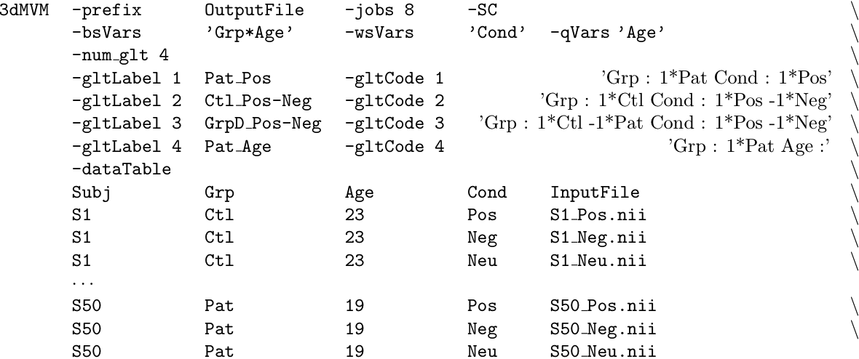
MVM Implementation in AFNI
Program 3dMVM [written in R programming language]
  No tedious and error-prone dummy coding needed!
  Symbolic coding for variables and post hoc testing
Variable types
Post hoc tests
Data layout

Slide 46
Group analysis with multiple basis functions
Fixed-Shape method (FSM)
Estimead-Shape method (ESM) via basis functions: TENTzero, TENT, CSPLINzero, CSPLIN
  Area under the curve (AUC) approach
    Ignore shape differences between groups or conditions
    Focus on the response magnitude measured by AUC
    Potential issues: Shape information lost; Undershoot may cause trouble (canceling out some of the positive signal)
  Better approach: maintaining shape information
    Take individual β values to group analysis (MVM)
Adjusted-Shape method (ASM) via SPMG2/3
  Only take the major component β to group level
  or, Reconstruct HRF, and take the effect estimates (e.g., AUC)

Slide 47
Group analysis with multiple basis functions
Analysis with effect estimates at consecutive time grids (from TENT or CSPLIN or reconstructed HRF)
  Used to be considered very hard to set up (in GLM)
  Extra variable in analysis: Time = t₀, t₁, …, t_{k}
  One group of subjects under one condition
    Accurate null hypothesis is
    H₀: β₁=0, β₂=0, …, β_{k}=0 (NOT β₁=β₂=…=β_{k})
      Testing the centroid (multivariate testing)
      3dLME
    Approximate hypothesis H₀: β₁=β₂=…=β_{k} (main effect)
      3dMVM
    Result: F-statistic for H₀ and t-statistic for each Time point

Slide 48
Group analysis with multiple basis functions
Multiple groups (or conditions) under one condition (or group)
  Accurate hypothesis:
    2 conditions: 3dLME
  Approximate hypothesis:
    Interaction
    Multiple groups: 3dANOVA3 –type 5 (two-way mixed ANOVA: equal #subjects), or 3dMVM
    Multiple conditions: 3dANOVA3 –type 4
  Focus: do these groups/conditions have different response shape?
    F-statistic for the interaction between Time and Group/Condition
    F-statistic for main effect of Group: group/condition difference of AUC
    F-statistic for main effect of Time: HDR effect across groups/conditions
Other scenarios: factor, quantitative variables
  3dMVM

Slide 49
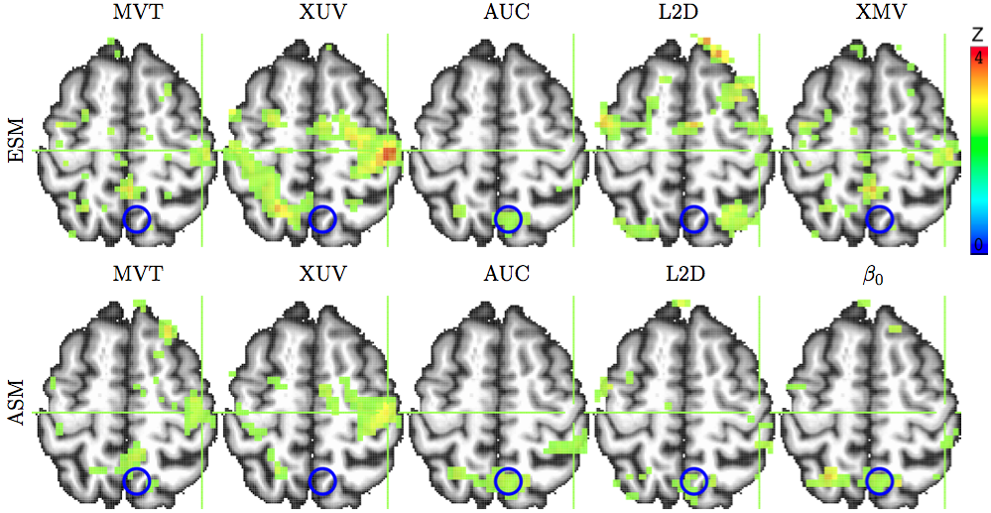
Group analysis with multiple basis functions
2 groups (children, adults), 2 conditions (congruent, incongruent), 1 quantitative covariate (age)
2 methods: HRF modeled by 10 (tents) and 3 (SPMG3) bases

Slide 50
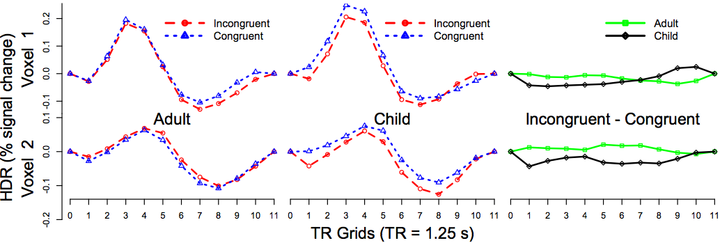
Group analysis with multiple basis functions
Advantages of ESM over FSM
  More likely to detect HDR shape subtleties
  Visual verification of HDR signature shape (vs. relying significance testing: p-values)
Study: Adults/Children with Congruent/Incongruent stimuli (2×2)

Slide 51
Correlation analysis
Correlation between brain response and behavioral measures
  Difference between correlation and regression?
    Essentially the same
    When explanatory (x_{i} ) and response variable (β_{i} ) are standardized (variance=1), then regression coefficient = correlation coefficient
  Two approaches to get correlation from statistics software
    Standardization
    Convert t-statistic to r (or determination coefficient)
    Programs: 3dttest++, 3dMEMA, 3dMVM, 3dRegAna
Seed-based correlation for resting-state data
  Fisher transform z has a variance of 1/(DoF – 2)
  May consider further standardization by sqrt(DoF – 2)

Slide 52
Trend analysis
Correlation between brain response and some gradation
  Linear, quadratic, or higher-order effects
    Habituation or attenuation effect across time (trials)
    Between-subjects: Age, IQ
      Fixed effect
    Within-subject measures (covariates): morphed images
      Random effects (trends in different subjects) : 3dLME
  Modeling: weights based on gradation
    Equally-spaced: coefficients from orthogonal polynomials
    With 6 equally-spaced levels, e.g., 0, 20, 40, 60, 80, 100%,
      Linear: -5 -3 -1 1 3 5
      Quadratic: 5 -1 -4 -4 -1 5
      Cubic: -5 7 4 -4 -7 5

Slide 53
Trend analysis
Correlation between brain response and some gradation
  Modeling: weights based on gradation
    Not equally-spaced: constructed from, e.g., poly() in R
    Ages of 15 subjects: 31.7 38.4 51.1 72.2 27.7 71.6 74.5 56.6 54.6 18.9 28.0 26.1 58.3 39.2 63.5
    https://afni.nimh.nih.gov/sscc/gangc/Trend.html

Slide 54
Trend analysis: summary
Cross-trials trend: AM2 single subject analysis with weights
Modeling with within-subject trend: 3 approaches
  Set up GLT weights among factor levels at group level (not directly using covariate values) 3dANOVA2/3, 3dMVM, 3dLME: best with equally-spaced with even number of levels
  Set up the covariates as the values of a variable
    Needs to account for deviation of each subject (random trends)
    3dLME
  Run trend analysis at individual level (i.e., -gltsym), and then take the trend effect coefficient estimates to group level
    Simpler than the other two approaches of doing trend analysis at the group level

Slide 55
Group analysis with quantitative variables
Covariate: 3 usages
  Quantitative (vs. categorical) variable of interest
    Age, IQ, behavioral measures, …
  Of no interest to the investigator (trying to remove variance)
    Age, IQ, sex, handedness, scanner,…
  Any explanatory variables in a model
Variable selection
  Infinite candidates for covariates: relying on prior information
  Typical choices: age, IQ, RT (reaction time), …
  RT: individual vs. group level
    Amplitude Modulation regression: cross-trial variability at individual level (cf. Advanced Regression talk)
    Group level: variability across subjects

Slide 56
Group analysis with quantitative variables
Conventional framework
  ANCOVA: one between-subjects factor (e.g., sex) + one quantitative variable (e.g., age)
    Extension to ANOVA: GLM
    Homogeneity of slopes
Broader framework
  Any modeling approaches involving quantitative variables
    Regression, GLM, MVM, LME
    Trend analysis, correlation analysis
Interpretations
  Regress/covariate out x?
  “Controlling x at …”, “holding x constant”: centering

Slide 57
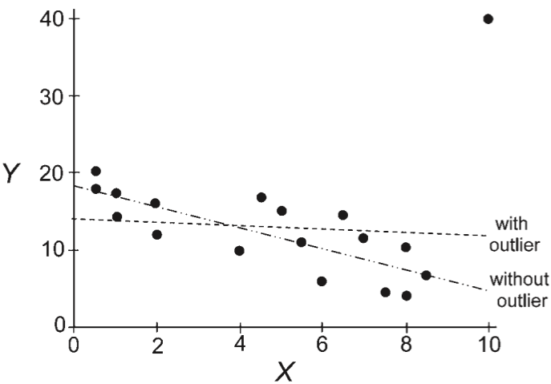
Caveats with covariate modeling
Regression with few data points: sensitive to outliers
Option -robust in 3dMVM

Slide 58
Caveats with covariate modeling
Specification error: excluding a crucial explanatory variable may lead to incorrect or distorted interpretations (spuriousness)
  Toddler’s vocabulary ~ α * shoe size: α = .50
  Toddler’s vocabulary ~ α * shoe size + β * age: α = .04, β = .6
    Explanatory variables (shoe size, age) are highly correlated: r = 0.8!
    Excluding one may lead to overestimated effect for the other, but not always the case
Suppression:
  y (# suicide attempts) ~ 0.49 * x₁ (depression)
  y ~ 0.19 * x₂ (amount of psychotherapy)
  y ~ 0.70 * x₁ - 0.30 * x₂ (r₁₂ = 0.7)
  Imagine that x₁ is head motion in FMRI!

Slide 59
Quantitative variables: subtleties
Regression: one group of subjects + quantitative variables
  Interpretation of effects (results of regression)
    α₁ - slope (change rate, marginal effect): effect per unit of x
    α₀ – intercept: group effect when x=0
      Not necessarily meaningful
      Linearity may not hold
      Solution: centering
      crucial for interpretability
      Mean centering?
      or Median centering?

Slide 60
Quantitative variables: subtleties + confusion
Trickier scenarios with two or more groups
  Interpretation of effects
    Slope: Interaction! Same or different slope?
    α₀ (intercept) – same or different center?

Slide 61
Quantitative variables: subtleties
Trickiest scenario with two or more groups in addition to interaction
More at http://afni.nimh.nih.gov/sscc/gangc/centering.html

Slide 62
Why should we report response magnitudes?
Unacceptable in some fields to report only significance (peak t and smallest p)
Neuroimaging is an exception currently!
Obsession in FMRI about p-value!
  Colored blobs of t-values
  Peak voxel selected based on peak t-value
Science is about reproducibility
  Response amplitude should be of primacy focus
  Statistics are only for thresholding
    No physical dimension, and are a mix of response size and noise magnitude
    Once surviving threshold, specific values are not informative

Slide 63
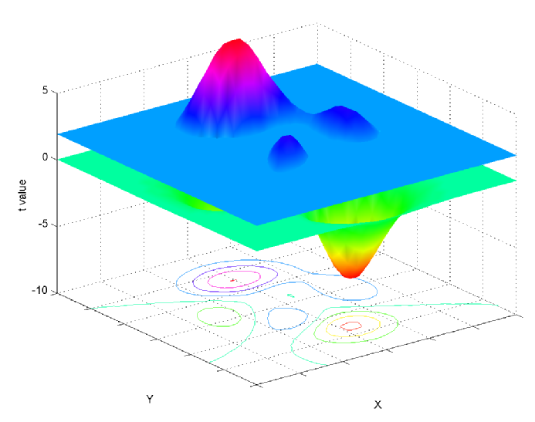
Basics: Null hypothesis significance testing (NHST)
  Should science be based on a binary (Yes/No) inference?
    If a cluster fails to survive thresholding, it has no value?
    Small Volume Correction (SVC): Band-Aid solution

Slide 64
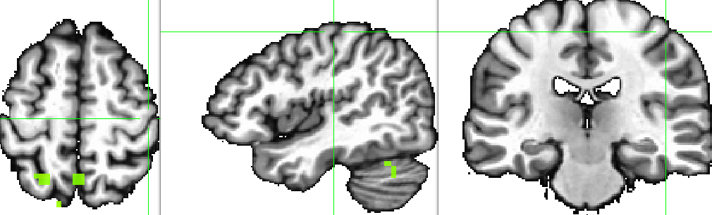
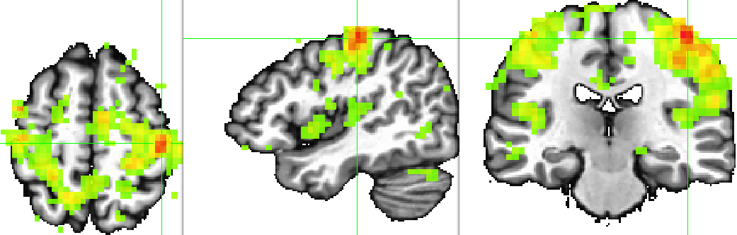
Modeling strategy & results: an example
SPMG3: 1st β (canonical HDR) [voxel-wise p=0.01]
TENT

Slide 65
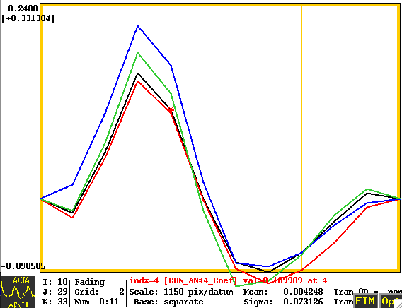
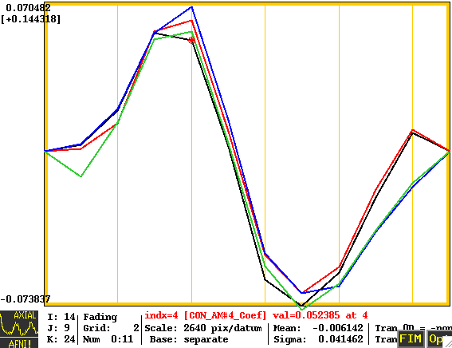
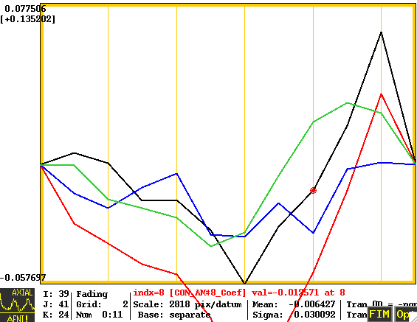
Is p-value everything? An example
p=10⁻⁷
p=0.5
p=10⁻⁴

Slide 66
Advantages of ESM
Multiple basis functions
  TENTzero, TENT, CSPLINzero, CSPLIN
  Similar to FIR in SPM, but FIR does not allow non-TR-synchronized modeling
Higher statistical power than FSM and ASM
  More likely to identify activations
Extra support for true positives (TP) with HRF signature shape
  Unavailable from FFM and ASM
Crucial evidence if significance is marginal: false negatives (FP)
Avoiding false positives (FP)
Works best for event-related experiments
  Useful for block designs if concerned about habituation, attenuation,…

Slide 67
How rigorous about corrections?
Two types of correction
  Multiple testing correction n(MTC): same test across brain
    FWE, FDR, SVC(?)
    People (esp. reviewers) worship this!
  Multiple comparisons correction (MCC): different tests
    Happy vs. Sad, Happy vs. Neutral, Sad vs. Neutral
    Two one-sided t-tests: p-value is ½ of two-sided test!
    How far do you want to go?
      Tests in one study
      Tests in all FMRI or all scientific studies?
    Nobody cares about this issue in FMRI (for unknown reasons)
Many reasons for correction failure (loss of statistical significance)
  Region size, number of subjects, alignment quality, substantial cross-subject variability (anxiety disorder, depression, …)

Slide 68
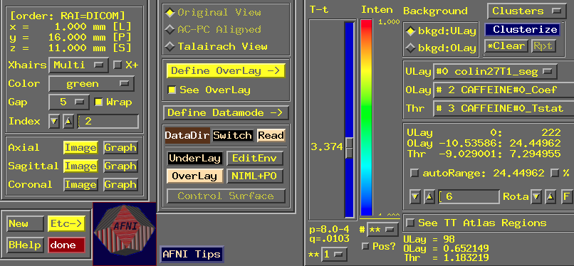
Presenting response magnitudes

Slide 69
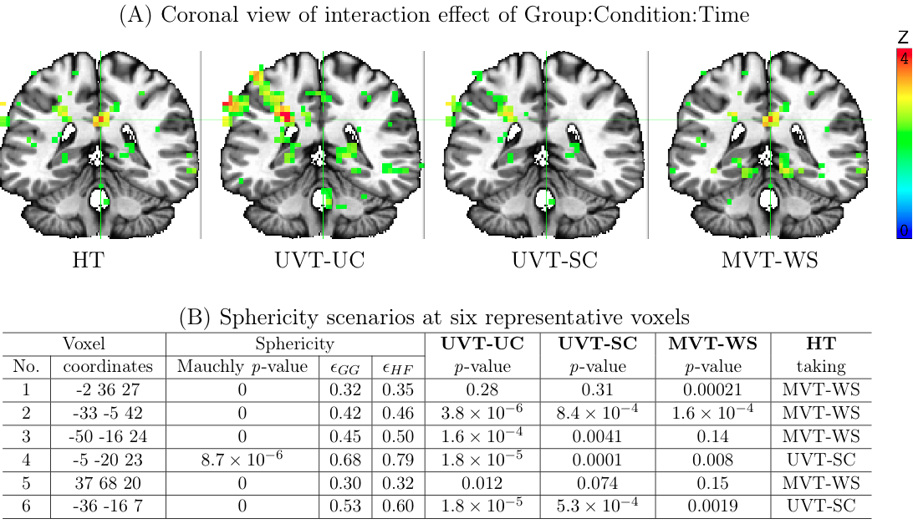
Presenting response magnitudes

Slide 70
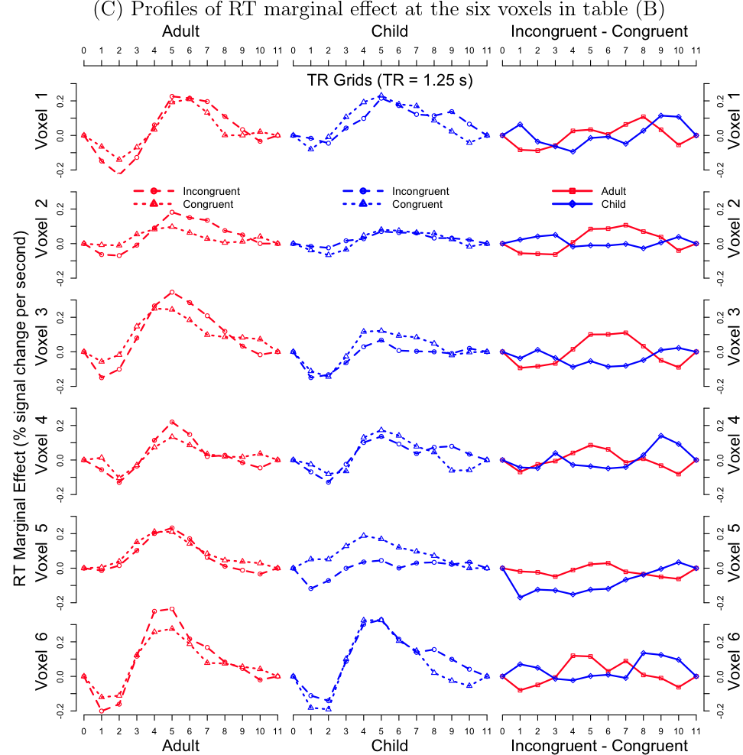
Presenting response magnitudes

Slide 71
IntraClass Correlation (ICC)
Reliability (consistency, agreement/reproducibility) across two or more measurements of the same condition/task (sessions, scanners, sites, studies, twins -- monozygous or dizygous): extent to which the levels of a factor are related to each other
  Example: 20 subjects scanned in two scanners (effect estimate of a condition/task, contrast between 2 conditions/tasks, functionality measure, etc.)
  Classic example in Shrout and Fleiss (1979): n targets are rated by k raters/judges
  Relationship with Pearson correlation:
    ICC is the Pearson correlation between any two measurements
  Difference with Pearson correlation
    Pearson correlation can be for any two different types of measure: e.g., BOLD response vs. RT
    ICC is for the same measurement with the same assumption G(μ, σ²)
  3dLME

Slide 72


IntraClass Correlation (ICC)
Three different definitions
  One-way random-effects ANOVA
  Assumptions: subject r_{i} ~ G(0, σ_{r}²), w_{ij} ~ G(0, σ_{w}²)
  Order cannot be assigned across multiple measurements
    e.g., twins: fixed or random effect of twins (index j) not considered
  ICC(1,1) in Shrout & Fleis (1979)
  Conceptualized as an LME model
  3dLME

Slide 73
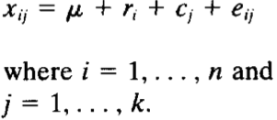

IntraClass Correlation (ICC)
Three different definitions
  Two-way random-effects ANOVA
  Assumptions: subject r_{i} ~ G(0, σ_{r}²), session c_{j} ~ G(0, σ_{c}²), w_{ij} ~ G(0, σ_{w}²)
  Order can be assigned across multiple measurements
    e.g., session: random effect (index j) – no systematic difference across sessions
  ICC(2,1) in Shrout & Fleis (1979)
  Conceptualized as an LME model
  3dLME

Slide 74

IntraClass Correlation (ICC)
Three different definitions
  Two-way mixed-effects ANOVA
  Assumptions: subject r_{i} ~ G(0, σ_{r}²), w_{ij} ~ G(0, σ_{e}²)
  Order can be assigned across multiple measurements
    e.g., scanner: fixed effect (index j) – systematic difference across scanners
  ICC(3,1) in Shrout & Fleis (1979)
  Conceptualized as an LME model
  3dLME

Slide 75
IntraClass Correlation (ICC)
Three different definitions
  Pearson correlation
  Proportion of total variance that can be accounted for across-subject variance
  ICC(1,1) and ICC(2,1): agreement/reproducibility;
  ICC(3,1): consistency
Implemented in 3dLME –ICC in AFNI
  The 3 types of ICC can be specified through options –model and –ranEff
  ICC of interest: cross-subjects ICC (labeled with subject)
Will be migrated to 3dICC

Slide 76
IntraClass Correlation (ICC)
Three different definitions
Implemented in 3dLME –ICC in AFNI
What is the advantage of LME over ANOVA?
  ANOVA may render negative ICC values: not interpretable nor meaningful
  LME places a boundary at 0, so all ICC estimates are ≥0
  Huge flexibility of LME: easy to incorporate fixed- and random-effects in the model (e.g., age, RT, etc.)
Problem with zero ICC
  Stuck at a numerical bounardy
  Not practical meaningful
Bayesian approach: a tiny nudge by a weak prior
  Implemented in 3dLME –ICCb in AFNI (recommended)

Slide 77

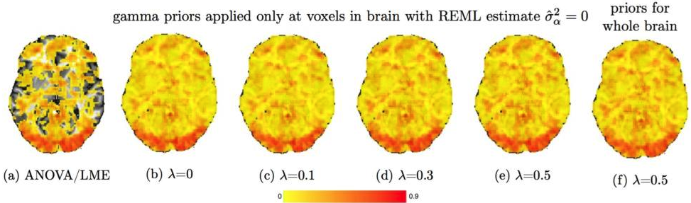
IntraClass Correlation (ICC)
Three different definitions
Implemented in 3dLME –ICCb in AFNI (recommended)
Prior: Gamma density function
Performance of Bayesian approach

Slide 78
IntraClass Correlation (ICC)
Three different definitions
Implemented in 3dLME –ICCb in AFNI (recommended)
Future developments?
  A standalone program 3dICC
  Significance testing for ICC
  Incorporation of effect estimate reliability into the model

Slide 79
Group Analysis: Non-Parametric Approach
Parametric approach
  When have enough number subjects: n > 10
  Random effects of subjects: usually Gaussian distribution
  Individual and group analyses: separate
Non-parametric approach
  Moderate number of subjects: 4 < n < 10
  No assumption of data distribution (e.g., normality)
  Statistics based on ranking or permutation
  Individual and group analyses: separate

Slide 80
Non-Parametric Analysis
Ranking-based: roughly equivalent to permutation tests
  3dWilcoxon (~ paired t-test)
  3dFriedman (~ one-way within-subject with 3dANOVA2)
  3dMannWhitney (~ two-sample t-test)
  3dKruskalWallis (~ between-subjects with 3dANOVA)
Pros: Less sensitive to outliers (more robust)
Cons
  Multiple testing correction limited to FDR (3dFDR)
  Less flexible than parametric tests
    Can’t handle complicated designs with more than one fixed-effects factor
    Can’t handle covariates
Direct permutation approach?

Slide 81
Group Analysis: Fixed-Effects Analysis (very old)
When to consider?
  LME approach
  Group level: a few subjects: n < 6
  Individual level: combining multiple runs/sessions
Case study: difficult to generalize to whole population
Model β_{i} = b+ε_{i}, ε_{i} ~ N(0, σ_{i}²), σ_{i}²: within-subject variability
  Fixed in the sense that cross-subject variability is not considered
Direct fixed-effects analysis (3dDeconvolve/3dREMLfit)
  Combine data from all subjects and then run regression
Fixed-effects meta-analysis (3dcalc) : weighted least squares
  β = ∑w_{i}β_{i}/∑w_{i}, w_{i} = t_{i}/β_{i} = weight for ith subject
  t = β√∑w_{i}

Slide 82
Group Analysis Program List
3dttest++ (one-sample, two-sample and paired t) + covariates (voxel-wise is allowed, e.g., GM fraction)
3dMEMA (R package for mixed-effects analysis, t-tests plus covariates)
3ddot (correlation between two datasets)
3dANOVA (one-way between-subject)
3dANOVA2 (one-way within-subject, 2-way between-subjects)
3dANOVA3 (2-way within-subject and mixed, 3-way between-subjects)
3dMVM (AN(C)OVA, and within-subject MAN(C)OVA)
3dLME (R package for sophisticated cases)
3dttest (obsolete: one-sample, two-sample and paired t)
3dRegAna (obsolete: regression/correlation, covariates)
GroupAna (mostly obsolete: Matlab package for up to four-way ANOVA)

Slide 83
FMRI Group Analysis Comparison
 |  | AFNI | SPM | FSL
t-test (one-, two-sample, paired) |  | 3dttest++, 3dMEMA | Yes | FLAME1, FLAME1+2
One categorical variable: one-way ANOVA |  | 3dANOVA/2/3, GroupAna | Only one WS factor: full and flexible factorial design | Only one within-subject factor: GLM in FEAT
Multi-way AN(C)OVA |  | 3dANOVA2/3, GroupAna, 3dMVM | --- | ---
Between-subject covariate |  | 3dttest++, 3dMEMA, 3dMVM | Partially | Partially
Sophisticated situations | Covariate + within-subject factor | 3dLME | --- | ---
 | Subject adjustment in trend analysis
 | Basis functions
 | Missing data

Slide 84
ISC: Overview
Naturalistic FMRI
  A middle point between task-related and resting-state scanning
  A special case of task-related FMRI: task from beginning to end
  Resting-state data: an asymptotic case of naturalistic canning
Challenges of analyzing naturalistic scanning data
Survey of previous approaches
Exploration of new nonparametric methods
Flexibility of linear mixed-effects (LME) modeling (program publicly available)
Potential application to resting-state data
  Focus on whole brain instead of one seed
Notes:
84

Slide 85
Two popular types of FMRI scanning
Task-related experiments
  Meticulously designed, well controlled
  Event-related or block design
  Effect of interest: regional responses to a task or a contrast
  Models: responses estimated through time series regression
  Potential issues
    Artificial tasks: absence of distinctive textures of real life events
    Artificial or discrete intervals between trials
    Poor understanding/modeling, low sensitivity (underpowered)
Resting state
  No explicit tasks
  Spontaneous, intrinsic fluctuations
  Effect of interest: regional correlation, networks
  Models: seed-based correlation, data-driven methods, etc.
  Caveats: difficult to separate physiological confounds, arbitrary in data manipulations/interpretations
Notes:
85

Slide 86
Naturalistic scanning
Subjects view a natural scene during scanning
  Visuoauditory movie clip (e.g., http://studyforrest.org/)
  Neural responses shared across languages
  Music, speech, games, …
Duration: lasting for a few minutes or more
Close to naturalistic settings: minimally manipulated; naturalistically, continuously, and dynamically evolving
Effect of interest
  Extent of synchronization/entrainment, similarity, or shared processing at the same brain regions across subjects in shared memory, communication and understanding through a common ground
Hasson et al., 2004. Intersubject synchronization of cortical activity during natural vision. Science 303:1634-1640.
Notes:
86

Slide 87
Inter-Subject Correlation (ISC)
Modeling with task-related regressors won’t work
  One regressor for the whole task: BOLD can’t be separated from baseline and drift effects
  Feature extractions: too rich or complicated to be practical
Inter-subject correlation (ISC)
  Proper preprocessing
    Nonlinear alignment to template space
    Removing physiological confounds (e.g., regressing out signal in the white matter and principal components from the CSF signal)
    Censoring out time points when significant motion occurred
Notes:
87

Slide 88
Inter-Subject Correlation (ISC)
Inter-subject correlation (ISC)
  Correlation of time series between two subjects at the same voxel
  No presumption of HDR
  Measuring synchronization/similarity/entrainment
  Avoiding the arbitrariness of seed selection
Voxel-wise ISC between any subject pair
  n = 3 subjects (A, B, C): 3 ISC values (AB, AC, BC)
  n = 4 subjects: 6 ISCs
  n = 5 subjects: 10 ISCs
  n subjects: n(n-1)/2 ISCs
ISC group analysis
  Summarization at the group level
  Investigate differences across groups in synchronization (ISC)
  Difficulty: some of ISC values are correlated
  n independent samples correspond to n(n-1)/2 ISCs
Notes:
88

Slide 89
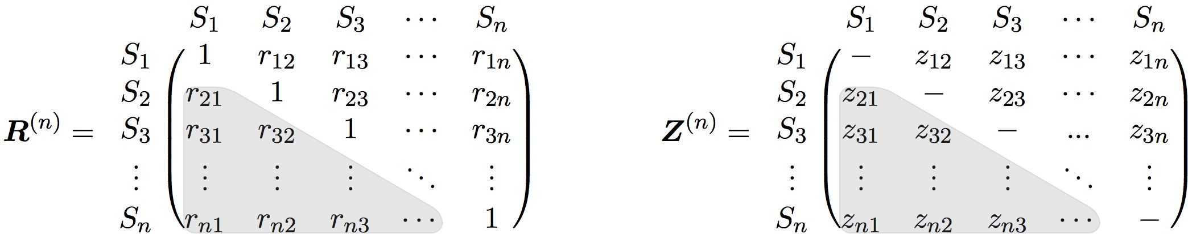
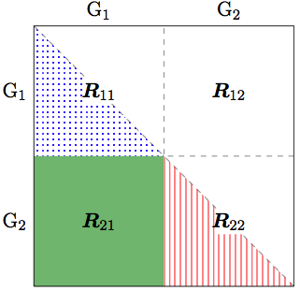
ISC group analysis
Voxel-wise ISC matrix (usually Fisher-transformed)
  One group
  Two groups
    Within-group ISC: R11, R22
    Inter-group ISC: R21
    3 group comparisons: R11 vs R22,
    R11 vs R21, R22 vs R21
Notes:
89
Positive semi-definite (PSD) matrix

Slide 90
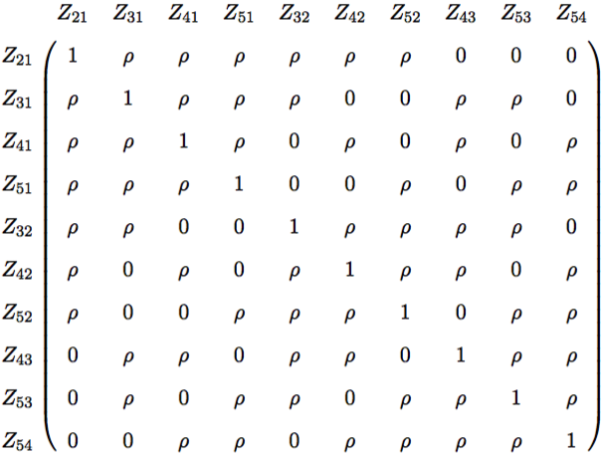
Correlation pattern of ISC values
2 ISC values associated with a common subject are correlated with each other: 5 subjects, 10 ISC values
ρ ≠ 0 characterizes non-independent relationship
Challenge: how to handle this irregular correlation matrix?
Notes:
90

Slide 91
ISC group analysis: previous methods
Student’s t-test
  Independence violation acknowledged but not accounted for
  Justification via observations that “null data” (generated by ISC values with randomly shifted time series) followed t(N-1)
Various nonparametric methods
  Permutations: null distribution via randomization across space (voxels) and time (e.g., circularly shifting each subject’s time series by a random lag)
    Matlab package: ISC Toolbox (Kauppi et al, 2014)
  Leave one out (LOO): Kauppi et al, 2010
    Compute ISC of a subject between a voxel’s BOLD time course in the subject and the average of that voxel’s time course in the remaining subjects
    Perform Student t-test on the LOO ISC values
All these methods have poor FPR controllability
Notes:
91

Slide 92
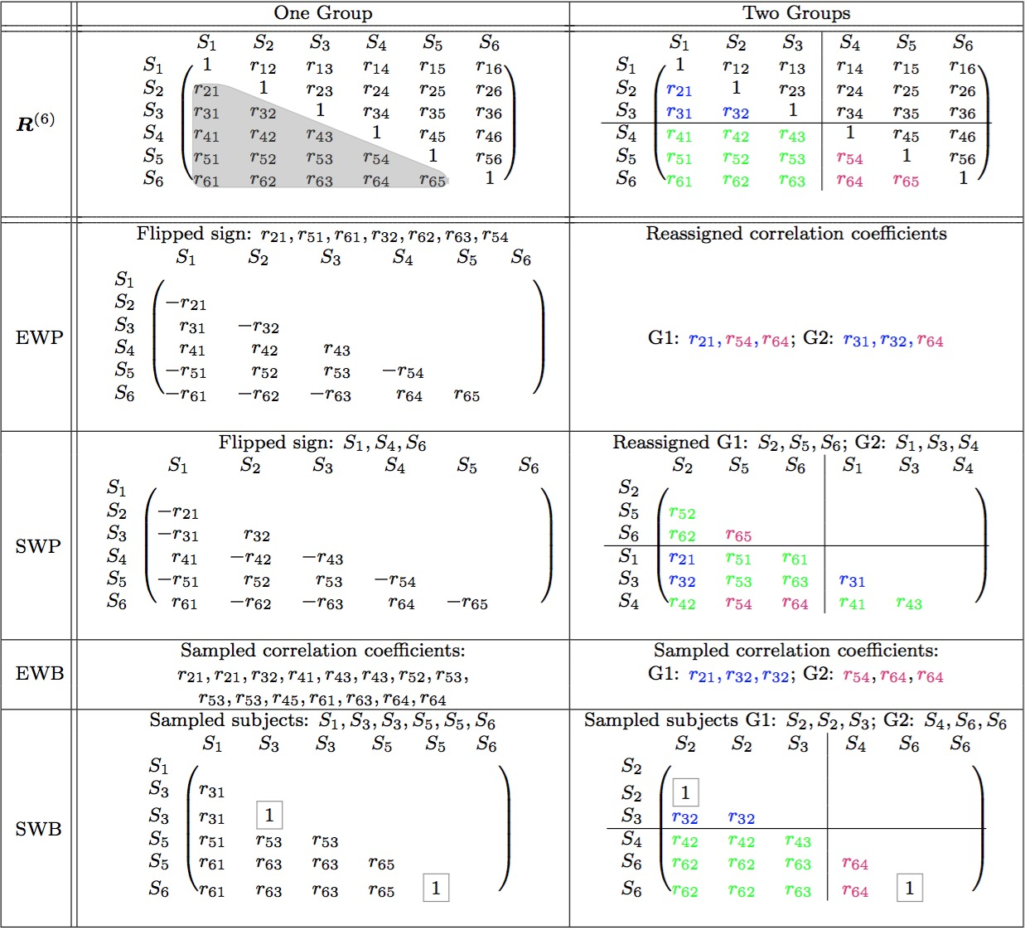
ISC group analysis: exploration with new nonparametric approaches
Schematic demo of how different methods work
Chen et al, 2016a. Untangling the relatedness among correlations, part I: Nonparametric approaches to inter-subject correlation analysis at the group level. Neuroimage (in press).
Notes:
92

Slide 93
New nonparametric approaches: simulations
Conclusion: SWB acceptable for one group
Chen et al, 2016a. Untangling the relatedness among correlations, part I: Nonparametric approaches to inter-subject correlation analysis at the group level. Neuroimage (in press).
Notes:
93

Slide 94
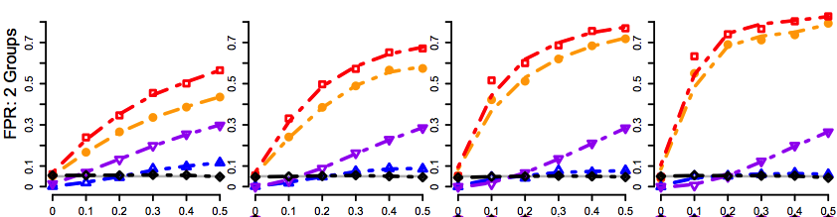
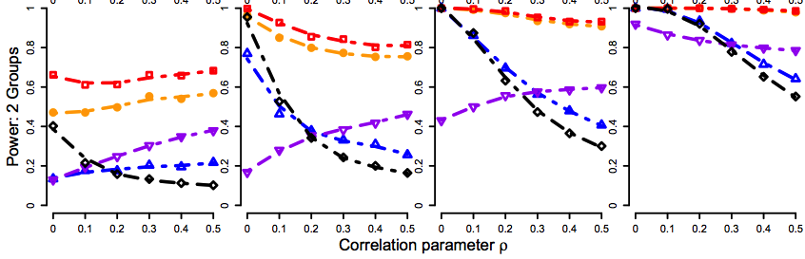
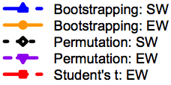
New nonparametric approaches: simulations
Conclusion: SWP ideal for group comparisons
Chen et al, 2016a. Untangling the relatedness among correlations, part I: Nonparametric approaches to inter-subject correlation analysis at the group level. Neuroimage (in press).
Notes:
94

Slide 95
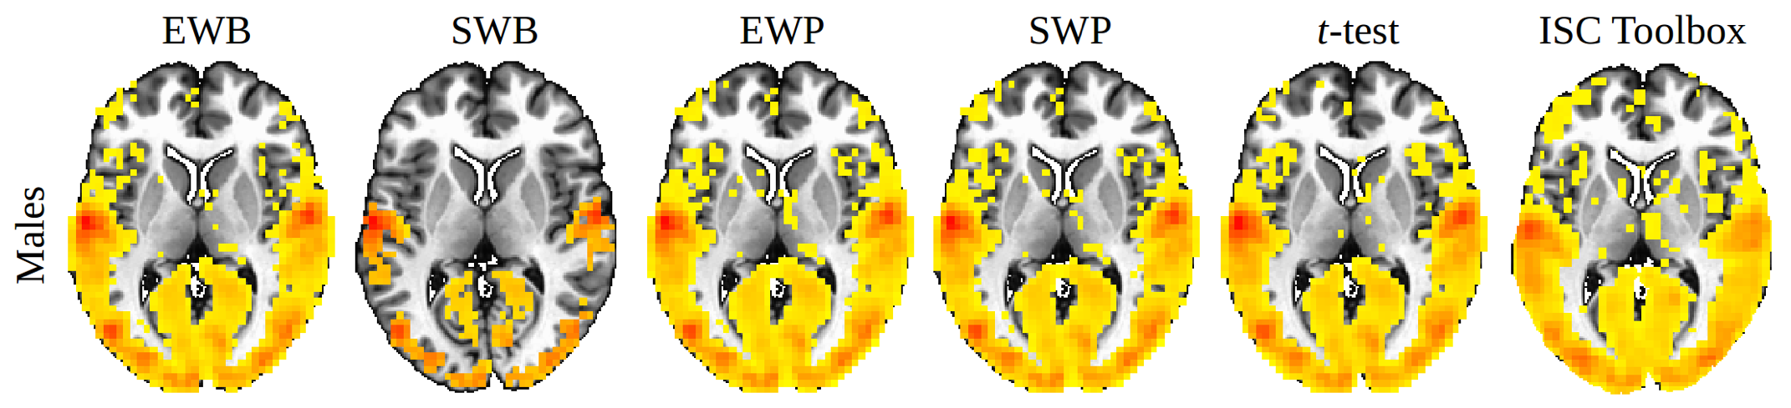
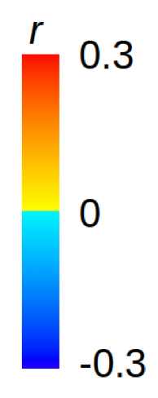
New nonparametric approaches: real data
One group: 24 male subjects
6 movie clips, 406 time points
Similar results for group comparisons with SWP
Results with real data are consistent with simulation results
new method
Chen et al, 2016a. Untangling the relatedness among correlations, part I: Nonparametric approaches to inter-subject correlation analysis at the group level. Neuroimage (in press).
Notes:
95

Slide 96


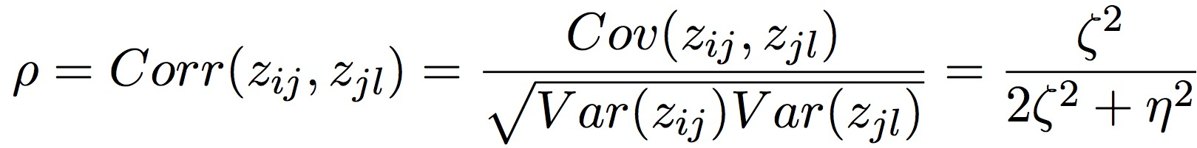
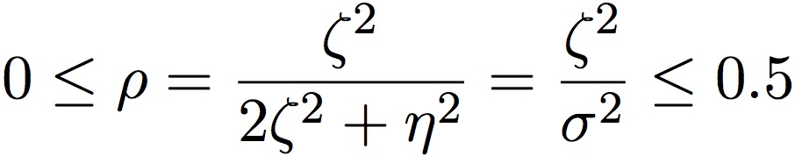
Linear mixed-effects modeling (LME)
Modeling via effect partitioning: crossed random-effects LME
Charactering the relatedness among ISCs via LME
cross-subject
within-subject
Chen et al, 2016b. Untangling the Relatedness among Correlations, Part II: Inter-Subject Correlation Group Analysis through Linear Mixed-Effects Modeling. Neuroimage (in press).
Notes:
96

Slide 97
Linear mixed-effects modeling (LME)
Formulation: crossed random-effects LME
Extendibility/flexibility of LME
  Easy to incorporate explanatory variables: between- and within-subject factors (or quantitative covariates), similar to extension of t-test to GLM
Data characterization and model quality: unavailable for nonparametric approaches
  Cross-subject variance ζ²
  Within-subject variance η²
  Relatedness of ISCs ρ
Chen et al, 2016b. Untangling the Relatedness among Correlations, Part II: Inter-Subject Correlation Group Analysis through Linear Mixed-Effects Modeling. Neuroimage (in press).
Notes:
97

Slide 98
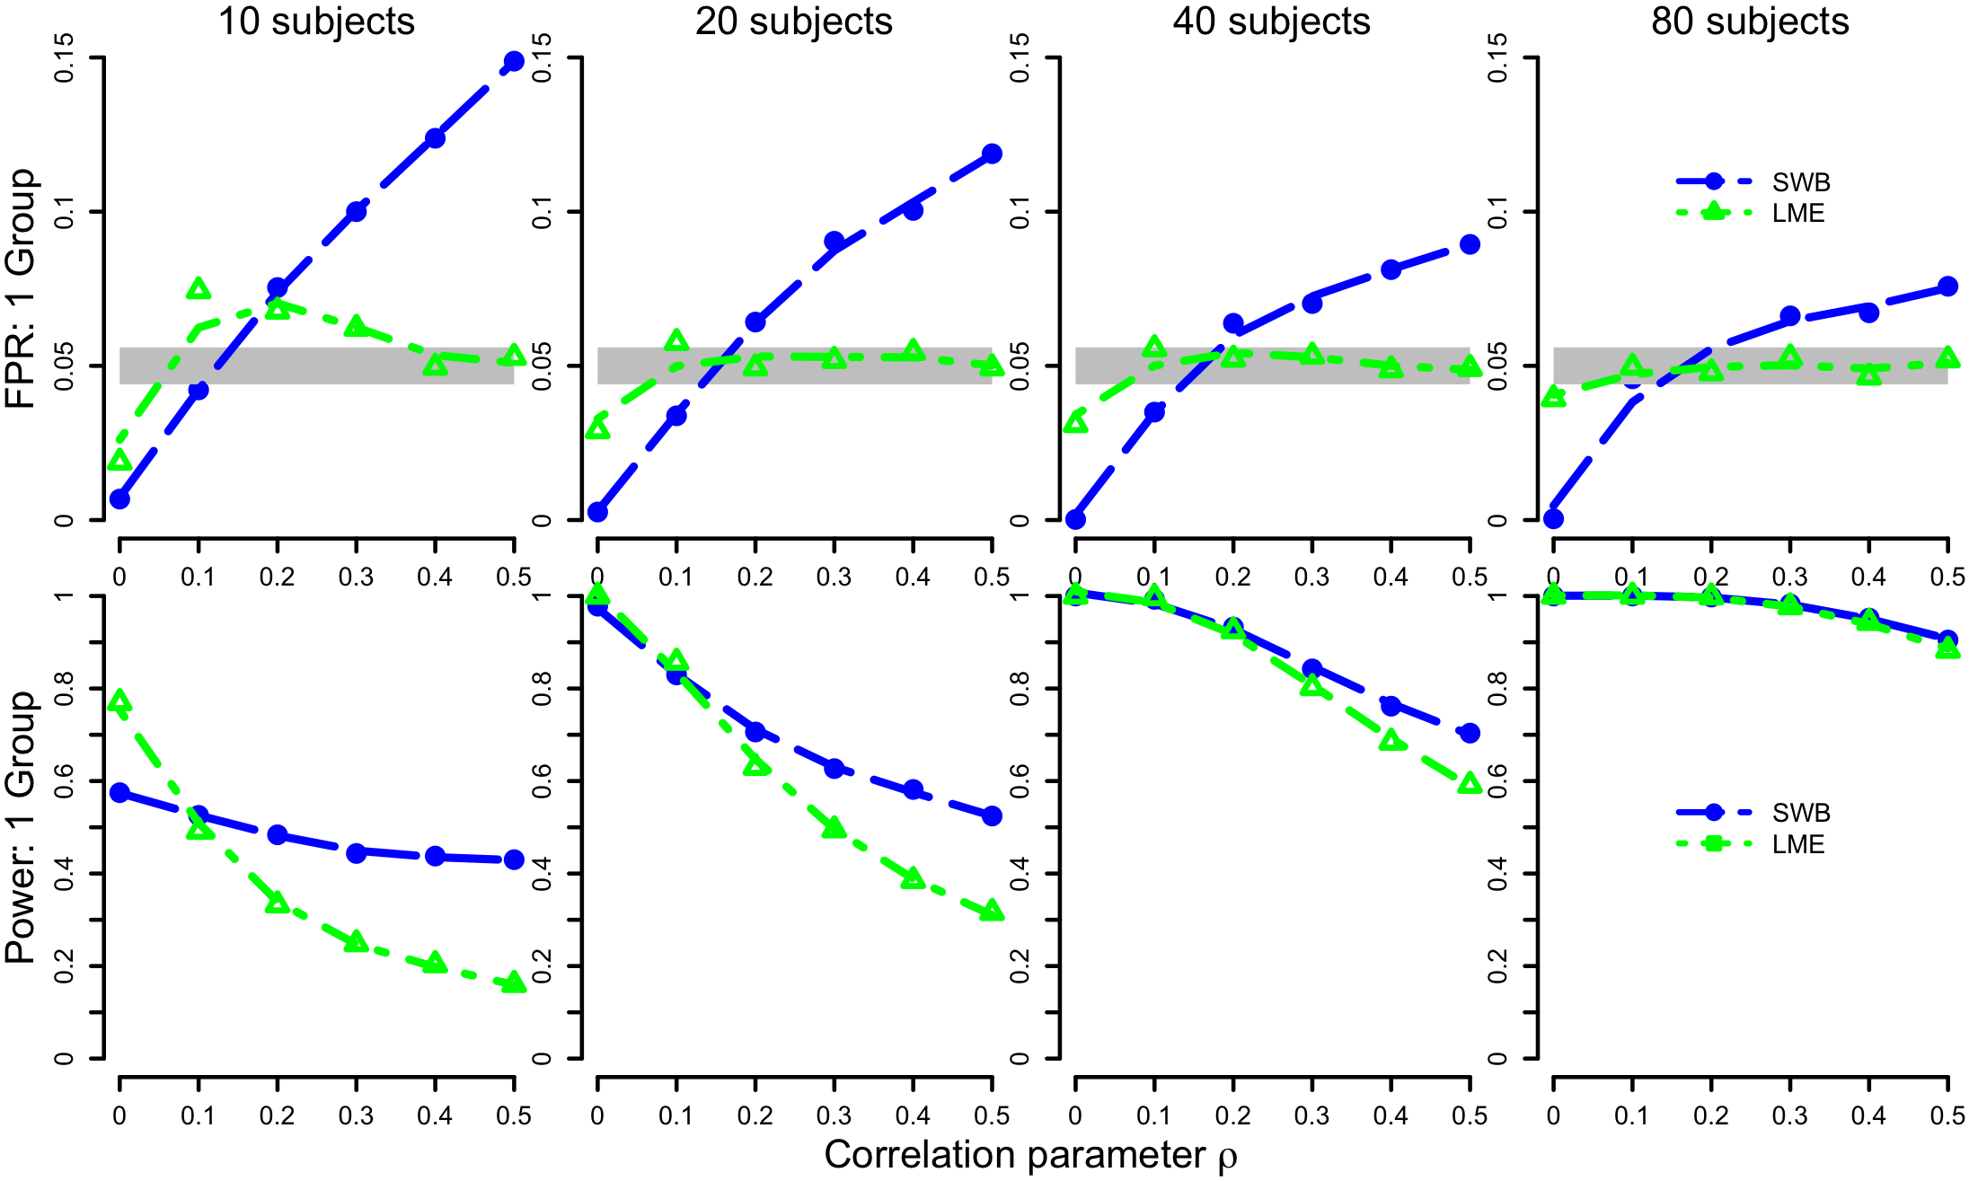
LME: simulations
LME: better FPR controllability than SWB for one group, and similar to SWP for group comparisons
Chen et al, 2016b. Untangling the Relatedness among Correlations, Part II: Inter-Subject Correlation Group Analysis through Linear Mixed-Effects Modeling. Neuroimage (in press).
Notes:
98

Slide 99
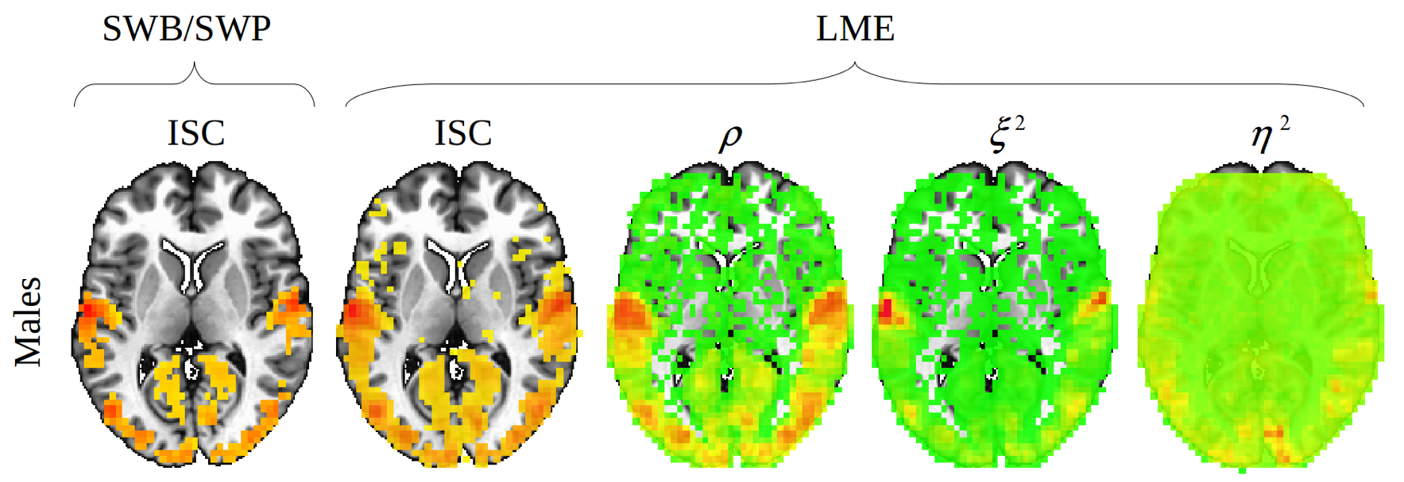
LME: real experiment data
48 subjects (24 males, 24 females)
6 movie clips, 406 time points
Similar results between SWB & LME
Data characterizations
via 3 parameters
Chen et al, 2016b. Untangling the Relatedness among Correlations, Part II: Inter-Subject Correlation Group Analysis through Linear Mixed-Effects Modeling. Neuroimage (in press).
Notes:
99

Slide 100
Benefits of naturalistic paradigm
Similar to resting-state FMRI
Extendable to other modalities
  EEG, MEG, ECoG, fNIRS…
No presumption about HDR function
More controlled and engaging (especially for children)
Practical benefit: subject less likely to fall asleep
Analysis benefits
  Less vulnerable to head motion effects
  Statistically more powerful
  Not dependent on seed selection (in seed-based approach)
  Not dependent on dimension reduction and component selection
  Well-fit by powerful LME with crossed random effects paradigm
Notes:
100

Slide 101
Overview
Basic concepts
  Why do we need to do group analysis?
  Factor, quantitative covariates, main effect, interaction, …
Various group analysis approaches
  Regression (t-test): 3dttest++, 3dMEMA, 3dttest, 3RegAna
  AN(C)OVA: 3dANOVAx, 3dMVM, GroupAna
  Quantitative covariates: 3dttest++, 3dMEMA, 3dMVM, 3dLME
  Impact & consequence of SFM, SAM, and SEM
Miscellaneous
  Issues regarding result reporting
  Intra-Class Correlation (ICC)
  Inter-Subject Correlation (ISC)
  Nonparametric approach and fixed-effects analysis
No routine statistical questions, only questionable routines!

