Slide 1
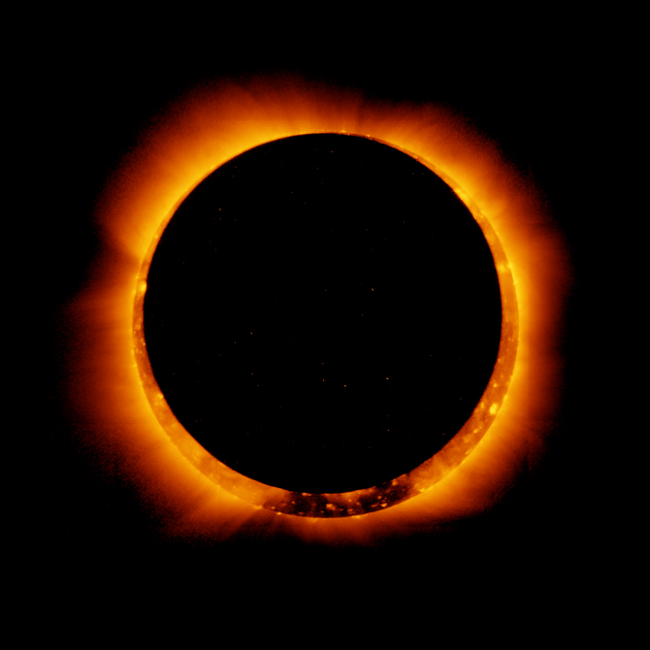
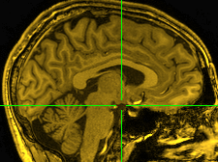
Alignment and Atlases

Slide 2
What does aligning mean and why do we want to do it?
Alignment means to bring two objects into the same space so that each location within one object corresponds to the same location in the other
Why?
motion correction across time
align EPI to anatomical data or vice versa – to assign a location with a functional result
compare data from longitudinal studies
compare data from different scanners, sites
compare results with a standard template or atlas for standardized locations and structures

Slide 3
Alignment goals and tools in AFNI
EPI data across time in a single run or across runs to a base image
3dvolreg – motion correction (rigid)
Align data to template
3dWarpDrive, @auto_tlrc – align similar volumes (affine) even across subjects
3dQwarp, auto_warp.py – align similar volumes nonlinearly to template
Align images across modalities – EPI to anat
3dAllineate – align different or similar volumes
align_epi_anat.py – general alignment script to align EPI with anatomical data
Include motion correction, alignment of EPI to anatomical in fMRI processing pipeline script
afni_proc.py
Correct for motion between two volumes by aligning in two dimensions using corresponding slices
@2dwarper.Allin – non-linear alignment of slices
@2dwarper, 2dimreg limit alignment to specific plane

Slide 4
Alignment tools in AFNI (continued)
Align partial data to roughly the right part of the brain
Nudge plug-in - visually align two volumes
rotate by known amount between volumes
3drotate – moves (shifts and rotates) volumes
3dWarp – make oblique, deoblique to match another dataset
Put centers of data from outside sources in roughly the same space
@Align_Centers, 3dCM – put centers or centers of mass of dataset in same place
align specific regions across subjects
3dTagalign, tagset plugin – place and align volumes using corresponding fiducial marker points
align one jpeg image to another
imreg – align two 2D images

Slide 5
Image and Volume Registration with AFNI
Goal: bring images collected with different methods and at different times into spatial alignment
Facilitates comparison of data on a voxel-by-voxel basis
Functional time series data will be less contaminated by artifacts due to subject movement
Can compare results across scanning sessions once images are properly registered
Can put volumes in standard space such as the stereotaxic Talairach-Tournoux coordinates
Most (all?) image registration methods now in use do pair-wise alignment:
Given a base image J(x) and target (or source) image I(x), find a geometrical transformation T[x] so that I(T[x]) ≈ J(x)
T[x] will depend on some parameters
Goal is to find the parameters that make the transformed I a ‘best fit’ to J
To register an entire time series, each volume I_{n}(x) is aligned to J(x) with its own transformation T_{n}[x], for n = 0, 1, …
Result is time series I_{n}(T_{n}[x]) for n=0, 1, …
User must choose base image J(x)

Slide 6
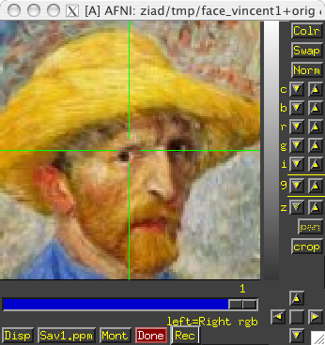
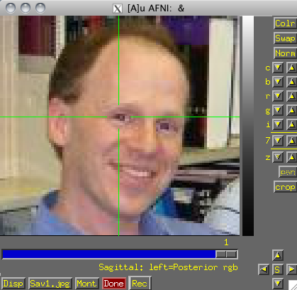
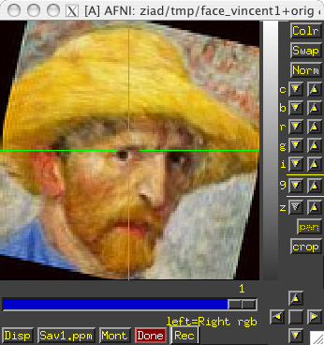
Most image registration methods make 3 algorithmic choices:
How to measure mismatch E (for error) between I(T[x]) and J(x)?
Or … How to measure goodness of fit between I(T[x]) and J(x)?
E(parameters) ≡ –Goodness(parameters)
How to adjust parameters of T[x] to minimize E?
How to interpolate I(T[x]) to the J(x) grid?
So we can compare voxel intensities directly
The input volume is transformed by the optimal T[x] and a record of the transform is kept in the header of the output.
Finding the transform to minimize E is the bulk of the registration work. Applying the transform is easy and is done on the fly in many cases.
If data starts off far from each other, may add a coarse pass (twopass) step
guess a lot among all the parameters (rotations, shifts, ...), measure cost
best guesses, tweak the parameters (optimize) and measure again
Now, applications of alignment…

Slide 7
Preprocess – mask, weight
Alignment process - overview
Initial interpolation, cost
Preprocess – mask data, weight data
If far off, take some random guesses (-twopass)
Optimize parameters on initial or best sets (6,12,39,1000's)
Use new parameters to transform input
Interpolate onto base data's grid
Measure alignment error with cost functional
Less than minimum error - finished
Better - keep adjusting with same direction
Worse – try other parameters
Create final output by interpolating onto output grid
save datasets, transform parameters
Lots of random guesses – follow n best
twopass?
Tweak
parameters
Transform & Interpolate
Optimization
Measure cost
Cost < tolerance?
Save final data

Slide 8
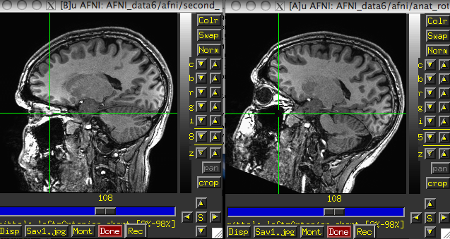
Within Modality Registration
AFNI 3dvolreg and 3dWarpDrive programs match images by grayscale (intensity) values
E = (weighted) sum of squares differences = Σ_{x} w(x) · {I(T[x]) - J(x)}²
Only useful for registering ‘like images’:
Good for SPGRSPGR, EPIEPI, but not good for SPGREPI
Several interpolation methods :
Fourier, linear, cubic, quintic, and heptic polynomials
3dvolreg is designed to run VERY fast for EPIEPI registration with small movements — good for FMRI purposes but restricted to 6-parameter rigid-body transformations.
3dWarpDrive is slower, but it allows for up to 12 parameters affine transformation. This corrects for scaling and shearing differences in addition to the rigid body transformations.

Slide 9
Looking for Motion
afni GUI – graph-image video/ricochet, arrow keys. Graph spikes.
Image courtesy of Jonathan Power, NIMH
In statistical results, “activation” / “deactivation” occurs at high contrast boundaries like edge of brain or ventricles.

Slide 10
AFNI program 3dvolreg is for aligning 3D volumes by rigid movements
T[x] has 6 parameters:
Shifts along x-, y-, and z-axes; Rotations about x-, y-, and z-axes
Generically useful for intra- and inter-session alignment
Motions that occur within a single TR (2-3 s) cannot be corrected this way, since method assumes rigid movement of the entire volume
AFNI program 3dWarpDrive is for aligning 3D volumes by affine transformations
T[x] has up to 12 parameters:
Same as 3dvolreg plus 3 Scales and 3 Shears along x-, y-, and z-axes
Generically useful for intra- and inter-session alignment
Generically useful for intra- and inter-subject alignment
AFNI program 2dImReg is for aligning 2D slices
T[x] has 3 parameters for each slice in volume:
Shift along x-, y-axes; Rotation about z-axis
No out of slice plane shifts or rotations!
Useful for sagittal EPI scans where dominant subject movement is ‘nodding’ motion that may be faster than TR
It is possible and sometimes even useful to run 2dImReg to clean up sagittal nodding motion, followed by 3dvolreg to deal with out-of-slice motion

Slide 11
Intra-session registration example:
3dvolreg -base 4 -heptic -zpad 4 \
-prefix fred1_epi_vr \
-1Dfile fred1_vr_dfile.1D \
fred1_epi+orig
-base 4 ⇒ Selects sub-brick #4 of dataset fred1_epi+orig as base image J(x)
-heptic ⇒ Use 7th order polynomial interpolation
-zpad 4 ⇒ Pad each target image, I(x), with layers of zero voxels 4 deep on each face prior to shift/rotation, then strip them off afterwards (before output)
Zero padding is particularly desirable for -Fourier interpolation
also good for large rotations, some data may get ‘lost’ if no zero padding
-prefix fred1_epi_vr ⇒ Save output dataset into a new dataset with the given prefix name (e.g., fred1_epi_vr+orig)
-1Dfile fred1_vr_dfile.1D ⇒ Save estimated movement parameters into a 1D (i.e., text) file with the given name
Movement parameters can be plotted with the 1dplot command and used later....
Input dataset name
Try this (in AFNI_data6/afni) :
3dvolreg -base 3 -cubic -prefix epi_r1_vrt -1Dfile vr_dfile.1D epi_r1+orig
1dplot -volreg vr_dfile.1D &

Slide 12
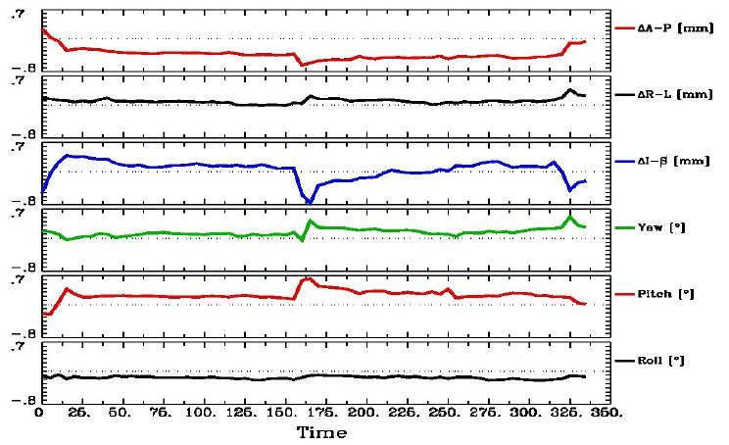
Can now register second dataset from same session:
3dvolreg -base 'fred1_epi+orig[4]' -heptic -zpad 4 \
-prefix fred2_epi_vr -1Dfile fred2_vr_dfile.1D \
fred2_epi+orig
Note base is from different dataset (fred1_epi+orig) than input (fred2_epi+orig)
Aligning all EPI volumes from session to EPI closest in time to SPGR (if not aligning to anatomical)
1dplot -volreg -dx 5 -xlabel Time fred2_vr_dfile.1D
About A-P
About R-L
Typical
About I-S
Note motion peaks at time ≈ 160s: subject jerked head up at that time

Slide 13
"Fixing Motion"
Motion occurs over slices and not volumes and moves data off original grid
"Regressing out" – motion parameters, derivatives, displacement, euclidean norm of derivatives (summary parameters)
Censoring ("scrubbing", "sweeping under the mat",...)
Experimental design – kids, monkeys, juice, talking, waving hands wildly....
Interpreting results – differences in motion between groups or something physiological
Notice – activation following high contrast borders, "blinds" effects
Try this (in AFNI_data6/afni) :
1d_tool.py -infile vr_dfile.1D -set_nruns 1 -censor_motion 1 ett
1dplot ett_enorm.1D &
cat ett_CENSORTR.txt

Slide 14
Motion correction – caveats
Motion is usually not completely correctable, so set motion parameters as regressors of no interest. Interpolation generally blurs data and depends on method and grid/resolution of EPI.
Check in the AFNI GUI to be sure the data is not bouncing around after correction
Example – Monkey sips juice at stimulus time, and large jaw muscles move. If the muscles are not masked, then motion correction may track muscles rather than brain.
original
3dvolreg
automask, 3dvolreg

Slide 15
Cross Modality Registration
3dAllineate can be used to align images from different methods
For example, to align EPI data to SPGR / MPRAGE:
Run 3dSkullStrip on the SPGR dataset so that it will be more like the EPI dataset (which will have the skull fat suppressed)
Use 3dAllineate to align the EPI volume(s) to the skull-stripped SPGR volume
Program works well if the EPI volume covers most of the brain
Allows more general spatial transformations – affine, bilinear, non-linear (polynomial warping)
3dAllineate has several different “cost” functions (E) available
leastsq = Least Squares (3dvolreg, 3dWarpDrive)
mutualinfo = Mutual Information
norm_mutualinfo = Normalized Mutual Information
hellinger = Hellinger Metric [the default cost function]
corrratio_mul = Correlation ratio (symmetrized by multiplication)
corratio_add = Correlation ratio (symmetrized by addition)
corratio_uns = Correlation ratio (unsymmetric)
lpc = Local Pearson Correlation (negative)
lpa = Local Pearson Correlation (absolute value)

Slide 16
align_epi_anat.py
Goal: Want to align anat and EPI (anat to EPI or EPI to anat or dset1to2 or dset2to1)
LPC method – Local Pearson Correlation to match dark CSF in anatomical data with bright CSF in EPI data.
align_epi_anat.py script – preprocessing and calls 3dAllineate for alignment
@AddEdge – for visualization
Simple Example:
align_epi_anat.py -anat anat+orig \
-epi epi_r1+orig \
-AddEdge -epi_base 0 -suffix _al4class
cd AddEdge
afni -niml -yesplugouts &
@AddEdge
Combines deoblique, motion correction, alignment and talairach transformations into a single transformation. Also performs slice timing correction and applies transformations to “child” datasets.

Slide 17
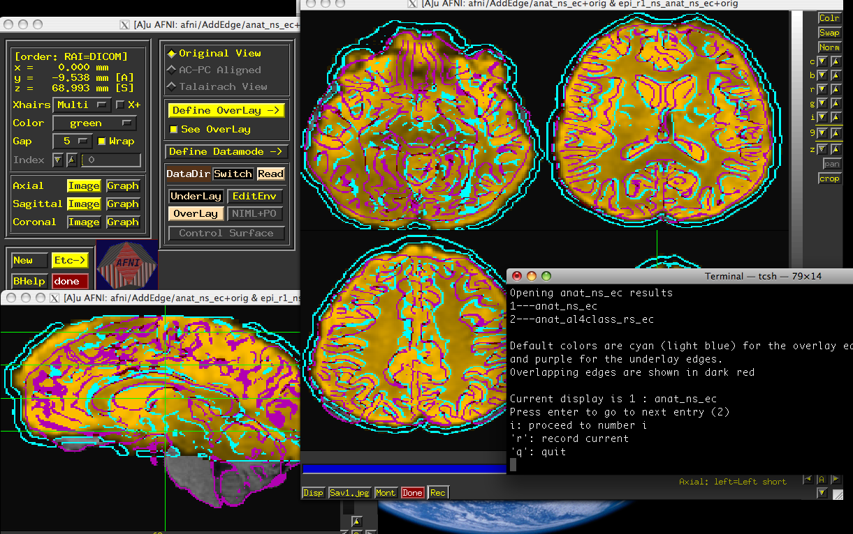
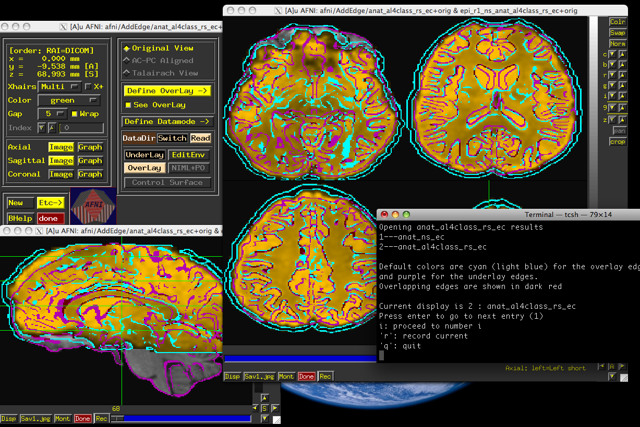
@AddEdge display
@Add
Before
After

Slide 18
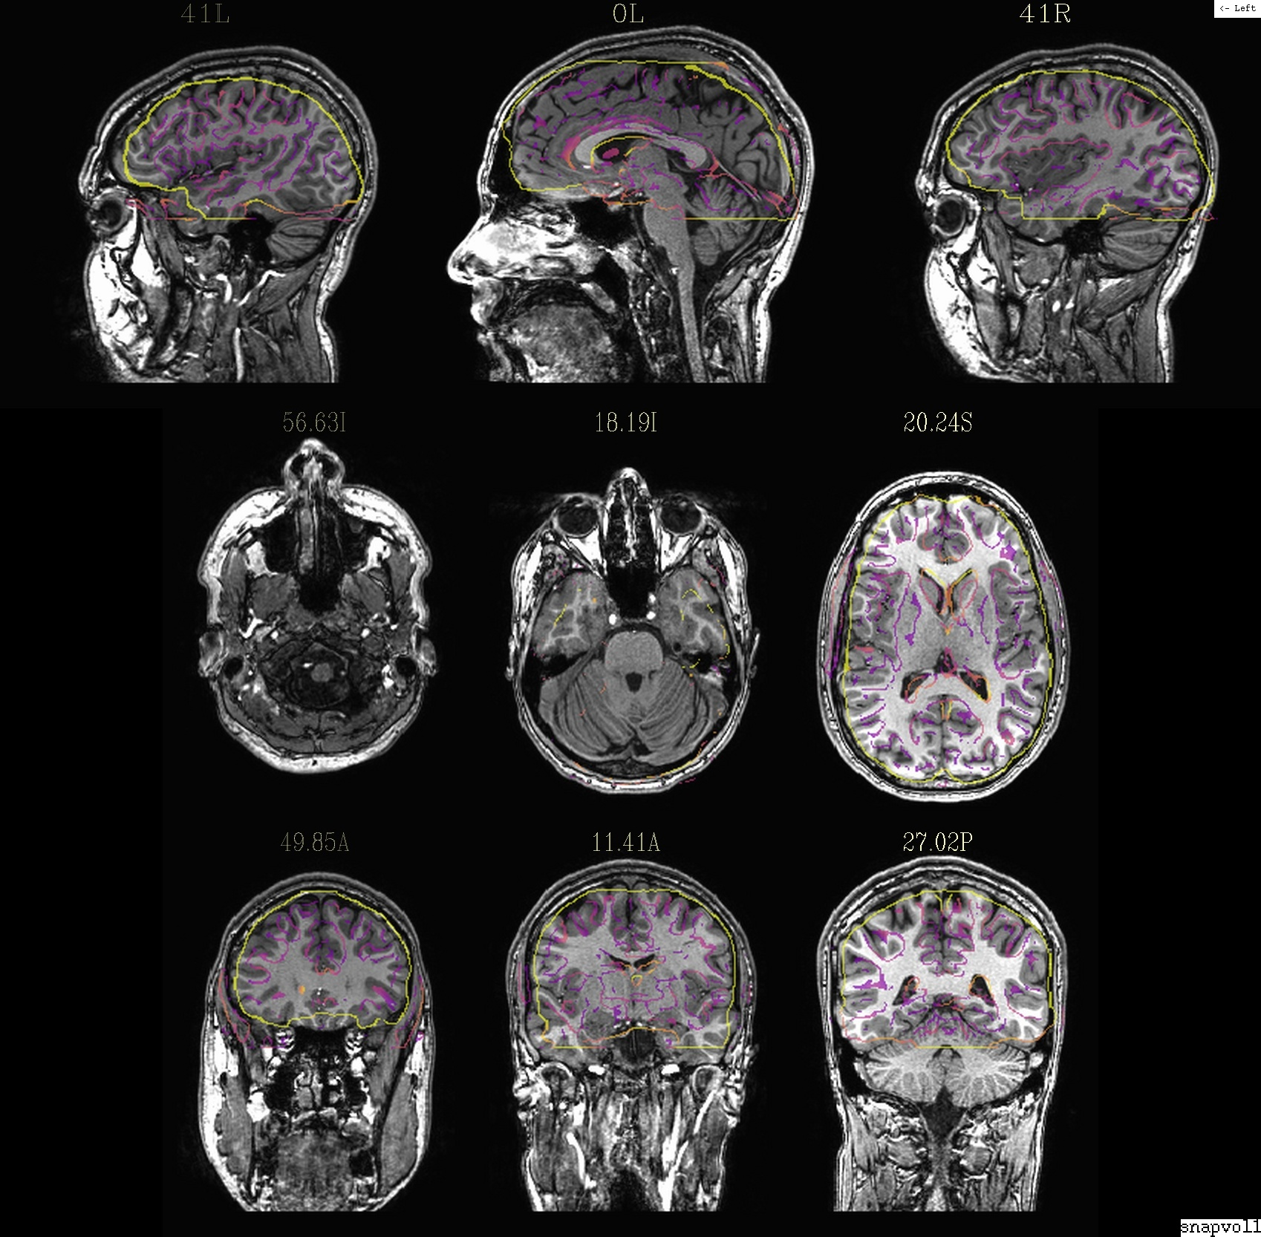
@snapshot_volreg anat+orig. epi_r1+orig edges.jpg
aiv edges.jpg

Slide 19
Alignment Visualization in AFNI
Graph and image – travel through time for motion correction or for a thousand datasets in a row.
Multiple controllers and crosshairs – up to ten datasets at a time, quick and rough.
Overlay display – opacity control, thresholding. A single pair – good for different or similar datasets.
Overlay toggle, Underlay toggle – wiggle, good but a little tricky ('o' and 'u' keys in image viewer)
Sliding Overlay ('4'/'5' keys), Fade-in overlay ('6' key), Checkerboard Underlay – ('#' key) two similar datasets in underlay but must be virtually identical. Good for comparing two processing methods
Edge display for underlay – effective pairwise comparison for quick fine structure display and comparison with overlay dataset with opacity. One dataset should have reliable structure and contrast. Now with 'e' toggle.
@AddEdge – single or dual edges with good contrast for pairwise comparison.

Slide 20
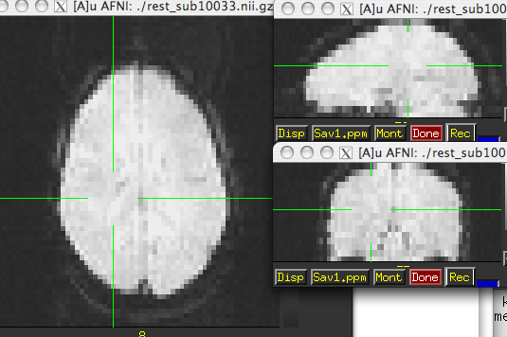
Alignment strategies with align_epi_anat.py
Defaults work usually (>90% - FCON1000)
Problems:
Far off start – “-big_move”, “-giant_move”,”-ginormous_move”
Poor contrast – “-cost lpa”, “-cost nmi”, “-cost lpc+ZZ”
Poor non-uniformity – “-edge”, “-cost lpa”
stroke/MS lesions, tumors, monkeys, rats, multi-modality (CT/PET/DTI/...), something else? – see us, post message

Slide 21
Real and Imaginary Problems

Slide 22
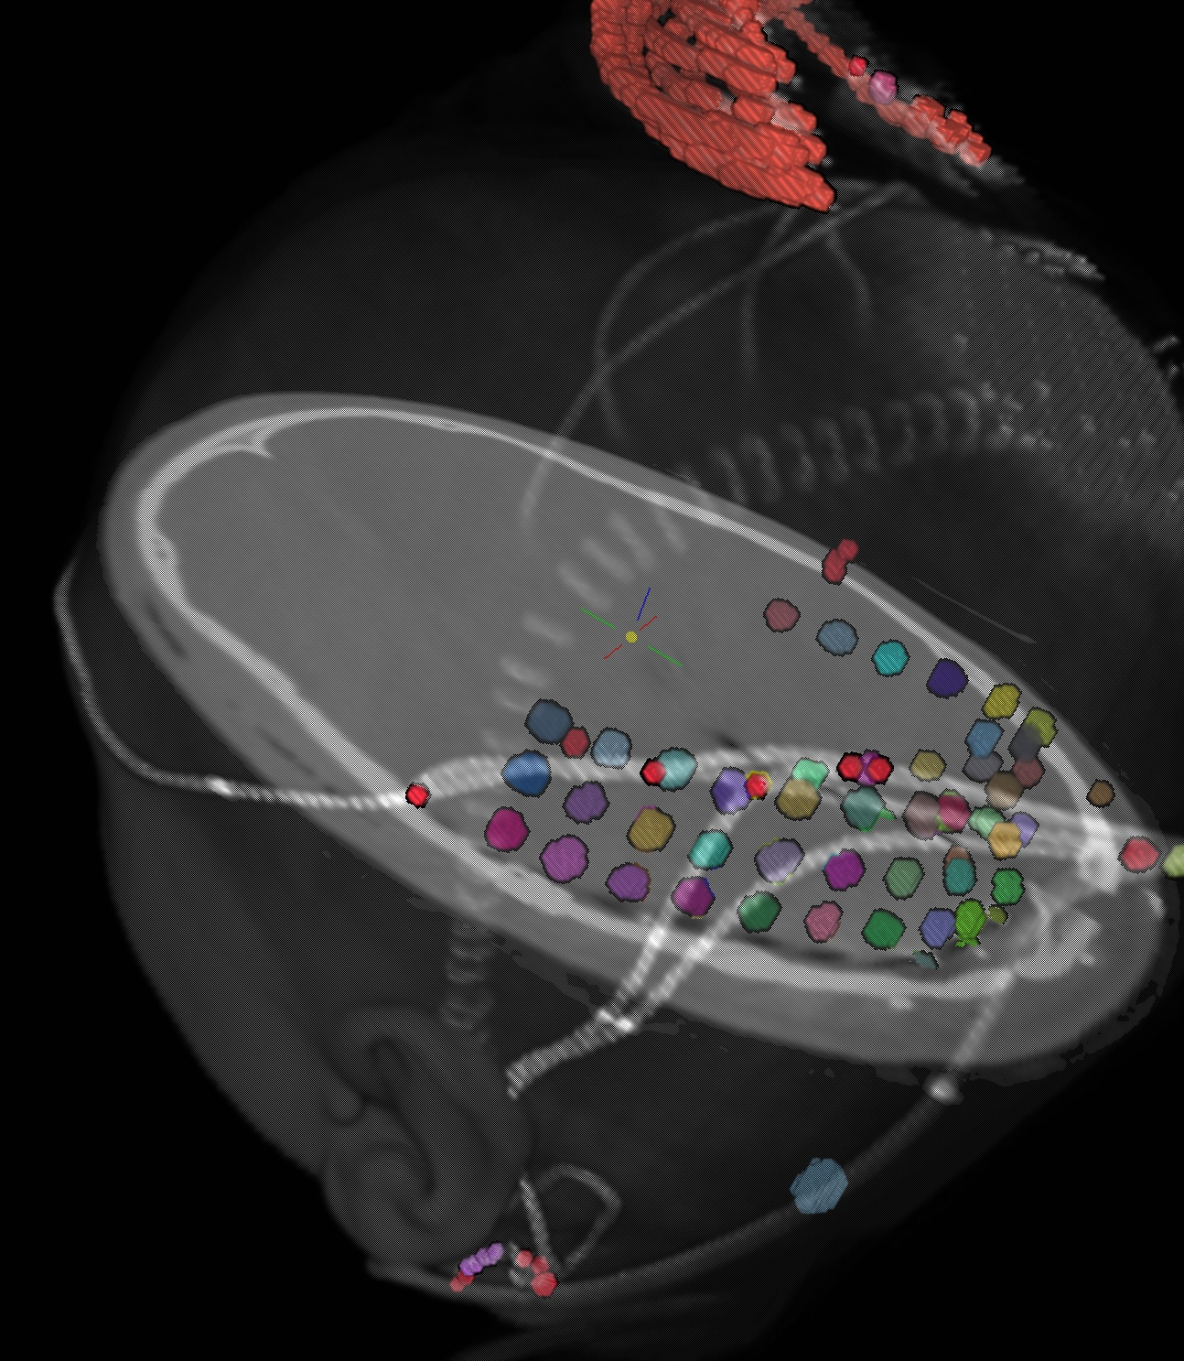
Alignment –special cases
DBS – align CT with electrodes to pre-surgical MRI, PET
ECOG – align CT with electrodes to pre-surgical MRI
Dataset courtesy of Justin Rajendra,
(Formerly at Emory, Now in our group. Woohoo!)
Also see @Install_DBSproc for DBS with CT and DTI processing
(S. Horovitz)
Dataset courtesy of Anna Gaglianese (University of Utrecht, Netherlands)

Slide 23
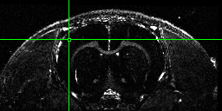
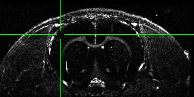
Rat Brains
Alignment of 12 hour Manganese enhanced MRI scan (MEMRI) to start
#!/bin/tcsh
# align_times.csh
set basedset = 14_pre+orig
foreach timedset ( 14_*hr+orig.HEAD)
align_epi_anat.py -prep_off -anat $timedset -epi $basedset \
-epi_base 0 -anat_has_skull no -epi_strip None -suffix _edge2prep \
-cost lpa -overwrite -edge -rat_align
end
3dTcat -prefix 14_timealigned_edge 14_pre+orig. 14*edge2prep+orig.HEAD
Data from Der-Yow Chen (NINDS)
Notes:
-rat_align sets blur size and neighborhood size for 3dAllineate’s LPC and rat option for 3dSkullStrip though it’s not used here
<number>

Slide 24
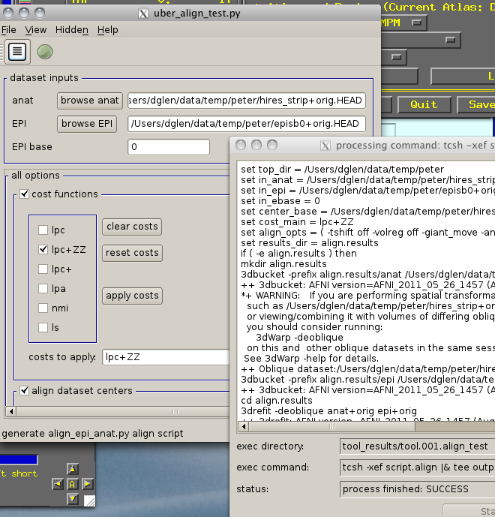
uber_align_test.py
select input data
set options
create script
run script

Slide 25
afni_proc.py – alignment handling
Single script to do all the processing of a typical fMRI pipeline including motion correction (3dvolreg), alignment (align_epi_anat.py)
combines transformations when possible
from example 6 in afni_proc.py’s prodigious help:
afni_proc.py -subj_id sb23.e6.align \
-dsets sb23/epi_r??+orig.HEAD \
-do_block align tlrc \
-copy_anat sb23/sb23_mpra+orig \
-tcat_remove_first_trs 3 \
-volreg_align_to last \
-volreg_align_e2a \
-volreg_tlrc_warp \
…
To process in orig space, remove -volreg_tlrc_warp.
To apply manual tlrc transformation, use -volreg_tlrc_adwarp.
To process as anat aligned to EPI, remove -volreg_align_e2a.

Slide 26
Transformation Chains Example
Session 1
Session 2
structural-functional alignment from align_epi_anat.py
(affine)
structural-functional alignment from align_epi_anat.py
(affine)
Freesurfer
Seg. (Atlas)
Anat1
Anat2
EPI_RUN1
TR=0
EPI_RUN1
TR=1
...
EPI_RUN1
TR=n
EPI_RUN1
TR=0
EPI_RUN1
TR=1
...
EPI_RUN1
TR=n
EPI_RUN2
TR=0
EPI_RUN2
TR=1
...
EPI_RUN2
TR=n
EPI_RUN2
TR=0
EPI_RUN2
TR=1
...
EPI_RUN2
TR=n
motion correction xforms from 3dvolreg
motion correction xforms from 3dvolreg
Template (Talairach/MNI/...)
alignment to template xform from @auto_tlrc
(affine/non-linear)
Talairach
Atlas
MNI
Atlas
MNI_ANAT
Atlas
Web-based
Atlas
Atlas information available to any space through shortest chain of xforms
Known or User-defined transformations
Resource
Transformation
Dataset
Same space / Identity xform

Slide 27
Alignment across two sessions
Session 1
Session 2
structural-functional alignment from align_epi_anat.py
(affine)
structural-functional alignment from align_epi_anat.py
(affine)
Freesurfer
Seg. (Atlas)
Anat1
In-between anat
Anat2
EPI_RUN1
TR=0
EPI_RUN1
TR=1
...
EPI_RUN1
TR=n
EPI_RUN1
TR=0
EPI_RUN1
TR=1
...
EPI_RUN1
TR=n
EPI_RUN2
TR=0
EPI_RUN2
TR=1
...
EPI_RUN2
TR=n
EPI_RUN2
TR=0
EPI_RUN2
TR=1
...
EPI_RUN2
TR=n
motion correction xforms from 3dvolreg
motion correction xforms from 3dvolreg
Template (Talairach/MNI/...)
alignment to template xform from @auto_tlrc
(affine/non-linear)
Atlas information available to any space through shortest chain of xforms
Talairach
Atlas
MNI
Atlas
MNI_ANAT
Atlas
Web-based
Atlas
Resource
Transformation
Dataset
Same space / Identity xform
Known or User-defined transformations
http://afni.nimh.nih.gov/sscc/dglen/alignmentacross2sessions

Slide 28
Nonlinear Warping
3dQwarp
I_{new}(x) = I_{old}( W(x) )
where W(x) depends on a lot of parameters (1000-50000+)
Method: Incremental transformation with Hermite cubic polynomials over finer and finer 3D patches. Output is both aligned dataset and the warp and the inverse warp deformations in Dx,Dy,Dz
Better alignment of anatomical volumes to template space
Then carry the functional results to template space for better group analyses?
As an aid to brain segmentation and atlas-ing accuracy?
Pre- and post-surgical alignment, EPI distortion correction
Related programs and scripts:
3dNwarpApply, 3dNwarpCat, 3dNwarpCalc, 3dNwarpAdjust, 3dNwarpFuncs
auto_warp.py, afni_proc.py
UnwarpEPI.py - blipup-blipdown script (Vinai Roopchansingh)

Slide 29
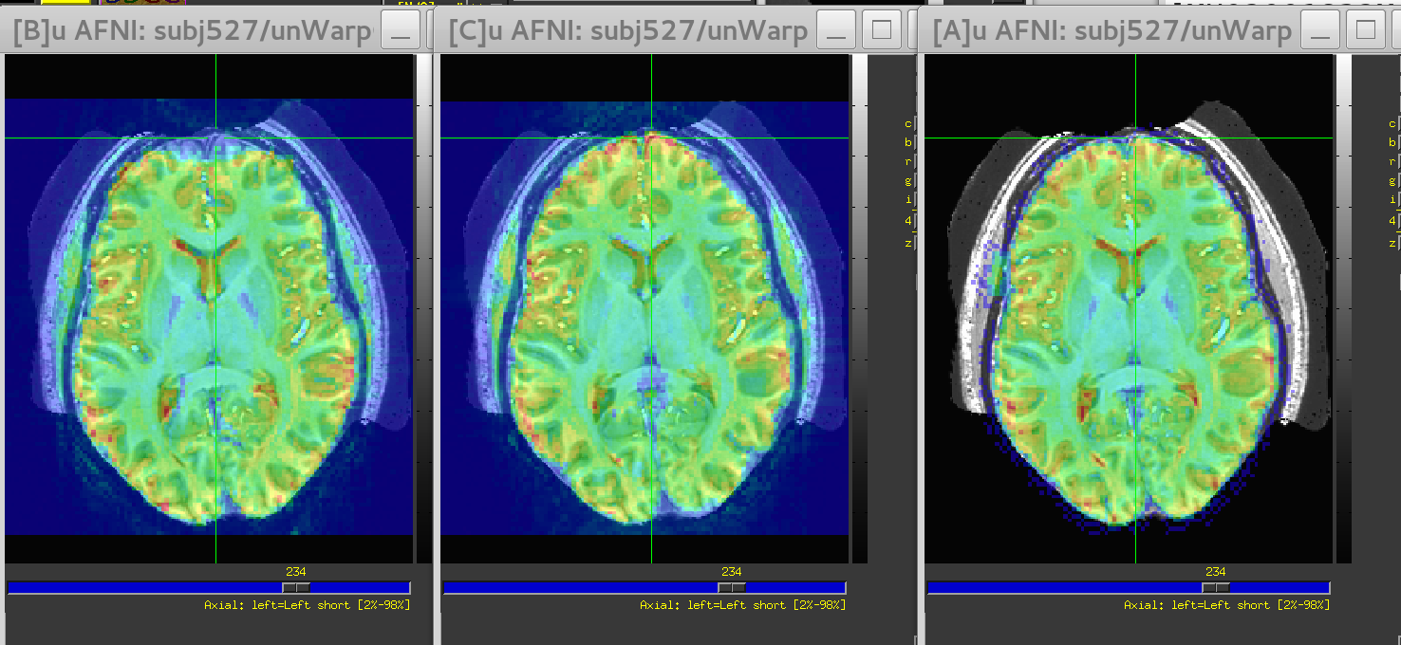
Blip-up/down distortion correction
Data courtesy of Sam Torrisi, NIMH
Blip-up (uncorrected)
Blip-down
Corrected

Slide 30
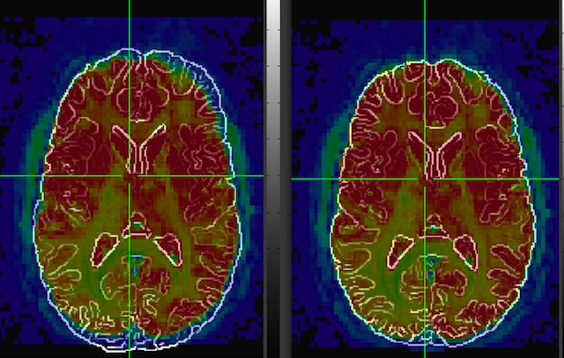
Left and Right - flipping
align_epi_anat.py -anat anat+orig -epi epi_r1+orig -epi_base 0 \
-giant_move -check_flip
The output will include this warning if the data is flipped:
WARNING: ************ flipped data aligns better than original data
Check for left - right flipping in the GUI ************************
If everything is okay, this message appears instead:
Data does not need flipping

Slide 31
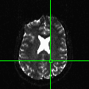
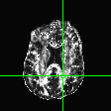
DWI Motion Correction
Original DWI data
Compute Tensor
(3dDWItoDT)
Compute ideal (synthesize) DWI
(3dDTtoDWI)
Original DWI data
Align (pairwise)
gradient to synthetic
counterpart
(3dvolreg/3dAllineate)
Update gradient
directions
Final DWI data
Finished?
More iterations?
Original motion
FA maps with iteration

Slide 32
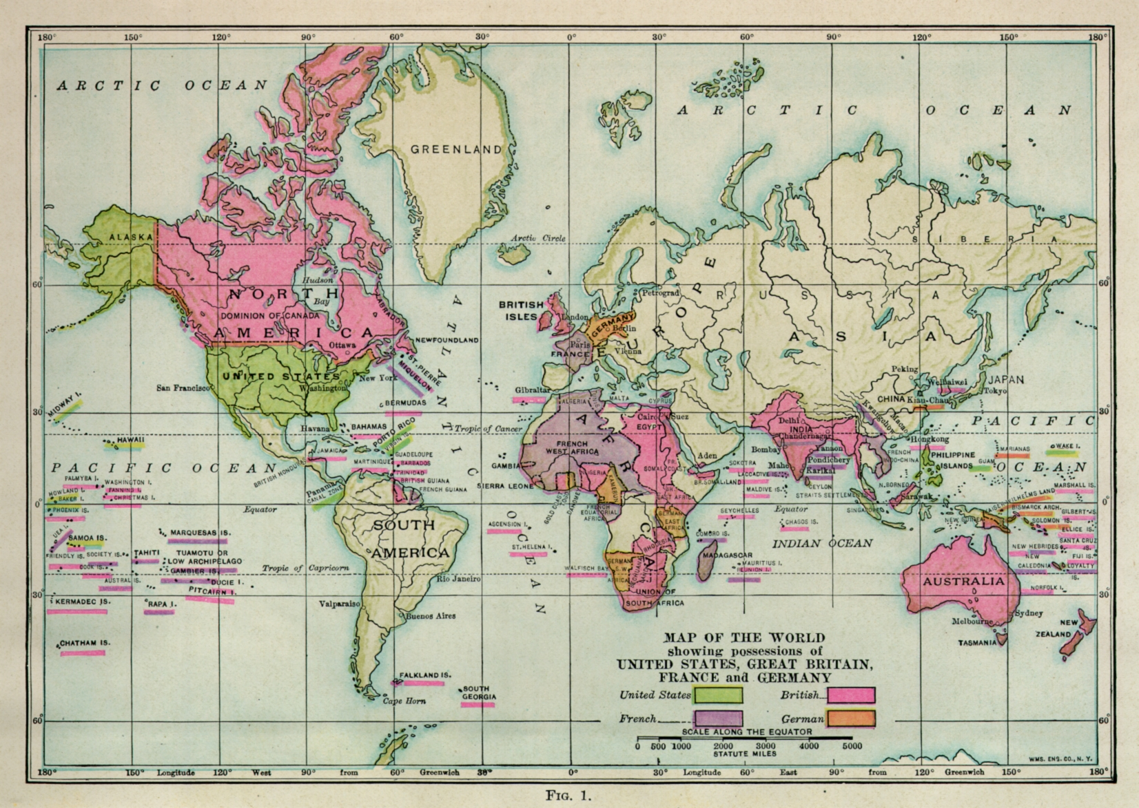
ATLASES

Slide 33
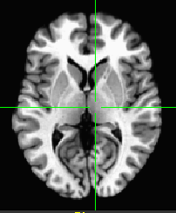
ATLAS DEFINITIONS
Template - a reference dataset used for matching shapes. Examples: TT_N27+tlrc, MNI_EPI+tlrc, TT_ICBM452+tlrc.
TT_N27+tlrc

Slide 34
ATLAS DEFINITIONS
Template Space - x,y,z coordinate system shared by many datasets (the basic shoebox) Examples: TLRC (Talairach-Tourneaux), MNI, MNI_ANAT, ORIG.

Slide 35
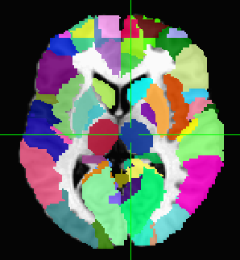
ATLAS DEFINITIONS
Atlas - segmentation info.
Examples: TTatlas+tlrc, TT_N27_EZ_ML+tlrc, roidset+orig.
TT_N27_EZ_ML+tlrc

Slide 36
Registration To Standard Spaces Transforming Datasets to Talairach-Tournoux Coordinates
The original purpose of AFNI (circa 1994 A.D.) was to perform the transformation of datasets to Talairach-Tournoux (stereotaxic) coordinates
The transformation can be manual, or automatic
In manual mode, you must mark various
anatomical locations, defined in
Jean Talairach and Pierre Tournoux
“Co-Planar Stereotaxic Atlas of the Human Brain”
Thieme Medical Publishers, New York, 1988
Marking is best done on a high-resolution T1-weighted structural MRI volume
In automatic mode, you need to choose a template to which your data are aligned. Different templates are made available with AFNI’s distribution. You can also use your own templates.
Transformation carries over to all other (follower) datasets in the same directory
This is where the importance of getting the relative spatial placement of datasets done correctly in to3d really matters
You can then write follower datasets, typically functional or EPI timeseries, to disk in Talairach coordinates
Purpose: voxel-wise comparison with other subjects
May want to blur volumes a little before comparisons, to allow for residual anatomic variability: AFNI programs 3dmerge or 3dBlurToFWHM

Slide 37
Hidden in GUI - right click on “DataDir” or set AFNI_ENABLE_MARKERS to YES in .AFNIRC
Manual Transformation proceeds in two stages:
Alignment of AC-PC and I-S axes (to +acpc coordinates)
Scaling to Talairach-Tournoux Atlas brain size (to +tlrc coordinates)
Stage 1: Alignment to +acpc coordinates:
Anterior commissure (AC) and posterior commissure (PC) are aligned to be the y-axis
The longitudinal (inter-hemispheric or mid-sagittal) fissure is aligned to be the yz-plane, thus defining the z-axis
The axis perpendicular to these is the x-axis (right-left)
Five markers that you must place using the [Define Markers] control panel:
AC superior edge = top middle of anterior commissure
AC posterior margin = rear middle of anterior commissure
PC inferior edge = bottom middle of posterior commissure
First mid-sag point = some point in the mid-sagittal plane
Another mid-sag point = some other point in the mid-sagittal plane
This procedure tries to follow the Atlas as precisely as possible
Even at the cost of confusion to the user (e.g., you)

Slide 38
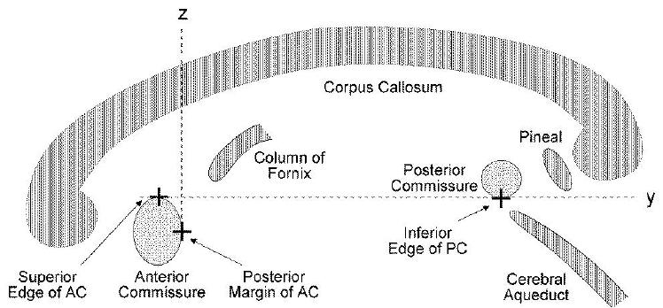
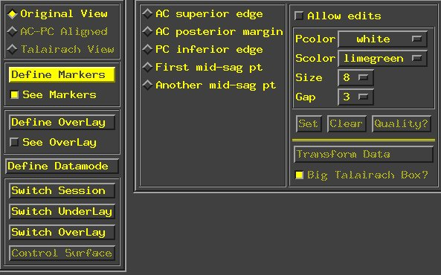
Press this IN to create or change markers
Color of “primary” (selected) marker
Click Define Markers to open the “markers” panel
Color of “secondary” (not selected) markers
Size of markers (pixels)
Size of gap in markers
Clear (unset) primary marker
Select which marker you are editing
Set primary marker to current focus location
Carry out transformation to +acpc coordinates
Perform “quality” check on markers (after all 5 are set)

Slide 39
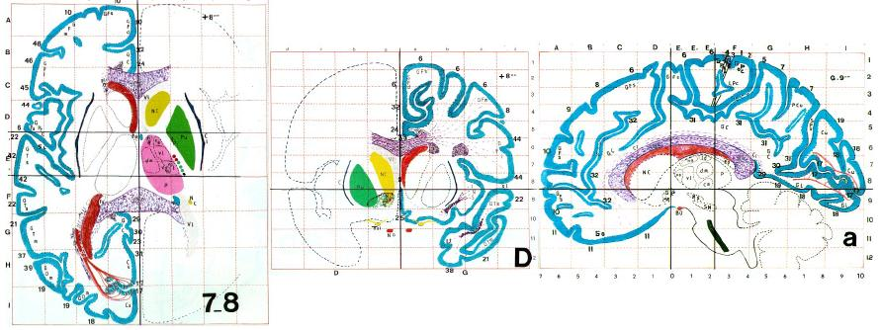
Stage 2: Scaling to Talairach-Tournoux (+tlrc) coordinates:
Once the AC-PC landmarks are set and we are in ACPC view, we now stretch/shrink the brain to fit the Talairach-Tournoux Atlas brain size (sample TT Atlas pages shown below, just for fun)
Most anterior to AC | 70 mm
AC to PC | 23 mm
PC to most posterior | 79 mm
Length of cerebrum | 172mm
Most inferior to AC | 42 mm
AC to most superior | 74 mm
Height of cerebrum | 116mm
AC to left (or right) | 68 mm
Width of cerebrum | 136mm

Slide 40
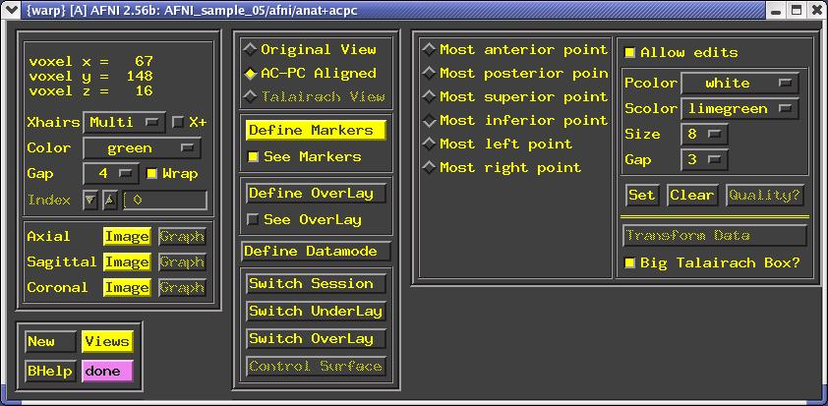
Selecting the Talairach-Tournoux markers for the bounding box:
There are 12 sub-regions to be scaled (3 A-P x 2 I-S x 2 L-R)
To enable this, the transformed +acpc dataset gets its own set of markers
Click on the [AC-PC Aligned] button to view our volume in ac-pc coordinates
Select the [Define Markers] control panel
A new set of six Talairach markers will appear and the user now sets the bounding box markers (see Appendix C for details):
Talairach markers appear only when the AC-PC view is highlighted
Once all the markers are set, and the quality tests passed. Pressing [Transform Data] will write new header containing the Talairach transformations (see Appendix C for details)
Recall: With AFNI, spatial transformations are stored in the header of the output

Slide 41
Automatic Talairach Transformation with @auto_tlrc
Is manual selection of AC-PC and Talairach markers bringing you down? You can now perform a TLRC transform automatically using an AFNI script called @auto_tlrc.
Differences from Manual Transformation:
Instead of setting ac-pc landmarks and volume boundaries by hand, the anatomical volume is warped (using 12-parameter affine transform) to a template volume in TLRC space.
Anterior Commisure (AC) center no longer at 0,0,0 and size of brain box is that of the template you use.
For various reasons, some good and some bad, templates adopted by the neuroimaging community are not all of the same size. Be mindful when using various atlases or comparing standard-space coordinates.
You, the user, can choose from various templates for reference but be consistent in your group analysis.
Easy, automatic. Just check final results to make sure nothing went seriously awry. AFNI is perfect but your data is not.

Slide 42
Templates in @auto_tlrc that the user can choose from:
TT_N27+tlrc:
AKA “Colin brain”. One subject (Colin) scanned 27 times and averaged. (www.loni.ucla.edu, www.bic.mni.mcgill.ca)
Has a full set of FreeSurfer (surfer.nmr.mgh.harvard.edu) surface models that can be used in SUMA (link).
Is the template for cytoarchitectonic atlases (www.fz-juelich.de/ime/spm_anatomy_toolbox)
For improved alignment with cytoarchitectonic atlases, I recommend using the TT_N27 template because the atlases were created for it. In the future, we might provide atlases registered to other templates.
TT_icbm452+tlrc:
International Consortium for Brain Mapping template, average volume of 452 normal brains. (www.loni.ucla.edu, www.bic.mni.mcgill.ca)
TT_avg152T1+tlrc:
Montreal Neurological Institute (www.bic.mni.mcgill.ca) template, average volume of 152 normal brains.
TT_EPI+tlrc:
EPI template from spm2, masked as TT_avg152T1. TT_avg152 and TT_EPI volumes are based on those in SPM's distribution. (www.fil.ion.ucl.ac.uk/spm/)
MNI152_T1_2009c+tlrc:
MNI's 152 nonlinear asymmetric template

Slide 43
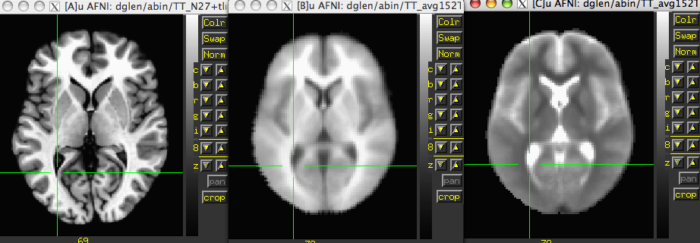
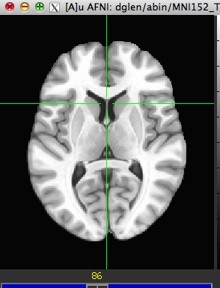
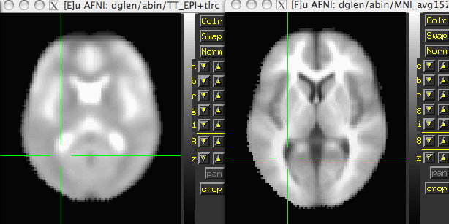
Templates included with AFNI
TT_N27
TT_avg152T1
TT_avg152T2
MNI152_T1_2009c
TT_EPI
MNI_avg152T1

Slide 44
Steps performed by @auto_tlrc
For warping a volume to a template (Usage mode 1):
Pad the input data set to avoid clipping errors from shifts and rotations
Strip skull (if needed)
Resample to resolution and size of TLRC template
Perform 12-parameter affine registration using 3dWarpDrive
Many more steps are performed in actuality, to fix up various pesky little artifacts. Read the script if you are interested.
Typically this steps involves a high-res anatomical to an anatomical template
Example: @auto_tlrc -base TT_N27+tlrc. -input anat+orig. -suffix NONE
One could also warp an EPI volume to an EPI template.
If you are using an EPI time series as input. You must choose one sub-brick to input. The script will make a copy of that sub-brick and will create a warped version of that copy.

Slide 45
Applying a transform to follower datasets
Say we have a collection of datasets that are in alignment with each other. One of these datasets is aligned to a template and the same transform is now to be applied to the other follower datasets
For Talairach transforms there are a few methods:
Method 1: Manually using the AFNI interface (see Appendix C)
Method 2: With program adwarp
adwarp -apar anat+tlrc -dpar func+orig
The result will be: func+tlrc.HEAD and func+tlrc.BRIK
Method 3: With @auto_tlrc script in mode 2
ONLY when -apar dataset was created by @auto_tlrc
@auto_tlrc -apar SubjectHighRes+tlrc. \
-input Subject_EPI+orig. -dxyz 3
(the output is named Subject_EPI_at+TLRC, by default)
Why bother saving transformed datasets to disk anyway?
Datasets without .BRIK files are of limited use, only for display of slice images

Slide 46
@auto_tlrc Example
Transforming the high-resolution anatomical:
(If you are also trying the manual transform on workshop data, start with a fresh directory with no +tlrc datasets )
@auto_tlrc \
-base TT_N27+tlrc \
-suffix NONE \
-input anat+orig
Transforming the function (“follower datasets”), setting the resolution at 2 mm:
@auto_tlrc \
-apar anat+tlrc \
-input func_slim+orig \
-suffix NONE \
-dxyz 2
You could also use the icbm452 or the mni’s avg152T1 template instead of N27 or any other template you like (see @auto_tlrc -help for a few good words on templates)
Output: anat+tlrc
Output: func_slim+tlrc

Slide 47
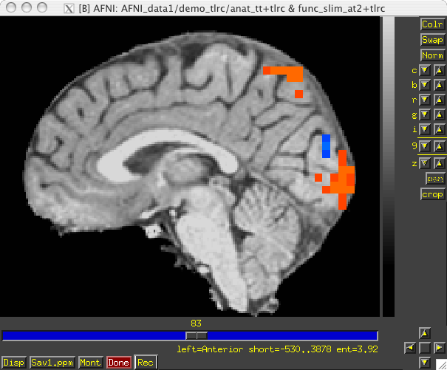
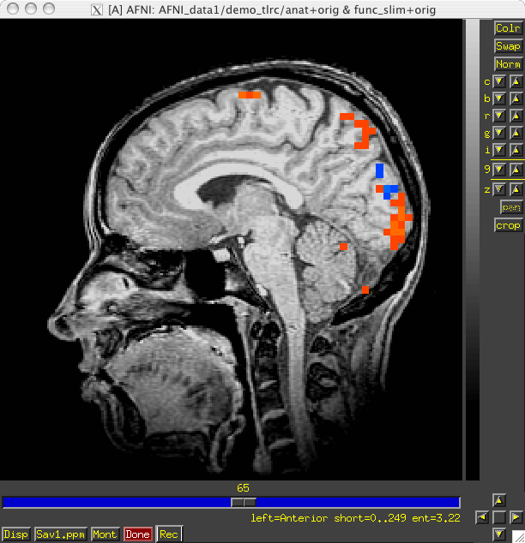
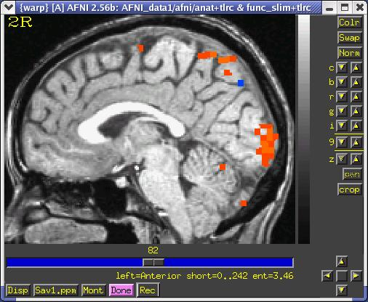
@auto_tlrc Results are Comparable to Manual TLRC:
@auto_tlrc
Original
Manual

Slide 48
Standard Spaces
Why use a standard template space?
Compare across subjects and groups easily for every voxel in the brain
Standardize coordinates with others
Know where a voxel is automatically from an atlas
Mostly automated and no specific ROI drawing required
Why not use a standard template space?
Inconsistency among subjects
Inconsistency among groups – elderly versus younger
Use consistent anatomical ROIs with good anatomical knowledge
Lower threshold for multiple comparison adjustments

Slide 49
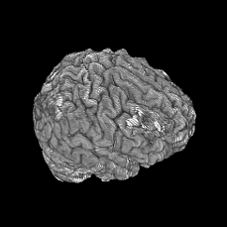
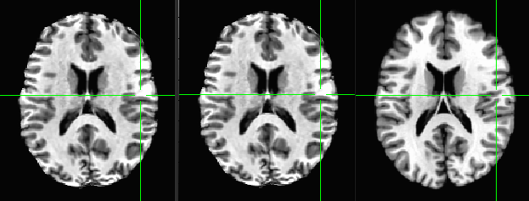
Nonlinear alignment to template
3dQwarp →
@auto_tlrc 3dUnifize qw0 qw1 qw2
qw3 qw4 qw5 qw6 qw7
qw8 qw9 TT_N27

Slide 50
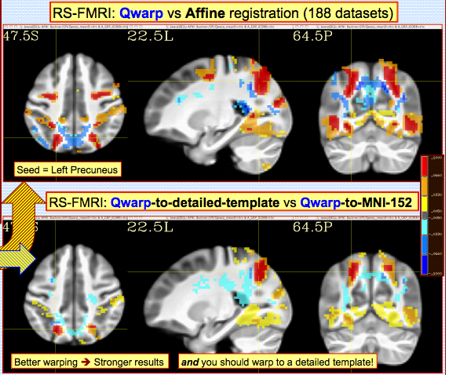
Nonlinear alignment
Advantages:
Great alignment – better spatial correspondence across data →
Aligned data matches template
Disadvantages:
Distortion of individual data
Aligned data matches template. Choose template carefully
End limits?
Skullstripping must be done much more carefully
Processing time much slower
Not yet integrated into AFNI GUI for warp-on-demand

Slide 51
Comparing data
How can I compare regions/voxels across subjects and groups?
What works “best”?
@auto_tlrc – affine registration method to align individual subjects to a template
auto_warp.py – nonlinear alignment to template – better.
manual Talairach – based on specific markers divides data up based on AC-PC line and brain enclosing boxes. Better for looking at medial structures.
3dTagalign – place markers on specific corresponding points among datasets and align with affine transformation
ROI creation – draw ROI’s (Draw Dataset plug-in) for each structure

Slide 52
Choosing a template
Similar to subject group – neonates, pediatric, young adults, elderly, macaque, rabbit...
Same modality, similar coverage
Relevant atlas segmentation
Individual or group template
Group – average or iterative
Make your own template (and maybe an atlas too)
Haskins pediatric atlas research
affine group averages
finding the most "typical" individual in group
nonlinear alignment to typical
iterative nonlinear alignment
@toMNI_Awarp, @toMNI_Qwarpar

Slide 53
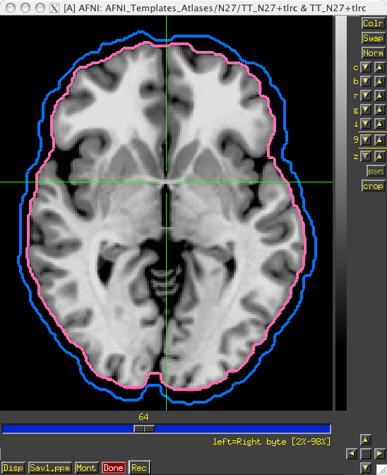
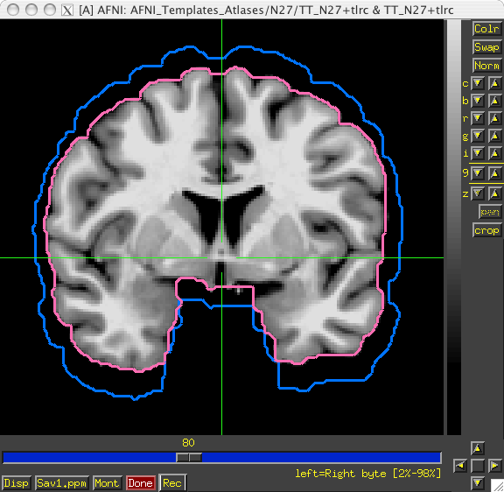
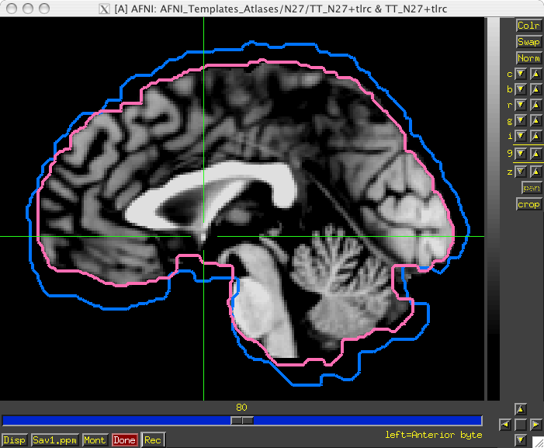
Atlas/Template Spaces Differ In Size
MNI is larger than TLRC space.

Slide 54
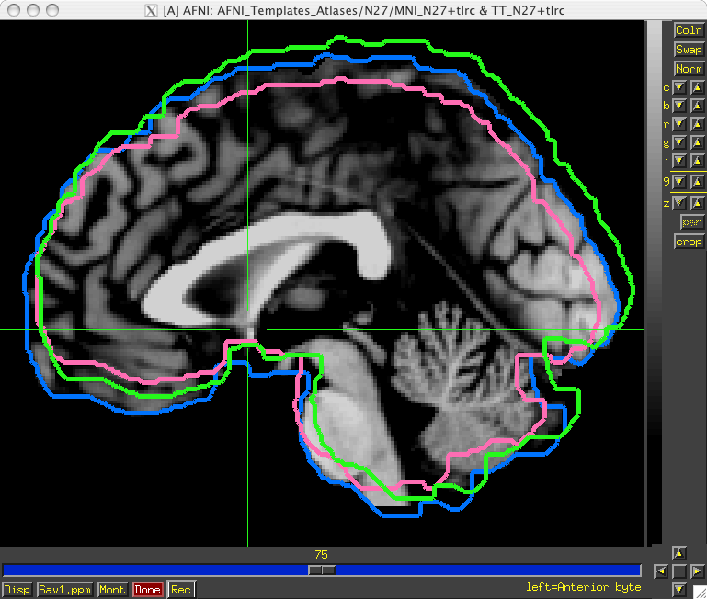
Atlas/Template Spaces Differ In Origin
TLRC
MNI
MNI-Anat.

Slide 55
From Space To Space
TLRC
MNI
MNI-Anat.
Going between TLRC and MNI:
Approximate equation
used by whereami and 3dWarp
Manual TLRC transformation of MNI template to TLRC space
used by whereami (as precursor to MNI Anat.), based on N27 template
Multiple space coordinates reported in whereami output (AFNI_ATLAS_TEMPLATE_SPACE_LIST)
Going between MNI and MNI Anatomical (Eickhoff et al. Neuroimage 25, 2005):
MNI + ( 0, 4, 5 ) = MNI Anat. (in RAI coordinate system)
Going between TLRC and MNI Anatomical (as practiced in whereami):
Go from TLRC (TT_N27) to MNI via manual xform of N27 template
Add ( 0, 4, 5 )

Slide 56
Atlases/Templates Use Different Coord. Systems
There are 48 manners to specify XYZ coordinates
Two most common are RAI/DICOM and LPI/SPM
RAI means
X is Right-to-Left (from negative-to-positive)
Y is Anterior-to-Posterior (from negative-to-positive)
Z is Inferior-to-Superior (from negative-to-positive)
LPI means
X is Left-to-Right (from negative-to-positive)
Y is Posterior-to-Inferior (from negative-to-positive)
Z is Inferior-to-Superior (from negative-to-positive)
To go from RAI to LPI just flip the sign of the X and Y coordinates
Voxel -12, 24, 16 in RAI is the same as 12, -24, 16 in LPI
Voxel above would be in the Right, Posterior, Superior octant of the brain
AFNI allows for all coordinate systems but default is RAI
Can use environment variable AFNI_ORIENT to change the default for AFNI AND other programs.
See whereami -help for more details.

Slide 57
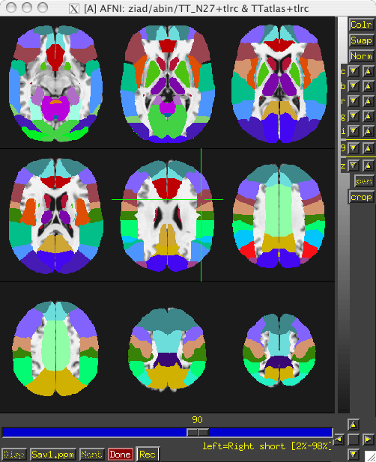
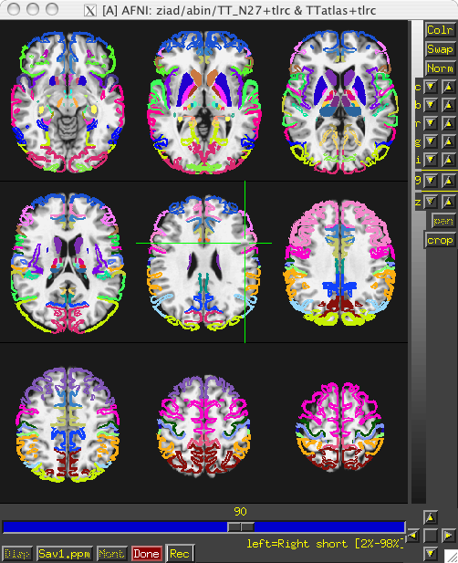
Atlases Distributed With AFNI TT_Daemon
TT_Daemon : Created by tracing Talairach and Tournoux brain illustrations.
Generously contributed by Jack Lancaster and Peter Fox of RIC UTHSCSA)

Slide 58
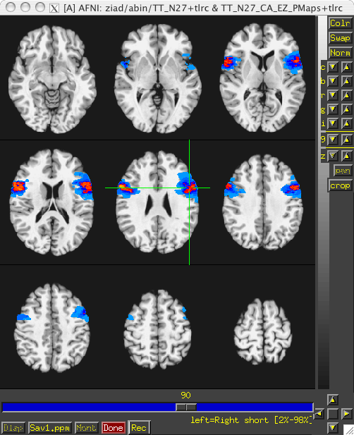
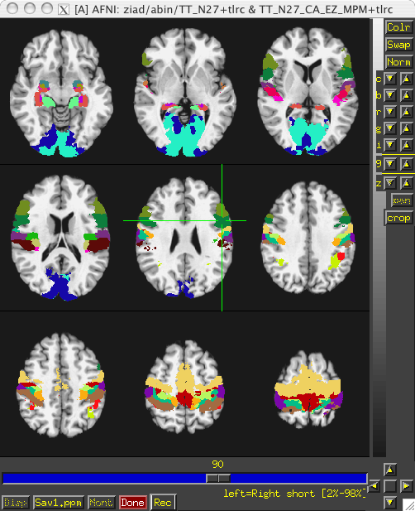
Atlases Distributed With AFNI Anatomy Toolbox: Prob. Maps, Max. Prob. Maps
CA_N27_MPM, CA_N27_ML, CA_N27_PM: Anatomy Toolbox's atlases with some created from cytoarchitectonic studies of 10 human post-mortem brains
Generously contributed by Simon Eickhoff, Katrin Amunts and Karl Zilles of IME, Julich, Germany

Slide 59
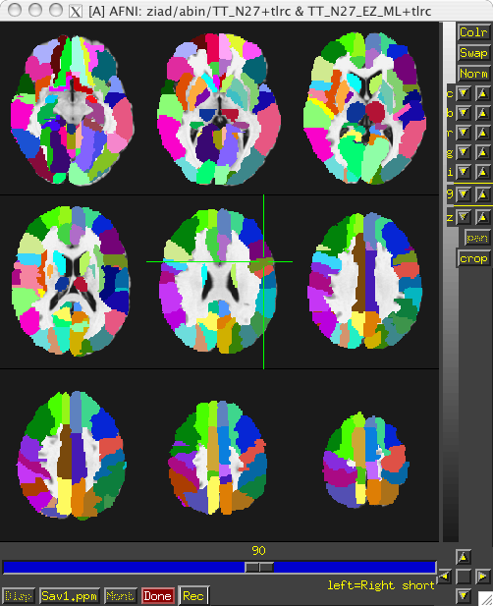
Atlases Distributed With AFNI: Anatomy Toolbox: MacroLabels
CA_N27_MPM, CA_N27_ML, CA_N27_PM: Anatomy Toolbox's atlases with some created from cytoarchitectonic studies of 10 human post-mortem brains
Generously contributed by Simon Eickhoff, Katrin Amunts and Karl Zilles of IME, Julich, Germany

Slide 60
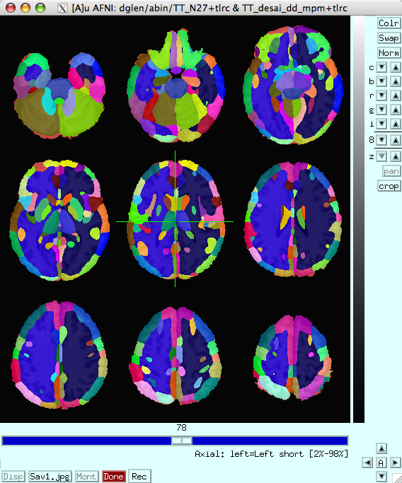
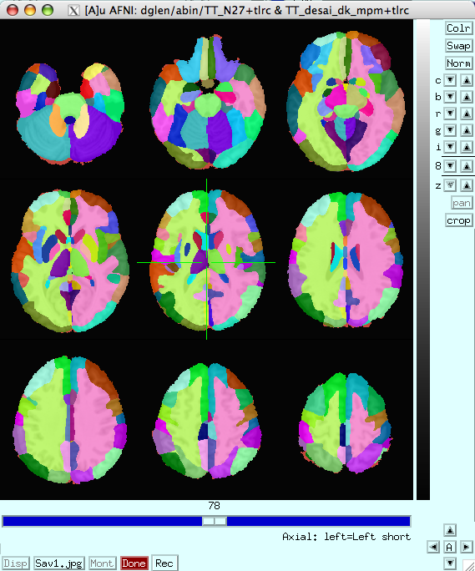
Atlases Distributed With AFNI: Desai PMaps and MPMs
Atlases generated with typical AFNI pipeline using @auto_tlrc and FreeSurfer segmentation across multiple subjects

Slide 61
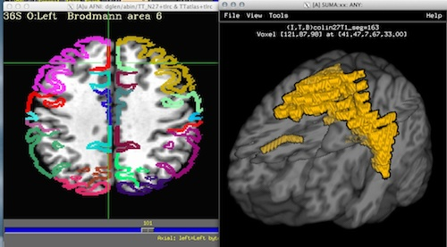
Talairach Daemon (TT_Daemon) problem

Slide 62
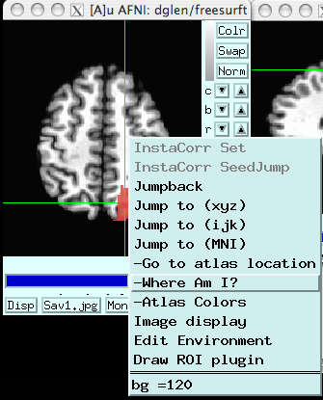
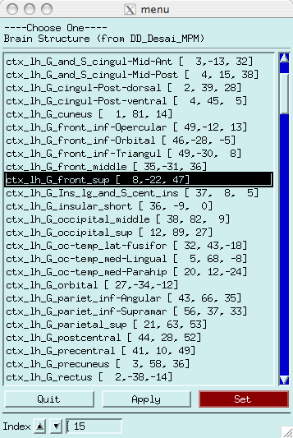
Some fun and useful things to do with +tlrc datasets are on the 2D slice viewer Right click to get menu:
[Go to Atlas Location]
Lets you jump to centroid of regions to current default atlas (set by AFNI_ATLAS_COLORS) Works in +orig too

Slide 63
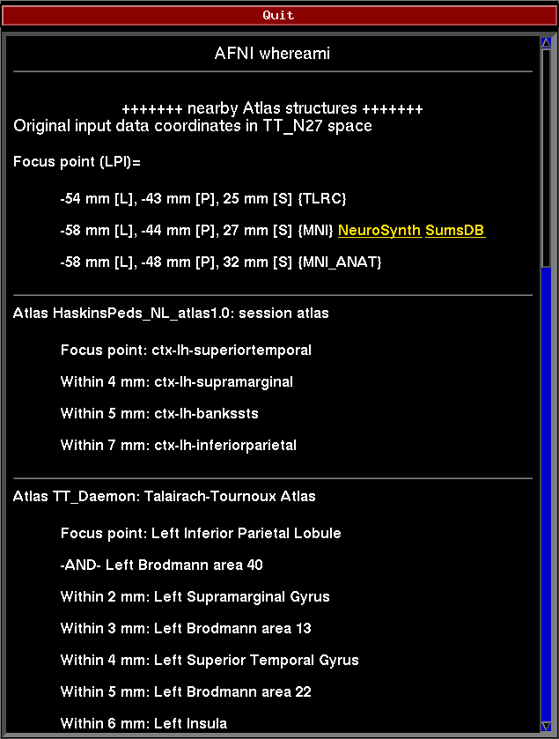
[Where am I?]
Shows you where you are in various atlases and spaces
(works in +orig too, if you have a transformed parent)
For atlas installation, and much, much more, see help in command line version:
whereami -help

Slide 64
whereami can provide the user with more detailed information regarding the output of 3dclust
For instance, say you want more information regarding the center of mass voxels from each cluster (from the 3dclust output). I.e., where do they fall approximately within the atlases?
3dclust -dxyz=1 -1clip 9.5 1 1000 func_FullF+tlrc > clusts.1D
whereami -coord_file clusts.1D'[1,2,3]' -tab | less
Center of mass output, columns 1,2,3, from 3dclust output
Shown: Cluster #1’s coordinates according to various atlases (TT, MNI, etc), as well as the name of the anatomical structure that is located at or near these coordinates (which may vary by atlas)
etc…
Notes:
<number>

Slide 65
whereami can report on the overlap of ROIs with atlas-defined regions
whereami -omask anat_roi+tlrc
Notes:
<number>

Slide 66
[Atlas colors]
Lets you show atlas regions over your own data (works only in +tlrc).

Slide 67
Haskins Pediatric Atlas
Pediatric brain atlas and templates (7-12 years old) – Peter Molfese, (formerly Haskins Labs, now at NIH - woohoo!)
Manually corrected segmentation from Freesurfer.
Probabilistic, MPM and template
~75 subjects -> 500 (ages 6-13)
Affine, nonlinear averages, ideal/typical subjects, outliers

Slide 68
Haskins Pediatric Atlas - templates
Affine Group
Nonlinear Group I –
iterative

Slide 69
Atlases and Templates Available!
Infant brain atlas and templates – neonate, 1-year, 2-year. Contributed by Feng Shi, UNC
Cerebellum atlas and templates – Jorn Diedrichsen,UCL,UK contribution

Slide 70
More Atlases and Templates Available!
Ventromedial Prefrontral Cortex (vmPFC, Scott Mackey)
Waxholm Rat Atlas - Papp, et al.
Rat brain templates in Paxinos space – Karolinska Institute, Woo Hyun Shim MGH contributions
BNST – Torrisi, NIMH
All of these are user requests or contributions!
What do you need?

Slide 71
Saleem macaque atlas – MRI, surfaces, connections, supplemental webpages

Slide 72
Saleem macaque atlas – MRI, surfaces, connections, supplemental webpages (in development)

Slide 73
Mapping the digital atlas onto different macaques MRI
A
D99 – Digital atlas
V. small female
D
Reveley, Gruslys, Ye, Samaha, Glen,
Saad, Seth, Leopold, and Saleem
(in preparation)
big male
Spatial transformation of the atlas segmentation to each macaque's native space
B
small female
E
medium female
small male
C
F
Notes:
Atlas and template application
Using five naive macaques, we aligned each macaque's T1 brain MRI to the template created here with a sequence of affine and nonlinear registration steps. An initial affine step proved and approximate scaling. A small amount of nonlinear warping was then used to warp the general brain shape to the template. A brain-only mask from the template was applied to the individual subject brains and the subject was more finely warped to the template by progressively smaller nonlinear warps. This procedure resulted in subject brain data to be registered to the D99 template space. In order to demonstrate the applicability of the atlas to each macaque, the combination of affine and nonlinear transformations were used to warp the atlas segmentation back to each subject's original native space. The results are shown in in figure XXX…
<number>

Slide 74
NMT (NIH Macaque Template) – Group template from 31 macaques, surfaces, GM/WM/CSF segmentation
Jakob Seidlitz, Caleb Sponheim, et al.,NeuroImage, April 2017

Slide 75
NIH Marmoset Template – Individual marmoset template - 150um resolution
Submitted - with Cirong Liu, Afonso Silva and others

Slide 76
Make your own template
MNI 152 template
Linear = Affine
@toMNI_Awarp
@toMNI_Qwarpar
Averages of 21
3 Tesla brain volumes
with varied
levels of refinement in
the nonlinear warping
(smaller patch=more refinement)
12 parameters
Nonlinear: Patch=101
Nonlinear: Patch=49
Nonlinear: Patch=23
+1002
+9048
+70008

Slide 77
ALTERNATIVE ATLAS CREATION TECHNIQUES: ITERATIVE AND TYPICAL METHODS
B
C
Iterative nonlinear alignment to affine template with progressively smaller patch sizes
“Typical”
Brain

Slide 78
Make your own atlas!
New atlases – easy and fun. Make your own!
make available in AFNI GUI and whereami and to other user
@AfniEnv -set AFNI_SUPP_ATLAS_DIR ~/MyCustomAtlases/ Then:
@Atlasize -space MNI -dset atlas_for_all.nii \ -lab_file keys.txt 1 0 -atlas_type G In ~/MyCustomAtlases/ you will now find atlas_for_all.nii along along with a modified CustomAtlases.niml file.

Slide 79
Haskins Pediatric Atlas

Slide 80
Upcoming atlases
Eickhoff-Zilles 2.2 cytoarchitectonic atlases
DTI fiber atlas – Susumo Mori
Princeton Visual Field Map, Kastner, et al.

Slide 81
Individual Subjects
@SUMA_MakeSpecFS – atlasizes too!
FreeSurfer segmentation
Overlay panel shows structure name. Now FreeSurfer segmentation can also be used in whereami
Manual segmentation

Slide 82
Web-based atlases
NeuroSynth, LinkrBrain, BrainMap.org, Allen Brain, ...
set AFNI_WEBBY_WAMI to YES and AFNI_NEUROSYNTH to YES

Slide 83
Web-based atlases
LinkrBrain - coordinates
set AFNI_LINKRBRAIN to YES

Slide 84
In Development
New templates and template spaces – fully supported in AFNI
macaque
rat, mouse, human
pediatric, …
On-the-fly transformations through all available template spaces
Extra information about atlas structures
HAWG standardized format – atlases for everyone!

Slide 85
Atlas Conclusions and Questions
Charles Atlas

