Slide 1

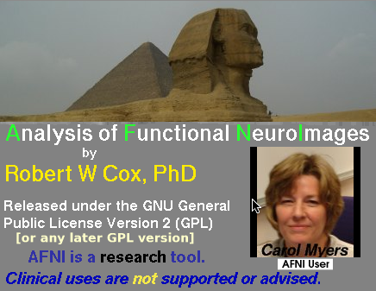







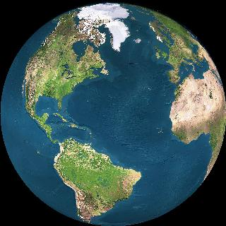
AFNI & FMRI
Introduction, Concepts, Principles
http://afni.nimh.nih.gov/afni

Slide 2
AFNI = Analysis of Functional NeuroImages
Developed to provide an environment for FMRI data analyses
  And a platform for development of new software
AFNI refers to both the program of that name and the entire package of external programs and plugins (more than 200)
Important principles in the development of AFNI:
  Allow user to stay close to the data and view it in many different ways
  Give users the power to assemble pieces in different ways to make customized analyses
    “With great power comes great responsibility”
    — to understand the analyses and the tools
  “Provide mechanism, not policy”
  Allow other programmers to add features that can interact with the rest of the package

Slide 3
Principles (and Caveats) We* Live By
Fix significant bugs as soon as possible
  But, we define “significant”
Nothing is secret or hidden (AFNI is open source)
  But, possibly not very well documented or advertised
Release early and often
  All users are beta-testers for life
Help the user (message board; consulting with NIH users)
  Until our patience expires
Try to anticipate users’ future needs
  What we think you will need may not be what you actually end up needing
*

Slide 4
Before We Really Start
AFNI has many programs and they have many options
Assembling the programs to do something useful and good seems confusing (OK, is confusing) when you start
To help overcome this problem, we have “super-scripts” that carry out important tasks
  Each script runs multiple AFNI programs
  We recommend using these as the basis for FMRI work
    When you need help, it will make things simpler for us and for you if you are using these scripts
afni_proc.py = Single subject FMRI pre-processing and time series analysis for functional activation
  uber_subject.py = GUI for afni_proc.py
align_epi_anat.py = Image alignment (registration), including anatomical-EPI, anatomical-anatomical, EPI-EPI, and alignment to atlas space (Talairach/MNI)

Slide 5
Synopsis of This Talk
Quick introduction to FMRI physics and physiology
  So you have some idea of what is going on in the scanner and what is actually being measured
    Most of the slides for this talk are “hidden” — only visible in the download, not in the classroom
Overview of basic AFNI concepts
  Datasets and file formats; Realtime input; Controller panels; SUMA; Batch programs and Plugins
Brief discussion of FMRI experimental designs
  Block, Event-Related, Hybrid Event-Block
  But this is not a course in how to design your FMRI experimental paradigm
Outline of standard FMRI processing pipeline (AFNI-ized)
  Keep this in mind for the rest of the class!
  Many experiments require tweaking this “standard” collection of steps to fit the design of the paradigm and/or the inferential goals

Slide 6
Quick Intro to MRI and FMRI
Physics and Physiology
(in pretty small doses)
MRI = Cool
(and useful)
Pictures about anatomy (spatial structure)
FMRI = Cool
(and useful)
Pictures about function (temporal structure)
2D slices extracted from a 3D (volumetric) image
[resolution about 1×1×1 mm ; acquisition time about 10 min]

Slide 7
Synopsis of MRI
1) Put subject in big magnetic field B₀ (and leave him there)
Magnetizes the H nuclei in water (H₂O)
2) Transmit radio waves (RF) into subject [about 3 ms]
Perturbs the magnetization of the water
3) Turn off radio wave transmitter
4) Receive radio waves re-transmitted by subject’s H nuclei
  Manipulate re-transmission with magnetic fields during this readout interval [10-100 ms]
  Radio waves transmitted by H nuclei are sensitive to magnetic fields — both those imposed from outside and those generated inside the body:
  Magnetic fields generated by tissue components — both on the micro and macro scales — change the data and so change the computed image
5) Store measured radio wave data vs. time
  Now go back to 2) to get some more data [many many times]
6) Process raw radio wave data to reconstruct images
Allow subject to leave scanner (optional)

Slide 8
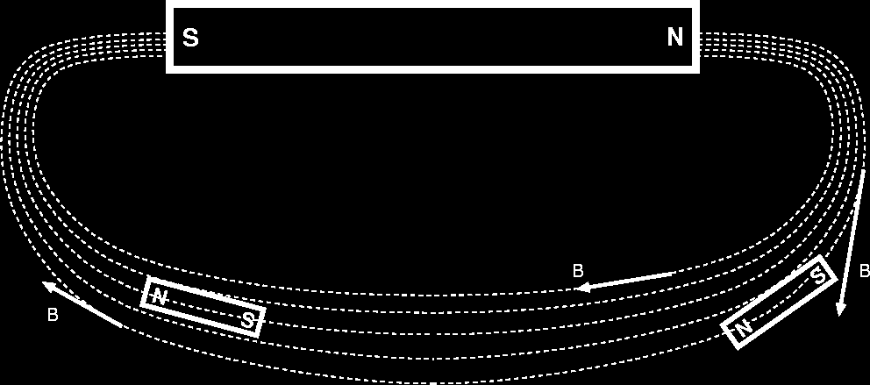
B₀ = Big Field Produced by Main Magnet
Purpose is to align H protons in H₂O (little magnets)
Units of B are Tesla (Earth’s field is about 0.00005 Tesla)
  Typical field used in FMRI is 3 Tesla
[Main magnet and some of its lines of force]
[Little magnets lining up with external lines of force]

Slide 9
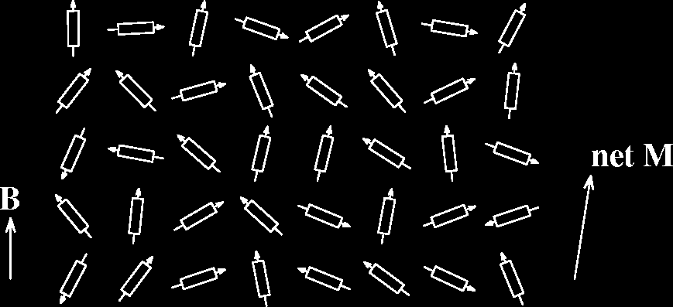
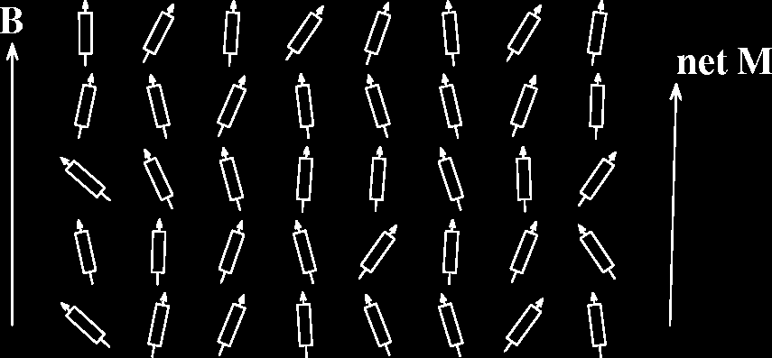
Subject is magnetized
Small B₀ produces
small net
magnetization M
Thermal energy
tries to randomize
alignment of
proton magnets
Larger B₀ produces
larger net
magnetization M,
lined up with B₀
Reality check:
0.0003% of protons
aligned per Tesla
of B₀

Slide 10
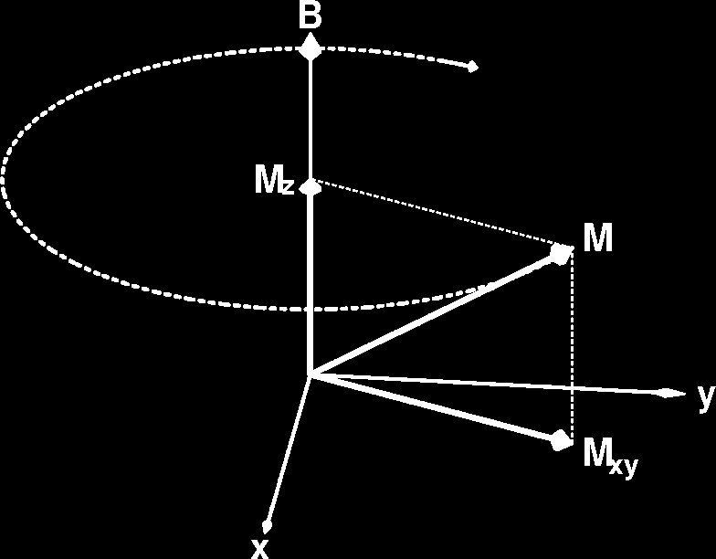
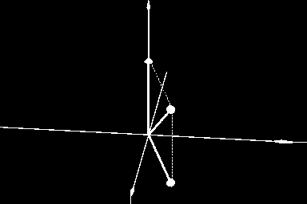
Precession of Magnetization M
Magnetic field B causes M to rotate (“precess” ) about the direction of B at a frequency proportional to the size of B — 42 million times per second (42 MHz), per Tesla of B
  127 MHz at B = 3 Tesla — range of radio frequencies
If M is not parallel to B, then
it precesses clockwise around
the direction of B.
However, “normal” (fully relaxed) situation has M parallel to B, which means there won’t be any
precession
N.B.: part of M parallel to B (M_{z})
does not precess

Slide 11
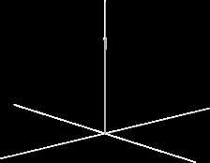
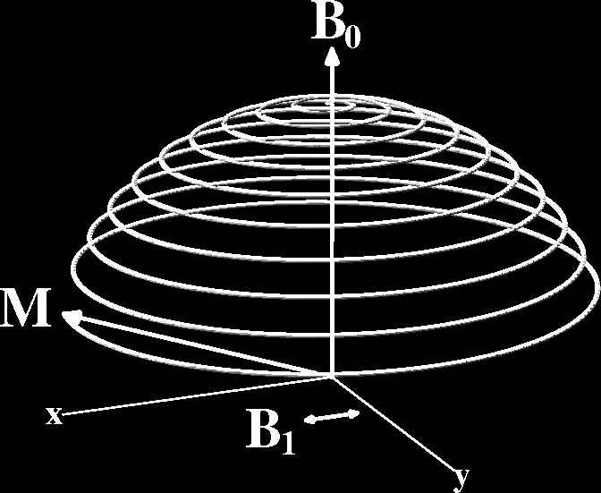
B₁ = Excitation (Transmitted) RF Field
Left alone, M will align itself with B in about 2–3 s
  ➔No precession ➔ no detectable signal
So don’t leave it alone: apply (transmit) a magnetic field B₁ that fluctuates at the precession frequency (radio frequency=RF ) and that points perpendicularly to B₀
The effect of the tiny B₁ is
to cause M to spiral away
from the direction of the
static B field
B₁≈10^{–4} Tesla
This is called resonance
If B₁ frequency is not close to
resonance, B₁ has no effect
Time = 2–4 ms

Slide 12
Readout RF
When excitation RF is turned off, M is left
pointed off at some angle to B₀ [flip angle]
Precessing part of M [M_{xy}] is like having a magnet rotating around at very high speed (at RF speed: millions of revs/second)
Will generate an oscillating voltage in a coil of wires placed around the subject — this is magnetic induction
This voltage is the RF signal = the raw data for MRI
  At each instant t, can measure one voltage V(t ), which is proportional to the sum of all transverse M_{xy} inside the coil
  Must separate signals originating from different regions
    By reading out data for 5-60 ms, manipulating B field, being clever …
    Then have image of M_{xy} = map of how much signal from each voxel

Slide 13
Relaxation: Nothing Lasts Forever
In the absence of external B₁, M will go back to being aligned with static field B₀ = relaxation
Part of M perpendicular to B₀ shrinks [M_{xy}]
  This part of M = transverse magnetization
  It generates the detectable RF signal
  The relaxation of M_{xy} during readout affects the image
Part of M parallel to B₀ grows back [M_{z}]
  This part of M = longitudinal magnetization
  Not directly detectable, but is converted into transverse magnetization by external B₁
    Therefore, M_{z} is the ultimate source of the NMR signal, but is not the proximate source of the signal
}
Time scale
for this relaxation
is called T2 or T2*
= 20-40 ms in brain
}
Time scale
for this relaxation
is called T1
= 500-2500 ms

Slide 14
Material Induced Inhomogeneities in B
Adding a non-uniform object (like a person) to B₀ will make the total magnetic field B non-uniform
  This is due to susceptibility: generation of extra magnetic fields in materials that are immersed in an external field
  Diamagnetic materials produce negative B fields [most tissue]
  Paramagnetic materials produce positive B fields [deoxyhemoglobin]
  f
Makes the H nuclei RF frequency non-uniform in space, which affects the image intensity and quality
  For large scale (100+ mm) inhomogeneities, scanner-supplied non-uniform magnetic fields can be adjusted to “even out” the ripples in B — this is called shimming
  Non-uniformities in B bigger than voxel size (≈1-3 mm) distort (spatially warp) whole image
  Non-uniformities in B smaller than voxel size affect voxel “brightness”

Slide 15
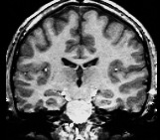
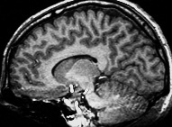
The Concept of Contrast (or Weighting)
Contrast = difference in RF signals — emitted by water protons — between different tissues
Example: gray-white contrast is possible because rate that magnetization returns to normal after RF transmit is different between these two types of tissue

Slide 16
Types of Contrast Used in Brain FMRI
T1 contrast at high spatial resolution
  Technique: use very short timing between RF shots (small TR) and use large flip angles
  Useful for anatomical reference scans
  5-10 minutes to acquire 256×256×128 volume
  1 mm resolution easily achievable
    finer voxels are possible, but acquisition time increases a lot
T2 (spin-echo) and T2* (gradient-echo) contrast
  Useful for functional activation studies
  100 ms per 64×64 2D slice ➔ 2-3 s to acquire whole brain
  4 mm resolution
    better is possible with better gradient system, and/or multiple RF readout coils

Slide 17
What is Functional MRI?
A
1991: Discovery that MRI-measurable signal increases a few % locally in the brain subsequent to increases in neuronal activity (Kwong, et al.)
Signal increase caused by change in H₂O surroundings: more oxygenated hemoglobin is present
Cartoon of MRI signal in a single “activated” brain voxel
D: 4-5 s
rise
E: 5 s plateau
Contrast
through
time
with no noise!
A: Pre-activation
baseline
C: ≈ 2 s
delay
G: Return to
baseline
(or undershoot)
time
B: 5 s neural activity
F: 4-6 s
fall

Slide 18
How FMRI Experiments Are Done
Alternate subject’s neural state between 2 (or more) conditions using sensory stimuli, tasks to perform, ...
  Can only measure relative signals, so must look for changes in the signal between the conditions
Acquire MR images repeatedly during this process
Search for voxels whose NMR signal time series (up-and-down) matches the stimulus time series pattern (on-and-off)
  FMRI data analysis is basically pattern matching in time
Signal changes due to neural activity are small
  Need 500 or so images in time series (in each slice) ➔ takes 30 min or so to get reliable activation maps
    Usually break image acquisition into shorter “runs” to give the subject and scanner some break time
  Other small effects can corrupt the results ➔ post-process the data to reduce these effects & be vigilant
Lengthy computations for image recon and temporal pattern matching ➔ data analysis usually done offline

Slide 19
Some Sample Data Time Series
16 slices, 64×64 matrix, 68 repetitions (TR=5 s)
Task: phoneme discrimination: 20 s “on”, 20 s “rest”
graphs of 9 voxel time series
“Active” voxels
time

Slide 20
One Fast Image
Graphs vs. time of 3×3 voxel region
This voxel did
not respond
Overlay on Anatomy
Colored voxels responded to the mental
stimulus alternation, whose pattern is shown in the
yellow reference curve plotted in the central voxel
68 points in time 5 s apart; 16 slices of 64×64 images

Slide 21
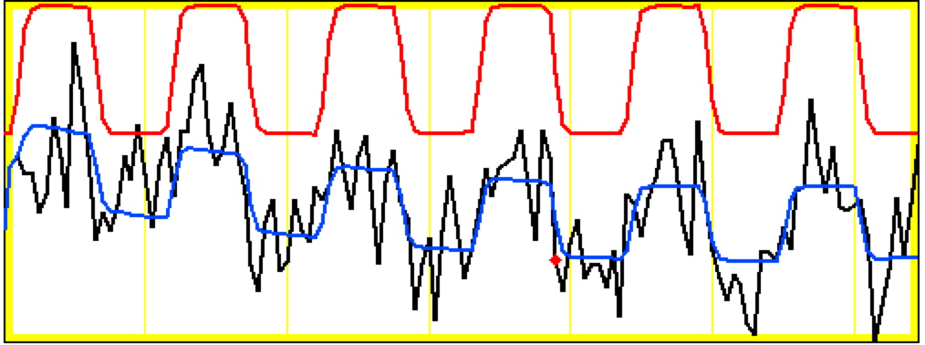
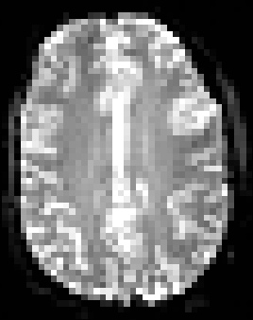
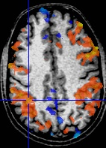
Sample Data Time Series
64×64 matrix (TR=2.5 s; 130 time points per imaging run)
Somatosensory task: 27 s “on”, 27 s “rest”
Note that this is really good data
pattern of expected BOLD signal
pattern fitted to data
data
One echo-planar image
One anatomical image, with voxels that match the pattern given a color overlay

Slide 22
Why (and How) Does NMR Signal Change
With Neuronal Activity?
There must be something that affects the water molecules and/or the magnetic field inside voxels that are “active”
  neural activity changes blood flow and oxygen usage
  blood flow changes which H₂O molecules are present
  and also changes the magnetic field locally because oxygenated hemoglobin and de-oxygenated hemoglobin have different magnetic properties
FMRI is thus at least doubly indirect from physiology of interest (synaptic activity)
  also is much slower: 4-6 seconds after neurons
  also “smears out” neural activity: cannot resolve 10-100 ms timing of neural sequence of events

Slide 23
Neurophysiological Changes & FMRI
There are 4 changes caused by neural activty that are currently observable using MRI:
Increased Blood Flow
  New protons flow into slice from outside
  More protons are aligned with B₀
  Equivalent to a shorter T1 (as if protons are realigned faster)
  NMR signal goes up [mostly in arteries]
Increased Blood Volume (due to increased flow)
  Total deoxyhemoglobin increases (as veins expand)
  Magnetic field randomness increases
  [more paramagnetic stuff in blood vessels]
  NMR signal goes down [near veins and capillaries]

Slide 24
BUT: “Oversupply” of oxyhemoglobin after activation
  Total deoxyhemoglobin decreases
  Magnetic field randomness decreases [less paramag stuff]
  NMR signal goes up [near veins and capillaries]
  This is the important effect for FMRI as currently practiced
Increased capillary perfusion
  Most inflowing water molecules exchange to parenchyma at capillaries
    i.e., the water that flows into a brain capillary is not the water that flows out!
  Can be detected with perfusion-weighted imaging methods
  This factoid is also the basis for ¹⁵O water-based PET
  May someday be important in FMRI, but is hard to do now

Slide 25
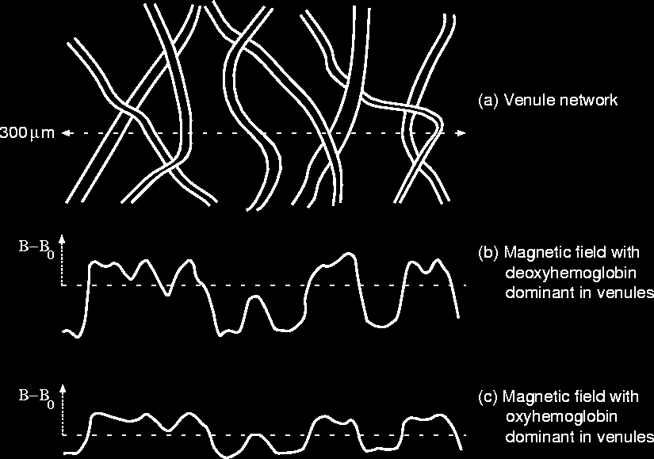
Deoxyhemo- globin is paramagnetic
(increases B)
Cartoon of Veins inside a Voxel
Rest of tissue
+oxyhemoglobin
is diamagnetic
(decreases B)

Slide 26
BOLD Contrast
BOLD = Blood Oxygenation Level Dependent
Amount of deoxyhemoglobin in a voxel determines how inhomogeneous that voxel’s magnetic field is at the scale of the blood vessels (and red blood cells) = micro structure
Increase in oxyhemoglobin in veins after neural activation means magnetic field becomes more uniform inside voxel
  So NMR signal goes up (T2 and T2* are larger), since it doesn’t decay as much during data readout interval
  So MR image is brighter during “activation” (a little)
Summary:
  NMR signal increases 4-6 s after “activation”, due to hemodynamic (blood) response
  Increase is same size as noise, so need lots of data

Slide 27
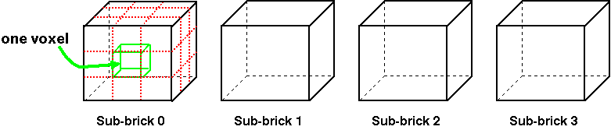
Fundamental AFNI Concepts
Basic unit of data in AFNI is the dataset
  A collection of 1 or more 3D arrays of numbers
    Each entry in the array is in a particular spatial location in a 3D grid (a voxel = 3D pixel)
    Image datasets: each array holds a collection of slices from the scanner
      Each number is the signal intensity for that particular voxel
    Derived datasets: each number is computed from other dataset(s)
      e.g., each voxel value is a t-statistic reporting “activation” significance from an FMRI time series dataset, for that voxel
  Each 3D array in a dataset is called a sub-brick
    There is one number in each voxel in each sub-brick
Jargon!
Jargon!
}
3x3x3
Dataset
With 4
Sub-bricks

Slide 28
A Little Bit Bigger

Slide 29
Quick Sample of AFNI: Analysis
Script to analyze one imaging run (5 min) of data from one subject [ cd AFNI_data6/afni ; tcsh quick.s1.afni_proc ]
afni_proc.py -dsets epi_r1+orig -copy_anat anat+orig \
-tcat_remove_first_trs 2 \
-do_block align \
-regress_stim_times quick.r1_times.txt \
-regress_basis 'BLOCK(20,1)' \
-execute
Stimulus timing in file quick.r1_times.txt
  0 30 60 90 120 150 180 210 240 270
  20 s of stimulus per block, starting at the given times
FMRI data in file epi_r1+orig
  Anatomical volume in file anat+orig
Actions: Align slices in time; align Anat to EPI; motion correct EPI; blur in space; activation analysis (thru time) in each voxel

Slide 30
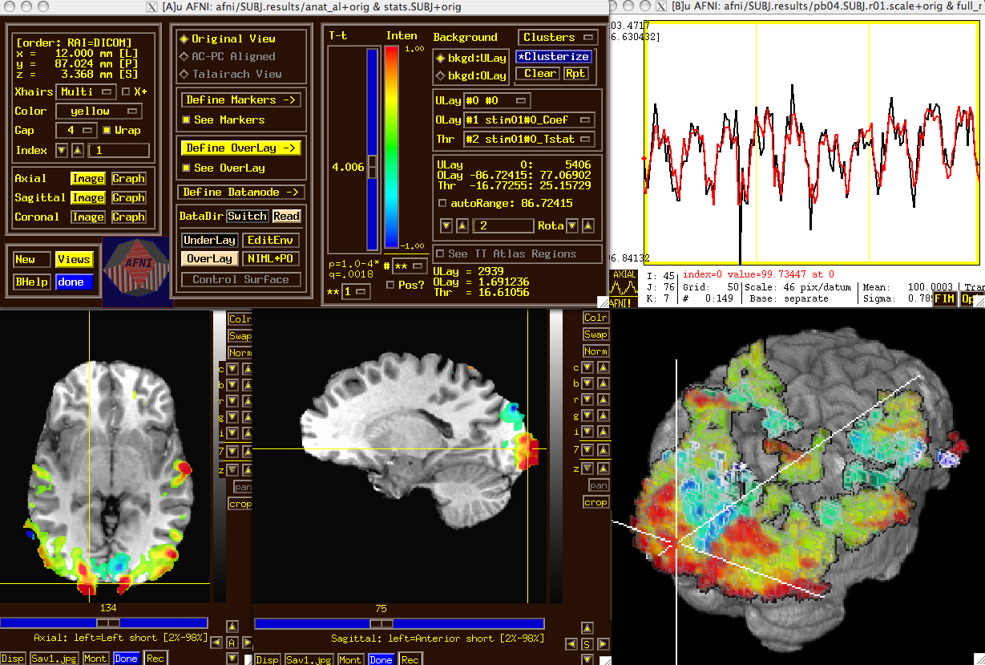
Quick Sample of AFNI: Viewing Results
Fit of activation pattern to data
Colorized+thresholded activation magnitudes

Slide 31
What's in a Dataset: Numbers
Different types of numbers can be stored in datasets
  8 bit bytes (e.g., from grayscale photos)
  16 bit short integers (e.g., from MRI scanners)
  32 bit floats (e.g., calculated values)
  24 bit RGB color triples (e.g., JPEGs from your digital camera!)
  64 bit complex numbers (e.g., for the physicists in the room)
Different sub-bricks are allowed to have different numeric types
  But this is not recommended
  Will occur if you “catenate” two dissimilar datasets together (e.g., using 3dTcat or 3dbucket commands)
    Programs will display a warning to the screen if you try this
and I mean this

Slide 32
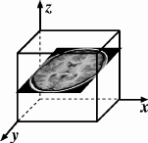
What's in a Dataset: Header Stuff
Besides the voxel numerical values, a dataset also contains auxiliary information, including (some of which is optional):
  xyz dimensions of each voxel (in mm)
  Orientation of dataset axes;
    for example, x-axis=R-L, y-axis=A-P, z-axis=I-S
    = axial slices (we call this orientation “RAI”)
  Location of dataset in scanner coordinates
    Needed to overlay one dataset onto another
    Very important to get right in FMRI, since we deal with many datasets
  Time between sub-bricks, for 3D+time datasets
    Such datasets are the basic unit of FMRI data (one per imaging run)
  Statistical parameters associated with each sub-brick
    e.g., a t-statistic sub-brick has degrees-of-freedom parameter stored
    e.g., an F-statistic sub-brick has 2 DOF parameters stored
  Et cetera, et cetera, et cetera …
Jargon!

Slide 33
AFNI Dataset Files - 1
AFNI formatted datasets are stored in 2 files
  The .HEAD file holds all the auxiliary information
  The .BRIK file holds all the numbers in all the sub-bricks
Datasets can be in one of 3 2 coordinate systems (“views”)
  Original data or +orig view: from the scanner
  AC-PC aligned or +acpc view:
    Dataset rotated/shifted so that the anterior commissure and posterior commissure are horizontal (y-axis), the AC is at (x,y,z)=(0,0,0), and the hemispheric fissure is vertical (z-axis)
  Talairach or +tlrc view:
    Dataset has also been rescaled to conform to the Talairach-Tournoux atlas dimensions (or another atlas, such as MNI)
    AKA Talairach or Stererotaxic coordinates
    All datasets scaled+aligned to some atlas are labeled +tlrc
      Header can contain name of actual atlas “space” (e.g., MNI)
      Alignment can be linear or nonlinear (3dQwarp program)

Slide 34
AFNI Dataset Files - 2
AFNI dataset filenames consist of 3 parts
  The user-selected prefix (almost anything)
  The view (one of +orig, +acpc, or +tlrc)
  The suffix (one of .HEAD or .BRIK)
  QinShiHuangdi+tlrc.HEAD & QinShiHuangdi+tlrc.BRIK
  When creating a dataset with an AFNI program, you supply the prefix; the program supplies the rest
AFNI programs can read datasets stored in several formats
  ANALYZE (.hdr/.img file pairs); i.e., from SPM, FSL
  MINC-1 (.mnc); i.e., from mnitools [but not MINC-2]
  CTF (.mri, .svl) MEG analysis volumes
  ASCII text (.1D) — numbers arranged into columns
  Have conversion programs to write out MINC-1, ANALYZE, ASCII, and NIfTI-1.1 files from AFNI datasets, if desired
Jargon!

Slide 35
NIfTI Dataset Files
NIfTI-1 (.nii or .nii.gz) is a standard format that AFNI, SPM, FSL, BrainVoyager, et al., have agreed upon
  Adaptation and extension of the old ANALYZE 7.5 format
  Goal: easier interoperability of tools from various packages
All data is stored in 1 file (cf. http://nifti.nimh.nih.gov/)
  352 byte header (extensions allowed; AFNI uses this feature)
  Followed by the image binary numerical values
  Allows 1D–5D datasets of diverse numerical types
  .nii.gz suffix means file is compressed (with Unix program gzip)
AFNI now reads and writes NIfTI-1 (and NIfTI-2) datasets
  To write: when you give the prefix for the output filename, end it in “.nii” or “.nii.gz”, and all AFNI programs will automatically write NIfTI-1.1 format instead of .HEAD/.BRIK
  To read: just give the full filename ending in “.nii” or “.nii.gz”

Slide 36
Creating Datasets from DICOM Files
Program 1: Rick Reynolds’ AFNI program Dimon
  Was originally created for sending image data directly into AFNI for “realtime FMRI” – more about that later
Program 2: Chris Rorden’s dcm2niix_afni
  Can create a whole collection of datasets
  Works with more DICOM formats than Dimon does
  Problem: The standard NIFTI .nii format cannot store complicated slice timings
  So programs like dcm2niix_afni cannot store this information even if the program can find it in the DICOM files
Solution: use 3drefit to add the slice timing information to the header (in AFNI extension for NIFTI .nii files)

Slide 37
Dataset Directories
Datasets are stored in directories (also called sessions)
  All the datasets in the same directory, in the same view, are presumed to be aligned in xyz-coordinates
    Voxels with same value of (x,y,z) correspond to same brain location
  Can overlay (in color) any one dataset on top of any other one dataset (in grayscale) from same directory
    Even if voxel sizes and orientations differ
    Overlay of one dataset upon another is based on xyz
  Typical AFNI contents of a session directory are all data derived from a single scanning session for one subject
    Anatomical reference (T1-weighted SPGR or MP-RAGE volume)
    10-20 3D+time datasets from FMRI EPI functional runs
    Statistical datasets computed from 3D+time datasets, showing activation (you hope and pray)
    Datasets transformed from +orig to +tlrc coordinates, for comparison and conglomeration with datasets from other subjects

Slide 38
Getting and Installing AFNI
AFNI runs on Unix systems: Linux, Sun, Mac OS X
  Can also run under Windows Subsystem for Linux
    Requires also installing X11 (Unix graphics display software)
You can download precompiled binaries from our Website
  http://afni.nimh.nih.gov/afni
  Also: documentation, message board, humor, data, class materials, …
You can download source code and compile it
  Also from GitHub: https://github.com/afni/AFNI
AFNI is updated fairly frequently, so it is important to update occasionally -- @update.afni.binaries
  We can’t help you with outdated versions!
  Please check for updates every 6 months (or less)

Slide 39
AFNI at the NIH Scanners
AFNI can take 2D or 3D images in “realtime” from an external program and assemble them into 3D+time datasets slice-by-slice
FMRI Facility scanners at the NIH (GE and Siemens) are set up to start AFNI on a remote Linux computer automatically when EPI acquisition starts, and then the Dimon program is used to send images into AFNI as they are reconstructed:
  For immediate display (images and graphs of time series)
  Plus: graphs of estimated subject head movement
Goal is to let you see image data as they are acquired, so that if there are any big problems, you can fix them right away
  Sample problem: someone typed in the imaging field-of-view (FOV) size wrong (240 cm instead of 24 cm), and so got garbage data, but only realized this too late (after scanning 8 subjects this way) — D’oh!

Slide 40
A Quick Overview of AFNI
Starting AFNI from the Unix command line
  afni reads datasets from the current directory
  afni dir1 dir2 … reads datasets from directories listed
  afni -R reads datasets from current directory and from all directories below it (this might be slow on a big disk!)
AFNI also reads file named .afnirc from your home directory
  Used to change many of the defaults
    Window layout and image/graph viewing setup; popup hints; whether to compress .BRIK files when writing
    cf. file README.environment in the AFNI documentation
Also can read file .afni.startup_script to restore the window layout from a previous run
  Created from Define Datamode->Misc->Save Layout menu
    cf. file README.driver for what can be done with AFNI scripts

Slide 41
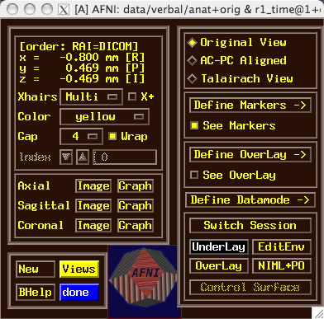
AFNI controller window at startup
Titlebar shows current datasets: first one is [A], etc
Coordinates of current focus point
Switch to different coordinate system for viewing images
Control crosshairs appearance
Markers control transformation to +acpc and +tlrc coordinates
Time index
Controls color functional overlay
Open images and graphs of datasets
Miscellaneous menus
Open new AFNI controller
Switch between directories, underlay (anatomical) datasets, and overlay (functional) datasets
Help Button
Controls display of overlaid surfaces
Close this controller
Place to show amusing logos

Slide 42
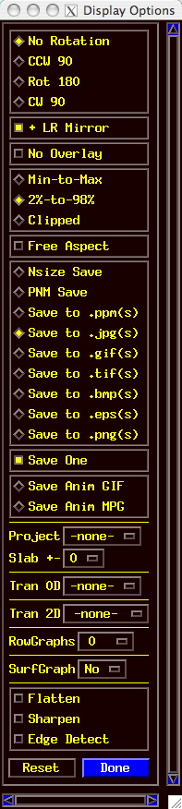
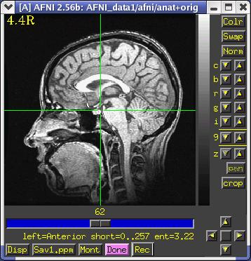
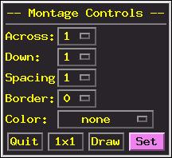
AFNI Image Viewer
Disp and Mont control panels

Slide 43
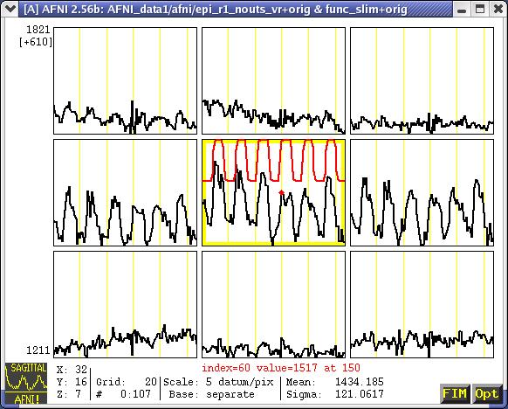
AFNI Time Series Graph Viewer
Data (black) and Reference waveforms (red)
Menus for controlling
graph displays

Slide 44
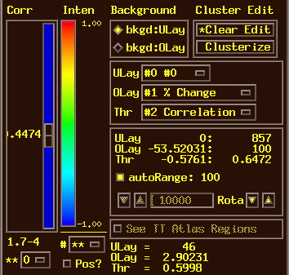
Define Overlay: Colorizing Panel (etc)
Cluster above-threshold voxels into contiguous “blobs” bigger than some given size
Color map for overlay
Hidden popup menus here
Choose which dataset makes the underlay image
Choose which sub-brick from Underlay dataset to display (usually an anatomical dataset)
Threshold slider: voxels with Thr sub-brick above this get colorized from Olay sub-brick
Choose which sub-brick of functional dataset is colorized (after threshold)
p-value of current threshold value
Choose which sub-brick of functional dataset is the Threshold
Shows ranges of data in Underlay and Overlay dataset
Choose range of threshold slider, in powers of 10
Shows automatic range for color scaling
Rotates color map
Positive-only or both signs of function?
Number of panes in color map (2-20 or **)
Shows voxel values at focus
Lets you choose range for color scaling (instead of autoRange)

Slide 45
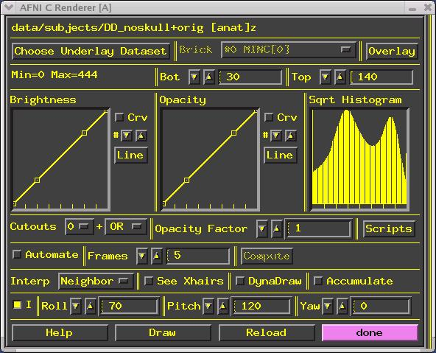
  Volume Rendering: an AFNI plugin
Pick new underlay dataset
Name of underlay dataset
Sub-brick to display
Open color overlay controls
Range of values in underlay
Range of values to render
Change mapping from values in dataset to brightness in image
Histogram of values in underlay dataset
Mapping from values to opacity
Maximum voxel opacity
Cutout parts of 3D volume
Menu to control scripting (control rendering from a file)
Compute many images in a row
Render new image immediately when a control is changed
Show 2D crosshairs
Control viewing angles
Accumulate a history of rendered images (can later save to an animation)
Detailed instructions
Force a new image to be rendered
Reload values from the dataset
Close all rendering windows

Slide 46
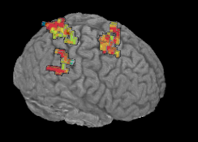
Staying Close to Your Data!
“ShowThru” rendering of functional activation:
animation created with Automate and Save:aGif controls

Slide 47
Other Parts of AFNI
Batch mode programs and scripts
  Are run by typing commands directly to computer, or by putting commands into a text file (script) and later executing them
Good points about batch mode
  Can process new datasets exactly the same as old ones
  Can link together a sequence of programs to make a customized analysis (a personalized pipeline)
  Some analyses take a long time (are not interactive)
Bad points about batch mode
  Learning curve is “all at once” rather than gradual
  If you are, like, under age 35, you may not know how to, like, type commands into a computer to make it do things
    But we don’t make you use punched cards or paper tape (yet)

Slide 48
AFNI Batch Programs
Many many important capabilities in AFNI are only available in batch programs
  A few examples (of more than 100, from trivial to complex)
3dDeconvolve + 3dREMLfit = multiple linear regression on 3D+time datasets; fits each voxel’s time series to activation model, tests these fits for significance (3dNLfim = nonlinear fitting)
3dvolreg = 3D+time dataset registration, to correct for small subject head movements, and for inter-day head positioning
3dANOVA + 3dLME = 1-, 2-, 3-, and 4- way ANOVA/LME layouts: combining & contrasting datasets in Talairach space
3dcalc = general purpose voxel-wise calculator (very useful)
3dsvm = SVM multi-voxel pattern analysis program
3dresample = re-orient and/or re-size dataset voxel grid
3dSkullStrip = remove “skull” from anatomical dataset
3dDWItoDT = compute diffusion tensor from DWI (nonlinearly)

Slide 49
AFNI Plugins
A plugin is an extension to AFNI that attaches itself to the interactive AFNI GUI
  Not the same as a batch program (which runs by itself)
  Offers a relatively easy way for a C programmer to add certain types of interactive functionality to AFNI
Draw Dataset = ROI drawing (draws numbers into voxels)
Render [new] = Volume renderer
Dataset#N = Lets you plot multiple 3D+time datasets as overlays in an AFNI graph viewer (e.g., fitted models over data)
3dsvm = Interactive version of SVM MVPA
RT Options = Controls the realtime image acquisition capabilities of AFNI (e.g., graphing, registration)
Plugout: a separate program that sends commands to AFNI to drive the display (sample scripts given in a later talk)

Slide 50
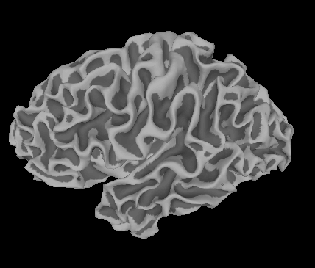
SUMA, et alii
SUMA is the AFNI surface mapper
  For displaying surface models of cortex
    Surfaces from FreeSurfer (MGH) or Caret (Wash U) or BrainVoyager (Brain Innovation)
  Can display functional activations mapped from 3D volumes to the cortical surface
  Can draw ROIs directly on the cortical surface
    vs. AFNI: ROIs are drawn into the 3D volume
SUMA is a separate program from AFNI, but can “talk” with AFNI (like a plugout) so that volume & surface viewing are linked
  Click in AFNI or SUMA to change focus point, and the other program jumps to that location at the same time
  Functional (color) overlay in AFNI can be sent to SUMA for simultaneous display
And much more — stayed tuned for the SUMA talks to come!

Slide 51
FMRI Experiment Design and Analysis
All on one unreadable slide!
FMRI experiment design
  Event-related, block, hybrid event-block? [next slide]
  How many types of stimuli? How many of each type? Timing (intra- & inter-stim)?
  Will experiment show what you are looking for? (Hint: bench tests)
  How many subjects do you need? (Hint: the answer does not have 1 digit)
Time series data analysis (individual subjects)
  Assembly of images into AFNI datasets; Visual & automated checks for bad data
  Registration of time series images (AKA motion correction)
  Smoothing & masking of images; Baseline normalization; Censoring bad data
  Catenation into one big dataset
  Spatial normalization to Talairach-Tournoux atlas (or something like it; e.g., MNI)
  Fit statistical model of stimulus timing+hemodynamic response to time series data
    Fixed-shape or variable-shape response models
  Segregation into differentially activated blobs (i.e., what got turned on – or off?)
    Threshold on statistic + clustering and/or Anatomically-defined ROI analysis
  Visual examination of maps and fitted time series for validity and meaning
Group analysis (inter-subject)
  Smoothing of fitted parameters
    Automatic global smoothing + voxel-wise analysis or ROI averaging
  ANOVA+ to combine and contrast activation magnitudes from the various subjects
  Visual examination of results (usually followed by confusion)
  Write paper, argue w/ boss, submit paper, argue w/ referees, publish paper, …
afni_proc.py

Slide 52
3 Classes of FMRI Experiments
Block Design: long duration activity
Task / Stimulus
Duration ≥ 10 s
time
Event-Related Design: short duration activity
time
Hybrid Block-Event Design
Condition #1
Condition #2
time

Slide 53
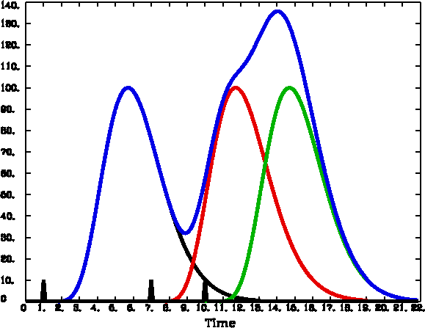
FMRI Experiment Design - 1
Hemodynamic (FMRI) response
  peak is 4-6 s after neural activation
  width is 4-5 s for very brief (< 1 s) activation
  ➔ two separate activations less than 12-15 s apart will have their responses overlap and add up (approximately — more on this in a later talk!)
Block design experiments: Extended activation, or multiple closely-spaced (< 2-3 s) activations
  Multiple FMRI responses overlap and add up to something more impressive than a single brief blip (as in the picture above)
  But can’t distinguish distinct but closely-spaced activations; example:
    Each brief activation is “subject sees a face for 1 s, presses button #1 if male, #2 if female” and faces come in every 2 s for a 20 s block, then 20 s of “rest”, then a new faces block, etc.
    What to do about trials where the subject makes a mistake? These are presumably neurally different than correct trials, but there is no way to separate out the activations when the hemodynamics blurs so much in time.

Slide 54
FMRI Experiment Design - 2
Therefore: Event-related designs:
  SLOW: Separate activations in time so can model the FMRI response from each separately, as needed (e.g., subject mistakes)
  RAPID: Need to make inter-stimulus intervals vary (“jitter”) if there is any potential time overlap in their FMRI response curves; e.g., if the events are closer than 12-15 s in time
    Otherwise, the tail of event #x always overlaps the head of event #x+1 in the same way, and as a result the amplitude of the response in the tail of #x can’t be told from the response in the head of #x+1
  Important note!
    You cannot treat every single event as a distinct entity whose response amplitude is to be calculated separately! (OK, you can try, but …)
    You must still group events into classes, and assume that all events in the same class evoke the same response.
      Approximate rule: 25+ events per class (with emphasis on the ‘+’)
    There is just too much noise in FMRI to be able to get an accurate activation map from a single event!
      Caveat: you can analyze each event by itself, but then have to combine the many individual maps in some way to get any significance

Slide 55
FMRI Experiment Design - 3
Hybrid Block/Event-related designs:
  The long “blocks” are situations where you set up some continuing condition for the subject
  Within this condition, multiple distinct events are given and analyzed
  Example:
    Event stimulus is a picture of a face
    Block condition is instruction on what the subject is to do when he sees the face:
      Condition A: press button #1 for male, #2 for female
      Condition B: press button #1 if face is angry, #2 if face is happy
    Event stimuli in the two conditions may be identical, or at least fungible
    It is the instructional+attentional modulation between the two conditions that is the goal of such a study
      Perhaps you have two groups of subjects (patients and controls) which respond differently in bench tests
      You want to find some neural substrates for these differences
      So you can tell an enthralling story and become wildly famous

Slide 56
3D Individual Subject Analysis
Assemble images into AFNI-formatted datasets
to3d
OR
can do at NIH scanners
Check images for quality (visual & automatic)
afni + 3dToutcount
Register (realign) images
3dvolreg
OR
3dWarpDrive
Smooth images spatially
3dmerge
OR
3dBlurToFWHM
(optional)
Mask out non-brain parts of images
3dAutomask + 3dcalc (optional)
Normalize time series baseline to 100 (for %-izing)
3dTstat + 3dcalc
(optional: could
be done post-fit)
Fit stimulus timing + hemodynamic model to time series
  catenates imaging runs, removes residual movement effects, computes response sizes & inter-stim contrasts
3dDeconvolve
Segregate into differentially “activated” blobs
3dClustSim + 3dmerge
OR
Extraction from ROIs
Look at results, and ponder
afni
AND
your personal brain
… to group analysis (next page)

Slide 57
Group Analysis: in 3D or on folded 2D cortex models
Datasets of results
from individual
subject analyses
Construct cortical
surface models
Normalize datasets
to Talairach “space”
Project 3D /results to
cortical surface models
OR
Smooth fitted
response amplitudes
Average fitted
response amplitudes
over ROIs
OR
Use ANOVA (etc) to combine + contrast results
View and understand results;
Write paper;
Start all over

Slide 58
Other Educational Presentations
How to get images into AFNI or NIfTI format (program to3d)
Detailed hands-on with using AFNI for data viewing (fun)
Signal modeling & analysis: theory & hands-on (3dDeconvolve et al.)
Image registration (3dvolreg et al.)
Volume rendering hands-on (fun level=high)
ROI drawing hands-on (fun level=extreme)
Transformation to Talairach hands-on (fun level=low)
Group analysis: theory and hands-on (3dANOVAx and beyond )
Experiment design
FMRI analysis from start to end (the “soup to nuts” hands-on)
SUMA hands-on (fun level=pretty good)
Surface-based analysis
Connectivity (resting state, white matter tracts)
AFNI “Jazzercise” (practice sessions & directed exercises)

Slide 59
Ongoing AFNI+SUMA Projects
Complex ANOVA-like models for group analyses [3dLME.R]
  Unbalanced designs, missing data, continuous covariates, multi-nested designs, …. (the list and the project don’t really end)
Changing 3dDeconvolve to incorporate physiological noise cancellation, and correction for EPI time series autocorrelation [3dREMLfit], and …
More surface-based analysis tools
  Especially for inter-subject (group) analyses
Better EPI-anatomical registration tools [3dAllineate]
  And nonlinear 3D inter-subject registration
Integrating some external diffusion tensor (DTI) tools with AFNI (e.g., DTIquery )
Integrating more atlas datasets (animal and human) into AFNI
Semi-linear global deconvolution analysis
This one
is done!

