Slide 1
Do We Have to Deal with
Multiple Comparisons in Neuroimaging?
Gang Chen
Scientific and Statistical Computing Core
National Institute of Mental Health
National Institutes of Health, USA
afni26_ROI-based-modeling.pdf

Slide 2
Preview
Multiplicity problems in neuroimaging
Improving modeling from two perspectives
Weirdness of p-value
Information waste and inefficient modeling
Application #1: region-based analysis (RBA)
Whole-brain voxel-wise group analysis
Program available in AFNI: BayesianGroupAna.py
Application #2: matrix-based analysis (MBA)
FMRI: inter-region correlation (IRC)
DTI: white-matter properties (FA, MD, RD, AD, etc.)
Naturalistic scanning: Inter-subject correlation (ISC)
Program available in AFNI: MBA

Slide 3
Conventional group analysis: voxel-wise
Simple situations
Student’s t-test: one-, two-sample, paired t-test
General linear model (GLM) with between-subjects variables (sex, age, …)
3dttest++ and 3dMVM in AFNI
Situations with within-subject factors
Univariate GLM for AN(C)OVA: not always performed correctly
Multivariate GLM: 3dMVM in AFNI
Other complicated situations
Missing data, within-subject quantitative covariates (reaction time, …)
Linear mixed-effects modeling: 3dLME in AFNI
Headache: multiplicity!
Notes:
ANOVA is a mature technique available for over 50 years, and it’s been implemented in generic packages such as R, SAS, SPSS, etc. However, I have to say that repeated-measures is not always conducted properly. The water is further muddied by esoteric terms such full or flexible factorial design.

Slide 4
Conventional matrix-based analysis
Matrices from individual subjects
Inter-region correlations (IRCs), inter-subject correction (ISC)
White-matter properties: missing data
Others: coherence, mutual information, entropy, …
Group analysis
Mirroring adoption of whole-brain analysis
Univariate GLM: treating matrix elements as isolated entities
NBS, CONN, FSLNets in FSL, GIFT, Brain Connectivity Toolbox, …
Graph theory
Arbitrary thresholding, artificial dichotomization
Garden of forking paths: scores of metrics (hub, community, clique, small-world, …)
Headache: multiplicity!

Slide 5
4 multiplicity problems
Element-wise modeling (multi-model problem)
aka massively univariate modeling
Perform whole-brain voxel-wise or element-wise in matrix analysis
Pretend all spatial elements are isolated and unrelated to each other
Recoup the false assumption through correction: heavy penalty and inefficient
Sidedness testing
Simultaneously infer both positive and negative effects: dominantly adopted
Multiple comparisons (conventional concept)
Simultaneously compare groups, conditions, and interactions
Not much attention paid so far
Multiverse problem: researcher degrees of freedom
Thousands of options coexist: different preprocessing pipelines, modeling strategies, software
Garden of forking paths: only reporting “significant discoveries”
No easy solutions exist
Notes:
Some correction methods for between-subjects factors, but no simple solutions for within-subject factors. We only focus on the first two multiplicity problems here

Slide 6
Conventional statistical testing strategy
Null hypothesis significance testing (NHST)
We are all indoctrinated under the paradigm
Build a strawman H₀: nothing happens in brain
Attack strawman H₀ with weirdness of data under H₀ : p-value
Type I error = P(reject H₀ | H₀) = false positive = p-value
Type II error = P(accept H₀ | H₁) = false negative
Dichotomize data based on magic number 0.05
Nice properties of NHST
Consistent with Karl Popper’s philosophy
Falsification or refutation
Inductive: all swans are white
Intuitive: innocent until proven guilty
Economical/utility: categorization
ADHD, autism, emission test (pass vs fail), …
Courtroom Hidden Truth
 | Innocent | Guilty
Reject H₀ (guilty) | Type I Error (defendant very unhappy) | Correct
Fail to Reject H₀ (not guilty) | Correct | Type II Error (defendant very happy)
Notes:
The p-value is not the same as probability of, for example, having snowstorm tomorrow. 2 x 2 factorial structure

Slide 7
Weirdness of p-value
Strawman H₀: artificial construct
Witch hunt: usually of no interest
Effect of absolute zeros? Who believes no effect everywhere in brain?
Artificially binarize continuous world: innocent vs guilty
“activated” vs “not activated”? Or strength of evidence for activation?
P-value flows in our blood: unaware of weirdness and troubles
Disconnection/misinterpretation: P (weirdness| H₀)$≠$P (H₀ | data)
P-value: P (weirdness | H₀)
Research interest: P (effect > 0 or < 0| data)
Problems with dichotomous decision
P-value of 0.05 vs 0.055 or cluster of 54 vs 53 voxels?
Statistically insignificant = non-existing effect? Absence of evidence = evidence of absence?
Difference between “significant” & “insignificant” results: not necessarily significant
Selection bias about effect estimates in results reporting
Power analysis based on literature: not very useful other than pleasing grant reviewers
One source of reproducibility problems: big/tall parents (violent men, engineers) have more sons;
beautiful parents (nurses) have more daughters; power posing
Unreliable meta analyses: many potential effects unreported
Notes:
Can we simply get P (effect > 0 | data)? Most software packages do not even allow you see those islands underneath the sea level! Like emission test: with or without pollution for gas engines? Ritualized step

Slide 8
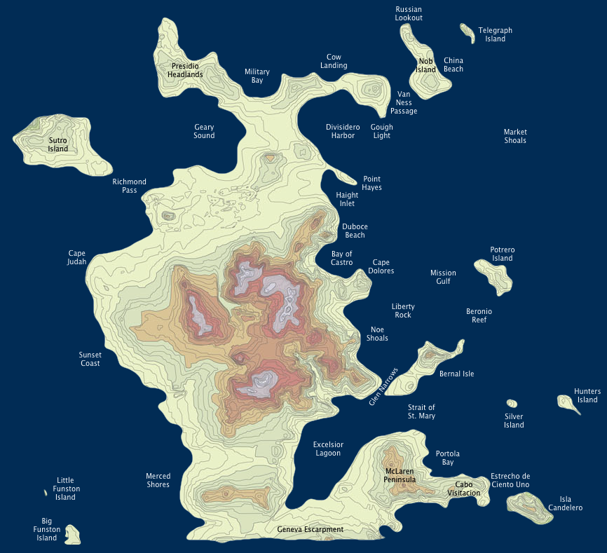
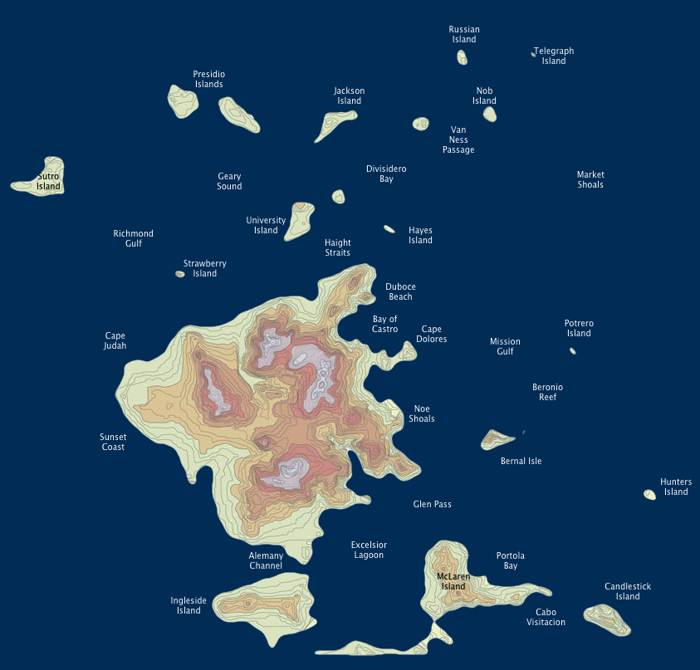
Clusters vs islands: arbitrariness
Threshold (sea level) 1
Threshold (sea level) 2
Notes:
Why do we have to worship one particular threshold?

Slide 9
Problems with clusters
Cluster thresholding: “islands above sea level” approach
Use cluster size as leverage in controlling overall false positives (FWE)
Monte Carlo simulations, RFT, combination of cluster size and signal strength
Hide everything below threshold
Arbitrary: regardless of rigor in FWE controllability
Penalize and discriminate small regions
Unfair: 2 regions with same signal strength: one large and one small
2 regions with same signal strength: one distant and one contiguous
Clusters are statistically defined
Do not respect anatomical structures
Lack spatial specificity: bleeding effect or forming huge clusters
Focus on statistically defined “peak” voxels
Sidedness for whole brain: one- or two-sided?
Notes:
Can we simply get P (effect > 0 | data)?

Slide 10
Problems with element-wise modeling
First step: apply same model to all elements
Pretend all elements are isolated and unrelated: false assumption
Source of multi-model problem: number of models = number of elements
Second step: correct for multi-model and false assumption
Use cluster size as leverage in controlling overall false positives
Monte Carlo simulations, RFT, combination of cluster size and signal strength
Problems
Loss of efficiency due to split-modeling and false assumption
Over-penalization
Reinforcing arbitrary thresholding and dichotomization
How can we do better? Prior knowledge: elements are not unrelated
Conceptually P(weirdness| H₀)$≠$P(H₀|data), but practically P(weirdness| H₀ )$≅$P(H₀|data)?
Notes:
Isolated and unrelated: I don’t mean the spatial relatedness! Instead I refer to the same measurement, e.g., BOLD response.

Slide 11
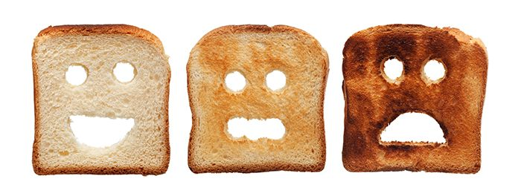
How to incorporate prior knowledge?
Priors are omnipresent in life
Walking stairs, prejudices, stereotypes, etc.
But priors are not always easy to digest!
Infamy: subjective???
Are we eating acrylamide for breakfast?
Both sides good
One side BURNT
Both sides BURNT
Notes:
Miss a step when walking downstairs. Monty Hall problem: TV show “let’s make a deal!”

Slide 12
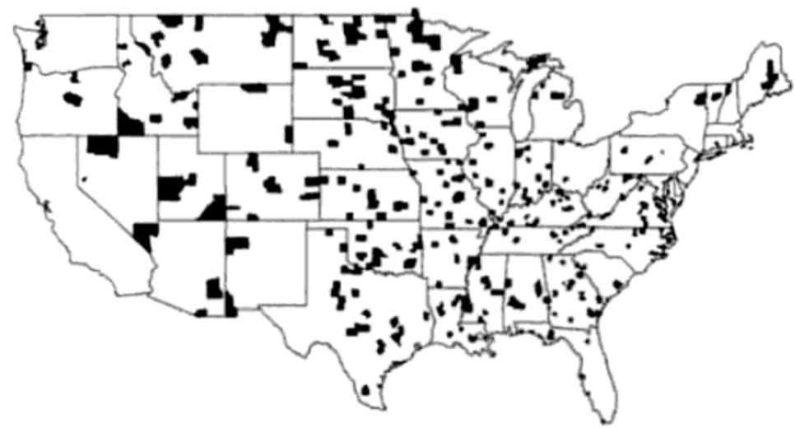
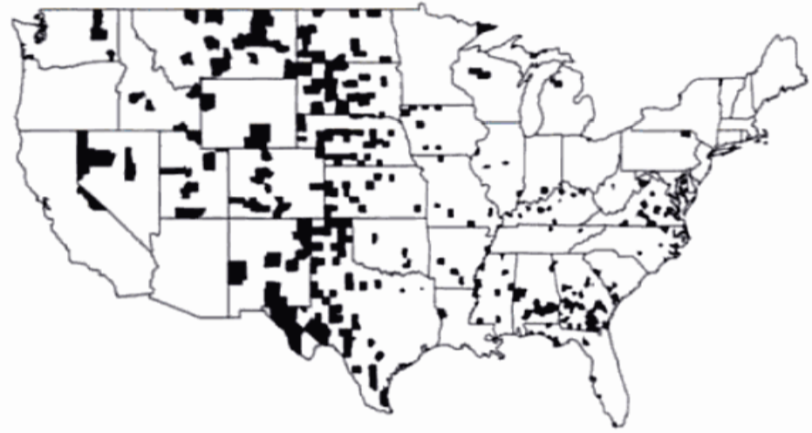
How to incorporate prior knowledge?
Kidney cancer distribution among U. S. counties
Highest rate
lowest rate
Calibration
Notes:
Don’t mention rare rate until last minute. 1 out of 100,000 people. Similar situation with monthly suicidal / divorce data in the military.

Slide 13
How to incorporate prior knowledge?
More examples
LeBron James field goals percentage: 50.4%
Monthly divorce rate, suicide rate
…
KISS principle
Stein’s paradox (1956)
Free market vs regulations
Calibration
Notes:
Don’t mention rare rate until last minute. 1 out of 100,000 people. Similar situation with monthly suicidal / divorce data in the military.

Slide 14
Morals from kidney cancer data
Multiplicity problem: > 3000 counties!
Divide p-value by number of counties?
Borrow idea from neuroimaging: leverage geographical relatedness?
What can we learn from the example? Food for thought
Care about the strawman H₀ (zero kidney rate), false positives, p-value?
Trust individual county-wise estimates? Unbiased! BLUE
Incorrect sign errors (type S): some counties really have higher kidney cancer rate than others?
Incorrect magnitude (type M): some counties really have higher/lower cancer rate?
Would correction for multiplicity help at all?
Useless in controlling for type S and M errors
How can we do better?
Information across spatial elements can be shared and regularized
How???
Notes:
Conventional statistics focuses on asymptotic properties such as unbiasedness, which requires large sample size. Can we simply get P (effect > 0 | data)?

Slide 15
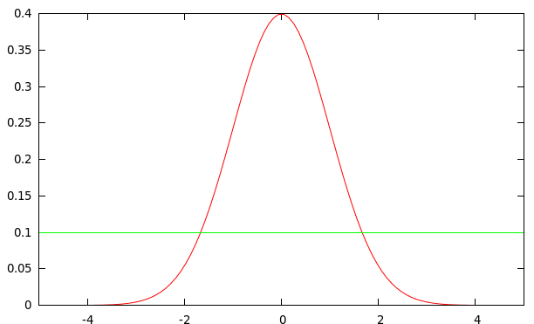
What do we know about spatial elements?
Element-wise modeling
Pretend full ignorance: fully trust the data
Uniform distribution: each element equally likely to have any value in (- $∞$, +$∞$)
Similar for variances: variances can be negative in ANOVA
One crucial prior for spatial elements
Reasonable to assume Gaussian distribution?
Gaussian assumption adopted everywhere!
Subjects, residuals across TRs
How can Gaussian assumption help?
Loosely constraining elements
No full trust for individual estimates
Information sharing: shrinkage or partial pooling
Controlling type S and M errors
Notes:
We already saw the consequence of full ignorance and full trust on data

Slide 16
Short summary: what we intend to achieve
Abandon strawman and p-value
Directly focus on research interest: P (effect > 0 | data)
Build one model
Incorporate all elements into a multilevel or hierarchical structure
Loosely constrain elements: leverage prior knowledge
Achieve higher modeling efficiency: no more multiplicity!
Validate the model by comparing with potential competitors
Be conservative on effect estimates by controlling type S and M errors: biased?
Always be mindful of uncertainties: strength of evidence (no proof)
Avoid dichotomous decisions
Report full results if possible
Highlight instead of hide based on gradient of evidence
Notes:
Three goals! Can we simply get P (effect > 0 | data)? Care more about model performance for future (out-of-sample) data instead of unbiasedness.

Slide 17
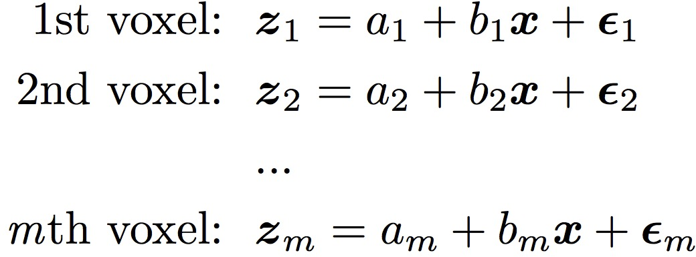
Application #1: region-based analysis
Dataset
Subjects: n = 124 children; resting-state data (Xiao et al., 2019)
Individual subjects: seed-based correlation for each subject
3D correlation between seed and whole brain (“functional connectivity”)
Explanatory variable (behavior data): Theory of Mind Index $xi$
Voxel-wise group analysis: GLMs
Focus: association between $x$ and seed-based correlation (z-score)
Pretense: voxels unrelated - equal likelihood within (-$∞, ∞)$
Information waste!
GLMs: mass univariate - multiplicity
m = 100,000 voxels →
100,000 models
Xiao et al., 2019. Neuroimage 184:707-716
Uniform distribution: total freedom - each parameter on its own
Notes:
Data kindly provided by Dr. Elizabeth Redcay

Slide 18
GLMs: dealing with multiplicity!
Voxel-based analysis: GLMs
Penalty time for pretense: multiple testing (m = 100,000), magic 0.05
Show time for various correction methods
Voxel-wise p, FWE, FDR, spatial smoothness, clusters, …
Simulations, random field theory, permutations, …
How would dataset turn out under GLM? 4 lucky clusters manage to survive
Notes:
If you’re always happy with GLM and never wished that the threshold (p or cluster size) could be a little demanding, I can stop here and you can leave the room. Depending reviewers’ leniency, currently reviewers may force you to stick with correction through voxel-wise p-value of 0.001!

Slide 19
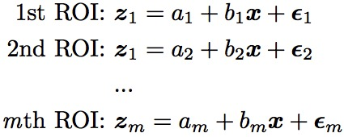
Switching from voxels to ROIs: still GLMs
Region-wise analysis : GLMs
Focus: association between and seed-based correlation (z-score)
Pretense: ROIs unrelated
GLMs: mass univariate
m = 21 ROIs →
21 models
Penalty time for pretense:
multiple testing – what to do?
Bonferroni? Unbearable
What else?
Uniform distribution: total freedom - each parameter on its own.
Notes:
This does not seem to be a viable solution: we rarely see many ROI-based analysis unless there are only a few ROIs.

Slide 20
Switching from GLMs to LME
Region-wise analysis : Linear Mixed-Effects (LME) model
One model integrates all regions
ROIs loosely constrained instead of being unrelated
Gaussian distribution: Is it far-fetched or subjective?
Similar to cross-subject variability
Goal: effect of interest b + β_{j}
Differentiation: fixed vs. random
Fixed: epistemic uncertainty
Random: aleatoric uncertainty
What can we get out of LME?
Conventional framework
Estimates for fixed effects
Variances for random effects
Dead end!
New components
idiosyncratic effect of ith subject
Overall effect: shared by all ROIs and subjects
Unique effect of jth ROI
Notes:
Two indices, i for subject, and j for regions. Intermediate and transition step!

Slide 21
Switching from GLMs to BML
Region-wise analysis : Bayesian multilevel (BML) model
One model integrates all regions: basically same as LME
ROIs loosely constrained instead of being unrelated
Gaussian distribution: Is it far-fetched or subjective?
Similar to cross-subject variability
Goal: effect of interest b + β_{j}
No more differentiation: fixed vs. random
All parameters: aleatoric
Same model as LME plus priors
Markov chain Monte Carlo (MCMC)
Inferences via posterior distribution
Ka-ching!
Chen, et al, 2019. Handling Multiplicity in Neuroimaging through
Bayesian Lenses with Multilevel Modeling. Neuroinformatics.
New components
Idiosyncratic effect by ith subject
Overall effect: shared by all ROIs and subjects
Unique effect by jth ROI
Notes:
Same model as LME except subtle differences

Slide 22
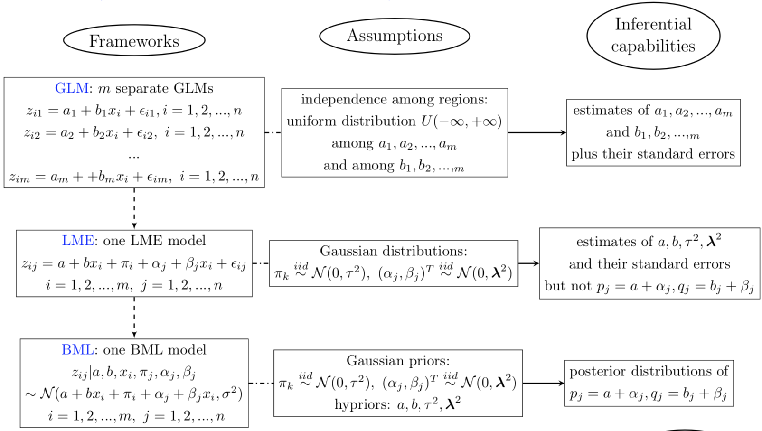
From GLMs to LME to BML
Chen, et al, 2019. Handling Multiplicity in Neuroimaging through Bayesian Lenses with Multilevel Modeling. Neuroinformatics.
Notes:
Same model as LME except subtle differences

Slide 23
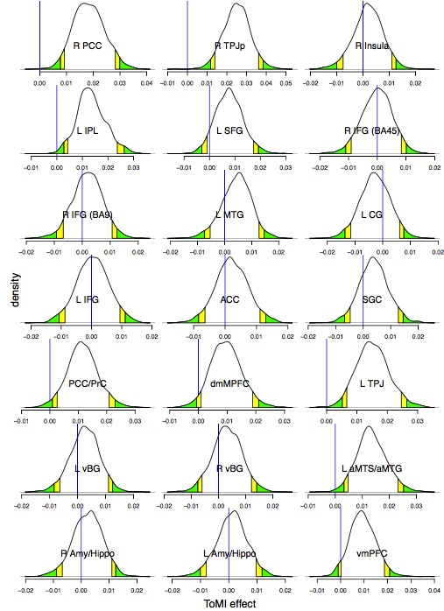
Inferences from BML: full distributions
Region-based BML: 21 ROIs
Full report with richer information:
posterior distributions for each ROI
No dichotomization
No results hiding
No discrimination against small regions
No ambiguities about spatial specificity
No inconvenient interpretation of confidence interval
Evidence for each ROI: P (effect > 0 | data)
8 ROIs with strong evidence of effect compared to
Region-wise GLM with Bonferroni correction
Voxel-wise GLM at cluster level: 4 clusters
Highlight, not hide
How about Left SFG?
Notes:
This is why few people adopt ROI-based analysis because of heavy penalty through Bonferroni correction

Slide 24
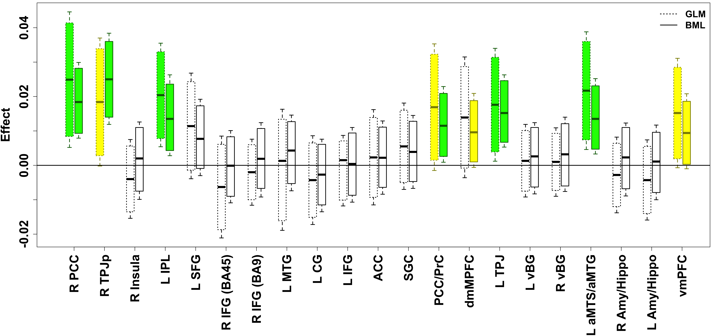
Inferences from BML: uncertainty
ROI-based BML: 21 ROIs
Full report with bar graph uncertainty intervals
Nothing hidden under sea level
8 ROIs with strong evidence for effect of interest
How about Left SFG?
Highlight, not hide
Shrinkage
/ partial
pooling
Notes:
Any reason we can’t discuss the evidence for the effect at Left Superior Gyrus?

Slide 25
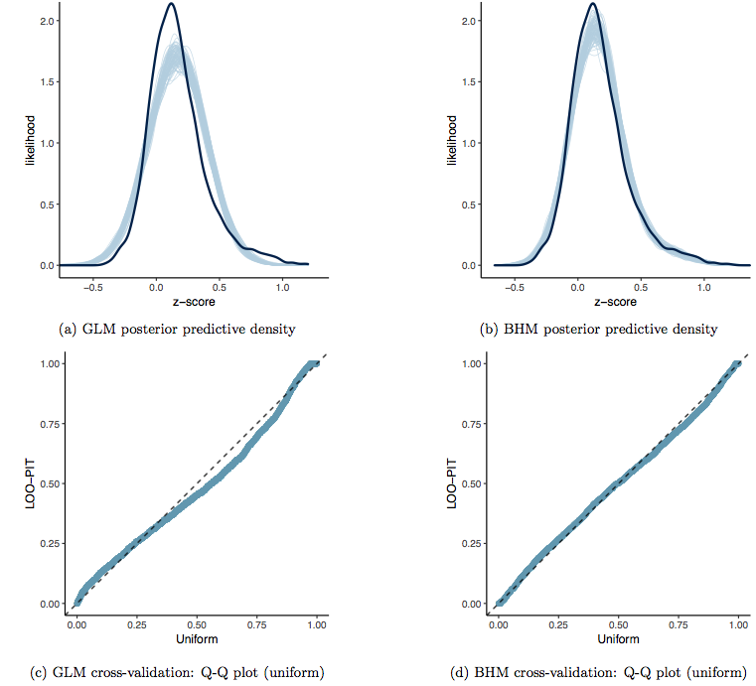
BML: model validations
ROI-based BML with 21 ROIs: cross-validation
Leave-one-out information criterion (LOOIC)
Posterior predictive checking
Effects of BML
Regularizing ROIs: don’t fully trust individual ROI data
Sacrificing fit at each ROI; achieving better overall fit
GLM
BML
Data
Realizations
from fitted
model
Cross-validation
Notes:
Let’s start with a simple example of 2 x 3 ANCOVA
Two groups with 17 subjects in each

Slide 26
BML: Whole-brain vs. region-base analysis
Region-based analysis
+ high region specificity: region definitions considered as priors
+ low computational cost
+ avoiding potential alignment issues by defining regions in native space
- not all regions have been defined
- information loss due to averaging within each region
- region definitions can be tricky
relying on results accuracy in literature (e.g., publication bias)
different atlases/parcellations
Whole-brain analysis
+ independent of region definitions
+ less likely to miss small regions that are not in available atlases/parcellations
- vulnerable to poor alignment across subjects
- region specificity problem
Voxel-wise results do not respect region definitions
- Computationally challenging
hopeful: within-chain parallelization and GPU usage

Slide 27
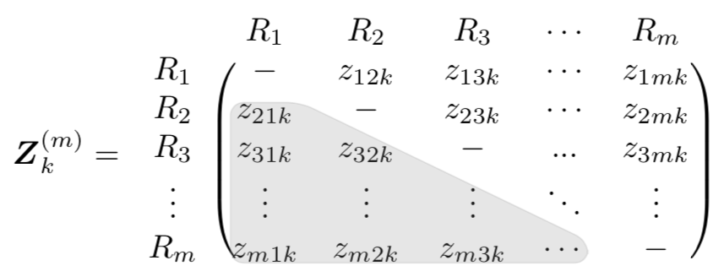
Application #2: matrix-based analysis
Dataset: correlation matrix
Subjects: n = 41 subjects; response-conflict task (Choi et al., 2012)
Individual subjects: correlation matrix among m = 16 ROIs
How to go about group analysis?
GLM for each element in correlation matrix: NBS, CONN, FSLNets in FSL, GIFT
Binarization approach: graph theory
More broadly: matrix-based analysis (MBA) (“network modeling”)
Inter-region correlation (IRC): FMRI
White matter properties (FA, MD, …): DTI
Other matrices (e.g., coherence, entropy, mutual information)
Focus on GLM
Student t-test or GLM on each element
M = 120 massively univariate models
Pretense again: all elements are unrelated
Equal likelihood within (-$∞, ∞)$
Information waste
Penalty time again: permutations? FDR?
Choi et al., 2012. Neuroimage 59(2):1912-1923
Notes:
Data were kindly provided by Luiz Pessoa

Slide 28
Dealing with inter-region correlations (IRCs)
Complexities of IRCs
Some region pairs are unrelated, but others are correlated
Correlation structure is intricate
$0≤ ρ ≤0.5$
Can we do a better job than GLMs or dichotomization?
Challenge: How to characterize the complex structure?

Slide 29
IRC: switching from GLM to LME
IRC analysis through linear mixed-effects (LME) modeling
One model integrates all ROIs: LME
ROIs loosely constrained instead of being unrelated
Gaussian distribution: Is it far-fetched?
Similar to cross-subject variability
Differentiation: fixed vs. random
Fixed: epistemic uncertainty
Random: aleatoric uncertainty
Effects of interest
region pair: b₀+$ξ$_{i}+$ξ$_{j}+$η$_{jj}
region: 0.5*b₀+$ξ$_{i}
LME wouldn’t work!
Dead end!
Unique effect at ith & jth ROI
Unique effect of RP
Unique effect at ith & jth ROI for kth subject
overall effect: shared by all
ROIs and subjects
unique effect by kth subject

Slide 30
IRC: one more jump from LME to BML
IRC analysis through Bayesian multilevel (BML) modeling
One model integrates all ROIs: BML (essentially same as LME)
ROIs loosely constrained instead of being unrelated
Gaussian distribution: Is it far-fetched?
Similar to cross-subject variability
No differentiation: fixed vs. random
All parameters: aleatoric uncertainty
Effects of interest
region pair: b₀+$ξ$_{i}+$ξ$_{j}+$η$_{jj}
region: 0.5*b₀ + $ξ$_{i}
LME plus priors
MCMC
Posterior distribution
Ka-ching!
Unique effect at ith & jth ROI
unique effect of RP
Unique effect at ith & jth ROI for kth subject
overall effect: shared by all
ROIs and subjects
unique effect by kth subject
Chen, et al, 2019. An integrative Bayesian approach to matix-based analysis in neuroimaging. bioRxiv.
Notes:
If you’re always happy with GLM and never wished that the threshold (p or cluster size) could be a little demanding, I can stop here and you can leave the room.

Slide 31
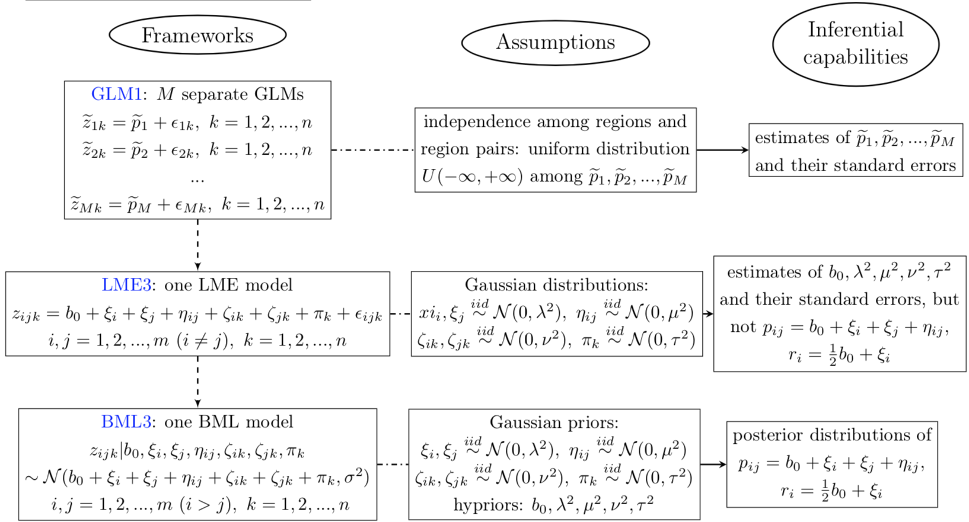
From GLMs to LME to BML
Chen, et al, 2019. An integrative Bayesian approach to matix-based analysis in neuroimaging. bioRxiv.
Notes:
Same model as LME except subtle differences

Slide 32
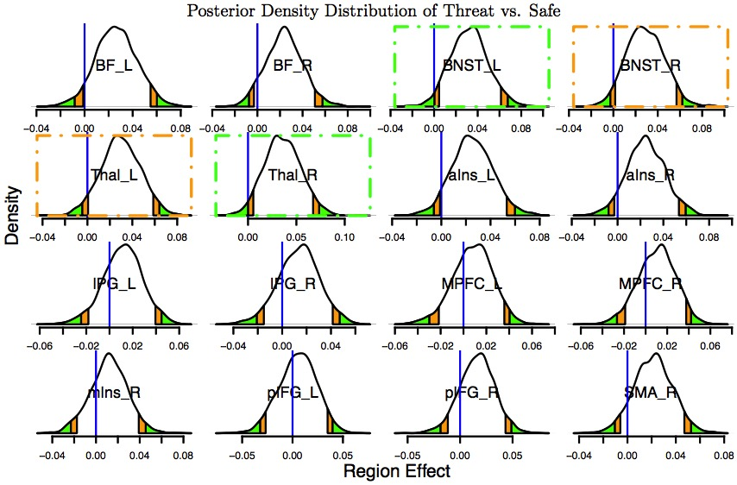
IRC – ROI effect from BML: full distributions
ROI-based BML: 16 ROIs
Full report with richer information: posterior distributions for each ROI
No dichotomization
Nothing hidden under sea level
4 ROIs with strong evidence of effect compared to
Region effect inferences: unavailable from GLM and graph theory
Hubness?
Highlight, not hide
How about Left & Right Anterior Insula?

Slide 33
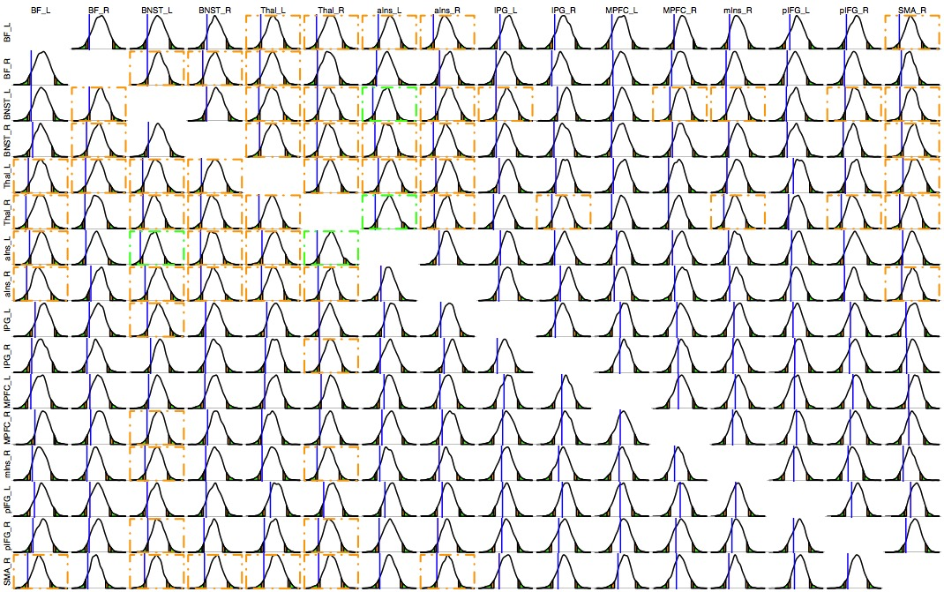
IRC – RP effect from BML: full distributions
120 RPs
Highlight, not hide

Slide 34
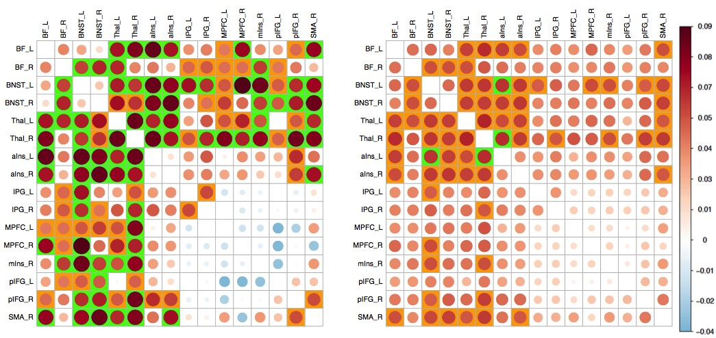
IRC- RP effect from BML
ROI-based BML: 16 ROIs
Full report for all region pairs (RPs)
Comparisons with GLMs: nothing hidden under sea level
63 RPs identified by GLMs with p of 0.05: none survived after correction with NBS via permutations
33 RPs with strong evidence under BML
GLM
BML
Highlight, not hide
Notes:
Poor club, big world

Slide 35
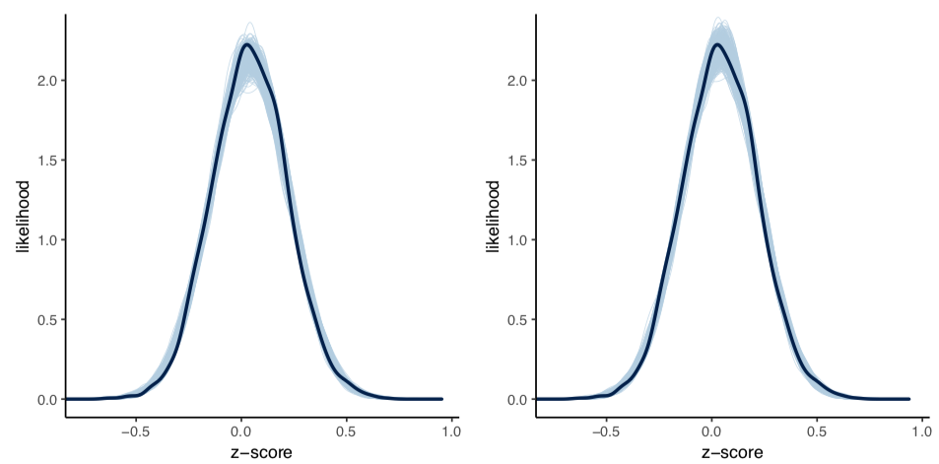
BML: model validations
ROI-based BML with IRD of 16 ROIs: cross-validation
Leave-one-out information criterion (LOOIC)
Posterior predictive checking
Effects of BML
Regularizing ROIs: don’t fully trust individual ROI data
Sacrificing fit at each ROI; achieving better overall fit
Cross-validation
GLM
BML
Notes:
Let’s start with a simple example of 2 x 3 ANCOVA
Two groups with 17 subjects in each

Slide 36
Summary
Multiplicity problems in neuroimaging
Improved modeling from two perspectives
Weirdness of p-value
Information waste and inefficient modeling
Application #1: region-based analysis (RBA)
Task-related experiment or resting state (seed-based correlation analysis)
Program available in AFNI: BayesianGroupAna.py
Application #2: matrix-based analysis (MBA)
FMRI: inter-region correlation (IRC)
DTI: white matter properties (FA, MD, etc.)
Naturalistic scanning: Inter-subject correlation (ISC)
Program available in AFNI: MBA

Slide 37
Keep Kidney Cancer in Mind!
Kidney cancer distribution among counties
Highest rate
lowest rate
Calibration
Notes:
Don’t mention rare rate until last minute. 1 out of 100,000 people. Similar situation with monthly suicidal / divorce data in the military.

Slide 38
Acknowledgements
Paul-Christian Bürkner (Department of Psychology, University of Münster)
Andrew Gelman (Columbia University), Stan Development Team, R Foundation
Yaqiong Xiao, Elizabeth Redcay, Tracy Riggins, Fengji Geng
Luiz Pessoa, Joshua Kinnison (Depart of Psychology, University of Maryland)
Zhihao Li (School of Psychology and Sociology, Shenzhen University, China)
Lijun Yin (Department of Psychology, Sun Yat-sen University, China)
Emily Finn, Daniel Handwerker (SFIM/NIMH, National Institutes of Health)
Paul A. Taylor, Daniel R. Glen, Justin K. Rajendra, Richard C. Reynolds, Robert W. Cox (SSCC/NIMH, National Institutes of Health)

