Slide 1
More Complex Mapping
Coming soon to an AFNI program near you: Nonlinear Warping
I_{new}(x) = I_{old}( W(x) )
where W(x) depends on a lot of parameters (1000-50000+)
Method: Incremental transformation with Hermite cubic polynomials over finer and finer 3D patches
Better alignment of anatomical volumes to template space
Then carry the functional results to template space for better group analyses?
As an aid to brain segmentation and atlas-ing accuracy?
Pre- and post-surgical alignment ?
Status of software:
Done: 3dQwarp program brings 2 volumes into alignment
TBD: Integrate it into scripts to make it actually useful

Slide 2
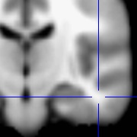
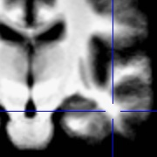
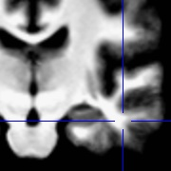
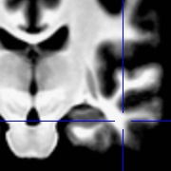
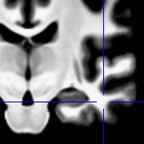
Example: Brain Averages
MNI 152 template
Linear = Affine
Averages of 21
3 Tesla brain volumes
with varied
levels of refinement in
the nonlinear warping
(smaller patch=more refinement)
12 parameters
Nonlinear: Patch=101
Nonlinear: Patch=49
Nonlinear: Patch=23
+1002
+9048
+70008

Slide 3
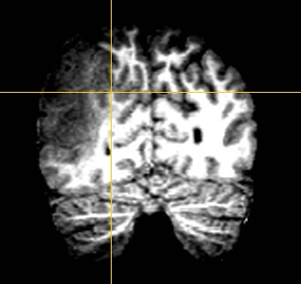
Example: Neurosurgery
Pre-surgical volume

Slide 4
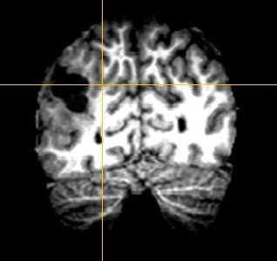
Example: Neurosurgery
Post-surgical volume

Slide 5
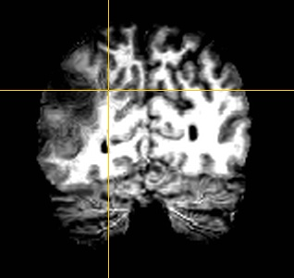
Example: Neurosurgery
Pre-surgical volume
3dQwarp-aligned to Post-surgical volume

Slide 6
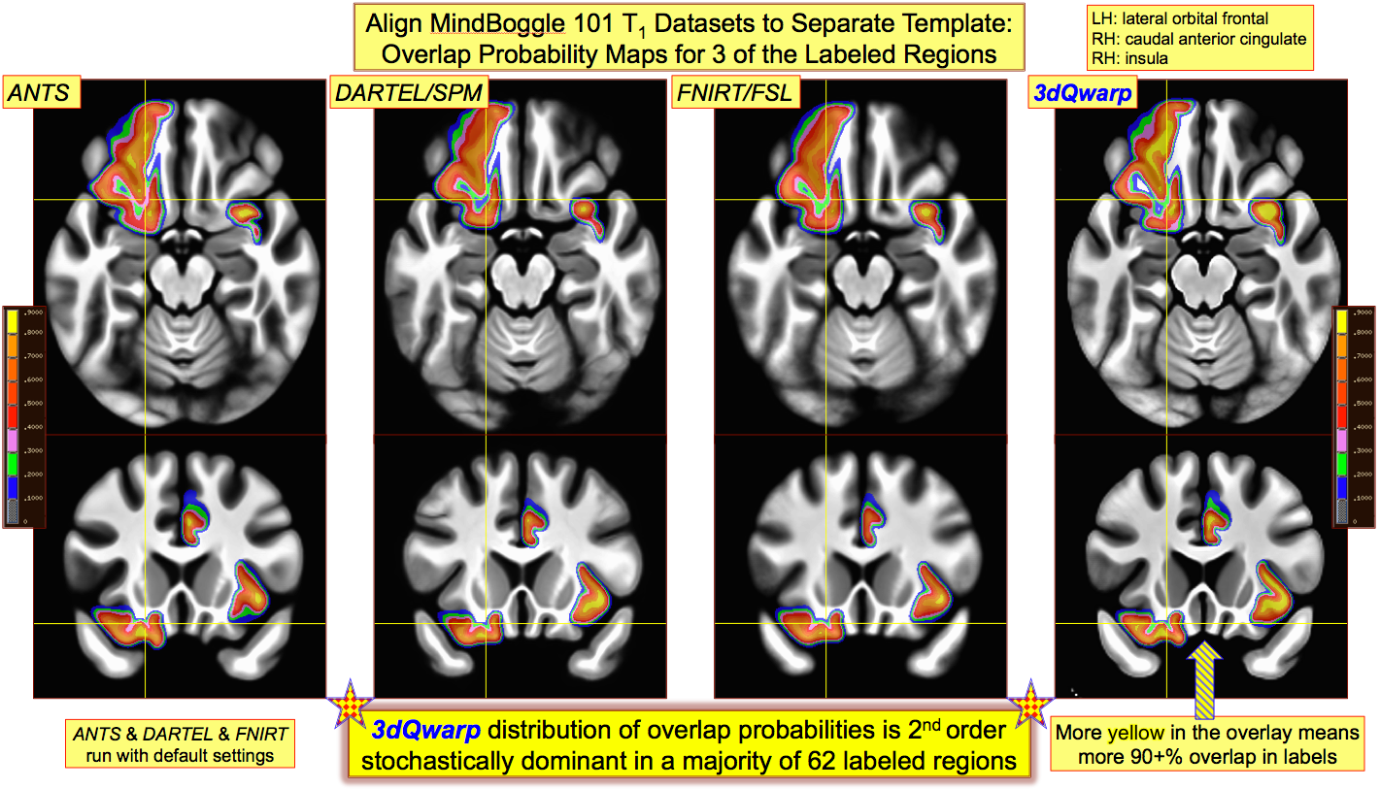
Example: Atlas Creation

