Slide 1








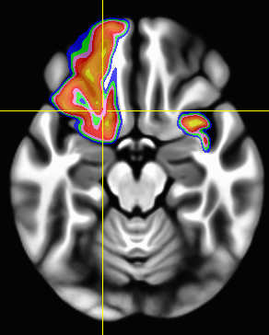
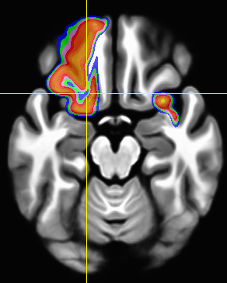
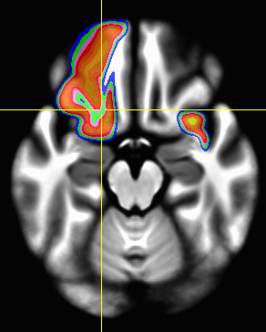
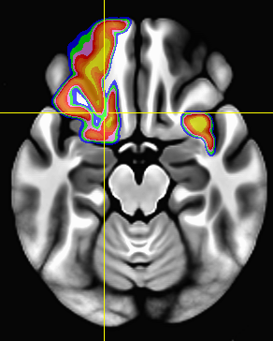
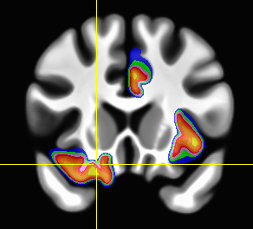
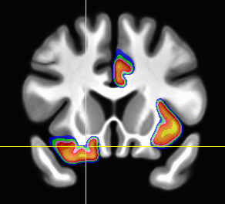
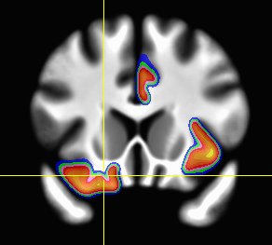
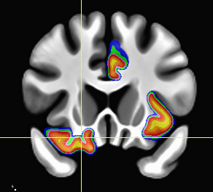

Nonlinear Warping in AFNI
RW Cox & DR Glen
Scientific and Statistical Computing Core
NIMH & NINDS / NIH / DHHS / Bethesda MD USA
Contact: robertcox@mail.nih.gov http://afni.nimh.nih.gov
Boring Text Introduction
RS-FMRI: Qwarp vs Affine registration (188 datasets)
3dQwarp = nonlinear alignment of 2 volumes
  C¹ polynomial patches ➔ incremental W_{i}(x)
  Optimize W₁(x), then W₂(W₁(x)), then W₃(W₂(W₁(x))), … , over shrinking patches
Script to template-ize a collection of datasets
Optional “meet-in-the-middle” warp = bring 2 datasets to alignment “half-way” in between
  Application: unwarping blip-up/blip-down EPI
Soon to be built into standard AFNI processing stream for FMRI datasets
  With parallel anatomical atlases & templates
Seed = Left Precuneus
RS-FMRI: Qwarp-to-detailed-template vs Qwarp-to-MNI-152
3dQwarp ➔ align 188 Cambridge datasets from FCON-1000
Underlay = template-ized T₁ anats
Overlay = difference in mean seed-based correlation maps when using 3dQwarp alignment to detailed template versus
  [upper] affine alignment to MNI-152
  [lower] 3dQwarp alignment to MNI-152
Better warping ➔ Stronger results
and you should warp to a detailed template!
Align MindBoggle 101 T₁ Datasets to Separate Template:
Overlap Probability Maps for 3 of the Labeled Regions
LH: lateral orbital frontal
RH: caudal anterior cingulate
RH: insula
ANTS
DARTEL/SPM
FNIRT/FSL
3dQwarp
ANTS & DARTEL & FNIRT
run with default settings
3dQwarp distribution of overlap probabilities is 2nd order stochastically dominant in a majority of 62 labeled regions
More yellow in the overlay means more 90+% overlap in labels
Unedited and unsolicited quote from a happy early adopter:
“Just got through testing the new non-linear warping scheme and I love it long time! It's every bit as good as manual warping with sub-cortex and cingulate. And wicked convenient. Let my testimony ring loud and clear throughout this glorious kingdom.”
Kudos to Shane Kippenham (NIMH IRP) for running DARTEL for us

