Slide 1
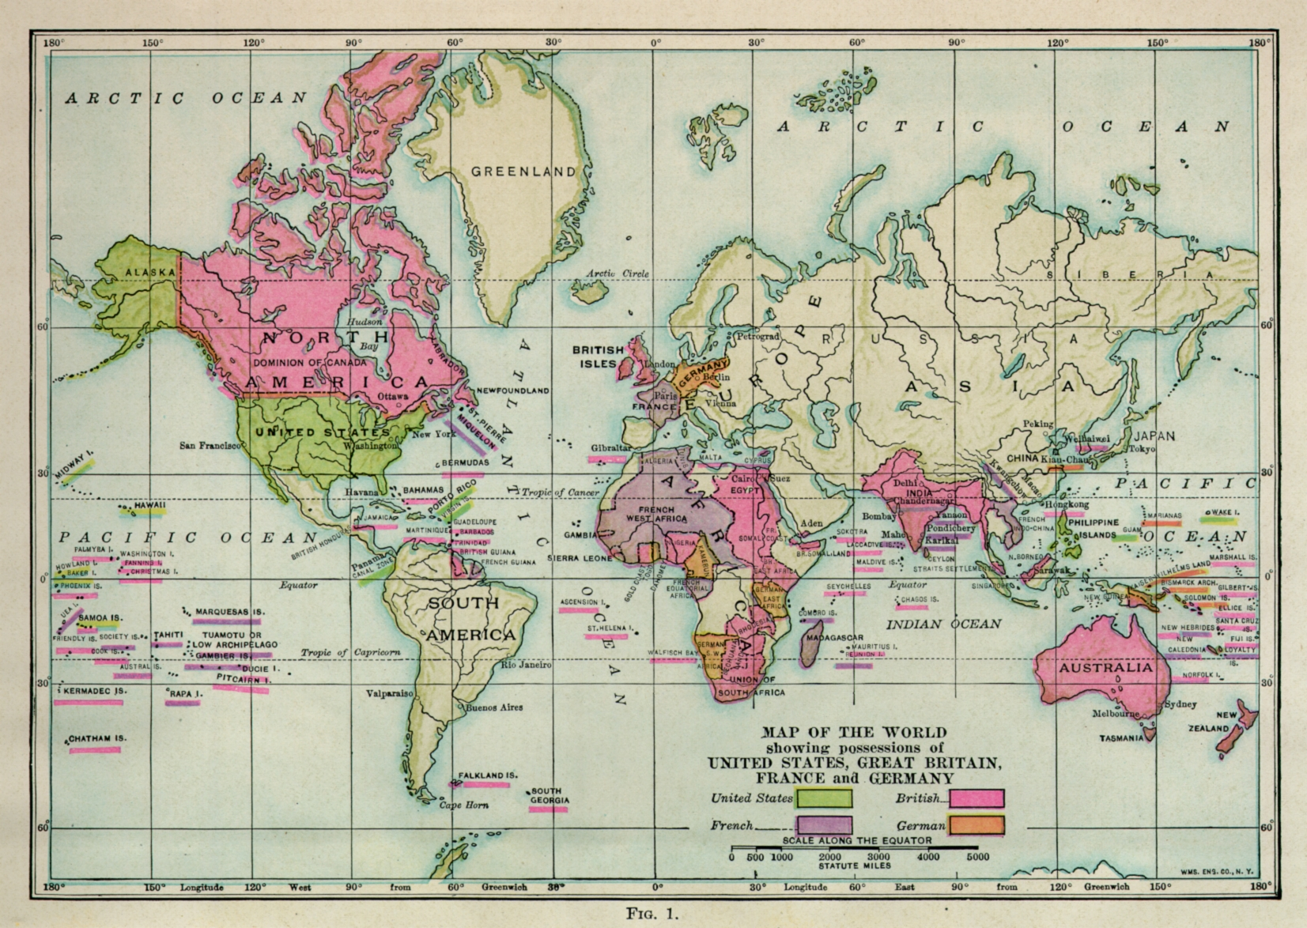
TEMPLATES AND ATLASES

Slide 2
Abbrevs used here
abbrev = abbreviation
AKA = also known as
anat = anatomical
corr = correlation
diff = difference
dset = dataset
e.g. = exempli gratia (= “for example”)
EPI = echo planar image
Ex = example
FOV = field of view
i.e. = id est (= “that is”)
ijk = coordinate indices (integer)
NB = nota bene (= “note well”)
phys = physics or physical
ref = reference
ROI = region of interest
subj = subject
vol = volume
vox = voxel(s)
xyz = physical coordinates (units of mm)

Slide 3
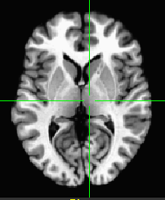
Definitions
Template
A reference dataset (typically whole brain) used for matching shapes, reporting coordinates of results, etc.
Ex: TT_N27+tlrc, MNI_EPI+tlrc, TT_ICBM452+tlrc.
TT_N27+tlrc

Slide 4
Definitions
Template Space
An (x, y, z) coordinate system shared by many datasets in alignment with a template.
Ex: TLRC (Talairach-Tourneaux), MNI, MNI_ANAT, ORIG.
To see what “space” a dset is in, type:
3dinfo -space DSET_NAME

Slide 5
Definitions
A note on AFNI usage of “tlrc”:
The “+tlrc” extension in a dataset’s name is used to denote that the volume in question is in a standardized space; it does not always mean that the standard space in question is the Talairach-Tournoux one, specifically-- it could be MNI, pediatric template, macaque, ...
Hopefully the context makes things clear.
(Typically, there are so many templates for a given space now-- MNI, for example, has several templates-- that one really has to specify the full file name of a template to be able to refer to it unambiguously, anyways.)

Slide 6
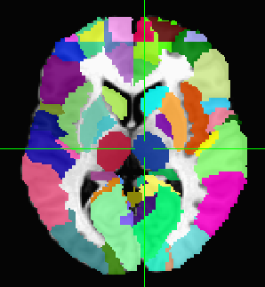
Definitions
Atlas
A dset containing segmentation or parcellation information. It can be considered a “map” of ROIs: each ROI is defined as a set of voxels with a certain integer value (and a string label can be attached to each ROI).
Ex: TTatlas+tlrc, TT_N27_EZ_ML+tlrc, my_roidset+orig.
TT_N27_EZ_ML+tlrc
See more description about templates+atlases (including making your own) on the AFNI website:
https://afni.nimh.nih.gov/pub/dist/doc/htmldoc/template_atlas/framework.html

Slide 7
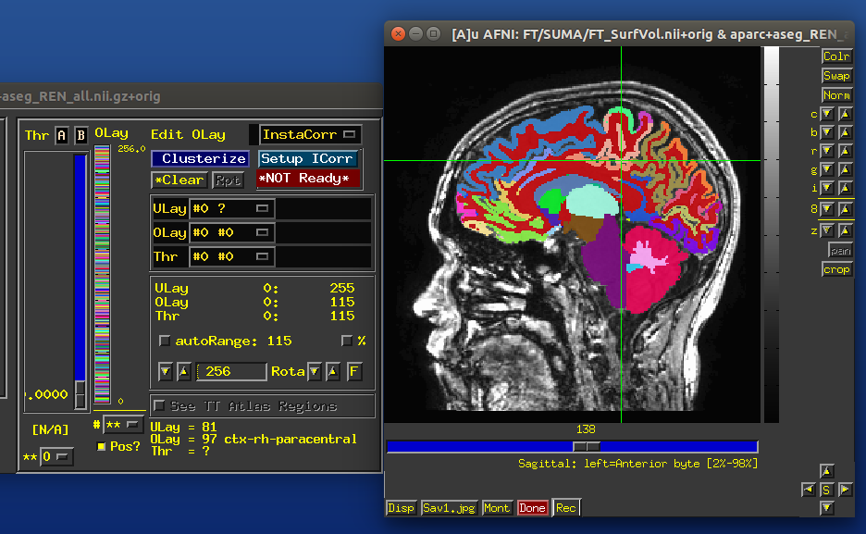
Definitions
Atlas (or general ROI) label in GUI
integer value of ROI
associated string label

Slide 8
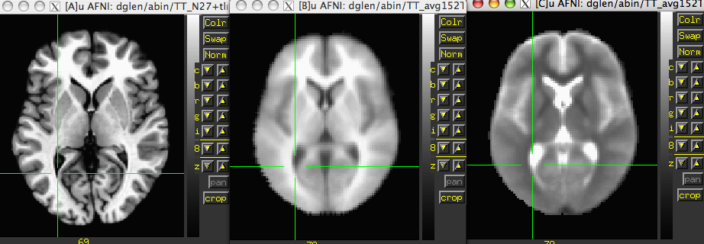
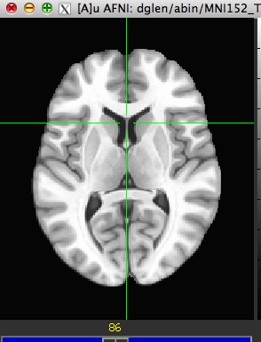
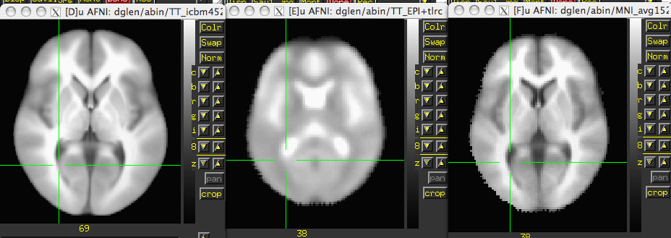
Templates included with AFNI
After default AFNI installation, these templates (and others) would be in ~/abin/:
TT_N27
TT_avg152T1
TT_avg152T2
MNI152_T1_2009c
TT_EPI
MNI_avg152T1
And a quick question: what important properties does each dset here have?

Slide 9
Templates included with AFNI
A helpful note on viewing templates (or any dsets) each time you open up the AFNI GUI, regardless of directory!
Set the AFNI_GLOBAL_SESSION variable in your ~/.afnirc file, e.g.,:
AFNI_GLOBAL_SESSION = /home/nmandela/abin
All dsets there will appear in your “Underlay” or “Overlay” menu in the AFNI GUI.
(Use full path of directory, no “~” or “$HOME”.)

Slide 10
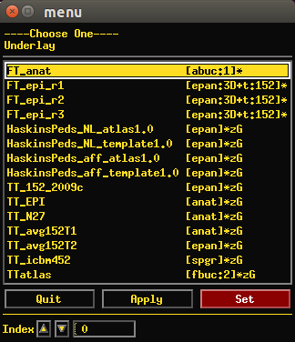
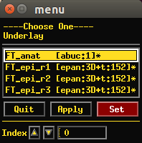
Templates included with AFNI
A helpful note on viewing templates (or any dsets) each time you open up the AFNI GUI, regardless of directory!
Set the AFNI_GLOBAL_SESSION variable in your ~/.afnirc file, e.g.,:
AFNI_GLOBAL_SESSION = /home/nmandela/abin
All dsets there will appear in your “Underlay” or “Overlay” menu in the AFNI GUI.
(Use full path of directory, no “~” or “$HOME”.)
Ex: then open AFNI GUI in some directory, say:
~/AFNI_data6/FT_analysis/FT/
after
before

Slide 11
Standard spaces
Reasons to use a standard template space:
Compare across subjects and groups easily for every voxel in the brain
Standardize coordinates with others
Know where a voxel is automatically from an atlas
Mostly automated and no specific ROI drawing required
Reasons not to use a standard template space:
Inconsistency among subjects
Inconsistency among groups – elderly versus younger
Use consistent anatomical ROIs with good anatomical knowledge
Lower threshold for multiple comparison adjustments

Slide 12
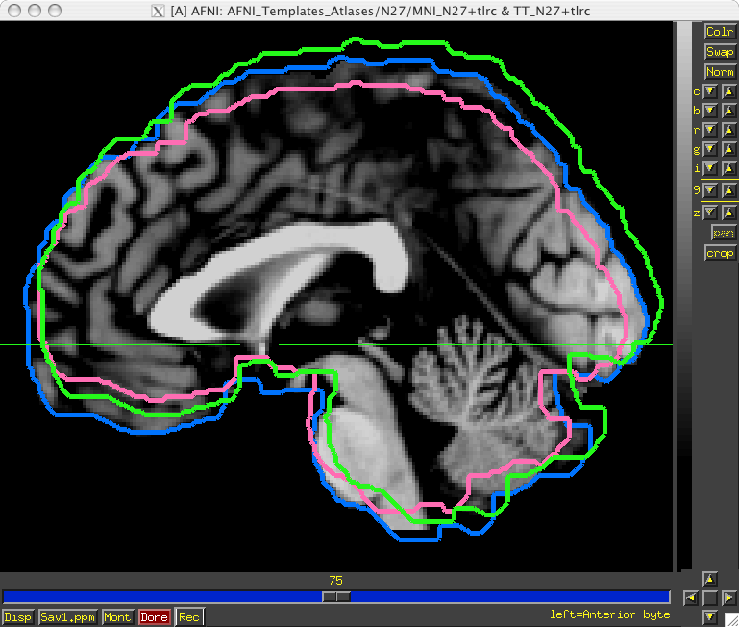
Template spaces differ in origin
TLRC, MNI, and MNI-Anat

Slide 13
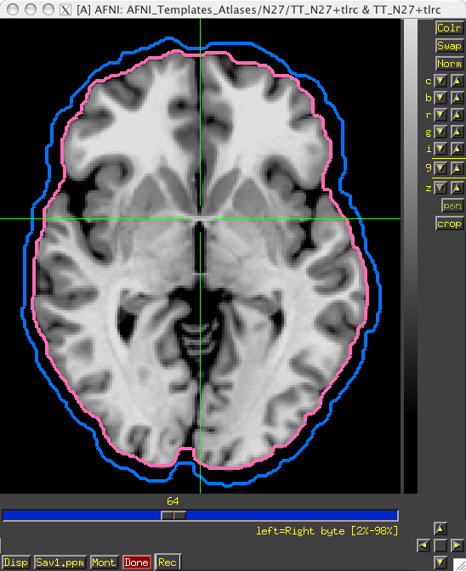
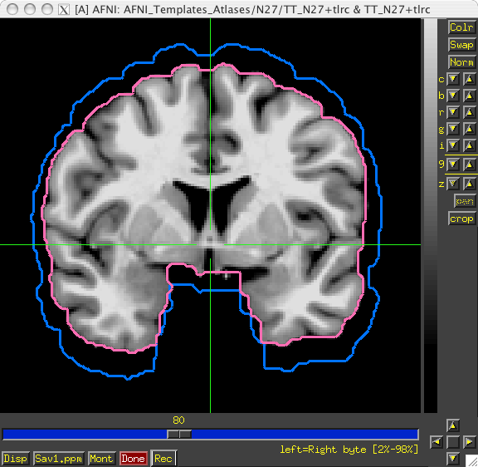
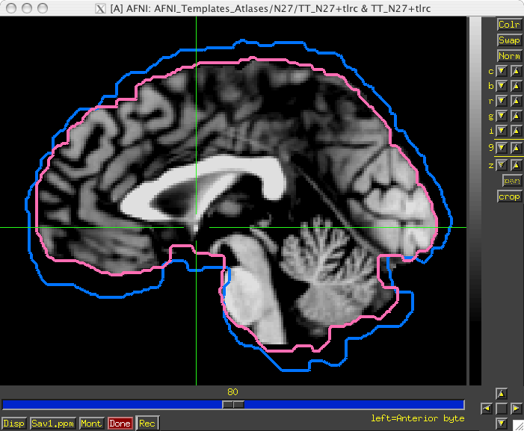
Template spaces differ in size
The MNI brain is larger than the TLRC brain.

Slide 14
From space to space
TLRC, MNI, and MNI-Anat
For going between TLRC and MNI:
Approximate equation
→ used by whereami and 3dWarp
A manual TLRC transformation of MNI
template to TLRC space
→ used by whereami (as precursor to
MNI Anat.), based on N27 template
Multiple space coordinates reported
in whereami output
(AFNI_ATLAS_TEMPLATE_SPACE_LIST)
For going between MNI and MNI Anat (Eickhoff et al., 2005):
MNI + (0, 4, 5) = MNI Anat. (in RAI coordinate system)
Going between TLRC and MNI Anat (as practiced in whereami):
Go from TLRC (TT_N27) to MNI via
manual transform of N27 template
Add ( 0, 4, 5 )
Going between TLRC and MNI:
Approximate equation
used by whereami and 3dWarp
Manual TLRC transformation of MNI template to TLRC space
used by whereami (as precursor to MNI Anat.), based on N27 template
Multiple space coordinates reported in whereami output (AFNI_ATLAS_TEMPLATE_SPACE_LIST)
Going between MNI and MNI Anatomical (Eickhoff et al. Neuroimage 25, 2005):
MNI + ( 0, 4, 5 ) = MNI Anat. (in RAI coordinate system)
Going between TLRC and MNI Anatomical (as practiced in whereami):
Go from TLRC (TT_N27) to MNI via manual xform of N27 template
Add ( 0, 4, 5 )

Slide 15
Choosing a template
Try to pick a template that...
is similar to the subject group: neonates, pediatric, young adults, elderly, macaque, rabbit...
is of the same modality and coverage as your data sets
has a relevant atlas segmentation.

Slide 16
Choosing a template
Try to pick a template that...
is similar to the subject group: neonates, pediatric, young adults, elderly, macaque, rabbit...
is of the same modality and coverage as your data sets
has a relevant atlas segmentation.
You can also make your own template (and maybe an atlas too):
Individual or group template
Group: average or iterative (discussed more later)
Scripts/commands exist in AFNI
Ex. Haskins pediatric atlas
several methods tested
best approach: iterative nonlinear alignment
@toMNI_Awarp, @toMNI_Qwarpar
And now/soon make_template_dask.py

Slide 17
Trading Spaces
How to transform data to a standard template space
@SSwarper – skullstrip and align data to some select standard spaces
@animal_warper - skullstrip, align data to animal template and bring atlas into native space
auto_warp.py -combination affine and nonlinear alignment to a template
@auto_tlrc – affine alignment to a template
Manual talairach
@SSW
AW
@at
manual

Slide 18
Trading Spaces
afni_proc.py options
tlrc block before volreg!
-volreg_tlrc_warp
-tlrc_base $tpath/$btemplate (runs @auto_tlrc)
-tlrc_NL_warp (runs auto_warp.py)
For @SSwarper output, add these:
-copy_anat anatSS.${subj}.nii \
-anat_has_skull no \
-tlrc_NL_warp \
-tlrc_NL_warped_dsets \
anatQQ.${subj}.nii \
anatQQ.${subj}.aff12.1D \
anatQQ.${subj}_WARP.nii

Slide 19
Registration To Standard Spaces Transforming Datasets to Talairach-Tournoux Coordinates
The original purpose of AFNI (circa 1994 A.D.) was to perform the transformation of datasets to Talairach-Tournoux (stereotaxic) coordinates
The transformation can be manual, or automatic
In manual mode, you must mark various
anatomical locations, defined in
Jean Talairach and Pierre Tournoux
“Co-Planar Stereotaxic Atlas of the Human Brain”
Thieme Medical Publishers, New York, 1988
Marking is best done on a high-resolution T1-weighted structural MRI volume
In automatic mode, you need to choose a template to which your data are aligned. Different templates are made available with AFNI’s distribution. You can also use your own templates.
Transformation carries over to all other (follower) datasets in the same directory
This is where the importance of getting the relative spatial placement of datasets done correctly in to3d really matters
You can then write follower datasets, typically functional or EPI timeseries, to disk in Talairach coordinates
Purpose: voxel-wise comparison with other subjects
May want to blur volumes a little before comparisons, to allow for residual anatomic variability: AFNI programs 3dmerge or 3dBlurToFWHM

Slide 20
Automatic Talairach transform (affine) with @auto_tlrc
In the olden days, people would spend a lot of time transforming data to standard space by hand (see Supplement slides for how to perform the Manual TLRC transform using the AFNI GUI by setting AC-PC landmarks).
Here, we describe how to perform a TLRC transform automatically using AFNI’s @auto_tlrc (used by afni_proc.py for linear affine alignment to standard space).
Differences from Manual Transformation:
Instead of setting AC-PC landmarks and volume boundaries by hand, the anatomical volume is warped (using 12-parameter affine transform) to a template volume in TLRC space.
The Anterior Commisure (AC) center is no longer at xyz = (0,0,0), and the size of brain box is that of the template you use.
For various reasons, some good and some bad, templates adopted by the neuroimaging community are not all of the same size. Be mindful when using various atlases or comparing standard-space coordinates.
You, the user, can choose from various templates for reference (just be consistent in your group analysis).
It is easy + automatic. Just check final results to make sure nothing went seriously awry.

Slide 21
@auto_tlrc example
To run in AFNI_data6/afni/
Transform the subj anat to a template space (output: anat_TT+tlrc):
Then apply the transform stored in anat_TT+tlrc’s header to a “follower dset” (here, func data), specifying output resolution at 3 mm (output: func_slim_TT+tlrc):
Instead of TT_N27, you could also use the icbm452, or the mni’s avg152T1 template, or any other template you like
(see @auto_tlrc -help for a few good words on templates)
@auto_tlrc \
-base TT_N27+tlrc \
-suffix _TT \
-input anat+orig
@auto_tlrc \
-apar anat_TT+tlrc \
-input func_slim+orig \
-suffix _TT \
-dxyz 3

Slide 22
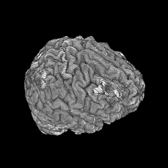
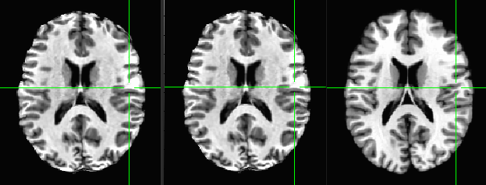
Nonlinear alignment to template
3dQwarp, through multiple levels of refinement →
@auto_tlrc 3dUnifize qw0 qw1 qw2
qw3 qw4 qw5 qw6 qw7
qw8 qw9 TT_N27

Slide 23
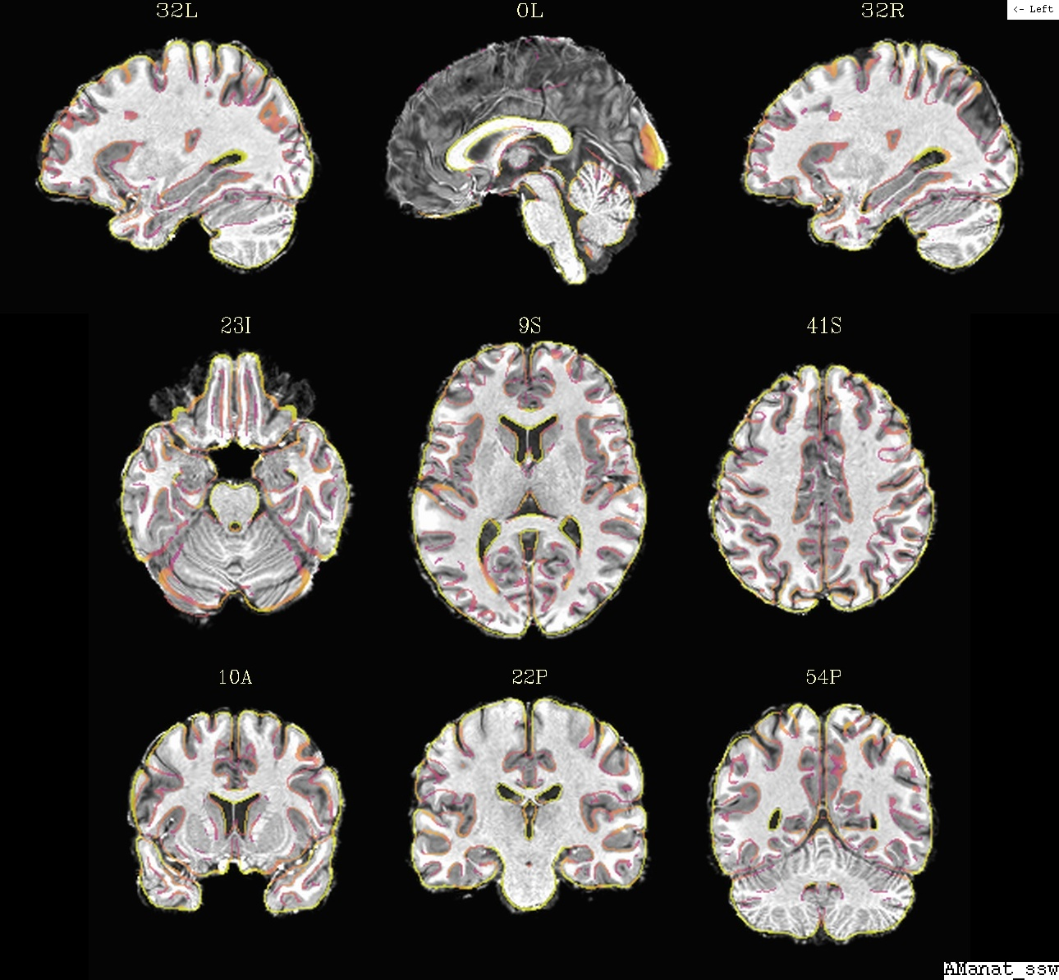
Nonlinear alignment to template
Multiple nonlinear alignment tools in AFNI
3dQwarp: the standard nonlinear workhorse
auto_warp.py: wrapper for alignment functionality, ~simpler syntax
(@auto_tlrc + 3dQwarp together)
Ex: auto_warp.py -base MNI152_T1_2009c+tlrc. \
-suffix _awarp -input strip+orig.
@SSwarper: skull stripping and alignment in one-- and bonus automatic QC images
+ @SSwarper uses a multi-volume base; several exist for standard templates already, and more can be made-- see full description for these online:
https://afni.nimh.nih.gov/pub/dist/doc/htmldoc/template_atlas/sswarper_base.html

Slide 24
Measuring quality of alignment
Can compare: nonlinear alignment vs affine alignment
+ Estimate warp from subject anat to template for a group of subjects
+ Apply warp when processing FMRI data (here, resting state)
+ Check changes in seed-based correlation maps between results
- better method would have higher corr in GM networks and lower corr in WM.

Slide 25
Measuring quality of alignment
Can compare: nonlinear alignment vs affine alignment
+ Estimate warp from subject anat to template for a group of subjects
+ Apply warp when processing FMRI data (here, resting state)
+ Check changes in seed-based correlation maps between results
- better method would have higher corr in GM networks and lower corr in WM.
red: [0.066, 0.100] corr increase for 3dQwarp results
blue: [0.066, 0.100] corr decrease for 3dQwarp results
188 FCON1000 Cambridge datasets
(Cox & Glen, 2013, OHBM)

Slide 26
Measuring quality of alignment
Can compare: using detailed vs non-detailed template for nonlinear alignment
+ Estimate warp from subject anat to template for a group of subjects
+ Apply warp when processing FMRI data (here, resting state)
+ Check changes in seed-based correlation maps between results
- better method would have higher corr in GM networks and lower corr in WM.

Slide 27
Measuring quality of alignment
Can compare: using detailed vs non-detailed template for nonlinear alignment
+ Estimate warp from subject anat to template for a group of subjects
+ Apply warp when processing FMRI data (here, resting state)
+ Check changes in seed-based correlation maps between results
- better method would have higher corr in GM networks and lower corr in WM.
red: [0.066, 0.100] corr increase for 3dQwarp results
blue: [0.066, 0.100] corr decrease for 3dQwarp results
(Cox & Glen, 2013, OHBM)

Slide 28
Measuring quality of alignment
Can compare 3dQwarp with other available nonlinear alignment tools
+ For a group of subjects, estimate warp from anat to template
+ Apply warp to labeled ROIs, and measure % overlap in results.
ANTS, DARTEL and FNIRT run with default settings
(Cox & Glen, 2013, OHBM)

Slide 29
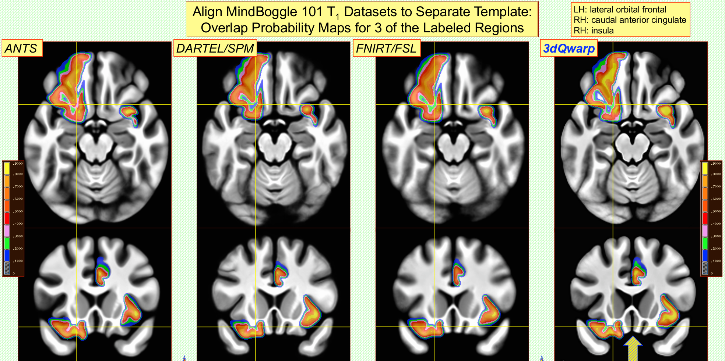
Measuring quality of alignment
Can compare 3dQwarp with other available nonlinear alignment tools
+ For a group of subjects, estimate warp from anat to template
+ Apply warp to labeled ROIs, and measure % overlap in results. (Yellow: >90% overlap)
ANTS, DARTEL and FNIRT run with default settings
(Cox & Glen, 2013, OHBM)

Slide 30
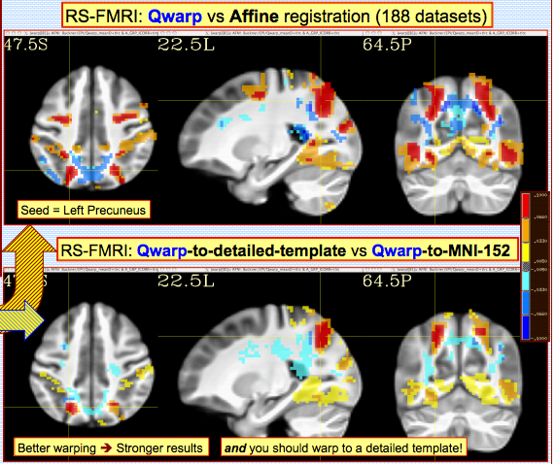
Nonlinear alignment to standard space
Advantages
Better spatial correspondence across data
→ consistent data reinforces across group
Final data matches template (reporting coordinates, etc.)
Disadvantages
Individual data is distorted
Aligned data matches template. Choose template carefully
Skullstripping must be done much more carefully
→ note that @SSwarper actually combines nonlinear warping with skullstripping, so benefit now!
Processing time much slower (but... such is life)
(Cox & Glen, 2013, OHBM)

Slide 31
Going where the atlases live
AFNI binary directory for datasets and configuration
AFNI_atlas_spaces.niml describe the distributed atlases
CustomAtlases.niml and SessionAtlases.niml allow for more atlases and templates
Saving the Environment
AFNI_ATLAS_LIST "CA_ML_18_MNI,DKD_Desai_MPM"
"ALL"
AFNI_TEMPLATE_SPACE_LIST “MNI,TLRC”
AFNI_ATLAS_COLORS CA_ML_18_MNI
AFNI_SUPP_ATLAS_DIR ~/MyAtlases
AFNI_WHEREAMI_DEC_PLACES 2
AFNI_WHEREAMI_MAX_SEARCH_RAD 3

Slide 32
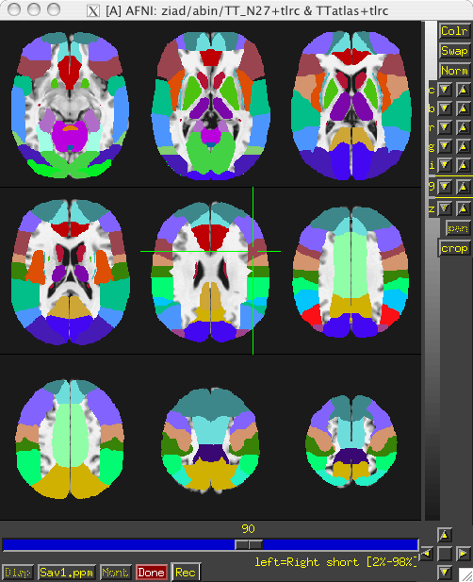
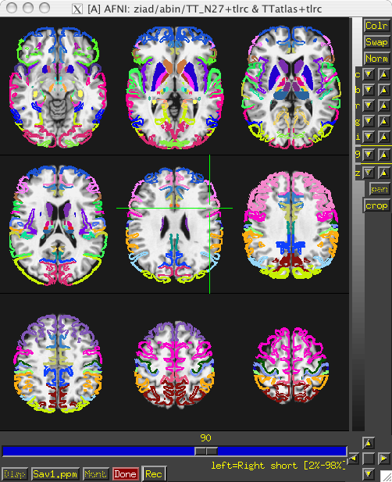
Atlases distributed with AFNI: TT_Daemon
TT_Daemon : Created by tracing Talairach and Tournoux brain illustrations.
Generously contributed by Jack Lancaster and Peter Fox of RIC UTHSCSA)

Slide 33
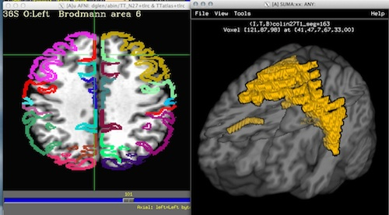
Caution: Talairach Daemon (TT_Daemon) problems
This piece is labeled as BA 6, but is really another part.

Slide 34
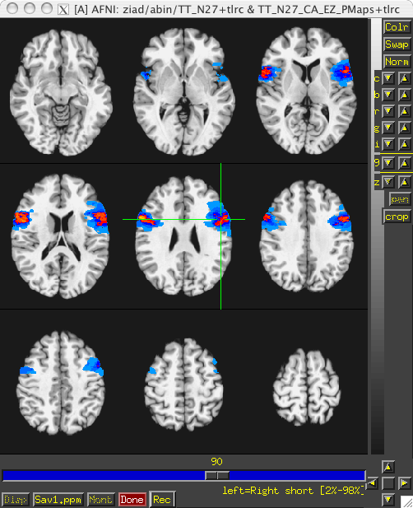
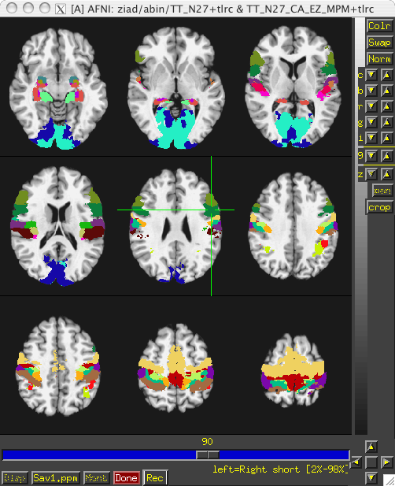
Atlases Distributed With AFNI Anatomy Toolbox: Prob. Maps, Max. Prob. Maps
Atlases distributed with AFNI: “Anatomy Toolbox”
CA_N27_MPM, CA_N27_ML, CA_N27_PM: Anatomy Toolbox's atlases with some created from cytoarchitectonic studies of 10 human post-mortem brains
Probabilistic maps and max. probability maps generously contributed by K. Amunts, S. Eickhoff, and K. Zilles of IME, Julich, Germany

Slide 35
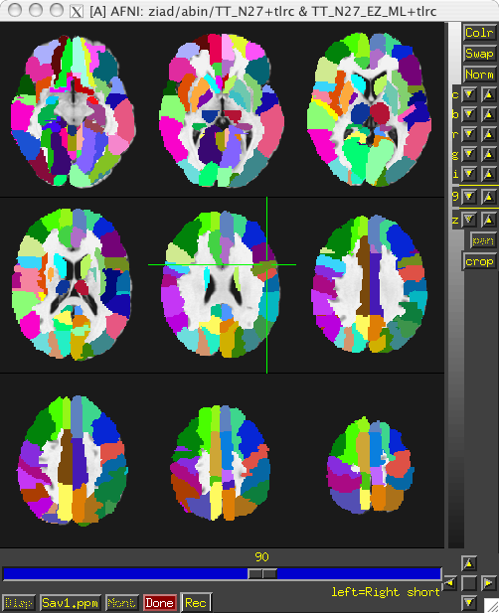
Atlases Distributed With AFNI: Anatomy Toolbox: MacroLabels
Atlases distributed with AFNI: “Anatomy Toolbox”
CA_N27_MPM, CA_N27_ML, CA_N27_PM: Anatomy Toolbox's atlases with some created from cytoarchitectonic studies of 10 human post-mortem brains
Probabilistic maps and max. probability maps generously contributed by K. Amunts, S. Eickhoff, and K. Zilles of IME, Julich, Germany
plus MacroLabels!

Slide 36
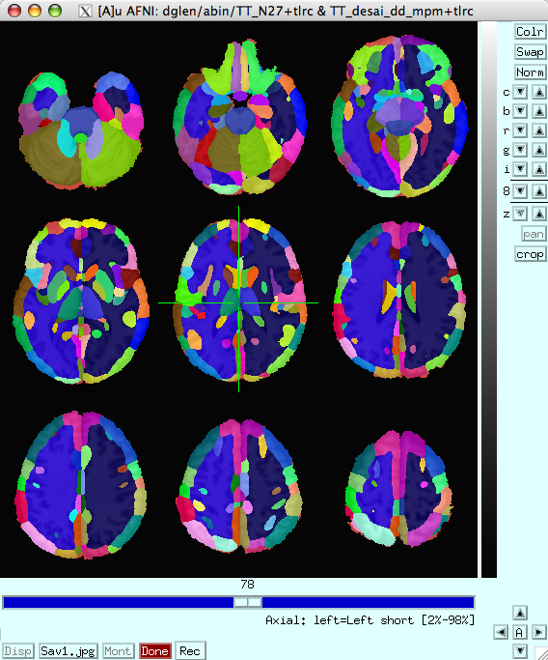
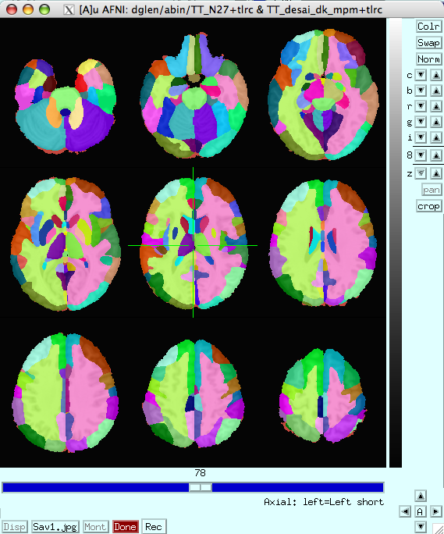
Atlases Distributed With AFNI: Desai PMaps and MPMs
Atlases distributed with AFNI: Desai PMaps and MPMs
Atlases generated with typical AFNI pipeline using @auto_tlrc and FreeSurfer segmentation across multiple subjects

Slide 37
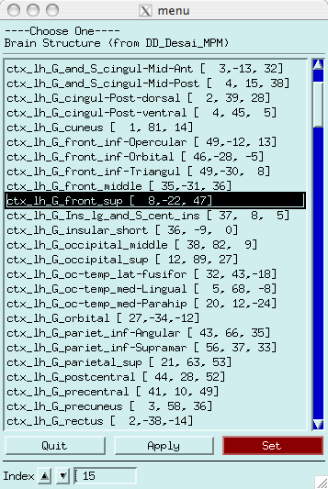
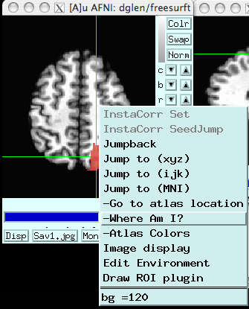
Using atlases in AFNI GUI
Some fun and useful things to do with +tlrc datasets are on the 2D slice viewer.
Ex: can be run in ~/AFNI_data6/afni/
1) Right click to get menu:
[Go to Atlas Location]
Lets you jump to centroid of regions to current default atlas (set by AFNI_ATLAS_COLORS) Works in +orig, too.

Slide 38
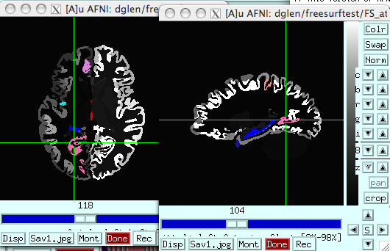
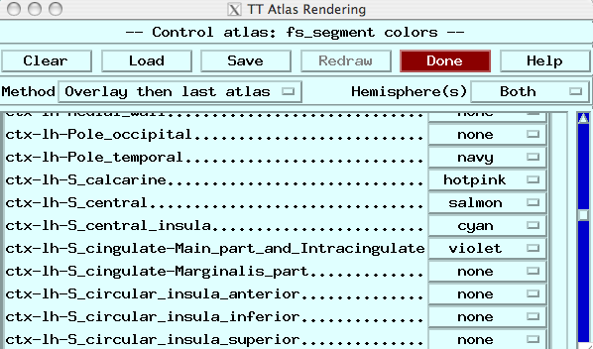
[Atlas colors]
Lets you show atlas regions over your own data (works only in +tlrc).

Slide 39
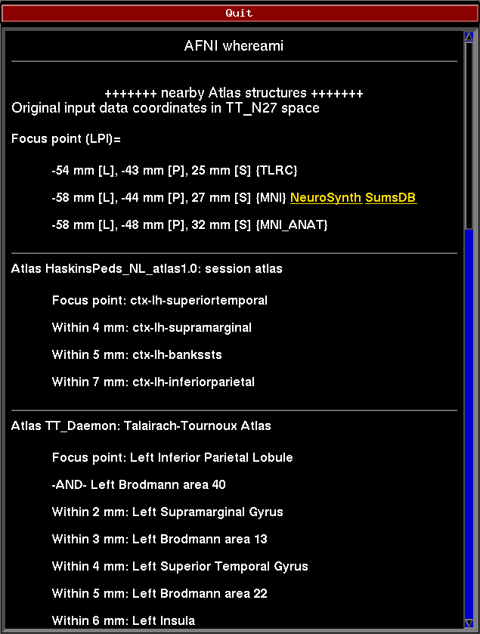
[Where am I?]
Shows you where you are in various atlases and spaces
(works in +orig too, if you have a transformed parent)
For atlas installation, and much, much more, see help in command line version:
whereami -help

Slide 40
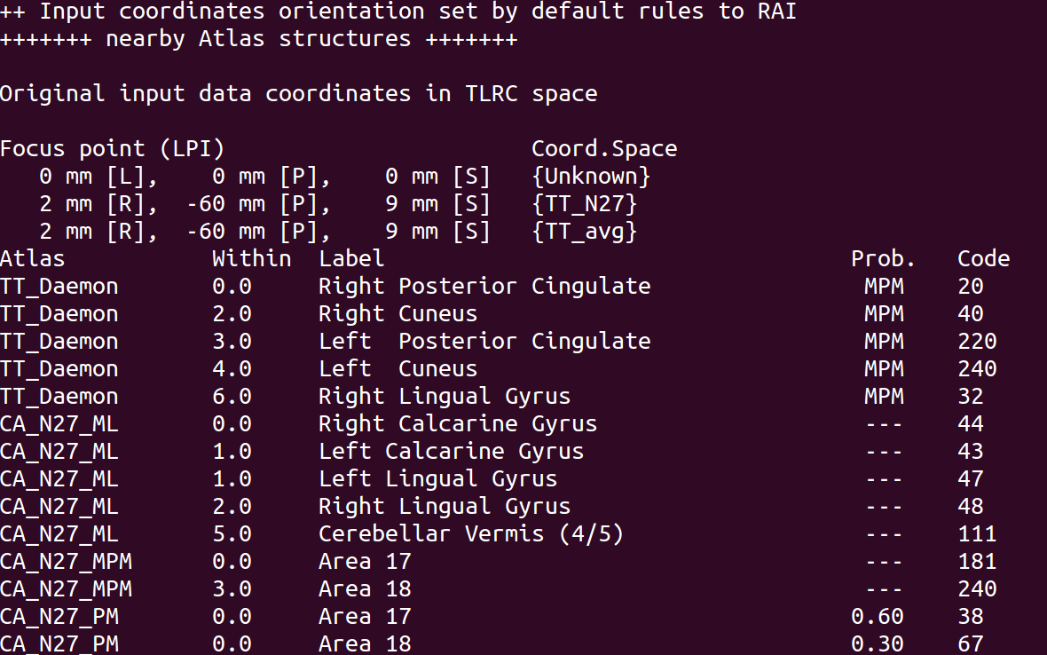
whereami on the command line
whereami can combine usefully with 3dClusterize:
1) 3dClusterize finds cluster volumes, and
2) whereami provides detailed info like overlap with atlas regions
Ex: can be run in ~/AFNI_data6/afni/
# Threshold the index-0 vol (an F-stat) at >9.5 and
# find clusters with >=1000 voxels
3dClusterize -1sided RIGHT 9.5 \
-clust_nvox 1000 -NN 1 \
-inset func_slim+orig -ithr 0 -idat 0 \
> clusts.1D
# Use the center of mass coords in
# cols [1,2,3] to show location according
# to several atlases (TT, MNI, etc.); also
# shows nearby structures
whereami \
-coord_file \
clusts.1D'[1,2,3]' \
-tab | more

Slide 41
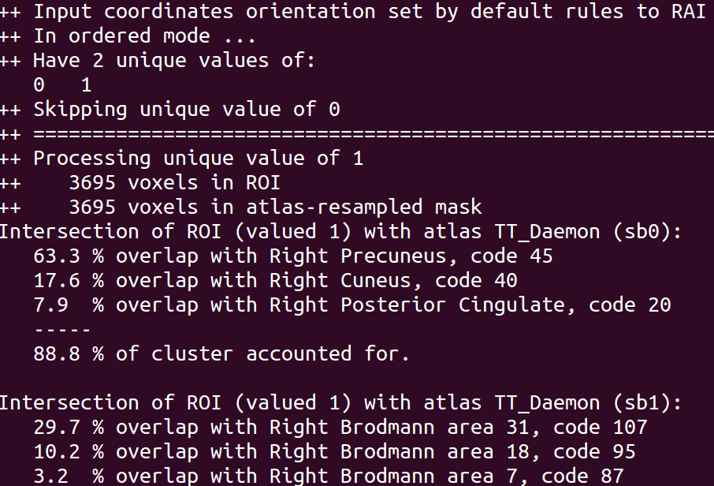
whereami on the command line
whereami can also report the overlap of ROIs with atlases
Ex: can be run in ~/AFNI_data6/afni/
# Quick way to make test ROI a sphere at a given location)
echo -14 66 23 > tmp.txt
3dUndump \
-xyz \
-prefix tmproi.nii.gz \
-master anat+tlrc \
-datum byte \
-srad 9.5 \
tmp.txt
# report overlap
whereami \
-omask tmproi.nii.gz

Slide 42
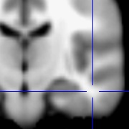
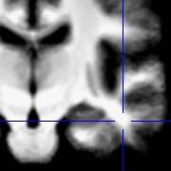
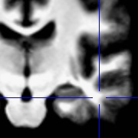
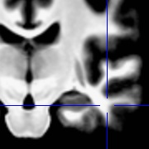
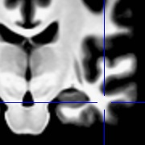
Make your own template
MNI 152 template
Linear = Affine
@toMNI_Awarp
@toMNI_Qwarpar
Averages of 21
3 Tesla brain volumes
with varied
levels of refinement in
the nonlinear warping
(smaller patch=more refinement)
12 parameters
Nonlinear: Patch=101
Nonlinear: Patch=49
Nonlinear: Patch=23
+1002
+9048
+70008

Slide 43
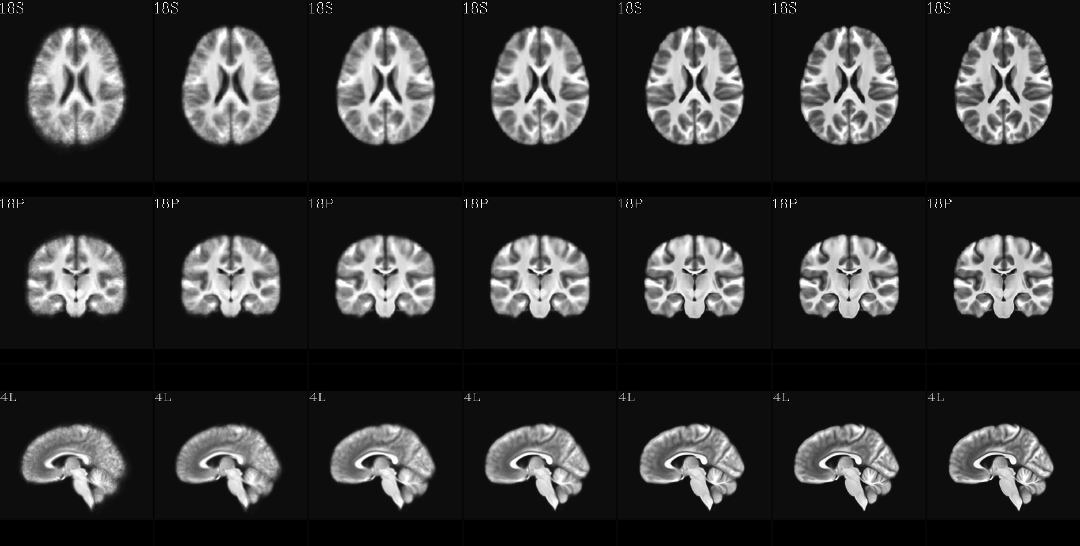
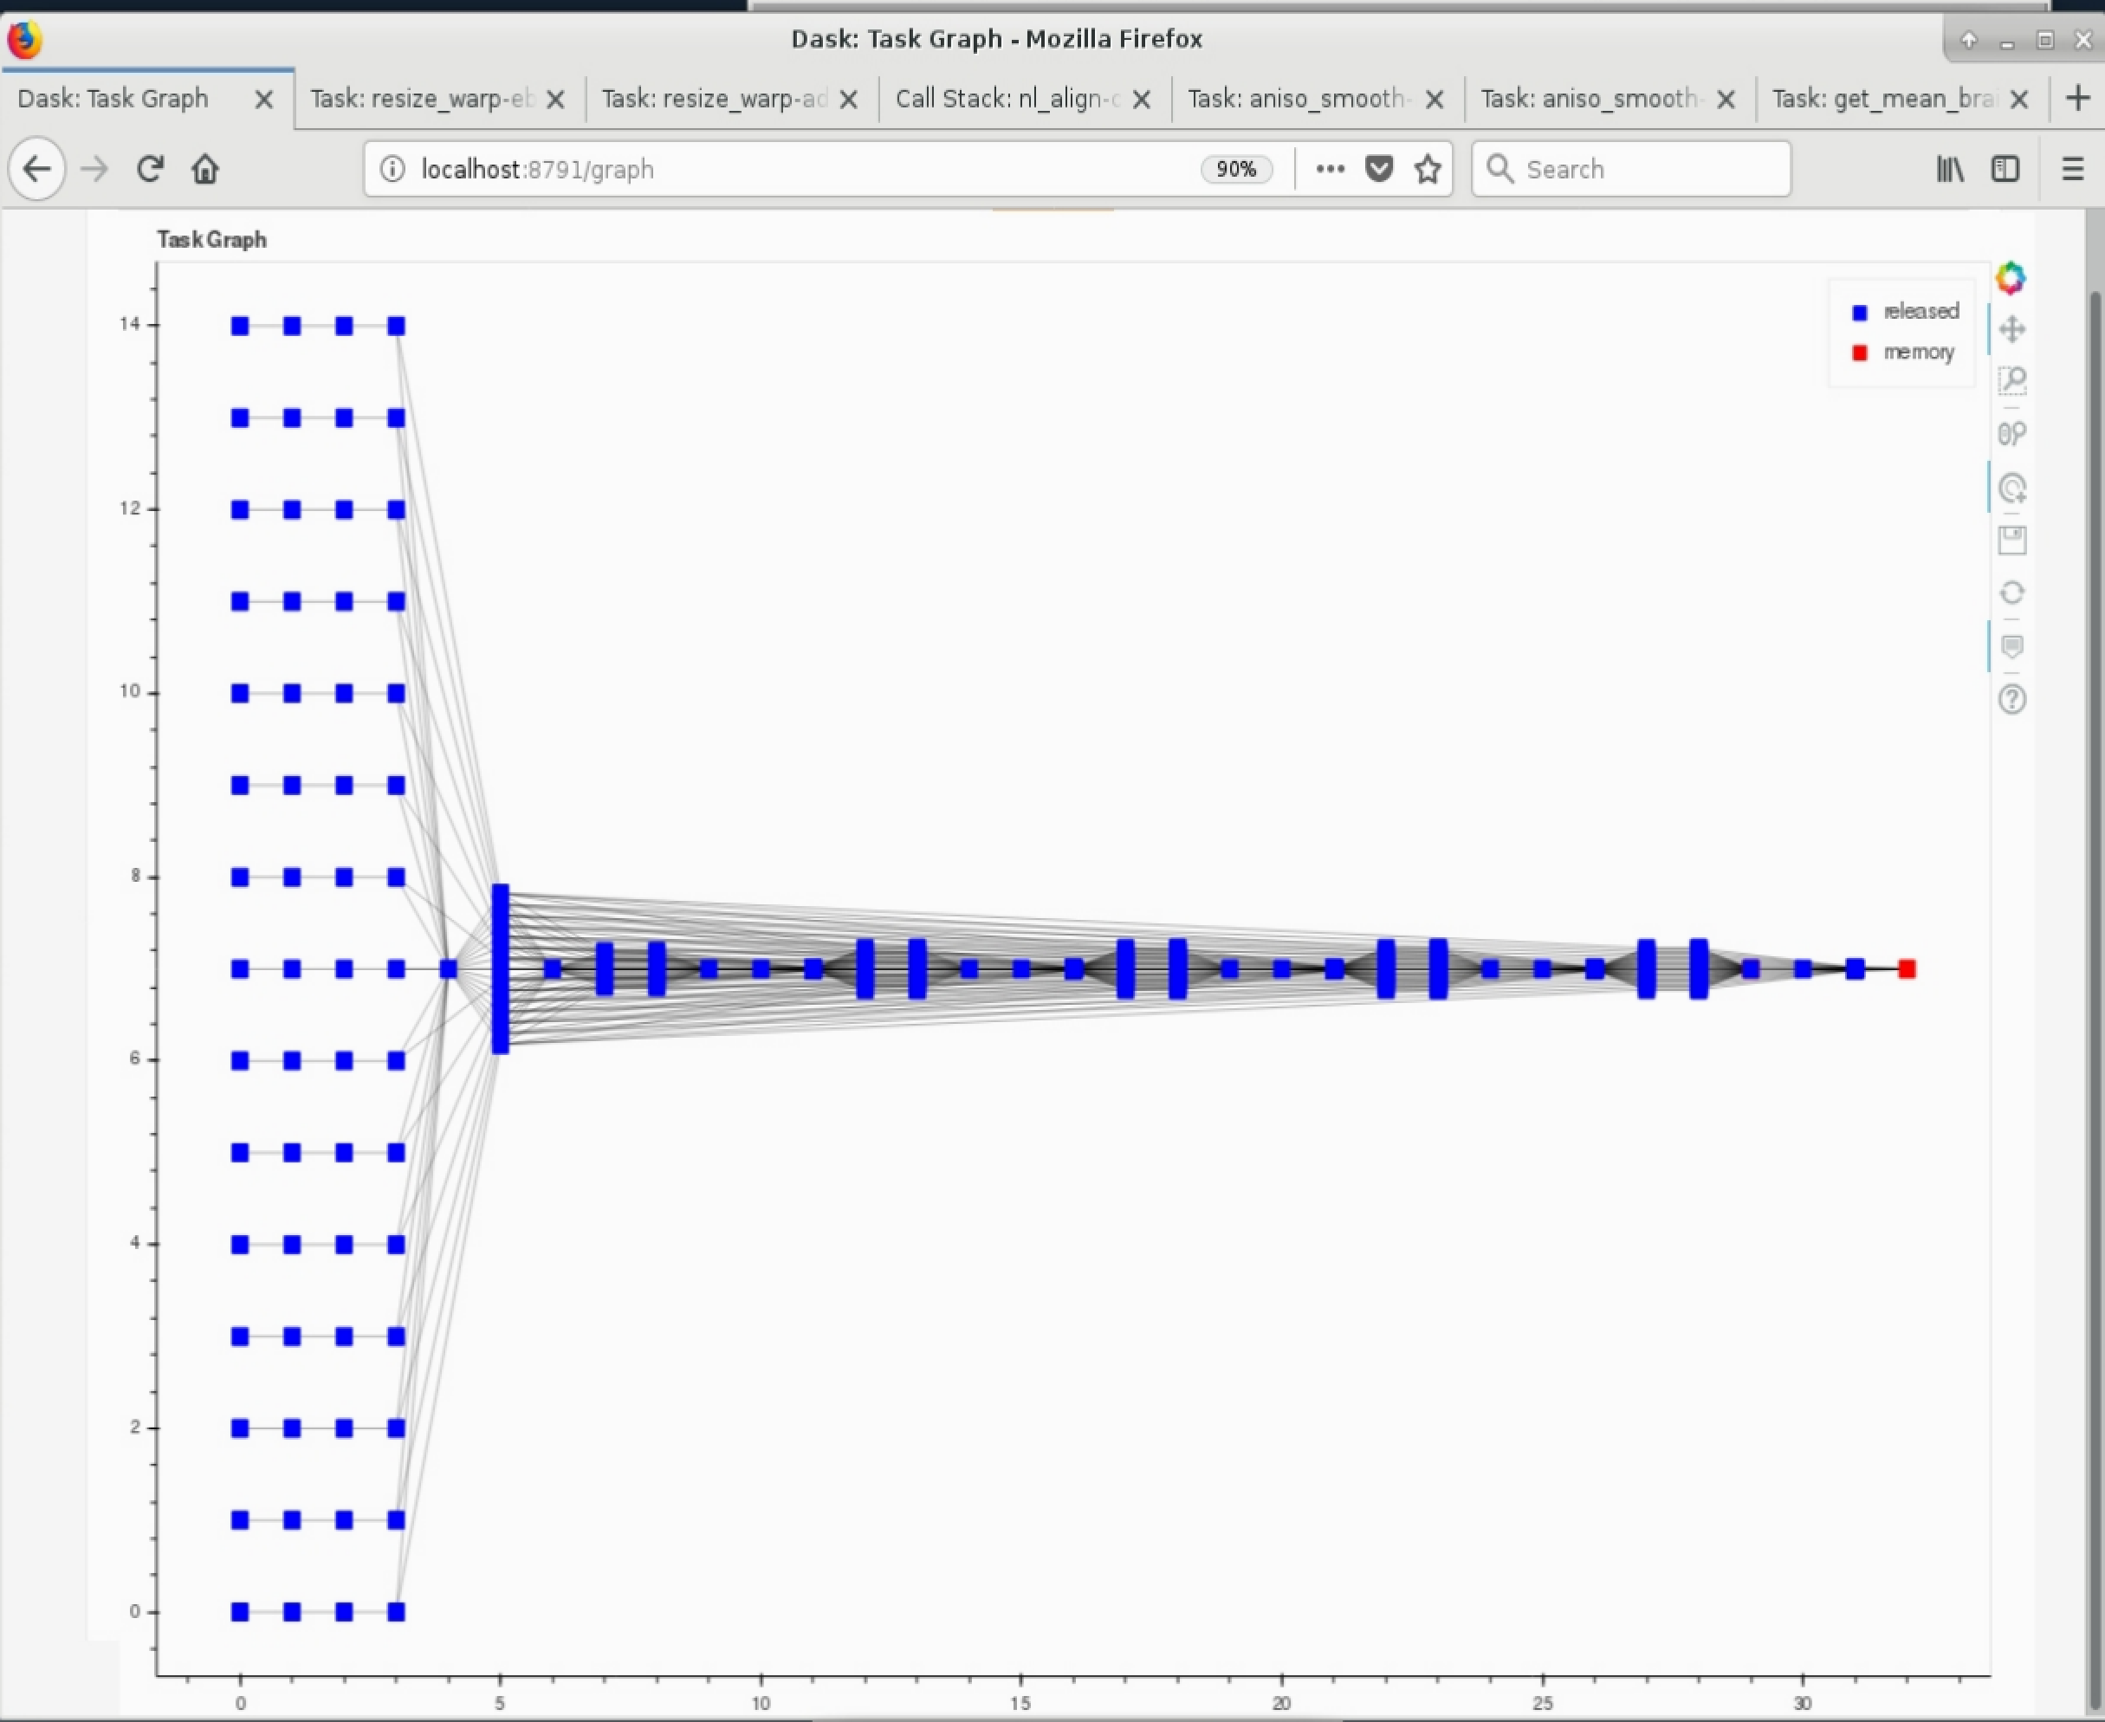
Make your own template - faster, easier!
make_template_dask.py - Dask parallelization - 10, 100 or 1000 subjects on a cluster, server or PC

Slide 44
Make your own atlas!
New atlases – easy and fun. Make your own!
make available in AFNI GUI and whereami and to other user
@AfniEnv -set AFNI_SUPP_ATLAS_DIR ~/MyCustomAtlases/ Then:
@Atlasize -space MNI -dset atlas_for_all.nii \ -lab_file keys.txt 1 0 -atlas_type G In ~/MyCustomAtlases/ you will now find atlas_for_all.nii along along with a modified CustomAtlases.niml file.

Slide 45
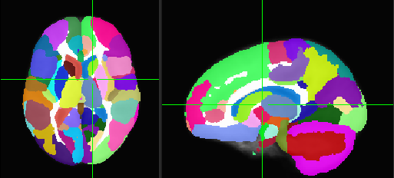
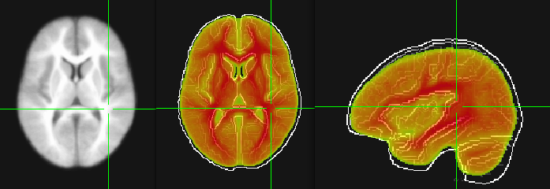
Haskins Pediatric Atlas
Pediatric brain atlas and templates (7-12 years old) – Peter Molfese, (formerly Haskins Labs, now at NIH - woohoo!)
Manually corrected segmentation from Freesurfer.
Probabilistic, MPM and template
~75 subjects → 500 (ages 6-13)
Affine, nonlinear averages, ideal/typical subjects, outliers

Slide 46
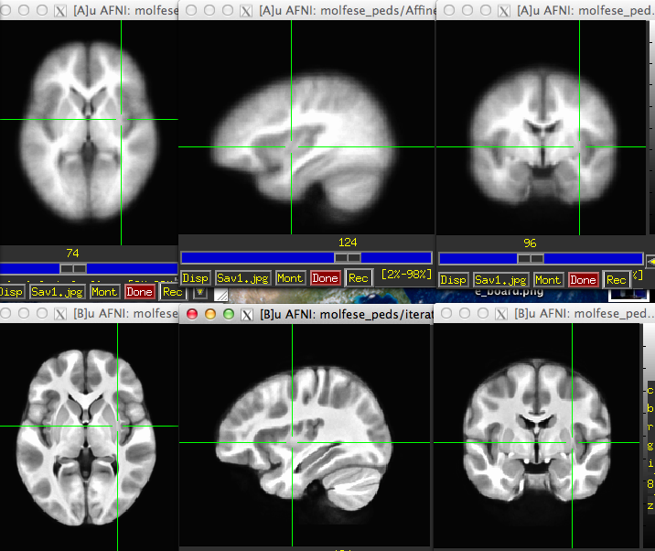
Haskins Pediatric Atlas: the templates
Affine Group
Nonlinear Group I –
iterative

Slide 47
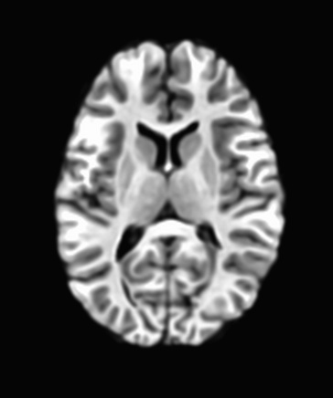
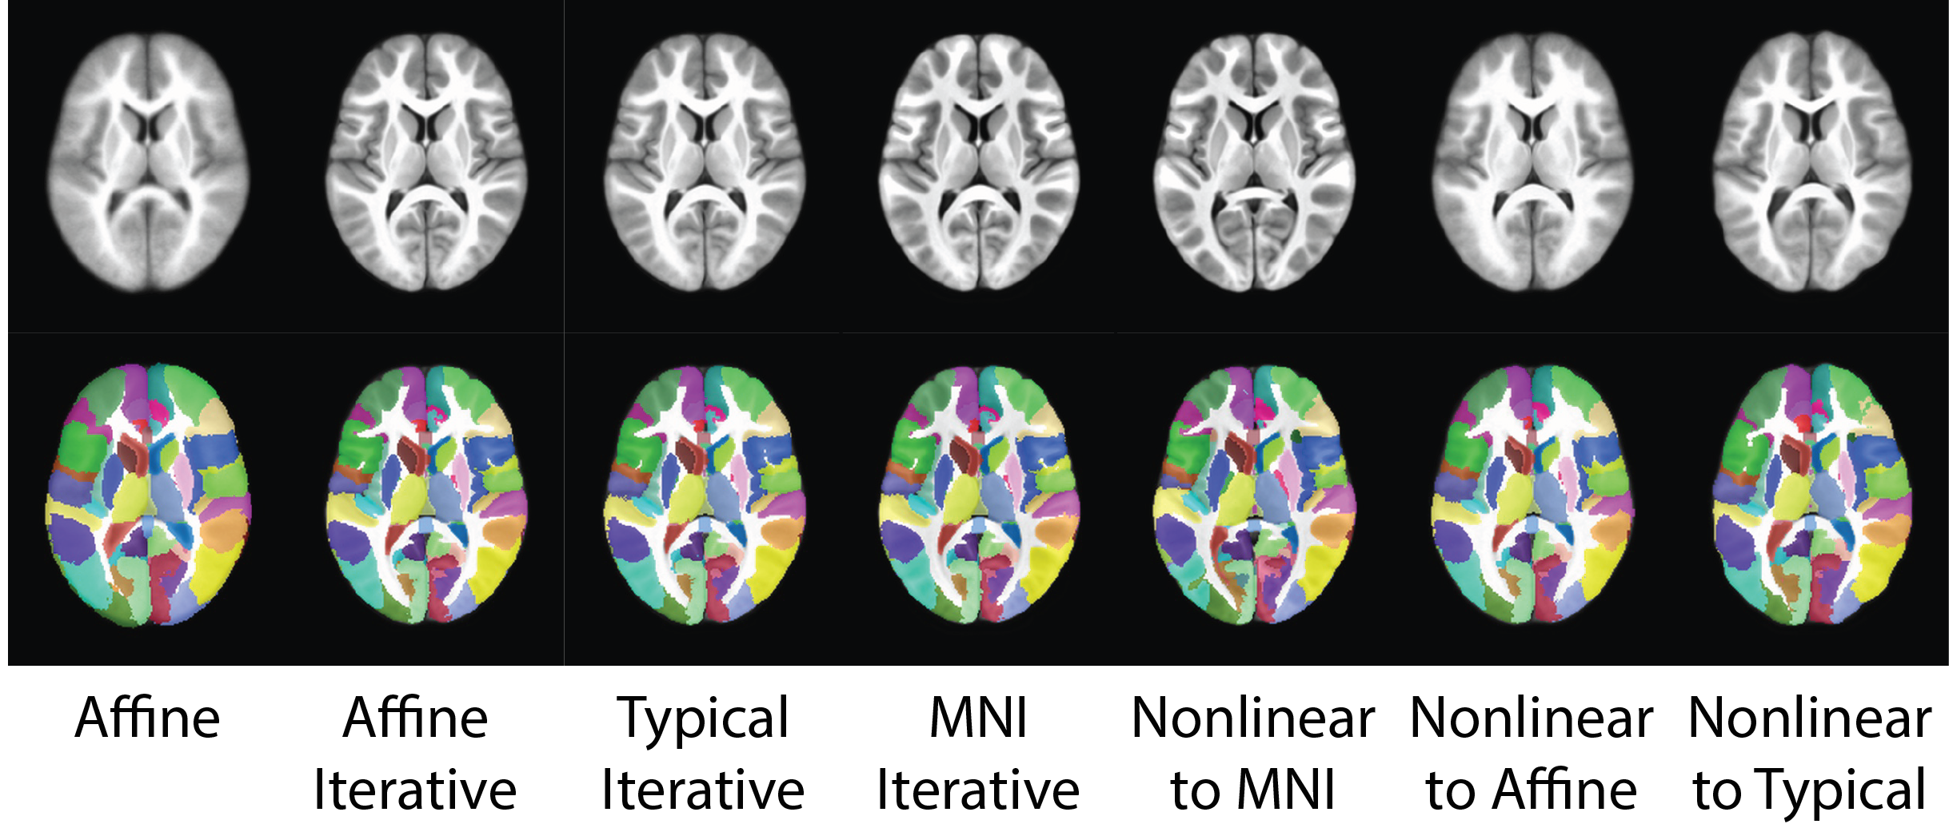
ALTERNATIVE ATLAS CREATION TECHNIQUES: ITERATIVE AND TYPICAL METHODS
B
C
Iterative nonlinear alignment to affine template with progressively smaller patch sizes
“Typical”
Brain

Slide 48
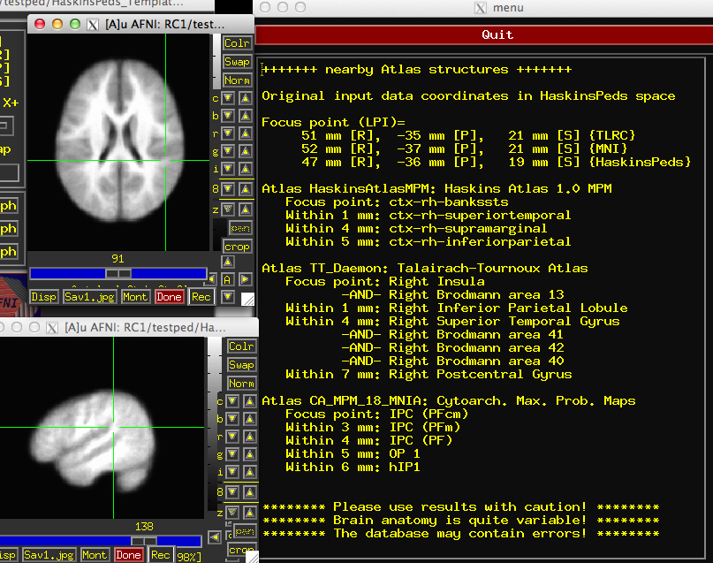
Haskins Pediatric Atlas

Slide 49
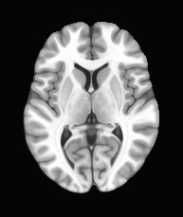
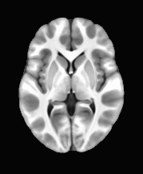
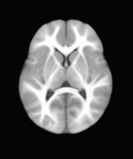
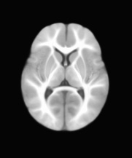
Templates and Atlases across Species in AFNI

Slide 50
Atlases and Templates Available!
Infant brain atlas and templates – neonate, 1-year, 2-year. Contributed by Feng Shi, UNC
Cerebellum atlas and templates – Jorn Diedrichsen,UCL,UK contribution

Slide 51
More Atlases and Templates Available!
Ventromedial Prefrontral Cortex (vmPFC, Scott Mackey)
Waxholm Rat Atlas - Papp, et al.
Rat brain templates in Paxinos space – Karolinska Institute, Woo Hyun Shim MGH contributions
BNST – Torrisi, NIMH
All of these are user requests or contributions!
What do you need?

Slide 52
Even More Atlases and Templates Available!
Brainnetome
Allen Mouse Brain
All of these are user requests or contributions!
What do you need?

Slide 53
Saleem macaque atlas – MRI, surfaces, connections, supplemental webpages
@Install_D99_macaque - install templates, atlas and set AFNI variables

Slide 54
Saleem macaque atlas – MRI, surfaces, connections, supplemental webpages (in development)

Slide 55
Mapping the digital atlas onto different macaques MRI
A
D99 – Digital atlas
V. small female
D
Reveley, Gruslys, Ye, Samaha, Glen,
Saad, Seth, Leopold, and Saleem
(in preparation)
big male
Spatial transformation of the atlas segmentation to each macaque's native space
B
small female
E
medium female
small male
C
F
Notes:
Atlas and template application
Using five naive macaques, we aligned each macaque's T1 brain MRI to the template created here with a sequence of affine and nonlinear registration steps. An initial affine step proved and approximate scaling. A small amount of nonlinear warping was then used to warp the general brain shape to the template. A brain-only mask from the template was applied to the individual subject brains and the subject was more finely warped to the template by progressively smaller nonlinear warps. This procedure resulted in subject brain data to be registered to the D99 template space. In order to demonstrate the applicability of the atlas to each macaque, the combination of affine and nonlinear transformations were used to warp the atlas segmentation back to each subject's original native space. The results are shown in in figure XXX…
<number>

Slide 56
NMT (NIH Macaque Template)
Group template from 31 macaques (+ surfaces, GM/WM/CSF segmentation)
https://github.com/jms290/NMT
https://afni.nimh.nih.gov/pub/dist/atlases/macaque/nmt/
https://github.com/jms290/NMT
(Seidlitz, et al., 2017)

Slide 57
NIH Marmoset Template
Individual marmoset template - 150um resolution
(Liu, Ye, Yen, Newman, Glen, Leopold, Silva, 2018)

Slide 58
2018: improved NIH Marmoset Template
@Install_NIH_Marmoset
@Install_NIH_Marmoset
(Liu et al., 2018, SfN)

Slide 59
Individual Subjects
@SUMA_MakeSpecFS – atlasizes too!
FreeSurfer segmentation
Overlay panel shows structure name. Now FreeSurfer segmentation can also be used in whereami.
Manual segmentation

Slide 60
In Development
New templates and template spaces – fully supported in AFNI
macaque
rat, mouse, (zebrafish?)
human
toddler, elderly, Indian
Extra information about atlas structures – long names, web links, ….
HAWG standardized format – atlases for everyone!
HCP Atlas - Glasser → Megan Robinson and Mike Beauchamp

Slide 61
Indian Brain Template C2: IBT

Slide 62
Preprocessing
(center, skullstrip, unifize)
Nonlinear mean
(resize, unifize/anisosmooth)
Rigid mean
Nonlinear means
Final mean
Affine subjects and mean
Nonlinear warps
Nonlinear warps-
resized
Rigid subjects
Dask Template task graph

Slide 63
Upcoming atlases
Eickhoff-Zilles 2.2 cytoarchitectonic atlas
Version 2.2 vs Version 1.8

Slide 64
Upcoming atlases
Jurgen Mai Human Brain Atlas -
Brodmann Areas!

Slide 65
Zebrafish atlas 2 micron data!
Harold Burgess, NIH

Slide 66
Supplements
extra stuff
Notes:
-rat_align sets blur size and neighborhood size for 3dAllineate’s LPC and rat option for 3dSkullStrip though it’s not used here
<number>

Slide 67
S1: Labeltables
Reading/creating labeltables
The text or string description of each ROI can be added to a dset by creating a “labeltable” that is either added to a file’s header or is a separate file pointed to in the header.
To view a labeltable on a dset:
3dinfo -labeltable DSET_NAME

Slide 68
S1: Labeltables
Reading/creating labeltables
The text or string description of each ROI can be added to a dset by creating a “labeltable” that is either added to a file’s header or is a separate file pointed to in the header.
To view a labeltable on a dset:
3dinfo -labeltable DSET_NAME
To make a labeltable and attach it to a file:
@MakeLabelTable \
-lab_file LABEL_FILE 1 0 \
-labeltable OUTPUT_LT \
-dset DSET_NAME
where LABEL_FILE contains one column of integer keys and one column of string values; OUTPUT_LT is the name for the created new table; and DSET_NAME is the dset it gets attached to.

Slide 69
S2: Manual transform to Talairach space using AFNI GUI
To start, right click on “DataDir” in the GUI or set AFNI_ENABLE_MARKERS to YES in ~/.afnirc.
Manual Transformation proceeds in two stages:
1) Alignment of AC-PC and I-S axes (to +acpc coordinates)
2) Scaling to Talairach-Tournoux Atlas brain size (to +tlrc coordinates)
Stage 1: Alignment to +acpc coordinates:
Anterior commissure (AC) and posterior commissure (PC) are aligned to be the y-axis
The longitudinal (inter-hemispheric or mid-sagittal) fissure is aligned to be the yz-plane, thus defining the z-axis
The axis perpendicular to these is the x-axis (right-left)
Five markers that you must place using the [Define Markers] control panel:
AC superior edge = top middle of anterior commissure
AC posterior margin = rear middle of anterior commissure
PC inferior edge = bottom middle of posterior commissure
First mid-sag point = some point in the mid-sagittal plane
Another mid-sag point = some other point in the mid-sagittal plane
This procedure tries to follow the Atlas as precisely as possible
Even at the cost of confusion to the user (e.g., you)

Slide 70
Press this IN to create or change markers
Color of “primary” (selected) marker
Click Define Markers to open the “markers” panel
Color of “secondary” (not selected) markers
Size of markers (pixels)
Size of gap in markers
Clear (unset) primary marker
Select which marker you are editing
Set primary marker to current focus location
Carry out transformation to +acpc coordinates
Perform “quality” check on markers (after all 5 are set)

Slide 71
Stage 2: Scaling to Talairach-Tournoux (+tlrc) coordinates:
Once the AC-PC landmarks are set and we are in ACPC view, we now stretch/shrink the brain to fit the Talairach-Tournoux Atlas brain size (sample TT Atlas pages shown below, just for fun)

Slide 72
Selecting the Talairach-Tournoux markers for the bounding box:
There are 12 sub-regions to be scaled (3 A-P x 2 I-S x 2 L-R)
To enable this, the transformed +acpc dataset gets its own set of markers
Click on the [AC-PC Aligned] button to view our volume in ac-pc coordinates
Select the [Define Markers] control panel
A new set of six Talairach markers will appear and the user now sets the bounding box markers (see Appendix C for details):
Talairach markers appear only when the AC-PC view is highlighted
Once all the markers are set, and the quality tests passed. Pressing [Transform Data] will write new header containing the Talairach transformations (see Appendix C for details)
Recall: With AFNI, spatial transformations are stored in the header of the output

Slide 73
@auto_tlrc Results are Comparable to Manual TLRCing
Comparison of results from “follower” func dsets: similar reduction in spurious voxels with high correlation.
Original
@auto_tlrc
Manual

