Slide 1


FMRI Task-Based Data Analysis at the Individual Level
SSCC/NIMH/NIH/DHHS/USA/Earth

Slide 2
Overview
Basics of linear models for data analysis
FMRI data decomposition: three components
  Baseline + slow drift + effects of no interest; Effects of interest; Noise
  Effects of interest – understanding BOLD vs. stimulus
    IRF and HRF and HDR
Three modeling strategies
  Fixed-shape HRF
  Variable HRF shape
  Fixed major HRF shape plus a little shape adjustment
Other issues
  Multicollinearity
  Run catenation
  Percent signal change

Slide 3
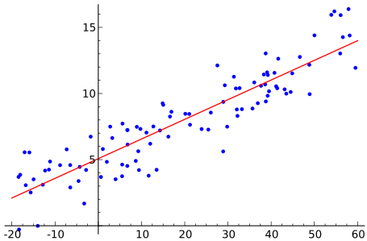
Basics of Linear Modeling
Regression: finding a relationship between a response/outcome (dependent) variable and one or more explanatory (independent) variables (regressors)
  Also called linear model or linear regression
Equations
  i=index of data = 0, 1, 2 … N-1 (total of N data points)
  x_{i}=explanatory model (known value) for data point number i
  y_{i}=data value for data point number i
  y_{i} = β₀ + β₁x_{i} + ε_{i} or y_{i} ≈ β₀ + β₁x_{i}
  β₀ and β₁ are model fit parameters
    to be calculated from the x_{i} and y_{i}
  ε_{i} are the residuals
    what are left after the regression
    assumed to be random noise

Slide 4
y_{i} = β₀ + β₁x_{i} + ε_{i} or y_{i} ≈ β₀ + β₁x_{i}
y
β₀ is the intercept
ε_{i}
β₁ is the slope
x

Slide 5
Modeling with Vectors and Matrices
Write the model y_{i} ≈ β₀ + β₁x_{i} out in columns (vectors)
In vector-matrix form (bold letters for vectors and matrices)
  y ≈ X β or with residual vector y = X β + ε
By writing it out this way, the equations become more compact and easier to look at and easier to understand
Each column of X matrix is a regressor or model component
We assume the columns of X are known (“the model”), and that data vector y is known (measured)
Goal is to compute parameter vector β (and statistics about β)
Most of this talk: where do we get X for FMRI task analysis?
y₀
y₁
y₂
…
1
1
1
…
x₀
x₁
x₂
…
1
1
1
…
x₀
x₁
x₂
…
β₀
β₁
≈
β₀ +
β₁ =
data vector
N×2 matrix

Slide 6
Solving a Linear Model
Vector y is sum of matrix X times vector β plus residuals ε
Solution for linear regression y = Xβ + ε
  “Project” data y onto the space of explanatory variables (X)
  OLS formula for solution:
  Columns of X are the model for data vector y
Meaning of coefficient: β_{k} value is slope, marginal effect, or effect size associated with regressor number k [column k in X]
β_{k} value says how much of regressor number k is needed to fit the data “best” – in the Ordinary Least Squares sense
  That is, the sum of the squares of ε_{i} is made as small as possible
If we don’t care about regressor number k, then we don’t care about the value of β_{k}
  But we included regressor number k in the model because it was needed to fit some part of the data
  Regressors of no interest make up the global Null Hypothesis in the model – in AFNI, we call these regressors the baseline model

Slide 7
Statistics in a Linear Model
Various statistical tests carried out after solving for β vector
Some examples, with particular null hypotheses H₀
  Student t-test for each β_{i} of interest
  H₀: β₃ = 0
  Student t-test for linear combination of some β_{i} values = general linear test (GLT)
  H₀: β₃ – β₅ = 0
  H₀: 0.5*(β₃ + β₄) – β₅ = 0
  F-test for composite null hypothesis
  H₀: β₃ = β₄ = β₅
  H₀: β₃ = β₄ = β₅ = 0
  Omnibus or Full F-test for the entire model
  H₀: all β_{i} values of interest are 0

Slide 8
Linear Model with FMRI
Time series regression: data vector y is time series = all values from one voxel throughout multiple image acquisitions (TRs)
Regressors: idealized BOLD response curves
  We can only find what we’re looking for
  Regression will miss something if we do not look for it
    So we must include regressors of no interest, so we can model things like baseline drifting up or down
  Regressor construction requires decisions
  Don’t want to over-fit or under-fit data
Same model matrix X for all voxels in the brain
  Simultaneously solve all the models (1 for each voxel)
  Voxel-wise analysis = “massively univariate” method
y₀
y₁
y₂
…
time

Slide 9
FMRI Experiment Terminology
Experiment setup
  Number of subjects
  Number of conditions [tasks, stimulus (trial, event) types]: Factorial design?
  Sample size (repetitions) per condition
  Block, event-related, or mixed?
  Inter-stimulus interval (ISI) – regular, random?
Scanning parameters: TR, voxel size, data points (volumes), slice sequence (sequential or interleaved), slice thickness, removing first few TRs
Scanning terms
  Run: continuous scanning; a brief break between runs
  Session: subjects come back after a long period of time
  Experiment or study

Slide 10
Types of FMRI Experiments
Two classical types of experiment design
  Block (boxcar) design
    Each stimulus block lasts for more than one TR (e.g., 4 to 20s)
    Each block is under one condition (e.g., watch a video clip), or a series of multiple trials (e.g., 10 consecutive blur images)
    BOLD response is often visible in time series
    SNR: noise magnitude about same as BOLD response
  Event-related design
    Each event or trial lasts for one TR or shorter
    Events are randomly spaced and/or sequenced in time
    BOLD response to stimulus tends to be weaker, since fewer nearby-in-time “activations” have overlapping signal changes
    SNR: data looks more like noise (to the pitiful human eye)
Mixed designs
  Containing both events and blocks, e.g., cue + video watching
Continuous stimulation (e.g., movie watching)
  Not covered here – more like resting state analysis

Slide 11
FMRI Data
Data partition: Data = Signal + Noise
  Data = acquisition from scanner (voxel-wise time series)
  Signal = BOLD response to stimulus; effects of interest + no interest
    We don’t actually know the real signal shape to look for!!!
    Look for idealized task responses by assuming a fixed shape for BOLD effect (FMRI response) for each task trial
    Or search for signal shape via repeated trials and basis functions
    Of interest: effect size (response amplitude) for each task: beta
    Of no interest: baseline, slow drifts, head motion effects, …
  Noise = components in data that interfere with signal
    Practically: the part of the data we can’t explain with the model
    Will have to make some assumptions about its probability distribution – to be able to carry out the statistical tests
Data = baseline + slow drift + other effects of no interest + response₁ + … + response_{k} + noise
How to construct the regressors of interest (responses)?

Slide 12
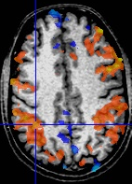
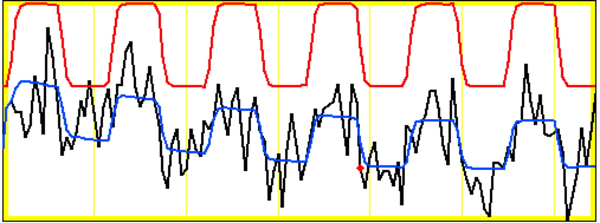
Block data of one run at a voxel
model regressor
model fitted to data
Noise ~ same size as signal change
data
Block: 27 s “on” / 27 s “off”; TR=2.5 s; 130 time points
This is “best” voxel; most voxels are not fitted as well as this
Data drifts downwards – this effect is captured in the model fit by baseline drift regressors
  If we did not model for drift, our fit would not be as good
Activation amplitude and shape vary across blocks
  Reasons why? We can only guess
  Habituation? Attention? Noise?

Slide 13
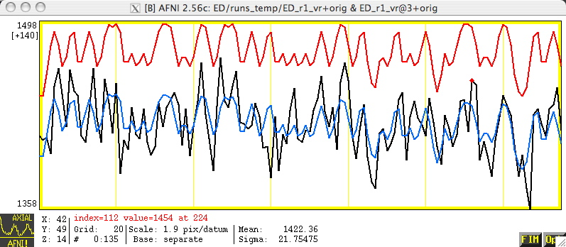
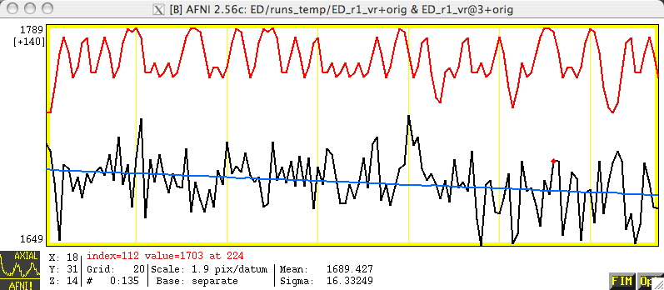
Event-Related Data at 2 Voxels
correlation with ideal = 0.56
Voxel activated
Voxel not activated
correlation with ideal = – 0.01
Lesson: ER-FMRI activation is not obvious via casual inspection

Slide 14
BOLD Response
Hemodynamic response (HDR)
  Brain+FMRI response to stimulus/task/condition
  Indirect measure of neural response: brain activation➔ changes in blood oxygen➔changes in FMRI signal
Hemodynamic response function (HRF)
  Mathematical formulation/idealization of HDR for one full stimulus interval
  HRF bridges between neural response (what we like) and BOLD signal (what we measure)
How to build the bridge?
  Most simple: Assume a fixed-shape (idealized) HRF
  Most complex: No assumption about HDR shape
    Basis function expansion of HRF shape and size
  In the middle: 1 major fixed shape + a little space for shape adjustment

Slide 15
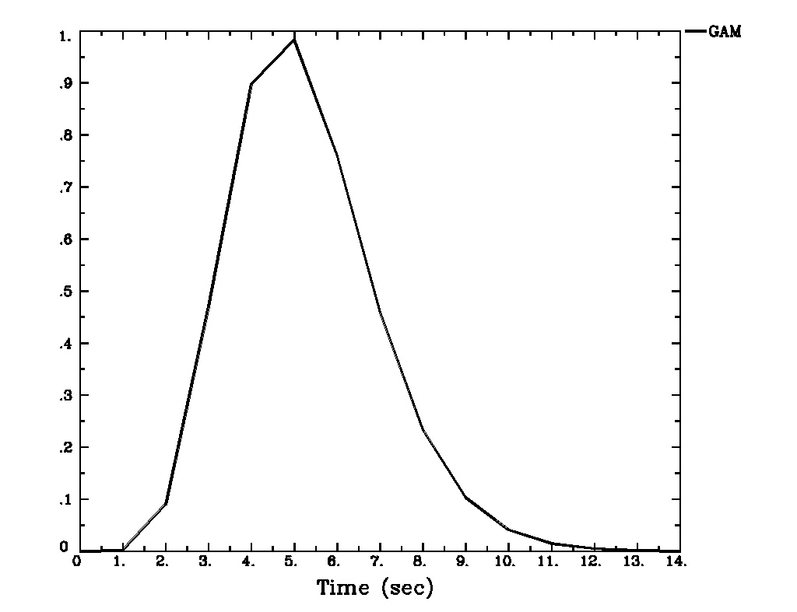
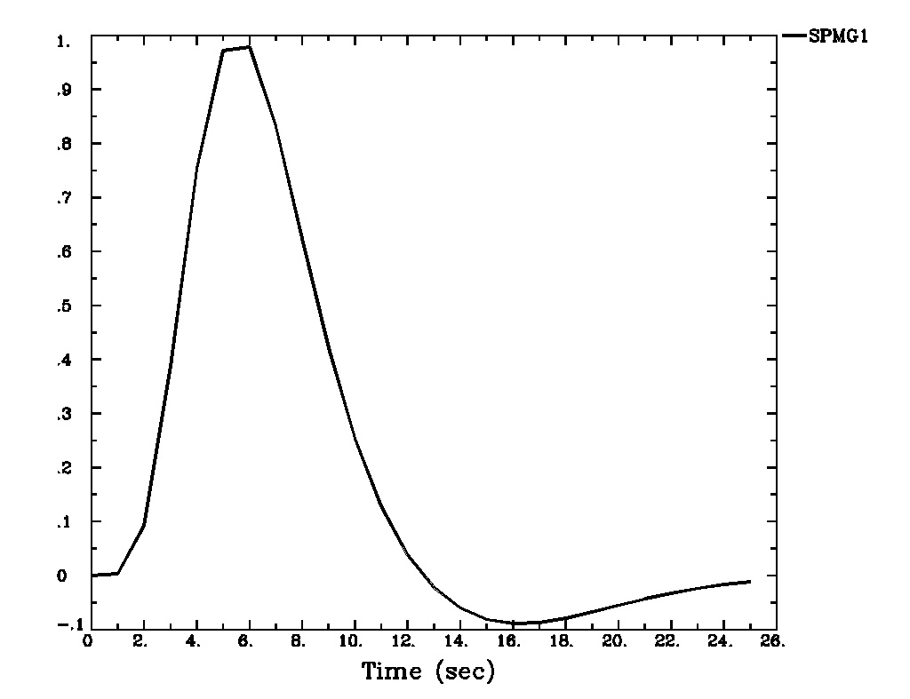
Fixed-Shape HRF – 1 s Stimulus
Assume a fixed shape h(t) for HRF to an instantaneous (very short) stimulus: impulse response function (IRF)
  GAM(p,q): h(t) = t ^{p} exp(t/q) for power p and time q
    Sample IRF: h(t) = t ^{8.6} exp(-t/0.547) [MS Cohen, 1997]
    A variation: SPMG1 (undershoot is added in)
  Build HRF based on presumed IRF through convolution
    Combine IRF h(t) with stimulus timing S(t):
GAM
SPMG1
Short
Stimulus
(≤ 1s)

Slide 16
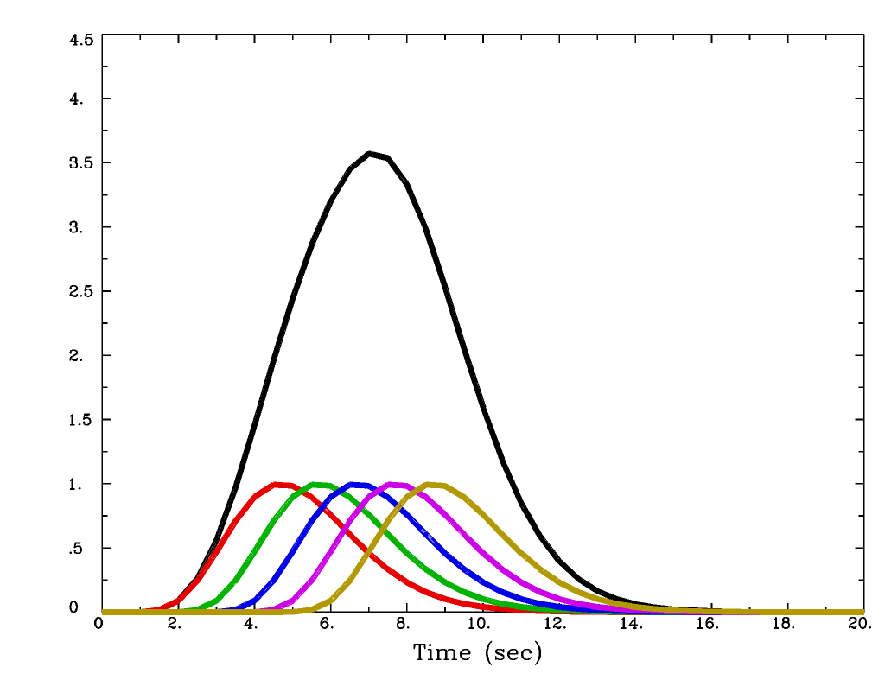
Fixed-Shape HRF – 5 s Stimulus
  Combine IRF h(t) with stimulus timing S(t):
Cannot distinguish individual responses to nearby stimuli with FMRI
Sum of 5 copies of GAM
Copies of GAM
= h(t) 1 s apart

Slide 17
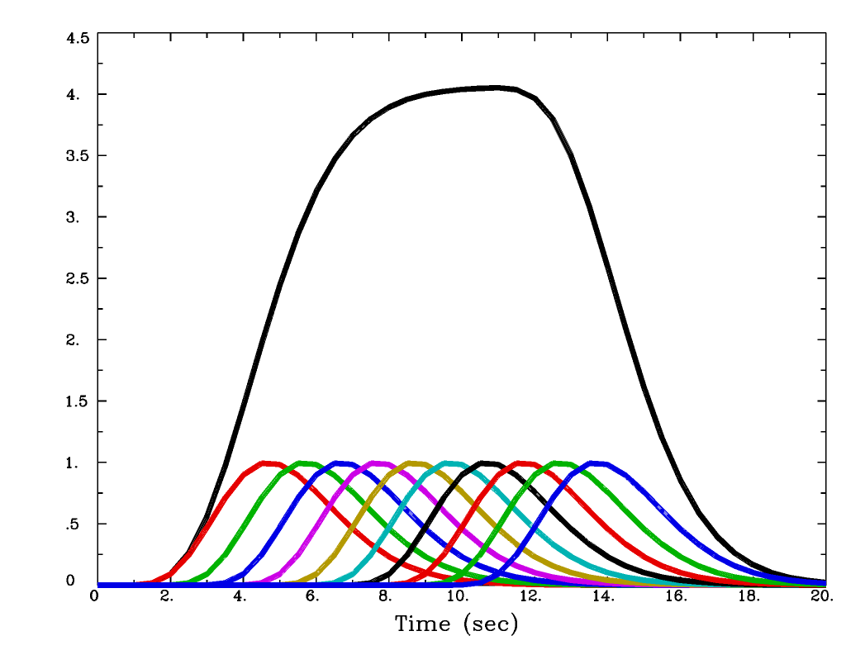
Fixed-Shape HRF – 10 s Stimulus
  Combine IRF h(t) with stimulus timing S(t):
Stimulus duration
longer than 10 s is
Block Design
Sum of 10
copies of GAM

Slide 18
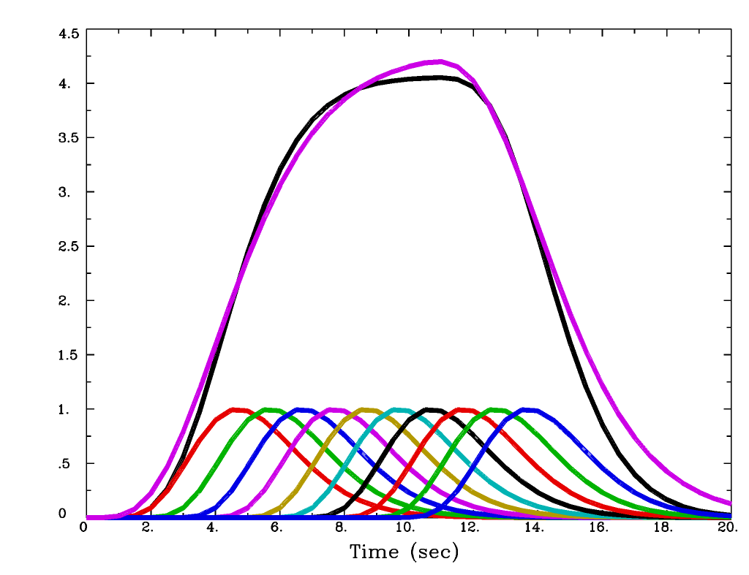
Fixed-Shape HRF – 10 s Stimulus
  With the ‘BLOCK(10)’ function in AFNI
BLOCK(d) function is used to specify HRF for individual responses to stimuli with duration d
HRF = BLOCK(10)

Slide 19
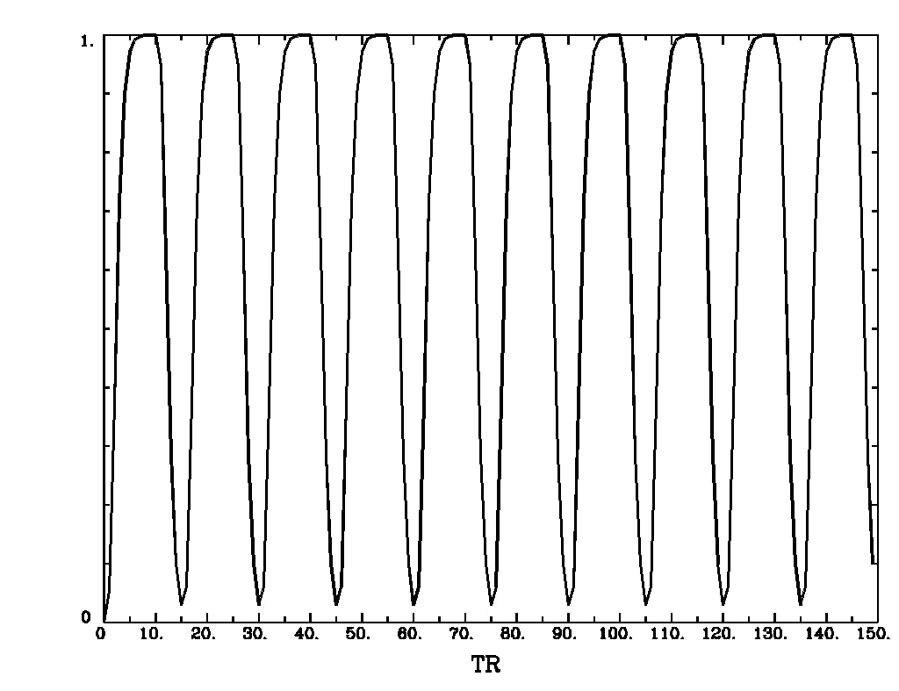
Fixed-Shape HRF for Block Design
Assuming a fixed shape h(t) for IRF to an instantaneous (very short) stimulus
  For each block, h(t) is convolved with stimulus timing and duration (d) to get idealized response (temporal pattern) as an explanatory variable (regressor): HRF = BLOCK(d,p)
    Equivalent to adding up a series of consecutive events
    scale HRF to p=1 for easy interpretation of β
HRF = BLOCK(20,1)
Start times for each block
Block: 20 s on and 10 s off; TR=2 s; 150 time points

Slide 20
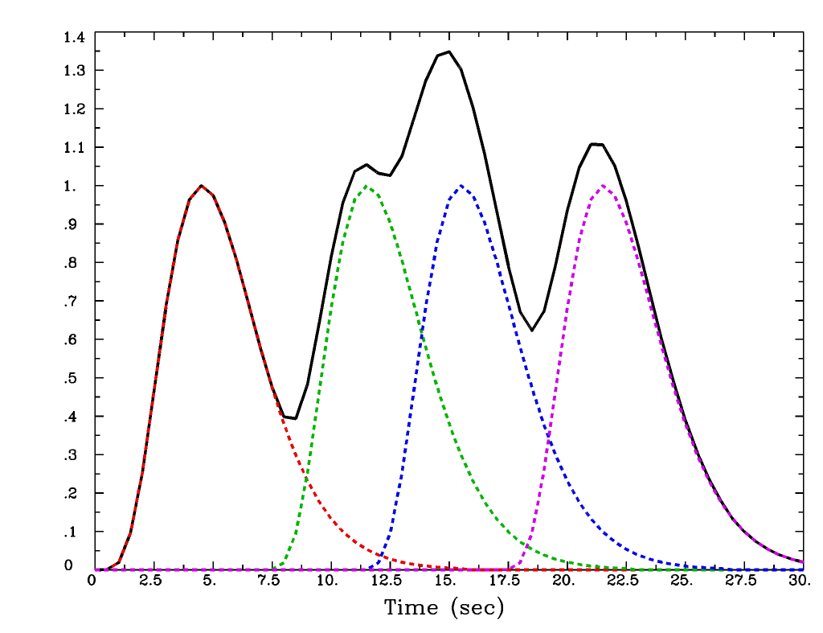
Fixed-Shape HRF for Event-Related Design
The BLOCK HRF shape is useful with event-related experiment designs
Just use a short duration, such as 1 second
Real experiments have more than 4 task repetitions!
Start times for each 1 s event
HRF = BLOCK(1,1)
Sum of 4 individual HRFs gives the regressor for this task

Slide 21
Linear Model with Fixed-Shape HRF
  FMRI data = baseline + drift + other effects of no interest + response₁ + … + response_{k} + noise
  ‘baseline’ = baseline + drift + other effects of no interest
    Drift: physiological effect, tiny motions, scanner fluctuations
    Data = ‘baseline‘ + effects of interest + noise
    Baseline condition (and drift) is treated in AFNI as baseline model, an additive effect, not an effect of interest (cf. SPM/FSL)
    Baseline+drift+… also need parameters in the model fit
  y_{i} = α₀ + α₁ t_{i} + α₂ t_{i}² + β₁x_{1i} +… + β_{k}x_{ki} +…+ ε_{i} [i = time]
  y = Xβ + ε, X = [1, t, t², x₁, x₂, …, x_{k}, …] [vector format]
  In AFNI baseline + slow drift is modeled with polynomials
    A longer run needs a higher order of polynomials
      One polynomial order per 150 sec is the default in AFNI
    With m>1 runs, m sets of polynomials needed to allow for temporal discontinuities across runs
    m(p+1) columns for baseline+slow drift with p-order polynomials
  Other effects of no interest: head movement estimates

Slide 22
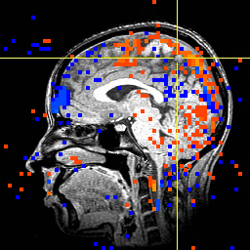
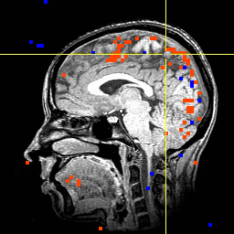
Stimulus Correlated Motion = Bad
Activation map with image registration but without using movement estimates as regressors
Activation map when also using movement estimates as regressors

Slide 23
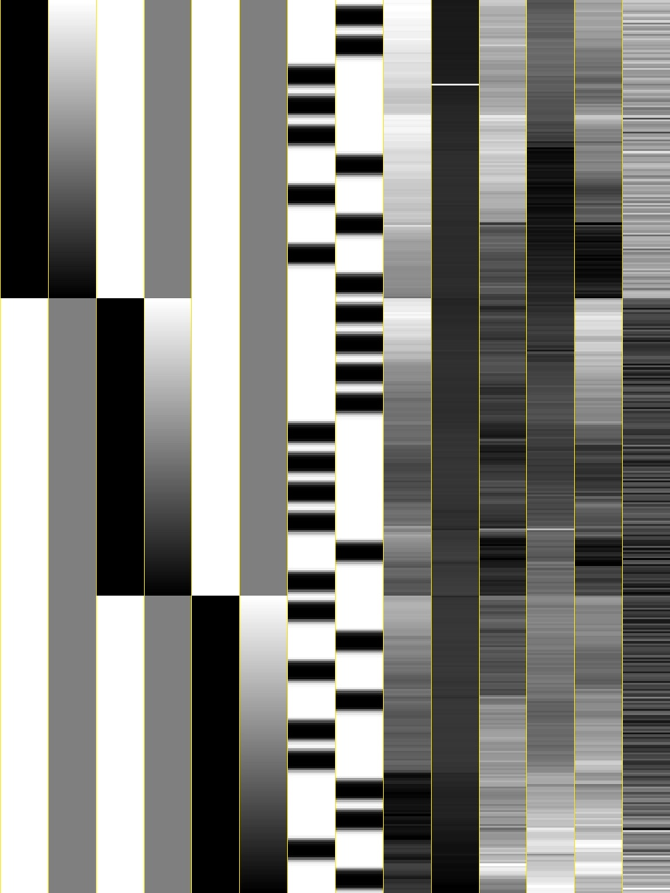
Design Matrix with Fixed-Shape HRF
Voxel-wise (massively univariate) linear model: y = Xβ+ε
  X: explanatory variables (regressors) – same across voxels
  y: data (time series) at a voxel – different across voxels
  β: regression coefficients (effects) – different across voxels
  ε: anything we can’t account for – different across voxels
Visualizing design matrix X = [1, t, x₁, x₂, …, x_{k}, …] in grayscale image
}
}
baseline + drift
stimuli
head motion
}
6 drift effect regressors
  linear baseline
  3 runs x 2 parameters/run
2 regressors of interest
  that is, relevant to brain activity
6 head motion regressors
  3 rotations + 3 shifts
Black = bigger numbers
White = smaller numbers
Each column of X scaled separately

Slide 24
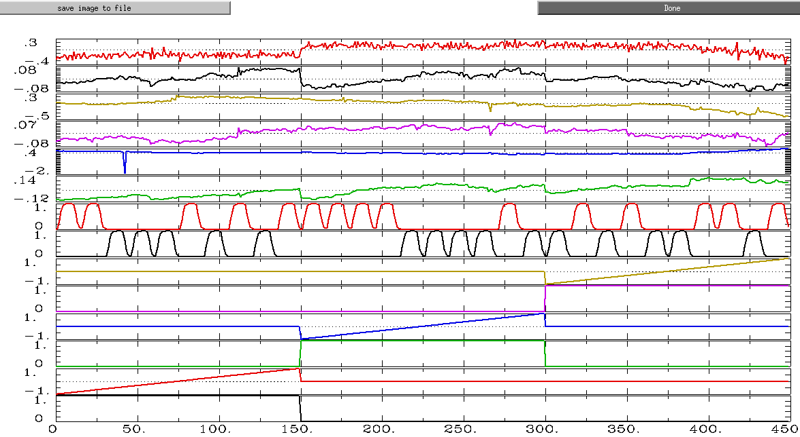
Design Matrix with Fixed-Shape HRF
Visualizing same design matrix X = [1, t, x₁, x₂, …, x_{k}, …] in graphs

Slide 25

Model Quality Check
First thing to do!
  Unfortunately most users in FMRI simply jump to specific effects of interest, their contrasts and their significance. They simply don’t pay any attention (or lip service) to overall model performance at all!
Approaches to judge your model
  Design matrix report from 3dDeconvolve
  Full F-statistic (automatically provided in AFNI); testing
    Data = ‘baseline‘ + effects of interest + noise versus
    Data = ‘baseline‘ + noise
  or, Determination coefficient R² at activated regions (-rout in 3dDeconvolve):
    Block design: ~50%
    Event-related experiments: 10-20%
  Modeled vs. not modeled: –fitts and –errts in 3dDeconvolve
    Fitted curve = ‘baseline‘ + effects of interest
    Residuals = noise = components we have no idea about
This message is usually due to setup mistakes

Slide 26
Statistical Testing
Everything is about contrast!
Effects (regression coefficients) of interest
  β: effect relative to baseline condition (by default in AFNI)
    β_{A} = Effect_{A} - β_{base}
  t-statistic: statistical significance of a β
Pairwise comparisons (contrasts)
  Conditions β_{A} vs. β_{B} (e.g., house vs. face)
    β_{A} – β_{B} = (Effect_{A} - β_{base}) – (Effect_{B} - β_{base}) = Effect_{A} - Effect_{B}
  t-statistic: statistical significance of this difference
General linear test – linear combination of multiple effects
  t-statistic of 0.5*happy + 0.5*sad – neutral
Composite tests
  F-statistic for composite (multi-part) null hypotheses: happy = sad = neutral = 0 [3 parts]; or, happy = sad = neutral [2 parts]

Slide 27
Assessing Fixed-Shape HRF Approach
Used 99% of time: Why is it popular?
  Assume brain responds with same shape across 4 levels: subjects, activated regions, stimulus conditions/tasks, trials
    Difference in magnitude β in different conditions or different subjects (and its significance) is what we focus on
    Strong assumption about four levels of shape information?
  Easy to handle and think about: one value per effect/task
  Works relatively well
    Block design: shape usually not important due to accumulating effects (modeled via convolution) of consecutive events
      Really plateau? Same magnitude across blocks?
    Event-related experiment: OK most of time
      Linearity when responses overlap? Same effect across events?
Not what you want if you
  Care/worry about shape difference across subjects, across regions, across conditions, and across trials
  Improved modeling

Slide 28
Alternative: No Constraint on HRF Shape
TENT expansion of HRF
  Set multiple tents at various equally-spaced locations to cover the potential BOLD response period
    Each TENT is a basis function
    HRF is a sum of multiple basis functions, each with its own β
  BOLD response measured by TENT heights (βs) at all locations
  TENTs are also known as ‘piecewise linear splines’
TENT with unit height
at location 3•TR
h
Formula for standardized TENT centered at x=0, width=±1
time
Cubic splines (CSPLIN)
are also available in AFNI
t = 0
t =TR
t = 2•TR
t = 3•TR
t = 4•TR
t = 5•TR

Slide 29
Σ Tent Functions = Linear Interpolation
5 equally-spaced TENT functions = linear interpolation between “knots” with TENTzero(b,c,n) = TENTzero(0,12,7)
TENT parameters are easily interpreted as function values (e.g., L: TENT radius; β₂ = response (TENT height) at time t = 2L after stimulus onset)
Relationship of TENT spacing L and TR (L ≥ TR), e.g., with TR=2s, L=2, 4s
In uber_subject.py or 3dDeconvolve with TENTzero(0, D, n), specify duration (D) of HRF and number (n): radius L = D/(n-1) with (n-2) full tents, each TENT overlaps half tent with two neighboring ones.
  In above example, D=12s, then L=2s n=7; covering 12s; TENTzero(0,12,7)
h
β₂
β₃
6 intervals = 5 β weights
stimulus onset
β₁
β₄
β₅
“knot” times
time
0
L
2L
3L
4L
5L
6L

Slide 30
Tent Functions Create the HRF
And then the HRF is repeated for all stimuli of the same type
In the example on the last slide, the HRF has 5 parameters (βs) to be estimated
The βs determine the amplitude (percent signal change) and the shape of the HRF
Each voxel in each subject gets a separate HRF shape now, not just a separate amplitude
  And if there are multiple types of tasks, each task gets a separate shape
Stimulus times do not have to be exactly on the TR grid

Slide 31
Modeling with TENTs - Example
Event-related study (Beauchamp et al., J Cogn Neurosci 15:991-1001)
  10 runs, 136 time points per run, TR=2 s
  Two factors
    Object type: human vs. tool
    Object form in videos: real image vs. points
  4 types (2x2 design) of stimuli (short videos)
    Tools moving (e.g., a hammer pounding) - ToolMovie
    People moving (e.g., jumping jacks) - HumanMovie
    Points outlining tools moving (no objects, just points) - ToolPoint
    Points outlining people moving - HumanPoint
  Goal: find brain area that distinguishes natural motions (HumanMovie and HumanPoint) from simpler rigid motions (ToolMovie and ToolPoint)

Slide 32
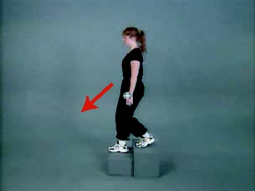
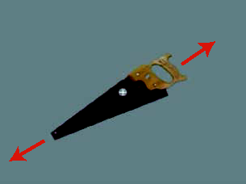
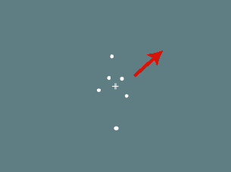
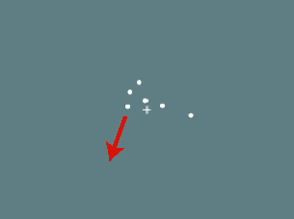
Experiment: 2 x 2 design
  Human whole-body motion (HM)
Tool motion (TM)
Human point motion (HP)
Tool point motion (TP)
From Figure 1
Beauchamp et al. 2003
  Hypotheses to test:
  Which areas are differentially activated by any of these stimuli (main effect)?
    point motion versus natural motion? (type of image)
    human-like versus tool-like motion? (type of motion)
  Interaction effects?
    Point: human-like versus tool-like? Natural: human-like versus tool-like?
    Human: point versus natural? Tool: point versus natural?

Slide 33

Tool motion (TM)
Human point motion (HP)
Tool point motion (TP)
From Figure 1
Beauchamp et al. 03
Each video is only shown once (2 seconds)

Slide 34
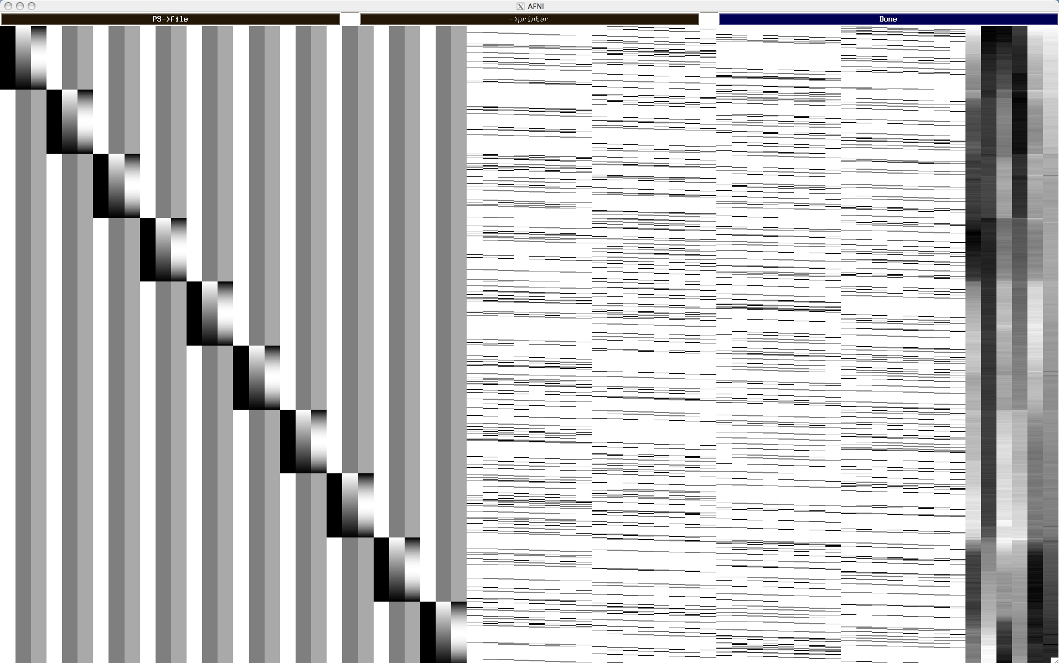
Design Matrix with TENTzero(0,16,9)
Baseline + quadratic trend for 10 runs
7 tents per condition × 4 conditions
head motion

Slide 35
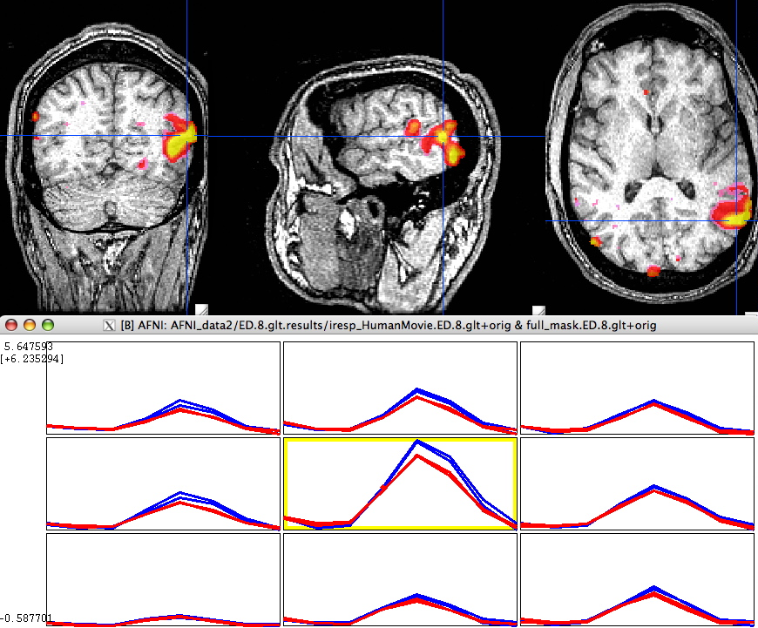
Results: Humans vs. Tools
Color overlay: Human vs Tool
(β_{HM}+β_{HP}−β_{TM}−β_{TP})
Blue (upper) : Human
Red (lower) : Tool

Slide 36
No Constraint on HRF Shape = Deconvolution
Deconvolution perspectives: inverse process of convolution
  HRF stimulus = unit BOLD response
    Like multiplication, we have to know two and estimate the 3rd
  Fixed-shape approach: Convolution + regression
    Known: HRF shape, stimulus
    Use convolution to create regressors (hidden from user inside 3dDeconvolve program)
    Response strength (β) estimated via linear model with programs 3dDeconvolve or 3dREMLfit
  Shape estimation: Deconvolution + regression
    Known: stimulus + BOLD response; unknown: impulse response
    HRF stimulus = BOLD response (note: HRF, not IRF)
    HDR estimated as a linear combination of multiple basis functions: TENTs
    Each TENT stimulus = one regressor column
    Deconvolution: HRF = a set of βs estimated via regression

Slide 37
No Constraint on HRF Shape: Pros + Cons
What is the approach good at?
  Usually for event-related experiments, but can be used for BLOCK
    Multiple basis functions for blocks: within-block attenuation with time
  Likely to have more accurate estimate on HDR shape across
    subject
    conditions/tasks
    brain regions
  Likely to have better model fit (the goal in the sample experiment)
  Likely to be statistically more powerful on test significance
  For block design, may detect within-block attenuation
    Cross-block attenuation?
Why is the approach not popular?
  Difficult to summarize at group level [see the program 3dMVM]
    Multiple parameters (βs) per task condition, instead of just one
  More regressors than alternatives: DoF’s per subject
  Risk of highly correlated regressors: Multicollinearity
    May need to reduce the number of basis functions
  Over-fitting: picking up something (head motion) unrelated to HDR

Slide 38
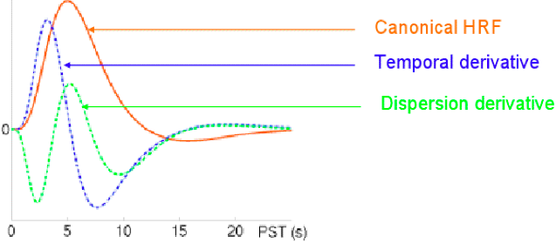
Intermediate Approach: SPMG1/2/3
Use just a few basis functions
  Constrain the HDR shape with a principal basis function
    SPMG1 (similar to GAM in AFNI): e^{-t}(a₁t^{p1}-a₂t^{p2}) where a₁ = 0.0083333333 p1 = 5 (main positive lobe)
    a₂ = 1.274527e-13 p2 = 15 (undershoot part)
  2 or 3 basis functions: parsimonious, economical
    SPMG1+SPMG2+SPMG3
    SPMG2: temporal derivative capturing differences in peak latency
    SPMG3: dispersion derivative capturing differences in peak width

Slide 39
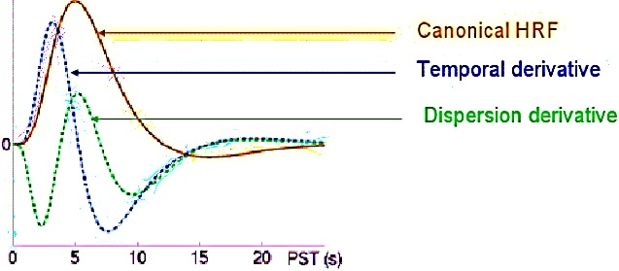
SPMG1/2/3
[Ready for their closeup, Mr. DeMille]
You can use these as basis functions in AFNI
We don’t usually recommend this
The next few talks show the details of how to choose the basis functions for the HRF

Slide 40
Multicollinearity
Voxel-wise regression model: y = Xβ+ε
  Regressors in design matrix X = [1, t, t², x₁, x₂, …, x_{k}, …]
Multicollinearity problem
  Two or more regressors highly correlated
  Difficult or impossible to distinguish the effects among these regressors (i.e., get reliable β estimates)
Multicollearity scenarios
  Collinearity - x_{i}= λx_{j} = model specification error; e.g., 2 identical regressors (mistake in stimulus timing specifications)
  Exact multicollinearity: linear dependence among multiple regressors = faulty design (rare)
  High degree of correlation (+ or -) among regressors = design problem (e.g., cue + movie watching)
  Too many basis functions in response model
Diagnosis tools: ExamineXmat.R, timing_tool.py, xmat_tool.py

Slide 41
Serial Correlation in Residuals
Why temporal correlation?
  In the residuals/noise (not the time series data)
  Short-term physiological effects (breathing, heartbeat)
  Other unknown reasons (scanner issues?)
What is the impact of temporal correlation?
  With white noise assumption, βs are unbiased, but the statistics tend to be inflated
  Little impact on group analysis – if only using βs from subjects
  May affect group analysis if considering effect reliability, as in AFNI’s 3dMEMA program (where βs and ts are used)
Approach in AFNI
  ARMA(1,1) noise model for residual time series correlation
  Slightly different from other packages:
    Serial correlation model is computed voxelwise, not globally
  Described in the Advanced Regression talk: 3dREMLfit

Slide 42
Dealing with Multiple Runs per Subject
Possible approaches
  Analyze each run separately: AFNI, FSL
    Have to have enough task repetitions per run
    Can test cross-run difference (trend, habituation) at group level
    Usually need to summarize multiple β’s before group analysis
  Concatenate but analyze with separate regressors across runs for each condition type: AFNI, SPM
    Can test cross-run difference (trend, habituation, etc.) at both individual and group level
    Still need to summarize multiple β’s before group analysis
  Concatenate but analyze with same regressor across runs for each condition type: default in AFNI
    Assumes no attenuation across runs
Cross-block (or cross-event) attenuation
    Method: IM or AM regression models
    cf. Advanced Regression talk

Slide 43
Percent Signal Change
Why conversion/scaling for %? Comparable across subjects
  MRI and BOLD data values don’t have any useful physical/physiological meaning
  Baseline is different across subjects (and possibly scaling)
  It’s the relative changes that can be compared across subjects
AFNI approach
  Pre-processing: data scaled by voxelwise mean
    % signal change relative to mean, not exactly to baseline
      Difference is tiny: less than 5% (since BOLD effect is small)
  Tied with modeling baseline as additive effects in AFNI
    Sometimes baseline explicitly modeled: in SPM and FSL
    Global mean scaling (multiplicative) for whole brain drift
    Grand mean scaling for cross-subject comparison: not %
    Global and grand mean scaling, although not usually practiced, can be performed in AFNI if desired

Slide 44
Percent Signal Change
Why not use scaled βs by real baseline???
  No catenation: scale β per run by the run’s baseline
    Sample size in each run could be low
    Have to summarize multiple βs before group analysis
    Simpler to convert to percent signal change at run level before summing over runs
    Be careful when motion parameters included in model
      Uber_subject.py automatically demeans the head motion regressors
  Catenation: problematic
    Baseline may be different across runs
    Effects are not comparable across runs

Slide 45
Lackluster Performance in Modeling
Essentially, all models are wrong, but some are useful (G.E.P. Box)
Noisy data: too easy excuse!
Regressors: idealized response model
  We find what we’re looking for
  We may miss something when we fail to look for it
Lots of variability across trials (response and noise)
  Amplitude Modulation if behavioral data are available
  Model each trial separately (Individual Modulation)
Linearity assumptions
  Data = baseline + drift + respone1 + resonse2 + … + noise
  When a trial is repeated, response is assumed same
  Response for a block = linearity (no attenuation)
Poor understanding of BOLD mechanism

Slide 46
Summary
Basics of linear model
FMRI data decomposition: three components
  Baseline + slow drift; Effects of interest; Unknown
  Effects of interest - understanding BOLD vs. stimulus: IRF
  Modeling with fixed-shape IRF: GAM(p,q), BLOCK(d,p)
Modeling with no assumption about IRF shape
  TENT(b,c,n) or CSPLIN(b,c,n)
Modeling with one major IRF plus shape adjustment
  SPMG1/2/3
Other issues
  Multicollinearity
  Catenation
  Percent signal change

