Slide 1
AFNI & FMRI Introduction, Concepts, Principles
http://afni.nimh.nih.gov/afni
Notes:
<number>

Slide 2
AFNI = Analysis of Functional NeuroImages
Developed to provide an environment for FMRI data analyses
And a platform for development of new software
AFNI refers to both the program of that name and the entire package of external programs and plugins (more than 200)
Important principles in the development of AFNI:
Allow user to stay close to the data and view it in many different ways
Give users the power to assemble pieces in different ways to make customized analyses
“With great power comes great responsibility”
— to understand the analyses and the tools
“Provide mechanism, not policy”
Allow other programmers to add features that can interact with the rest of the package
Notes:
<number>

Slide 3
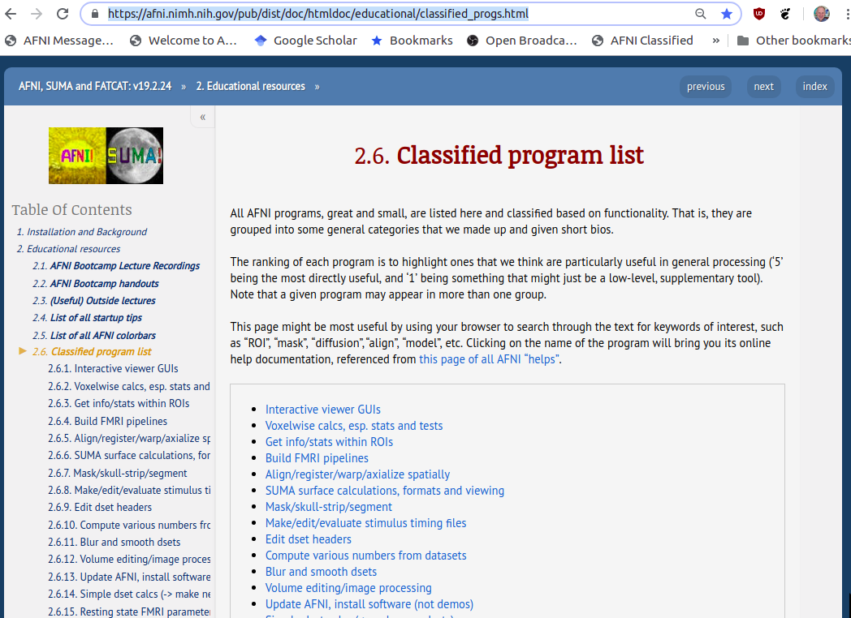

Slide 4
Principles (and Caveats) We* Live By
Fix significant bugs as soon as possible
But, we define “significant”
Nothing is secret or hidden (AFNI is open source)
But, possibly not very well documented or advertised
Release early and often
All users are beta-testers for life
Help the user (message board; consulting with NIH users)
Until our patience expires
Try to anticipate users’ future needs
What we think you will need may not be what you actually end up needing
*
Notes:
<number>

Slide 5
Before We Really Start
AFNI has many programs and they have many options
Assembling the programs to do something useful and good seems confusing (OK, is confusing) when you start
To help overcome this problem, we have “super-scripts” that carry out important tasks
Each script runs multiple AFNI programs
We recommend using these as the basis for FMRI work
When you need help, it will make things simpler for us and for you if you are using these scripts
afni_proc.py = Single subject FMRI pre-processing and time series analysis for functional activation
uber_subject.py = GUI for afni_proc.py
align_epi_anat.py = Image alignment (registration), including anatomical-EPI, anatomical-anatomical, EPI-EPI, and alignment to atlas space (Talairach/MNI)
Notes:
<number>

Slide 6
What is Functional MRI?
A
1991: Discovery that MRI-measurable signal increases a few % locally in the brain subsequent to increases in neuronal activity (Kwong, et al.)
Signal increase caused by change in H₂O surroundings: more oxygenated hemoglobin is present
Cartoon of MRI signal in a single “activated” brain voxel
D: 4-5 s
rise
E: 5 s plateau
Contrast
through
time
with no noise!
A: Pre-activation
baseline
C: ≈ 2 s
delay
G: Return to
baseline
(or undershoot)
time
B: 5 s neural activity
F: 4-6 s
fall
Notes:
<number>

Slide 7
How FMRI Experiments Are Done
Alternate subject’s neural state between 2 (or more) conditions using sensory stimuli, tasks to perform, ...
Can only measure relative signals, so must look for changes in the signal between the conditions
Acquire MR images repeatedly during this process
Search for voxels whose NMR signal time series (up-and-down) matches the stimulus time series pattern (on-and-off)
FMRI data analysis is basically pattern matching in time
Signal changes due to neural activity are small
Need 500 or so images in time series (in each slice) ➔ takes 30 min or so to get reliable activation maps
Usually break image acquisition into shorter “runs” to give the subject and scanner some break time
Other small effects can corrupt the results ➔ post-process the data to reduce these effects & be vigilant
Lengthy computations for image recon and temporal pattern matching ➔ data analysis usually done offline
Notes:
<number>

Slide 8
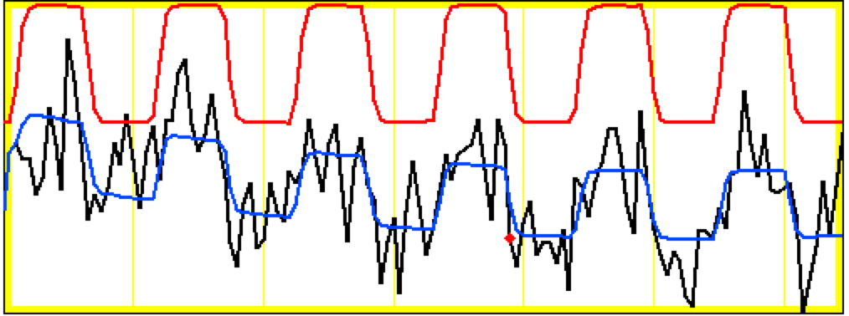
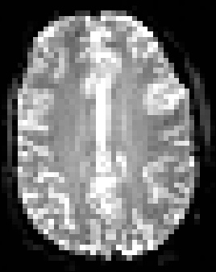
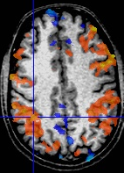
Sample Data Time Series
64×64 matrix (TR=2.5 s; 130 time points per imaging run)
Somatosensory task: 27 s “on”, 27 s “rest”
Note that this is really good data
pattern of expected BOLD signal
pattern fitted to data
data
One echo-planar image
One anatomical image, with voxels that match the pattern given a color overlay
Notes:
<number>

Slide 9
3D Individual Subject Analysis
Assemble images into AFNI-formatted datasets
to3d
OR
can do at NIH scanners
Check images for quality (visual & automatic)
afni + 3dToutcount
Register (realign) images
3dvolreg
OR
3dWarpDrive
Smooth images spatially
3dmerge
OR
3dBlurToFWHM
(optional)
Mask out non-brain parts of images
3dAutomask + 3dcalc (optional)
Normalize time series baseline to 100 (for %-izing)
3dTstat + 3dcalc
(optional: could
be done post-fit)
Fit stimulus timing + hemodynamic model to time series
catenates imaging runs, removes residual movement effects, computes response sizes & inter-stim contrasts
3dDeconvolve
Segregate into differentially “activated” blobs
3dClustSim + 3dmerge
OR
Extraction from ROIs
Look at results, and ponder
afni
AND
your personal brain
… to group analysis (next page)
Notes:
<number>

Slide 10
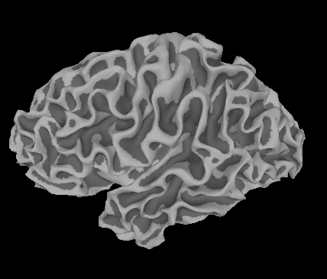
Group Analysis: in 3D or on folded 2D cortex models
Datasets of results
from individual
subject analyses
Construct cortical
surface models
Normalize datasets
to Standard “space”
Project 3D /results to
cortical surface models
OR
Smooth fitted
response amplitudes
Average fitted
response amplitudes
over ROIs
OR
Use ANOVA (etc) to combine + contrast results
View and understand results;
Write paper;
Start all over
Notes:
<number>

Slide 11
What is a volumetric data set?
How do I get one?

Slide 12
Abbrevs used here
abbrev = abbreviation
AKA = also known as
anat = anatomical
diff = difference
dset = dataset
e.g. = exempli gratia (= “for example”)
EPI = echo planar image
Ex = example
FOV = field of view
i.e. = id est (= “that is”)
ijk = coordinate indices (integer)
NB = nota bene (= “note well”)
phys = physics or physical
ref = reference
subj = subject
vol = volume
vox = voxel(s)
xyz = physical coordinates (units of mm)

Slide 13
Creating dsets from DICOM files
Data are often aquired as DICOM files
AFNI has several programs for creating BRIK-HEAD and NIFTI files from DICOMs
One has to be careful with DICOMs- not really standardized (booo!), fields/structure can change across scanner vendor, across version numbers, across acquisition sequences, and on the 3rd Tuesday after a blue moon.
Some AFNI programs:
+ dcm2niix_afni: Chris Rorden's popular program, distributed in AFNI (thx, Chris!)
- very general use, can create whole collection of dsets
- NB: NIFTI does not store complicated slice timings, so even if dcm2niix_afni can
find it, it can't be stored
- AFNI's 3drefit can be used to add slice timing info to the AFNI header extension
+ Dimon: R Reynold's creation, originally for sending "realtime FMRI" direct to AFNI
+ fat_proc_convert_dcm_{anat,dwis}: wrappers of dcm2niix_afni for DWI proc
+ and:
*Always* check your results carefully (left-right flips!) when converting from DICOM!
https://afni.nimh.nih.gov/pub/dist/doc/htmldoc/educational/classified_progs.html#dicom-info-and-conversion

Slide 14
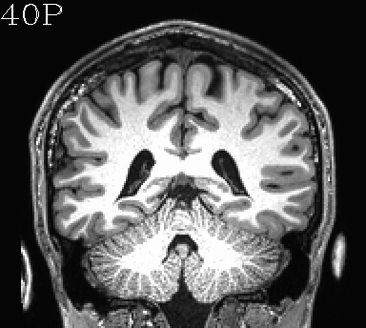
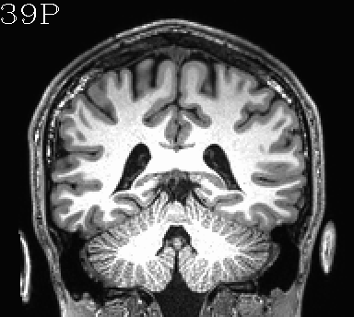
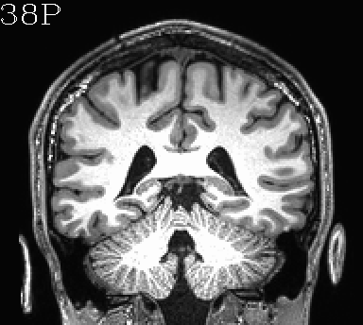
Volumetric data structure
What is a volumetric data set?

Slide 15
Volumetric data structure
What is a volumetric data set?
→ It a grid made up of voxels (basic case: 3D).
3D grid
voxel
dz
edges
dy
dx

Slide 16
Volumetric data structure
What is a volumetric data set?
→ It a grid made up of voxels (basic case: 3D).
3D grid
voxel
centroid
dz
edges
dy
dx
2 ways to describe each voxel location
+ “i, j, k”: integer indices, counting voxels from one corner
- independent of voxel size (just storage indices on disk)
+ “x, y, z”: units of mm, physical location of voxel centroid
- depends on voxel size (dx, dy, dz)

Slide 17
Volumetric data structure
What is a volumetric data set?
→ It a grid made up of voxels (basic case: 3D).
Each voxel contains a number, which is represented by a color (gray, RGB, etc.).
3D grid
voxel
centroid
dz
edges
dy
dx
color mapping
4
2 ways to describe each voxel location
+ “i, j, k”: integer indices, counting voxels from one corner
- independent of voxel size (just storage indices on disk)
+ “x, y, z”: units of mm, physical location of voxel centroid
- depends on voxel size (dx, dy, dz)

Slide 18
Volumetric data structure
What is a volumetric data set?
→ It a grid made up of voxels (basic case: 3D).
Each voxel contains a number, which is represented by a color (gray, RGB, etc.).
A time series data set is an ordered set of 3D vols (→ a ‘4D data set’).
3D grid
… at t=0
… at t= 1TR
… at t= 2TR
… at t= 3TR
…

Slide 19
Volumetric data structure
What is a volumetric data set?
→ It a grid made up of voxels (basic case: 3D).
Each voxel contains a number, which is represented by a color (gray, RGB, etc.).
A time series data set is an ordered set of 3D vols (→ a ‘4D data set’).
3D grid
3D grid + time dimension
→ “4D data set”
+ Can talk about time as “t” in physical units of seconds, or as “n” in index units of simple counting.
… at t=0
… at t= 1TR
… at t= 2TR
… at t= 3TR
…

Slide 20
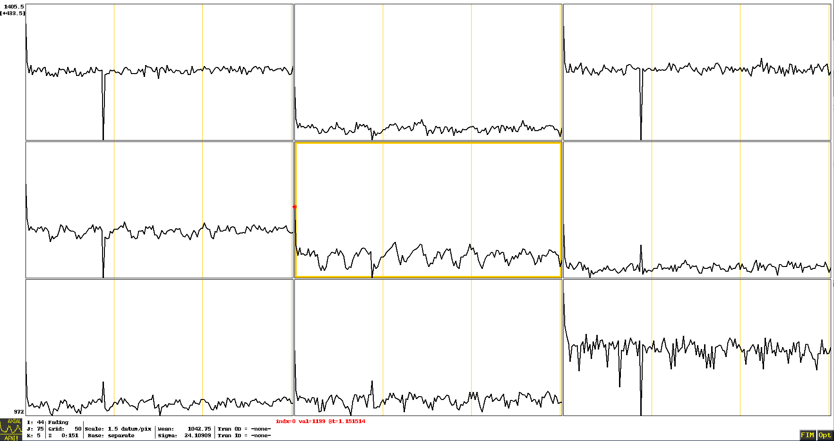
Volumetric data structure
What is a volumetric data set?
→ It a grid made up of voxels (basic case: 3D).
Each voxel contains a number, which is represented by a color (gray, RGB, etc.).
A time series data set is an ordered set of 3D vols (→ a ‘4D data set’).
3D grid
3D grid + time dimension
→ “4D data set”
+ Can talk about time as “t” in physical units of seconds, or as “n” in index units of simple counting.
+ Also say that each voxel contains a “time series”, e.g.:
… at t=0
… at t= 1TR
… at t= 2TR
… at t= 3TR
…

Slide 21
*AFNI terminology sidenote*
What is a volumetric data set?
→ It a grid made up of voxels (basic case: 3D).
Each voxel contains a number, which is represented by a color (gray, RGB, etc.).
A time series data set is an ordered set of 3D vols (→ a ‘4D data set’).
3D grid
We often refer to a 3D volume as a brick, because, well, it is an example of a solid, similar-looking 3D shape.
…

Slide 22
*AFNI terminology sidenote*
What is a volumetric data set?
→ It a grid made up of voxels (basic case: 3D).
Each voxel contains a number, which is represented by a color (gray, RGB, etc.).
A time series data set is an ordered set of 3D vols (→ a ‘4D data set’).
3D grid
We often refer to a 3D volume as a brick, because, well, it is an example of a solid, similar-looking 3D shape.
Particularly in the context of 4D data sets, we also call a 3D volume a sub-brick.
This is an odd lingual quirk. But to date, this appears to be the only quirk in the AFNI software (or its developers).
…

Slide 23
*AFNI terminology sidenote*
Sub-brick selection by volume index
AFNI has a convenience feature of being able to select subset(s) of volumes for copying, calculation, etc. from a 4D set.
This works by putting the index or index range in square brackets and quotation marks "[ ]" ("" keep the terminal from interpreting the square brackets specially).

Slide 24
*AFNI terminology sidenote*
Sub-brick selection by volume index
AFNI has a convenience feature of being able to select subset(s) of volumes for copying, calculation, etc. from a 4D set.
This works by putting the index or index range in square brackets and quotation marks "[ ]" ("" keep the terminal from interpreting the square brackets specially).
A comma separates indices, and two dots .. specifies an (inclusive) range; $ means final volume. Ex.:
DSET"[0]" # initial subbrick (NB: count from 0!)
DSET"[0..5]" # subbricks 0,1,2,3,4,5
DSET"[3,5..8,19]" # subbricks 3,5,6,7,8,19
DSET"[1,14,29..$]" # subbricks 1,14,29-to-the-last
DSET[0,4,5,15] # ERROR in tcsh (no quotes); OK in bash
Ex. application, to copy out subset:
3dcalc -a DSET "[3,5..8,19]" -expr 'a' -prefix DSET_NEW
Fun fact: there are other forms of subbrick selection (brik label, voxel value...).

Slide 25
Grids
What are the grid’s properties?

Slide 26
Grids
What are the grid’s properties?
→ One is “size.” Three ways to describe it:
1) matrix size: count voxels in each dimension (n_{i} rows, n_{j} cols, n_{k} slices)
- independent of voxel size
2 vox,
3 vox,
k
j
i
6 vox

Slide 27
Grids
What are the grid’s properties?
→ One is “size.” Three ways to describe it:
1) matrix size: count voxels in each dimension (n_{i} rows, n_{j} cols, n_{k} slices)
- independent of voxel size
2) field of view (FOV): units of mm, 3D phys vol of all voxels
- depends on voxel size (dx, dy, dz)
2 vox,
2*dz
(mm)
3 vox,
k
z
j
y
3*dy
(mm)
i
x
6 vox, 6*dx (mm)

Slide 28
Grids
What are the grid’s properties?
→ One is “size.” Three ways to describe it:
1) matrix size: count voxels in each dimension (n_{i} rows, n_{j} cols, n_{k} slices)
- independent of voxel size
2) field of view (FOV): units of mm, 3D phys vol of all voxels
- depends on voxel size (dx, dy, dz)
3) slab: units of mm, phys dist between first & last centroids
- e.g., dist between [0]th and [n_{i}-1]th centroid
2 vox,
1*dz
(mm)
2*dz
(mm)
2*dy
(mm)
3 vox,
k
z
j
y
5*dx (mm)
3*dy
(mm)
i
x
6 vox, 6*dx (mm)

Slide 29
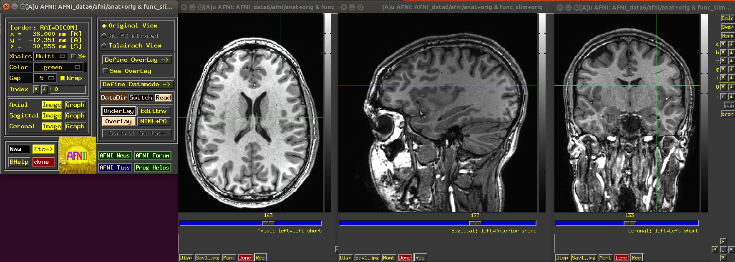
Describing location in dsets
When reporting location of interest-- e.g., cluster peak-- one can't just provide
(x, y, z) values. One also has to provide the coordinate order being used.
Two main families of coordinate order in the literature:
RAI (DICOM): negative numbers are to the right, anterior and inferior
LPI (SPM): negative numbers are to the left, posterior and inferior
e.g.: in RAI order, cross-hair coordinates are (-36, -12, 31)

Slide 30
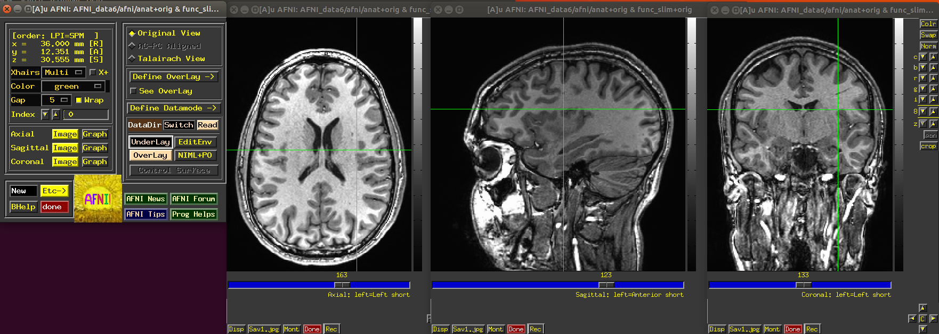
Describing location in dsets
When reporting location of interest-- e.g., cluster peak-- one can't just provide
(x, y, z) values. One also has to provide the coordinate order being used.
Two main families of coordinate order in the literature:
RAI (DICOM): negative numbers are to the right, anterior and inferior
LPI (SPM): negative numbers are to the left, posterior and inferior
e.g.: in LPI order, cross-hair coordinates are (36, 12, 31)

Slide 31
Describing location in dsets
When reporting location of interest-- e.g., cluster peak-- one can't just provide
(x, y, z) values. One also has to provide the coordinate order being used.
Two main families of coordinate order in the literature:
RAI (DICOM): negative numbers are to the right, anterior and inferior
LPI (SPM): negative numbers are to the left, posterior and inferior
e.g.: in LPI order, cross-hair coordinates are (36, 12, 31)
*
*
* The GUI default coordinate order can be set in the ~/.afnirc file.

Slide 32
Describing location in dsets
When reporting location of interest-- e.g., cluster peak-- one can't just provide
(x, y, z) values. One also has to provide the coordinate order being used.
Two main families of coordinate order in the literature:
RAI (DICOM): negative numbers are to the right, anterior and inferior
LPI (SPM): negative numbers are to the left, posterior and inferior
e.g.: in LPI order, cross-hair coordinates are (36, 12, 31)
A better way to report coordinates, which avoids this hassle (and chance for error), is to report directionalized coordinates, e.g., (36R, 12A, 31S). That way, there is not ambiguity/mental calculation.

Slide 33
Volumetric data sets: files
Where is information stored in files?
→ A file contains two categories of information:
data block: the numbers stored at each voxel
header: organizational information about the dset, like:
origin, orient, dimensions, voxel size, TR, labeltables, etc.
→ use 3dinfo to see all header info, or individual parts

Slide 34
Volumetric data sets: files
Where is information stored in files?
→ A file contains two categories of information:
data block: the numbers stored at each voxel
header: organizational information about the dset, like:
origin, orient, dimensions, voxel size, TR, labeltables, etc.
→ use 3dinfo to see all header info, or individual parts
→ There are multiple volumetric file formats. In AFNI, we mostly use two:
BRIK-HEAD: pair of files, e.g., DSET+orig.HEAD and DSET+orig.BRIK
BRIK file contains data block (only); is binary format
HEAD file contains header info (only); is text format
NIFTI: single file, e.g., DSET.nii, or (compressed) DSET.nii.gz
both header and data block in the same file; is binary format

Slide 35
*AFNI terminology sidenote*
VIEW and SPACE properties in a header
BRIK/HEAD file names contain more info than just names (for NII, just in header):
DSET+orig.HEAD and DSET+orig.BRIK, or
DSET+tlrc.HEAD and DSET+tlrc.BRIK, etc.
This is the (AFNI) view. It describes if the dset is in original/native/acquired coordinates, or if it has been aligned to a template space (or AC-PC aligned).

Slide 36
*AFNI terminology sidenote*
VIEW and SPACE properties in a header
BRIK/HEAD file names contain more info than just names (for NII, just in header):
DSET+orig.HEAD and DSET+orig.BRIK, or
DSET+tlrc.HEAD and DSET+tlrc.BRIK, etc.
This is the (AFNI) view. It describes if the dset is in original/native/acquired coordinates, or if it has been aligned to a template space (or AC-PC aligned).
The space property carries the specific name of which space (MNI, etc.) it is in.
3dinfo -space -av_space DSET
Hands-on time!

Slide 37
*AFNI terminology sidenote*
VIEW and SPACE properties in a header
BRIK/HEAD file names contain more info than just names (for NII, just in header):
DSET+orig.HEAD and DSET+orig.BRIK, or
DSET+tlrc.HEAD and DSET+tlrc.BRIK, etc.
This is the (AFNI) view. It describes if the dset is in original/native/acquired coordinates, or if it has been aligned to a template space (or AC-PC aligned).
The space property carries the specific name of which space (MNI, etc.) it is in.
3dinfo -space -av_space DSET
In the GUI, tlrc dsets have special features like "whereami" and atlas access.
Dsets of different spaces cannot be overlayed in the GUI.

Slide 38
*AFNI terminology sidenote*
VIEW and SPACE properties in a header
BRIK/HEAD file names contain more info than just names (for NII, just in header):
DSET+orig.HEAD and DSET+orig.BRIK, or
DSET+tlrc.HEAD and DSET+tlrc.BRIK, etc.
This is the (AFNI) view. It describes if the dset is in original/native/acquired coordinates, or if it has been aligned to a template space (or AC-PC aligned).
The space property carries the specific name of which space (MNI, etc.) it is in.
3dinfo -space -av_space DSET
In the GUI, tlrc dsets have special features like "whereami" and atlas access.
Dsets of different spaces cannot be overlayed in the GUI.
Ex.: VIEW SPACE
orig ORIG # some original space
orig TLRC # mapped to a template space, called TLRC
orig MNI # mapped to a template space, called MNI
orig HaskinsPeds # mapped to a template space, called HaskinsPeds
Note: tlrc is generic view, while TLRC name is specific to a template space.
Fun fact: these properties also map onto NIFTI sform and qform codes directly.

Slide 39
Sidenote: Getting to know your neighbors
Who are a voxel’s neighbors?

Slide 40
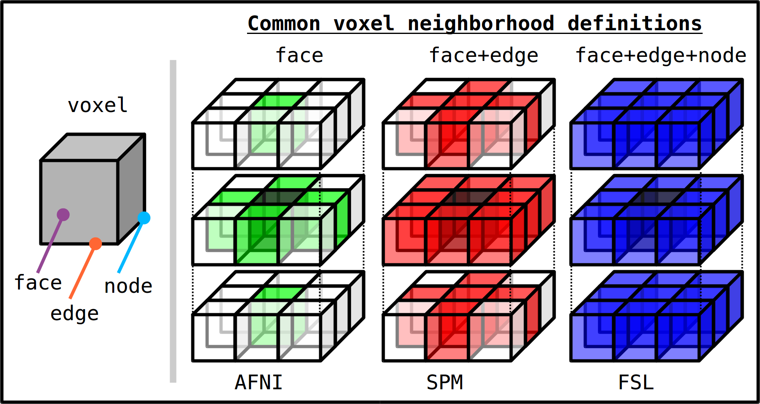
Sidenote: Getting to know your neighbors
Who are a voxel’s neighbors?
→ This is used for blurring, dilating, clustering and several other steps.
→ Different softwares define this differently by default (o-o-o-of course…).
(NN=1)
(NN=2)
(NN=3)
NB: in AFNI, one can choose any of these three definitions, typically with the “NN” specification. Just be consistent.

Slide 41
Other data set formats
AFNI can read/transform other data set formats
+ ANALYZE (.hdr/.img file pairs), such as from SPM, FSL; e.g., 3dcopy
+ MINC-1 (.mnc), such as from mnitools [but not MINC-2]; e.g., 3dMINCtoAFNI
+ CTF (.mri, .svl), from MEG analysis volumes
+ BrainVoyager (.vmr), from BrainVoyager; e.g., 3dBRAIN_VOYAGERtoAFNI
+ ASCII text (.1D): just numbers arranged into columns; e.g., 3dUndump
Note: these other formats may be missing some standard header information, which may need to be borrowed/used from other known files in NII or BRIK/HEAD format (e.g., 3dUndump to get grid)
AFNI can convert volumes to MINC-1, ANALYZE, text file of coordinates (3dAFNItoMINC, 3dAFNItoANALYZE, 3dmaskdump, etc.)
For fuller related program list, see:
Always check your results carefully when converting to other format/software!
https://afni.nimh.nih.gov/pub/dist/doc/htmldoc/educational/classified_progs.html#copy-convert-manipulate-dsets

Slide 42
Appendix 1: non-volumetric files

Slide 43
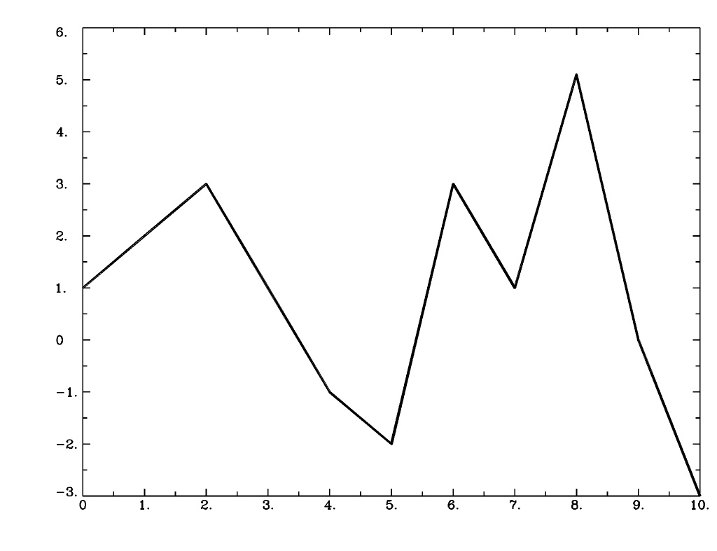
*.1D files
1D files: text file, columns and/or rows of numbers
+ can represent time series, alignment/motion parameters,
voxel locations, etc.
+ might include "# commented regions" at the top
Ways to view
+ open in text editor: "afni_open -t FILE.1D"
+ view in terminal: less, cat
+ plot: AFNI's 1dplot or 1dplot.py
- each column is one time series
- Ex.: 1dplot file.1D
1dplot.py -infiles file.1D -prefix OUT.jpg
Useful programs for these types of dsets
+ 1dcat, 1dtranspose, 1d_tool.py, cat_matvec, 1deval, …
+ see:
1
2
3
1
-1
-2
3
1
5.1
0
-3
https://afni.nimh.nih.gov/pub/dist/doc/htmldoc/educational/classified_progs.html#deal-with-1d-time-series

Slide 44
*.txt and/or *.dat files
TXT/DAT files: text file, could be numbers, could be words/strings
+ e.g., stimulus timing files with numbers and symbols
+ might include "# commented regions" at the top
Ways to view
+ open in text editor: "afni_open -t FILE.1D"
+ view in terminal: less, cat

Slide 45
*.json files
JSON files: text file, stores dictionaries and lists of information
+ general/standard file format, stands for JavaScript Object Notation
+ increasingly commonly used in neuroimaging to include extra/meta
information about datasets
Ways to view
+ open in text editor: "afni_open -t FILE.1D"
+ view in terminal: less, cat
++ but to read/write/use: very common to use Python functionality

Slide 46
*.niml.dset and *.gii files
GII (GifTI): surface equivalent of NifTI files; standard format
NIML-DSET: surface data file format used in AFNI
→ for both, will deal more with these in the SUMA talks
(SUMA also has other intermediate/useful files *.niml*)
Useful programs for these types of dsets
+ See:
https://afni.nimh.nih.gov/pub/dist/doc/htmldoc/educational/classified_progs.html#suma-surface-calculations-formats-and-viewing

Slide 47
*.niml.lt files
“labeltable” files made by and used in AFNI
+ files to associate a label (text string) with an ROI value (integer)
+ e.g., store names of ROIs in an atlas, such as FS parcellation
+ discussed more in the ROI talks
If you can’t wait to read more
+ See @MakeLabelTable’s help:
+ See ROI demo examples in AFNI doc tutorials:
https://afni.nimh.nih.gov/pub/dist/doc/htmldoc/programs/@MakeLabelTable_sphx.html#ahelp-makelabeltable
https://afni.nimh.nih.gov/pub/dist/doc/htmldoc/tutorials/rois_corr_vis/main_toc.html

Slide 48
Appendix 2: data storage on disk (+ set origin/orient)

Slide 49
Dataset storage: origin and orientation
How is a 3D vol stored on the computer?

Slide 50
Dataset storage: origin and orientation
How is a 3D vol stored on the computer?
→ Row by row (as a flattened matrix), starting from one corner called the origin.
Orientation states which corner, and in which order the rows are read (e.g., RPI).
At dset origin (i, j, k) = (0, 0, 0); at coordinate origin (x, y, z) = (0, 0, 0)!

Slide 51
Dataset storage: origin and orientation
How is a 3D vol stored on the computer?
→ Row by row (as a flattened matrix), starting from one corner called the origin.
Orientation states which corner, and in which order the rows are read (e.g., RPI).
At dset origin (i, j, k) = (0, 0, 0); at coordinate origin (x, y, z) = (0, 0, 0)!
S
Example,
2D grid
L
R
coordinate origin:
(x, y) = (0, 0)
dset origin:
(i, j) = (0, 0)
I
→ stored on comp:
...

Slide 52
Dataset storage: origin and orientation
How is a 3D vol stored on the computer?
→ Row by row (as a flattened matrix), starting from one corner called the origin.
Orientation states which corner, and in which order the rows are read (e.g., RPI).
At dset origin (i, j, k) = (0, 0, 0); at coordinate origin (x, y, z) = (0, 0, 0)!
S
Example,
2D grid
read order:
L
R
coordinate origin:
(x, y) = (0, 0)
dset origin:
(i, j) = (0, 0)
I
→ orientation: LI
→ stored on comp:
...

Slide 53
Dataset storage: origin and orientation
How is a 3D vol stored on the computer?
→ Row by row (as a flattened matrix), starting from one corner called the origin.
Orientation states which corner, and in which order the rows are read (e.g., RPI).
At dset origin (i, j, k) = (0, 0, 0); at coordinate origin (x, y, z) = (0, 0, 0)!
S
Example,
2D grid
read order:
L
R
coordinate origin:
(x, y) = (0, 0)
dset origin:
(i, j) = (0, 0)
I
→ orientation: IL
→ stored on comp:
...

Slide 54
Dataset storage: origin and orientation
How is a 3D vol stored on the computer?
→ Row by row (as a flattened matrix), starting from one corner called the origin.
Orientation states which corner, and in which order the rows are read (e.g., RPI).
At dset origin (i, j, k) = (0, 0, 0); at coordinate origin (x, y, z) = (0, 0, 0)!
Ex: orientation = LAI
read order:
Q1: So where is the origin here?
3D vol grid:
S
P
L
R
A
I
→ stored on comp:
...
See this in a vol with: 3dinfo -orient -origin DSET

Slide 55
Dataset storage: origin and orientation
How is a 3D vol stored on the computer?
→ Row by row (as a flattened matrix), starting from one corner called the origin.
Orientation states which corner, and in which order the rows are read (e.g., RPI).
At dset origin (i, j, k) = (0, 0, 0); at coordinate origin (x, y, z) = (0, 0, 0)!
Ex: orientation = LAI
read order:
3D vol grid:
S
P
L
R
A
I
origin
Q2: So how is the data read into storage?
→ stored on comp:
...
See this in a vol with: 3dinfo -orient -origin DSET

Slide 56
Dataset storage: origin and orientation
How is a 3D vol stored on the computer?
→ Row by row (as a flattened matrix), starting from one corner called the origin.
Orientation states which corner, and in which order the rows are read (e.g., RPI).
At dset origin (i, j, k) = (0, 0, 0); at coordinate origin (x, y, z) = (0, 0, 0)!
Ex: orientation = LAI
read order:
3D vol grid:
S
P
L
R
A
I
origin
→ stored on comp:
...
See this in a vol with: 3dinfo -orient -origin DSET

Slide 57
Dataset storage: origin and orientation
How is a 3D vol stored on the computer?
→ Row by row (as a flattened matrix), starting from one corner called the origin.
Orientation states which corner, and in which order the rows are read (e.g., RPI).
At dset origin (i, j, k) = (0, 0, 0); at coordinate origin (x, y, z) = (0, 0, 0)!
Ex: orientation = AIL
read order:
3D vol grid:
S
P
(NB: the arrows point “into” slide here...)
L
R
A
I
origin
→ stored on comp:
...
See this in a vol with: 3dinfo -orient -origin DSET

Slide 58
Dataset storage: origin and orientation
How is a 3D vol stored on the computer?
→ Row by row (as a flattened matrix), starting from one corner called the origin.
Orientation states which corner, and in which order the rows are read (e.g., RPI).
At dset origin (i, j, k) = (0, 0, 0); at coordinate origin (x, y, z) = (0, 0, 0)!
Ex: orientation = RPI
read order:
3D vol grid:
S
P
origin
L
R
A
I
→ stored on comp:
...
See this in a vol with: 3dinfo -orient -origin DSET

Slide 59
AFNI program note on dset and grid properties
To simply find out what the dset’s grid, orientation, origin, etc. properties are, 3dinfo is the way to go. Ex.:
3dinfo -orient -o3 DSET

Slide 60
AFNI program note on dset and grid properties
To simply find out what the dset’s grid, orientation, origin, etc. properties are, 3dinfo is the way to go. Ex.:
3dinfo -orient -o3 DSET
To alter dset/grid properties:
In AFNI, the program 3dresample is useful for starting with one input and making a dset with a new grid, orientation, origin, etc. The program assumes that the starting information (both header and brick info) are correct. Ex.:
3dresample -orient RAI -prefix DSET_NEW -inset DSET
To change grid, orientation, origin, etc. properties when the header information is incorrect, then the program 3drefit is useful. Ex.:
3drefit -orient RAI -inset DSET
Note the different purposes of 3dresample and 3drefit.

