Slide 1
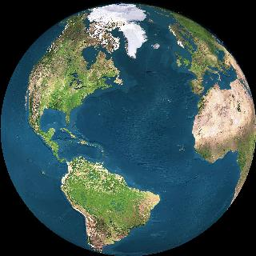
Equitable Thresholding And Clustering (ETAC)
Robert W Cox
SSCC / NIMH / NIH / DHHS / USA / EARTH
Ahu Akivi
https://afni.nimh.nih.gov
2017

Slide 2
Voxel-Wise Group Analysis
Do first level time series analysis on each subject’s data separately
Transformed to common template (e.g., MNI)
Best with nonlinear transformation (3dQwarp)
Can restrict analysis to dilated gray matter mask
Second level group analysis on voxel 𝛃 values = % signal change (not ROIs)
Can be as simple as t-tests (3dttest++)
Or a complicated model such as Linear Mixed Effects (3dLME), etc.
Notes:
Questions about 3dQwarp? Ask me later.

Slide 3
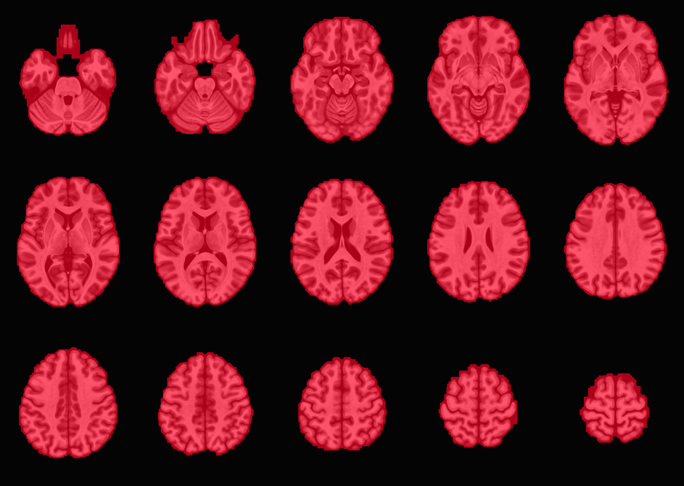
Aside: Whole Brain Mask

Slide 4
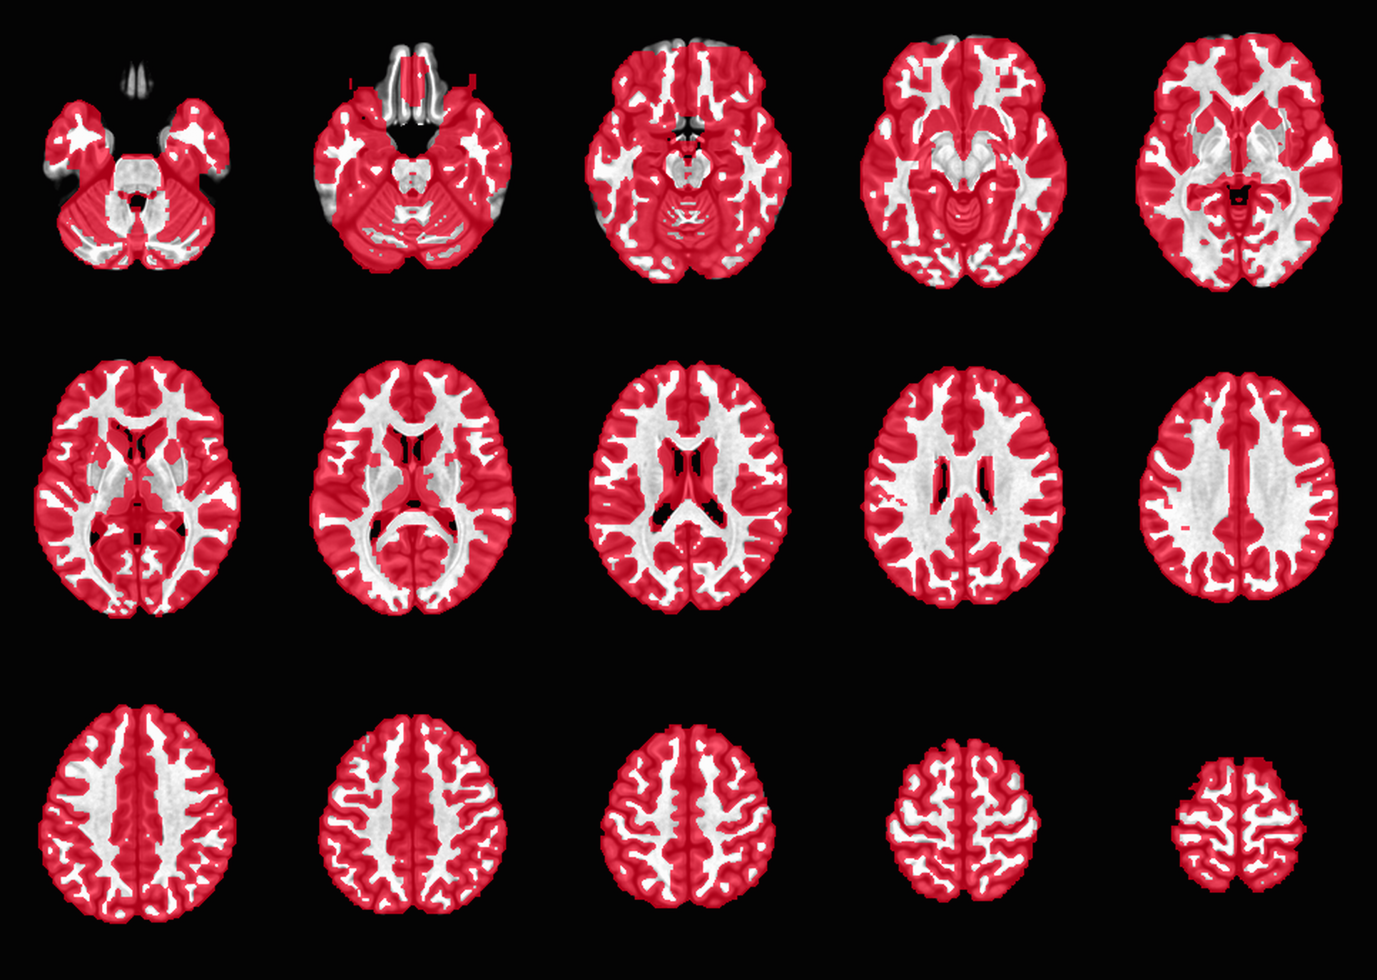
Dilated GM Mask (≈60% of WB)
Recommend use of script @SSwarper

Slide 5
Group Spatial Inference - 1
Goal: control global False Positive Rate (FPR) – to 5% level (e.g.)
FPR = FWE = Family-Wise Error
= rate of errors across the family of voxel tests
“error” = when anything is found in noise-only data vs the null hypothesis (i.e., no “activity”)
Different approach: to control the False Discovery Rate (FDR, voxel-wise)
= fraction of ”discoveries” that are “errors”
Not what I’m going to talk about here
Difficult to allow for inter-voxel correlation in noise
Notes:
Super conservative because so many voxels = so many tests = even a small per-voxel FPR gives a large global FPR

Slide 6
Group Spatial Inference - 2
Voxel-wise thresholding on group t-statistic is usually super conservative (to get global FPR≈5%)
Can estimate false non-discovery rate (FNDR of voxels) using adaptation of voxel-wise FDR algorithm
Not highly accurate, nor widely used in FMRI
An algorithm for this estimate is hidden in AFNI
Typically 60-90% (or more)
Depends on number of subjects (i.e., statistical power) – figure above is for ≈20 subjects
Notes:
Super conservative because so many voxels = so many tests = even a small per-voxel FPR gives a large global FPR

Slide 7
Group Spatial Inference - 3
A Solution: form clusters of neighboring voxels, each above a lower (less strict) voxel-wise t-statistic (or z-statistic)
With a larger voxel-wise p-value (=smaller t )
Then: threshold on cluster-size as well
Or some other cluster-FOM (Figure of Merit)
e.g., Sum over cluster of voxel-wise z²
Reject small/weak isolated clusters
Given voxel-wise p, adjust cluster-FOM threshold to get desired global FPR ➾➾…
Notes:
Solution started with PET, adopted early on in FMRI (by 1995 or so)

Slide 8
Group Spatial Inference - 4
Double threshold method (voxel then cluster) can be weak (low power to detect)
A Solution: use spatial blurring ≈ average nearby voxel 𝛃 (“Coef ”) values together, in each subject, before group statistics
To reduce noise and reinforce commonality
To reduce effective number of independent statistical tests (but lose spatial resolution)
To select the minimum spatial scale of what we are hunting for

Slide 9
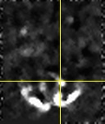
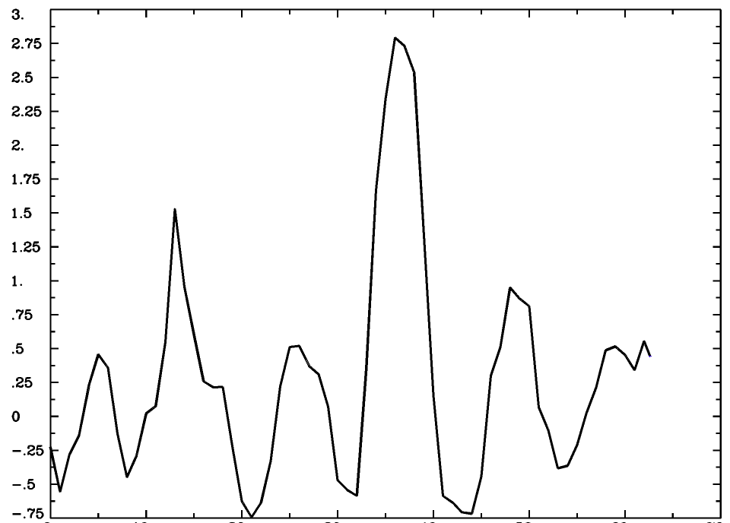
1D Double Thresholding (real data)
6 mm blur

Slide 10
1D Double Thresholding (real data)
6 mm blur

Slide 11
1D Double Thresholding (real data)
6 mm blur

Slide 12
1D Double Thresholding (real data)
6 mm blur

Slide 13
(Semi-) Arbitrary Choices
I’ve mentioned two parameters that must be chosen by the researcher:
Voxel-wise p-value for first-level thresholding
Typical values range from 0.001 to 0.01
Amount of spatial blurring to add to data
Typical values range from 4 to 10 mm
But there are no “best” values ☹
ETAC can rescue you! (from these choices) ☺

Slide 14
Old ClustSim - 1
Spatial correlation of “noise” in FMRI data means no exact formula for cluster-FOM threshold, for a given p threshold
So: Assume Gaussian-shape for spatial auto-correlation function (ACF) of noise
Fit Gaussian width parameter (Forman 1995)
Use approximate formula (SPM) or Monte-Carlo simulation (AFNI) to get cluster-size threshold
SPM method possible due to Gaussian ACF
Notes:
Why a Gaussian ACF? Partially from notion of multiple types of blurring end up as Gaussian. Also arose in analysis of PET data, which has little intrinsic spatial correlation

Slide 15
Old ClustSim - 2
Generate random noise-only dataset with Gaussian ACF (with chosen FWHM)
Threshold at various per-voxel p-values
Find largest cluster in brain mask
Repeat steps 1-3 10,000+ times
For each per-voxel p-value, cluster-size threshold is largest cluster size which occurs only in 5% (e.g.) of cases
Notes:
Simple in concept. Careful programming needed to make efficient.

Slide 16
ClustSim: Table of Sizes Found
Out of 10000 simulations
size count
1 1830
2 2106
3 1572
4 1204
5 792
6 595
7 405
8 302
9 177
10 127
11 82
12 45
13 44
14 32
15 12
16 13
17 11
18 9
19 6
20 5
21 2
22 3
23 0
24 3
25 0
26 1
27 0
28 0
29 1
Add up until total just less than 500
Smallest cluster size with < 500 false positives (5% FPR) above
Notes:
396 to be exact

Slide 17
ClustSim - 4
3dClustSim outputs tables like this:
# CLUSTER SIZE THRESHOLD(pthr,alpha)
# -NN 2 | alpha=Prob(Cluster > given size)
# pthr |.10000 .05000 .02000 .01000
# ------ | ------ ------ ------ ------
0.010000 50.3 57.2 66.3 73.6
0.005000 34.4 39.5 46.3 51.6
0.002000 22.1 25.7 30.4 34.1
0.001000 16.0 19.0 22.8 26.0
0.000500 12.0 14.5 17.4 20.1
0.000200 8.1 10.0 12.6 14.6
0.000100 6.1 7.7 9.9 11.6
➾
Notes:
e.g., p=0.002 and desired FPR=5% ➔ cluster-size threshold = 26 voxels

Slide 18
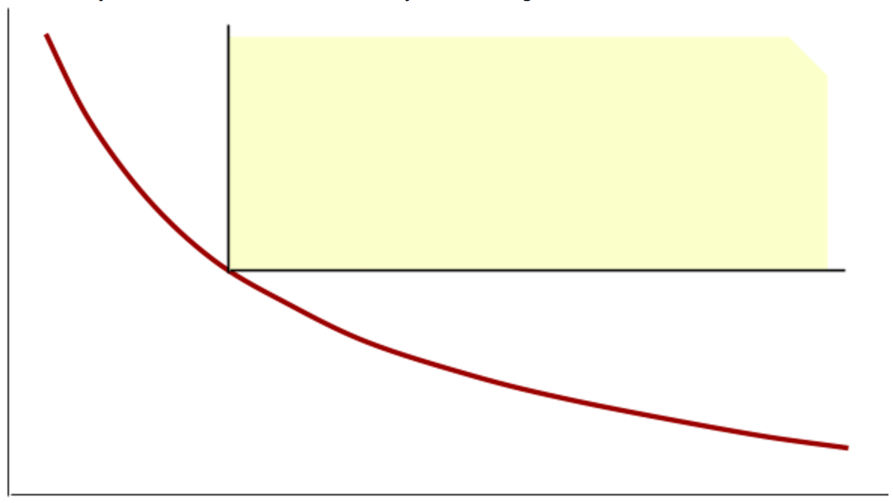
ClustSim - 5
High t threshold ➾ small cluster threshold
Voxel configurations in
here will be accepted
Cluster-size threshold
5% FPR tradeoff curve
-log(p) or t- or z-statistic voxel-wise threshold
Notes:
Grand Canyon hiking idea

Slide 19
FPR: Testing Some Method
Eklund et al: use rsFMRI (FCON-1000) as null data
Analyze each of 198 x 2 subject collections (Beijing and Cambridge) with fake task timings
2 x Block design, 2 x Event-related design
4 x spatial blur levels (4, 6, 8, 10 mm)
Carry out 1- and 2-sample t-tests between subsets of these collections – 1000 random subsets (per case, per collection, per diverse variations)
Count clusters surviving the given software, get FPR estimate
Scripts and tabular results available on GitHub
}
16 basic
cases

Slide 20
Old ClustSim - We Got Trouble
Eklund et al, PNAS 113:7900-7905 (2016)
AFNI’s
3D t-testing program
AFNI’s
3D t-testing program
• FPR≫5%: notably for voxel-wise p=0.01
• A lot of doom-crying about this in 2016:
“Could Invalidate 15 Years of Brain Research ”

Slide 21
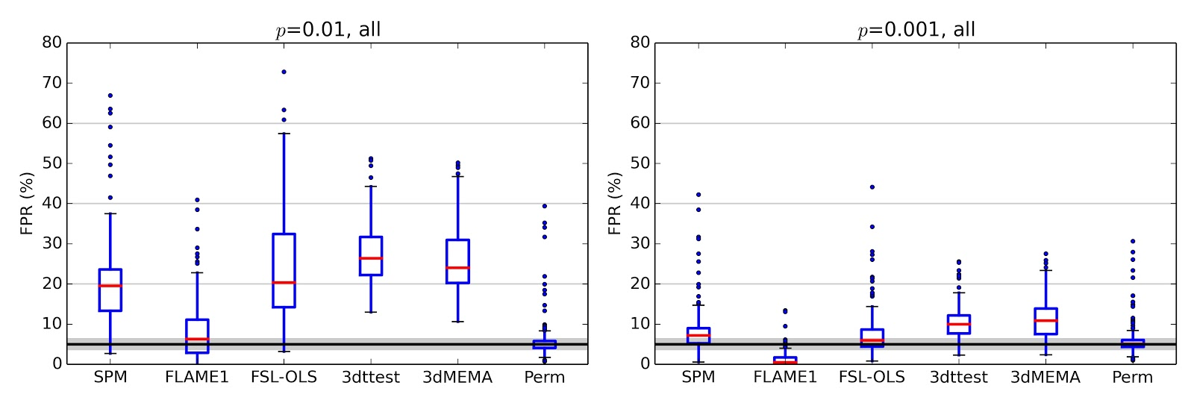
All Their Results Summarized
Eklund et al’s method
Box plots across all cases: 1- and 2-sample, various sample sizes, various “stimuli”, various data sources
“Up to 70%” FPR (triply-used quote from Eklund et al) is not a decent summary of the situation.
Notes:
Up to 30% would have been more reasonable IMHO

Slide 22
Rest: A Good Null for Task?
Is rsFMRI data a good/valid null case for task-based analysis?
Perhaps it has some task-like temporal structure being uncovered by accident?
Is it more correlated in space than the noise (residuals) in task-based datasets?
Not in the datasets I’ve looked at (cursorily)
My opinion:
rsFMRI not perfect as a null, but as real data, it is reasonable to use it (vs simulations)

Slide 23
1 Fix + 3 Solutions in AFNI
0 ) Fix 3dClustSim bug found by Eklund
Extend ACF model in 3dClustSim to be more complicated than a Gaussian shape (the mixed model)
Eliminate ACF modeling by extending 3dClustSim to directly use residuals from 3dttest++ via randomization
Generalize cluster-thresholding model in several more directions: ETAC
Notes:
The outline of my life from July 2016 to June 2017

Slide 24
0) Bugs and Flaws
AFNI’s cluster-size threshold calculating program (3dClustSim) had a bug
A big deal in the PNAS paper (and popular press)
Not actually that important (cf 5 slides ahead)
Forman method for FWHM estimate = another flaw (FHWM = Full Width at Half Maximum)
Using statistics of nearest-neighbor differences of noise to estimate FWHM of noise correlation
FWHM
RWC: Feb 2017
Notes:
Forman method = estimate FWHM from moments of first-differences of noise (residuals)

Slide 25
0) Bugs and Flaws
However, there was/is a much bigger flaw
Shared with FSL and SPM for unnumbered years
Assumption of Gaussian shape for spatial autocorrelation function (ACF) of the noise
ACF(r) describes how noise in one voxel is correlated with noise in another voxel (distance r away)
We are interested in clusters caused by true differences in signal
But we also have to study clusters caused by noise (signal fluctuations)
Estimate probability of results being “bad luck”
RWC: Feb 2017
Notes:
Forman method = estimate FWHM from moments of first-differences of noise (residuals)

Slide 26
1) NonGaussianity in ACF
ACF from single subject datasets has long tails – nonGaussian shape + 1st difference fail
Modify 3dClustSim to use mixed ACF model (Gaussian plus mono-exponential) with 3 parameters (a,b,c) instead of 1 (FWHM)
1st-diff bad for FWHM estimate: too small;
Forman
method
unreliable
ACF(r)=$a$exp[-$r^{2}/(2b^{2}$)]$+\left(1−a\right)exp⁡[−r/c$]
Notes:
Where did this idea come from? A simple plot of log(ACF) vs r

Slide 27
1) Updated ClustSim
Program 3dFWHMx now estimates the mixed model (a,b,c) ACF parameters
No longer shows Forman estimates
Program 3dClustSim takes ACF parameters and
Simulates random noise-only 3D dataset with mixed model ACF
A little slower than Gaussian ACF approach
Otherwise, the same method as before:
Builds tables of cluster sizes found
Notes:
Note ACF is still assumed to be the same everywhere = “stationary”

Slide 28
1) ¿Do Long Tails Matter? Yes…
x=y line
x=y line
Compare cluster-size thresholds for 198 subjects
Computed via 3dClustSim using 2 different ACF models
In words: don’t use Gaussian ACF for FMRI (as is usually done)
NB: Gaussian FWHM taken from mixed model ACF (not Forman)
Notes:
Has longer tails ➾ voxel noise is more correlated ➾ noise-only clusters more likely

Slide 29
0 & 1) AFNI Results Redux
Pre-bug fix
Post-bug fix
Mixed-model ACF
p=0.010
p=0.005
p=0.001
Notes:
Column 1-2 ➔ ”bug” fix did relatively little
Column 2-3 ➔ ACF helps for some, but not enough to be close to 5% for larger p-values

Slide 30
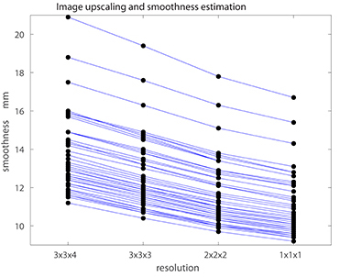
Resampling & Smoothness
Frontiers commentary (K Mueller et al, June 2017)
Examined effect of resampling voxel size on smoothness estimates in SPM (47 datasets; 8 mm blur)
Smoothness goes down as resampled voxel size goes down ⇒ cluster-size threshold volumes go down ⇒ “more sensitive★”
Smoothed by 8 mm
2 mm
★ KJ Friston

Slide 31
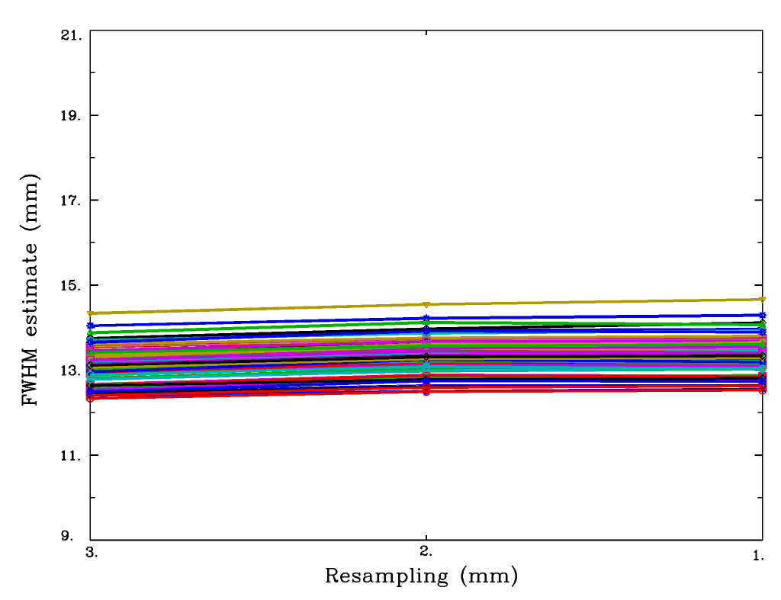
Resampling & Smoothness
Same calculation in AFNI (78 datasets from UCLA Phenomics study @OpenFMRI)
Using mixed model ACF FWHM estimate
Little change in smoothness estimates with resampled voxel size (perhaps a slight drift upwards?)
2 mm
Gaussian FWHM estimate also stable w.r.t. resampling size

Slide 32
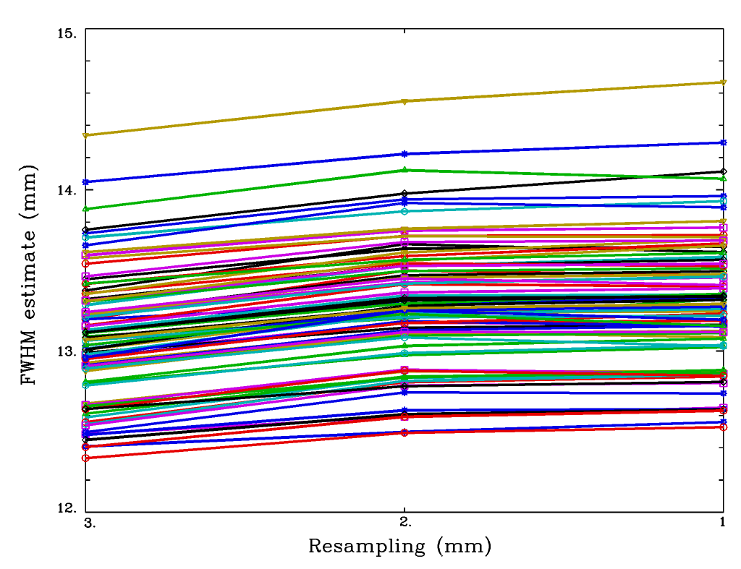
Resampling & Smoothness
Same calculation in AFNI (78 datasets from UCLA Phenomics study @OpenFMRI)
Using mixed model ACF FWHM estimate
Little change in smoothness estimates with resampled voxel size (perhaps a slight drift upwards?)
2 mm
Note y-axis scale change

Slide 33
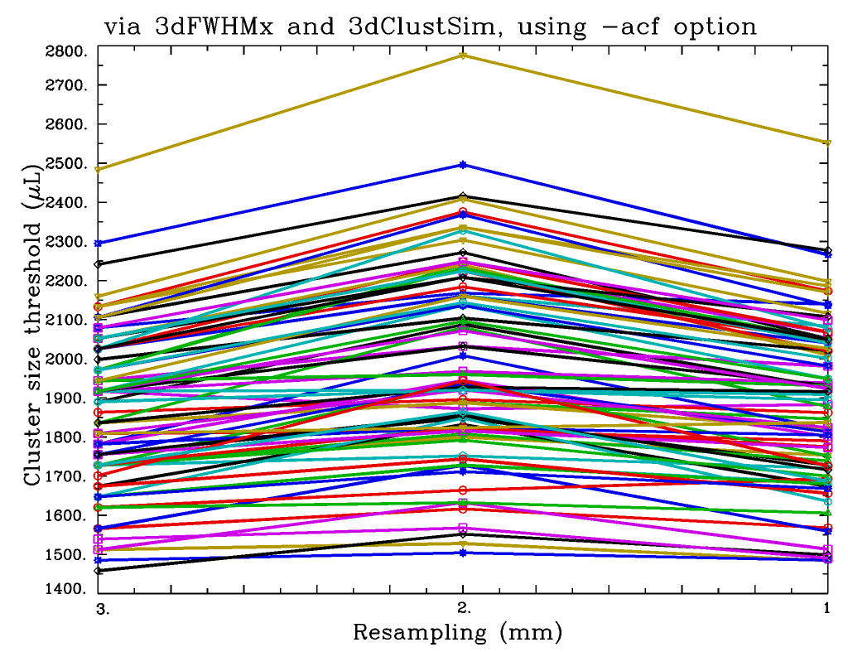
Resampling & Smoothness
Same calculation in AFNI (78 datasets from UCLA Phenomics study @OpenFMRI)
Using mixed model ACF FWHM estimate
Cluster-volume thresholds ($μL$) for resampled voxels sizes =
3, 2, & 1 mm

Slide 34
1) How to: ACF method
Run 3dFWHMx with ‘-acf’ option to get (a,b,c) for each subject, from residuals dataset errts*+tlrc.HEAD
This calculation is done now in afni_proc.py
Average each of the 3 ACF parameters across subjects (not automatic)
Use 3dClustSim with ‘-acf’ option (giving it the 3 averaged parameters) to get cluster size threshold tables for group analysis
This method is OK, if per-voxel p $≤$ 0.002

Slide 35
¿Why Is Model-Based FPR Still High?
Using ACF mixed model improved results
So the wider ACF and longer tails are a part of the original problem – but not all of it
Too short tails in the group t-statistics, caused by outlier subjects in the data
Also explained a part of it – but not very much
Spatial ACF is not stationary (same everywhere)
Over-wide in some places
Drives up FPR in those regions
FWHM
Notes:
Could develop non-stationary ACF model for ClustSim – but that is not the approach I have followed to date

Slide 37
2) A Different Solution: Nonparametric Clustering in AFNI
t-test residuals are permuted/randomized (10000 times)
10000 re-t-tests computed from residuals fed to 3dClustSim
Notes:
Global FPR control is as desired

Slide 38
2) How to: Nonparametric Clustering
Only for t-tests at this time
Re-running many 3dLME cases (e.g.) is too slow
3dttest++ with the –Clustsim option
Gives excellent FPR control ☺
Has stringently large cluster-size thresholds ☹
Seems to be needed to deal with the extra-wide spatial ACF in some regions (notably, midline)
Cluster-size threshold is nonlinear in smoothness
Leads to the idea of making the cluster-size threshold depend on spatial location ➾➾ …
RWC: Feb 2017
Notes:
Large cluster size thresholds here inspired ETAC -- plus a hike over Brown’s Pass in Colorado

Slide 39
3) ETAC
☺ ☺ ☺
Equitable Thresholding And Clustering
Uses multiple sub-methods at same time
Equity = balancing FPRs of sub-methods
Voxel-wise thresholding at multiple p-values, then cluster-FOM thresholding
Multiple cases of spatial blurring
Different cluster-FOM thresholds in different brain regions (vs global thresh)
No model for ACF: uses randomization
Notes:
Potential to find both small intense and large weak clusters
Remove some arbitrariness from group thresholding decisions

Slide 40
Equity: A Toy Example
Is mean of a set different from 0?
Compute t-statistic from the set
Method #1: accept if t > X
Occurs by chance: probability = A(X )
Method #2: accept if t < −Y
Occurs by chance: probability = A(Y )
Accept either case (2-sided): A(X )+A(Y )
Get 5% FPR with many combinations of X & Y
Equity says: take X =Y ➾ normal 2-sided test
1-sided
tests
Notes:
Balance FPR from #1 and #2 unless there is some extrinsic reason not to do this

Slide 41
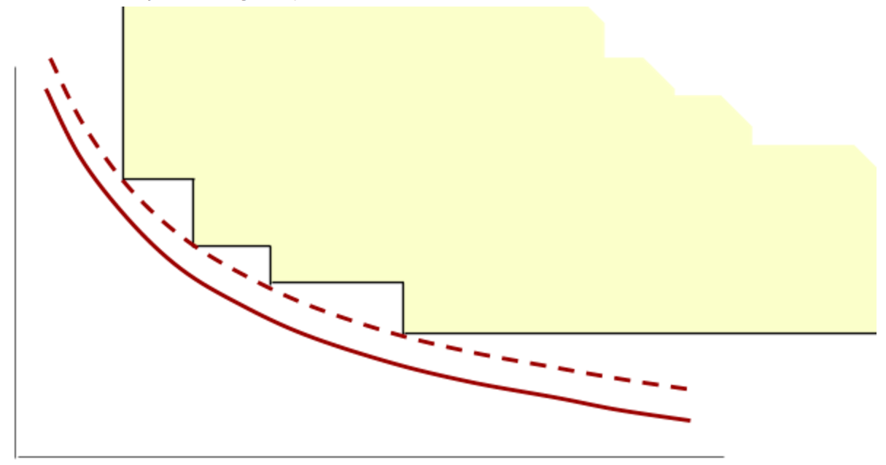
Equity: Multi-Thresholding
Voxel configurations in
here will be accepted
This is what
ClustSim
computes
Single per-voxel
p-value threshold
giving 5% global FPR
= 5% FPR tradeoff curve
Cluster-size threshold
Voxel configurations in here will be accepted;
Individual thresholds fall along
the same t-vs-cluster-size
tradeoff curve = equity (balance)
Adjust to
make final
FPR 5%
Four per-voxel p-
value thresholds, adjusted
to give 5% global FPR
< 5% FPR tradeoff curve
-log(p) or t- or z-statistic voxel-wise threshold
Notes:
This is the Grand Canyon inspired figure

Slide 42
Equity: Across Methods
Balancing can apply to any multi-choice method for selecting voxel clusters
Each sub-method has a cluster-FOM threshold adjustable to get desired FPR
Balance = choose each sub-method’s cluster-FOM threshold to have the same global FPR α₀ < α_{Goal} (e.g., 5%)
ETAC method (set union): accept a voxel if it survives at least one sub-method
Adjust α₀ up or down to get final FPR = α_{Goal}
Notes:
Generalization and abstraction of the previous figure

Slide 43
Equity: Across Blur Cases
Blurring at (e.g.) 4, 6, 8, 10 mm
Potential to detect both small intense clusters and larger weak clusters
Blur = 10 mm might “wash out” small cluster
Blur = 4 mm might not reduce noise enough to find larger weak cluster
Combined with multi-thresholding (different p-values), reduces number of arbitrary choices to make in thresholding
Notes:
Slightly different than multiple p-values in that different datasets need to be processed for each blur case ←→ input datasets for t-tests that have been blurred differently for each case

Slide 44
Equity: Across Space
Smoothness (ACF) of noise varies across the brain
Using same cluster threshold everywhere will make FPR non-uniform
Could try to differentially smooth to make ACF more uniform (not implemented in AFNI)
ETAC method: Use different cluster-FOM thresholds at different locations
For each sub-method, produce a 3D map of the cluster-FOM threshold to use
Notes:
This concept is the Brown’s Pass inspiration

Slide 45
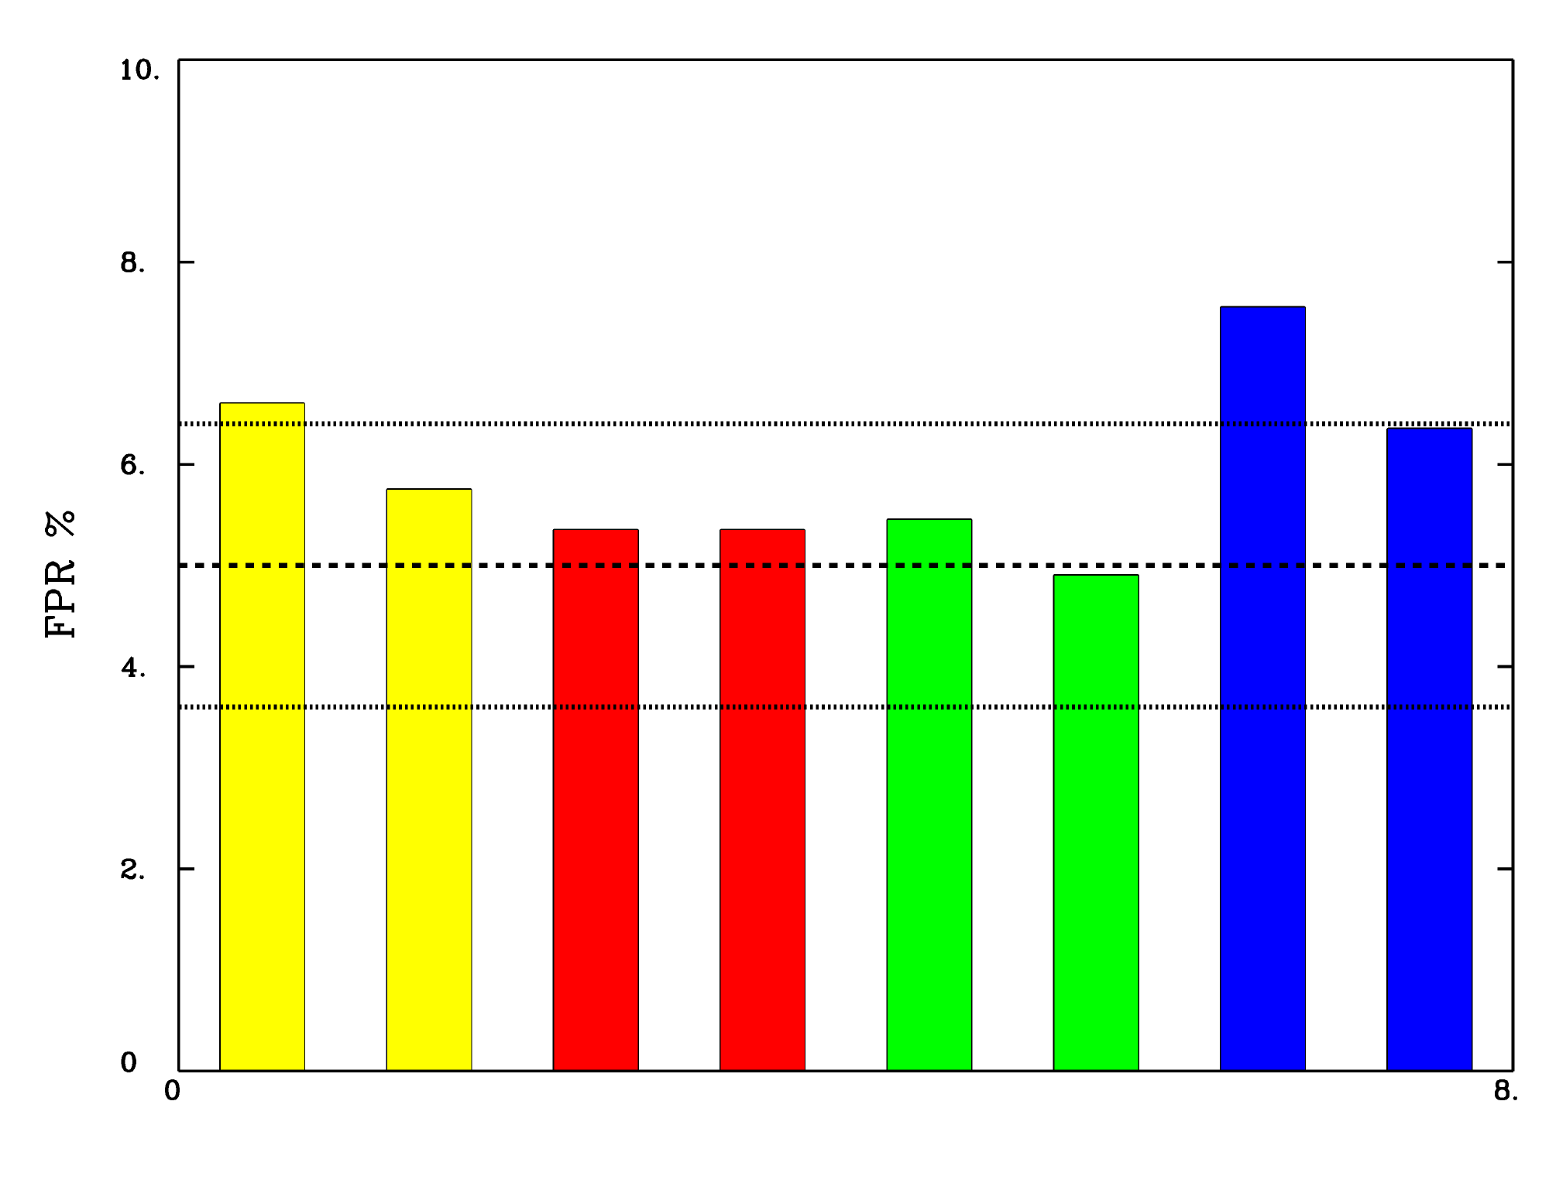
ETAC: Global FPR Control
1000 simulations each
10s blocks
30s blocks
regular events
random events
p = 0.01, 0.005, 0.003, 0.002, 0.001 blurs = 4, 6, 8, 10
Notes:
Reasonably close to 5% level
1000 simulations (each) from rsFMRI datasets

Slide 46
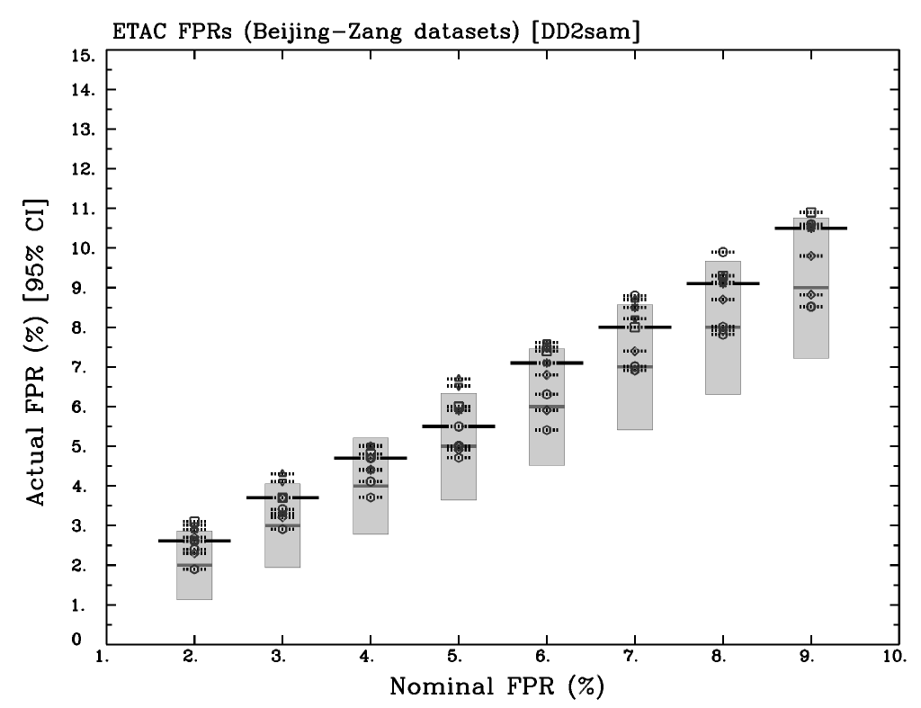
ETAC: Global FPR Control
1000 simulations each
2-sample
p = 0.01, 0.005, 0.002, 0.001 blur = 4, 7, 10
Notes:
Reasonably close to 5% level
1000 simulations (each) from rsFMRI datasets

Slide 47
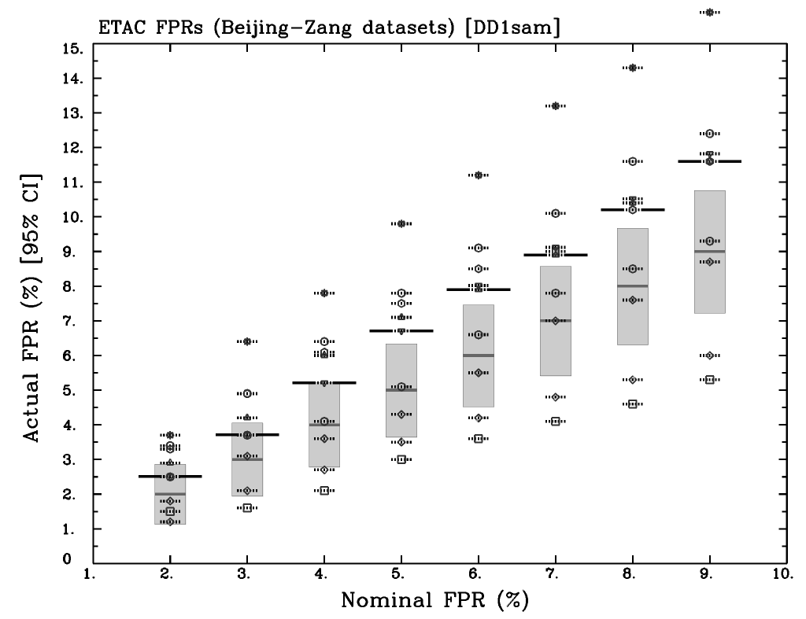
ETAC: Global FPR Control
1000 simulations each
1-sample
p = 0.01, 0.005, 0.002, 0.001 blur = 4, 7, 10
Notes:
Reasonably close to 5% level
1000 simulations (each) from rsFMRI datasets

Slide 48
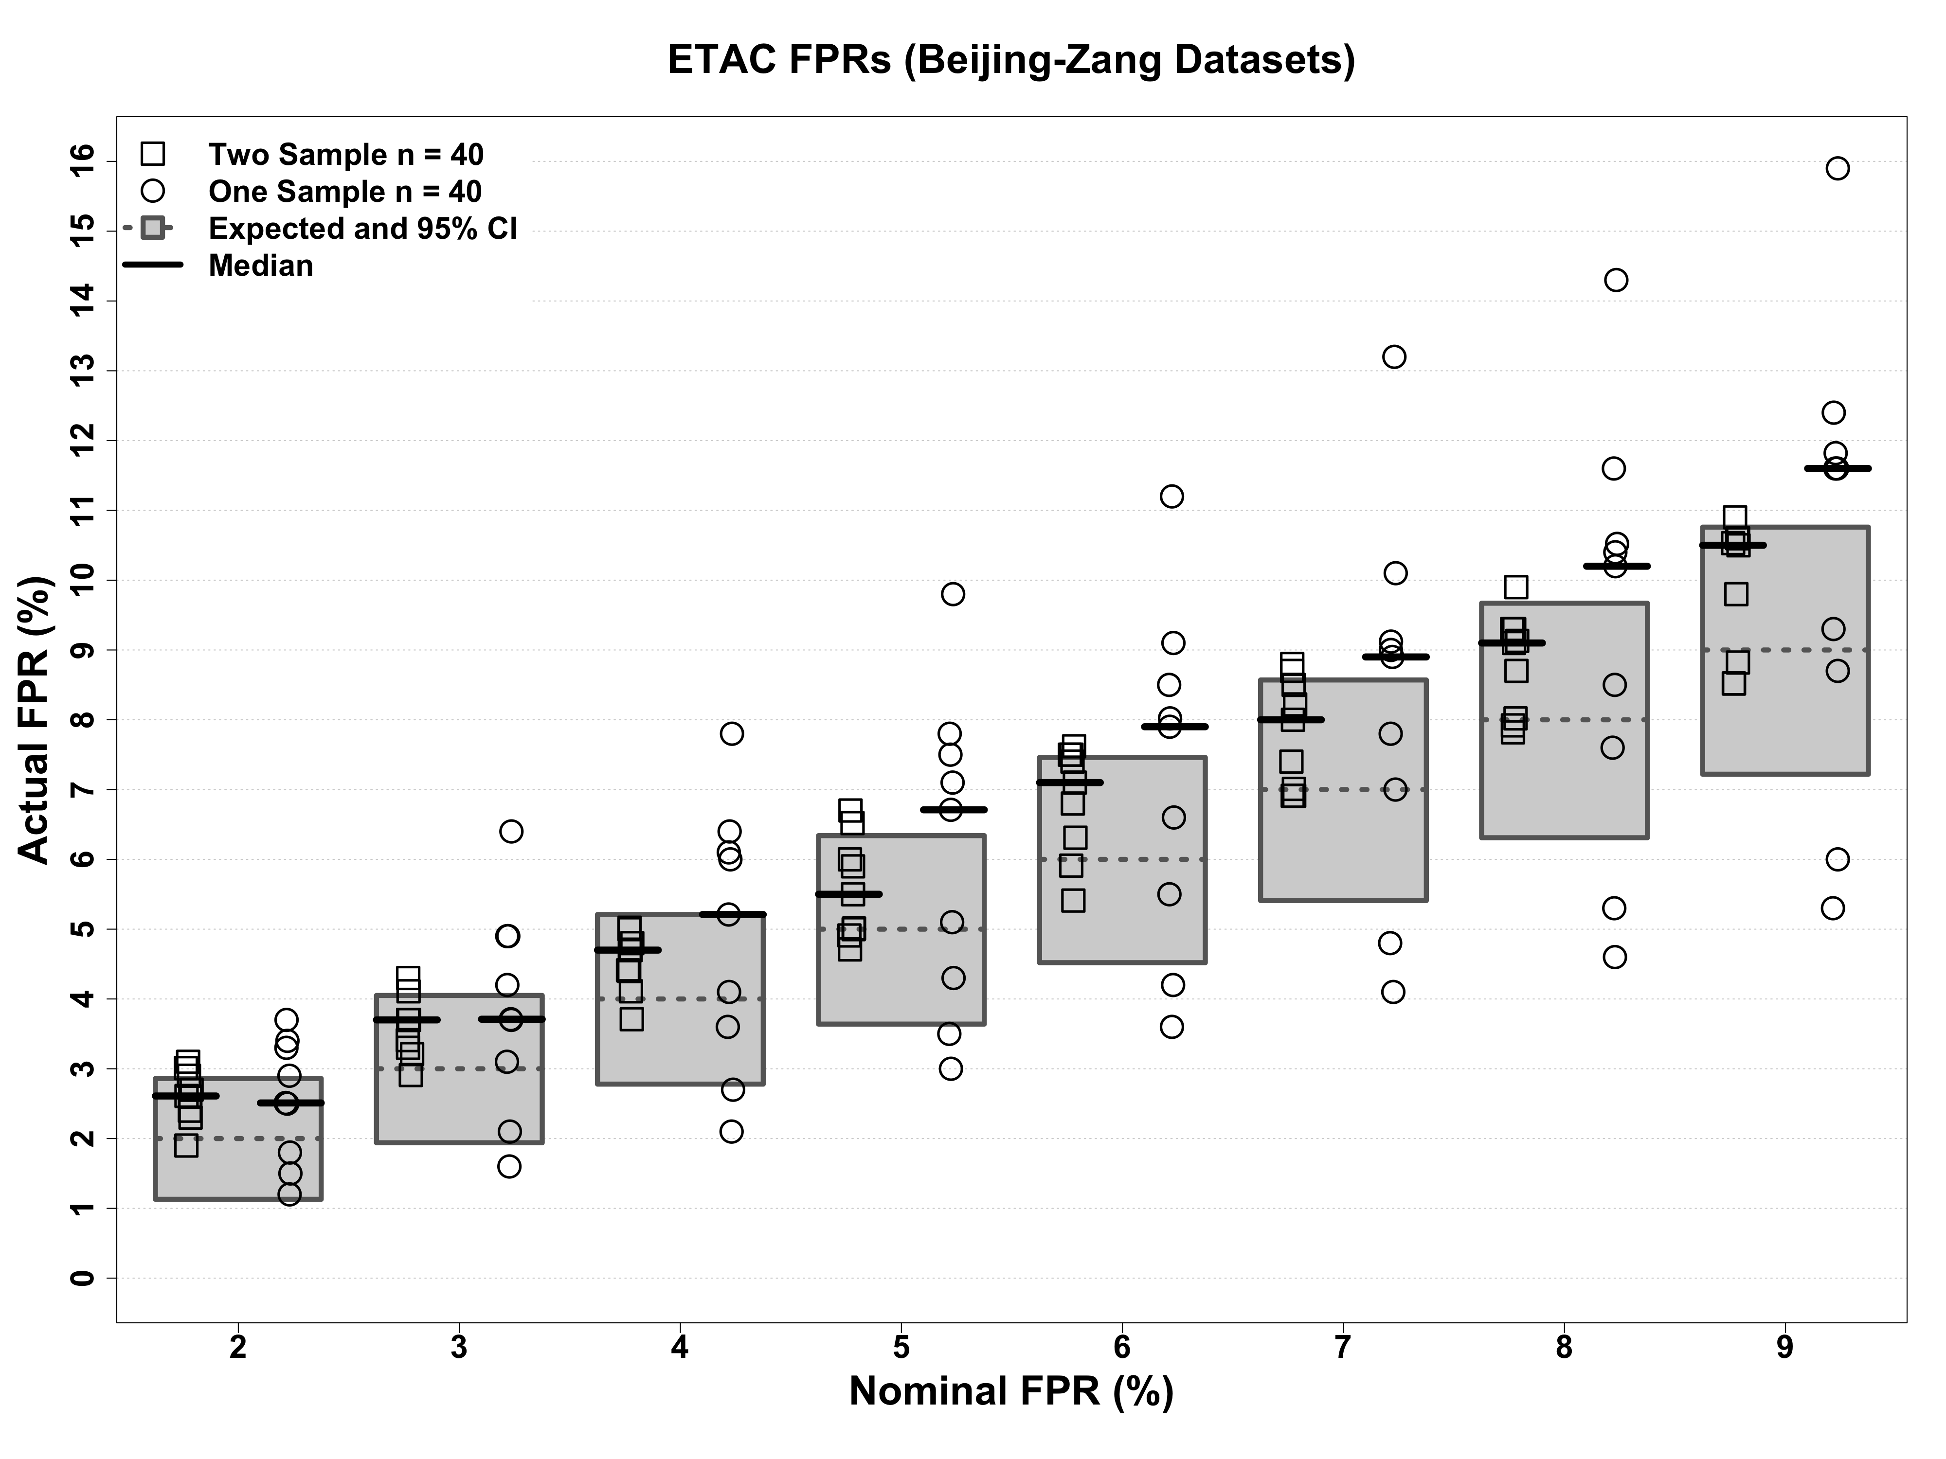
ETAC: Global FPR Control
1000 simulations each
3 stimuli x (1-sided & 2-sided tests)
Various FPR α_{Goal} from 2%‒9%
p = 0.01, 0.005, 0.002, 0.001 blurs = 4, 7, 10
Notes:
Reasonably close to 5% level
1000 simulations (each) from rsFMRI datasets

Slide 49
Dataset Resampling
Eklund-Nichols resampling methodology:
Given 198 datasets, choose 40 of them
1-sample tests = all 40 in one sample t-test
2-sample tests = 20 per sample
Do this 1000 times
But … the 1000 samples aren’t independent
In 1-sample tests, FPR results much wilder (bigger variance) than should be
Verified by doing yet more simulations ➾ …

Slide 50
500 Noise-only Simulations
Each simulation runs 1000 3D t-test cases (40 datasets, 1 sample) and does cluster-detection (fixed cluster-size threshold, not ETAC – for speed)
Left column: all 40,000 inputs are independent in each simulation
Right column: inputs resampled from 198 datasets in each simulation

Slide 51
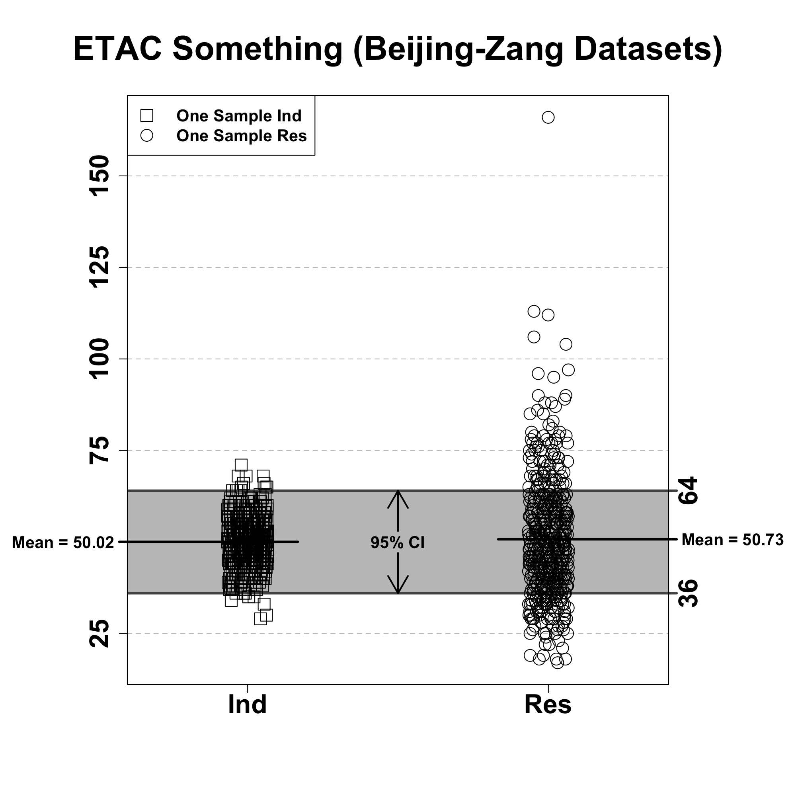
500 Noise-only Simulations
Each simulation runs 1000 3D t-test cases (40 datasets, 1 sample) and does cluster-detection (fixed cluster-size threshold, not ETAC – for speed)
Left column: all 40,000 inputs are independent in each simulation
Right column: inputs resampled from 198 datasets in each simulation
Independent
dataset
Resampled
datasets

Slide 52
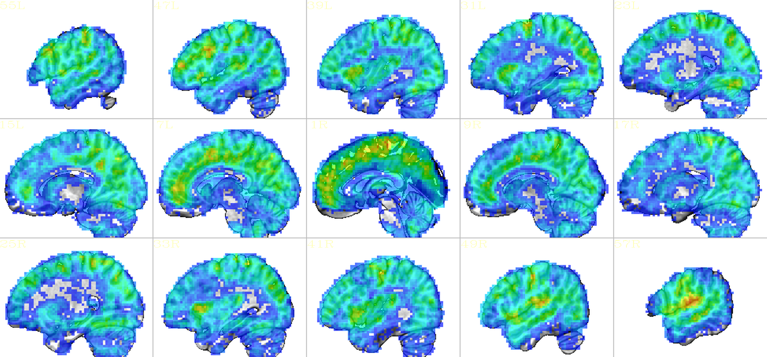
ETAC: FPR spatial density
20000 simulations
small
max
Fairly uniform in space
Notes:
20,000 simulations from rsFMRI datasets

Slide 53
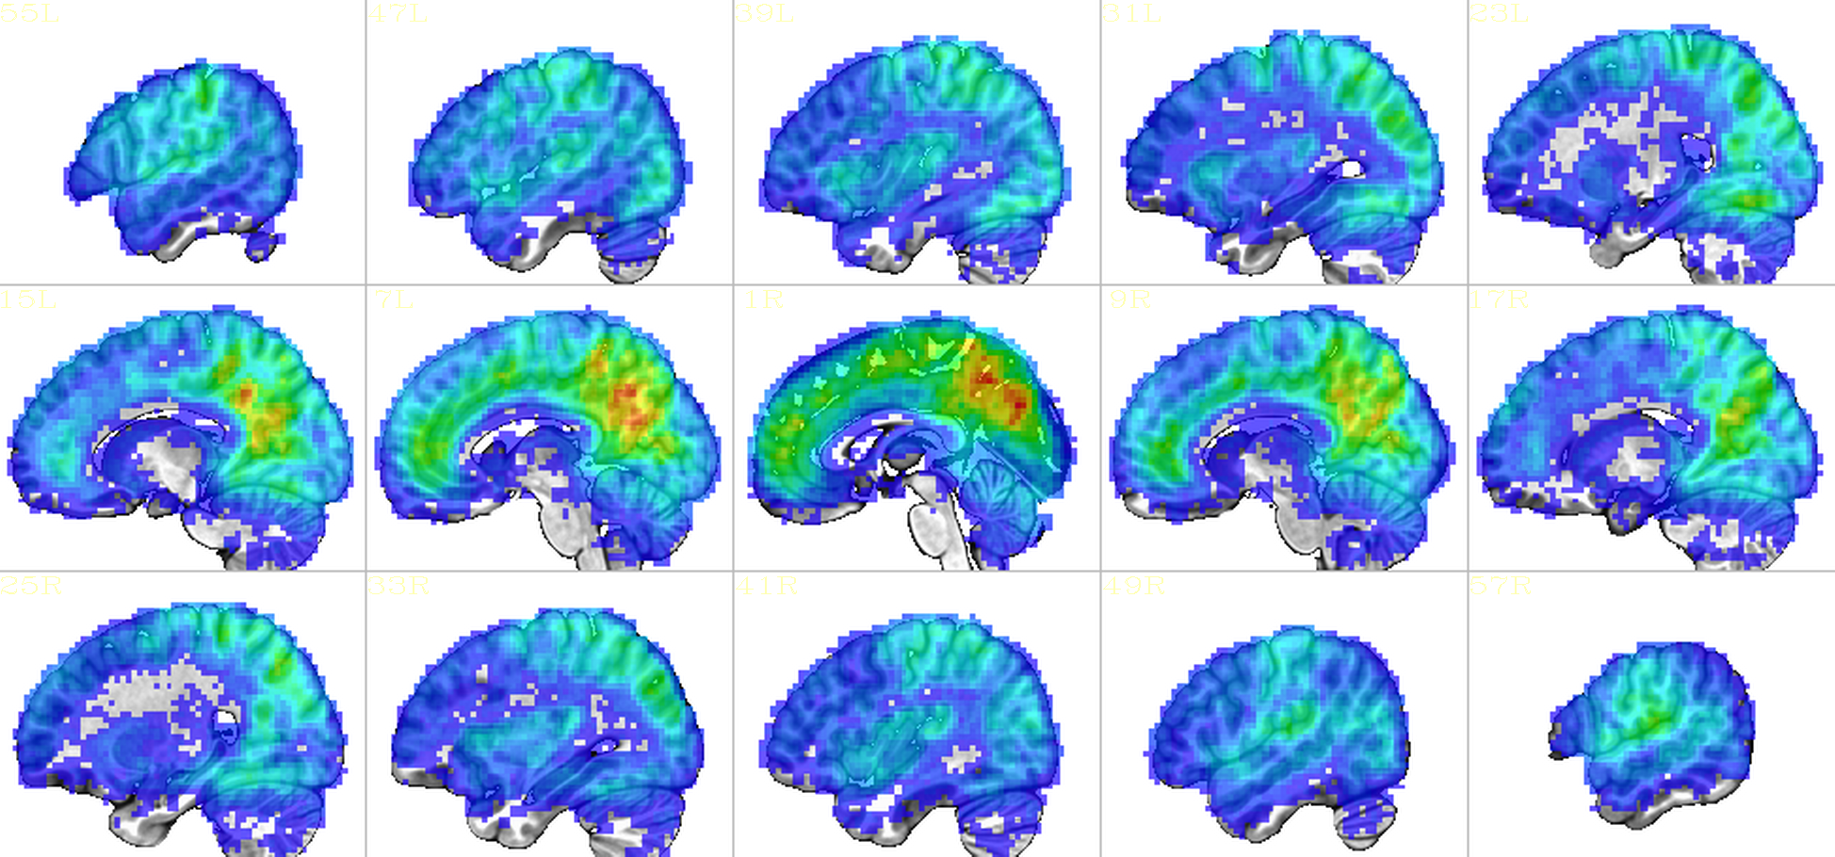
Global Threshold: FPR density
small
max
Not so uniform in space
Notes:
Single blur case (8 mm); single p threshold (0.002)

Slide 54
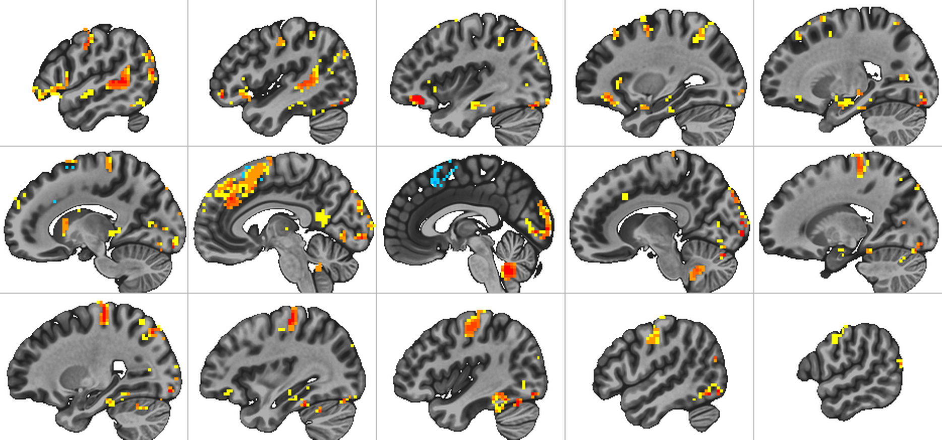
Task Detection Power: ETAC minus Global Threshold
500 simulations
UCLA Phenomics study (pamenc vs control task)
20 (out of 81) subjects per test
➾ data from OpenFMRI web site
Notes:
Main point: ETAC has no LOSS of power, and a little gain – in this one case

Slide 55
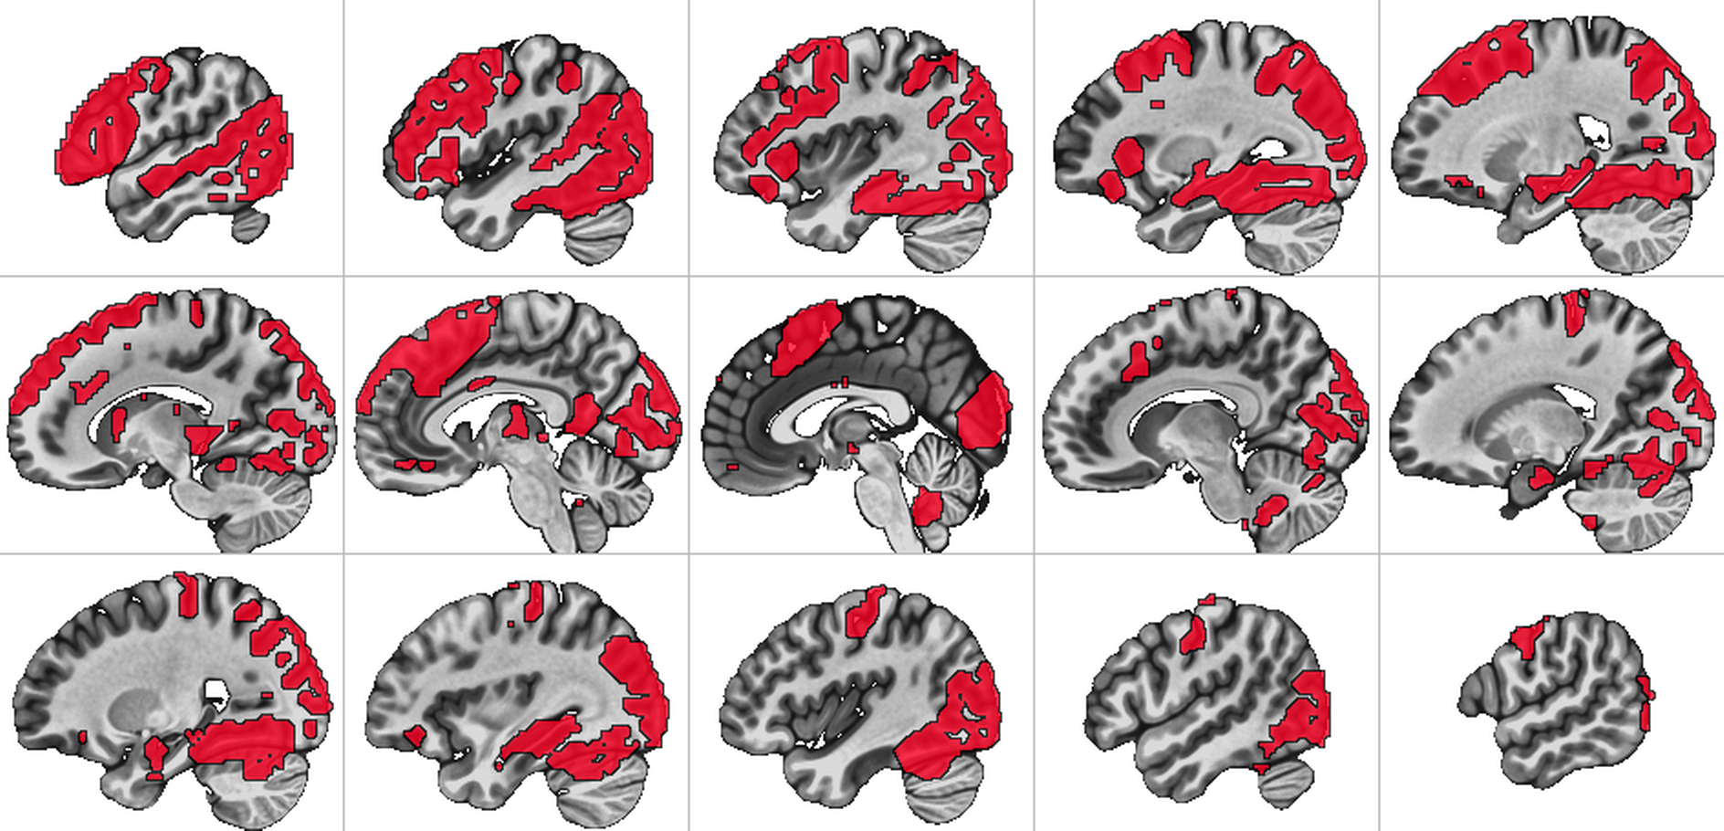
ETAC activation mask (2% FPR, all 81 subjects)
UCLA Phenomics study (pamenc vs control task)
20 (out of 81) subjects per test
➾ data from OpenFMRI web site
Notes:
Main point: ETAC has no LOSS of power, and a little gain – in this one case

Slide 56
Using ETAC
ETAC algorithm: program 3dXClustSim
User adds options to 3dttest++ to run ETAC after the group t-tests are done
–ETAC to enable the algorithm
–ETAC_blur to specify blur cases to use
–ETAC_opt to specify thresholding options
To change from default per-voxel p-values of 0.0100 0.0056 0.0031 0.0018 0.0010
To change default clustering parameters NN=2 FOM=$\sum{z^{2}}$ 2-sided tests goal=α_{Goal}=5%
Notes:
For the AFNI users

Slide 57
ETAC Sample Command
3dttest++
-setA datasets
-setB datasets { other options here ... }
-prefix Gtest.nii
-prefix_clustsim GtestX
-ETAC
-ETAC_blur 6 12
-ETAC_opt
sid=2:pthr=0.01,0.003,0.001:name=TestA
-ETAC_opt
sid=1:pthr=0.01,0.003,0.001:name=TestB
Combines with any other blurring
Notes:
If you use –ETAC_blur, then single subject analysis should be done without blurring

Slide 58
ETAC Sample Outputs
Gtest.nii
Gtest.B6.0.nii
GtestX.B6.0.5percent.txt
GtestX.TestA.ETAC.mthresh.B6.0.nii
GtestX.TestA.ETACmask.2sid.nii
GtestX.TestB.ETAC.mthresh.B6.0.nii
GtestX.TestB.ETACmask.1pos.nii
GtestX.TestB.ETACmask.1neg.nii
Plus a set of B12.0 outputs
Notes:
ETACmask outputs ➔ main result of direct interest
ETAC.mthresh outputs ➔ used if want to apply thresholds yourself

Slide 59
ETAC Sample Outputs
Gtest.nii
Gtest.B6.0.nii
GtestX.B6.0.5percent.txt
GtestX.TestA.ETAC.mthresh.B6.0.nii
GtestX.TestA.ETACmask.2sid.nii
GtestX.TestB.ETAC.mthresh.B6.0.nii
GtestX.TestB.ETACmask.1pos.nii
GtestX.TestB.ETACmask.1neg.nii
The main t-test output file, unthresholded

Slide 60
ETAC Sample Outputs
Gtest.nii
Gtest.B6.0.nii
GtestX.B6.0.5percent.txt
GtestX.TestA.ETAC.mthresh.B6.0.nii
GtestX.TestA.ETACmask.2sid.nii
GtestX.TestB.ETAC.mthresh.B6.0.nii
GtestX.TestB.ETACmask.1pos.nii
GtestX.TestB.ETACmask.1neg.nii
t-test output file, with 6 mm extra blurring

Slide 61
ETAC Sample Outputs
Gtest.nii
Gtest.B6.0.nii
GtestX.B6.0.5percent.txt
GtestX.TestA.ETAC.mthresh.B6.0.nii
GtestX.TestA.ETACmask.2sid.nii
GtestX.TestB.ETAC.mthresh.B6.0.nii
GtestX.TestB.ETACmask.1pos.nii
GtestX.TestB.ETACmask.1neg.nii
Multi-threshold dataset for blur=6 mm, 3 p-values

Slide 62
ETAC Sample Outputs
Gtest.nii
Gtest.B6.0.nii
GtestX.B6.0.5percent.txt
GtestX.TestA.ETAC.mthresh.B6.0.nii
GtestX.TestA.ETACmask.2sid.nii
GtestX.TestB.ETAC.mthresh.B6.0.nii
GtestX.TestB.ETACmask.1pos.nii
GtestX.TestB.ETACmask.1neg.nii
Multi-thresholded mask for Gtest.nii (2 blurs, 3 p’s)

Slide 63
ETAC Sample Outputs
GtestX.B6.0.5percent.txt
4.292 = 1-sided 5% FPR
4.465 = 2-sided 5% FPR
You get this “free” when running –ETAC
and/or –Clustsim in 3dttest++
Voxel-wise threshold for 5% global FPR, unclustered;
Smaller than Bonferroni correction (spatial correlation)
Notes:
These statistical threshold values will be lower the Bonferroni corrected values due to the smoothing

Slide 64
¿Using ClustSim with ETAC?
Also in 3dttest++: option -Clustsim
Can combine with –ETAC for comparison
ETAC and ClustSim use lots (40000) of randomized t-tests to create “noise-only” data for cluster FPR analysis (slow)
1-sample test: randomize signs of t-test residuals
2-sample test: & inter-sample permutations
Uses multiple CPUs to help with speed
Why both? To compare results.
Notes:
-Clustsim and –ETAC together are mainly just for testing (i.e., for RWCox)

Slide 65
Images of Multi-Thresh Maps
blur=4mm
FOM=$\sum{z^{2}}$
blur=12mm
13000
p=0.001
p=0.001
1600
p=0.003
p=0.003
200
log
scale
p=0.010
p=0.010
Notes:
Blur=8mm not shown

Slide 66
How ETAC Works
More complex than ClustSim
Must keep cluster-FOM tables for each sub-method and for each voxel
Some voxels don’t get many “hits”
Clusters are dilated to get brain coverage
But FOM for cluster is based on original size
How to apply spatially variable cluster-FOM to a given cluster in real data?
Sort thresholds for all voxels in real cluster
Use the 80% point (100% = maximum)
Notes:
TMI, but this was a lot of work

Slide 67
ETAC: Things to be Done - 1
Single-subject via mixed-model ACF
Spatially non-stationary? A little complex.
ETAC algorithm without voxel equity
Multi-method with global cluster thresholds
Implementation details (short term):
Different α_{Goal}s in same run (e.g., 2% 3% 4% 5%)
Apply multi-thresholds to other t-volumes in 3dttest++ output
e.g., 1-sample results in 2-sample tests
Other cluster-FOMs (e.g., TFCE’s)?
Notes:
When will this happen? A good question.

Slide 68
ETAC: Things to be Done - 2
Test more null cases for FPR
3dttest++ options, such as covariates
Do multi-threshold maps from the main effect apply to the extra t-tests, such as covariates and 1-sample results in 2-sample tests?
And give approximately the desired FPR?
Or does ETAC need to be run separately for each t-test included in the output? ☹☹
Resting state FMRI seed-based correlation maps (all tests up to now are task-based)
Other scenarios?
Notes:
When will this happen? A good question.

Slide 69
ETAC: Things to be Done - 3
Test more positive cases for power
Task-based and resting state
Need large number of subjects for this work
So can test subsets of different sizes
And draw lots of random sub-collections
For task cases, need a variety of conditions
So can cover large parts of brain
Including conditions with small (focal) activations, such as amygdala
Will ETAC work well for such cases?

Slide 70
ETAC: Things to be Done - 4
Extend method to work on surface domains, not just 3D volumes
Will need a lot of work ☹ ☹ ☹ ☹ ☹ ☹ ☹ ☹
Need to write ClustSim for surfaces
Need to write ETAC (multi-thresholding and FPR solving) for surfaces
Or for mixed 2D+3D domains, as in the CIFTI-format data (e.g., HCP)
Cortical surfaces plus basal ganglia volumes
ETAC is based on topology not on geometry
Notes:
When will this happen? In my next incarnation

Slide 71
ETAC: Things to be Done - 5
Should ETAC output show you which sub-methods a voxel passed?
e.g., which p-values, which blur cases?
Need experience with actual users/actual studies to find things out:
What other outputs would be interesting?
How useful is ETAC now, compared to other methods for global thresholding?
These 5 slides are just part of the list …
Notes:
When will this happen? In my next incarnation

Slide 72
Other Ruminations
With many subjects in a study, does cluster-FOM thresholding continue to make sense?
More and more of brain will pass test
Unless looking at a restricted hypothesis, such as brain regions correlated with some subject behavior/condition
How to interpret such results?
At what point does voxel-wise only thresholding become ”reasonable”?

Slide 73
Conclusions (At Long Last! )
If 3dttest++ can do your group analysis, ETAC might be your new friend
Fewer arbitrary thresholding choices ☺
No loss of power ☺
Not fully tested yet ☹
No publication to cite yet ☹☹
If you need 3dLME, 3dMVM, etc., then the mixed model ACF method is decent
With per-voxel p ≤ 0.002
Publication you can cite ☺
Notes:
Second point is why a non-stationary ACF model for Clustsim is desirable

Slide 74
AFNI Clustering Papers
Somewhere over the rainbow – ETAC paper
FMRI Clustering and False Positive Rates. PNAS 114: E3370–E3371, 2017.
https://arxiv.org/abs/1702.04846
https://doi.org/10.1073/pnas.1614961114
FMRI Clustering in AFNI: False Positive Rates Redux. Brain Connectivity 7:152-171, 2017.
https://arxiv.org/abs/1702.04845
https://doi.org/10.1089/brain.2016.0475

Slide 75
Where It Started
Clear Creek trail, Grand Canyon

Slide 76
Finally … Thanks
The list of people I should thank is not quite as large as Skewes’ number★ …
MM Klosek. JS Hyde. JR Binder. EA DeYoe. SM Rao.
EA Stein. A Jesmanowicz. MS Beauchamp. BD Ward.
KM Donahue. PA Bandettini. AS Bloom. T Ross.
M Huerta. ZS Saad. K Ropella. B Knutson. J Bobholz.
G Chen. RM Birn. J Ratke. PSF Bellgowan. J Frost.
K Bove-Bettis. R Doucette. RC Reynolds. PP Christidis.
LR Frank. R Desimone. L Ungerleider. KR Hammett.
DS Cohen. DA Jacobson. EC Wong. J Gonzalez-Castillo. D Glen.
P Kundu (AKA IMoM). E Raab. A Martin. S Gotts. PA Taylor.
And YOU, the suffering audience …
★Currently thought to be about 1.4×10³¹⁶

