Slide 1
Important Features of a Pipeline for Processing Diffusion Weighted Images
Carlo Pierpaoli
Quantitative Medical Imaging Section
NIBIB

Slide 2
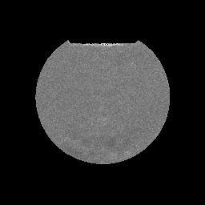
Quantitative diffusion MRI requires multiple coregistered images
b (s/mm²)
8
200
400
650
S = S₀ e^{-bD}
Diffusion coefficient map
Notes:
Typically, we take the log of the equation and fit the linear form

Slide 3
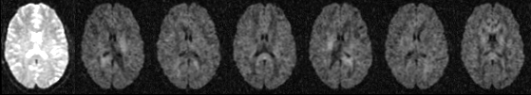
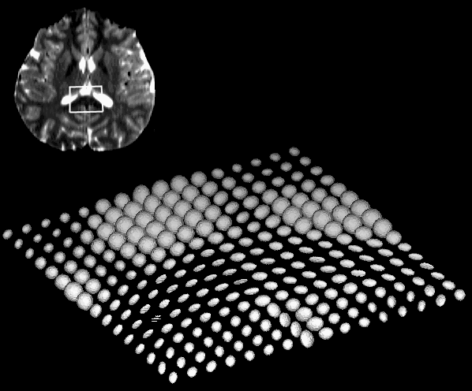
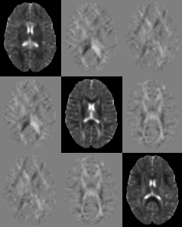
Assessment diffusion in anisotropic tissues requires multiple images with non-collinear gradient directions
Radiology. 1996 Dec;201(3):637-48

Slide 4
Tasks to address in a DWI processing pipeline
Importing data, check if images are sorted correctly
Initial quality control by visual inspection
Production of “corrected” raw images
- EPI distortion correction
- Motion and eddy-current distortion correction
- Registration to standard template
- Rotation of b-matrices
- Generate interpolation-corrected weighting
coefficients
Tensor computation (correct weighting)
Analysis of residuals of tensor fitting, inspection χ² maps
Robust tensor estimation
Computation of tensor derived variables or HARDI analysis

Slide 5
Importing data correctly
Gradient conventions are not standardized across vendors
Possibility of wrong information being reported in the DICOM header
Handling of oblique DWI acquisitions is inconsistent across vendors and even across software releases from the same vendor

Slide 6
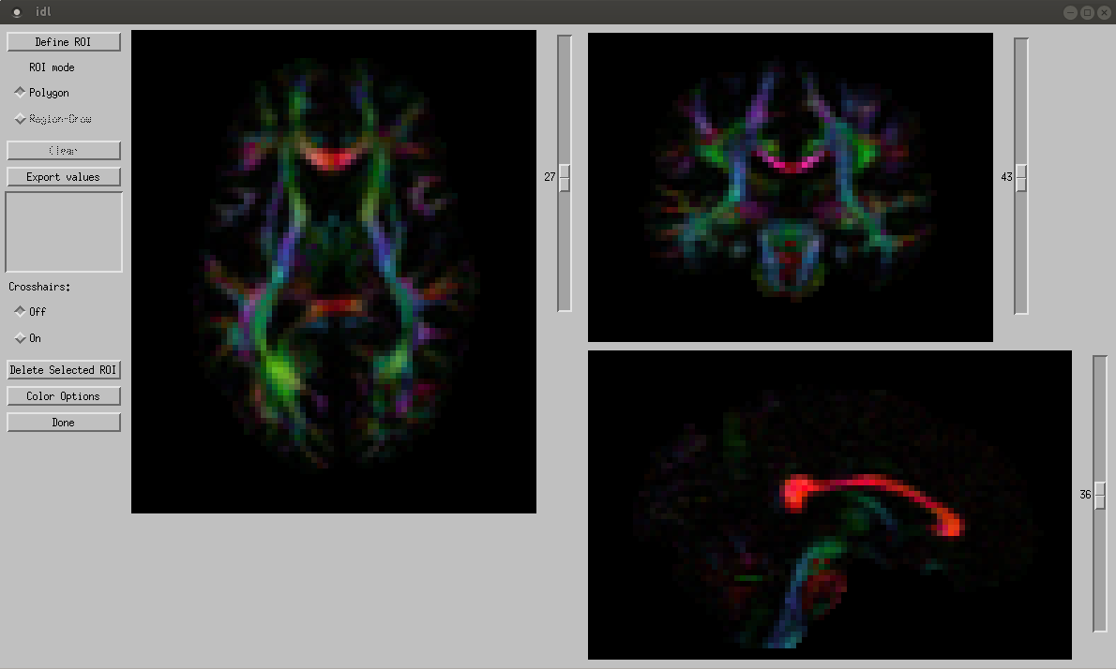
DEC map (absolute value scheme) may look correct

Slide 7
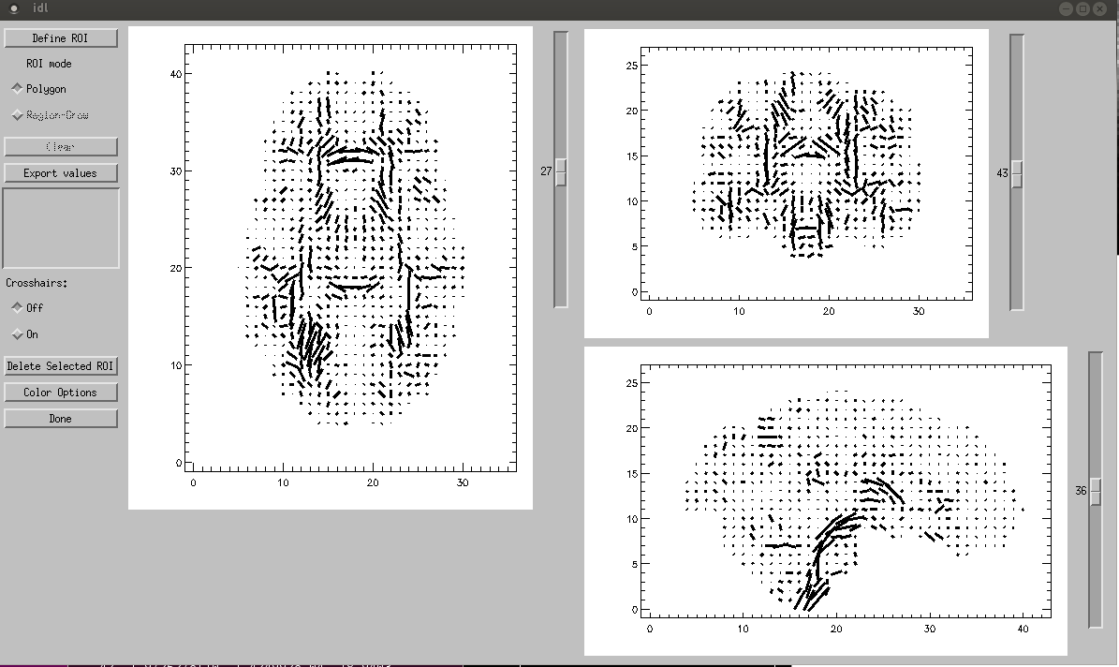
Underlying vector field is incorrect

Slide 8
Magnetic Resonance in Medicine 42:526–540 (1999)

Slide 9
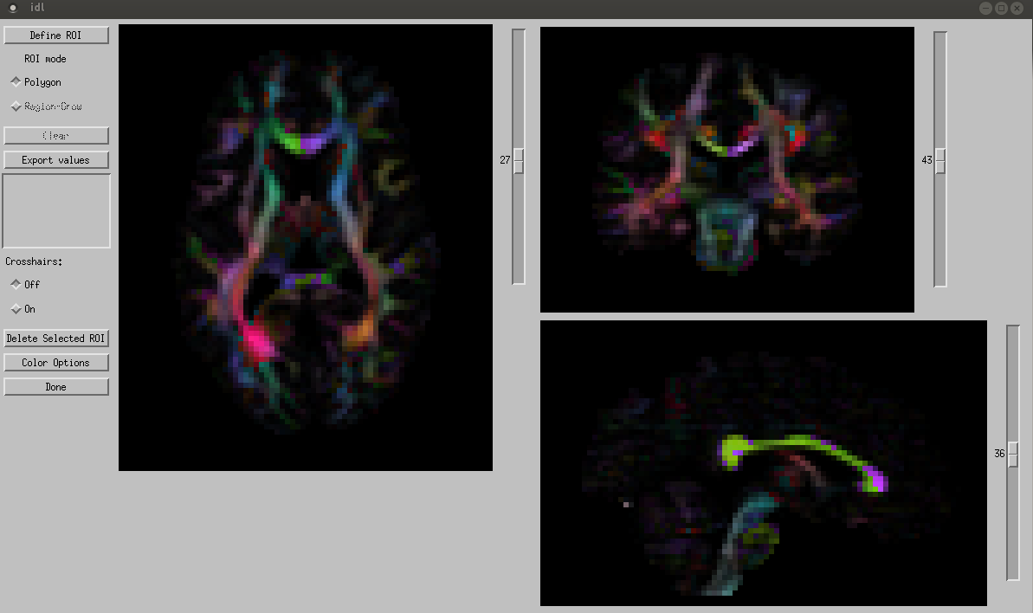
USE no symmetry DEC map to verify correct eigenvector
orientation

Slide 10
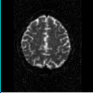
Subject motion

Slide 11
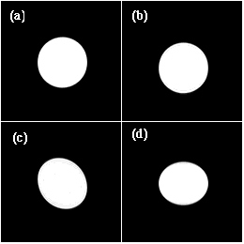
Eddy Current Induced Distortions
Gradient along X
Gradient along Y
B_{o} along Z
Reference
Image
Shift
Shear
Stretch /
Compress
Courtesy of Derek Jones who in turn thanks Joe Zhou

Slide 12
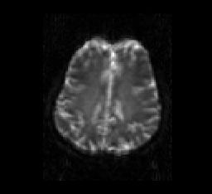
Eddy Current Induced Distortions

Slide 13
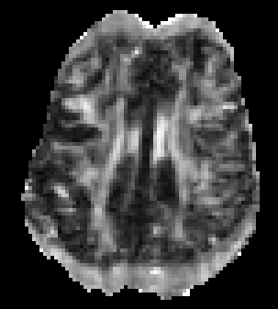
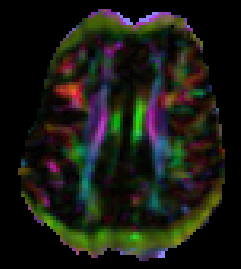
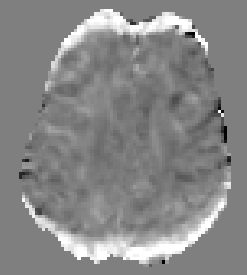
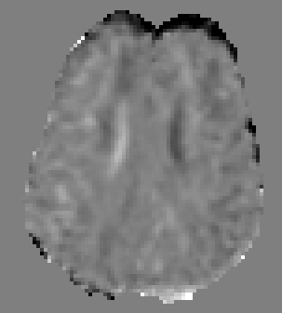
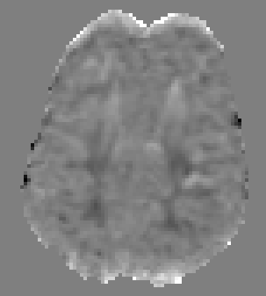
Effects of image mis-registration on tensor-derived parameters Artifactually high anisotropy…
FA
DEC
Dxy
Dxz
Dyz

Slide 14
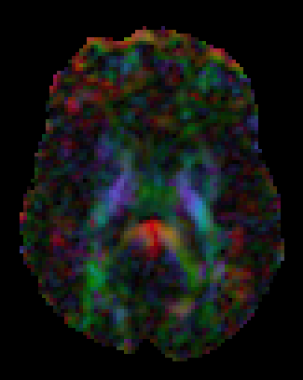
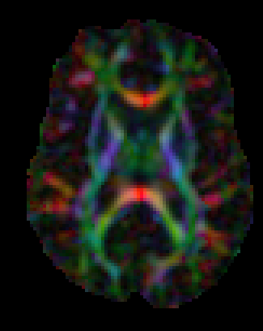
Effects of image mis-registration on tensor-derived parameters ….and/or artifactually low anisotropy
DEC map computed from data corrupted by severe motion
DEC map computed after motion correction

Slide 15
Remedies for misregistration artifacts
Subject motion:
image registration (Andersson, 2002; Rohde, 2004)
Eddy current distortion:
acquisition (e.g. twice refocused spin echo, Reese 2003)
field maps (Jezzard 1998)
image registration (Haselgrove,1996; Bastin 1999; Horsfield, 1999; Andersson, 2002; Rohde, 2004)
opposite diffusion gradient polarity (Bodammer 2004,
Andersson, 2016)

Slide 16
Desirable features in registration algorithms for diffusion MRI
Motion correction, eddy current correction, and registration to a standard template done with only one interpolation step

Slide 17
Desirable features in registration algorithms for diffusion MRI
Motion correction, eddy current correction, and registration to a standard template done with only one interpolation step
Correct deformation model

Slide 18
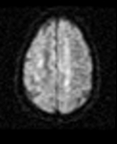
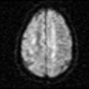
Eddy distortion correction head to head comparison
AFFINE registration
Affine + Quadratic TORTOISE
Notes:
Not all algorithms are created equally. Affine versus higher order term (reference ASB)

Slide 19
Desirable features in registration algorithms for diffusion MRI
Motion correction, eddy current correction, and registration to a standard template done with only one interpolation step
Correct deformation model
- Parsimonious deformation model

Slide 20
Desirable features in registration algorithms for diffusion MRI
Motion correction, eddy current correction, and registration to a standard template done with only one interpolation step
Correct deformation model
- Parsimonious deformation model
- No additional data needed (e.g. no phantom calibration)

Slide 21
Desirable features in registration algorithms for diffusion MRI
Motion correction, eddy current correction, and registration to a standard template done with only one interpolation step
Correct deformation model
- Parsimonious deformation model
- No additional data needed (e.g. no phantom calibration)
- Appropriate reorientation of b-matrices

Slide 22
Desirable features in registration algorithms for diffusion MRI
Motion correction, eddy current correction, and registration to a standard template done with only one interpolation step
Correct deformation model
- Parsimonious deformation model
- No additional data needed (e.g. no phantom calibration)
- Appropriate reorientation of b-matrices
- co-registration of images with very different contrast

Slide 23
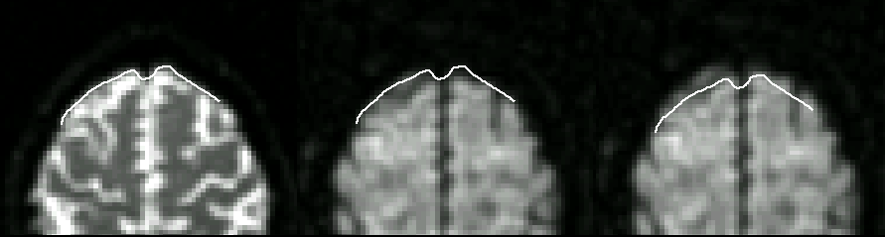
T2WI
DWI
Registration based on mutual information
DWI
Registration based on correlation

Slide 24
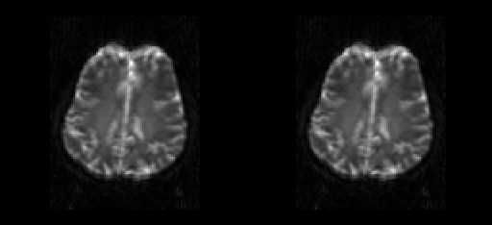
Example of correction of eddy-current and motion artifacts (according to Rohde et al. MRM 2004)

Slide 25
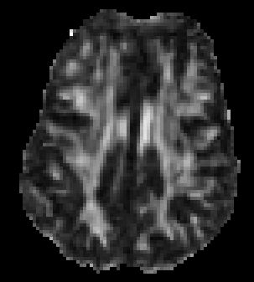
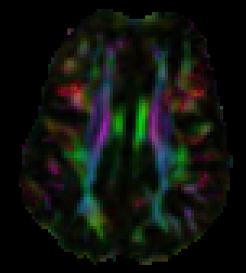
Correction of eddy-current and motion artifacts according to Rohde et al. MRM 2004
Computed from unregistered raw images
FA
DEC
Computed from registered raw images

Slide 26
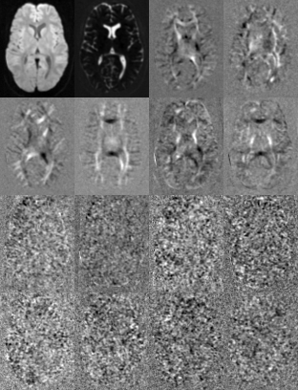
Principal Component Analysis of signals in a DWI data set
From Rohde et al, MRM 2004
No motion
Principal components are displayed in order of decreasing variance from top-left
Notes:
The n volumes of a dti dataset can be seen as a random vector of n components and m elements where m is the number of voxels in the imaged volume.
We compute a new set of n volumes
PCA reference: Anderson TW 1957

Slide 27
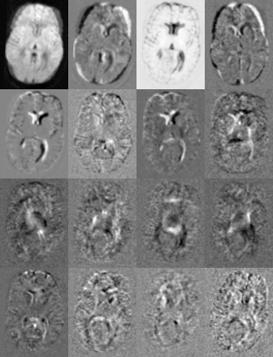
Principal Component Analysis of signals in a DWI data set
From Rohde et al, MRM 2004
In presence of
uncorrected
motion
Principal components are displayed in order of decreasing variance from top-left
Notes:
The n volumes of a dti dataset can be seen as a random vector of n components and m elements where m is the number of voxels in the imaged volume.
We compute a new set of n volumes
PCA reference: Anderson TW 1957

Slide 28
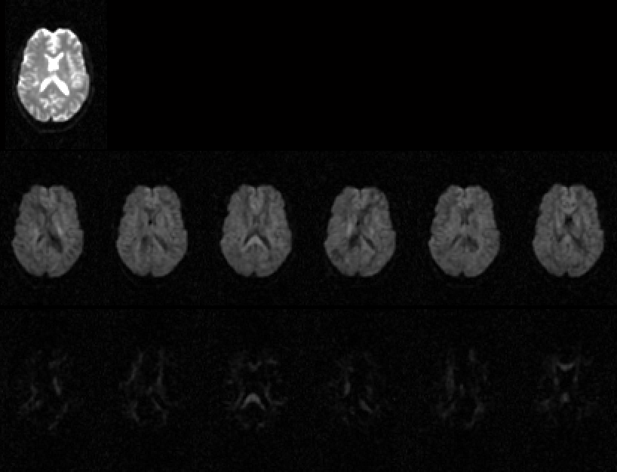
Registration of high b-value images: Challenging…
.
B = 30 s/mm²
B = 900 s/mm²
B = 9000 s/mm²
…but interesting approaches have been proposed
(e.g. J.Andersson, S Sotiropoulos NEUROIMAGE 2016, 125 1063-78)

Slide 29
EPI distortion

Slide 30
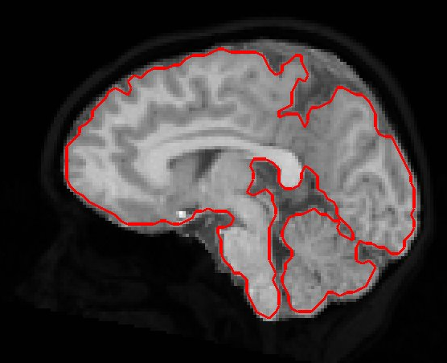
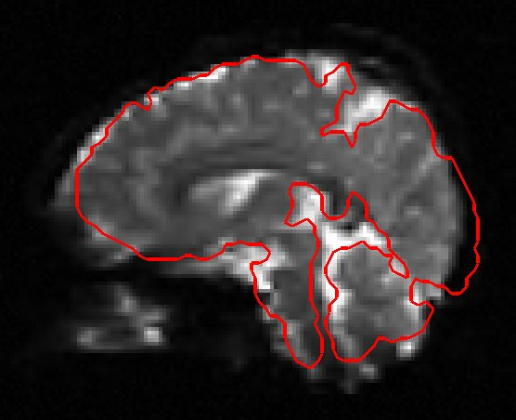
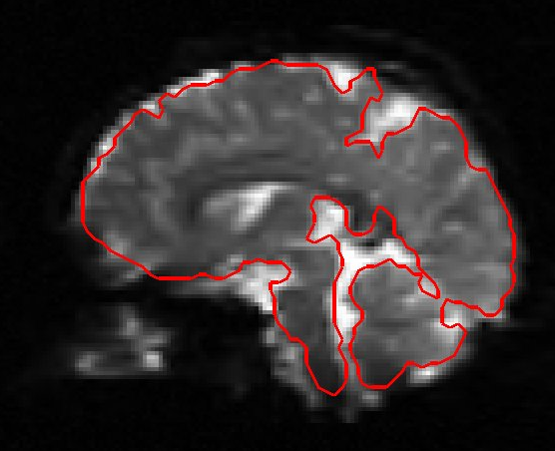
EPI distortion
T1 Target
before correction
after correction

Slide 31
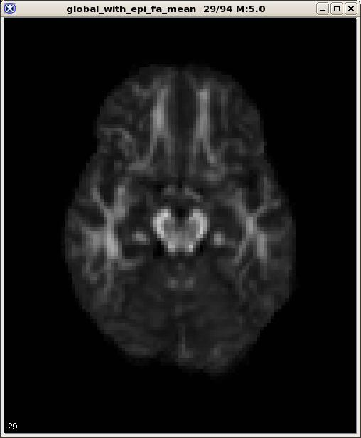
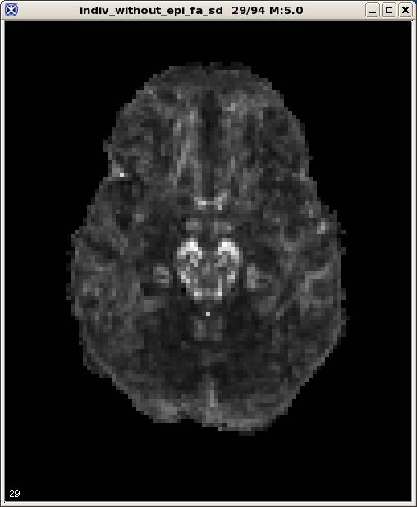
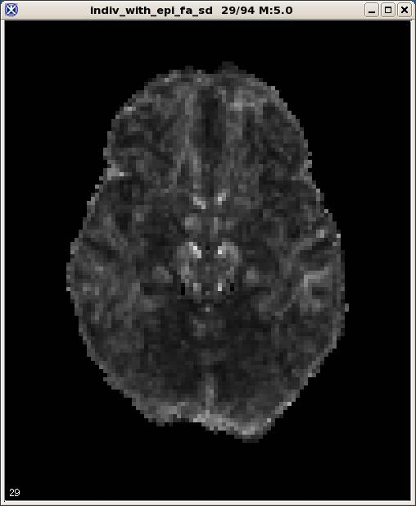
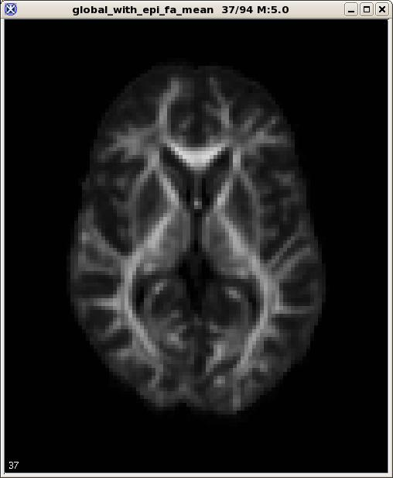
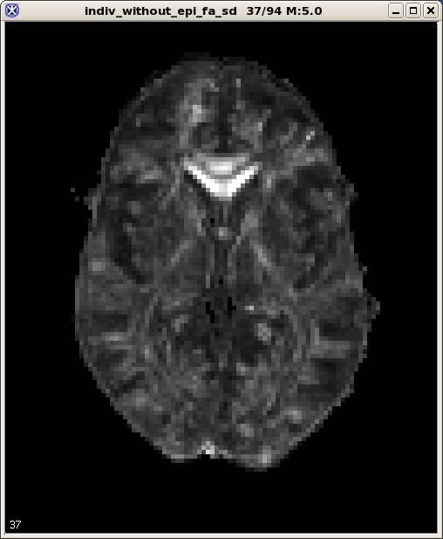
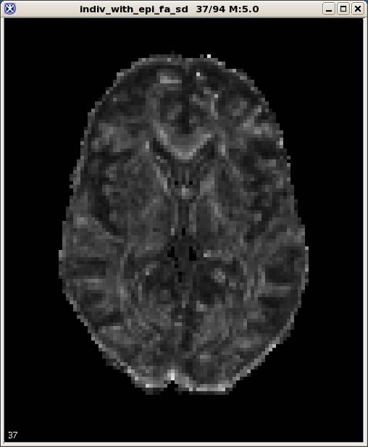
Voxelwise analysis of tensor derived quantities from
Living Phantom data (21 scans from 5 sites)
No EPI Correction
With EPI Correction (Wu et al, MICCAI 2008
Mean FA
SD of FA
SD of FA
Notes:
Living Phantom standard deviation across N=21 scans from 5 sites (BOS = 6, CIN = 4, PHI = 5, UCLA = 3, STL=3). These were processed with the individual target T2 which were all rigidly co-registered. Mean FA is from the EPI corrected data. All data were corrected for Eddy and Motion.

Slide 32


Slide 33
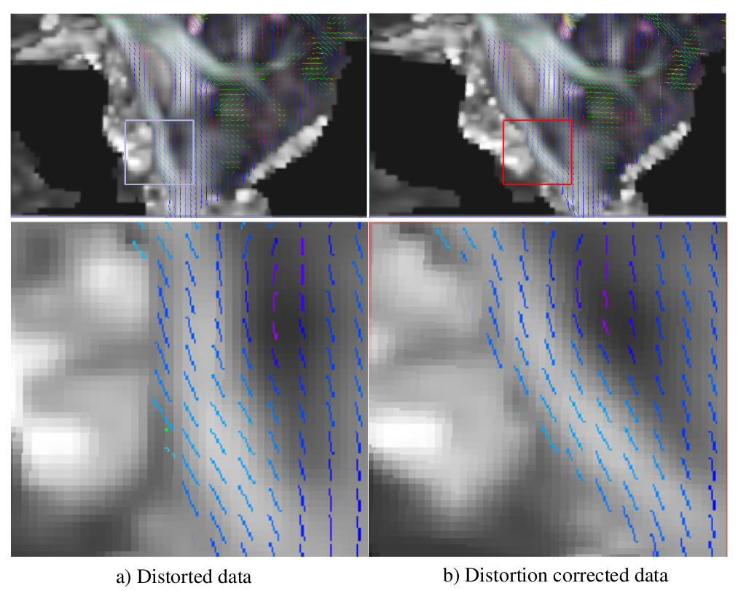

Slide 34
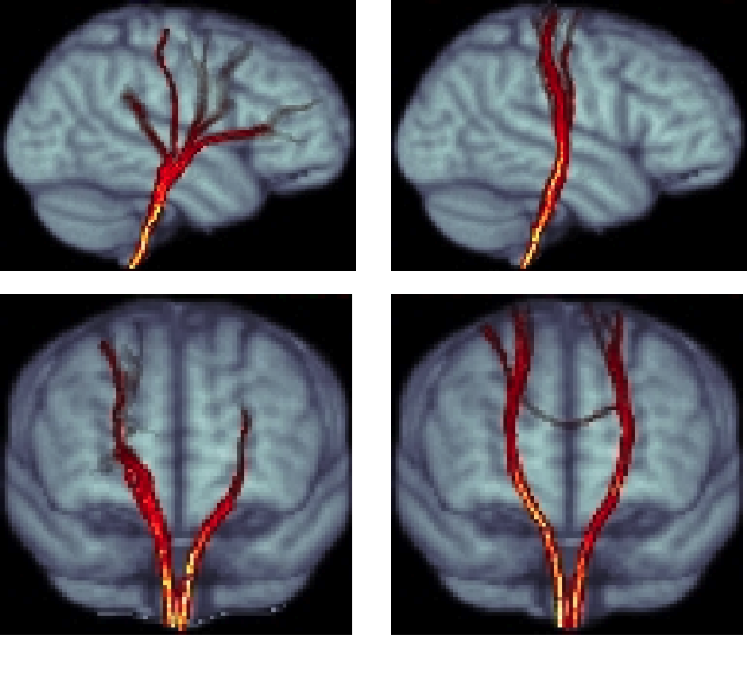
Native EPI distortion
EPI distortion corrected

Slide 35
EPI distortion correction strategies
EPI distortion correction strategies can be broadly categorized into three classes:
  Field-mapping.
  Image registration.
  Reverse phase encoding (Blip-up blip-down).
Field-mapping (Jezzard et al, 1995).
  Requires estimated B₀ inhomogeneity maps from two scans with different echo times.
  Accurate estimation of the B₀ map may be challenging.
  Can not properly correct regions of severe signal pile-up.

Slide 36
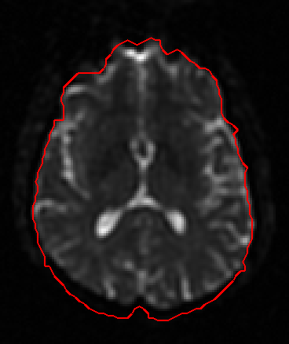
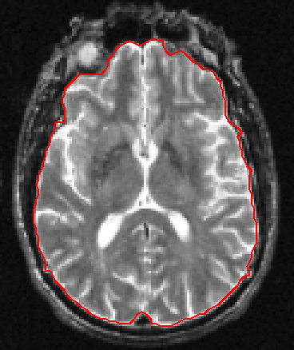
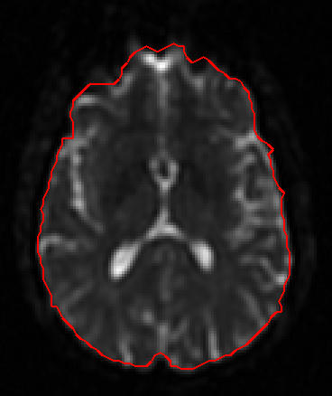
Elastic image registration based approaches (Kybic et al, 2000, Wu et al. 2008).
  Requires a distortion-free anatomical image.
  Can not properly correct regions of severe signal pile-up.
Constrained elastic registration

Slide 37
Reversed phase encoding (blip-up blip-down) correction (Chang et al. 1992, Bowtell, 1994, Andersson et al., 2003, Holland et al., 2010.)
It exploits the symmetry of distortions in two identical images acquired with opposite polarity of phase encoding
Acquired with RL phase encoding
Acquired with LR phase encoding

Slide 38
  Only strategy that can correct for signal pile-ups and expansions, as well as geometrical distortions.
  More robust with larger deformations than standard elastic registration approaches.
  May need longer scan time
Corrected data
Blip-up blip-down data

Slide 40
Important features of DR-BUDDI (Diffeomorphic Registration for Blip-Up blip-Down Diffusion Imaging)
Can use a structural image as additional information for registration (fat suppressed T2-WI)
Performs blip-up blip down correction also on DWIs
All corrections are applied to the original images with one interpolation step
Diffeomorphic
Symmetric
Large deformation
Constrained

Slide 41
DR-BUDDI pipeline

Slide 42
DR-BUDDI Results
Correction of highly distorted CONNECTOME data
Notes:
3/27/19
42

Slide 43
Cardiac Pulsation
Cardiac pulsation has been identified as an important source of variability in fMRI.
Previous studies have shown some benefits of cardiac gating in DWI and apparent diffusion coefficient measurements . (Chien et al. 1990, Turner et al. 1990, Conturo et al. 1995, Skare et al. 2001)
However, the effect of cardiac pulsation on DTI measurements has not been extensively investigated and cardiac gating is rarely used in clinical DT-MRI.

Slide 44
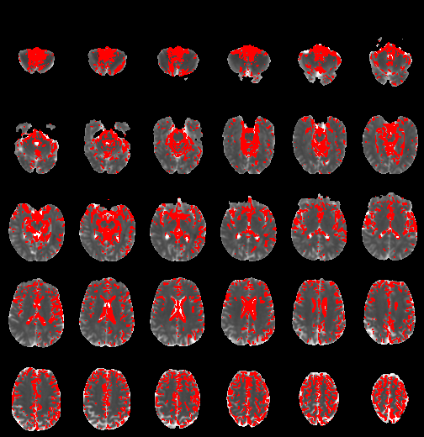
Trace(D)
Kruskal-Wallis test
Statistically significant voxels in red
Bonferroni correction
C Pierpaoli – Artifacts in Diffusion MRI in Diffusion MRI: Theory, Methods and Applications, 2010

Slide 45
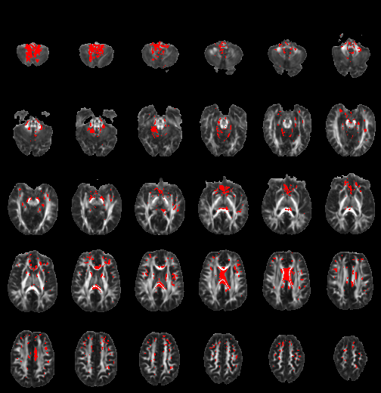
FA
Kruskal-Wallis test
Statistically significant voxels in red
Bonferroni correction
C Pierpaoli – Artifacts in Diffusion MRI in Diffusion MRI: Theory, Methods and Applications, 2010

Slide 46
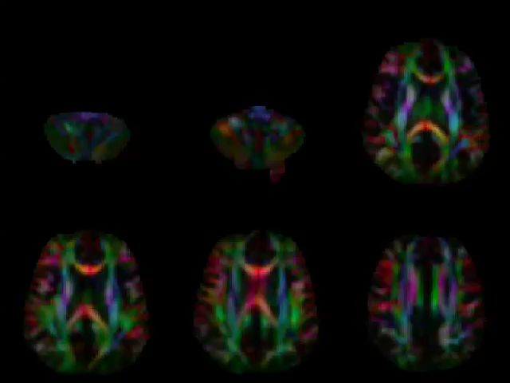

Slide 47
Cardiac pulsation significantly affects, Trace(D), anisotropy measures, and apparent fiber orientation in several brain regions
Most of the variability is produced by data acquired from 100 to 250 ms after the QRS

Slide 48
Possible solutions
1) Cardiac gating
- in product sequences: not widely used, not optimized, sometimes buggy
- believed to increase scan time (somewhat incorrectly because often the rate limiting factor is gradient duty cycle).
2) Retrospective gating
3) Robust tensor fitting

Slide 49
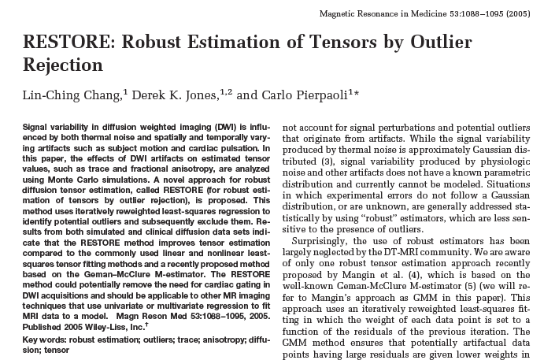

Slide 50
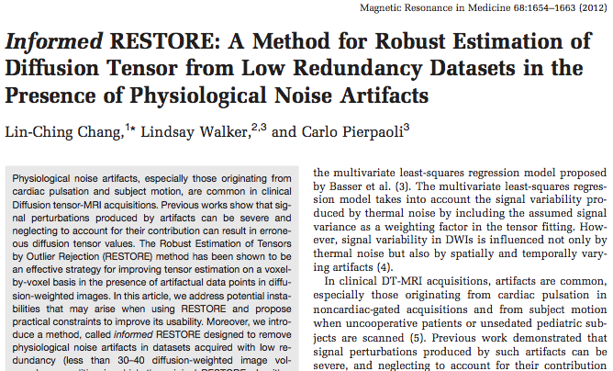

Slide 52
Nonlinear LS fit
RESTORE:
Robust
EStimation of
Tensors by
Outlier
REjection
Goodness of fit criterion
satisfied?
Yes
No
Iterative re-weighting process
Reset weights
based on the residuals
Nonlinear robust fit
Chang et al,
MRM 2005
Convergence?
No
Yes
Outlier identification
and exclusion
Final nonlinear LS fit
Tensor Maps

Slide 53
RESTORE performance. Monte carlo simulation

Slide 54
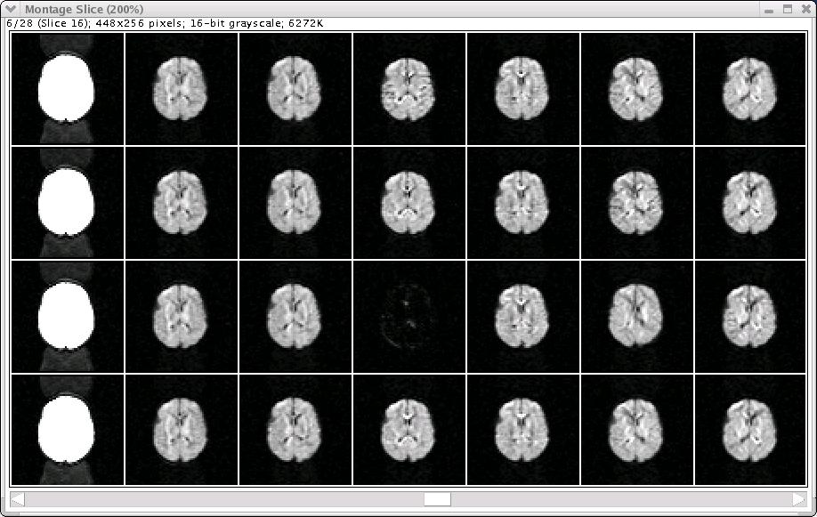
Automatic exclusion of “bad images”

Slide 55
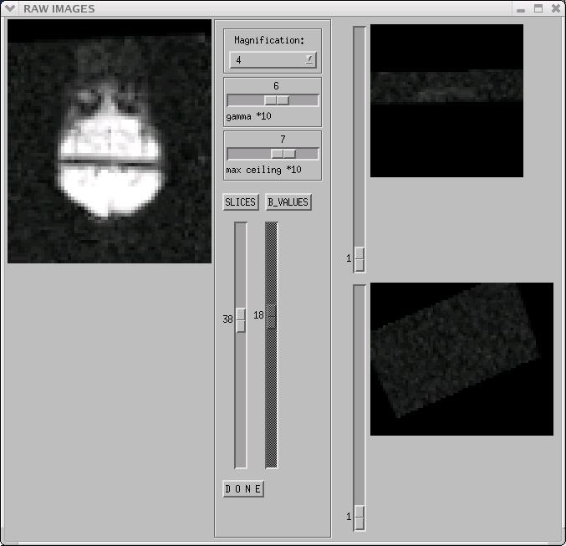
After registration the “bad” image is distributed across several slices

Slide 56
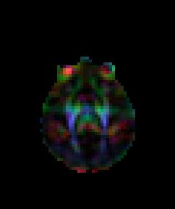
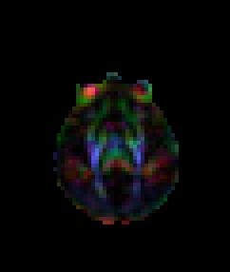
One “bad” image out of 28 DWIs can significantly corrupt tensor -derived quantities
Conventional tensor fitting
Robust tensor fitting using RESTORE

Slide 57
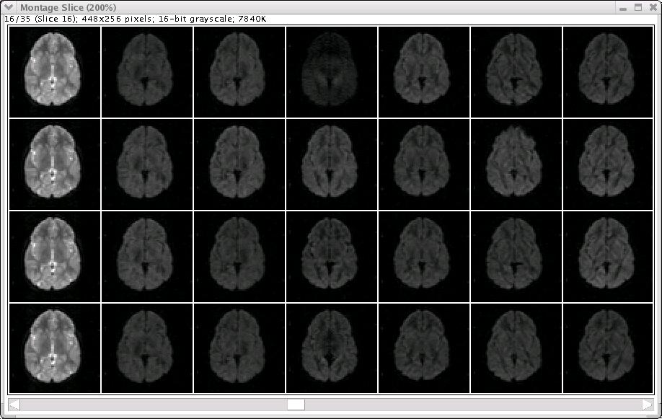
Robust tensor fitting: Selective (voxel-based) exclusion of corrupted data

Slide 58
Robust tensor fitting: Selective (voxel-based) exclusion of corrupted data

Slide 59
Robust tensor fitting: Selective (voxel-based) exclusion of corrupted data

Slide 60

RESTORE performance. Cardiac Pulsation
Diastolic data
Diastolic + systolic data
T2wi
Outlier map
Outlier map

Slide 61


Outlier Rejection Probability Map
Lindsay Walker et al Neuroimage 2011

Slide 62
Importance of outlier and artifact detection in clinical imaging
Biological Psychiatry - 2013

Slide 63












white matter skeleton voxels
A) Clusters of significant differences in FA (TYP > AUT)
statistically significant voxels
B) Clusters of significant differences in MD (AUT > TYP)
Notes:
Figure 1

Slide 64



Percentage of Outlier Data Points in a single subject example
~3% outliers detected
up to 50% outliers detected
Notes:
Supplemental figure S5

Slide 65

Subtraction of Percentage of Outliers – AUT minus TYP
-7%
7%
Notes:
Figure 4 – Difference in distribution of outliers

Slide 66
A good and somewhat forgotten “diagnostic” tool to help detecting artifacts in diffusion MRI
Map of reduced χ_{ν}² (goodness of fit) from tensor fitting (Papadakis JMR 2003)

Slide 67
Relevant references
A measure of curve fitting error for noise filtering diffusion tensor MRI data
Papadakis NG, Martin KM, Wilkinson ID, Huang CLH
JOURNAL OF MAGNETIC RESONANCE
164 (1): 1-9 SEP 2003
Characterization of normal brain and brain tumor pathology by chisquares parameter maps of diffusion-weighted image data
Maier SE, Mamata H, Mulkern RV
EUROPEAN JOURNAL OF RADIOLOGY
45 (3): 199-207 MAR 2003

Slide 68



χ_{ν}² = S² / <σ_{i}²>
<σ_{i}²> = expected variance
Ref: Bevington PR, Robinson DK. 3rd Ed. 2003.

Slide 69
χ_{ν}² = measured variance (S²) /
expected variance (<σ_{i}²>)
If thermal noise is the only source of variability and the tensor model fits the data perfectly …
….The χ_{ν}² map should be homogeneous with an average value of 1

Slide 70




χ_{ν}² maps. Healthy human brain, cardiac gating, motion correction
Grayscale: 0 black, 5 brightest

Slide 71



Examples of the utility of χ_{ν}² for detecting artifacts in diffusion MRI

Slide 72

Examples of the utility of χ_{ν}² for detecting artifacts in diffusion MRI

Slide 73

Cause of the artifact: imperfect fat suppression

Slide 74


FA
DEC
χ_{ν}²

Slide 75

Residual histogram in TORTOISE

Slide 76

Residual histogram. What problem are we detecting?

Slide 77

Processing pipeline should enable checking for artifacts like this
….

Slide 78


First DWI
Last DWI after 20 min of scanning

Slide 79
B0 Frequency shift caused by gradient heating
First DWI
Last DWI after 20 min of scanning

Slide 80
Tasks to address in a DTI processing pipeline

Slide 81
Tasks to address in a DTI processing pipeline
Importing data, check if images are sorted correctly
Initial quality control by visual inspection

Slide 82
Tasks to address in a DTI processing pipeline
Importing data, check if images are sorted correctly
Initial quality control by visual inspection
Production of “corrected” raw images
- EPI distortion correction
- Motion and eddy-current distortion correction
- Registration to standard template
- Rotation of b-matrices
- Generate interpolation-corrected weighting
coefficients

Slide 83
Tasks to address in a DTI processing pipeline
Importing data, check if images are sorted correctly
Initial quality control by visual inspection
Production of “corrected” raw images
- EPI distortion correction
- Motion and eddy-current distortion correction
- Registration to standard template
- Rotation of b-matrices
- Generate interpolation-corrected weighting
coefficients
Tensor computation (correct weighting)

Slide 84
Tasks to address in a DTI processing pipeline
Importing data, check if images are sorted correctly
Initial quality control by visual inspection
Production of “corrected” raw images
- EPI distortion correction
- Motion and eddy-current distortion correction
- Registration to standard template
- Rotation of b-matrices
- Generate interpolation-corrected weighting
coefficients
Tensor computation (correct weighting)
Analysis of residuals of tensor fitting, inspection χ² maps

Slide 85
Tasks to address in a DTI processing pipeline
Importing data, check if images are sorted correctly
Initial quality control by visual inspection
Production of “corrected” raw images
- EPI distortion correction
- Motion and eddy-current distortion correction
- Registration to standard template
- Rotation of b-matrices
- Generate interpolation-corrected weighting
coefficients
Tensor computation (correct weighting)
Analysis of residuals of tensor fitting, inspection χ² maps
Robust tensor estimation

Slide 86
Tasks to address in a DTI processing pipeline
Importing data, check if images are sorted correctly
Initial quality control by visual inspection
Production of “corrected” raw images
- EPI distortion correction
- Motion and eddy-current distortion correction
- Registration to standard template
- Rotation of b-matrices
- Generate interpolation-corrected weighting
coefficients
Tensor computation (correct weighting)
Analysis of residuals of tensor fitting, inspection χ² maps
Robust tensor estimation
Computation of tensor derived variables

Slide 87
Tasks to address in a DTI processing pipeline
Importing data, check if images are sorted correctly
Initial quality control by visual inspection
Production of “corrected” raw images
- EPI distortion correction
- Motion and eddy-current distortion correction
- Registration to standard template
- Rotation of b-matrices
- Generate interpolation-corrected weighting
coefficients
Tensor computation (correct weighting)
Analysis of residuals of tensor fitting, inspection χ² maps
Robust tensor estimation
Computation of tensor derived variables and/or HARDI analysis

