Slide 1

Quick Tasks for AFNI Interactive Learning-by-Doing
RW Cox

Slide 2
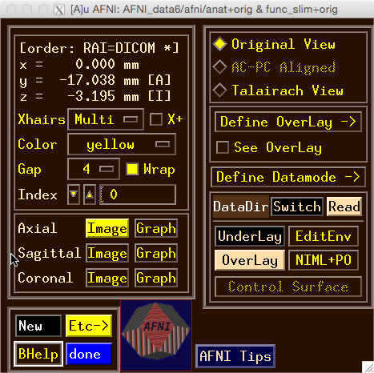
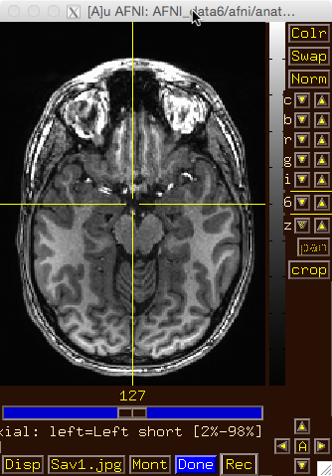
Try the BHelp button
  Over some other GUI button
  Over an image
  Over the grayscale bar next to the image
Bhelp works with majority of GUI

Slide 3
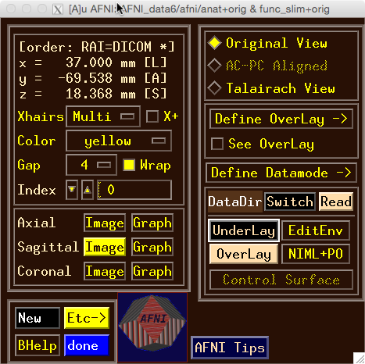
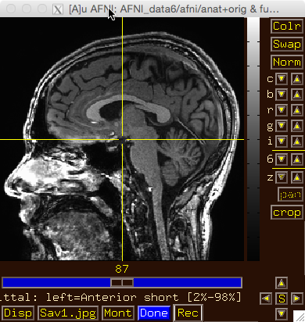
Drag image viewer far away, then
Right click
  what happens to the image window?

Slide 4
Image viewer #1: Can you do …
  Invert image grayscale?

Slide 5
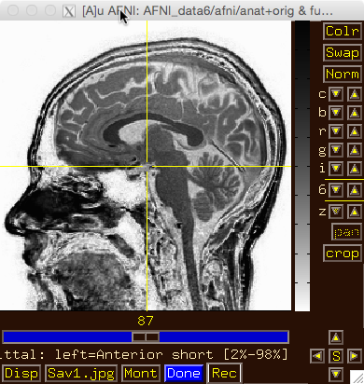
Image viewer #1: Can you do …
  Invert image grayscale?

Slide 6
Image viewer #2: Can you do …
  Change contrast and/or brightness?

Slide 7
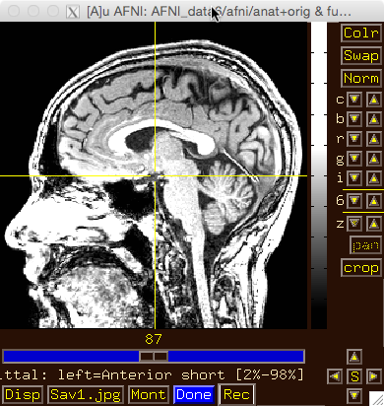
Image viewer #2: Can you do …
  Change contrast and/or brightness?
You can also left-click mouse, hold button down, and drag up/down or left/right to change brightness or contrast

Slide 8
Image viewer #3: Can you do …
  Zoom in and out?

Slide 9
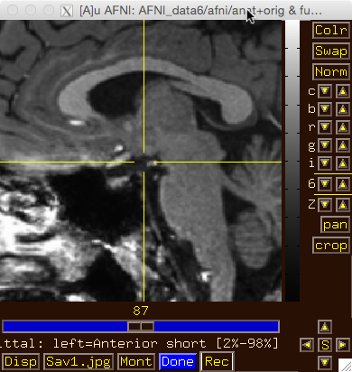
Image viewer #3: Can you do …
  Zoom in and out?
Use ‘pan’ to adjust zoom window

Slide 10
Image viewer #4: Can you do …
  Create a 3x3 montage?

Slide 11
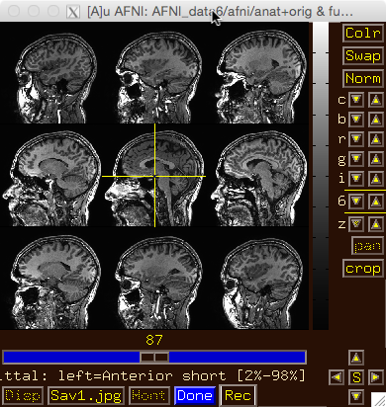
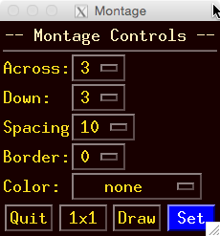
Image viewer #4: Can you do …
  Create a 3x3 montage?

Slide 12
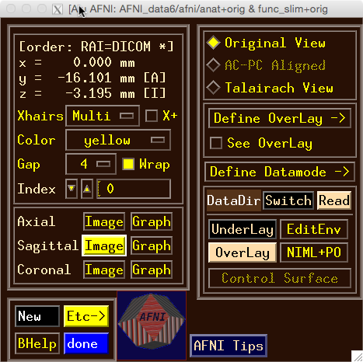
Try some of the right-click popup menus
  this one is simple: for spatial coordinates

Slide 13
Try some of the right-click popup menus
  this one is mostly for fun

Slide 14
Try some of the right-click popup menus
  this one has several commonly used functions for image display and navigation

Slide 15
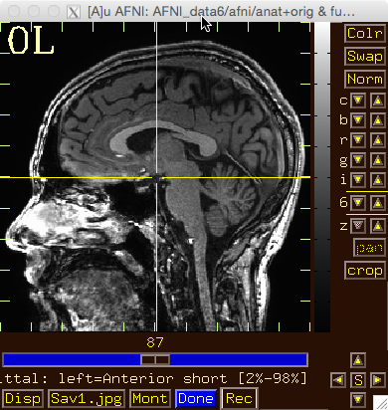
Try some of the right-click popup menus
  has many rarely used options

Slide 16
Try some of the right-click popup menus
  this one is a shortcut for some options on the more complicated ‘Disp’ menu

Slide 17
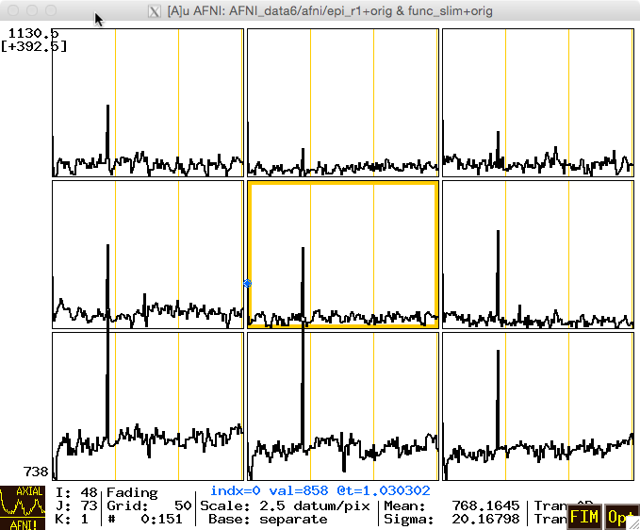
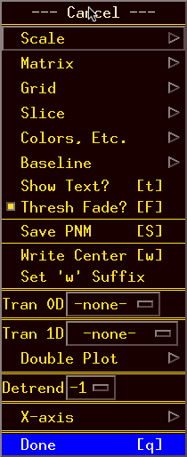
What does ‘I’ keypress do to graph? Then ‘i’?
Use BHelp in graph window
  Shortcut keys
  Click Opt menu for more shortcuts, etc
Change vertical Grid spacing to 15

