Slide 1
7 Tesla EPI at 2 mm3
Subject moves head = warps volume ☹
Data from Javier

Slide 2
Ramp up the brightness to emphasize artifacts

Slide 3
SAME DAY RESULTS

Slide 4
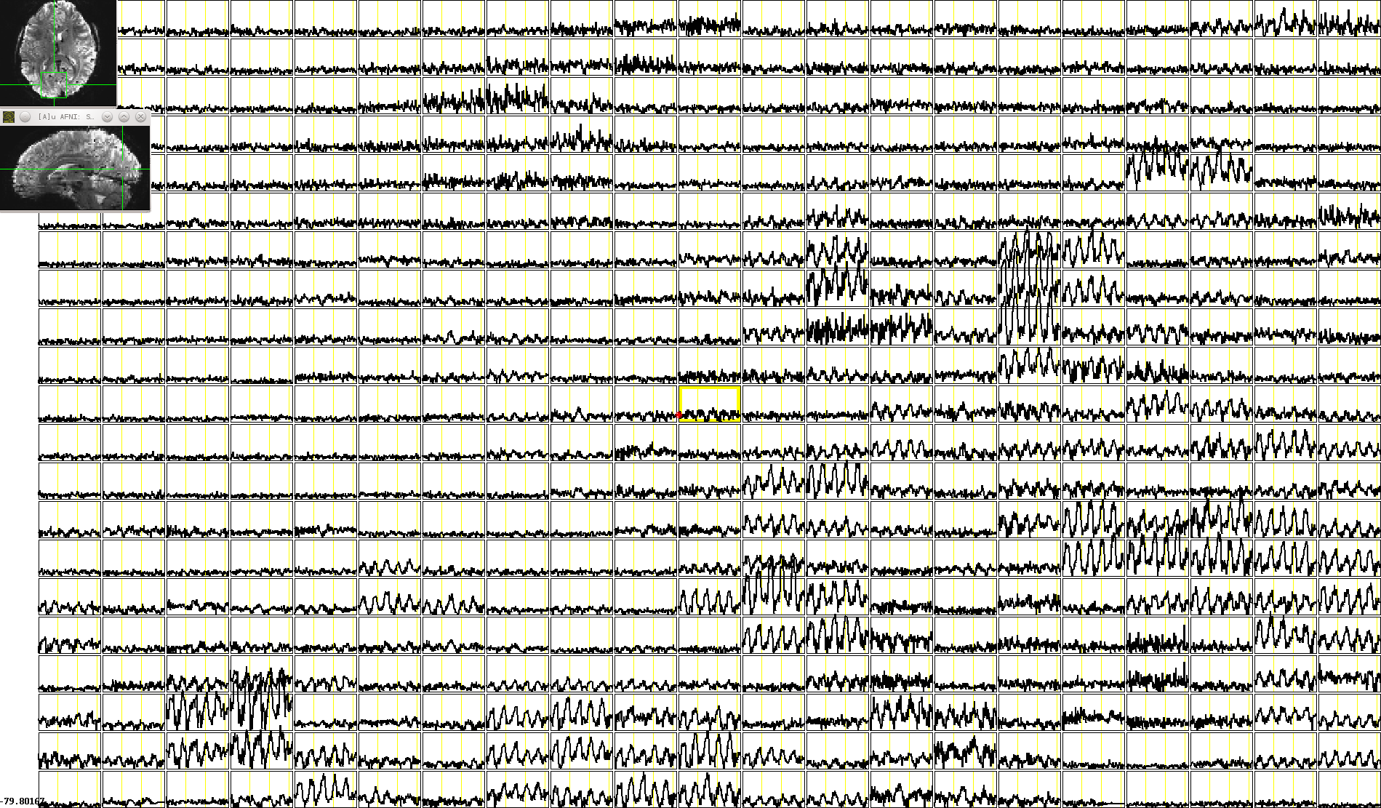
TIME SERIES FROM REFERENCE RUN

Slide 5
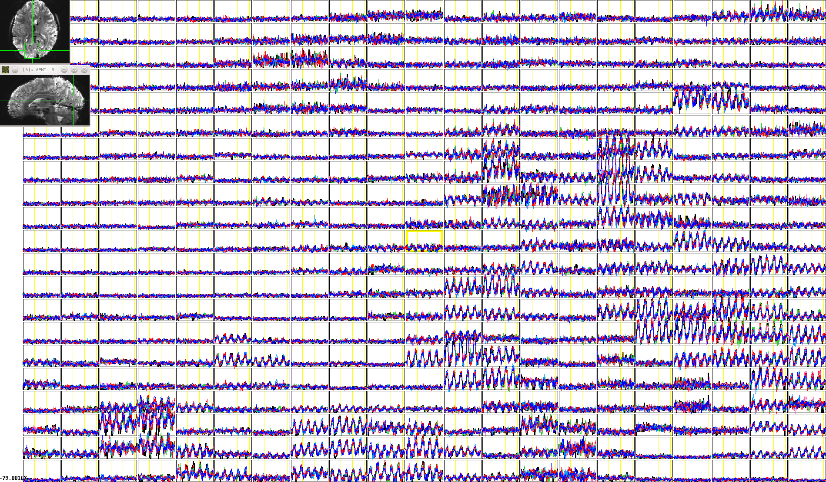
REFERENCE RUN + OTHER 7 RUNS FROM THE SAME DAY (LINEAR)

Slide 6
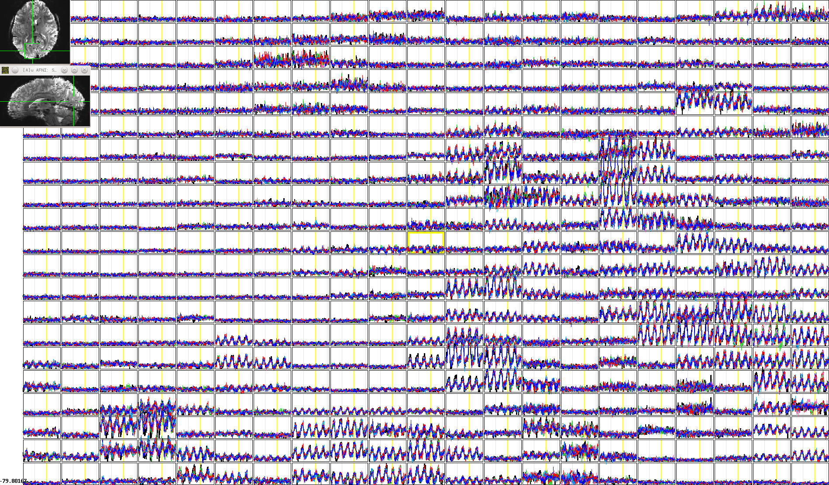
REFERENCE RUN + OTHER 7 RUNS FROM THE SAME DAY (NONLINEAR)

Slide 7
ACROSS DAYS

Slide 8
GOOD SLICE
REFERENCE RUN

Slide 9
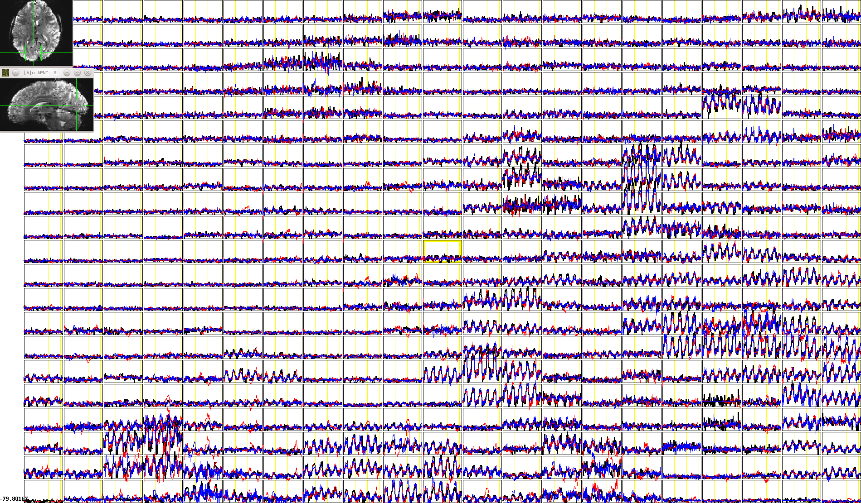
GOOD SLICE
REFERENCE RUN + 2 OTHER DAYS (LINEAR)

Slide 10
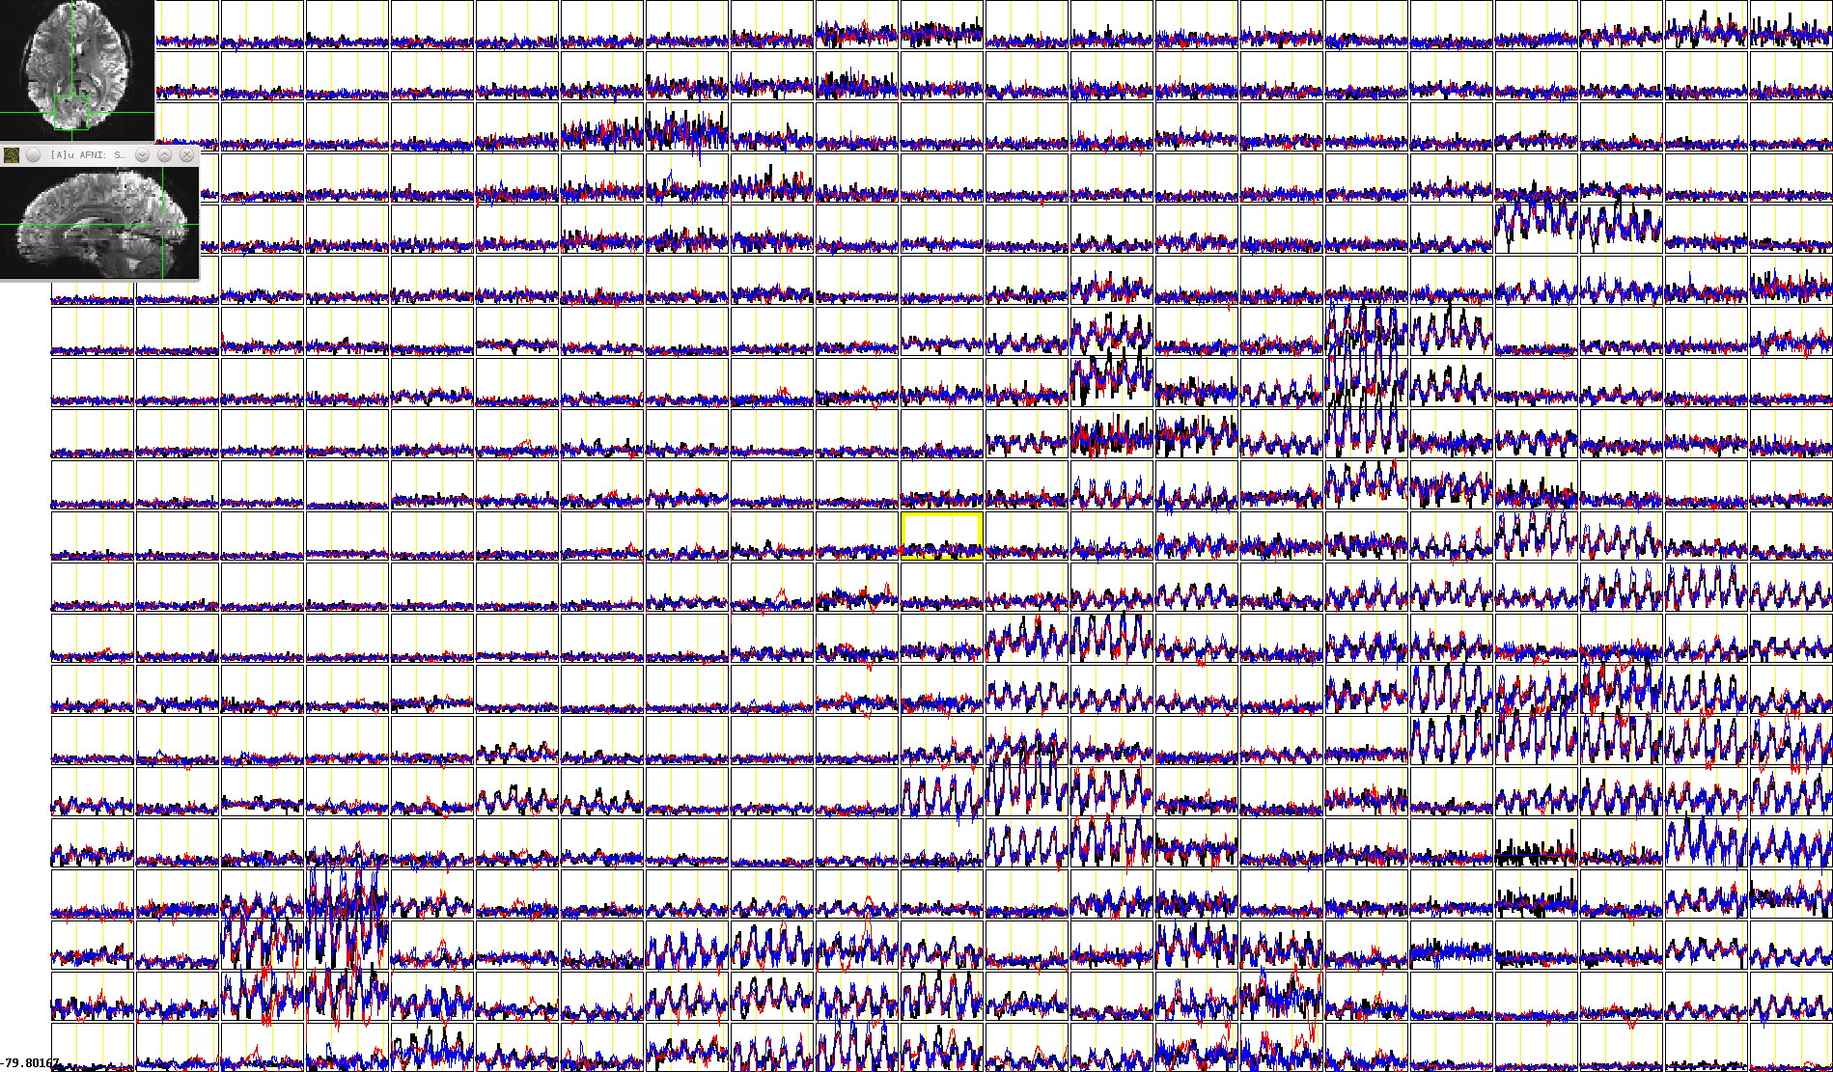
GOOD SLICE
REFERENCE RUN + 2 OTHER DAYS (NONLINEAR)

Slide 11
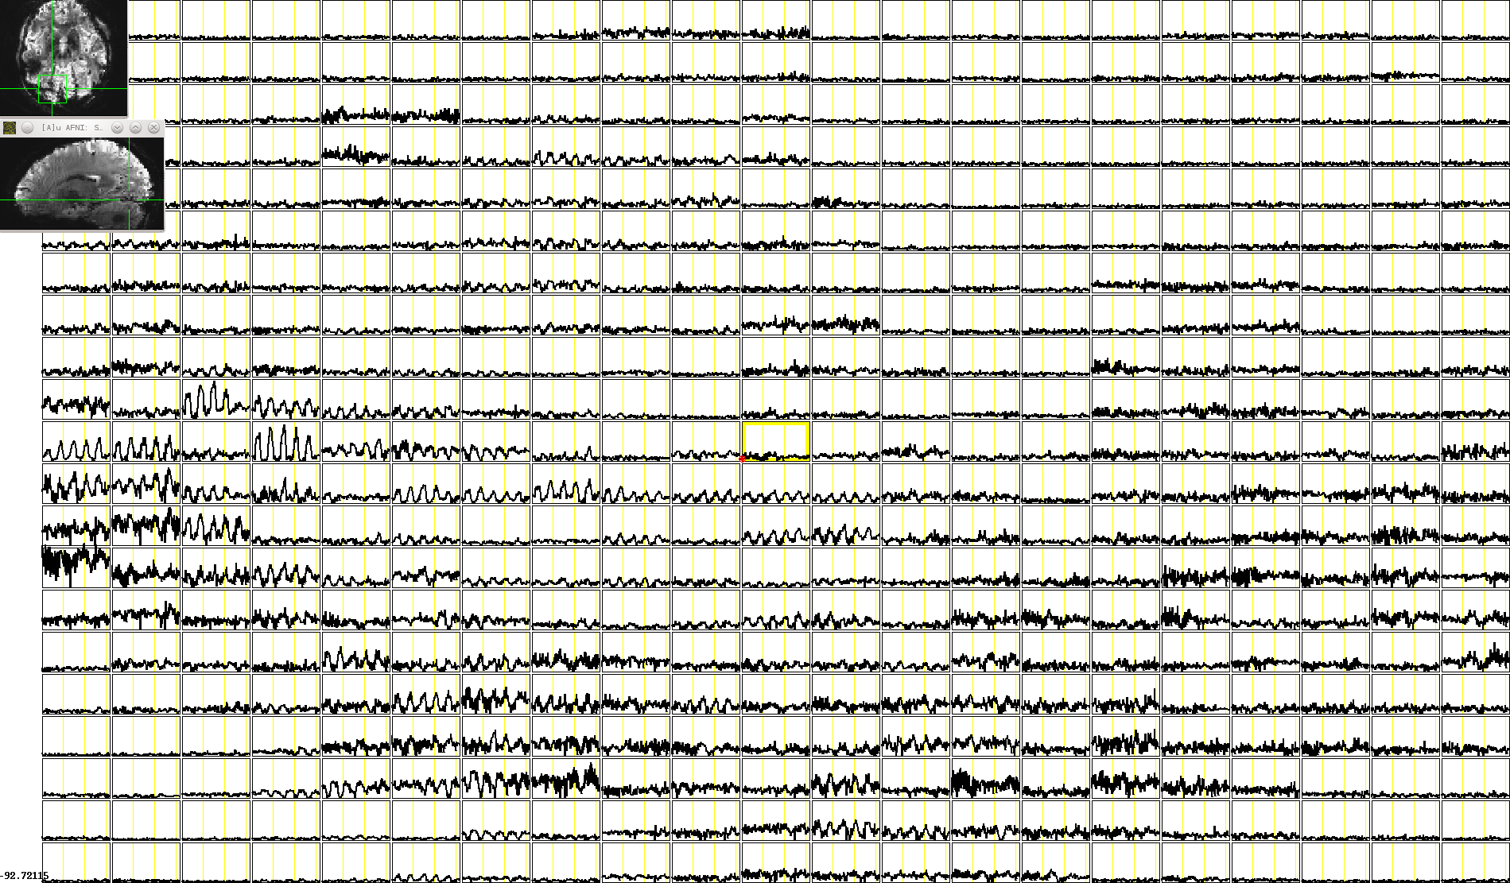
BAD SLICE
REFERENCE RUN

Slide 12
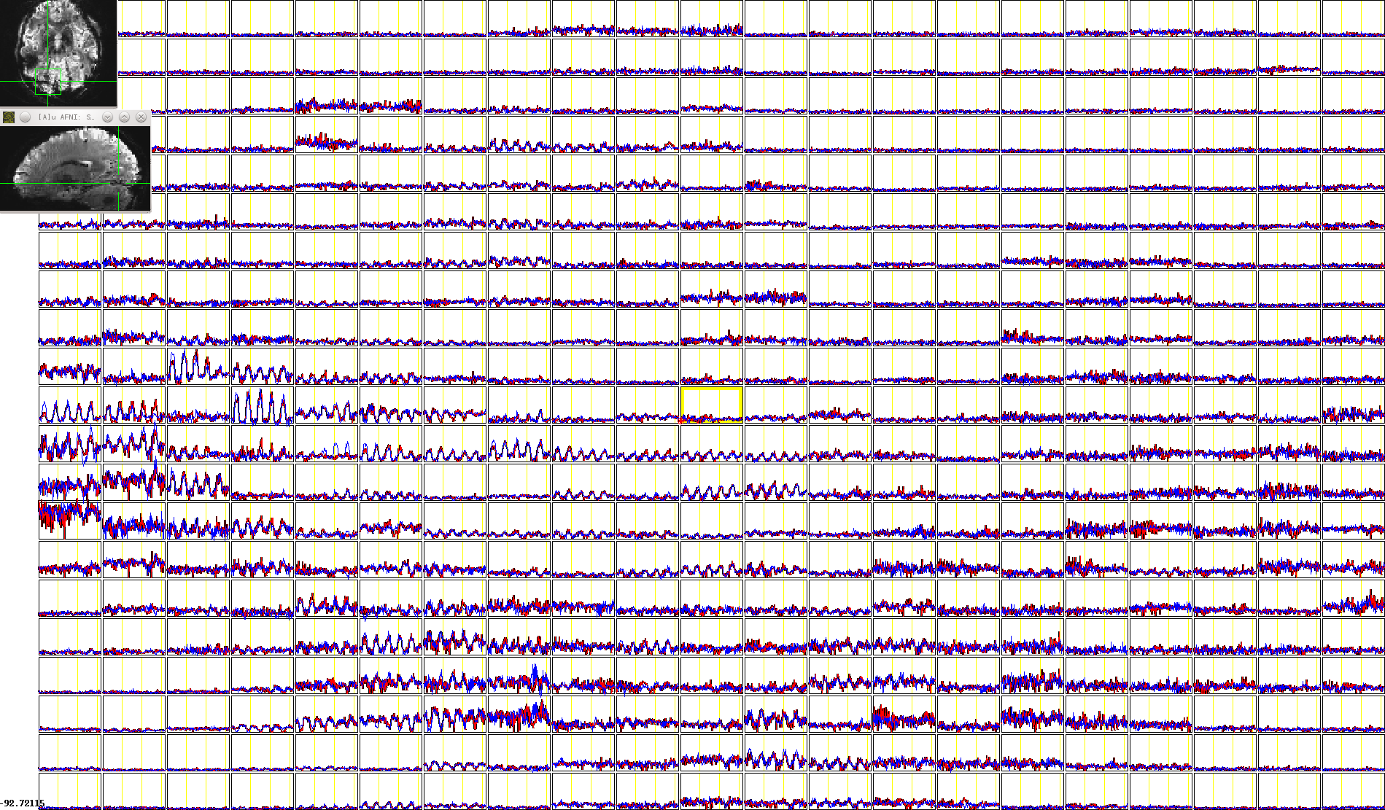
BAD SLICE
REFERENCE RUN + 2 OTHER DAYS (LINEAR)

Slide 13
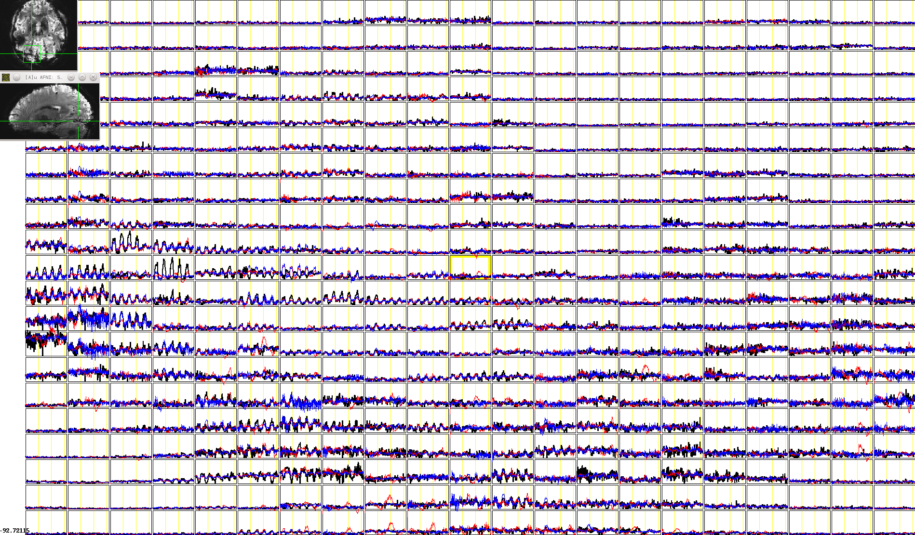
BAD SLICE
REFERENCE RUN + 2 OTHER DAYS (NONLINEAR)

Slide 14
Conclusory Remarks
Nonlinear warping doesn’t help Javier much, might even hurt him some
At present, nonlinear warp can’t magically fix bad data
Javier’s life is hard

