Slide 1
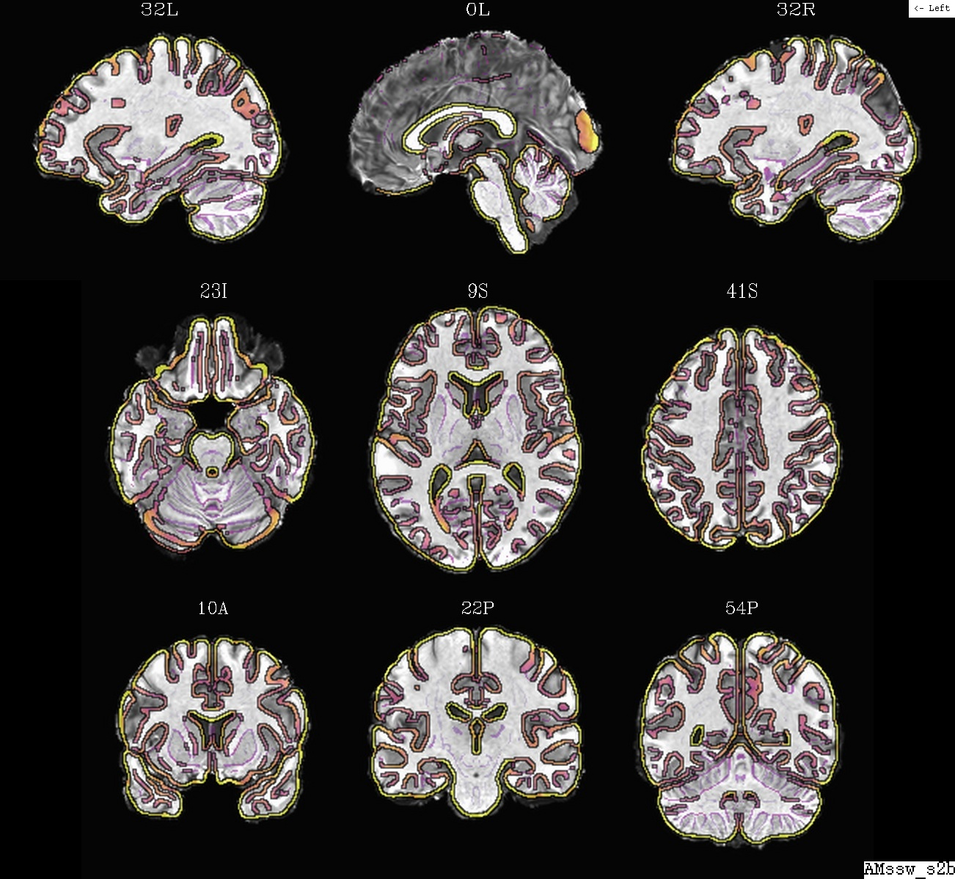
Updated:
2019-11-21
NB about font used here:
Trebuchet MS is found in:
ttf-mscorefonts-installer
Use, e.g.,
sudo apt-get install ttf-mscorefonts-installer

Slide 2
Abbrevs used here
abbrev = abbreviation
AKA = also known as
anat = anatomical
diff = difference
dset = dataset
e.g. = exempli gratia (= “for example”)
EPI = echo planar image
Ex = example
FOV = field of view
i.e. = id est (= “that is”)
ijk = coordinate indices (integer)
NB = nota bene (= “note well”)
phys = physics or physical
ref = reference
subj = subject
vol = volume
vox = voxel(s)
xyz = physical coordinates (units of mm)

Slide 3
Alignment and its purpose(s)
Alignment (AKA registration): bringing separate objects into the same space so that each location (e.g., voxel) within one object corresponds to the same location in the other
  note: other software might refer to this process as “normalization,”
  but not in AFNI; too many things can be “normalized” (e.g., a vol’s brightness), so it is not descriptive enough on its own.

Slide 4
Alignment and its purpose(s)
Alignment (AKA registration): bringing separate objects into the same space so that each location (e.g., voxel) within one object corresponds to the same location in the other
Common types of alignment
  EPI-EPI: align a subject’s EPI vols across time (to a selected ref EPI)
    for motion “correction” (= “reduction” or “mitigation”)
  EPI-anat: align a subject’s EPI with anatomical vol
    to assign a location with a functional result
  anat-template: register a subject’s anatomical to a standard template
    for group level alignment, also compare/use locations from lit.
    can then utilize associated atlases (= maps of regions)
  and more:
    distortion correction (such as EPI distortion)
    “axialize”: rotate brain to standardize slice viewing
    quality control: check for left-right flipping
    ….

Slide 5
Mechanics of alignment
Several different tools exist for alignment
  choose based on properties of the images, what type of distortion/diff is present, and the type of desired alignment
Some important questions about each alignment:
  what is the purpose (e.g., undo distortion, or just overlay good volumes)?
  are we aligning data from the same or different subjects?
  do the data sets have similar or different appearance (both have bright CSF? or opposite tissue contrast?)
  do both data sets have whole brain converage? do both data sets have skull on or off?
important concepts for selecting parameters include: contrast, smoothness, detail, resolution, field of view (FOV), concatenation, source/base dsets, grid
NB: afni_proc.py will take care of many of these details for FMRI processing (so use it!), but it is still good to have some familiarity with them!
We highlight some alignment/registration programs in this presentation.
See the complete list on the AFNI website:
https://afni.nimh.nih.gov/pub/dist/doc/htmldoc/educational/classified_progs.html#align-register-warp-axialize-spatially

Slide 6
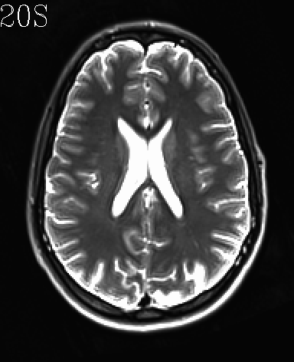
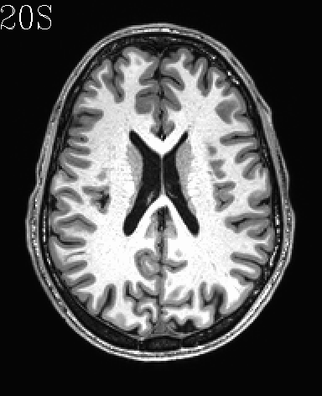
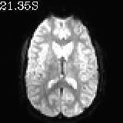
Alignment concepts: tissue contrast
Do the vols have similar or different tissue contrast?
A) T2w
B) T1w
C) EPI

Slide 7
Alignment concepts: tissue contrast
Do the vols have similar or different tissue contrast?
→ determines what cost function we use (see slides 25-27).
different
different
similar
A) T2w
B) T1w
C) EPI

Slide 8
Alignment concepts: spatial resolution
What kind of resolution do vols have (high/low)?
A) T2w
B) T1w
C) EPI

Slide 9
Alignment concepts: spatial resolution
What kind of resolution do vols have (high/low)?
→ affects how we choose which vol is “source” (to-be-warped) and which is “base” (=target) and level of warping
high res
high res
low res
A) T2w
B) T1w
C) EPI

Slide 10
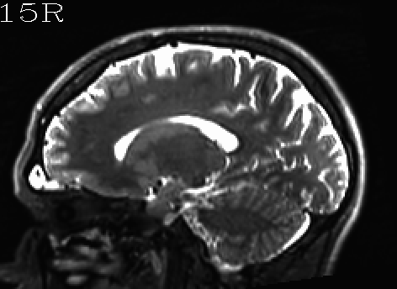
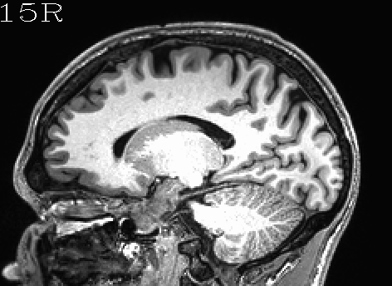

Alignment concepts: field of view (FOV) coverage
What kind of coverage does the FOV have? Does it include the whole brain?
A) T2w
B) T1w
C) EPI

Slide 11
Alignment concepts: field of view (FOV) coverage
What kind of coverage does the FOV have? Does it include the whole brain?
→ might need extra options, affects how we view quality of alignment, and we might just expect some alignment problems
cut-off FOV
(both sup cortex and cerebellum
whole brain FOV
whole brain FOV
A) T2w
B) T1w
C) EPI

Slide 12
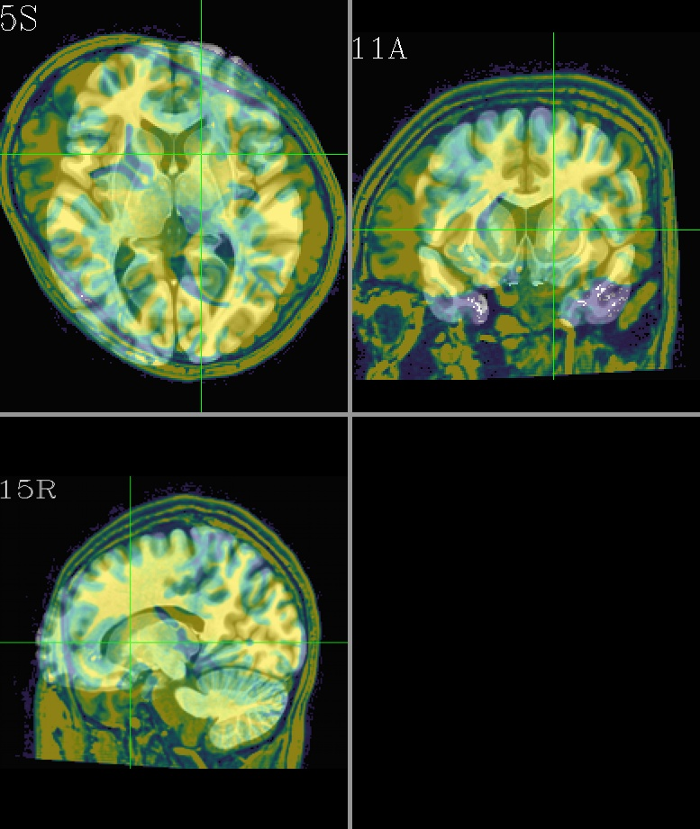
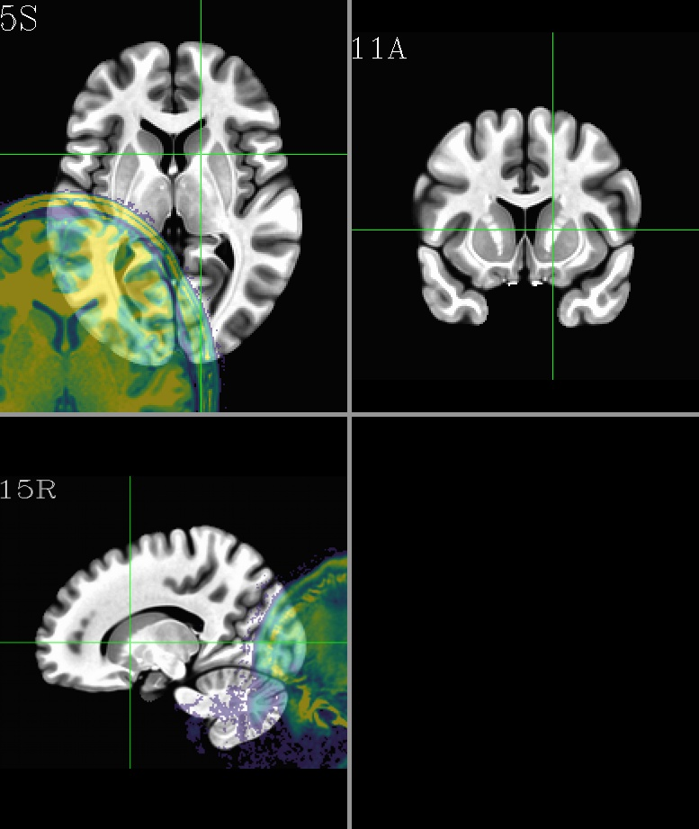
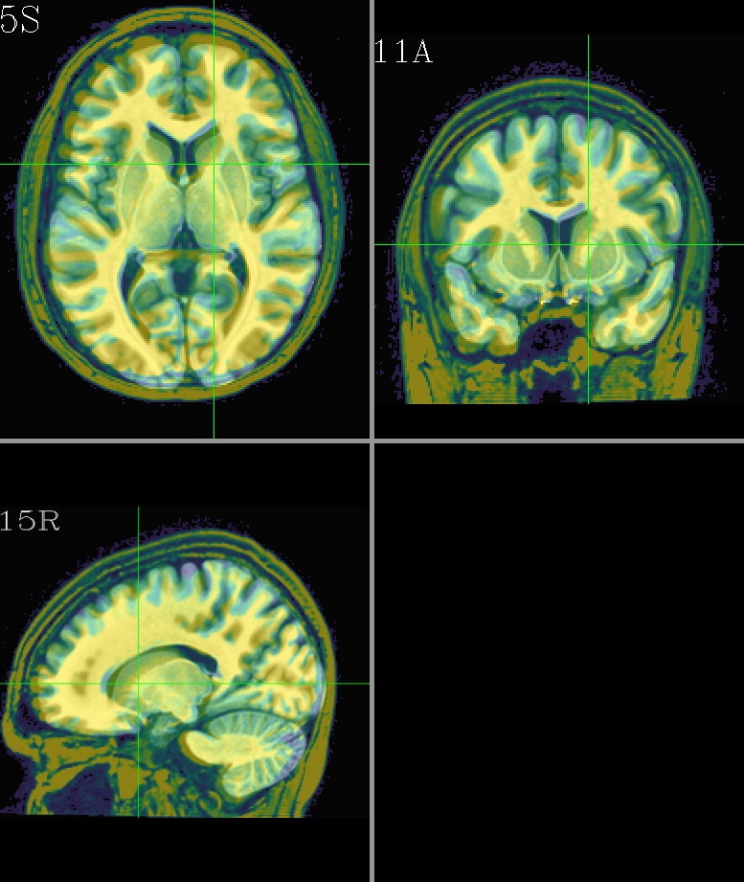
Alignment concepts: dset overlap
How far apart are the “source” and “base” dsets? Do they overlap in the GUI?

Slide 13
Alignment concepts: dset overlap
How far apart are the “source” and “base” dsets? Do they overlap in the GUI?
→ large differences in location, rotation, size, etc. can make alignment tricky. The greater the overlap/similarity of the dsets, the better the alignment prospects.
large rotation!
large translation!
pretty darn close
To deal with large relative differences, one might need to use additional preprocessing steps or options for the alignment programs. [See S1 at end of slides for image script.]

Slide 14
How is alignment transformation calculated?
The fundamental aspects are the same across the tools:
  Take two images, a base (=reference) and source (=to be adjusted)
  1) quantify “how similar” they are,
  2) if they are “similar enough,” then stop;
  otherwise, tweak/perturb the source image,
  3) quantify “how similar” the new source and base are, … [repeat]

Slide 15
How is alignment transformation calculated?
The fundamental aspects are the same across the tools:
  Take two images, a base (=reference) and source (=to be adjusted)
  1) quantify “how similar” they are,
  2) if they are “similar enough,” then stop;
  otherwise, tweak/perturb the source image,
  3) quantify “how similar” the new source and base are, … [repeat]
To quantify how similar dsets are, we need a cost function
  the cost function is how we take values from both dsets and make an overall assessment of a desired property; different functions yield different alignments
  For example, could:
    reward similarity or when peak values line up (e.g., for matching contrasts)
    reward when anti-peaks line up (e.g., for opposite contrasts)

Slide 16
Cost functions in AFNI
There are many cost functions in AFNI, from historical development/evolution
but there are just a few we now recommend (from 3dAllineate’s help):
“lpa” is basic choice for vols with similar contrast
“lpc” is basic choice for vols with differing/opposite contrast
  and “lpc+ZZ” might be even better for awkward cases: robuster, but slower
(“ls” is okay for simple EPI-EPI alignment in 3dvolreg)
ls :: 1 - abs(Pearson correlation coefficient)
sp :: 1 - abs(Spearman correlation coefficient)
mi :: - Mutual Information = H(base,source)-H(base)-H(source)
crM :: 1 - abs[ CR(base,source) * CR(source,base) ]
nmi :: 1/Normalized MI = H(base,source)/[H(base)+H(source)]
je :: H(base,source) = joint entropy of image pair
hel :: - Hellinger distance(base,source)
crA :: 1 - abs[ CR(base,source) + CR(source,base) ]
crU :: CR(source,base) = Var(source|base) / Var(source)
lss :: Pearson correlation coefficient between image pair
lpc :: nonlinear average of Pearson cc over local neighborhoods
lpa :: 1 - abs(lpc)
lpc+:: lpc + hel + mi + nmi + crA + overlap
ncd :: mutual compressibility (via zlib) -- doesn't work yet

Slide 17
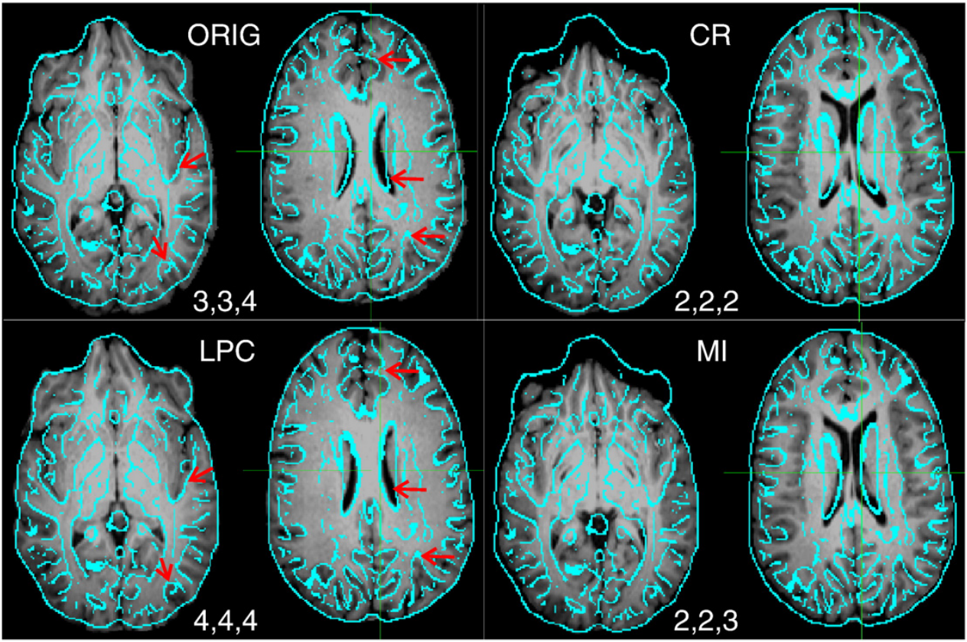
Cost functions in AFNI
“lpc” in action, EPI-to-anat (olay: edges from same EPI slice; ulay: matched anat):
ZS Saad, DR Glen, G Chen, MS Beauchamp, R Desai, RW Cox (2009). A new method for improving functional-to-structural MRI alignment using local Pearson correlation. NeuroImage 44: 839-848.

Slide 18
How is alignment transformation calculated?
The fundamental aspects are the same across the tools:
  Take two images, a base (=reference) and source (=to be adjusted)
  1) quantify “how similar” they are,
  2) if they are “similar enough,” then stop;
  otherwise, tweak/perturb the source image,
  3) quantify “how similar” the new source and base are, … [repeat]
To quantify how similar dsets are, we need a cost function
  the cost function is how we take values from both dsets and make an overall assessment of a desired property; different functions yield different alignments
  For example, could:
    reward similarity or when peak values line up (e.g., for matching contrasts)
    reward when anti-peaks line up (e.g., for opposite contrasts)
To tweak/perturb the source, we need to know what kind of parameters to change
  rotations, translations, shear, scaling, higher order (determined by degrees of freedom)
  and whether we are matching entire FOV or smaller pieces (family: linear/affine or nonlinear)

Slide 19
Preprocess – mask, weight
View inside alignment process
Initial interpolation, cost
Preprocess – mask data, weight data
If far off, take some random guesses (-twopass)
Optimize parameters on initial or best sets (6,12,39,1000's)
  Use new parameters to transform input
    Interpolate onto base data's grid
  Measure alignment error with cost functional
    Less than minimum error - finished
    Better - keep adjusting with same direction
    Worse – try other parameters
Create final output by interpolating onto output grid
  save datasets, transform parameters
Lots of random guesses – follow best
twopass?
Tweak
parameters
Transform & Interpolate
Optimization
Measure cost
Cost < tolerance?
Save final data
Notes:
-rat_align sets blur size and neighborhood size for 3dAllineate’s LPC and rat option for 3dSkullStrip though it’s not used here
<number>

Slide 20
Types of warps: Linear affine (average FOV fit)
original
warped
Parameters (applied globally)
rotation
translation
There are four parameters in the
linear affine family of warps:
rotation translation
shearing scaling
In 3D alignment, each parameter has
three degrees of freedom (DOFs):
+ rigid body (AKA “solid body”)
6 DOF = 3 transl + 3 rot
Ex: 3dvolreg
+ linear affine
12 DOF = 3*(transl + rot + scale + shear)
Ex: 3dAllineate, align_epi_anat.py
scaling
shearing

Slide 21
Types of warps: nonlinear (patch refinement)
original
warped
Parameters (applied locally)
nonlinear warps
In nonlinear warping, a first pass is done
with simpler global alignment, and then the matching is refined locally in “patches” down to a certain length scale.
There are many more DOFs used here, and one can match more features-- but details also matter more (e.g., skullstripping)
+ nonlinear warping
12 DOF initially + hundreds (or thousands) more DOFs in refinement steps
Ex: 3dQwarp, @SSwarper, @animal_warper, auto_warp.py

Slide 22
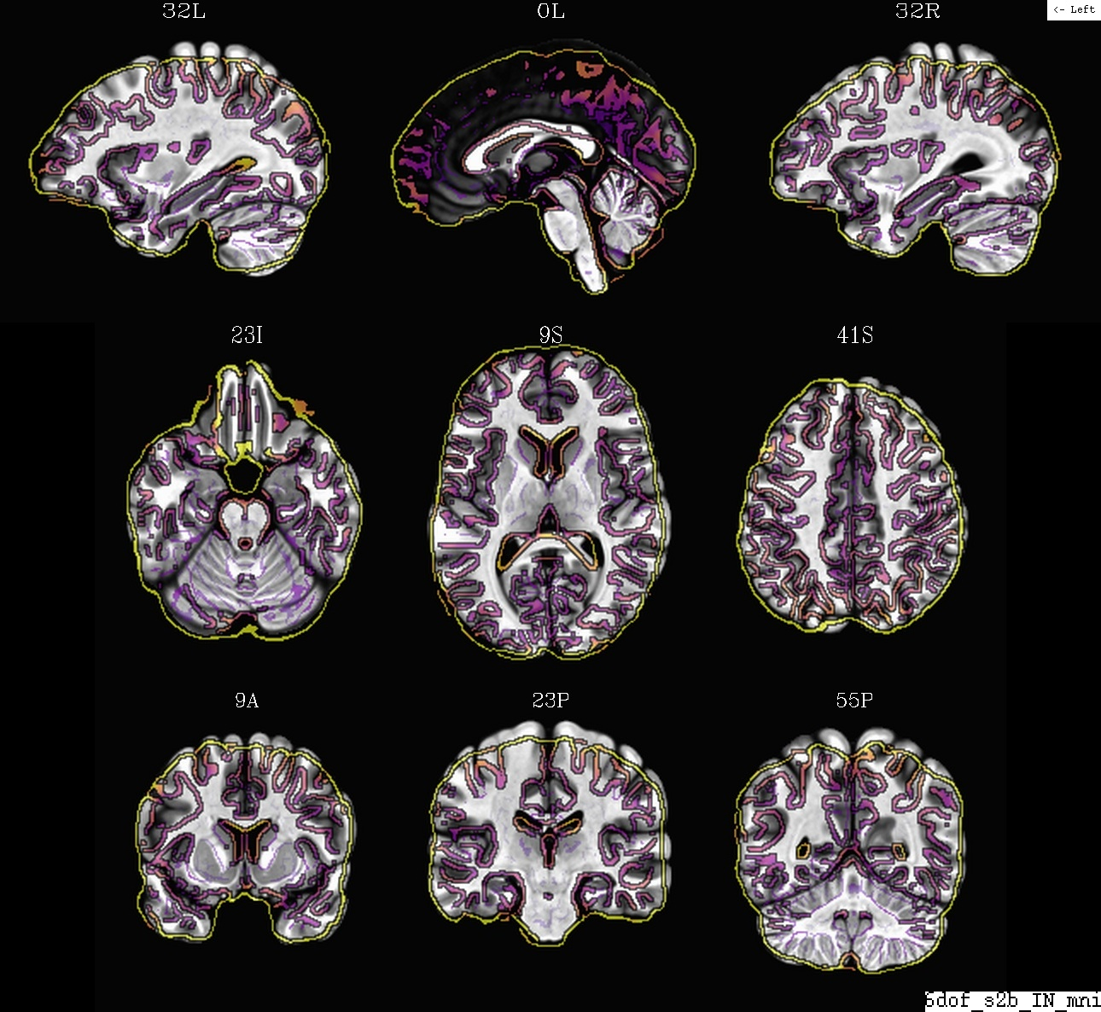
Types of warps: example case “rigid”
ulay: base template
olay: warped dset (6DOF, linear, “rigid body”)
Compare alignment with overlaying edges of warped source dset on base template
“Base” volume in this case is MNI template; “source” is typical subject anat vol.
Overall fit: OK, some major parts align, but brain shapes are (and remain) different.
PLOT: @snapshot_volreg TEMPLATE_VOL WARPED_VOL

Slide 23
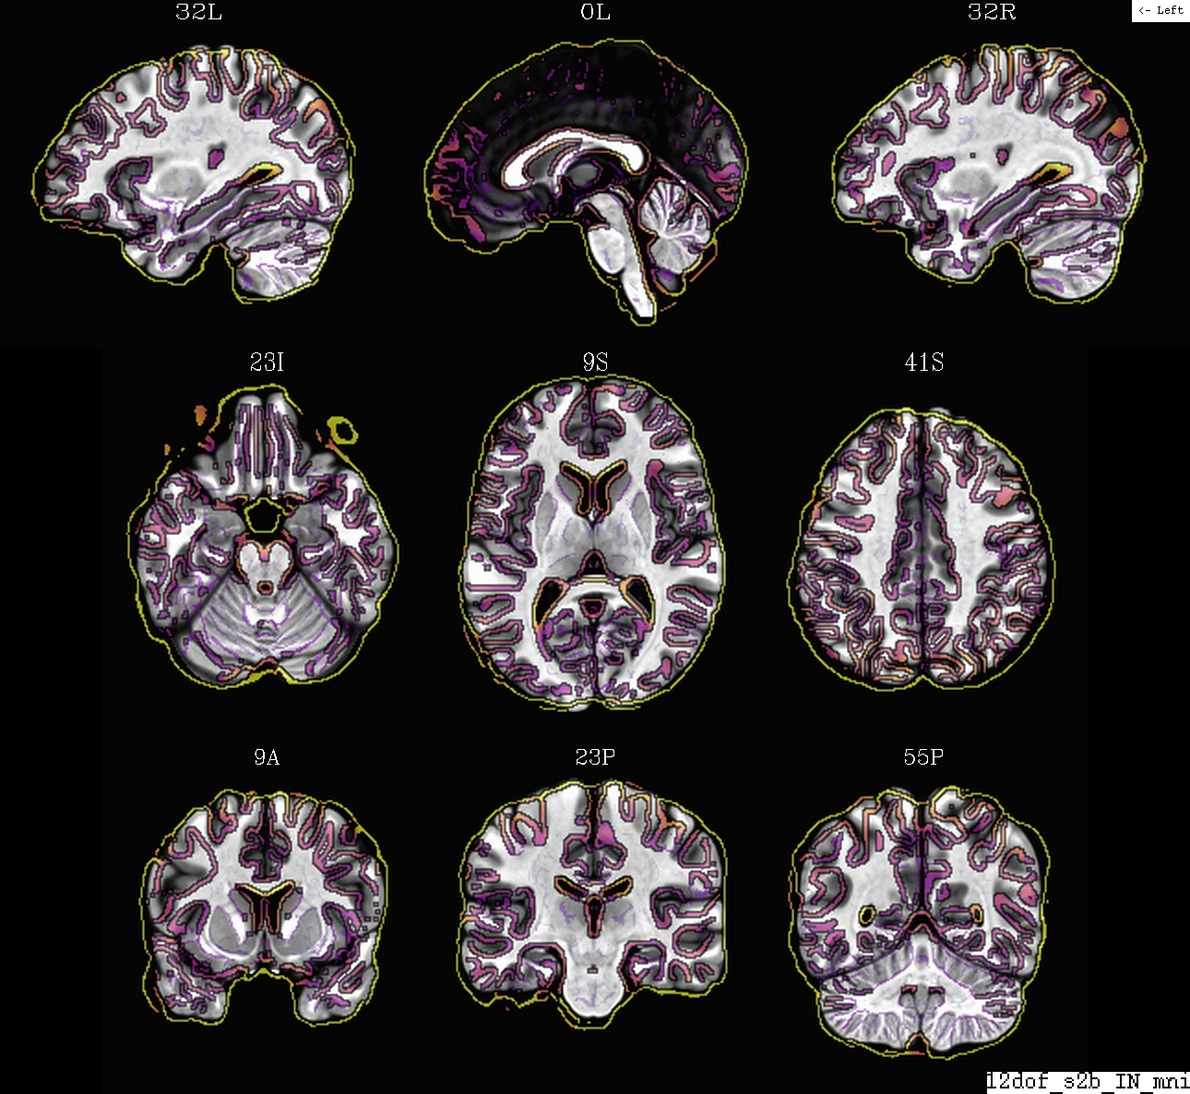
Types of warps: example case “linear affine”
ulay: base template
olay: warped dset (12DOF, affine)
Compare alignment with overlaying edges of warped source dset on base template
“Base” volume in this case is MNI template; “source” is typical subject anat vol.
Overall fit: Good, general shape and many sulci/gyri match, but not all and many are approximate.
Bonus Type -
rigid equivalent
6-parameters extracted.
"Axializing" subjects to template of different size
PLOT: @snapshot_volreg TEMPLATE_VOL WARPED_VOL

Slide 24
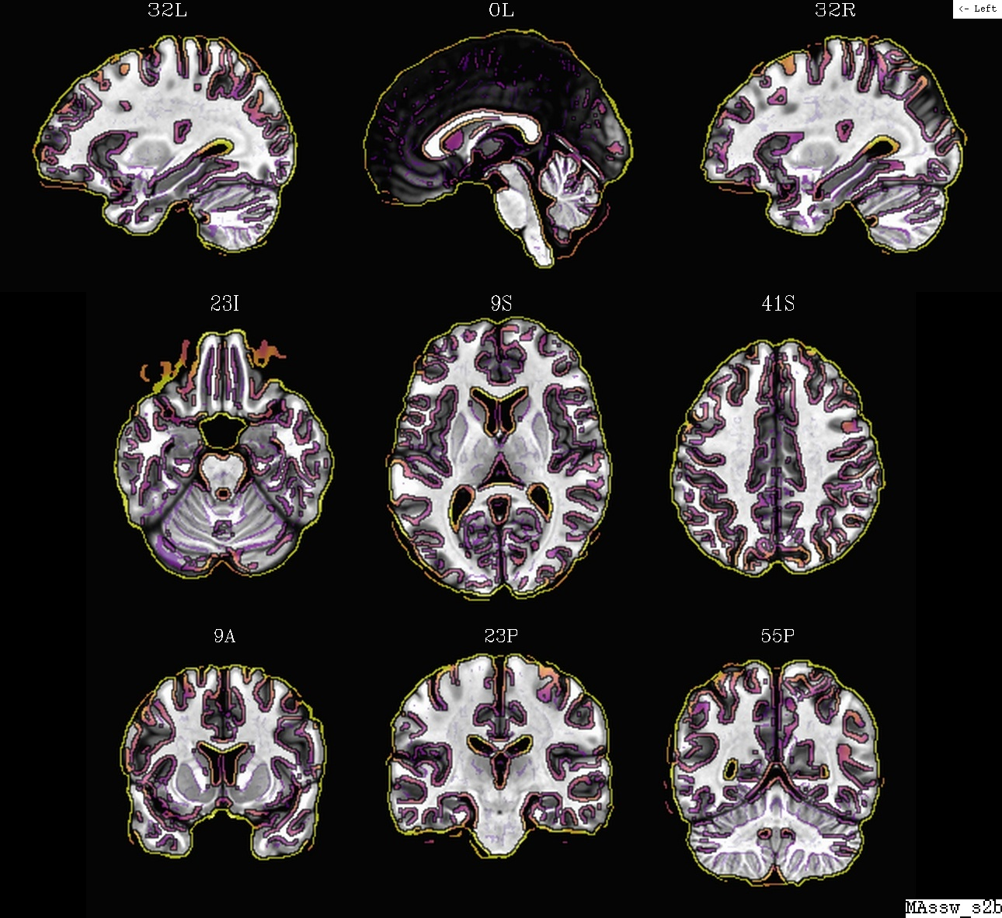
Types of warps: example case “nonlinear”
ulay: base template
olay: warped dset (nonlinear, @SSwarper)
Compare alignment with overlaying edges of warped source dset on base template
“Base” volume in this case is MNI template; “source” is typical subject anat vol.
Overall fit: Very good, nearly all sulci/gyri match closely throughout.
PLOT: @snapshot_volreg TEMPLATE_VOL WARPED_VOL

Slide 25
Transformation and mapping
What is a transformation (or warp)?
→ It is a rule for mapping information from a source dset S onto a base B’s grid.
It says where a given spot (x_{B}, y_{B}, z_{B}) in B pulls information from in S.
data sets
base B
source S
T
For alignment, we want a transform T, such that
B’ = T(S) is similar to B.

Slide 26
Transformation and mapping
What is a transformation (or warp)?
→ It is a rule for mapping information from a source dset S onto a base B’s grid.
It says where a given spot (x_{B}, y_{B}, z_{B}) in B pulls information from in S.
data sets
base B
source S
T
For alignment, we want a transform T, such that
B’ = T(S) is similar to B.
We choose how much warping T is allowed to do: match FOV average or refine over smaller patches; and how much “freedom” of movement.
Goal: maximize structure matching, and minimize smoothing.

Slide 27
Transformation and mapping
What is a transformation (or warp)?
→ It is a rule for mapping information from a source dset S onto a base B’s grid.
It says where a given spot (x_{B}, y_{B}, z_{B}) in B pulls information from in S.
data sets
base B
source S
T
We often think of T as “sending” values from S to B, but actually we start from a point in B and ask,
“Where do I get my value from in S?”

Slide 28
Transformation and mapping
What is a transformation (or warp)?
→ It is a rule for mapping information from a source dset S onto a base B’s grid.
It says where a given spot (x_{B}, y_{B}, z_{B}) in B pulls information from in S.
data sets
(zoom in)
base B
source S
T
Where to pull data from here?
We often think of T as “sending” values from S to B, but actually we start from a point in B and ask,
“Where do I get my value from in S?”

Slide 29
Mapping and Interpolation
Where exactly to pull data from?
Choose with interpolation (or resampling) mode
Basic case:
the location to pull data “from” is not directly on a centroid, so we interpolate with a weighted average-- here a cubic spline (in 3D)
Cu = “cubic Lagrange
polynomial”
→ decent interp (bit of smoothing)
1D vers:

Slide 30
Mapping and Interpolation
Where exactly to pull data from?
Choose with interpolation (or resampling) mode
Cu = “cubic Lagrange
polynomial”
→ decent interp (bit of smoothing)
wsinc5 = “sinc
function”
→ preserve edges and sharpness (some ringing)
NN = “nearest
neighbor”
→ preserve int values (atlases!)
1D vers:
(There are other modes, such as linear Li, etc.; see program help files.)

Slide 31
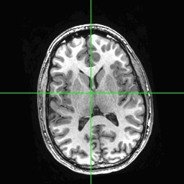
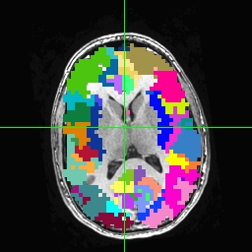
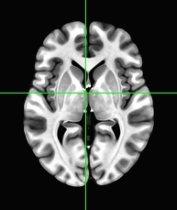
Applying transformations: moving ROIs
How can we move ROIs between spaces?
ROI map
source S
base B

Slide 32
Applying transformations: moving ROIs
How can we move ROIs between spaces?
→ Once we have the mapping T from S to B, we can apply it to other dsets-- like an atlas, a map of ROIs, and more.
ROI map
source S
base B

Slide 33
Applying transformations: moving ROIs
How can we move ROIs between spaces?
→ Once we have the mapping T from S to B, we can apply it to other dsets-- like an atlas, a map of ROIs, and more.
ROI map
source S
T
Estimate transformation T,
using the anatomical and template volumes to find the mapping between locations in each space (e.g., 12 DOF linear affine).
base B

Slide 34
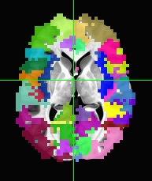
Applying transformations: moving ROIs
How can we move ROIs between spaces?
→ Once we have the mapping T from S to B, we can apply it to other dsets-- like an atlas, a map of ROIs, and more.
ROI map
source S
Apply transformation T to the ROI map.
We also include an option to make the interpolation be “NN” (nearest neighbor) in order to avoid smoothing of ROIs: ints stay ints, so the ROIs keep their identity.
T
T
base B

Slide 35
Concatenating transforms
Note: as observed earlier, any alignment/warping/interpolation/resampling leads to smoothing of data.
Therefore, when mapping data through several spaces (EPI → anat → template), we DON’T want to regrid at each step; we concatenate the transforms into a single one, and then have to only regrid once!

Slide 36
Concatenating transforms
Note: as observed earlier, any alignment/warping/interpolation/resampling leads to smoothing of data.
Therefore, when mapping data through several spaces (EPI → anat → template), we DON’T want to regrid at each step; we concatenate the transforms into a single one, and then have to only regrid once!
So, calculate individual transforms, such as within EPI (e.g., 3dvolreg), EPI-anat (e.g., align_epi_anat.py) and anat-template (e.g. @SSwarper):
but DON’T apply T₀ to make a new dset, and then apply T₁ to that, etc.
T₀
T₁
T₂
subj EPIs
subj ref EPI
subj anat
template

Slide 37
Concatenating transforms
Note: as observed earlier, any alignment/warping/interpolation/resampling leads to smoothing of data.
Therefore, when mapping data through several spaces (EPI → anat → template), we DON’T want to regrid at each step; we concatenate the transforms into a single one, and then have to only regrid once!
So, calculate individual transforms, such as within EPI (e.g., 3dvolreg), EPI-anat (e.g., align_epi_anat.py) and anat-template (e.g. @SSwarper):
but DON’T apply T₀ to make a new dset, and then apply T₁ to that, etc.
DO concatenate T₀, T₁, and T₂ to make T_{full}, and then apply T_{full} to the EPIs to send the data to the template space in a single step (i.e., only one regridding)
T₀
T₁
T₂
subj EPIs
subj ref EPI
subj anat
template
T_{full}

Slide 38
Concatenating transforms
Note: as observed earlier, any alignment/warping/interpolation/resampling leads to smoothing of data.
Therefore, when mapping data through several spaces (EPI → anat → template), we DON’T want to regrid at each step; we concatenate the transforms into a single one, and then have to only regrid once!
So, calculate individual transforms, such as within EPI (e.g., 3dvolreg), EPI-anat (e.g., align_epi_anat.py) and anat-template (e.g. @SSwarper):
but DON’T apply T₀ to make a new dset, and then apply T₁ to that, etc.
DO concatenate T₀, T₁, and T₂ to make T_{full}, and then apply T_{full} to the EPIs to send the data to the template space in a single step (i.e., only one regridding)
sidenote: probably don’t upsample the EPI data a lot, e.g., from 3.5mm to 2mm iso
  cannot “create” higher resolution information, no matter how it looks
  just makes larger dsets, more processing time, more disk space, etc.
T₀
T₁
T₂
subj EPIs
subj ref EPI
subj anat
template
T_{full}

Slide 39
Some warping guidelines
Warping guidelines
+ For most EPI-EPI alignment, ls cost function (via 3dvolreg) is fine
  for blip up-down EPI, there are nonlinear warping opts (lpa cost)
  always check subj motion profiles and censoring
+For all other warping, look to lpa (similar contrast) and lpc or lpc+ZZ
(differing contrasts)
+ Use nonlinear warping when aligning anat data between different subjects
(including subject to reference)
  consider @SSwarper for combined nonlinear warping + skullstripping
  can input results directly into afni_proc.py
  lots of templates are fine, but use one with good detail as base
+ Calculate all warps in a chain individually, then concatenate them into one
before applying, to reduce smoothing (less regridding steps)
+ Use afni_proc.py when processing FMRI data
  concatenation and other tiny details are managed automatically

Slide 40
Considerations for:
within EPI (EPI-EPI) alignment

Slide 41


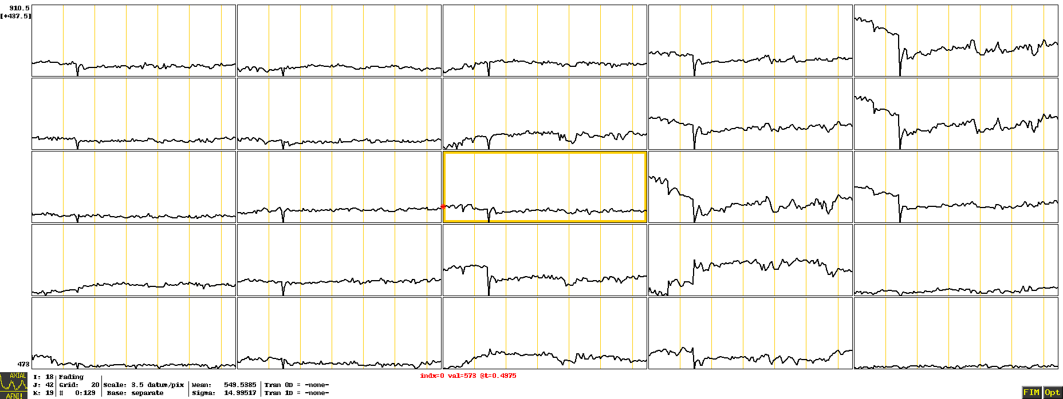
EPI time series: motion
EPI vols: standard, interleave acquisition
without motion
with motion
EPI time series
+ see the motion
effect(s)?
+ see differences
between voxels?

Slide 42
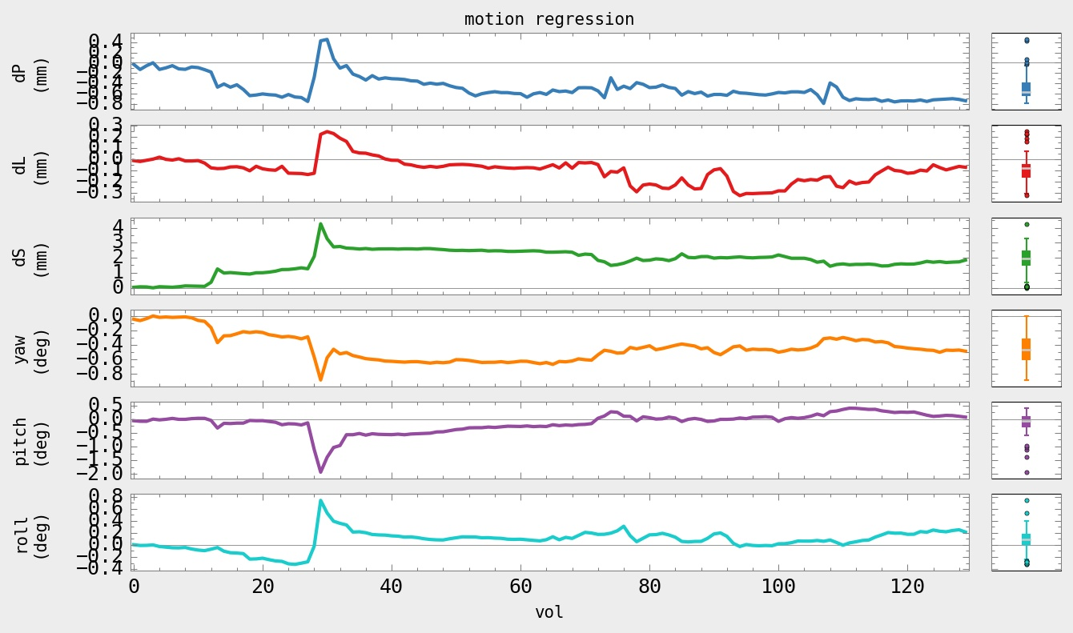
EPI time series: motion
Main tool: 3dvolreg (often via afni_proc.py). Use EPI-EPI alignment to:
1) estimate motion “time series” (rigid body params: rot + transl) and
2) use these “time series” as regressors and as censoring criteria
“with motion” subject from above
PLOT: 1dplot.py -sepscl -boxplot_on -reverse_order -ylabels VOLREG -xlabel vol \
-title "motion regression" -prefix OUTPUT_NAME -infiles MOT_EST_VR.1D

Slide 43
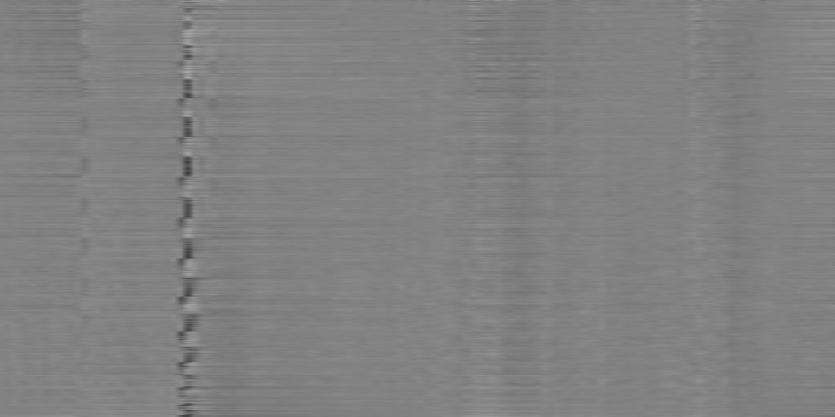
EPI time series: motion
Can visualize motion’s effects in time series as a (normalized) “grayplot”:
+ each row is one time series (values translated to grayscale)
+ each col is one instant/volume in time
Probably large outlier fractions where motion occurs (→ censoring)
--> space (voxel)
“with motion” subject from above
--> time (vol)
PLOT: 3dGrayplot -mask mask+orig. -input FILE_TIMESERIES -prefix OUTPUT_NAME

Slide 44
EPI time series: censoring
Typically two measures to detect and censor motion
enorm (Euclidean norm): based on 3dvolreg's motion parameter estimates
  suprathreshold enorm leads to censoring multiple vols
For each [i]th volume, use the derivatives of motion profiles to calc enorm:
enorm_{i} = (ΔdP_{i}² + ΔdL_{i}² + ΔdS_{i}² + Δyaw_{i}² + Δpitch_{i}² + Δroll_{i}²)^{0.5}
… which is to say, where there are bigger changes in motion due to either translation, rotation or both, the enorm value is larger.
Enorm has units of ~mm (for human head radius, approx. 1deg ~1mm).
Can threshold with a preset value, e.g., 0.2 (~mm); since enorm is based on a derivative (difference), two volumes get censored for suprathreshold values.
Ex. calculation from output of 3dvolreg:
1d_tool.py \
-infile VOLREG_OUTPUT.1D -set_nruns 1 \
-derivative -collapse_cols euclidean_norm \
-write ENORM_OUTPUT

Slide 45
EPI time series: censoring
Typically two measures to detect and censor motion
enorm (Euclidean norm): based on 3dvolreg's motion parameter estimates
  suprathreshold enorm leads to censoring multiple vols
outliers: based on outliers from time series trends (total fraction in volume)
For each [i]th volume, count how many voxels have an outlier; record fraction:
outlier_frac_{i} = (# vox with outlier)_{i} / (# vox in automask)
Outlier frac has no units; just has a range [0, 1].
Can threshold with a preset value, e.g., 0.05. Only one volume gets censored for supratheshold values.
Ex. calculation from unprocessed data set:
3dToutcount \
-automask -fraction -polort 3 -legendre \
DSET > OUTLIER_FRAC.1D

Slide 46
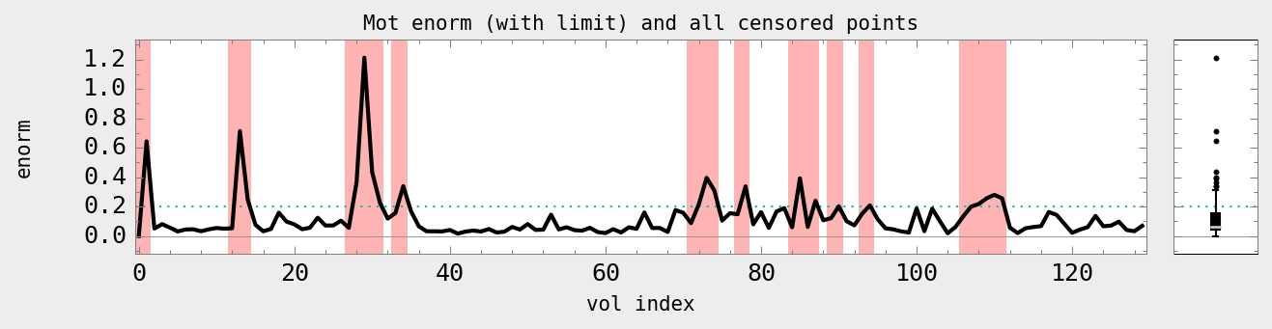
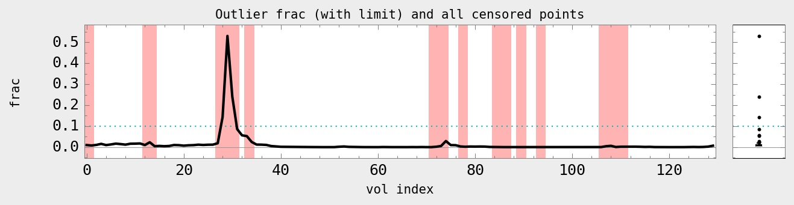
EPI time series: censoring
Typically two measures to detect and censor motion
enorm (Euclidean norm): based on 3dvolreg's motion parameter estimates
  suprathreshold enorm leads to censoring multiple vols
outliers: based on outliers from time series trends (total fraction in volume)
PLOT (for motion-enorm, and similar for outlier frac):
1dplot.py -boxplot_on -reverse_order -infiles MOT_ENORM.1D -censor_hline VAL \
-censor_files CEN_FILE.1D -xlabel "vol index" -ylabels "enorm" \
-title "Mot enorm (with limit) and all censored points" -prefix OUT_MOT.jpg

Slide 47
Example: 3dvolreg
Can run the following in “AFNI_data6/afni/”:
3dvolreg -base 3 -cubic -zpad 1 \
-1Dfile dfile_vr.1D \
-1Dmatrix_save mat_vr.aff12.1D \
-prefix epi_r1_vrt \
epi_r1+orig
epi_r1+orig: (last entry) input time series to align
-base 3: select brick [3] of input epi_r1+orig dset as reference vol
    (NB: in afni_proc.py, one can select the ref vol to be the one with fewest outliers, with keyword: MIN_OUTLIERS)
-cubic: use cubic polynomial interpolation
-zpad 1: put (intermed) layer of zeros around base vol, helps if large rotations exist
-1Dfile ...: save motion estimates as columns of numbers in text (1D) file
-1Dmatrix_save ...: save motion params (12 DOF in matrix form) to text (1D) file
-prefix ...: save motion-corrected vol to new 4D volumetric dset
... and a quick view of motion estimates:
1dplot -volreg dfile_vr.1D &

Slide 48
Example: 3dvolreg (cont’d)
... and a quick calculation of ‘enorm’ (= Euclidean norm) and possible censoring (see “1d_tool.py -help” for description of opts here):
1d_tool.py -infile dfile_vr.1D \
-set_nruns 1 \
-show_censor_count \
-censor_prev_TR \
-censor_motion 0.3 SUBJ
... with a quick view of those results (with censorline fanciness):
1dplot -one SUBJ_enorm.1D "1D: 152@0.3" &
and to see the (command line-usable) string of indices to be censored:
cat SUBJ_CENSORTR.txt
or pro-level fanciness combining the previous two:
1dplot -one `cat SUBJ_CENSORTR.txt` SUBJ_enorm.1D "1D: 152@0.3" &

Slide 49



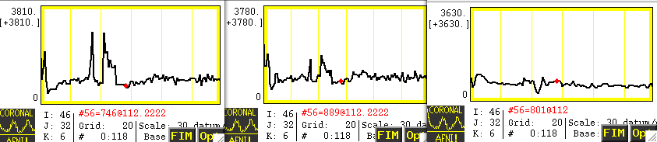
Motion correction: caveats
Alignment cannot fix motion; use motion pars as regressors (helps more, not total).
Motion correction → volume alignment → regridding → smoothing.
Check in the AFNI GUI to be sure the “corrected” data is not “bouncing” around
Example: Monkey sips juice at stimulus time, and large jaw muscles move. If the muscles are not masked, then motion correction may track muscles, not brain.
original
3dvolreg
automask, 3dvolreg
[movies→]

Slide 50
“Fixing” Motion
Motion occurs over slices and not volumes and moves data off original grid
“Regressing out” – motion parameters, derivatives, displacement, euclidean norm of derivatives (summary parameters)
Censoring (“scrubbing”, “sweeping under the mat”,...)
Experimental design – kids, monkeys, juice, talking, waving hands wildly....
Interpreting results – differences in motion between groups or something physiological
Be on the lookout – activation following high contrast borders, bright/dark patterns in sagittal views ("blinds" effects)

Slide 51
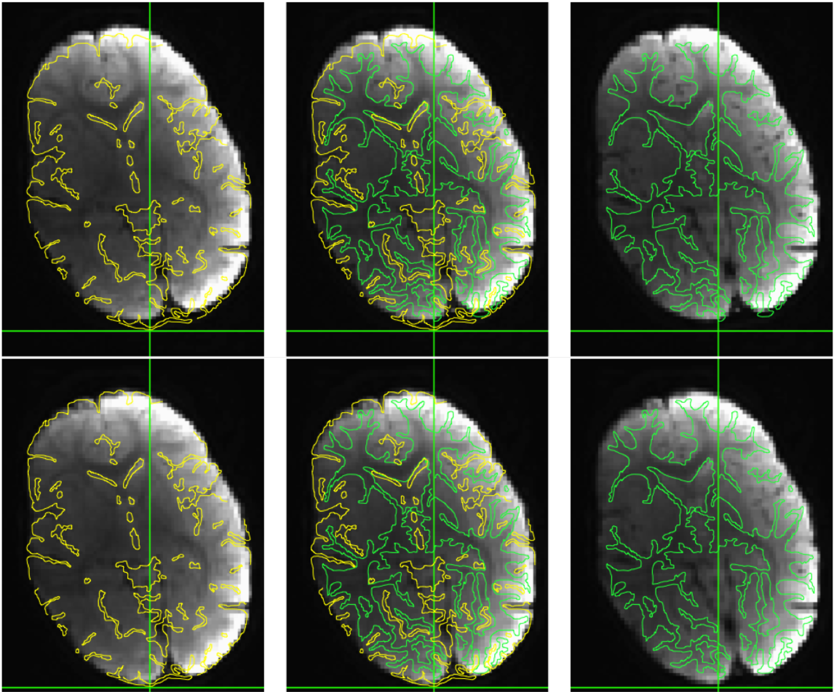
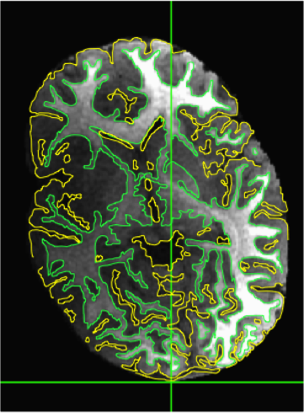
EPI distortion correction in EPI data (1/2)
Data acquired with an EPI sequence has distortions due to B0 inhomogeneity
One way to correct: acquire data with opposite phase encoding (PE) to help “undo” the warping (AKA, “blip up, blip down” acquisitions)
1) Align opposite PE dsets nonlinearly. 2) Apply “half” warp to est. undistorted dset.
Example
+ EPI dset from toddler study
+ Unwarping calculated with
3dQwarp+3dNwarpApply in
afni_proc.py.
+ [Watch this space for more
scripts/tools]
ulay: EPI, olay: anat edges
orig
anat
proc’ed
Roopchansingh et al. (2018, ISMRM)

Slide 52
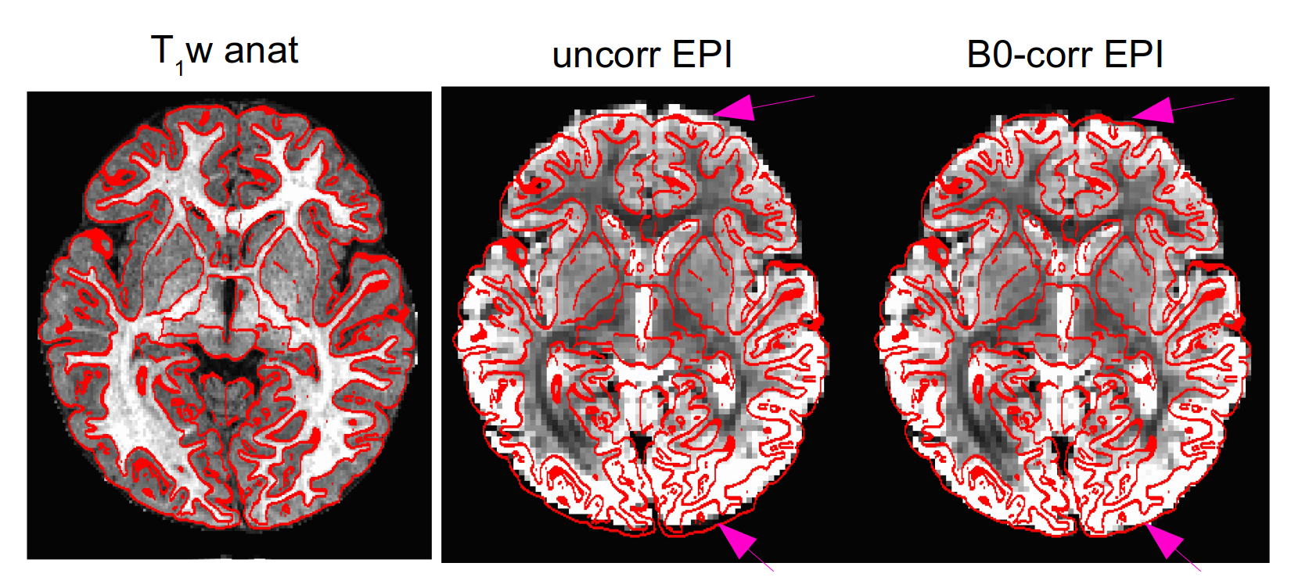
EPI distortion correction in EPI data (2/2)
New tool in AFNI for B0 (phase dset) correction: epi_b0_correct.py
  Also put together by Vinai Roopchansingh, uses 3dNwarpApply
  can be integrated in afni_proc.py
Example
+ EPI dset from toddler study (Roopchansingh et al., in prep)
+ compare outlines of anatomical tissues (red)
with EPI structures before and after correction

Slide 53
EPI alignment: general comments
Comments on motion “correction” (= reduction) in EPI
One cannot fully “correct” effects of motion
  intravol motion can’t be corrected, but bad cases will
  likely be censored (e.g., via outlier count, enorm vals)
  motion parameter estimation+regression is useful,
  but won’t totally account for motion variance
Motion is probably a bigger problem in resting state (and naturalistic) FMRI than in task-based, because there aren’t beta weights to focus on
In general, global signal regression is not recommended (Saad et al., 2012; Gotts et al. 2013; Murphy et al. 2009)
GCOR parameter might be one way to include motion information on group level, esp. for rs-fMRI (Saad et al. 2013; Gotts et al. 3013)
Dealing with motion requires planning before scanning (make subjects comfortable, practice scanner, study design)
Work must always be done to show that motion differences between groups is not driving effects

Slide 54
Considerations for:
EPI-anatomical alignment

Slide 55
Affine alignment
Main tool: align_epi_anat.py (often via afni_proc.py), and 3dAllineate.
1) align EPI to anatomical of same subject; assumes no major/nonlinear distortions.
2) can check for left-right flipping in EPI/anat (e.g., bad header info)
align_epi_anat.py
+ Combines deoblique, motion correction, alignment and talairach transformations into a single transformation.
+ Can also perform slice timing correction and applies transformations to “child” datasets.
+ “lpc” or “lpc+ZZ” cost function to align vols with opposite contrast (e.g., T1w and EPI)

Slide 56
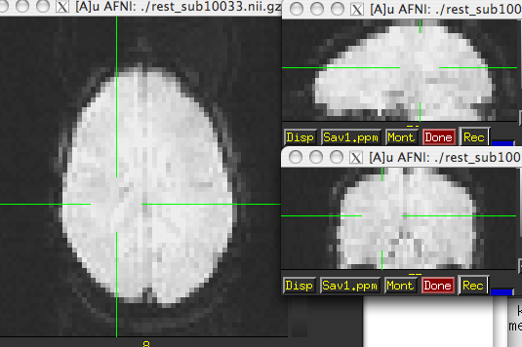
Alignment strategies with align_epi_anat.py
Defaults work usually (>90% - FCON1000)
Examples of problems and → solutions to try:
  Far off start → “-big_move”, “-giant_move”,”-ginormous_move”
  Poor contrast → “-cost lpa”, “-cost nmi”, “-cost lpc+ZZ”
  Poor non-uniformity → “-edge”, “-cost lpa”
Non-standard dsets: stroke/MS lesions, tumors, monkeys, rats, multi-modality (CT/PET/DTI/...), something else? → see us, post on Message Board

Slide 57
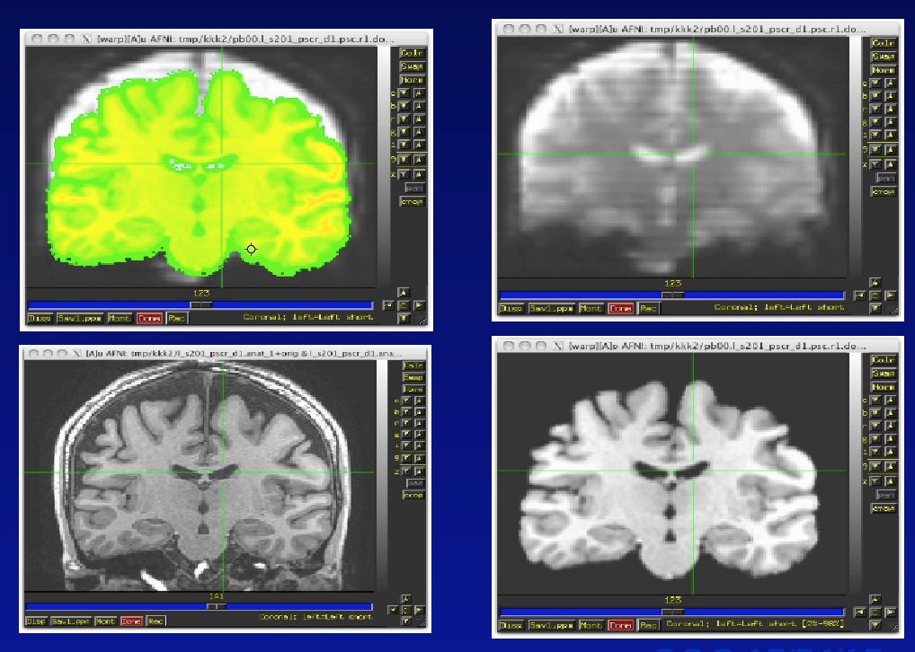
Checking alignment: what to look for
It’s what’s on the inside that counts!
→ match sulcal gyral patterns, ventricle location, tissue boundaries...

Slide 58
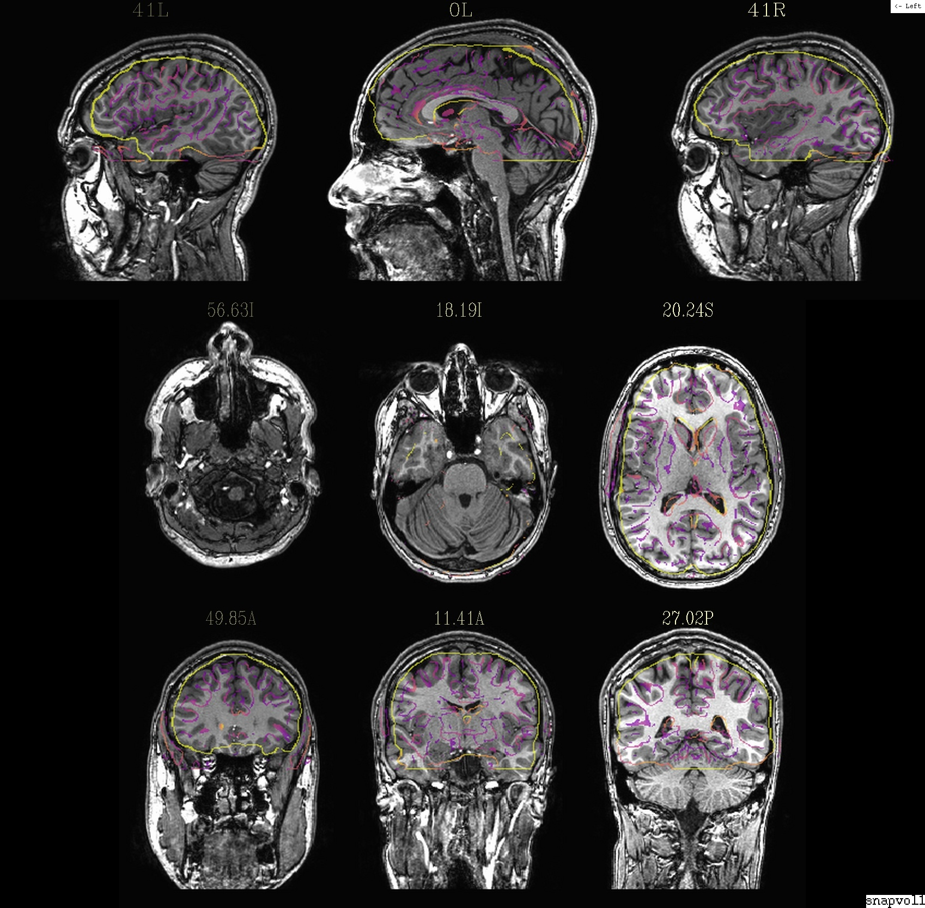
Checking alignment: edge-y view
CMD : @snapshot_volreg VOL_ULAY VOL_OLAY output.jpg
view: aiv output.jpg

Slide 59
Alignment visualization in AFNI
Graph and image – travel through time for motion correction or for a thousand datasets in a row.
Multiple controllers and crosshairs – up to ten datasets at a time, quick and rough.
Overlay display – opacity control, thresholding. A single pair – good for different or similar datasets.
Overlay toggle, Underlay toggle – wiggle, good but a little tricky ('o' and 'u' keys in image viewer)
Sliding Overlay ('4'/'5' keys), fade-in overlay ('6' key), checkerboard underlay – ('#' key) two similar datasets in underlay but must be virtually identical. Good for comparing two processing methods
Edge display for underlay – effective pairwise comparison for quick fine structure display and comparison with overlay dataset with opacity. One dataset should have reliable structure and contrast. Now with 'e' toggle.
@AddEdge – single or dual edges with good contrast for pairwise comparison.

Slide 60
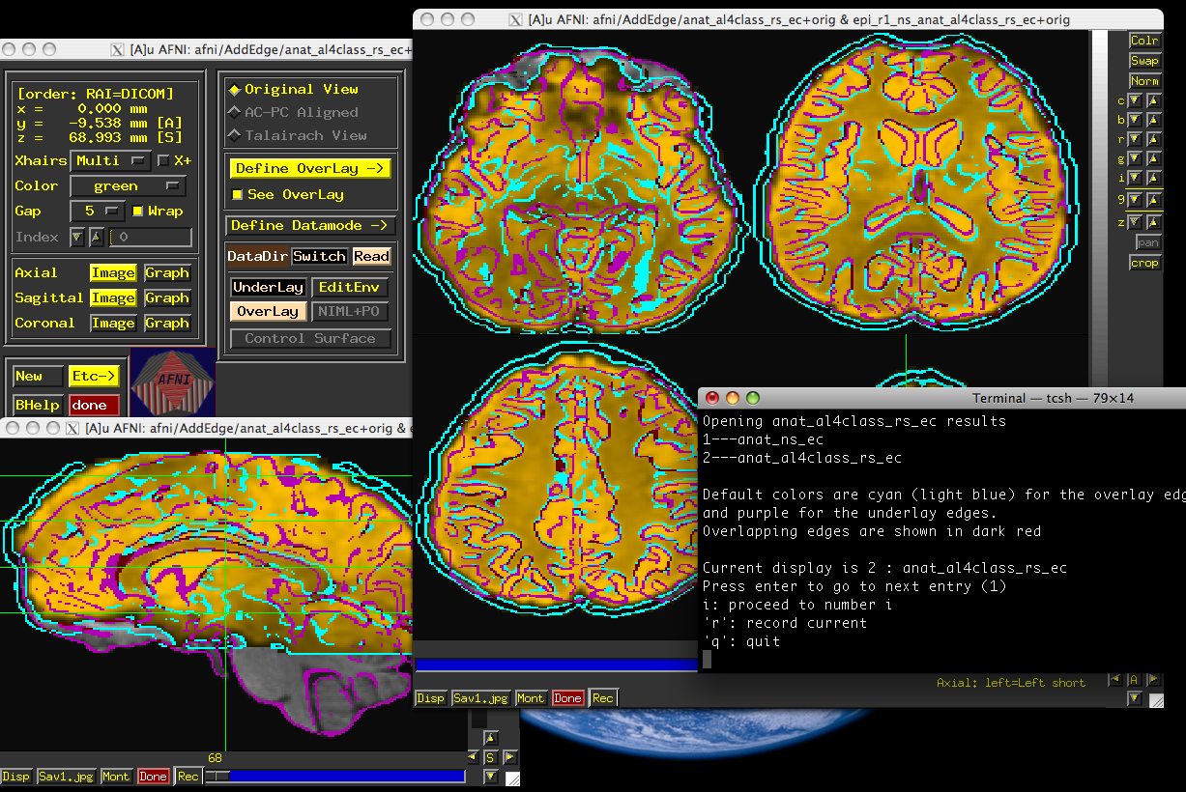
Affine alignment: auto-QC
Can run align_epi_anat.py with assistance for QCing alignment
+ use “-AddEdge” option to view edge-highlights of dsets in AFNI GUI
AFNI GUI with “@AddEdge” display settings

Slide 61
Affine alignment: auto-QC
Can run align_epi_anat.py with assistance for QCing alignment
+ use “-AddEdge” option to view edge-highlights of dsets in AFNI GUI
Example to run in AFNI_data6/afni/ (NB: takes a few mins in total):
align_epi_anat.py \
-anat anat+orig \
-epi epi_r1+orig \
-epi_base 0 \
-suffix _adde \
-AddEdge
cd AddEdge
@AddEdge

Slide 62

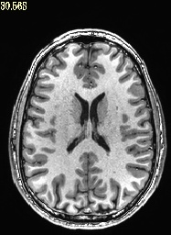

Using alignment to check for left-right flipping
Check for dset header problems (esp. conversion software issues):
$ align_epi_anat -check_flip ...
$ afni_proc.py -check_flip ...
→ compare EPI<->anatomical alignment cost results for both flipped and unflipped dsets.
?

Slide 63
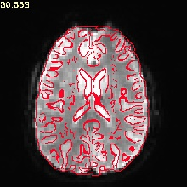
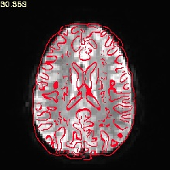
Using alignment to check for left-right flipping
Check for dset header problems (esp. conversion software issues):
$ align_epi_anat -check_flip ...
$ afni_proc.py -check_flip ...
→ compare EPI<->anatomical alignment cost results for both flipped and unflipped dsets.
when correct
when flipped
Glen et al. (2018, OHBM).

Slide 64
Using alignment to check for left-right flipping
Check for dset header problems (esp. conversion software issues):
$ align_epi_anat -check_flip ...
$ afni_proc.py -check_flip ...
→ compare EPI<->anatomical alignment cost results for both flipped and unflipped dsets.
when correct
when flipped
(Has found systematic LR-flips in public FCP and OpenFMRI data sets.)

Slide 65
Using alignment to check for left-right flipping
Check for dset header problems (esp. conversion software issues):
$ align_epi_anat -check_flip ...
$ afni_proc.py -check_flip ...
→ compare EPI<->anatomical alignment cost results for both flipped and unflipped dsets.
when correct
when flipped
NB: does not tell
absolute left-right.
(Has found systematic LR-flips in public FCP and OpenFMRI data sets.)

Slide 66
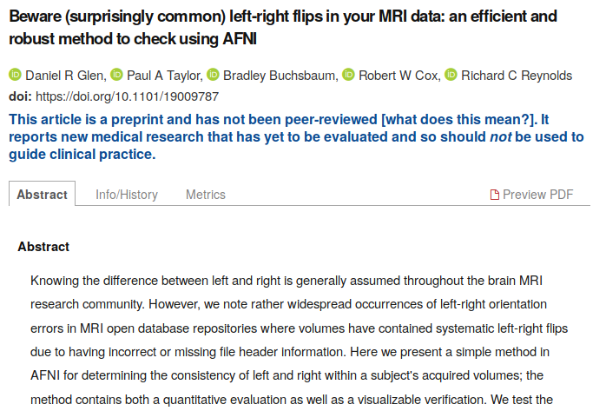
Using alignment to check for left-right flipping
Read more about it here:
https://www.medrxiv.org/content/10.1101/19009787v1

Slide 67
Considerations for:
anatomical-template alignment

Slide 68
Registration to a template: nonlinear warps
Main tools: 3dQwarp, @SSwarper (skull-strip & align), auto_warp.py
  for animal dsets: @animal_warper (skullstrip & align, too)
In general, one should use a nonlinear warp for all registration between different subjects (if the resolution/detail is high enough)
Choosing a template similar/relevant to your subject group helps a lot
  e.g., use a pediatric template for a study of children
With nonlinear warping,
  one wants a detailed template to latch onto
  details of the source dset (like skullstripping) matter
    e.g., small bits of skull left on can lead to odd warping
Nonlinear warping is slooow, but parallelized for speedup on multi-core machines
  set an environment variable for specifying number of CPUs:
    # for tcsh script or ~/.cshrc file:
    set OMP_NUM_THREADS = 7
    # for bash script or ~/.bashrc file:
    export OMP_NUM_THREADS=7
  check setting (yours or default) in terminal with “3dQwarp -hview”

Slide 69


@SSwarper: skull-strip and nonlinear warp
@SSwarper does two jobs for the prices of one!
1) Remove the skull of the subject’s anatomical in native space,
2) Estimate the nonlinear warp to a standard space template
Call now and receive a bonus set of QC images of the alignment:
ulay: anat, olay: template edges
ulay: template, olay: anat edges
Presently, @SSwarper is the recommended tool for skullstripping (and maybe/probably for nonlinear warping, as well)
Results can be passed directly to afni_proc.py (see “@SSwarper -help”).

Slide 70
Measuring quality of alignment
Can compare 3dQwarp with other available nonlinear alignment tools
+ For a group of subjects, estimate warp from anat to template
+ Apply warp to labeled ROIs, and measure % overlap in results.
ANTS, DARTEL and FNIRT run with default settings
(Cox & Glen, 2013, OHBM)

Slide 71
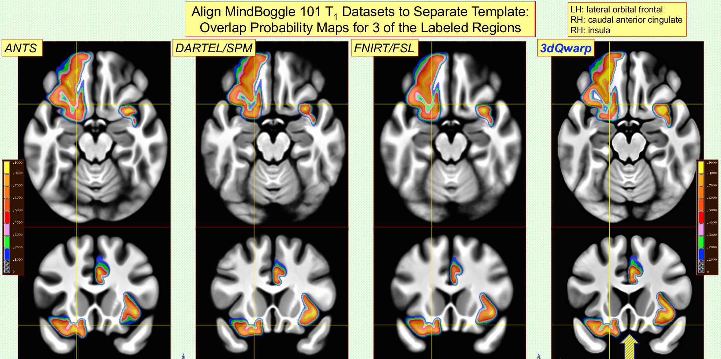
Measuring quality of alignment
Can compare 3dQwarp with other available nonlinear alignment tools
+ For a group of subjects, estimate warp from anat to template
+ Apply warp to labeled ROIs, and measure % overlap in results. (Yellow: >90% overlap)
ANTS, DARTEL and FNIRT run with default settings
(Cox & Glen, 2013, OHBM)

Slide 72
other types of alignments
that are possible in AFNI
PLOT: 1dplot.py -sepscl -boxplot_on -reverse_order -ylabels VOLREG -xlabel vol \
-title "motion regression" -prefix OUTPUT_NAME -infiles MOT_EST_VR.1D

Slide 73
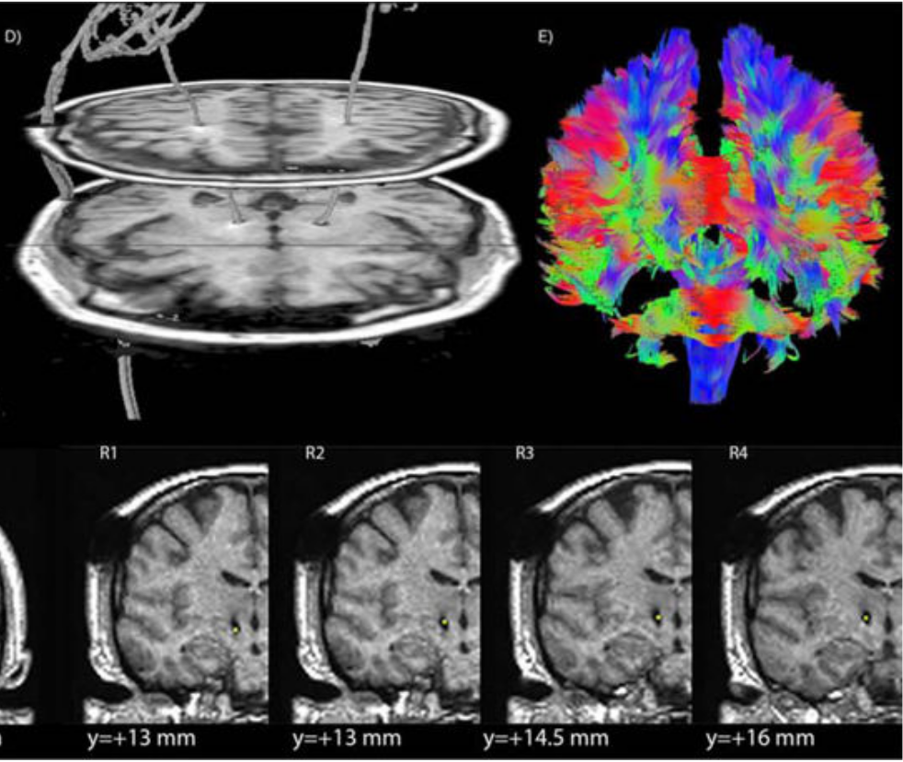
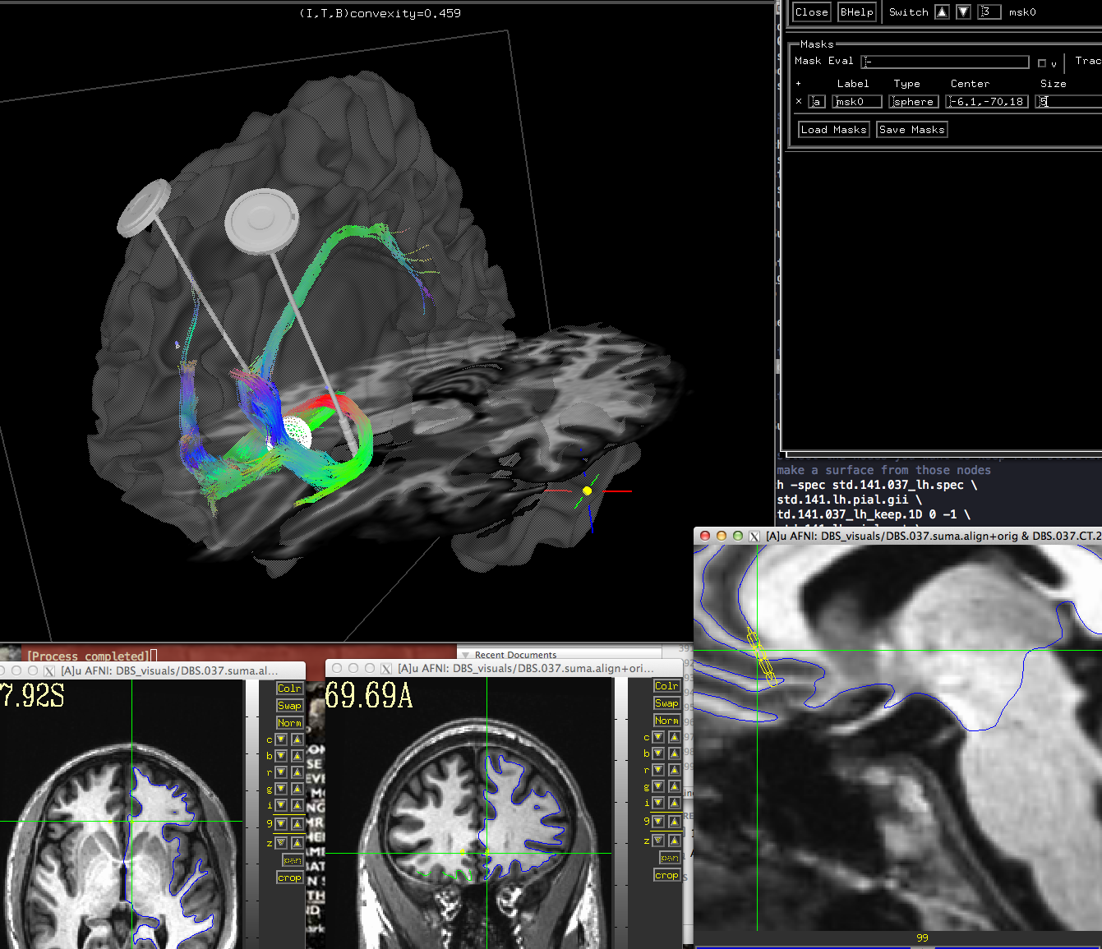
Alignment with non-MRI data
DBS – align CT with electrodes to pre-surgical MRI, PET (and sometimes DWI)
Lauro et al. (2016). And check out @Install_DBSproc for demo on DBS processing with CT and DTI processing in AFNI (with Silvina Horovitz).
Dset courtesy of Justin Rajendra (now in AFNI group!) and Helen Mayberg.

Slide 74
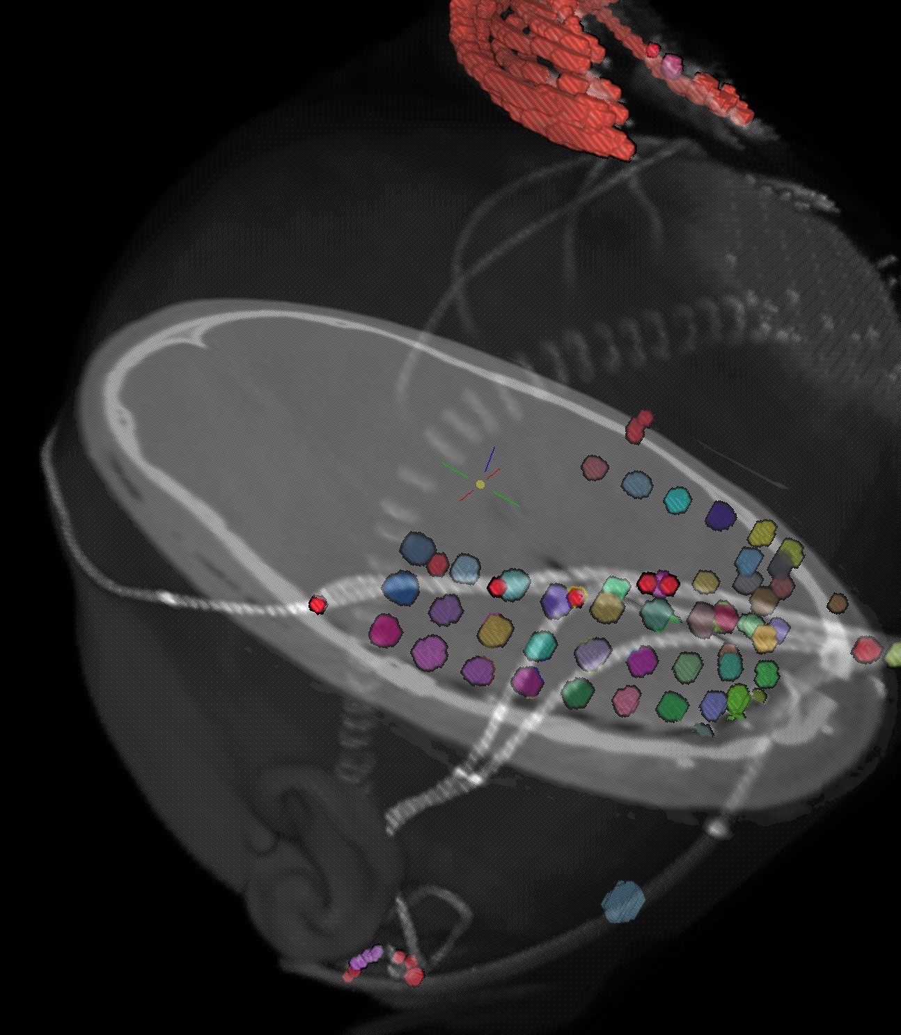
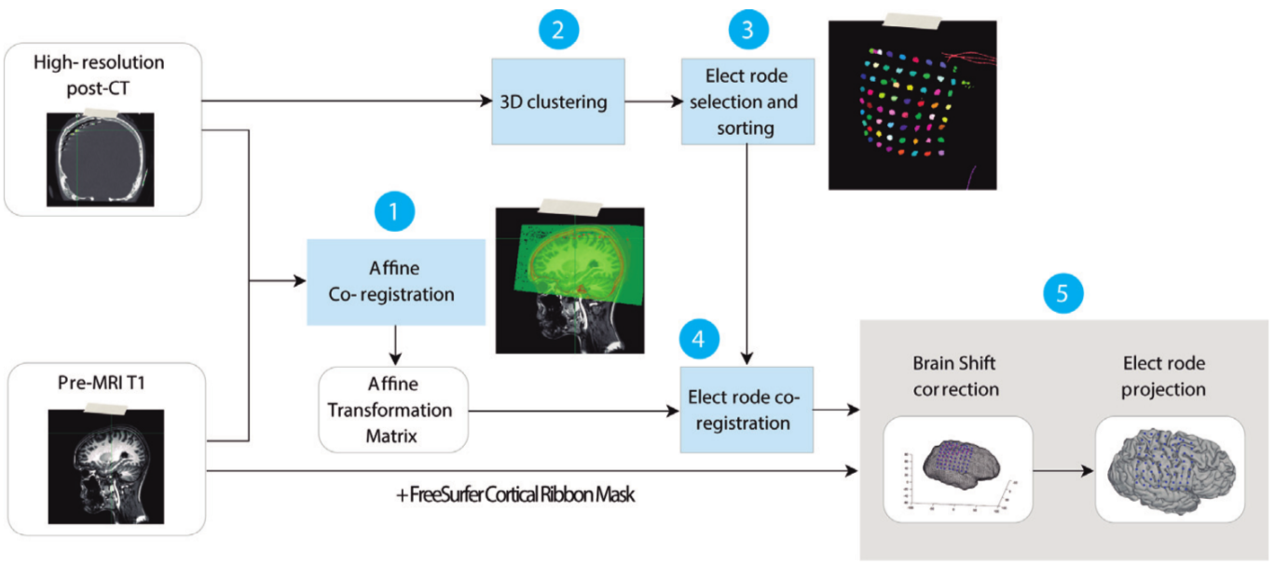
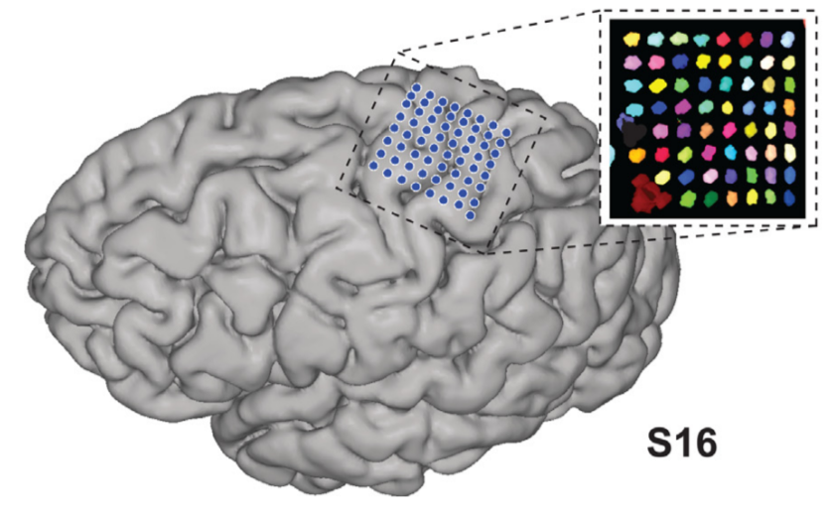
Alignment with non-MRI data
ECOG – align post-op CT with electrodes to pre-surgical MRI, view grids in 2D (AFNI slices) and 3D (SUMA surfaces).
Dataset courtesy of Anna Gaglianese (University of Utrecht, Netherlands)
Branco et al. (2018):
ALICE toolbox using AFNI+SUMA.

Slide 75
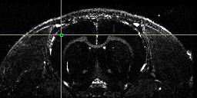
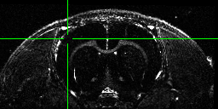
Alignment with non-human data: rats
Alignment of 12 hour Manganese enhanced MRI scan (MEMRI) to start
before
after
[movies→]
#!/bin/tcsh
# align_times.csh
set basedset = 14_pre+orig
foreach timedset ( 14_*hr+orig.HEAD)
align_epi_anat.py -prep_off -anat $timedset -epi $basedset \
-epi_base 0 -anat_has_skull no -epi_strip None -suffix _edge2prep \
-cost lpa -overwrite -edge -rat_align
end
3dTcat -prefix 14_timealigned_edge 14_pre+orig. 14*edge2prep+orig.HEAD
Data from Der-Yow Chen (NINDS)
Notes:
-rat_align sets blur size and neighborhood size for 3dAllineate’s LPC and rat option for 3dSkullStrip though it’s not used here
<number>

Slide 76
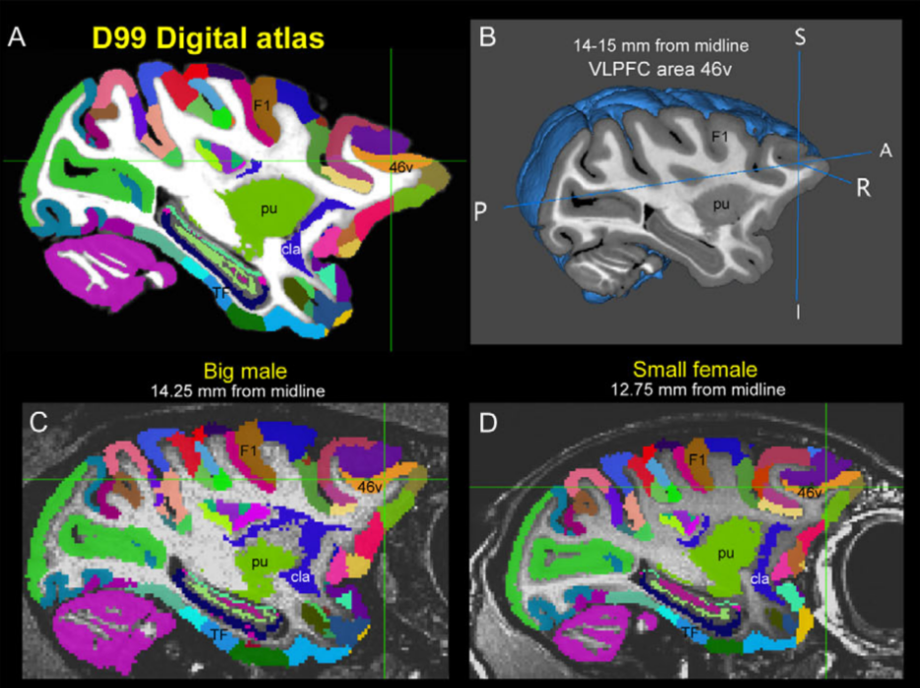
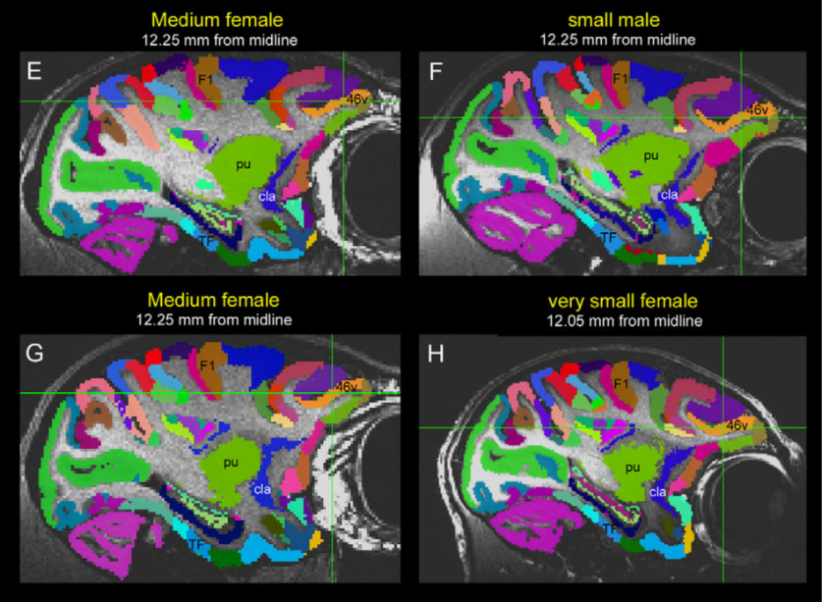
Reveley, Gruslys, Ye, Glen, Samaha,
Russ, Saad, Seth, Leopold, Saleem (2017)
Alignment with non-human data: macaques
Align new D99 template (Reveley et al. 2017) to individual subjects
See here for alignment scripts and more:
+ Demo with scripts (e.g., macaque_align.csh): @Install_D99_macaque
+ https://github.com/jms290/NMT (e.g., NMT_subject_align.csh)
For questions on non-human alignment, contact D. Glen in AFNI group (email, Message Board).
Notes:
-rat_align sets blur size and neighborhood size for 3dAllineate’s LPC and rat option for 3dSkullStrip though it’s not used here
<number>

Slide 77
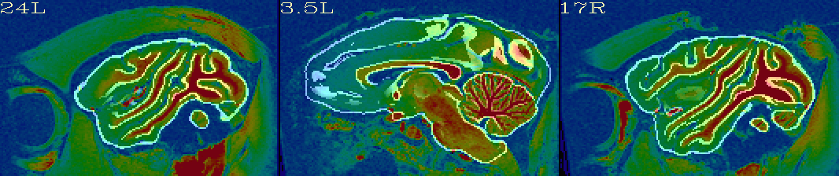
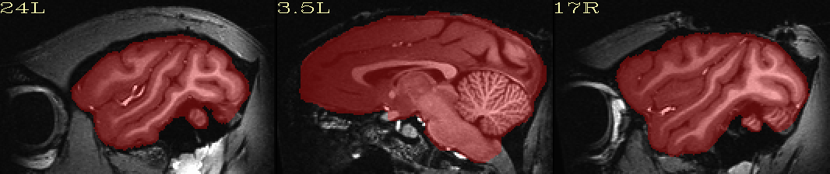
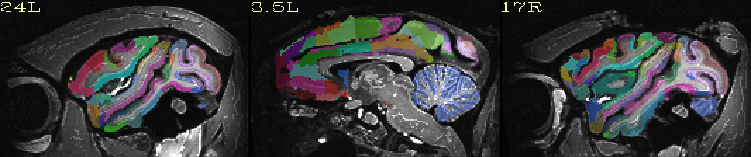
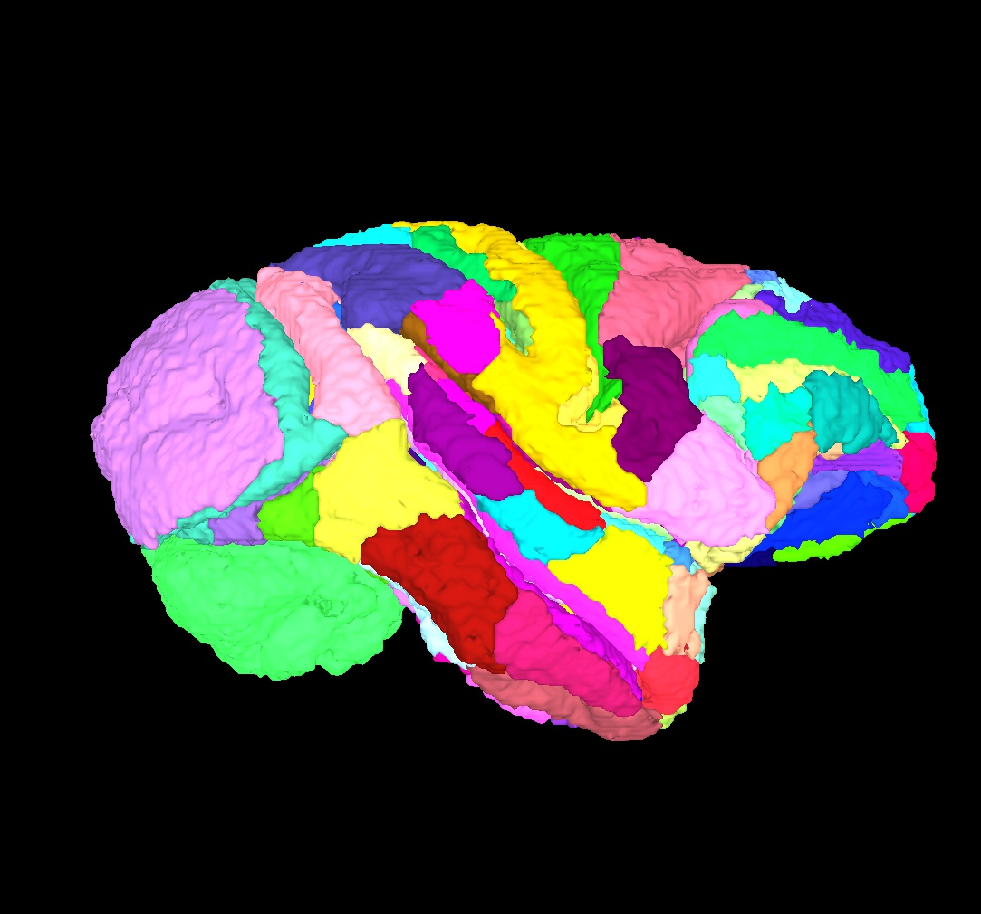
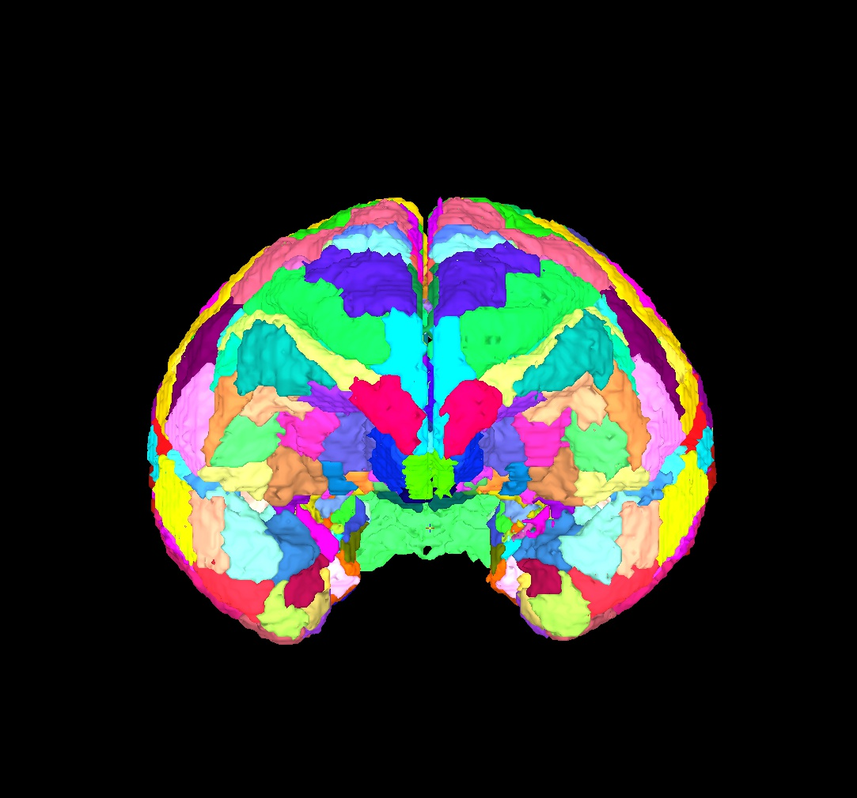
Reveley, Gruslys, Ye, Glen, Samaha,
Russ, Saad, Seth, Leopold, Saleem (2017)
Alignment with non-human data: macaques
New macaque FMRI demo with afni_proc.py (@Install_MACAQUE_DEMO)
1) Uses new @animal_warper program in AFNI for nonlinear alignment
2) afni_proc.py generates pipeline with stats modeling + automatic QC
align: template (white lines) to orig anatomical (color)
skullstrip: focus on brain (red) from tissue
map atlas: map D99 atlas locations to anatomy
Bonus: SUMA surfaces
For questions on non-human alignment, contact D. Glen in AFNI group (email, Message Board).
Notes:
-rat_align sets blur size and neighborhood size for 3dAllineate’s LPC and rat option for 3dSkullStrip though it’s not used here
<number>

Slide 78
Conclusions
Lots of details and concepts to keep in mind:
+ what are the volume contrasts? resolutions? FOV? overlaps? …?
Always visually check results of alignments
+ some scripts/commands make images automatically
+ the AFNI GUI has many useful features to check ulay/olay
+ you can build your own image-making commands (@chauffeur_afni)
For FMRI: afni_proc.py is your new best friend
+ many features of alignment are taken care of for you, for free!
+ you can also learn more alignment tips by reading the AP script
Notes:
-rat_align sets blur size and neighborhood size for 3dAllineate’s LPC and rat option for 3dSkullStrip though it’s not used here
<number>

Slide 79
Supplements
extra stuff
Notes:
-rat_align sets blur size and neighborhood size for 3dAllineate’s LPC and rat option for 3dSkullStrip though it’s not used here
<number>

Slide 80
S1: script for @chauffeur_afni + imcat
#!/bin/tcsh
# Image-generating script for "Alignment concepts: dset overlap" slide; might be useful.
set odir = . # output dir: here
set lcol = ( 150 150 150 ) # grey gaps in imcat cmd
set refv = MNI152_2009_template_SSW.nii.gz # refvol, ulay
foreach ff ( `\ls mni_match*gz` )
# base name of vol, and make a list of all prefixes for later
set ibase = `3dinfo -prefix_noext "${ff}"`
set cpref = img0_${ibase}
# Make a montage of the zeroth brick of each image
@chauffeur_afni \
-ulay ${refv] \
-olay $ff \
-thr_olay 14 \
-set_subbricks 0 -1 -1 \
-prefix $odir/${cpref} \
-pbar_posonly \
-opacity 5 \
-func_range 110 \
-cbar Viridis \
-montx 1 -monty 1 \
-set_dicom_xyz -15 -11 5 \
-set_xhairs MULTI \
-label_mode 1 -label_size 3 \
-do_clean
# Glue together in 2x2 square, with empty matrix element zero-filled
imcat \
-echo_edu \
-gap 5 \
-gap_col $lcol \
-nx 2 \
-ny 2 \
-zero_wrap \
-prefix $odir/ALL_subj_${ibase}.jpg \
$odir/${cpref}*
end
Notes:
-rat_align sets blur size and neighborhood size for 3dAllineate’s LPC and rat option for 3dSkullStrip though it’s not used here
<number>

