Slide 1
3dQwarp and Its Nwarp Friends
Or, How I Learned to Stop Worrying and Love Getting My Datasets all Warped

Slide 2
Linear and Nonlinear Warping
The Central Equation:
  S(x) = source image B(x) = base image
  S(W(x)) ≈ B(x) where W(x) = desired warp function = shows where each point x in B maps to in S
3dAllineate: W(x) = Mx where M = 4x3 matrix
  M has 12 parameters to optimize
3dQwarp: W(x) = W₁( W₂( … W_{n-1}( W_{n}(x) )) … ))
  Each W_{k}(x) is a 3D polynomial function over a “patch” that covers part of the 3D brain volume
  Patches start big [W₁(x)] and shrink and shrink
  Cubic patch = 24 parameters ; Quintic = 81 params
  By the end, 1000s of parameters have been used

Slide 3
The Good and The Ugly
the Good:
  Nonlinear warping can match anatomical structures between subjects more closely than linear transformation
  Can also be used for intra-subject warping for high accuracy matching (e.g., pre- and post-surgery)
the Ugly:
  Nonlinear warping can seriously distort when it tries to match in regions that don’t really “fit together” (e.g., 2 gyri in one person, 1 gyrus in another)
  Extraneous small features can drive warping in strange ways (unlike linear transformation)
  Partial brain coverage is a problem

Slide 4
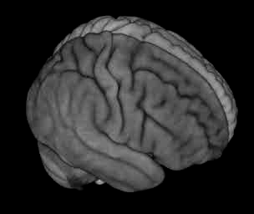
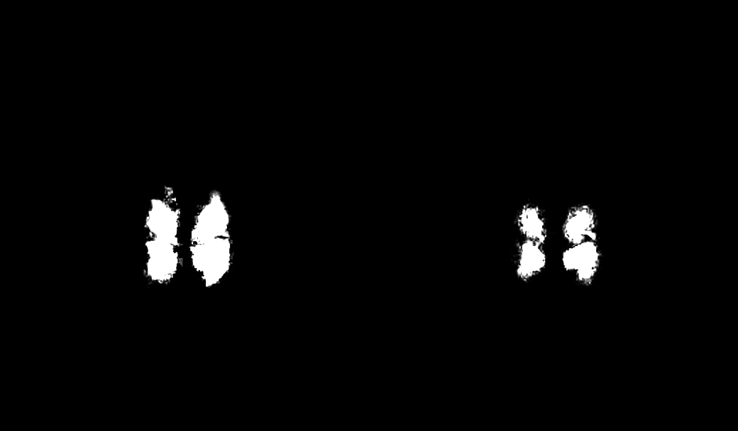
Start: Looking Good
Compare FSL FNIRT vs AFNI 3dQwarp
Average of 101 brain volumes warped to template

Slide 5
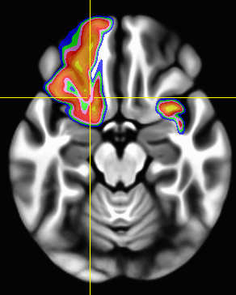
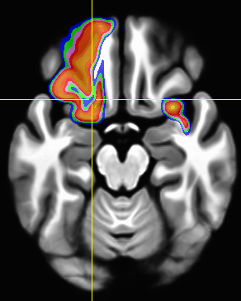
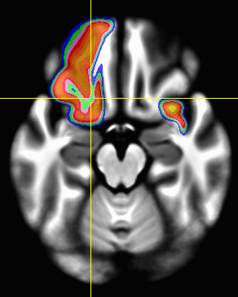
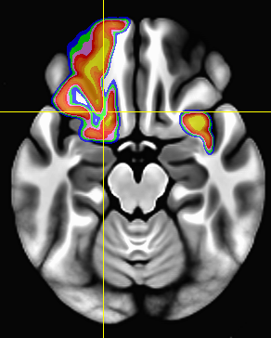
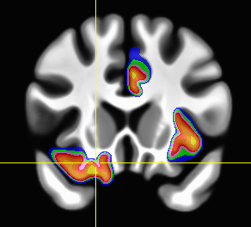
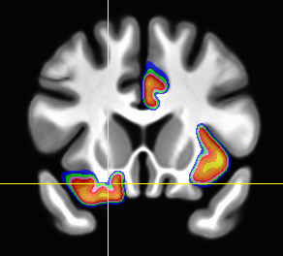
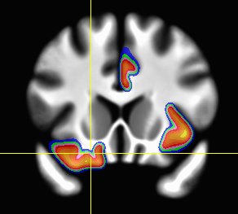
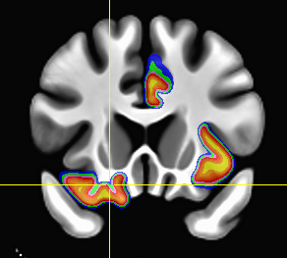
Good Matches to Anatomical Labels
Align MindBoggle 101 T₁ Datasets to Separate Template:
Overlap Probability Maps for 3 of the Labeled Regions
LH: lateral orbital frontal
RH: caudal anterior cingulate
RH: insula
ANTS
DARTEL/SPM
FNIRT/FSL
3dQwarp
ANTS & DARTEL & FNIRT
run with default settings
3dQwarp distribution of overlap probabilities is 2nd order stochastically dominant in a majority of 62 labeled regions
More yellow in the overlay means more 90+% overlap in labels

Slide 6
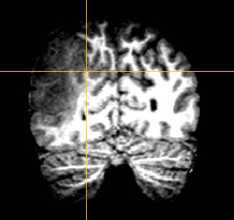
Maybe Even Useful: Neurosurgery
Pre-surgical volume

Slide 7
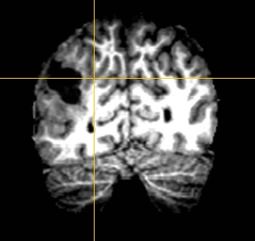
Neurosurgery
Manually
drawn
“exclusion
Mask"
Post-surgical volume

Slide 8
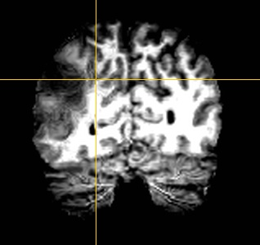
Neurosurgery
Pre-surgical volume
3dQwarp-aligned to Post-surgical volume

Slide 9
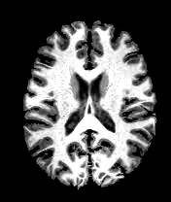
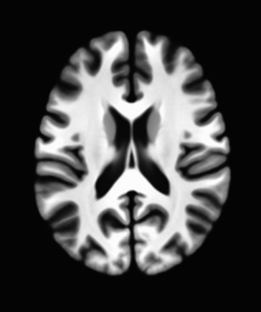
But … Some Ugly
All 101 Volumes
After Warping
Mean of 101 Volumes
After Warping

Slide 10
How to Make a Template
Given a collection of skull-stripped structural (T₁-weighted) datasets
Script @toMNI_Awarp pre-processes each dataset (3dUnifize and @auto_tlrc)
  3dUnifize make the image intensity more uniform over the volume
Script @toMNI_Qwarpar runs 3dQwarp to collectively warp them together over finer and finer patch levels
Has been used to create Haskins pediatric brain atlas (now distributed with AFNI)

Slide 11
What Else to Do with a Warp?
Warp another dataset the same way
  3dNwarpApply (e.g., carry EPI to template)
Warp some discrete points the same way
  3dNwarpXYZ (e.g., eCog electrode locations)
Compute voxel-wise functions of a warp
  3dNwarpFuncs (e.g., volume distortion)
Compose multiple warps together
  3dNwarpCat and 3dNwarpCalc
Can compute inverse warp W⁻¹(x), to map locations in S(x) to matching locations in B
  S(W(x)) ≈ B(x) ➔ S(x) ≈ B(W⁻¹(x))

Slide 12
How to Use 3dQwarp
Run it yourself (the “old school” or “real man” way)
auto_warp.py (easier, less flexible)
Use @SSwarper script to Skull Strip and Warp to MNI template
Use ‘-tlrc_NL_warp’ option in afni_proc.py to have transformation to template space be done via auto_warp.py
Use @toMNI_Awarp and @toMNI_Qwarpar to create a study (or population) specific template
Use ‘-plusminus’ option in 3dQwarp to warp blip-up and blip-down EPI datasets to “meet in the middle” (script unWarpEPI.py)

Slide 13
Yet to Be Done
Incorporate more fully into afni_proc.py and uber_subject.py
  Warping to template; un-warping EPI distortions
Explore how much nonlinear warping to a template can improve group analysis in functional and anatomical MRI
  And improvements to 3dSeg (segmentation)
Extend matching algorithm to allow label-based matches, vs. existing intensity-based
Speed the damn thing up!
Write a paper about it!

Slide 14
Distortion Correction of EPI
Acquire a few 3D images with opposite phase encoding method (“blip up” and “blip down”)
  This will reverse the distortions of the EPI data
  You don’t need many opposite blip images
  Ideally, also reverse the slice-selection gradient to also reverse the small slice-selection distortions
EPI scanning method
(in Fourier k-space)
”Blip up”

Slide 15
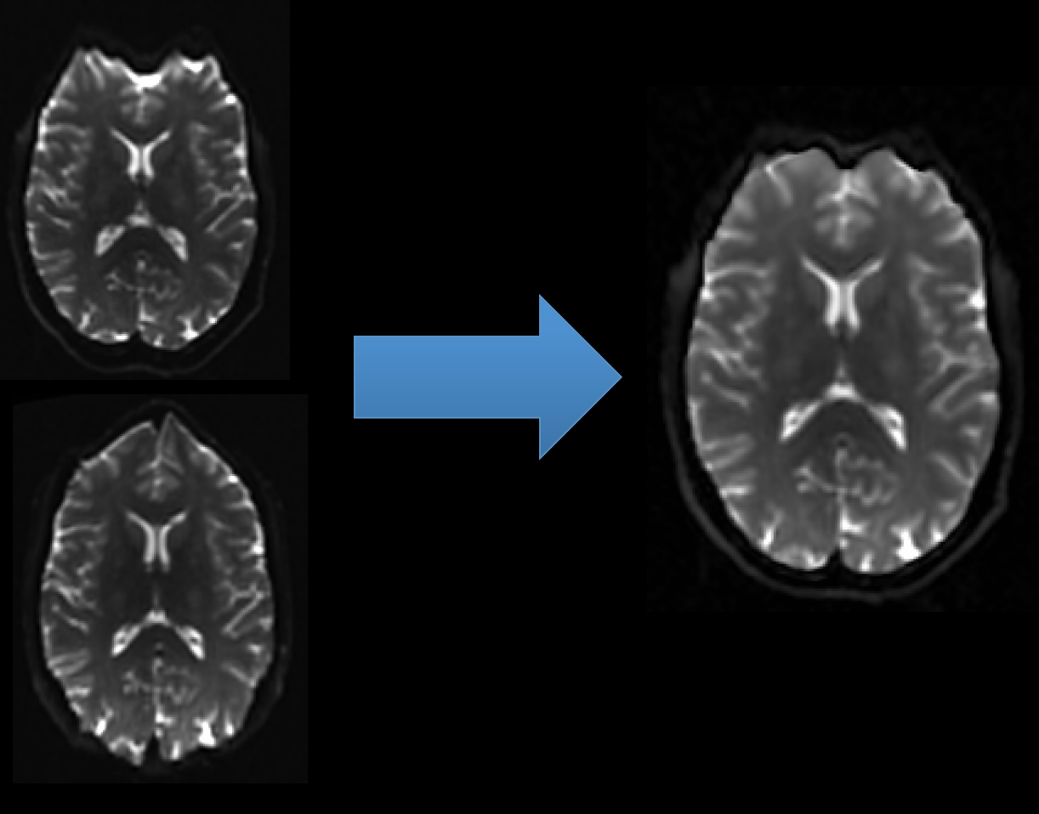
Distortion Correction of EPI
Use unWarpEPI.py to fix the distortions

Slide 16
Nonlinear Warping to MNI Template
afni_proc.py can do the nonlinear warping for you
  But, nonlinear warping is slow (in fact, slowly slow)
  If you need to re-rerun subject analysis, nonlinear warping will slow the re-run script down a lot
Solution: do the nonlinear warping before using afni_proc.py, then supply the warping results so that afni_proc.py will skip doing the warping itself
Mechanism: the @SSwarper script (tcsh)
  Does Skull Stripping (”SS”) and nonlinear warping
  Base dataset is MNI152_2009_template_SSW.nii.gz
    Nonlinearly warped, not too blurry

Slide 17
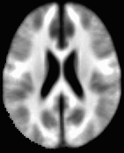
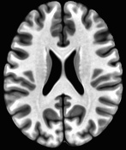
Two MNI Templates
MNI152_1mm_uni+tlrc
Affine alignments
MNI152_2009_template.nii.gz
Nonlinear alignments

Slide 18
What @SSwarper Reads and Writes
Inputs:
  T1-weighted anatomical image of subject (skull-on)
  Subject ID code, for names of output files
Outputs (subject ID = sub007):
  anatSS.sub007.nii
    skull-stripped dataset in original coordinates
  anatQQ.sub007.nii
    skull-stripped dataset, nonlinearly warped to MNI template
  anatQQ.sub007.aff12.1D
    affine matrix to transform original dataset to MNI template
  anatQQ.sub007_WARP.nii
    incremental warp from affine transformation to nonlinearly aligned dataset
These files are needed for later use in afni_proc.py

Slide 19
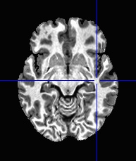
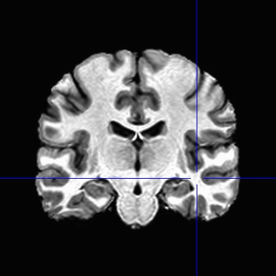
@SSwarper Results
sub00440 from Beijing-Zang
in the FCON-1000 collection

Slide 20
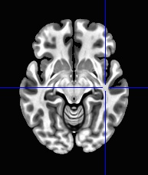
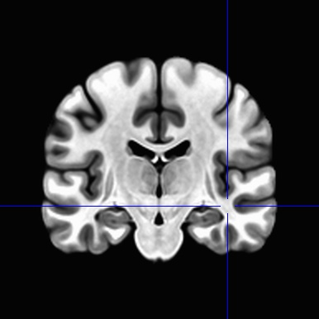
MNI Template Slices
For comparison

