Slide 1



FMRI Data Analysis at Individual Level
SSCC/NIMH/NIH/HHS

Slide 2
Overview
Basics of linear model
FMRI experiment types
  Block design; Event related experiment; Mixed
FMRI data decomposition: three components
  Baseline + slow drift + effects of no interest; Effects of interest; Unknown
  Effects of interest - understanding BOLD vs. stimulus: IRF
Three modeling strategies
  Fixed-shape IRF
  No assumption about IRF shape
  One major IRF plus shape adjustment
Other issues
  Multicollinearity
  Catenation
  Percent signal change

Slide 3
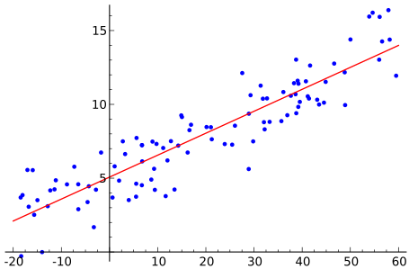
Basics of Linear Model
Regression: relationship between a response/outcome (dependent) variable and one or more explanatory (independent) variables (regressors)
  Simple regression: fit data with a straight line: Sir Francis Galton’s original meaning: regression to mean
    When 2 variables are not perfectly correlated, regression to mean exists
    May show up in psychology (Daniel Kahneman): Rewards for good performance vs. punishment of mistakes (correlation vs. causation)
    Lost in most cases including FMRI
  Some statisticians just call it linear model
Mathematical crystallization
  y_{i} = α + βx_{i} + ε_{i}, or y_{i} = α + β₁x_{1i} +… + β_{k}x_{ki} + ε_{i}
  y = Xβ + ε, X = [1, x₁, x₂, …, x_{k}]
  Assumption
    linearity
    white noise (independence) and
    Gaussianity ε ~ N(0, σ²I)

Slide 4
Basics of Linear Model
Solution for linear regression y = Xβ + ε
  Project data y onto the space of explanatory variables (X)
  OLS
Meaning of coefficient: β value, slope, marginal effect or effect size associated with a regressor
Various statistical tests
  Student t-test for each β (H₀: β₃ = 0)
  Student t-test for linear combination of β values - general linear test (GLT), e.g., H₀: β₃ – β₅ = 0, or H₀: 0.5*(β₃ + β₄) – β₅ = 0
  F-test for composite null hypothesis, e.g., H₀: β₃ = β₄ = β₅ or H₀: β₃ = β₄ = β₅ = 0
  Omnibus or overall F-test for the whole model, e.g, H₀: all β values are 0, or H₀: all β values of interest are 0

Slide 5
Linear Model with FMRI
Time series regression: data y is time series
  Regressors: idealized response or yardstick
    We get what we’re looking for
    It may miss something when we fail to recognize it
    Regressor construction is quite challenging
  Special handling: noise not white ε ~ N(0, σ²Σ) with temporal or serial correlation
    Banded variance-covariance matrix Σ
  AKA general linear model (GLM) in other FMRI packages
    General vs. generalized
Same model for all voxels in the brain
  Simultaneously solve the models: voxel-wise analysis, massively univariate method

Slide 6
FMRI Experiment Terminology
Experiment setup
  Number of subjects
  Number of conditions (tasks, stimulus (trial, event) types): Factorial design?
  Sample size (repetitions) per condition
  Block, event-related, or mixed?
  Inter-stimulus interval (ISI)
Scanning parameters: TR, voxel size, data points (volumes), slice sequence (sequential or interleaved), slice thickness, removing first few TRs
Scanning terms
  Run: continuous scanning; a brief break before next run
  Session: subjects come back after along period of time
  Experiment or study

Slide 7
Types of FMRI Experiments
Two classical types of experiment design
  Block (boxcar) design
    Each block lasts for more than one TR (e.g., 4 to 20s)
    Each block is under one condition (e.g., watch a video clip), or a series of multiple trials (e.g., 10 consecutive blur images)
    BOLD response is often visible in time series
    SNR: noise magnitude about same as BOLD response
  Event-related design
    Each event or trial lasts for one TR or shorter
    Events are randomly spaced and/or sequenced in time
    BOLD response to stimulus tends to be weaker, since fewer nearby-in-time “activations” have overlapping signal changes
    SNR: data looks more like noise (to the pitiful human eye)
Mixed designs
  Containing both events and blocks, e.g., cue + video watching

Slide 8
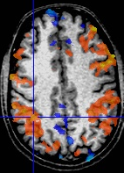
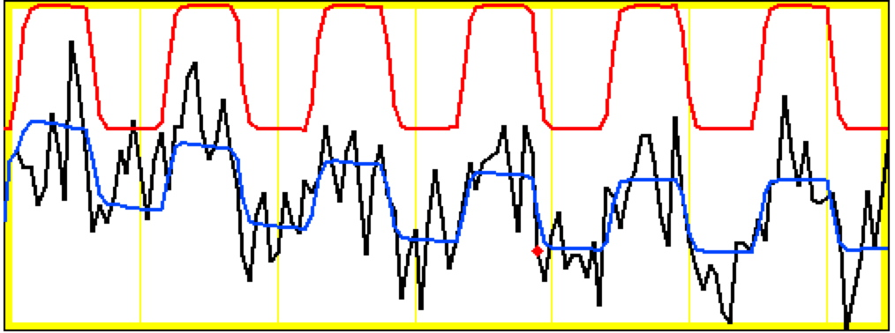
Block data of one run at a voxel
model regressor
model fitted to data
Noise ~ same size as signal change
data
Block: 27 s “on” / 27 s “off”; TR=2.5 s; 130 time points
This is best voxel; most voxels are not fitted as good as this
Activation amplitude and shape vary across blocks
  Subject attention variability
  Habituation (or attenuation): psychological/physiological level
  Linearity assumption
  Pure random effects

Slide 9
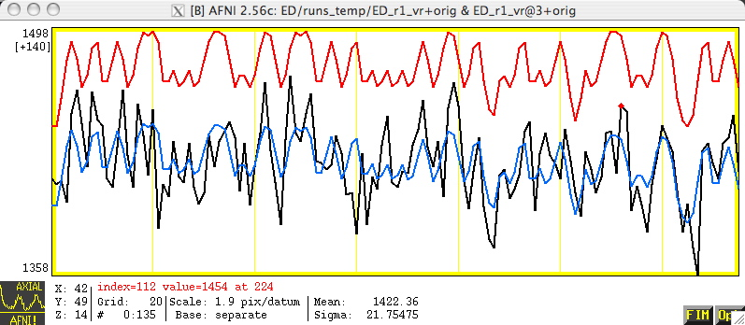
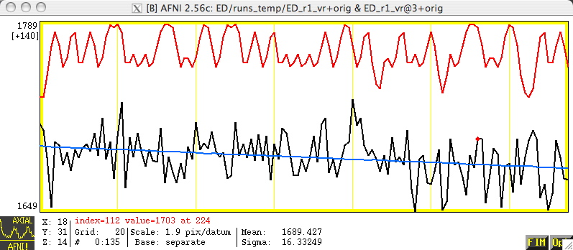
Event-Related Data at 2 Voxels
correlation with ideal = 0.56
Voxel activated
Voxel not activated
correlation with ideal = – 0.01
Lesson: ER-FMRI activation is not obvious via casual inspection

Slide 10
FMRI Data
Data partition: Data = Signal + Noise
  Data = acquisition from scanner (voxel-wise time series)
    What we have
  Signal = BOLD response to stimulus; effects of interest + no interest
    We don’t really know the real signal!!!
    Look for idealized components, or search for signal via repeated trials
    Of interest: effect size (response amplitude) for each condition: beta
    Of no interest: baseline, slow drift, head motion effects, …
  Noise = components in data that interfere with signal
    Practically the part we have don’t know and/or we don’t care about; that is, noise is the part we can’t explain in the model
    Will have to make some assumptions about its distribution
Data = baseline + slow drift + other effects of no interest + response₁ + … + response_{k} + noise
  How to construct the regressors of interest (responses)?

Slide 11
BOLD Response
Hemodynamic response (HDR)
  Brain response to stimulus/task/condition
    Ideally we want to know the response (activation) at neuronal level, but that is beyond the FMRI capability
  Indirect measure of neural response: dynamic regulation of blood flow
Hemodynamic response function (HDF)
  Mathematical formulation/idealization of HDR
  BOLD signal is further an indirect measure of brain response
  HDF bridges between neural response and BOLD signal
How to build the bridge?
  One extreme: Assume a fixed-shape (idealized) HDF
  The other extreme: No assumption about HDR shape
  Middle ground: major shape + wiggle room for shape adjustment

Slide 12
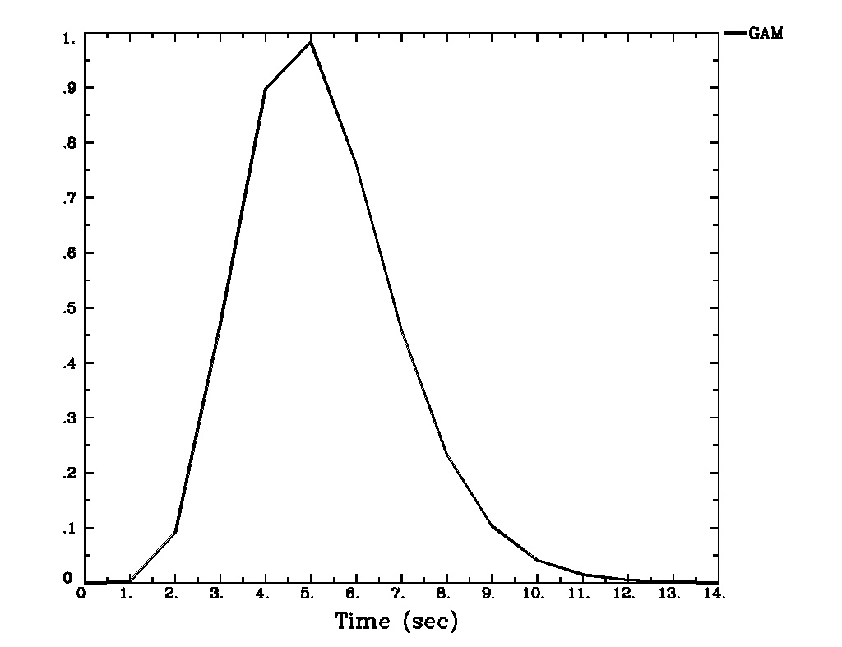
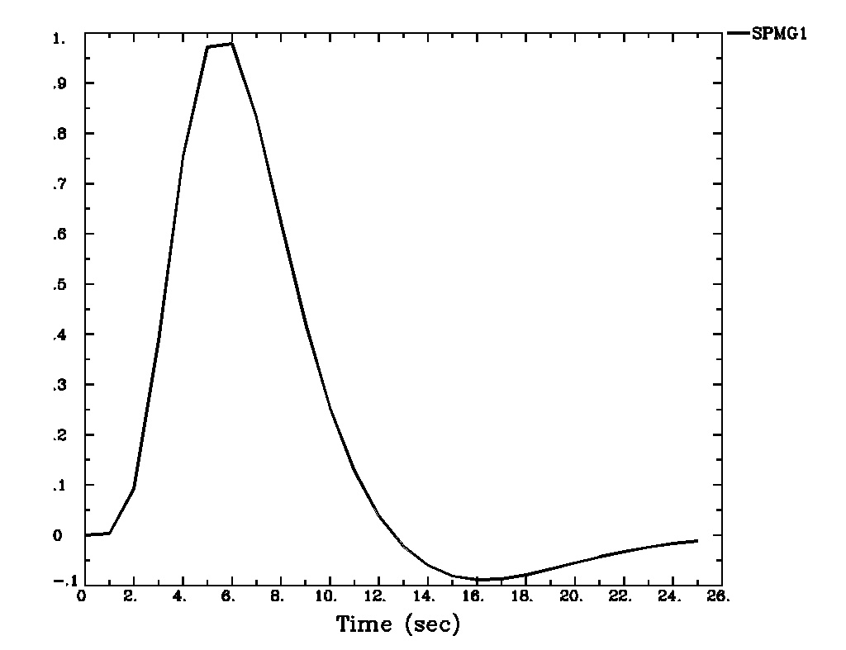
Fixed-Shape IRF
Assuming a fixed shape h(t ) for HDF to an instantaneous stimulus: impulse response function (IRF)
  GAM(p,q): h(t ) = [t/(p*q)]^{p} * exp(p-t/q)
    Default IRF: h(t ) = t ^{8.6} exp(-t /0.547) [MS Cohen, 1997]
    A variation: SPMG1 (undershoot)
  Build HDF based on presumed IRF through convolution
    Roll IRF h(t ) with stimulus timing S(t):
Instant
stimulus

Slide 13
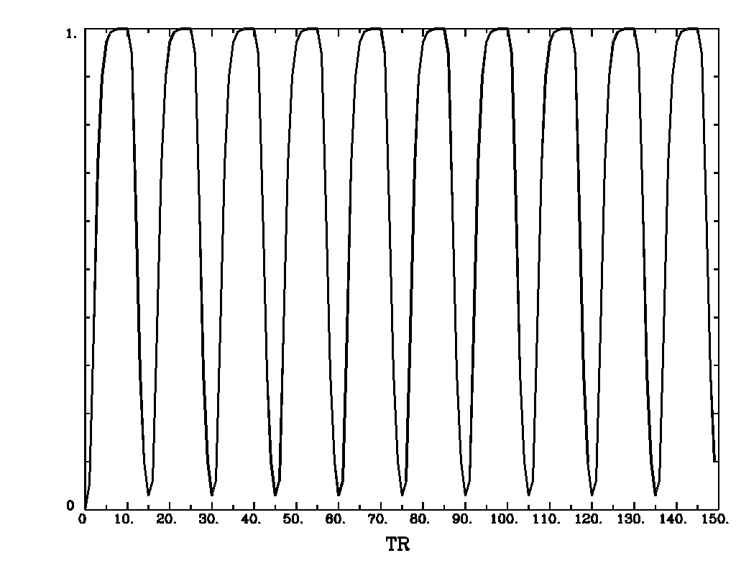
Fixed-Shape HDF for Block Design
Assuming a fixed shape h(t ) for IRF to an instantaneous stimulus
  For each block, h(t ) is convolved with stimulus timing AND duration (d) to get idealized response (temporal pattern) as an explanatory variable (regressor): BLOCK(d,p)
    Equivalent to convolving a series of consecutive events
    Linearity assumed within each block: plateau-like response
    p: scale HDF to 1 for easy interpretation of β
Block: 10 s on and 10 s off; TR=2 s; 150 time points

Slide 14
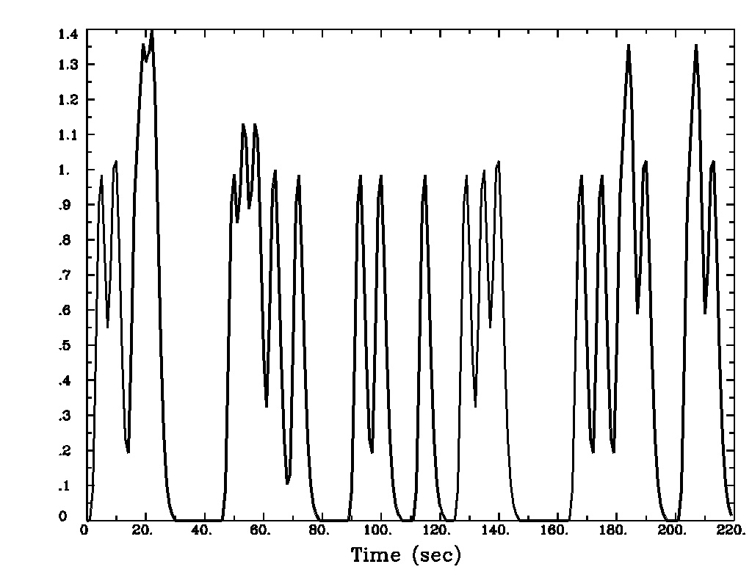
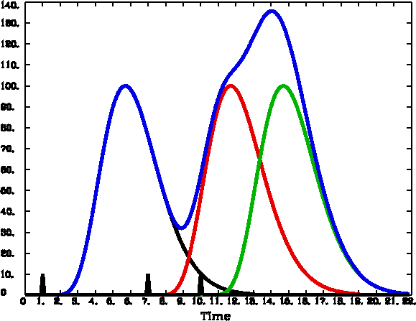
Fixed-Shape HDF for Event-Related Design
Fixed shape h(t ) for IRF to an instantaneous stimulus
  For multiple events of a condition/task, h(t ) is convolved with stimulus timing to get idealized response (temporal pattern) as an explanatory variable (regressor): GAM(p,q)
    Linearity assumed when events are close with each other: overlapping impulse responses

Slide 15
Linear Model with Fixed-Shape IRF
  FMRI data = baseline + drift + other effects of no interest + response₁ + … + response_{k} + noise
  ‘baseline’ = baseline + drift + other effects of no interest
    Drift: psychological/physiological effect, thermal fluctuation
    Data = ‘baseline‘ + effects of interest + noise
    Baseline condition (and drift) is treated in AFNI as baseline, an additive effect, not an effect of interest (cf. SPM and FSL)!
  y_{i} = α₀ + α₁ t_{i} + α₁ t_{i}² + β₁x_{1i} +… + β_{k}x_{ki} +…+ ε_{i}
  y = Xβ + ε, X = [1, t, t², x₁, x₂, …, x_{k}, …]
  In AFNI baseline + slow drift is modeled with polynomials
    A longer run needs a higher order of polynomials
      One order per 150 sec
    With m runs, m separate sets of polynomials needed to account for temporal discontinuities across runs
      m(p+1) columns for baseline + slow drift: with p-order polynomials
  Other typical effects of no interest: head motion effects

Slide 16
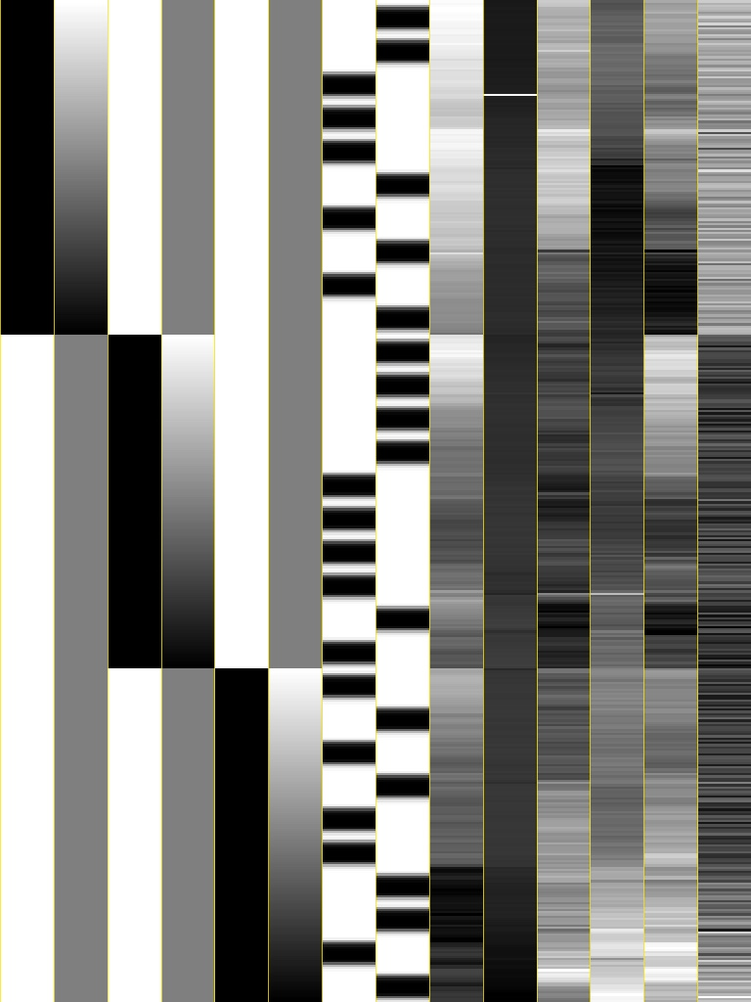
Design Matrix with Fixed-Shape IRF
Voxel-wise (massively univariate) linear model: y = Xβ+ε
  X: explanatory variables (regressors) – same across voxels
  y: data (time series) at a voxel – different across voxels
  β: regression coefficients (effects) – different across voxels
  ε: anything we can’t account for – different across voxels
Visualizing design matrix X = [1, t, t², x₁, x₂, …, x_{k}, …] in grayscale
}
}
baseline + drift
stimuli
head motion
}
6 drift effect regressors
  linear baseline
  3 runs x 2 parameters/run
2 regressors of interest
6 head motion regressors
  3 rotations + 3 shifts

Slide 17
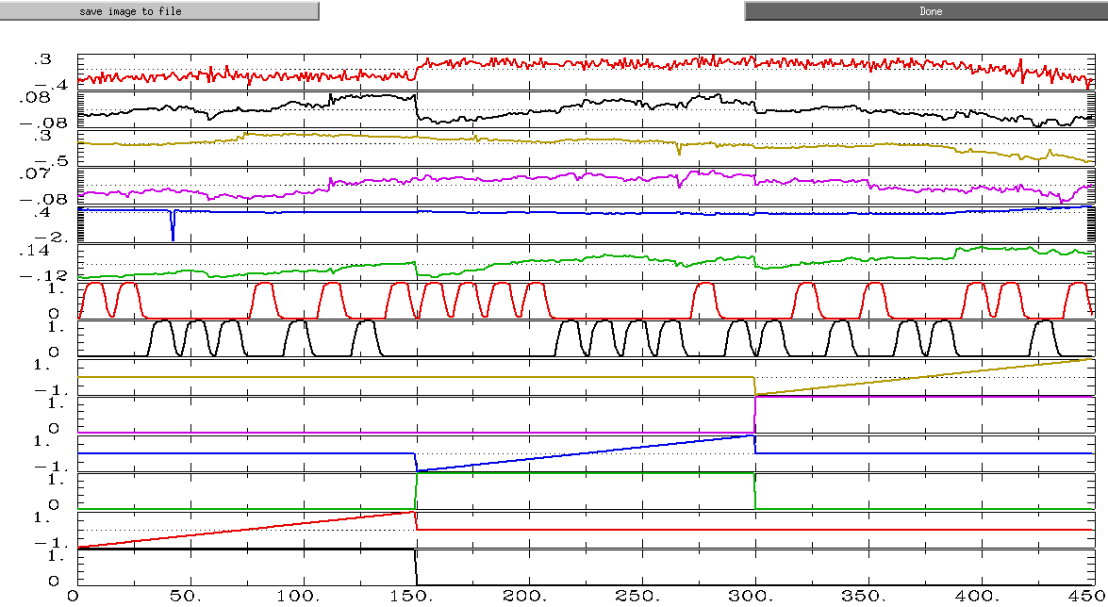
Design Matrix with Fixed-Shape IRF
Visualizing design matrix X = [1, t, t², x₁, x₂, …, x_{k}, …] in curves

Slide 18
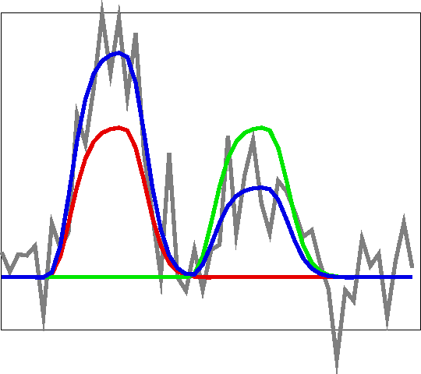
Solving Linear Model
Gray = data
Red = Expected response shape for #1
Green = Expected response shape for #2
Blue = modeled response = β₁x₁+β₂x₂
where β₁ and β₂ vary from 0.1 to 1.7
OLS: wiggle around and find β₁ and β₂ that make best fit with blue curve to data Gray = data =
1.5x₁+0.6x₂+noise

Slide 19

Model Quality Check
First thing to do!
  Unfortunately most users in FMRI simply jump to specific effects of interest, their contrasts and their significance. They simply don’t pay any attention (or lip service) to overall model performance at all!
Approaches to judge your model
  Design matrix report from 3dDeconvolve
  Full F-statistic (automatically provided in AFNI)
    Data = ‘baseline‘ + effects of interest + noise versus
    Data = ‘baseline‘ + noise
  Determination coefficient R² at activated regions (-rout in 3dDeconvolve): poor modeling in FMRI!
    Block design: ~50%
    Event-related experiments: 10-20%
  Modeled vs. not modeled: –fitts and –errts in 3dDeconvolve
    Fitted curve = ‘baseline‘ + effects of interest
    Residuals = noise = components we have no idea about

Slide 20
Statistical Testing
Everything is about contrast!
  Even true for happiness in life
Effects (regression coefficients) of interest
  β: effect relative to baseline condition by default in AFNI
    β_{A} = Effect_{A} - β_{base}
  t-statistic: significance
Pairwise comparisons (contrasts)
  Conditions β_{A} vs. β_{B} (e.g., house vs. face)
    β_{A} – β_{B} = (Effect_{A} - β_{base}) – (Effect_{B} - β_{base}) = Effect_{A} - Effect_{B}
  t-statistic: significance
General linear test – linear combination of multiple effects
  t-statistic: 0.5*happy + 0.5*sad – neutral
Composite tests
  F-statistic for composite null hypotheses: happy = sad = neutral = 0; or, happy = sad = neutral

Slide 21
Assessing Fixed-Shape IRF Approach
Used 99% of time: Why popular?
  Assume brain responds with same shape across 4 levels: subjects, activated regions, stimulus conditions/tasks, trials
    Difference in magnitude β and its significance: what we focus on
    Strong assumption about four levels of shape information?
  Easy to handle: one value per effect
  Works relatively well
    Block design: shape usually not important due to accumulating effects (modeled via convolution) of consecutive events
      Really plateau? Same magnitude across blocks?
    Event-related experiment: OK most of time
      Linearity when two responses overlap? Same effect across events?
Not what you want if you
  care about subtle shape difference across subjects, across regions, across conditions, and across trials
  improve modeling

Slide 22
No Constraint on IRF Shape
Yardstick (or TENT) perspective
  Set multiple yardsticks (or tents) at various equally-spaced locations to cover the potential BOLD response period
    Each yardstick or TENT is a basis function
  BOLD response measured by yardstick heights at all locations
    Condition effect is reflected by as many as number of yardsticks
Yardsticks (percent signal change sticks): TENT functions
  Also known as ‘piecewise linear splines’
yardstick with unit height
@ location 3•TR
h
Cubic splines
are also available
time
t = 0
t =TR
t = 2•TR
t = 3•TR
t = 4•TR
t = 5•TR

Slide 23
Tent Functions = Linear Interpolation
A
5 equally-spaced tent functions (yardsticks): linear interpolation between “knots” with TENTzero(b,c,n) = TENTzero(0,12,7)
Tent parameters are easily interpreted as function values (e.g., L: tent radius; β₂ = response (tent height) at time t = 2L after stimulus onset)
Relationship of tent spacing L and TR (L ≥ TR), e.g., with TR=2s, L=2, 4s
In uber_subject.py or 3dDeconvolve with TENTzero(0, D, n), specify duration (D) of HRF and number (n): radius L = D/(n-1) with (n-2) full tents, each tent overlaps half tent with two neighboring ones.
  In above example, D=12s, then L=2s n=7; covering 12s; TENTzero(0,12,7) ~ TENT(2,12,6)
CSPLIN(b,c,n):
smoother
h
β₂
β₃
6 intervals = 5 β weights
stimulus onset
β₁
β₄
β₅
“knot” times
time
0
L
2L
3L
4L
5L
6L

Slide 24
Modeling with TENTs - Example
Event-related study (Beauchamp et al., J Cogn Neurosci 15:991-1001)
  10 runs, 136 time points per run, TR=2 s
  Two factors
    Object type: human vs. tool
    Object form: real image vs. points
  4 types (2x2 design) of stimuli (short videos)
    Tools moving (e.g., a hammer pounding) - ToolMovie
    People moving (e.g., jumping jacks) - HumanMovie
    Points outlining tools moving (no objects, just points) - ToolPoint
    Points outlining people moving - HumanPoint
  Goal: find brain area that distinguishes natural motions (HumanMovie and HumanPoint) from simpler rigid motions (ToolMovie and ToolPoint)

Slide 25
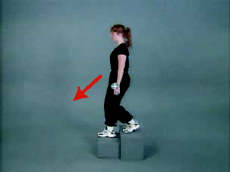
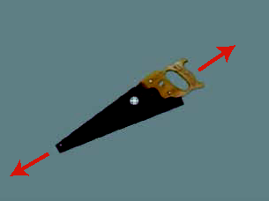
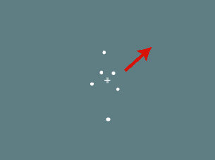
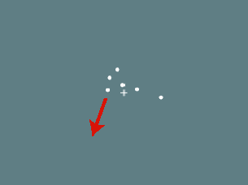
Experiment: 2 x 2 design
  Human whole-body motion (HM)
Tool motion (TM)
Human point motion (HP)
Tool point motion (TP)
From Figure 1
Beauchamp et al. 03
  Hypotheses to test:
  Which areas are differentially activated by any of these stimuli (main effect)?
    point motion versus natural motion? (type of image)
    human-like versus tool-like motion? (type of motion)
  Interaction effects?
    Point: human-like versus tool-like? Natural: human-like versus tool-like?
    Human: point versus natural? Tool: point versus natural?

Slide 26
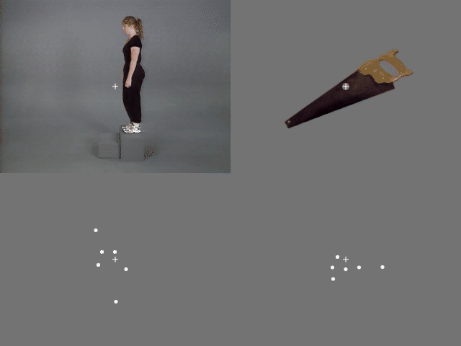
Tool motion (TM)
Human point motion (HP)
Tool point motion (TP)
From Figure 1
Beauchamp et al. 03

Slide 27
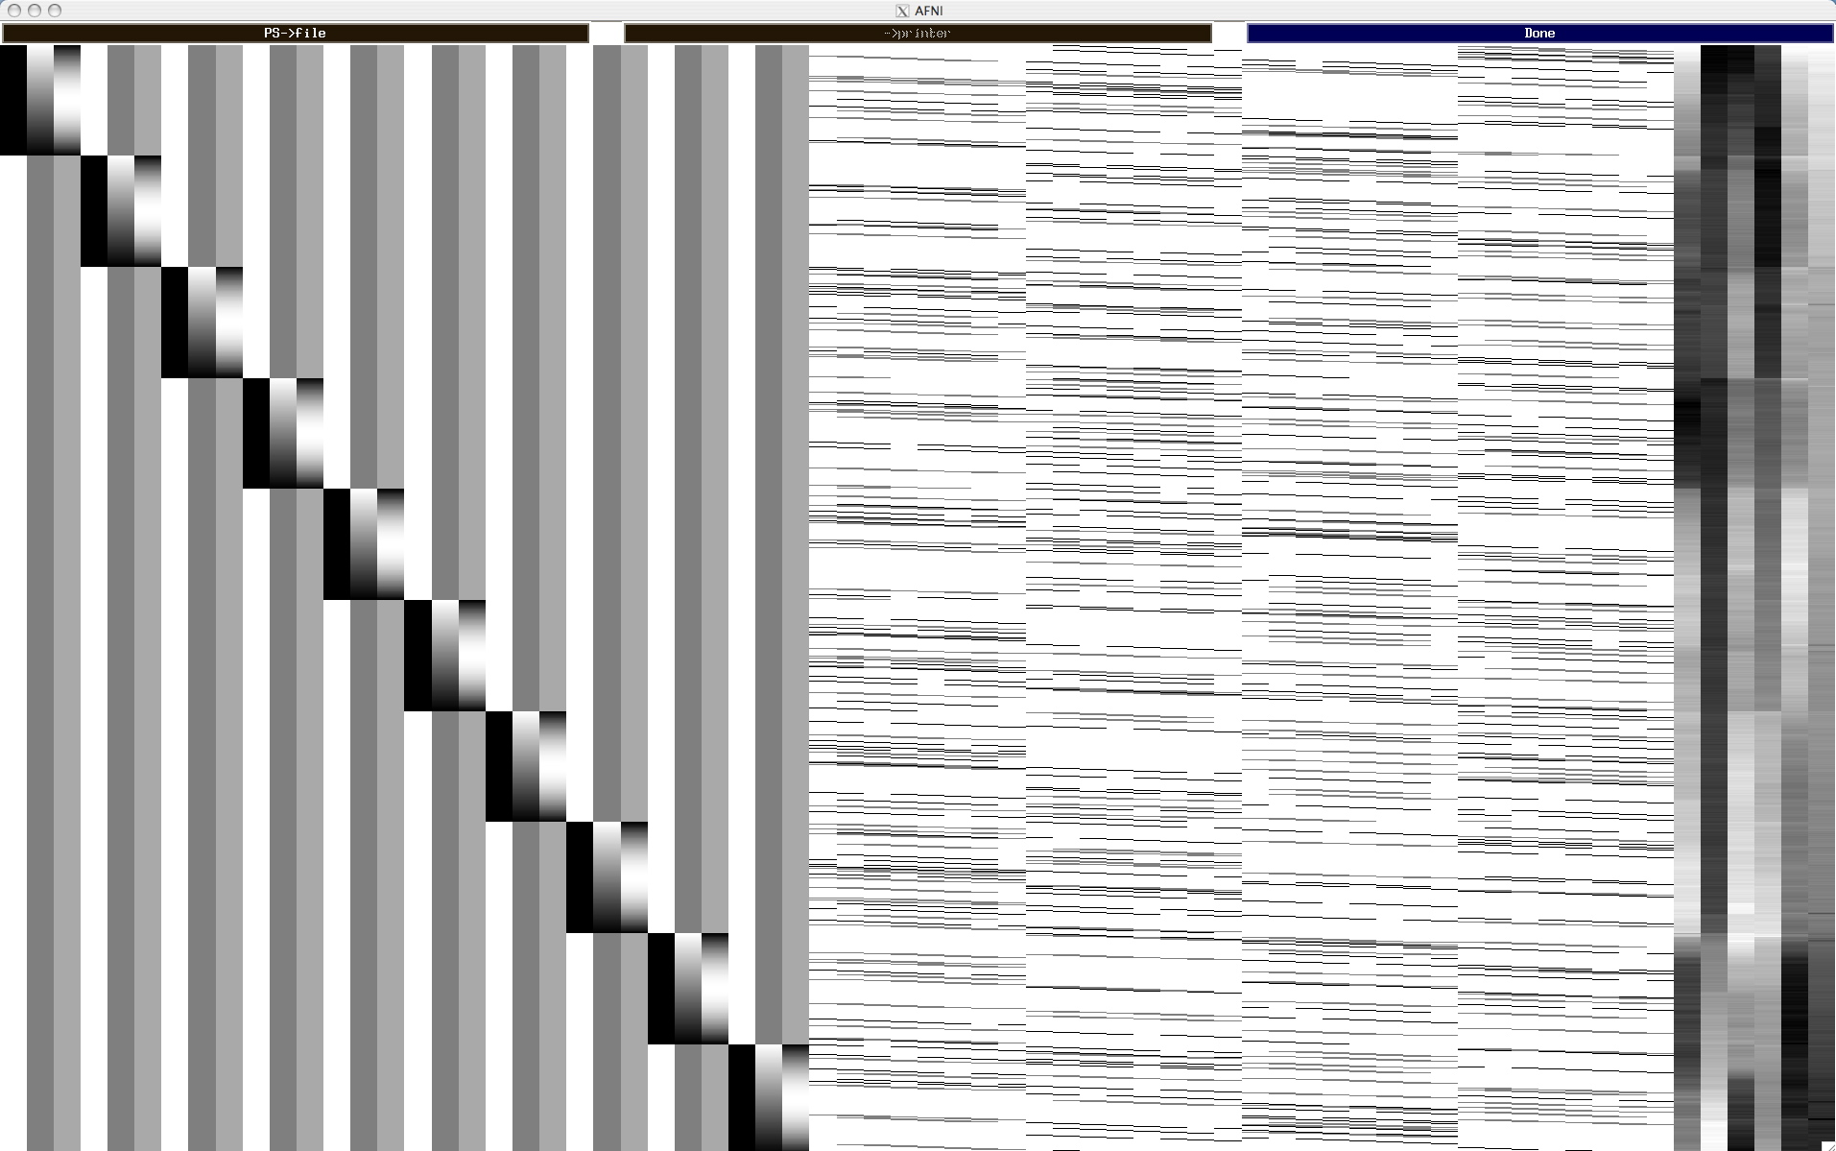
Design Matrix with TENTzero(0,16,9)
Baseline + quadratic trend for 10 runs
7 tents per condition × 4 conditions
head motion

Slide 28
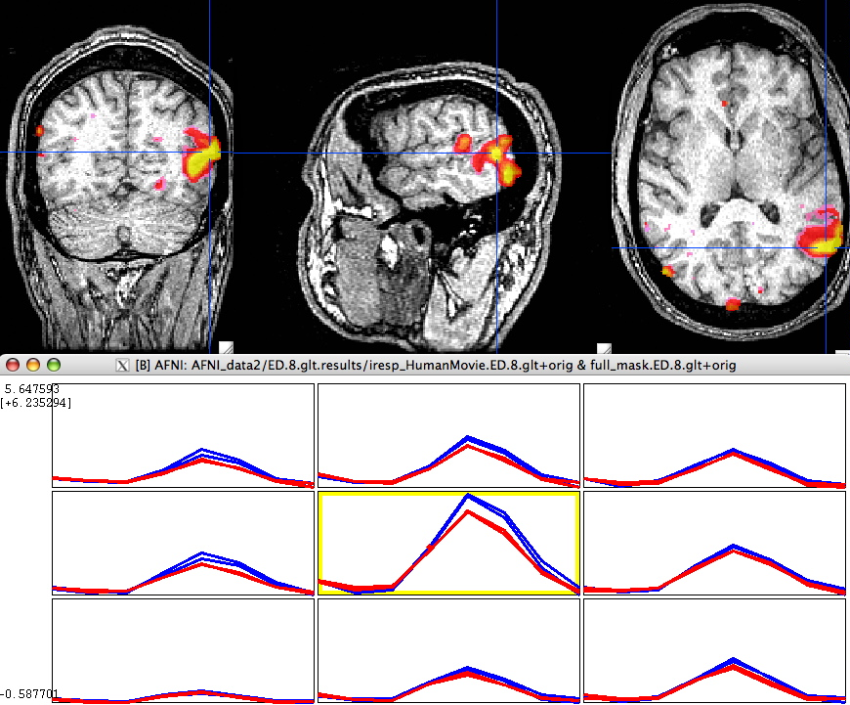
Results: Humans vs. Tools
Color overlay: Human vs Tool
Blue (upper) : Human
Red (lower) : Tool

Slide 29
No Constraint on IRF Shape: Deconvolution
Deconvolution perspectives: inverse process of convolution
  IRF stimulus = unit BOLD response
    Like multiplication, we have to know two and estimate the 3rd
  Fixed-shape approach: Convolution + regression
    Known: impulse response, stimulus
    Use convolution to create regressors (hidden: waver or 3dDeconvolve)
    Response strength (β) estimated via linear model with 3dDeconvolve/3dREMLfit
  Shape estimation: Deconvolution + regression
    Known: stimulus + BOLD response; unknown: impulse response
    HRF stimulus = BOLD response (note: HRF, not IRF)
    HDR estimated as a linear combination of multiple yardsticks (basis TENT functions)
    Each yardstick (TENT) stimulus = regressor
    Deconvolution: HDF = a set of β’s estimated via regression

Slide 30
No Constraint on IRF Shape: Pros + Cons
What is the approach good at?
  Usually for event-related experiments, but can be used for BLOCK
    Multiple basis functions for blocks: within-block attenuation
  Likely to have more accurate estimate on HDR shape across
    subject
    conditions/tasks
    brain regions
  Likely to have better model fit
  Likely to be statistically more powerful on test significance
  For block design, may detect within-block attenuation
    Cross-block attenuation?
Why is the approach not popular?
  Difficult to summarize at group level
  A few times more regressors than alternatives: DF’s
  Risk of highly correlated regressors: Multicollinearity
    May change the number of basis functions
  Overfitting: picking up something (head motion) unrelated to HDR

Slide 31
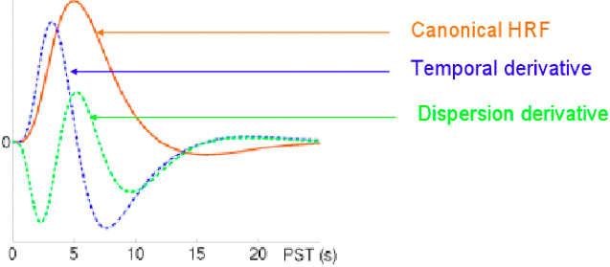
Moderate Approach: SPMG1/2/3
Balance in shape flexibility and basis functions
  Constrain the HDR shape with a principal basis function
    SPMG1 (similar to GAM in AFNI): e^{-t}(a₁t^{p1}-a₂*t^{p2}) where a₁ = 0.0083333333 p1 = 5 (main positive lobe)
    a₂ = 1.274527e-13 p2 = 15 (undershoot part)
  2 or 3 basis functions: parsimonious, economical
    SPMG1+SPMG2+SPMG3
    SPMG2: temporal derivative capturing differences in peak latency
    SPMG3: dispersion derivative capturing differences in peak duration

Slide 32
Multicollinearity
Voxel-wise regression model: y = Xβ+ε
  Regressors in design matrix X = [1, t, t², x₁, x₂, …, x_{k}, …]
Multicollinearity problem
  Two or more regressors highly correlated
  Difficult or impossible to tear apart the effects
Multicollearity scenarios
  Collinearity - x_{i}= λx_{j}: model specification error, e.g., 2 identical regressors (mistake in stimulus timing specifications)
  Exact multicollinearity: linear among regressors: faulty design (rare)
  High degree of correlation (+ or -) among regressors: design problem
    E.g., cue + movie watching
  Too many basis functions
Diagnosis tools: ExamineXmat.R, timing_tool.py, xmat_tool.py

Slide 33
Serial Correlation in Residuals
Why temporal correlation?
  In the residuals (not the time series data)
  Short-term psychological and physiological effect
  Other unknown reasons
What is the impact of temporal correlation?
  With white noise assumption, β‘s are unbiased, but the statistics tend to be inflated
  Little impact on group analysis if only taking β‘s
  May affect group analysis if considering effect reliability
Approach in AFNI
  ARMA(1,1) for residual time series
  Slightly different from other packages

Slide 34
Dealing with Multiple Runs
Concatenation?
  Analyze each run separately: AFNI, FSL
    Have to have enough repetitions per run
    Can test cross-run difference (trend, habituation) at group level
    Summarize multiple β’s before group analysis
  Concatenate but analyze with separate regressors across runs for each condition type: AFNI, SPM
    Can test cross-run difference (trend, habituation, etc.) at both individual and group level
    Summarize multiple β’s before group analysis
  Concatenate but analyze with same regressor across runs for each condition type: default in AFNI
    Assume no attenuation across runs
Cross-block (or cross-event) attenuation
    Crude method: -stim_times_IM

Slide 35
Percent Signal Change
Why conversion? Comparable across subjects
  BOLD data don’t have any physical/physiological meaning
  Baseline is different across subjects
  It’s the relative changes that can be compared across subjects
AFNI approach
  Pre-processing: data scaled by voxel-wise mean
    % signal change relative to mean, not exactly to baseline
    Difference is tiny: less than 5%
  Tied with modeling baseline as additive effects in AFNI
    Sometimes baseline explicitly modeled in SPM and FSL
    Global mean scaling (multiplicative) for whole brain drift
    Grand mean scaling for cross-subject comparison: not %
    Global and grand mean scaling, although not usually practiced, can be performed in AFNI if desirable

Slide 36
Percent Signal Change
Why not scaled β‘s by real baseline???
  No catenation: scale β per run by the run’s baseline
    Sample size in each run could be low
    Have to summarize multiple β’s before group analysis
    Better convert to percent signal change at run level before summing over runs
    Be careful when motion parameters included in model
      Uber_subject.py automatically demeans the head motion regressors
  Catenation: problematic
    Baseline may be different across runs
    Effects are not comparable across runs

Slide 37
Lackluster Performance in Modeling
Essentially, all models are wrong, but some are useful (G.E.P. Box)
Noisy data: easy excuse!
Regressors: idealized response or yardstick
  We get what we’re looking for
  It may miss something when we fail to recognize it
Lots of variability across trials
  Amplitude modulation if behavioral data are available
  Model each trial separately
Linearity assumptions
  Data = baseline + drift + respone1 + resonse2 + … + noise
  When a trial is repeated, response is assumed same
  Response for a block = linearity (no attenuation)
Poor understanding of BOLD mechanism

Slide 38
Summary
Basics of linear model
FMRI experiment types
  Block design; Event related experiment; Mixed
FMRI data decomposition: three components
  Baseline + slow drift; Effects of interest; Unknown
  Effects of interest - understanding BOLD vs. stimulus: IRF
  Modeling with fixed-shape IRF: GAM(p,q), BLOCK(d,p)
Modeling with no assumption about IRF shape
  TENT(b,c,n), CSPLIN(b,c,n)
Modeling with one major IRF plus shape adjustment
  SPMG1/2/3
Other issues
  Multicollinearity
  Catenation
  Percent signal change

