Slide 1
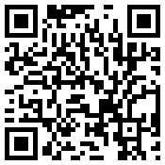


Group Analysis
File: afni24_GroupAna.pdf
Gang Chen
SSCC/NIMH/NIH

Slide 2
Preview
Concepts and terminology
Group analysis approaches
  GLM: 3dttest++, 3dMEMA
  GLM, ANOVA, ANCOVA: 3dMVM
  LME: 3dLME, 3dLMEr
  Assumed vs. estimated HDR
Miscellaneous
  Issues with covariates
  Intra-Class Correlation (ICC)
  Inter-Subject Correlation (ISC)

Slide 3
Program List
3dttest++ (GLM: one-, two-sample, paired t, between-subjects variables)
3dMVM (generic AN(C)OVA)
3dLME, 3dLMEr (sophisticated random-effects structure, missing data, within-subject covariates)
3dMEMA (similar to 3dttest++: measurement errors)
3dICC (intraclass correlation)
3dISC (inter-subject correlation)
RBA (region-based analysis)
MBA (matrix-based analysis)
3dANOVA (one-way between-subject)
3dANOVA2 (one-way within-subject, 2-way between-subjects)
3dANOVA3 (2-way within-subject and mixed, 3-way between-subjects)

Slide 4
Why Group Analysis?
Reproducibility and generalization
  Summarization
  Generalization: from current results to population level
  Sample size: typically 10 or more subjects per group
  Individualized inferences: case studies, pre-surgical planning, lie detection, classifications, machine learning, …
One model combining both steps?
  + Ideal: less information loss, more accurate inferences
  - Historical
  - Computationally unmanageable, and very hard to set up
  - Data quality check at individual level
  - Flexible group-level model

Slide 5
Simplest case
BOLD responses from a group of 20 subjects
  data: (β₁, β₂, …, β₂₀)=(1.13, 0.87, …, 0.72)
  mean: 0.92
  standard deviation: 0.40, 0.90
  Do we have strong evidence for the effect?
Modeling perspective
  Simple GLM: one-sample t-test
  Statistical evidence - t-test
  Summary: b (dimensional), SE, and t / p (dimensionless)
  Chen et al. (2017). Is the statistic value all we should care about in neuroimaging? Neuroimage 147:952-959.

Slide 6
Terminology
Response/outcome variable: left-hand side of model
  Regression β coefficients (plus measurement errors)
  Structured: subjects, tasks, groups
Explanatory variables: right-hand side of model
  Categorical (factors) vs quantitative (covariates)
  Fixed- vs random-effects: conventional statistics
Models
  Univariate GLM: Student’s t-tests, regression, AN(C)OVA
  Multivariate GLM: within-subject factors
  LME: linear mixed-effects model
  MEMA: mixed-effects multilevel analysis
  BML (Bayesian multilevel model)

Slide 7
Terminology: categorical vs quantitative
Factors
  Number of levels: categories
  Within-subject (repeated-measures): tasks, conditions
  Between-subjects
    Patients/controls, sex, genotypes, scanners/sites, handedness, …
    Each subject nested within a group
  Subjects: random-effects factor - measuring randomness
    Of no interest: random samples from a population
Quantitative variables
  Numeric or continuous
  Age, IQ, reaction time, brain volume, …
  3 meanings of covariate
    Quantitative
    Of no interest: sex, qualitative (scanner/site, groups) or quantitative
    Explanatory variable

Slide 8
Terminology: fixed vs random
Fixed-effects variables
  Of research interest
    Population mean, visual vs auditory, age, …
    Unable to extend to something else: visual vs auditory => smell, touch
  Modeled as constants, not random variables
    Shared by all subjects
  Not exchangeable/replaceable or extendable to something else
Random-effects variables
  Of research interest?
    Subjects: random samples
    Trials, regions, scanners/sites?
  Modeled as random variables: Gaussian distributions
  Exchangeable (vs independent), replaceable, generalizable
Differentiations blurred under BML

Slide 9
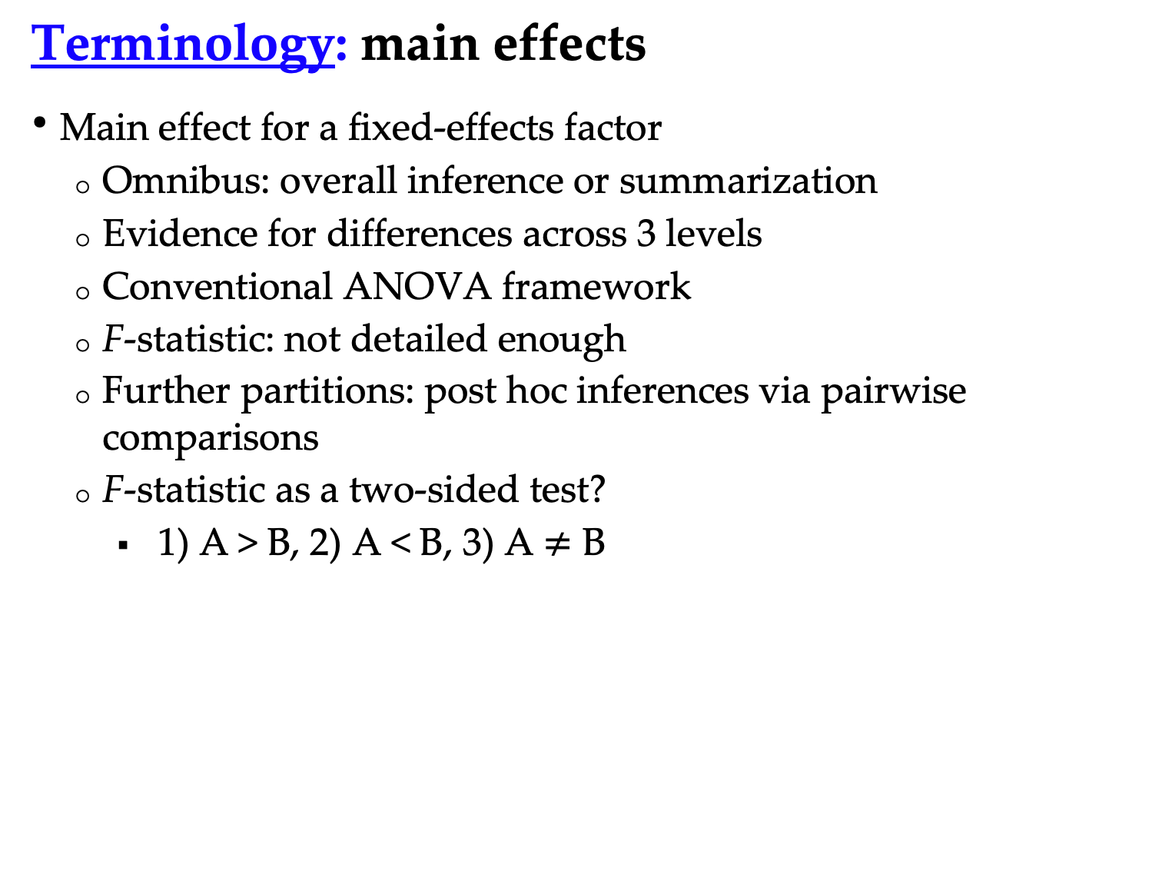
Terminology: main effects
Main effect for a fixed-effects factor
  Omnibus: overall inference or summarization
  Evidence for differences across 3 levels
  Conventional ANOVA framework
  F-statistic: not detailed enough
  Further partitions: post hoc inferences via pairwise comparisons
  F-statistic as a two-sided test?
    1) A > B, 2) A < B, 3) A $≠\text{B}$

Slide 10
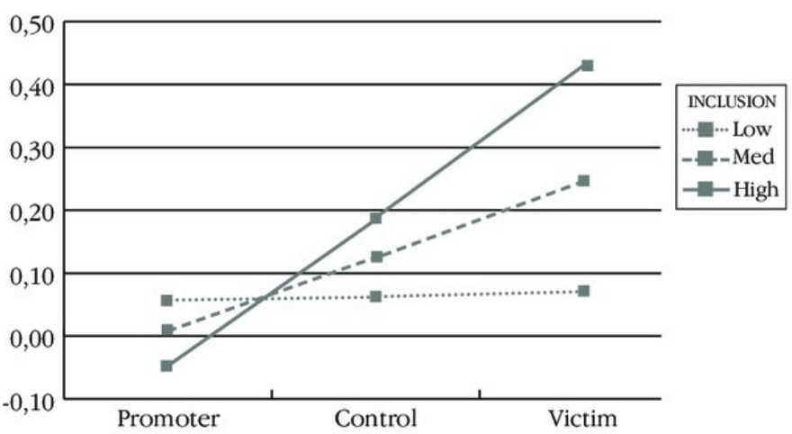
Terminology: interactions
Interaction effects between 2 or more factor
  Omnibus: overall inference or summarization
    Conventional ANOVA framework
    F-statistic: not detailed enough
    Further partitions: post hoc inferences via pairwise comparisons
  2 × 2 design: difference of difference
    F-test for interaction = t-test of
  (A1B1 - A1B2) - (A2B1 - A2B2) or (A1B1 - A2B1) - (A1B2 - A2B2)

Slide 11
Terminology
Interaction effects involving a quantitative variable
  By default: linearity (age, RT modulation, …)
    Controlling: misconception - covariate out or regress out?
    Effect of interest
  Interaction between a factor and a quantitative variable

Slide 12
Terminology
Interaction effect involving a quantitative variable
  Validity of linearity
    Nonlinear: difficult! Polynomials? Theory-driven?

Slide 13
Example: 2 × 3 Mixed ANCOVA
Explanatory variables
  Factor A (Group): 2 levels (patient and control)
  Factor B (Condition): 3 levels (pos, neg, neu)
  Factor S (Subject): 15 ASD children and 15 healthy controls
  Quantitative covariate: Age
Piecemeal: multiple t-tests – too tedious
  Group comparison + age effect
  Pairwise comparisons among three conditions
    Assumption: same age effect across conditions
  Difficulties with t-tests
    Main effect of Condition: 3 levels plus age?
    Interaction between Group and Condition
    Age effect across three conditions?

Slide 14
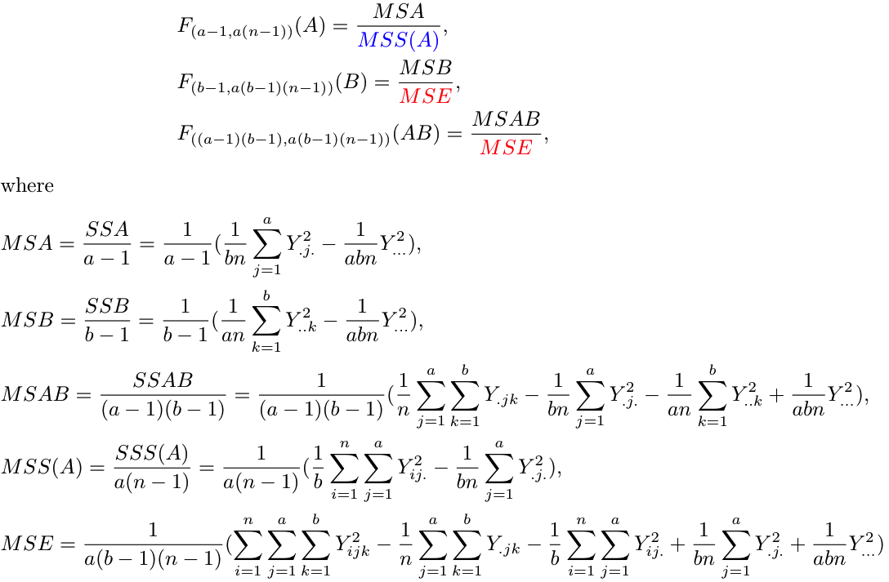
Classical ANOVA: 2 × 3 Mixed ANOVA
Factor A (Group): 2 levels (patient and control)
Factor B (Condition): 3 levels (pos, neg, neu)
Factor S (Subject): 15 ASD children and 15 healthy controls
Covariate (Age): cannot be modeled; no correction for sphericity violation
Different
denominator
3dANOVA3 –type 5 (equal # of subjects across groups)

Slide 15
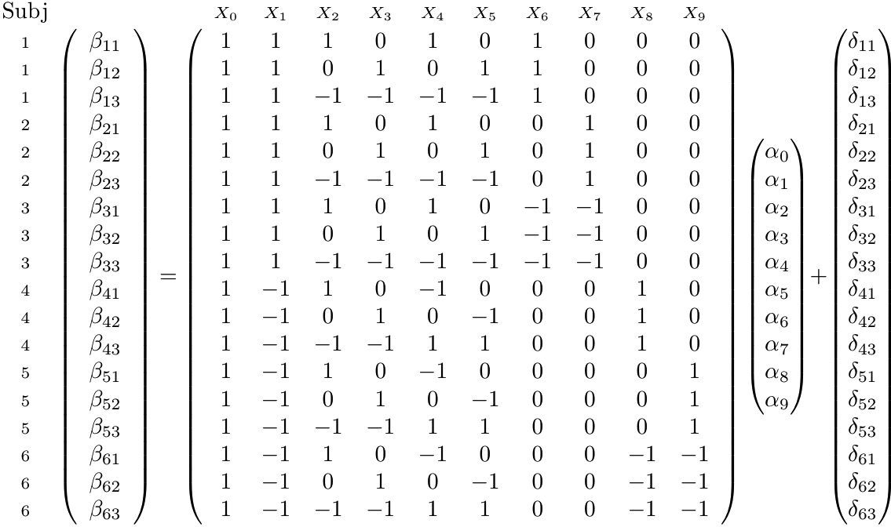
Univariate GLM: 2 x 3 mixed ANOVA
Difficult to incorporate covariates
Broken orthogonality of matrix
No correction for sphericity violation
Group: 2 levels (patient and control)
Condition: 3 levels (pos, neg, neu)
Subject: 3 ASD children and 3 healthy controls
b
a
d
X

Slide 16
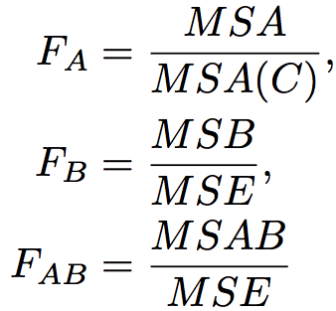
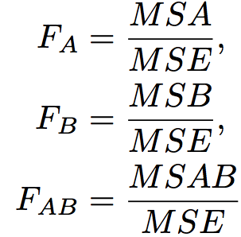
Univariate GLM: problematic implementations
Two-way mixed ANOVA
Between-subjects Factor A (Group): 2 levels (patient, control)
Within-subject Factor B (Condition): 3 levels (pos, neg, neu)
1) Omnibus tests
2) Post hoc tests (contrasts)
- Incorrect t-tests for factor A due to incorrect denominator
- Incorrect t-tests for factor B or interaction effect AB when weights do
not add up to 0
Correct
Incorrect

Slide 17
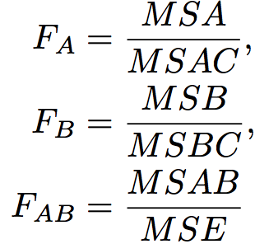
Univariate GLM: problematic implementations
Two-way repeated-measures ANOVA
Within-subjects Factor A (Object): 2 levels (house, face)
Within-subject Factor B (Condition): 3 levels (pos, neg, neu)
1) Omnibus tests
2) Post hoc tests (contrasts)
- Incorrect t-tests for both factors A and B due to incorrect denominator
- Incorrect t-tests for interaction effect AB if weights don’t add up to 0
Correct
Incorrect

Slide 18
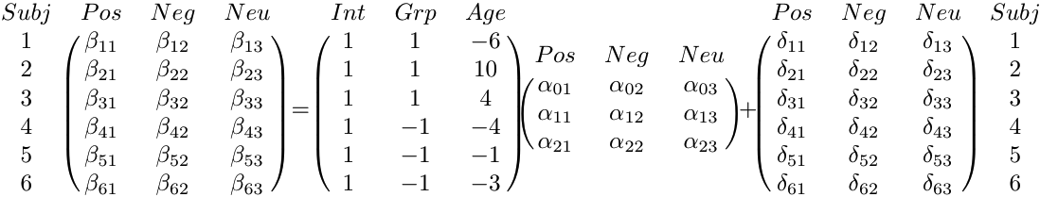
Better Approach: Multivariate GLM
Group: 2 levels (patient and control)
Condition: 3 levels (pos, neg, neu)
Subject: 3 ASD children and 3 healthy controls
Age: quantitative covariate
Β_{n×m} = X_{n×q} A_{q×m} + D_{n×m}
B
A
D
B
X
Chen et al. (2014). Applications of Multivariate Modeling to Neuroimaging Group Analysis: A Comprehensive Alternative to Univariate General Linear Model. NeuroImage 99:571-588.

Slide 19
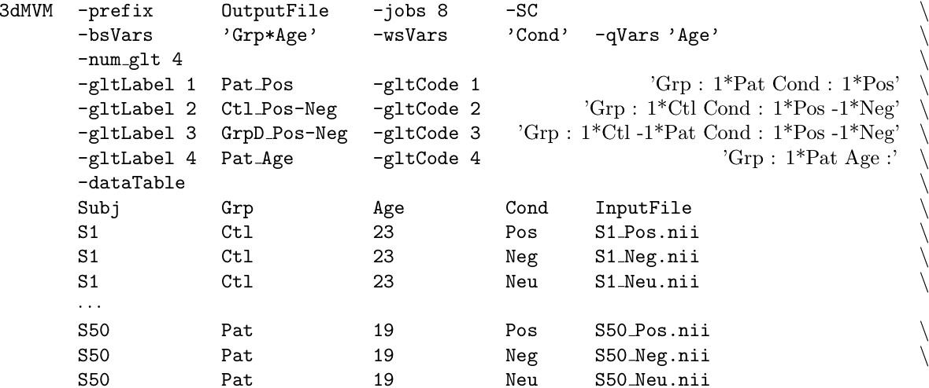
MVM Implementation in AFNI
Program 3dMVM
  No dummy coding needed!
  Symbolic coding for variables and post hoc testing
Variable types
Post hoc tests
Data layout

Slide 20
Improvement 1: precision information
Conventional approach: βs as response variable
  Assumptions
    no measurement errors
    all subjects have same precision
  All subjects are treated equally
More precise method: βs and their t-stats as input
  t-statistic contains precision
  βs and their t-stats as input
  Only available for GLM types: 3dMEMA
  Regions with substantial cross-subject variability
Best approach: combining all subjects in one big model
  Currently not feasible
Chen et al. (2012). FMRI Group Analysis Combining Effect Estimates and Their Variances. NeuroImage 60:747-765.

Slide 21
One group: Example
3dttest++: β as input only
3dttest++ –prefix Vis -mask mask+tlrc -zskip \
-setA ‘FP+tlrc[Vrel#0_Coef]’ \
’FR+tlrc[Vrel#0_Coef]’ \
……
’GM+tlrc[Vrel#0_Coef]’
3dMEMA: β and t-statistic as input
3dMEMA –prefix VisMEMA -mask mask+tlrc -setA Vis \
FP ’FP+tlrc[Vrel#0_Coef]’ ’FP+tlrc[Vrel#0_Tstat]’ \
FR ’FR+tlrc[Vrel#0_Coef]’ ’FR+tlrc[Vrel#0_Tstat]’ \
……
GM ’GM+tlrc[Vrel#0_Coef]’ ’GM+tlrc[Vrel#0_Tstat]’ \
-missing_data 0
Voxel value = 0 ➔ treated it as missing
Voxel value = 0 ➔ treated it as missing

Slide 22
Paired comparison: Example
3dttest++: comparing two conditions
3dttest++ –prefix Vis_Aud \
-mask mask+tlrc –paired -zskip \
-setA ’FP+tlrc[Vrel#0_Coef]’ \
’FR+tlrc[Vrel#0_Coef]’ \
……
’GM+tlrc[Vrel#0_Coef]’ \
-setB ’FP+tlrc[Arel#0_Coef]’ \
’FR+tlrc[Arel#0_Coef]’ \
……
’GM+tlrc[Arel#0_Coef]’

Slide 23
Paired Comparison: Example
3dMEMA: accounting for differential accuracy
  Contrast as input
3dMEMA –prefix Vis_Aud_MEMA \
-mask mask+tlrc -missing_data 0 \
-setA Vis-Aud \
FP ’FP+tlrc[Vrel-Arel#0_Coef]’ ’FP+tlrc[Vrel-Arel#0_Tstat]’ \
FR ’FR+tlrc[Vrel-Arel#0_Coef]’ ’FR+tlrc[Vrel-Arel#0_Tstat]‘ \
……
GM ’GM+tlrc[Vrel-Arel#0_Coef]’’GM+tlrc[Vrel-Arel#0_Tstat]’

Slide 24
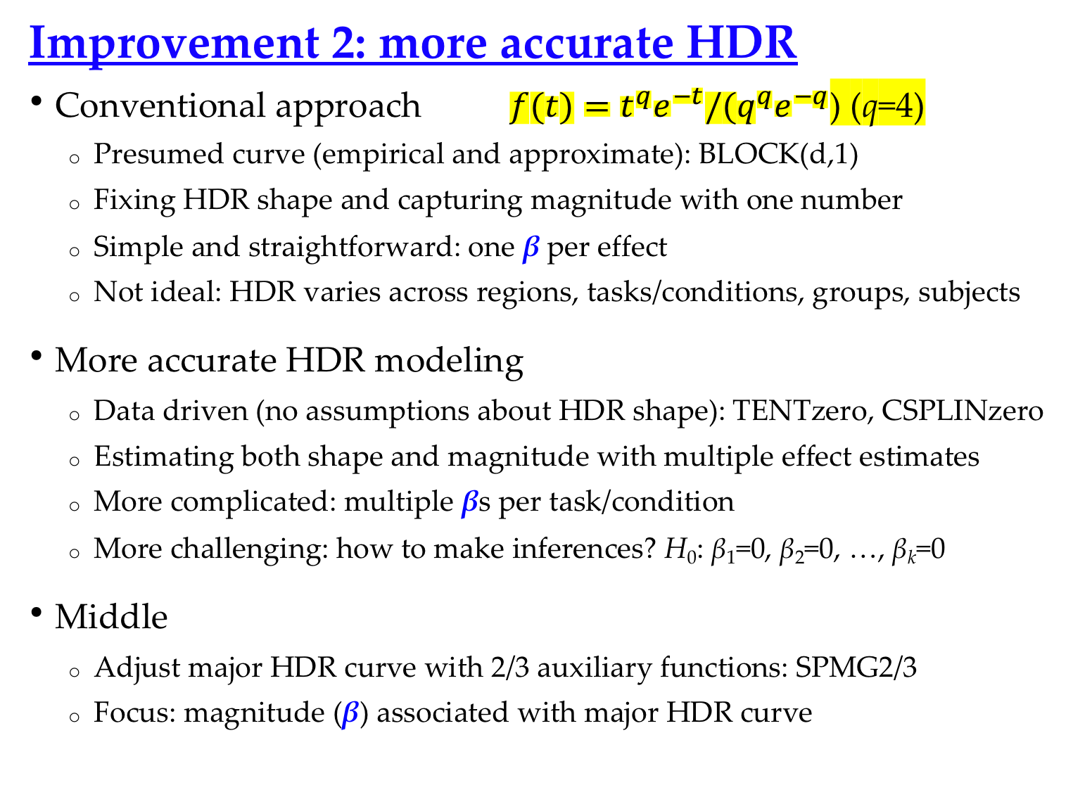
Improvement 2: more accurate HDR
Conventional approach $f(t)=t^{q}e^{−t}/{(q}^{q}e^{−q}$) (q=4)
  Presumed curve (empirical and approximate): BLOCK(d,1)
  Fixing HDR shape and capturing magnitude with one number
  Simple and straightforward: one β per effect
  Not ideal: HDR varies across regions, tasks/conditions, groups, subjects
More accurate HDR modeling
  Data driven (no assumptions about HDR shape): TENTzero, CSPLINzero
  Estimating both shape and magnitude with multiple effect estimates
  More complicated: multiple βs per task/condition
  More challenging: how to make inferences? H₀: β₁=0, β₂=0, …, β_{k}=0
Middle
  Adjust major HDR curve with 2/3 auxiliary functions: SPMG2/3
  Focus: magnitude (β) associated with major HDR curve

Slide 25
Improvement 2: more accurate HDR
Group analysis with HDR estimates: TENTzero, CSPLINzero
  NHST: H₀: β₁=0, β₂=0, …, β_{k}=0
  Area under curve (AUC) approach
    Reduce to one number: use area as magnitude approximation
    Ignore shape subtleties
    Shape information loss: (undershoot, peak location/width)
  Better approach: maintaining shape integrity
    Take individual βs to group analysis (MVM)
    One group with one condition: 3dLME
    Other scenarios: treat βs as levels of a factor (e.g., Time) - 3dMVM
    ** Task or group effect: F-stat for interaction between task group and Time, complemented with main effect for task/group (AUC)
Chen et al. (2015). Detecting the subtle shape differences in hemodynamic responses at the group level. Front. Neurosci., 26 October 2015.

Slide 26
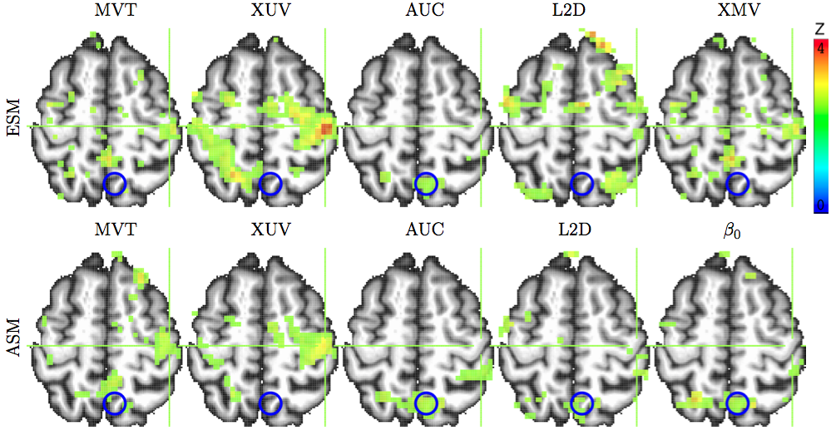
Improvement 2: more accurate HDR
2 groups (children, adults), 2 conditions (congruent, incongruent), 1 quantitative covariate (age)
2 methods: HRF modeled by 10 (tents) and 3 (SPMG3) bases
Effect of interaction: interaction group:condition – 3dMVM

Slide 27
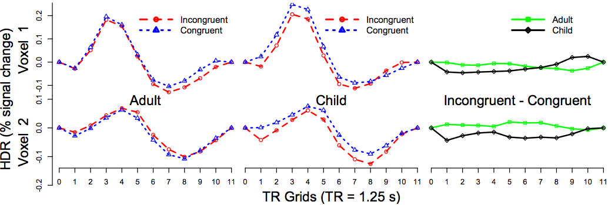
Improvement 2: more accurate HDR
Advantages of ESM over FSM
  More likely to detect HDR shape subtleties
  Visual verification of HDR signature shape (vs. relying significance testing: p-values)
Study: Adults/Children with Congruent/Incongruent stimuli (2×2)

Slide 28
Improvement 3: complex situations - LME
Missing data
  Missing at subject level: Longitudinal study
  Missing at random: unrelated to effect of interest
  GLM would not work
Within-subject covariate: random slope
  Reaction time across multiple conditions
  Age in longitudinal study
  Random slope: varying covariate effect across subjects
Hierarchical data
  Subjects, families, groups
  Subjects are genetically related in multilevel structure
  Adolescent Brain Cognitive Development (ABCD) Study
Chen et al. (2013). Linear Mixed-Effects Modeling Approach to FMRI Group Analysis. NeuroImage 73:176-190.

Slide 29
Dealing with quantitative variables
Reasons to consider a covariate
  Effect of interest
  Model improvement: accounting for data variability
Frameworks
  ANCOVA: between-subjects factor (e.g., group) + quantitative variable
  Broader frameworks: regression, GLM, MVM, LME, BML
  Assumptions: linearity, homogeneity of slopes (interaction)
Interpretations
  Effect of interest: slope, rate, marginal effect
  Regress/covariate out x? Head motion at individual level
  “Controlling x at …”, “holding x constant”: centering

Slide 30
Quantitative variables: centering
Model
    α₁, α₂ - slope
    α₀ – intercept: group effect when x = 0
      Not necessarily meaningful
      Linearity may not hold
      Centering for interpretability
      Centering around: mean, median,
      or something else

Slide 31
Quantitative variables: centering
When a factor is involved
    Complicated: within-level or
    grand centering
https://afni.nimh.nih.gov/pub/dist/doc/htmldoc/STATISTICS/center.html

Slide 32
IntraClass Correlation (ICC)
Reliability (consistency, agreement/reproducibility) across two or more measurements of a condition/task
  sessions, scanners, sites, studies, twins
  Classic example (Shrout and Fleiss, 1979): n targets are rated by k raters
  Relationship with Pearson correlation
    Pearson correlation: two different types of measure: e.g., BOLD response vs. RT
    ICC: same measurement (intraclass)
  Modeling frameworks: ANOVA, LME
  3 types ICC: ICC(1,1), ICC(2,1), ICC(3,1) – one-, two-way random- and mixed-effects ANOVA

Slide 33

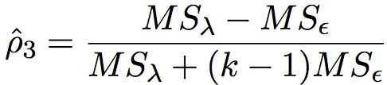
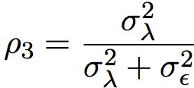
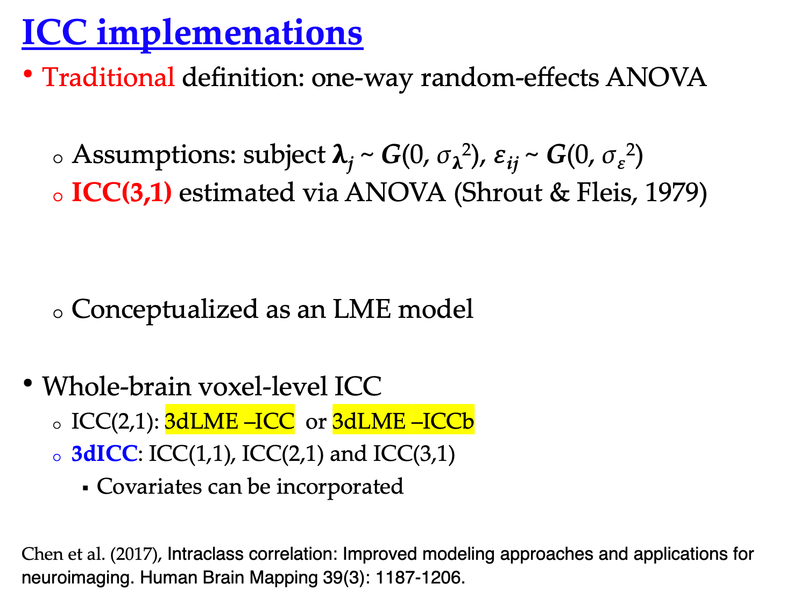
ICC implemenations
Traditional definition: one-way random-effects ANOVA
  Assumptions: subject $λ$_{j} ~ G(0, σ$λ$²), $ε$_{ij} ~ G(0, σ$ε$²)
  ICC(3,1) estimated via ANOVA (Shrout & Fleis, 1979)
  Conceptualized as an LME model
Whole-brain voxel-level ICC
  ICC(2,1): 3dLME –ICC or 3dLME –ICCb
  3dICC: ICC(1,1), ICC(2,1) and ICC(3,1)
    Covariates can be incorporated
Chen et al. (2017), Intraclass correlation: Improved modeling approaches and applications for neuroimaging. Human Brain Mapping 39(3): 1187-1206.

Slide 34
Naturalistic scanning
Subjects view a natural scene during scanning
  Visuoauditory movie clip (e.g., http://studyforrest.org/)
  Music, speech, games, …
Duration: a few minutes or more
Close to naturalistic settings: minimally manipulated
Effect of interest: inter-subject correlation (ISC) – 3dTcorrelate
  Extent of synchronization/entrainment
Whole-brain voxel-wise analysis: 3dISC
Hasson et al., 2004. Intersubject synchronization of cortical activity during natural vision. Science 303:1634-1640.
Notes:
34

Slide 35
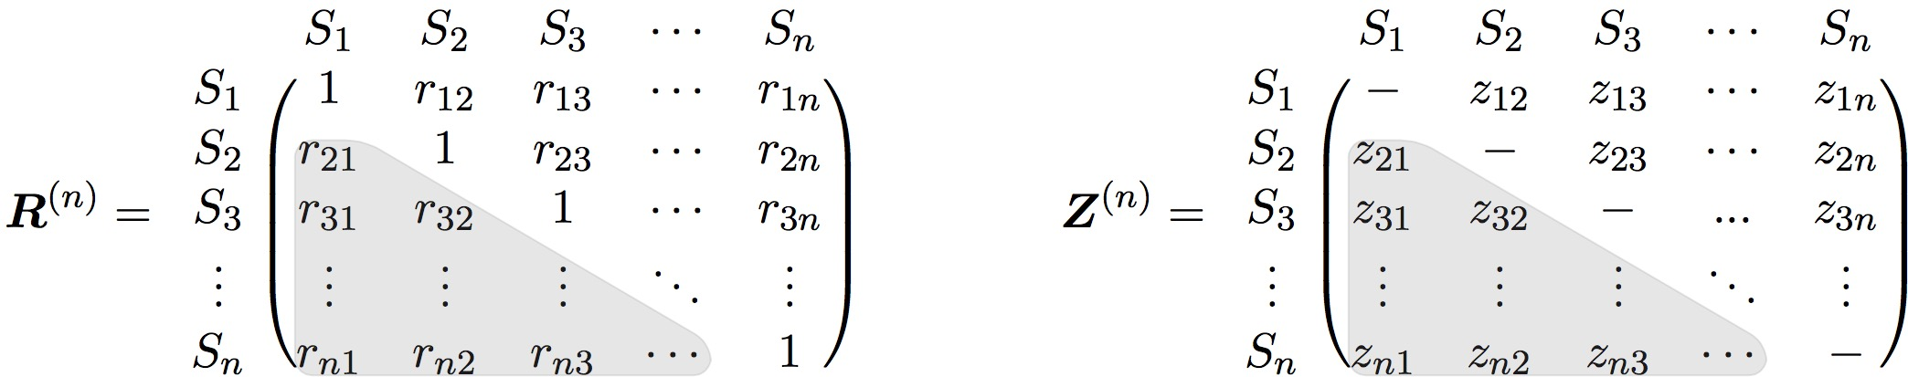
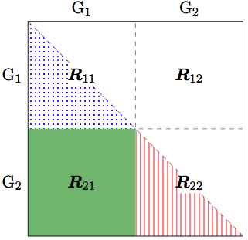
ISC group analysis
Voxel-wise ISC matrix (usually Fisher-transformed)
  One group
  Two groups
    Within-group ISC: R11, R22
    Inter-group ISC: R21
    3 group comparisons: R11 vs R22,
    R11 vs R21, R22 vs R21
Notes:
35
Positive semi-definite (PSD) matrix

Slide 36
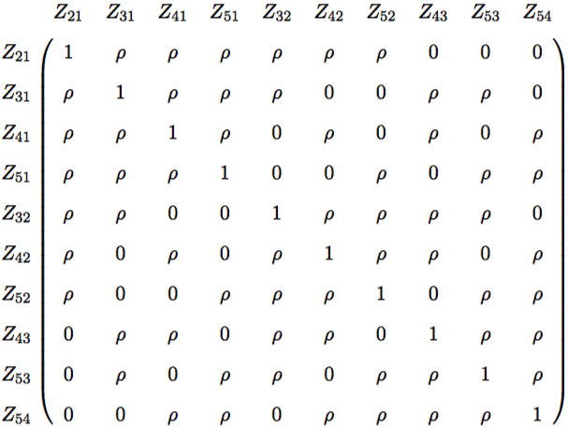
Complexity of ISC analysis
2 ISC values associated with a common subject are correlated with each other: 5 subjects, 10 ISC values
ρ ≠ 0 characterizes non-independent relationship
Challenge: how to handle this irregular correlation matrix?
Notes:
36

Slide 37
Previous methods
Student’s t-test
  Independence violation acknowledged but not accounted for
  Justification via observations that “null data” (generated by ISC values with randomly shifted time series) followed t(N-1)
Various nonparametric methods
  • Permutations: null distribution via randomization across space (voxels) and time (e.g., circularly shifting each subject’s time series by a random lag)
  Matlab package: ISC Toolbox (Kauppi et al, 2014)
• Leave one out (LOO): Kauppi et al, 2010
  Compute ISC of a subject between a voxel’s BOLD time course in the subject and the average of that voxel’s time course in the remaining subjects
  Perform Student t-test on the LOO ISC values
Notes:
37

Slide 38
Nonparametric methods
Subject-wise bootstrapping
Subject-wise permutations
Chen et al, 2016. Untangling the relatedness among correlations, part I: Nonparametric approaches to inter-subject correlation analysis at the group level. Neuroimage.
Notes:
38

Slide 39


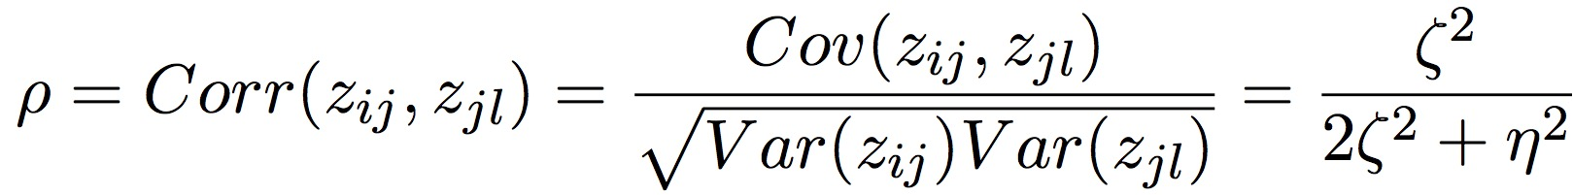
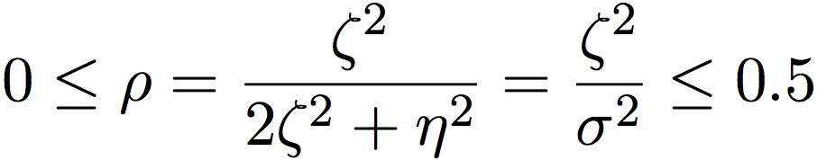
ISC: LME approach
Modeling via effect partitioning: crossed random-effects LME
Charactering the relatedness among ISCs via LME
3dISC
cross-subject
within-subject
Chen et al, 2017. Untangling the Relatedness among Correlations, Part II: Inter-Subject Correlation Group Analysis through Linear Mixed-Effects Modeling. Neuroimage. NeuroImage 147:825-840
Notes:
39

Slide 40

Region-based ISC analysis through BML
  One model integrates all ROIs: BML
  ROIs loosely constrained instead of being unrelated
  Effects of interest
    region: b₀+$π$_{k}
    subject: b₀ + $ξ$_{i}
Unique effect at ith & jth subject
unique effect of subject pair
Unique effect at ith & jth subject for kth region
overall effect: shared by all
ROIs and subjects
unique effect by kth region
Chen, G. et al., 2019. Untangling the Relatedness among Correlations, Part III: Extending Model Capabilities of Inter-Subject Correlation Analysis for Naturalistic Scanning. In press.
Notes:
If you’re always happy with GLM and never wished that the threshold (p or cluster size) could be a little demanding, I can stop here and you can leave the room.

Slide 41
Program List
3dttest++ (GLM: one-, two-sample, paired t, between-subjects variables)
3dMVM (generic AN(C)OVA)
3dLME (sophisticated cases: missing data, within-subject covariates)
3dMEMA (similar to 3dttest++: measurement errors)
3dICC (intraclass correlation)
3dISC (inter-subject correlation)
RBA (region-based analysis)
MBA (matrix-based analysis)
3dANOVA (one-way between-subject)
3dANOVA2 (one-way within-subject, 2-way between-subjects)
3dANOVA3 (2-way within-subject and mixed, 3-way between-subjects)
3dttest (obsolete: one-sample, two-sample and paired t)
3dRegAna (obsolete: regression/correlation, covariates)
GroupAna (obsolete: up to four-way ANOVA)

Slide 42
Summary
Concepts and terminology
Group analysis approaches
  GLM: 3dttest++, 3dMEMA
  GLM, ANOVA, ANCOVA: 3dMVM
  LME: 3dLME
  Presumed vs. estimated HDR
Miscellaneous
  Issues with covariates
  Intra-Class Correlation (ICC)
  Inter-Subject Correlation (ISC)

