Slide 1





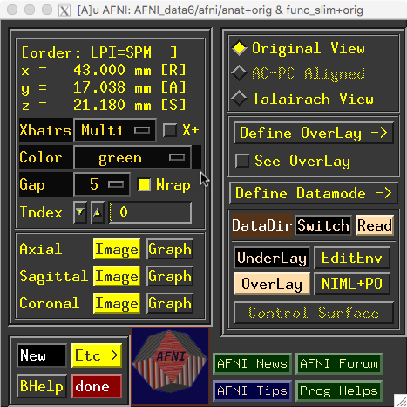
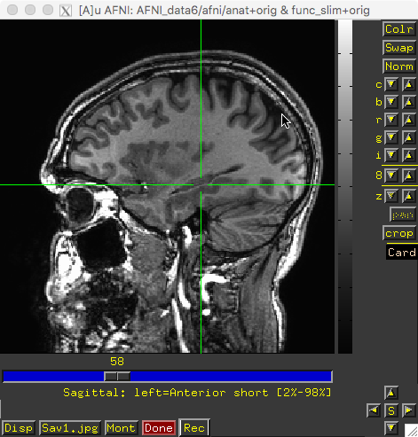
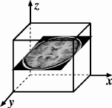
AFNI
Didactics and Demonstrations
Introduction, Concepts, Principles
March 2020

Slide 2
Web Page to Bookmark
https://afni.nimh.nih.gov/pub/dist/doc/htmldoc/index.html
== https://bit.ly/AFNIstuff
Links to AFNI Installation instructions, Documentation, Data, Tips, et cetera
To use hands-on videos: install AFNI and then the Prep for Bootcamp link

Slide 3
AFNI = Analysis of Functional NeuroImages
Created to provide an environment for FMRI data analyses
AFNI refers to both the program of that name and the entire package of external programs and plugins (several hundred)
Important principles in the development of AFNI:
  Allow user (you) to stay close to the data and view it in different ways
  Give users the power to assemble computing pieces in different ways to make customized analyses
    With great power comes great responsibility
    — to understand the analyses and the tools
  “Provide mechanism, not policy”
  Allow other programmers to add features/components

Slide 4
Principles (and Caveats) We Live By
Fix significant bugs as soon as possible
  But, we define “significant”
Nothing is secret or hidden (AFNI is open source)
  But, possibly not very well documented or advertised
Release early and often
  So, All users are beta-testers for life
Help the user (message board; consulting with NIH users)
  Until our patience expires
Try to anticipate users’ future needs
  What we think you need may not be what you really need

Slide 5
Before We Really Start
AFNI has many programs and each has many options
Assembling the programs to do something useful and good seems confusing (OK, is confusing) when you start
To help overcome this problem, we have “super-scripts” that carry out important tasks
  Each script runs multiple AFNI programs
  We recommend using these as the basis for FMRI work
afni_proc.py = Single subject FMRI pre-processing and time series analysis for functional activation
align_epi_anat.py = Image alignment (registration), including anatomical-EPI, anatomical-anatomical, EPI-EPI, and alignment to atlas space (Talairach/MNI)

Slide 6
What is Functional MRI?
A
1991 discovery: MRI-measurable signal increases few % locally in brain after increases in neuronal activity (Kwong, et al.)
Signal increase caused by change in H₂O surroundings: more oxygenated hemoglobin is present
Cartoon of MRI signal in a single “activated” brain voxel
D: 4-5 s
rise
E: 5 s plateau
Contrast
through
time
with no noise!
A: Pre-activation
baseline
C: ≈ 2 s
delay
G: Return to
baseline
(or undershoot)
time
B: 5 s neural activity
F: 4-6 s
fall

Slide 7
How FMRI Experiments Are Done
Alternate subject’s neural state between 2 (or more) conditions using sensory stimuli, tasks to perform, ...
  Can only measure relative signals, so must look for changes in the signal between the conditions
Acquire lots of MR images repeatedly during this process
Search for voxels whose NMR signal time series (up-and-down) matches stimulus time series pattern (on-and-off)
  FMRI data analysis is basically pattern matching in time
MRI signal changes due to neural activity are small
  Need 500 or so images in time series (in each slice) ➔ takes 30 min or so to get reliable activation maps
  Other small effects can corrupt the results ➔ post-process the data to reduce these effects & be vigilant

Slide 8
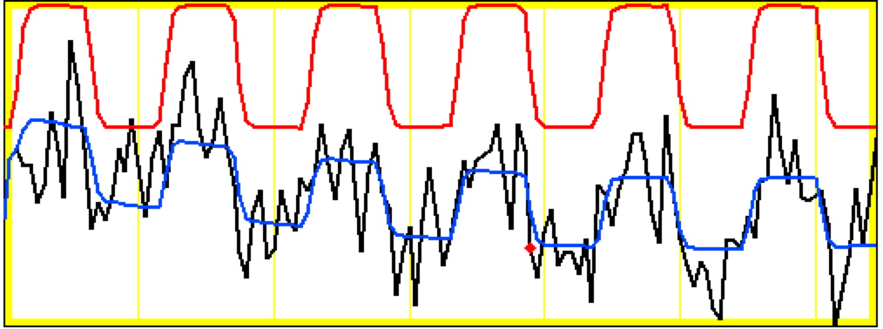
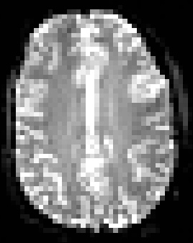
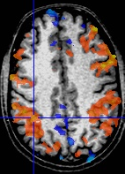
Sample Data Time Series
64×64 matrix (TR=2.5 s; 130 time points per imaging run)
Somatosensory task: 27 s “on”, 27 s “rest”
Note that this is really good data
pattern of expected BOLD signal
pattern fitted to data
data
One echo-planar image
One anatomical image, with voxels that match the pattern given a color overlay

Slide 9
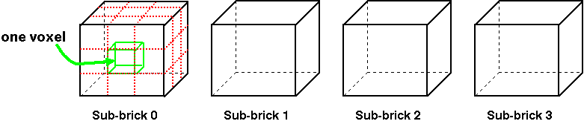
Fundamental AFNI Concepts
Basic unit of data in AFNI is the dataset
  A collection of 1 or more 3D arrays of numbers
    Each entry in array is in a particular spatial location in a 3D grid
    Image datasets: each array holds collection of slices from scanner
      Each number is the signal intensity for that particular voxel
    Derived datasets: each number is computed from other dataset(s)
      e.g., each voxel value is a t-statistic reporting “activation” significance from an FMRI time series dataset, for that voxel
  Each 3D array in a dataset is called a sub-brick
    There is one number in each voxel in each sub-brick (volume)
Jargon!
Jargon!
}
3x3x3
Dataset
With 4
Sub-bricks

Slide 10
Dataset Cartoon: A Little Bit Bigger
“sub-brick” = one 3D volume
inside a multi-volume dataset

Slide 11
What's in a Dataset: Header Stuff
Besides the voxel numerical values, a dataset also contains auxiliary information, including (some of which is optional):
  xyz dimensions of each voxel (in mm)
  Orientation of dataset axes;
    for example, x-axis=R-L, y-axis=A-P, z-axis=I-S
    = axial slices (we call this orientation “RAI”)
  Location of dataset in scanner coordinates
    Needed to overlay one dataset onto another
    Important to get right in FMRI, since we deal with many datasets
  Time (s) between sub-bricks, for 3D+time datasets
    Such datasets are basic unit of FMRI data (one per imaging run)
  Statistical parameters associated with each sub-brick
    e.g., a t-statistic sub-brick has degrees-of-freedom parameter stored
Jargon!

Slide 12
AFNI Formatted Dataset Files - 1
AFNI formatted datasets are stored in 2 files
  The .HEAD file holds all the auxiliary information (ASCII)
  The .BRIK file holds all the numbers in all the sub-bricks
Datasets can be in one of 2 coordinate systems (“views”)
  Original data or +orig view = from the scanner
  “Talairach” or +tlrc view =
    Dataset has been rescaled to conform to the Talairach-Tournoux atlas dimensions or another atlas, such as MNI
    AKA Stererotaxic coordinates
    All datasets scaled+aligned to some atlas are labeled +tlrc
      Header file holds name of actual atlas “space” (e.g., “MNI”)
      Alignment can be linear or nonlinear (3dQwarp program)

Slide 13
AFNI Formatted Dataset Files - 2
AFNI dataset filenames consist of 3 parts
  The user-selected prefix (almost anything)
  The view (one of +orig, or +tlrc)
  The suffix (one of .HEAD or .BRIK)
  TonyFauci_epi+tlrc.HEAD & TonyFauci_epi+tlrc.BRIK
  You supply the prefix; the AFNI program supplies the rest
AFNI programs can read datasets stored in several formats
  ANALYZE (.hdr/.img file pairs); very old nowadays
  MINC-1 (.mnc); i.e., from mnitools (also very old now)
  CTF (.mri, .svl) MEG analysis volumes
  ASCII text (.1D) — text numbers arranged into columns
  Have conversion programs to write out MINC-1, ANALYZE, ASCII, and NIfTI-1.1 files, if desired
Jargon!

Slide 14
NIfTI Dataset Files
NIfTI-1 (.nii or .nii.gz) is a standard format that AFNI, SPM, FSL, FreeSurfer, BrainVoyager, et al., agreed upon
  Goal: easier interoperability of tools from various packages
All data is stored in one file (cf. http://nifti.nimh.nih.gov/)
  352 byte header (extensions allowed; AFNI uses this feature)
  Followed by the image binary numerical values
  Allows 1D–5D datasets of diverse numerical types
  .nii.gz suffix means file is compressed (using Unix program gzip)
AFNI reads and writes NIfTI-1 (and NIfTI-2) datasets
  To write: when you give the prefix for the output filename, end it in “.nii” or “.nii.gz”, and AFNI programs will automatically write NIfTI-1.1 format instead of .HEAD/.BRIK
  To read: just give the full filename ending in “.nii” or “.nii.gz”

Slide 15
Creating Datasets from DICOM Files
Program 1: Rick Reynolds’ AFNI program Dimon
  Was originally created for sending image data directly into AFNI for “realtime FMRI”
Program 2: Chris Rorden’s dcm2niix_afni
  Can create a whole collection of datasets
  Works with more DICOM formats than Dimon does
  Problem: Standard NIFTI .nii format can’t store complicated slice timings
  So programs like dcm2niix_afni cannot store this information even if the program can find it in the DICOM files
Solution: use 3drefit to add the slice timing information to the header (inside AFNI extension for NIFTI .nii files)

Slide 16
Dataset Directories
Datasets are stored in directories (AKA “folders”)
  All the datasets in the same directory, in the same view, are presumed to be aligned in xyz-coordinates
    Voxels with same value of (x,y,z) correspond to same brain location
  Can overlay (in color) any one dataset on top of any other one dataset (underlay in grayscale) from same directory
    Even if voxel sizes and spatial orientations differ
    Overlay of one dataset upon another is based on xyz coordinates
  Typical AFNI contents of a directory are all data derived from a single scanning session for one subject
    Anatomical reference (T1-weighted SPGR or MP-RAGE volume)
    10-20 3D+time datasets from FMRI EPI functional runs
    Statistical datasets computed from 3D+time datasets
    Datasets transformed from +orig to +tlrc coordinates

Slide 17
Getting and Installing AFNI
AFNI runs on Unix systems: Linux, Sun, Mac OS X
  Can also run under Windows Subsystem for Linux
    Requires also installing X11 (Unix graphics display software)
You can download precompiled binaries from our Website
  https://afni.nimh.nih.gov/pub/dist/doc/htmldoc/index.html
  Documentation, message board, data, class materials,…
You can download source code and compile it
  And from GitHub: https://github.com/afni/AFNI
AFNI is updated fairly frequently, so it is important to update occasionally = @update.afni.binaries
  It’s hard to help you with outdated versions!
  Please check for updates every 6 months (or less)

Slide 18
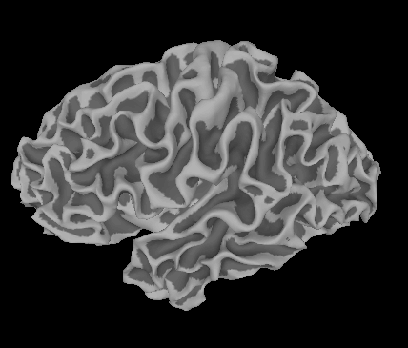
SUMA, et alii
SUMA is the AFNI surface mapper
  For displaying surface models of cortex
    Surfaces from FreeSurfer (MGH) et cetera
  Interactively display functional activations mapped from 3D volumes to the cortical surface representation
  Draw ROIs directly on the cortical surface
    vs. AFNI: ROIs are drawn into the 3D volume
SUMA is separate from AFNI, but can “talk” with AFNI
  Click in AFNI or SUMA to change focus point, and the other program jumps to that location at the same time
  Functional (color) overlay in AFNI can be sent to SUMA for simultaneous display
And much more — stayed tuned for the SUMA talks to come!

Slide 19

That’s All for Now

