Slide 1





AFNI
Didactics and Demonstrations
Learning-by-Doing
March 2020
Following along requires installing AFNI – see next slide

Slide 2
Getting Setup
Install AFNI from https://bit.ly/AFNIstuff
Including the Prep for Bootcamp
Which will include the data we use
After proper setup, data for this video should be in directory AFNI_data6/afni
In a terminal window, cd into that directory
Type command afni to view datasets
Type command ls to see file listing in directory

Slide 3
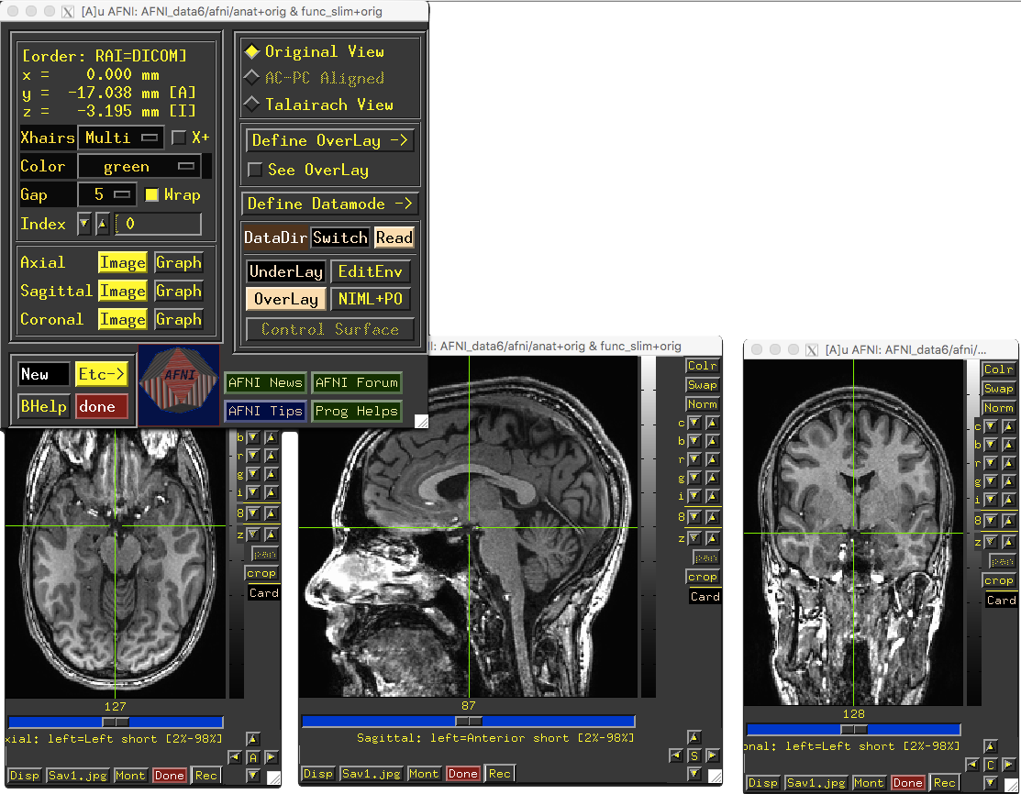
Screen Should Look Something Like This
title bar shows directory
and name of dataset
AFNI
Controller
crosshairs intersect at same
focus point in all slice viewers
Image
viewers

Slide 4
And now – an Interlude with AFNI Hands-On

Slide 5
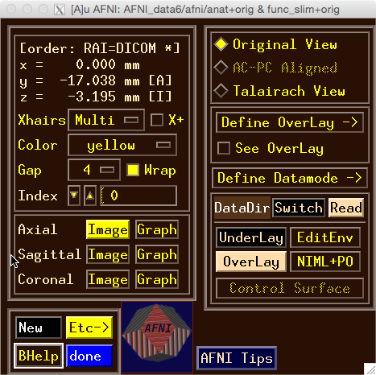
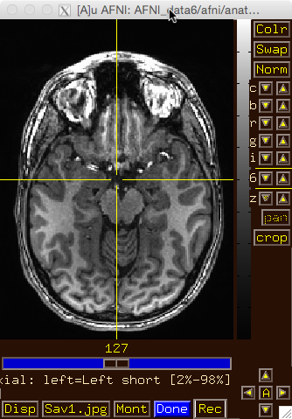
Try the BHelp button
Over some other GUI button
Over an image
Over the grayscale bar next to the image
Bhelp works with majority of GUI

Slide 6
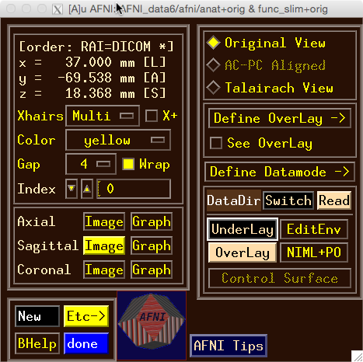
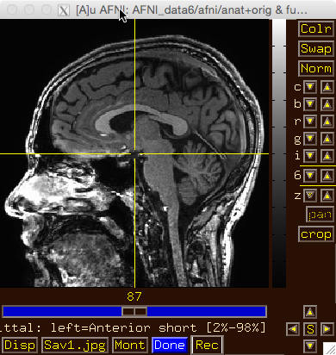
Drag image viewer far away, then
Right click
what happens to the image window?

Slide 7
Image viewer #1: Can you do …
Invert image grayscale?

Slide 8
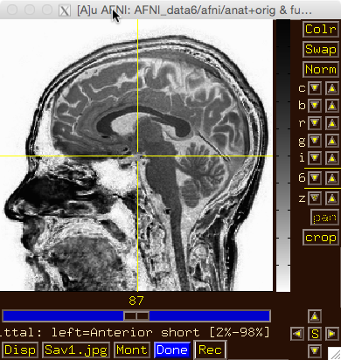
Image viewer #1: Can you do …
Invert image grayscale?

Slide 9
Image viewer #2: Can you do …
Change contrast and/or brightness?

Slide 10
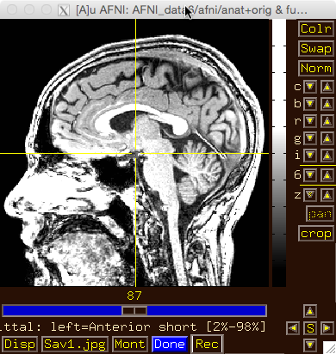
Image viewer #2: Can you do …
Change contrast and/or brightness?
You can also left-click mouse, hold button down, and drag up/down or left/right to change brightness or contrast

Slide 11
Image viewer #3: Can you do …
Zoom in and out?

Slide 12
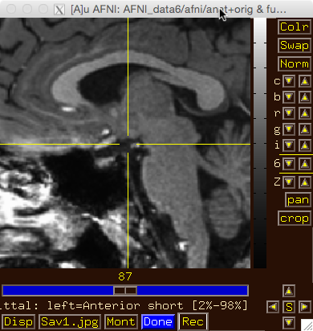
Image viewer #3: Can you do …
Zoom in and out?
Use ‘pan’ to adjust zoom window

Slide 13
Image viewer #4: Can you do …
Create a 3x3 montage?

Slide 14
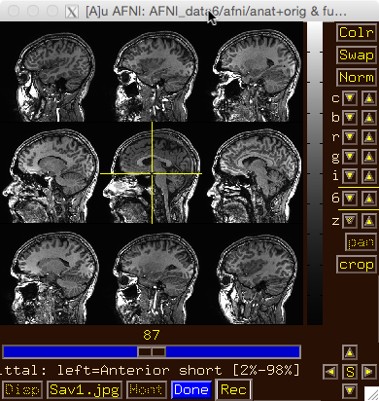
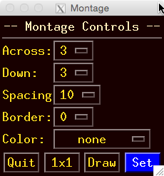
Image viewer #4: Can you do …
Create a 3x3 montage?

Slide 15
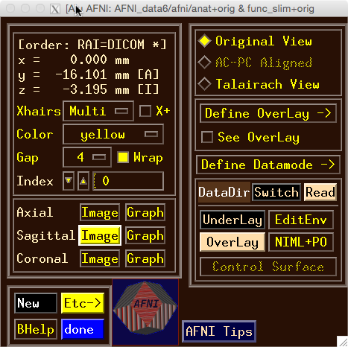
Try some of the right-click popup menus
this one is simple: for spatial coordinates

Slide 16
Try some of the right-click popup menus
this one is mostly for fun

Slide 17
Try some of the right-click popup menus
this one has several commonly used functions for image display and navigation

Slide 18
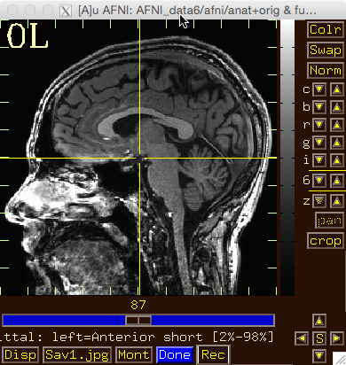
Try some of the right-click popup menus
has many rarely used options

Slide 19
Try some of the right-click popup menus
this one is a shortcut for some options on the more complicated ‘Disp’ menu

Slide 20
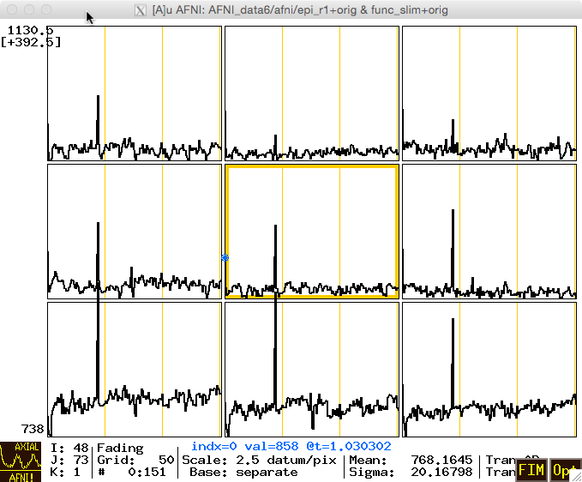
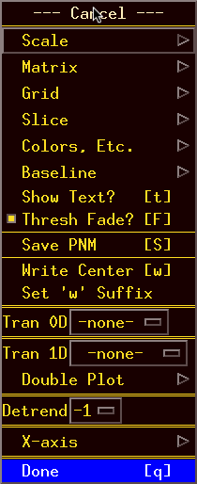
What does ‘I’ keypress do to graph? Then ‘i’?
Use BHelp in graph window
Shortcut keys
Click Opt menu for more shortcuts, etc
Change vertical Grid spacing to 15

Slide 21

That’s All for Now

