Slide 1


Classification of fMRI-based cognitive states using 3dsvm
Stephen LaConte
Department of Neuroscience

Slide 2
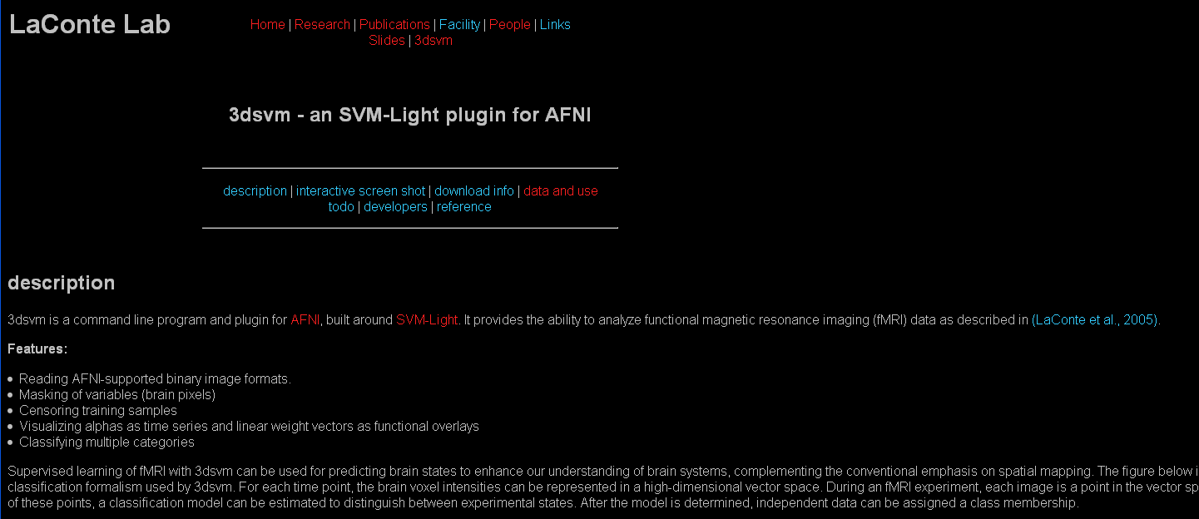
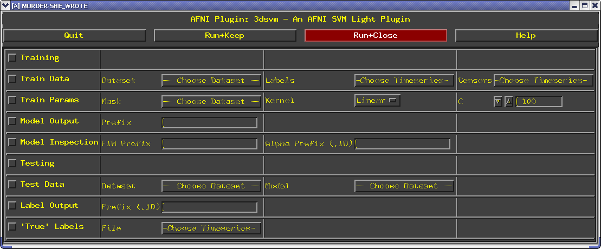
3dsvm
3dsvm is a command line program and plugin for AFNI, built around SVM-Light. It provides the ability to analyze functional magnetic resonance imaging (fMRI) data as described in (LaConte et al., 2005)
http://www.cpu.bcm.edu/laconte/3dsvm.html
Stephen LaConte July 22, 2009
Notes:
Increased my own productivity

Slide 3
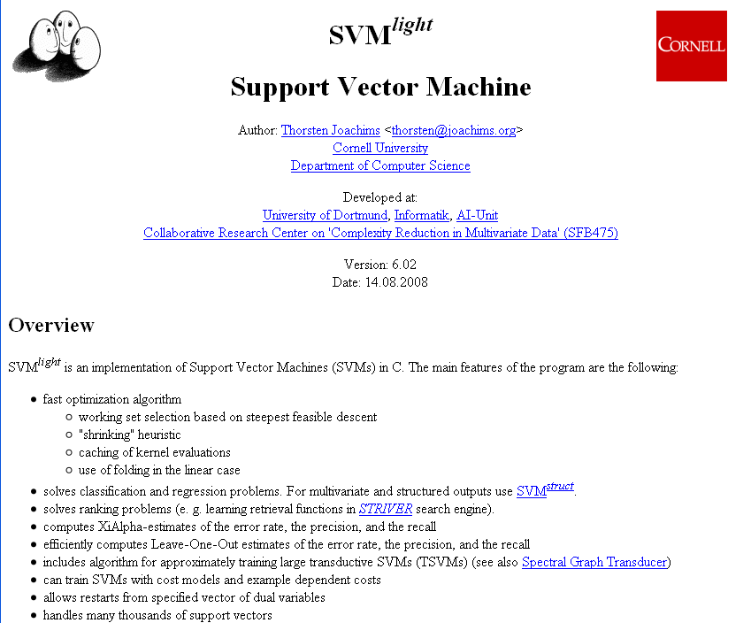
SVMLight is an implementation of Support Vector Machine (SVM) in C.
Download source from :http://svmlight.joachims.org/
Stephen LaConte July 22, 2009

Slide 4
3dsvm features
Distributed with AFNI
Reading AFNI-supported formats (including NIfTI)
  Thus all preprocessing and data manipulation of the major software packages
Masking of variables (brain pixels)
Censoring training samples
Visualizing alphas as time series and linear weight vectors as functional maps
Multi-class classification
Support for non-linear kernels
Stephen LaConte July 22, 2009
Notes:
Increased my own productivity

Slide 5
“Organization”
Who cares?!
Basic principles
Evaluation of predictive models
Model interpretation
fMRI considerations for MVPA
3dsvm examples
Stephen LaConte July 22, 2009

Slide 6
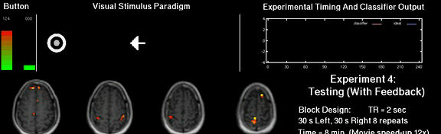
Who cares?
Stephen LaConte July 22, 2009

Slide 7
Background and Motivation
Complements univariate approaches
(Friston, 1995; McIntosh, 1996; Strother, 2002;
Moeller and Habeck 2006)
Early demonstration
(Dehaene, 1998)
Methodology and validation
(Strother, 2002; LaConte, 2003; Shaw, 2003;
Mitchell 2004; Mourão-Miranda, 2005;
Martinez-Ramon, 2006)
Representation of
different classes of stimuli
(Haxby, 2001; Cox and Savoy, 2003;
Haynes & Rees, 2005; Kamitani & Tong 2005)
Detecting and tracking
cognitive states
(Polyn, 2005)
Natural representation
for real-time fMRI
(LaConte, 2007)
Data analysis competitions
HBM ’06 and ‘07
Stephen LaConte July 22, 2009

Slide 8
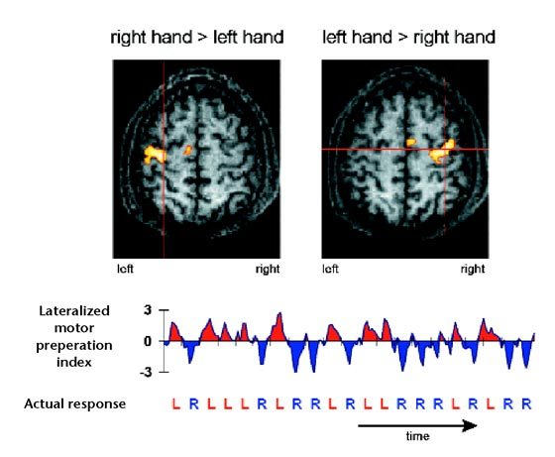
Background and Motivation
Complements univariate approaches
(Friston, 1995; McIntosh, 1996; Strother, 2002;
Moeller and Habeck 2006)
Early demonstration
(Dehaene, 1998)
Methodology and validation
(Strother, 2002; LaConte, 2003; Shaw, 2003;
Mitchell 2004; Mourão-Miranda, 2005;
Martinez-Ramon, 2006)
Representation of
different classes of stimuli
(Haxby, 2001; Cox and Savoy, 2003;
Haynes & Rees, 2005; Kamitani & Tong 2005)
Detecting and tracking
cognitive states
(Polyn, 2005)
Natural representation
for real-time fMRI
(LaConte, 2007)
Data analysis competitions
HBM ’06 and ‘07
(Dehaene, 1998)
Stephen LaConte July 22, 2009

Slide 9
Background and Motivation
Complements univariate approaches
(Friston, 1995; McIntosh, 1996; Strother, 2002;
Moeller and Habeck 2006)
Early demonstration
(Dehaene, 1998)
Methodology and validation
(Strother, 2002; LaConte, 2003; Shaw, 2003;
Mitchell 2004; Mourão-Miranda, 2005;
Martinez-Ramon, 2006)
Representation of
different classes of stimuli
(Haxby, 2001; Cox and Savoy, 2003;
Haynes & Rees, 2005; Kamitani & Tong 2005)
Detecting and tracking
cognitive states
(Polyn, 2005)
Natural representation
for real-time fMRI
(LaConte, 2007)
Data analysis competitions
HBM ’06 and ‘07
(LaConte, 2003)
Stephen LaConte July 22, 2009

Slide 10
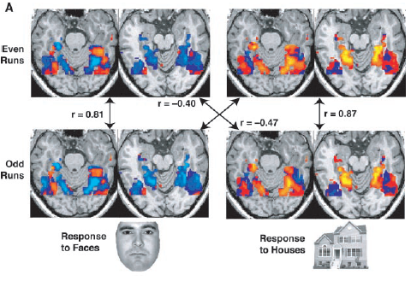
Background and Motivation
Complements univariate approaches
(Friston, 1995; McIntosh, 1996; Strother, 2002;
Moeller and Habeck 2006)
Early demonstration
(Dehaene, 1998)
Methodology and validation
(Strother, 2002; LaConte, 2003; Shaw, 2003;
Mitchell 2004; Mourão-Miranda, 2005;
Martinez-Ramon, 2006)
Representation of
different classes of stimuli
(Haxby, 2001; Cox and Savoy, 2003;
Haynes & Rees, 2005; Kamitani & Tong 2005)
Detecting and tracking
cognitive states
(Polyn, 2005)
Natural representation
for real-time fMRI
(LaConte, 2007)
Data analysis competitions
HBM ’06 and ‘07
(Haxby, 2001)
Stephen LaConte July 22, 2009

Slide 11
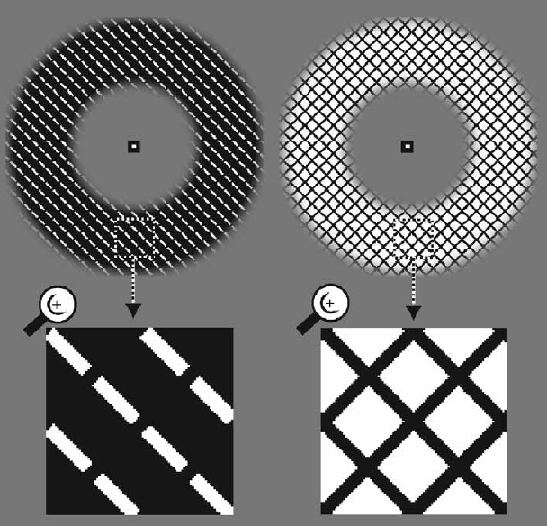
Background and Motivation
Complements univariate approaches
(Friston, 1995; McIntosh, 1996; Strother, 2002;
Moeller and Habeck 2006)
Early demonstration
(Dehaene, 1998)
Methodology and validation
(Strother, 2002; LaConte, 2003; Shaw, 2003;
Mitchell 2004; Mourão-Miranda, 2005;
Martinez-Ramon, 2006)
Representation of
different classes of stimuli
(Haxby, 2001; Cox and Savoy, 2003;
Haynes & Rees, 2005; Kamitani & Tong 2005)
Detecting and tracking
cognitive states
(Polyn, 2005)
Natural representation
for real-time fMRI
(LaConte, 2007)
Data analysis competitions
HBM ’06 and ‘07
(Haynes & Rees, 2005)
Stephen LaConte July 22, 2009

Slide 12
Background and Motivation
Complements univariate approaches
(Friston, 1995; McIntosh, 1996; Strother, 2002;
Moeller and Habeck 2006)
Early demonstration
(Dehaene, 1998)
Methodology and validation
(Strother, 2002; LaConte, 2003; Shaw, 2003;
Mitchell 2004; Mourão-Miranda, 2005;
Martinez-Ramon, 2006)
Representation of
different classes of stimuli
(Haxby, 2001; Cox and Savoy, 2003;
Haynes & Rees, 2005; Kamitani & Tong 2005)
Detecting and tracking
cognitive states
(Polyn, 2005)
Natural representation
for real-time fMRI
(LaConte, 2007)
Data analysis competitions
HBM ’06 and ‘07
(Polyn, 2005)
Stephen LaConte July 22, 2009

Slide 13
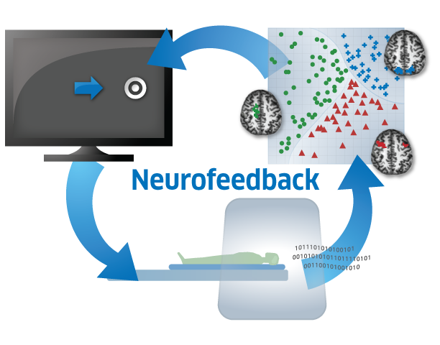
Background and Motivation
Complements univariate approaches
(Friston, 1995; McIntosh, 1996; Strother, 2002;
Moeller and Habeck 2006)
Early demonstration
(Dehaene, 1998)
Methodology and validation
(Strother, 2002; LaConte, 2003; Shaw, 2003;
Mitchell 2004; Mourão-Miranda, 2005;
Martinez-Ramon, 2006)
Representation of
different classes of stimuli
(Haxby, 2001; Cox and Savoy, 2003;
Haynes & Rees, 2005; Kamitani & Tong 2005)
Detecting and tracking
cognitive states
(Polyn, 2005)
Natural representation
for real-time fMRI
(LaConte, 2007)
Data analysis competitions
HBM ’06 and ‘07
(LaConte, 2007)
Stephen LaConte July 22, 2009

Slide 14
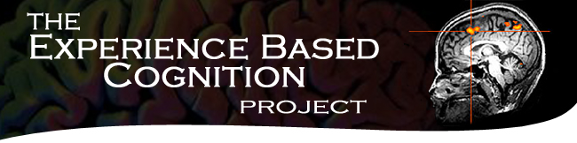
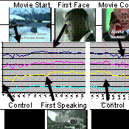
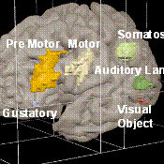
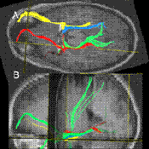
Background and Motivation
Complements univariate approaches
(Friston, 1995; McIntosh, 1996; Strother, 2002;
Moeller and Habeck 2006)
Early demonstration
(Dehaene, 1998)
Methodology and validation
(Strother, 2002; LaConte, 2003; Shaw, 2003;
Mitchell 2004; Mourão-Miranda, 2005;
Martinez-Ramon, 2006)
Representation of
different classes of stimuli
(Haxby, 2001; Cox and Savoy, 2003;
Haynes & Rees, 2005; Kamitani & Tong 2005)
Detecting and tracking
cognitive states
(Polyn, 2005)
Natural representation
for real-time fMRI
(LaConte, 2007)
Data analysis competitions
HBM ’06 and ‘07
Stephen LaConte July 22, 2009

Slide 15
“Organization”
Who cares?!
Basic principles
Evaluation of predictive models
Model interpretation
fMRI considerations for MVPA
3dsvm examples
Stephen LaConte July 22, 2009

Slide 16
Supervised learning applied to fMRI
Step 1: Train with labeled data
Step 2: Use model to predict/decode
y represents the stimulus/behavioral categories for each volume.
For classification, there is a set of stimulus categories y = {0, 1, 2, …, N}.
Stephen LaConte July 22, 2009

Slide 17
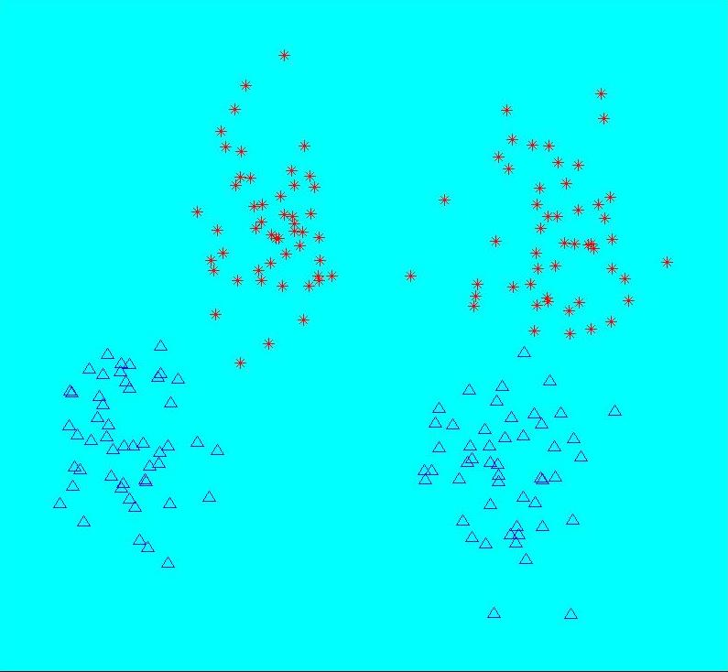
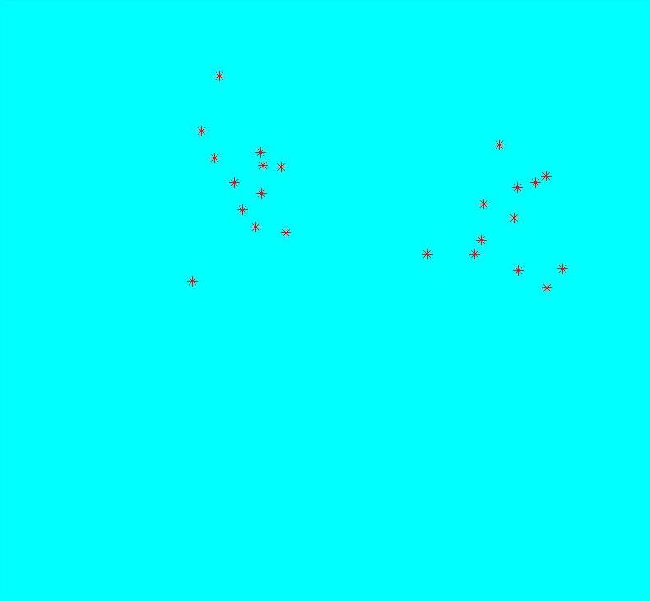
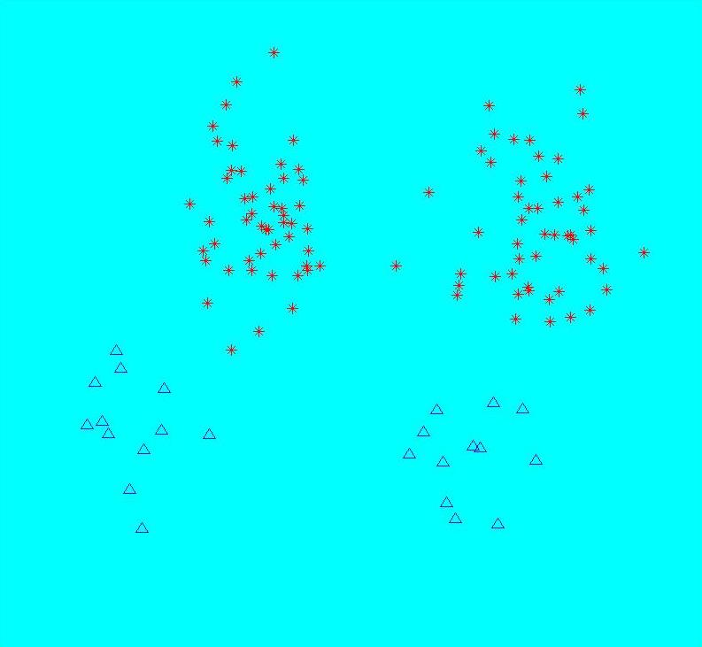
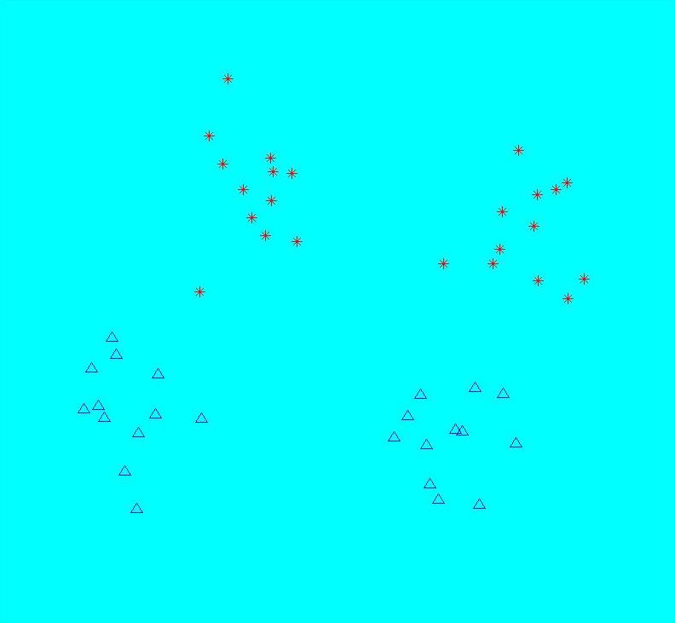

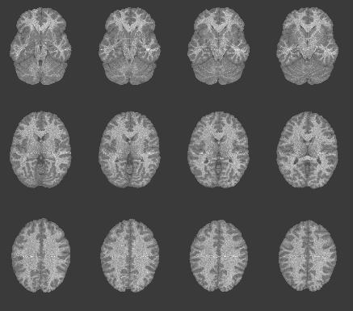

Classification with individual volumes
experiment
time
Stephen LaConte July 22, 2009

Slide 18
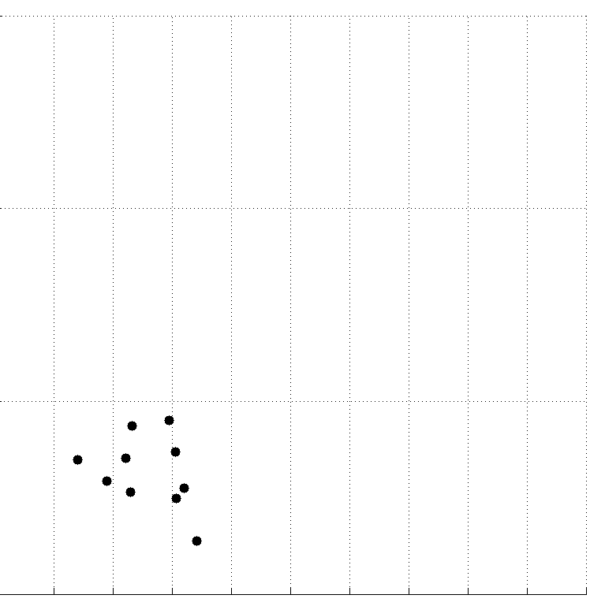

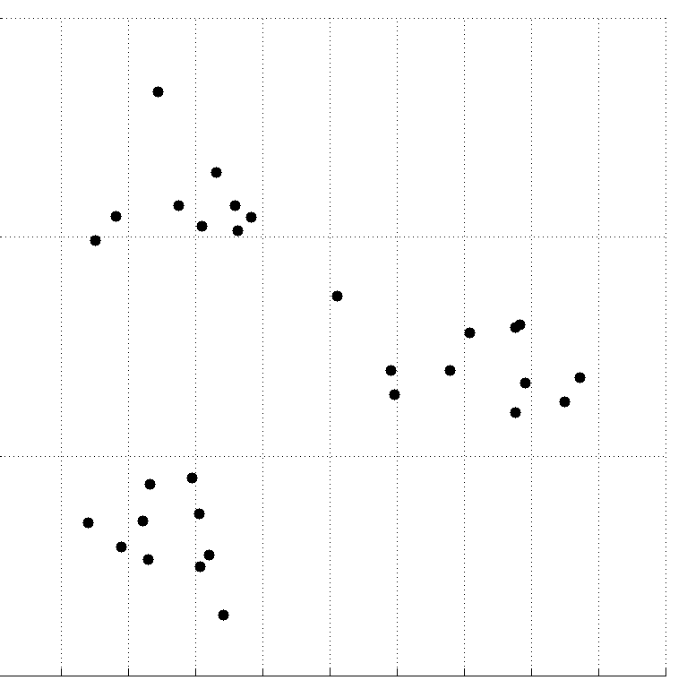
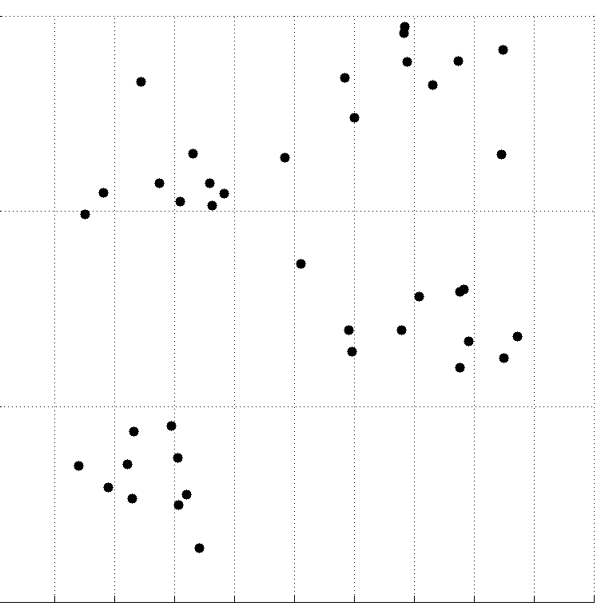
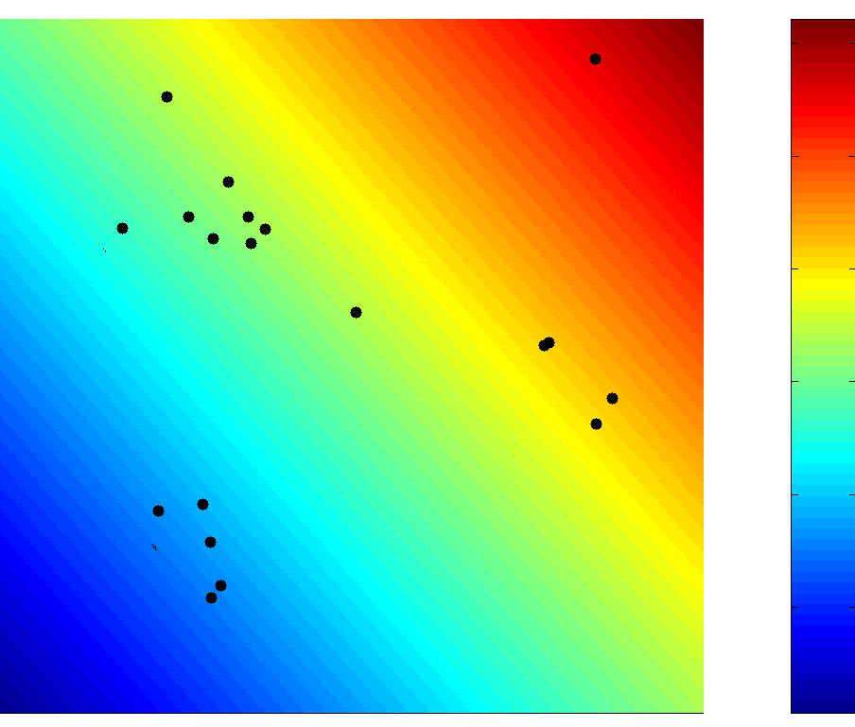
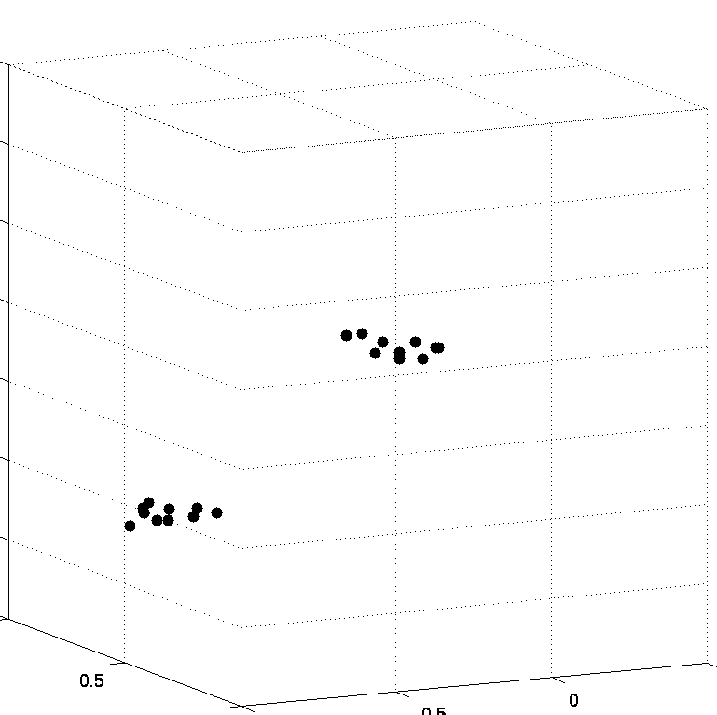
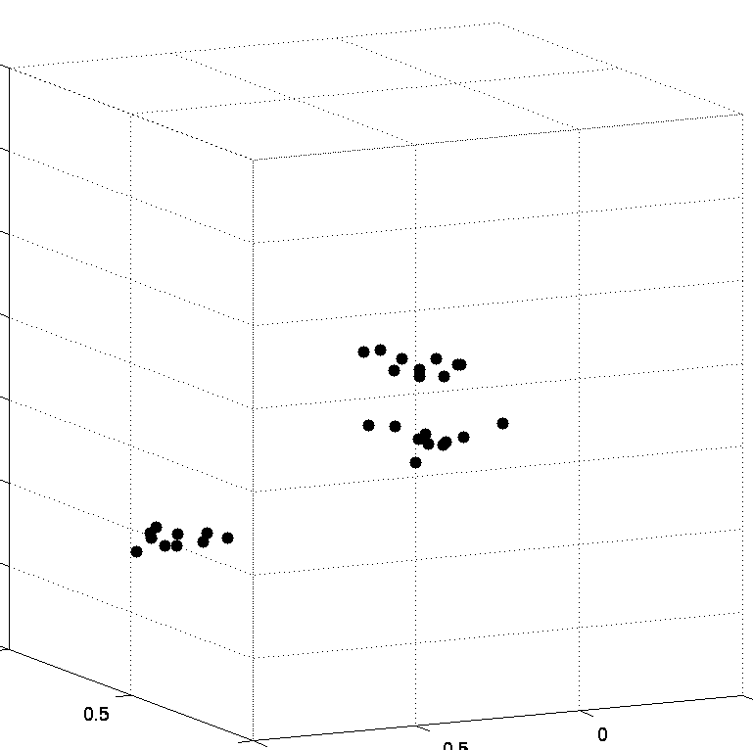
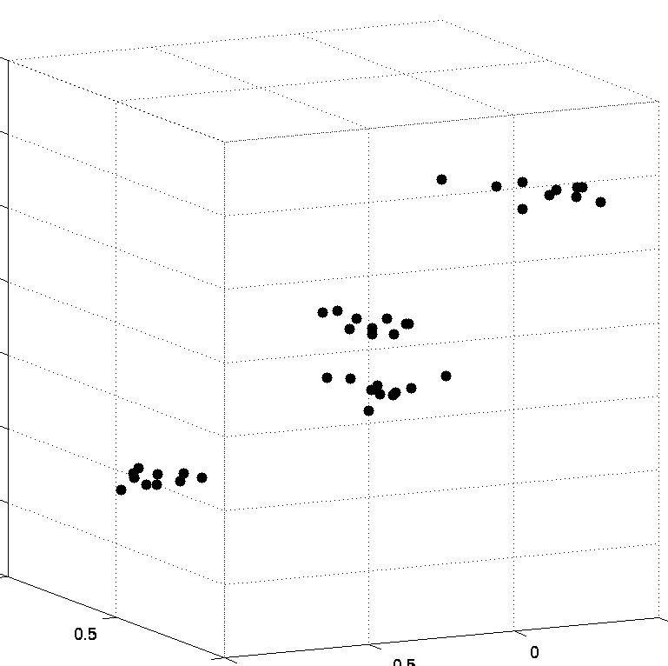
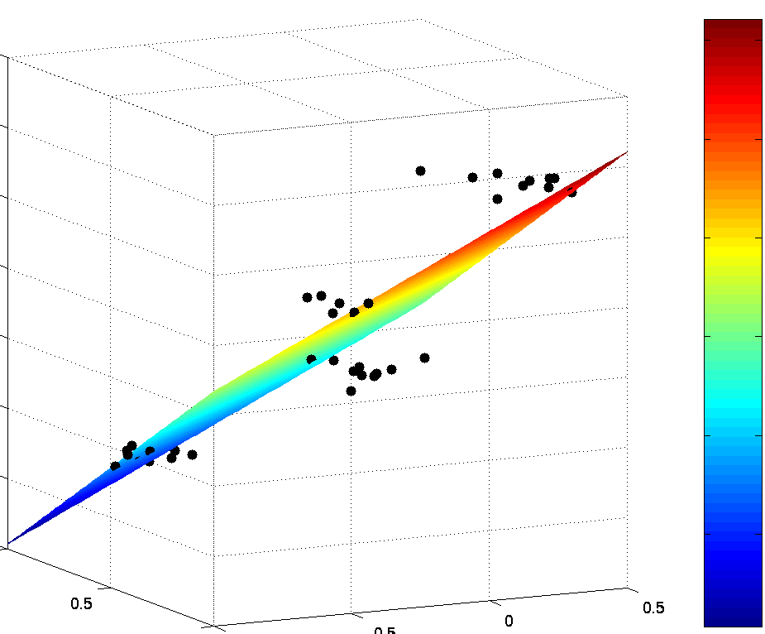
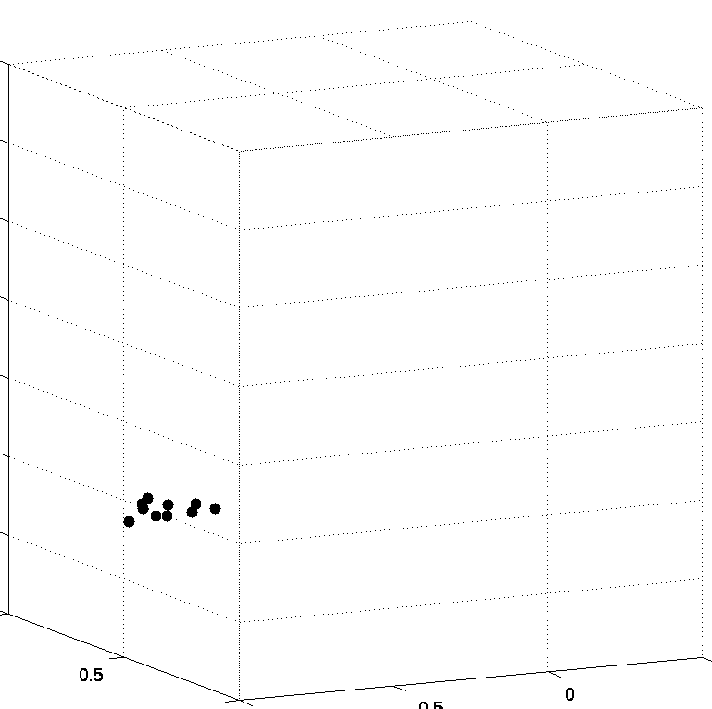
Temporal Regression
10
10
8
8
6
6
4
4
2
2
0
0
fMRI experiment
9
6
3
1
time
Stephen LaConte July 22, 2009

Slide 19
Classification
Stephen LaConte July 22, 2009

Slide 20
Training Data and Decision Boundary
Stephen LaConte July 22, 2009

Slide 21
Training Data and Decision Boundary
Stephen LaConte July 22, 2009

Slide 22
Training Data and Decision Boundary
Stephen LaConte July 22, 2009

Slide 23
Multi-class
There are several methods for generalizing two class classifiers
new optimization formulation
one vs. rest
one vs. one
  error correcting codes
  voting
  directed acyclic graph
Stephen LaConte July 22, 2009

Slide 24
Multi-class
There are several methods for generalizing two class classifiers
new optimization formulation
one vs. rest
one vs. one
  error correcting codes
  voting
  directed acyclic graph
Currently implemented
Stephen LaConte July 22, 2009

Slide 25
Directed
Acyclic
Graph
Test Input
SVM₁ (1 vs. 4)
SVM₂ (2 vs. 4)
SVM₃ (1 vs. 3)
SVM₄ (3 vs. 4)
SVM₅ (2 vs. 3)
SVM₆ (1 vs. 2)
Class 4
Class 3
Class 2
Class 1
Stephen LaConte July 22, 2009

Slide 26
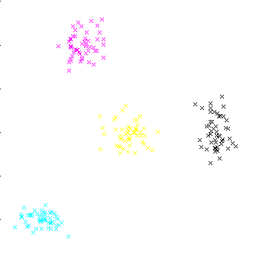
Multi-class
Training Data
2
4
3
1
Stephen LaConte July 22, 2009

Slide 27



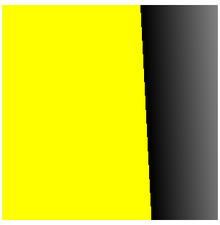
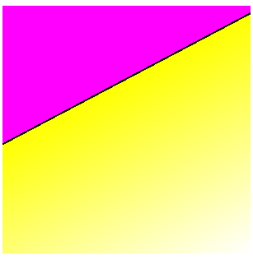

Multi-class
Training Data
Individual 2-class models
1 vs. 4
2 vs. 4
1 vs. 3
2
4
3
3 vs. 4
2 vs. 3
1 vs. 2
1
Stephen LaConte July 22, 2009

Slide 28
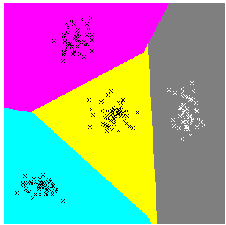
Multi-class
4-Class Model
Individual 2-class models
1 vs. 4
2 vs. 4
1 vs. 3
2
4
3
3 vs. 4
2 vs. 3
1 vs. 2
1
Stephen LaConte July 22, 2009

Slide 29
3vs2
3
3
3
3
3
3
3
3
3
2
3
3
2
2
3
3
2
3
3
3
2
2
2
3
3
3
3
3
3
2
2
2
2
3
3
2
2
2
3
3
3
3
3
3
3
3
2
3
2
2
Example:
2
2
2
2
2v3
1vs3
1
2v1
1v3
1
1
1
1
1
1
1
1
1
1
1
1
1
1
1
1
1
1
1
1
1
1
1vs2
Stephen LaConte July 22, 2009

Slide 30
3vs2
3
3
3
3
3
3
3
3
3
2
3
3
2
2
3
3
2
3
3
3
2
2
2
3
3
3
3
3
3
2
2
2
2
3
3
2
2
2
3
3
3
3
3
3
3
3
2
3
2
2
Example:
2
2
2
2
2v3
2
1
2v1
1v3
1
1
1
1
1
1
1
1
1
1
1
1
1
1
1
1
1
1
1
1
1
1
Stephen LaConte July 22, 2009

Slide 31
3
3
3
3
3
3
3
3
3
2
3
3
2
2
3
3
2
3
3
3
2
2
2
3
3
3
3
3
3
2
2
2
2
3
3
2
2
2
3
3
3
3
3
3
3
3
2
3
2
2
Example:
2
2
2
2
2v3
2
1
2v1
1v3
1
1
1
1
1
2
1
1
1
1
1
1
1
1
1
1
1
1
1
1
1
1
1
1vs2
Stephen LaConte July 22, 2009

Slide 32
3
3
3
3
3
3
3
3
3
2
3
3
2
2
3
3
2
3
3
3
2
2
2
3
3
3
3
3
3
2
2
2
2
3
3
2
2
2
3
3
3
3
3
3
3
3
2
3
2
2
Example:
2
2
2
2
2v3
2
1
2v1
1v3
1
1
1
1
1
2
1
1
1
1
1
1
1
1
1
1
1
1
1
1v2
1
1
1
1
2
1v3
3v2
1vs2
Stephen LaConte July 22, 2009

Slide 33
3vs2
3
3
3
3
3
3
3
3
3
2
3
3
2
2
3
3
2
3
3
3
2
2
2
3
3
3
3
3
3
2
2
2
2
3
3
2
2
2
3
3
3
3
3
3
3
3
2
3
2
2
Example:
2
2
2
2
2v3
2
1
2v1
1v3
1
1
1
1
1
2
1
1
1
1
1
1
1
1
1
1
1
1
1
1v2
1
1
1
1
2
1v3
3v2
2
Stephen LaConte July 22, 2009

Slide 34
3
3
3
3
3
3
3
3
3
2
3
3
2
2
3
3
2
3
3
3
2
2
2
3
3
3
3
3
3
2
2
2
2
3
3
2
2
2
3
3
3
3
3
3
3
3
2
3
2
2
Example:
2
2
2
2
2v3
2
1vs3
1
2v1
1v3
1
1
1
1
1
2
1
1
1
1
1
1
1
1
1
1
1
1
1
1v2
1
1
1
1
2
1v3
3v2
2
1v3
3
1v2
2v3
Stephen LaConte July 22, 2009

Slide 35
3vs2
3
3
3
3
3
3
3
3
3
2
3
3
2
2
3
3
2
3
3
3
2
2
2
3
3
3
3
3
3
2
2
2
2
3
3
2
2
2
3
3
3
3
3
3
3
3
2
3
2
2
Example:
2
2
2
2
2v3
2
1
2v1
1v3
1
1
1
1
1
2
1
1
1
1
1
1
1
1
1
1
1
1
1
1v2
1
1
1
1
2
1v3
3v2
2
1v3
3
1v2
2v3
2
Stephen LaConte July 22, 2009

Slide 36
Classification
Stephen LaConte July 22, 2009

Slide 37
Canonical Variates Analysis
Stephen LaConte July 22, 2009

Slide 38
PCA/CVA
time
Data Matrix:
voxels
PCA via SVD:
Truncate Q (model complexity)
CVA:
Columns of L are determined by the eigenvectors of W⁻¹B. W is the within class variance and B the between class variance, and both are obtained from Q.
Stephen LaConte July 22, 2009
Notes:
PCA: reduce dimensionality and control complexity
CVA: produce linear, multivariate discriminant functions to classify brain-state class labels

Slide 39
Support Vector Machine
Stephen LaConte July 22, 2009

Slide 40
SVM
minimize
This term allows some training errors.
This term favors the widest possible
margin,
C = infinity is hard margin SVM (as apposed to soft margin)
because it does not allow any training errors
Stephen LaConte July 22, 2009

Slide 41
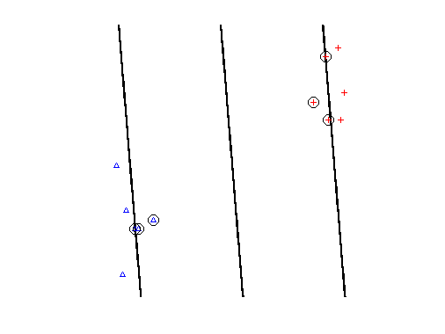
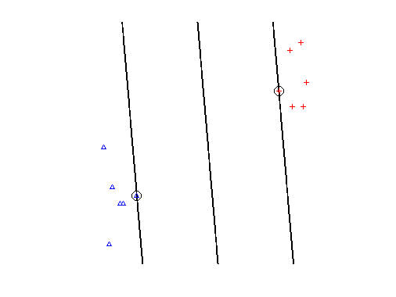
Separable
C = “small”
C = large
Side note:
The w map
z1
Considering the role each voxel plays in the
direction of the discriminant boundary, the
absolute value of component 2 of w should
be larger than component 1. So the “activation map” would show voxel 2.
z2
Stephen LaConte July 22, 2009

Slide 42
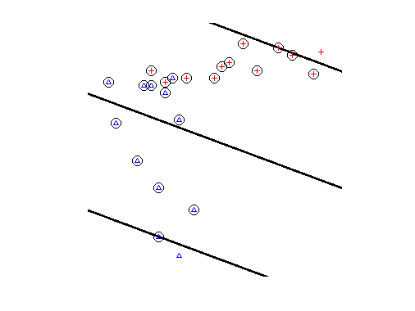
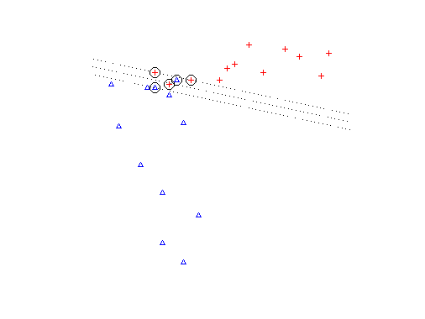
Non-separable
The use of C was primarily motivated by this case
C = small
C = large
Stephen LaConte July 22, 2009

Slide 43

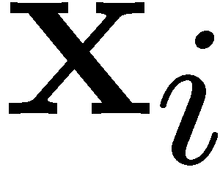
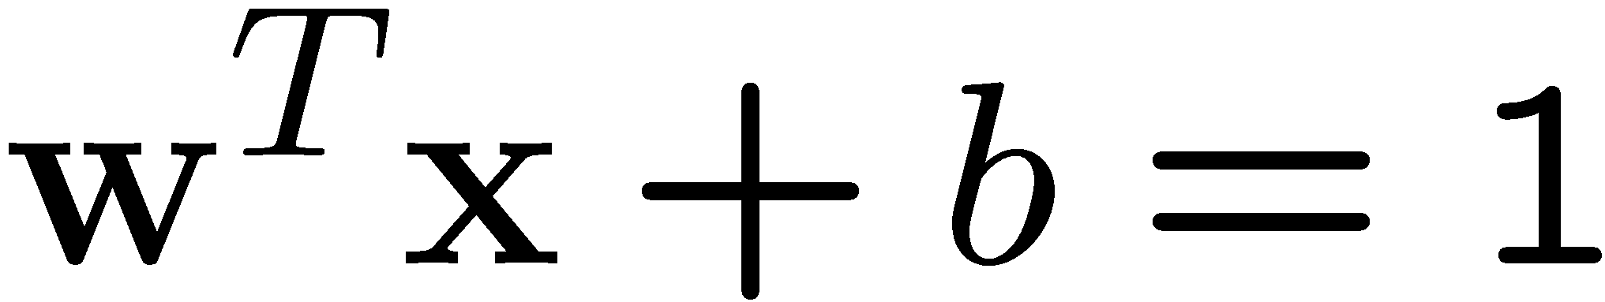
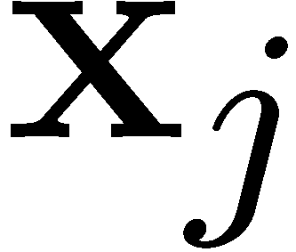

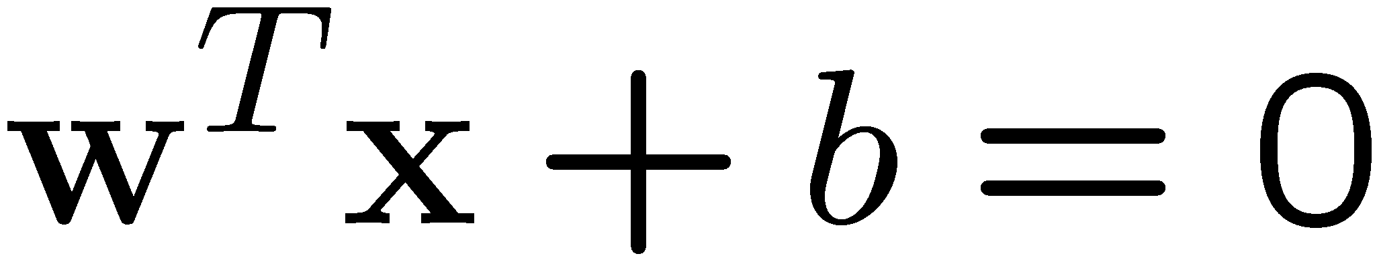
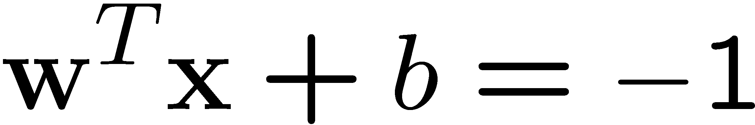
Non-seperable
The use of C was primarily motivated by this case
C = small
C = large
Stephen LaConte July 22, 2009

Slide 44
Non-seperable
The use of C was primarily motivated by this case
C = small
C = large
w
Stephen LaConte July 22, 2009

Slide 45
3dsvm provides an “alpha time series”
Non-zero alphas are support vectors
Stephen LaConte July 22, 2009

Slide 46
“Organization”
Who cares?!
Basic principles
Evaluation of predictive models
Model interpretation
fMRI considerations for MVPA
3dsvm examples
Stephen LaConte July 22, 2009

Slide 47
Evaluating the model:
Generalization
Prediction accuracy on independent data
Independence
  Autocorrelation within a run
  Across runs
  Across sessions
  Across individuals
Stephen LaConte July 22, 2009

Slide 48
Evaluating the model:
Generalization
Confusion matrix for binary classification
Class decision
Positive
Negative
Positive
True positive
False negative
Negative
False positive
True negative
Stephen LaConte July 22, 2009

Slide 49
Evaluating the model:
Generalization
Quantifying predictive performance
overall performance
performance on class 1
performance on class 0
Stephen LaConte July 22, 2009

Slide 50
Evaluating the model:
Generalization
Quantifying predictive performance
svmlight
Originally developed for text classification
Training process provides computationally efficient estimates that characterize the performance on the “positive” class
Stephen LaConte July 22, 2009

Slide 51
“Organization”
Who cares?!
Basic principles
Evaluation of predictive models
Model interpretation
fMRI considerations for MVPA
3dsvm examples
Stephen LaConte July 22, 2009

Slide 52
Interpretation
“the predictive learning setting does not guarantee that accurate predictive models closely approximate the true model” – Cherkassky and Mulier, 2007.
  A consequence of modeling finite data
Interpretation can be difficult if input (e.g. brain voxels) diffusely contributes to the model
  non-linear models are often difficult to interpret
As multivariate models, we can obtain information about both spatial and temporal properties
Get to know your data and the analysis method being applied!
Stephen LaConte July 22, 2009

Slide 53
Interpreting SVM Models
Linear Kernel
3rd Order Polynomial Kernel
5th Order Polynomial Kernel
Each point in feature space corresponds to a spatial pattern
Support vectors, conceptually are the observations that are most difficult to classify
Conversely, observations far away from the separating hyperplane are most easily classified
  In fact, changing non-support vector training data will result in an identical model
Stephen LaConte July 22, 2009

Slide 54
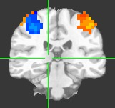
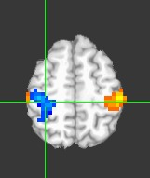
Interpreting SVM Models
Linear Kernel
3rd Order Polynomial Kernel
5th Order Polynomial Kernel
Each point in feature space corresponds to a spatial pattern
Support vectors, conceptually are the observations that are most difficult to classify
Conversely, observations far away from the separating hyperplane are most easily classified
  In fact, changing non-support vector training data will result in an identical model
Stephen LaConte July 22, 2009

Slide 55
Interpreting SVM Models
Linear Kernel
3rd Order Polynomial Kernel
5th Order Polynomial Kernel
Each point in feature space corresponds to a spatial pattern
Support vectors, conceptually are the observations that are most difficult to classify
Conversely, observations far away from the separating hyperplane are most easily classified
  In fact, changing non-support vector training data will result in an identical model
Stephen LaConte July 22, 2009

Slide 56
“Organization”
Who cares?!
Basic principles
Evaluation of predictive models
Model interpretation
fMRI considerations for MVPA
3dsvm examples
Stephen LaConte July 22, 2009

Slide 57
Hemodynamic response
Model HRF
Temporal shift to compensate
Drop transition scans
(LaConte, 2003; LaConte 2005; Mitchell, 2004)
Stephen LaConte July 22, 2009

Slide 58
Effect of training with task transition images
180
all images
exclude 1
160
140
120
100
Total Misclassifications
80
60
40
training
X
X
X
X
X
X
X
X
X
X
X
X
20
0
testing
180
exclude 2
exclude 3
160
140
120
100
Total Misclassifications
80
60
40
20
0
2
6
10
14
18
22
26
30
2
6
10
14
18
22
26
30
seconds
seconds
Stephen LaConte July 22, 2009

Slide 59
Effect of training with task transition images
180
all images
exclude 1
160
140
120
100
Total Misclassifications
80
60
40
20
0
180
exclude 2
exclude 3
160
140
120
100
Total Misclassifications
80
60
40
20
0
2
6
10
14
18
22
26
30
2
6
10
14
18
22
26
30
seconds
seconds
Stephen LaConte July 22, 2009

Slide 60
Effect of training with task transition images
testing last 20 of 30 s
(10 of 15 images)
100
95
90
Accuracy (%)
85
80
75
testing all data
70
all images
exclude 1
exclude 2
exclude 3
Discarded Transition Images
Stephen LaConte July 22, 2009

Slide 61
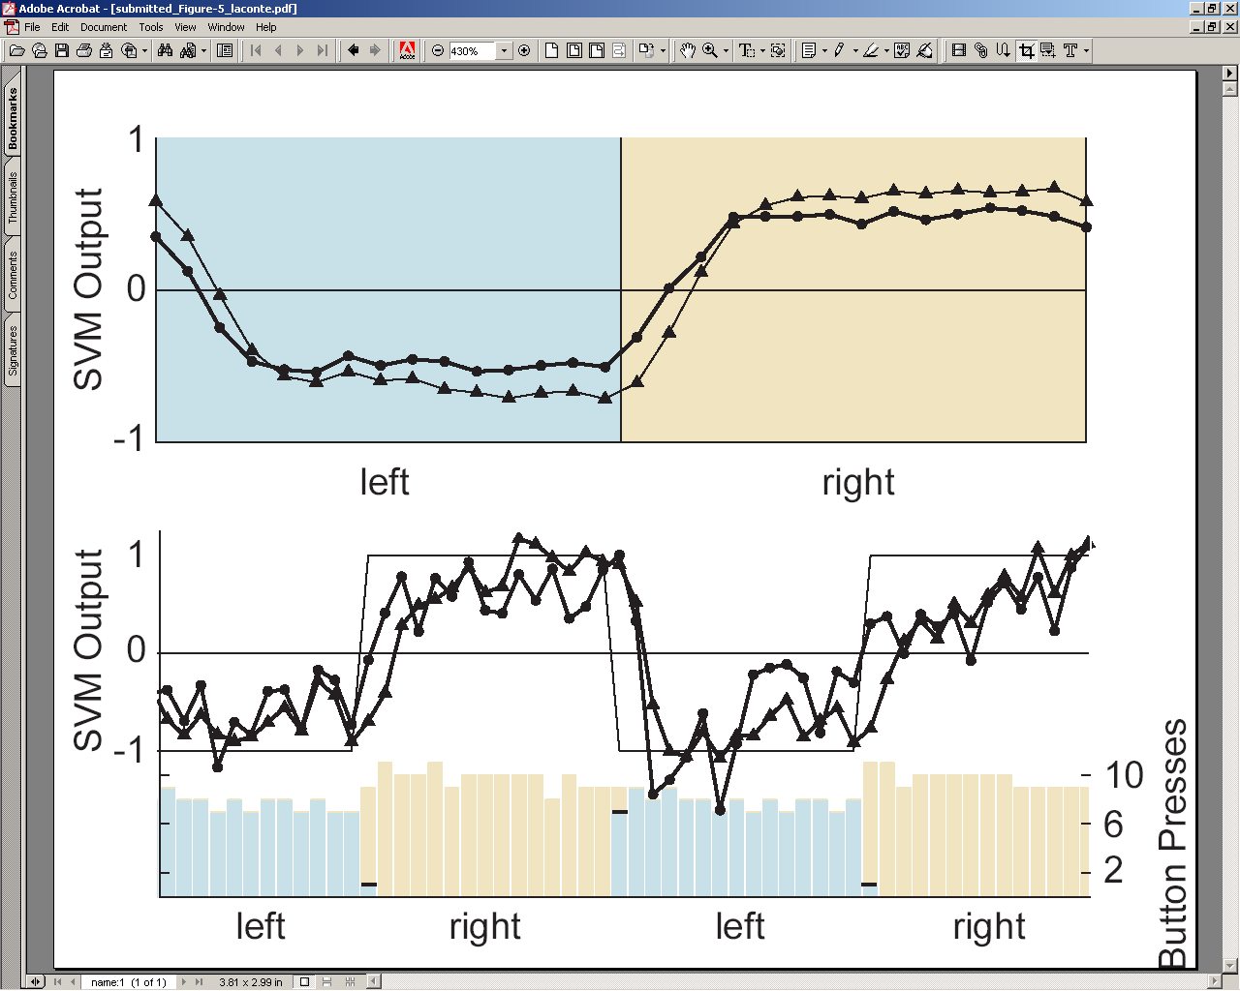
Responsiveness to stimulus changes
Average classifier output
exclude 2
The model trained without
transition images is more stable
all images
The model trained without
transition images is more sluggish
Individual classifier output with behavioral data
Stephen LaConte July 22, 2009

Slide 62
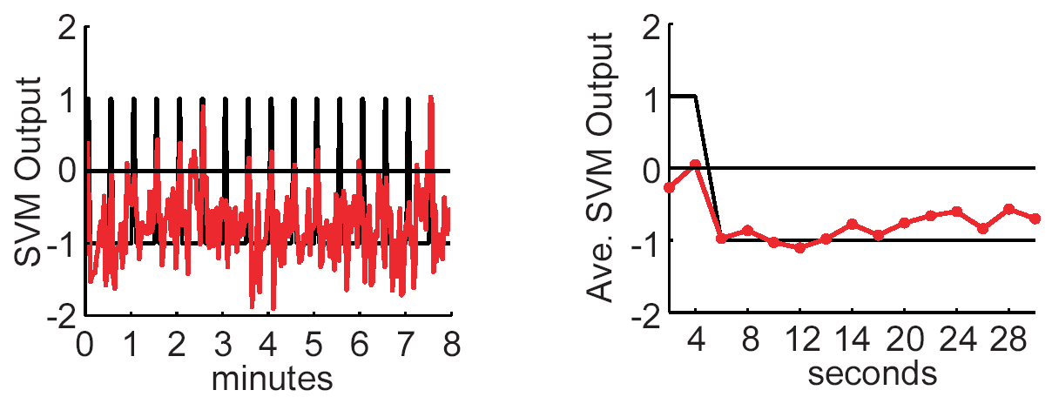
Classification of “transition” images
Stephen LaConte July 22, 2009

Slide 63
“Organization”
Who cares?!
Basic principles
Evaluation of predictive models
Model interpretation
fMRI considerations for MVPA
3dsvm examples
  Quick tour
  Hands on example 1: Two 2-class tasks
  Hands on example 2: multi-class
Stephen LaConte July 22, 2009

Slide 64
3dsvm tour: basic steps
Prepare training and test data sets
  fMRI (3D+t)
  Labels (1D) – labels for test data are optional (needed to to calculate accuracy)
  Mask for training data (3D) – 3dsvm considers mask to be part of the model it generates
3dsvm training
  Creates a model that can be tested with independent data
  For convenience, inspecting the model
    Model alphas (1D)
    Weight vector map (3D)
3dsvm testing
  Calculates class and/or distance measure for each new timepoint
  Prediction accuracy (if test set labels are available)
Stephen LaConte July 22, 2009

Slide 65
3dsvm tour: plugin snapshot
training
testing
Stephen LaConte July 22, 2009

Slide 66
3dsvm tour: command line
Training - 3dsvm -trainvol run1+orig \
-trainlabels run1_categories.1D \
-mask mask+orig \
-model model_run1
Testing - 3dsvm -testvol run2+orig \
-model model_run1+orig \
-predictions pred2_model1
Stephen LaConte July 22, 2009

Slide 67
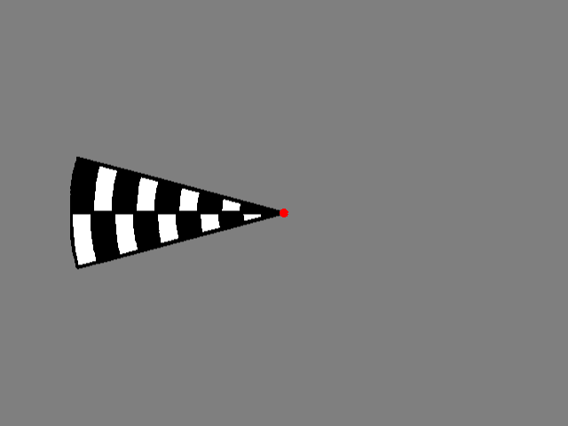
3dsvm tour: example 0
Left vs. Right visual stimulus
3T fmri 31 axial EPI slices, TR/TE = 2000/31 msec, voxel=3.4 X 3.4 X 4 mm).
Randomized block lengths alternating between left and right stimulus.
Stephen LaConte July 22, 2009

Slide 68
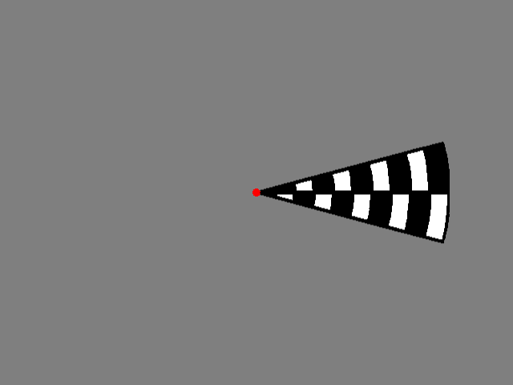
3dsvm tour: example 0
Left vs. Right visual stimulus
3T fmri 31 axial EPI slices, TR/TE = 2000/31 msec, voxel=3.4 X 3.4 X 4 mm).
Randomized block lengths alternating between left and right stimulus.
Stephen LaConte July 22, 2009

Slide 69
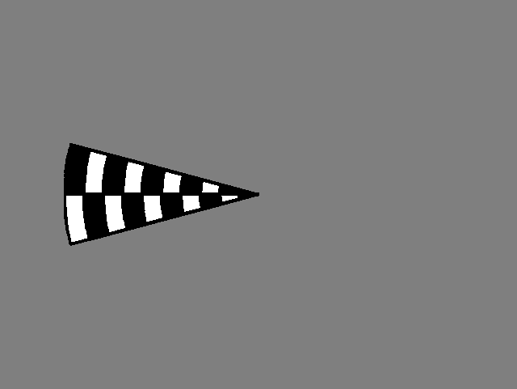
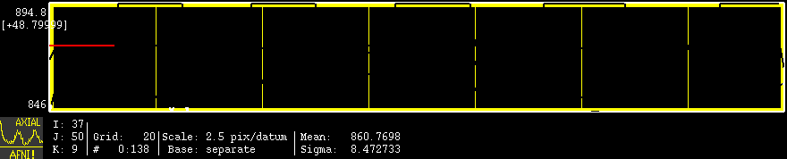
3dsvm tour: example 0
Left vs. Right visual stimulus
3T fmri 31 axial EPI slices, TR/TE = 2000/31 msec, voxel=3.4 X 3.4 X 4 mm).
Randomized block lengths alternating between left and right stimulus.
Stephen LaConte July 22, 2009

Slide 70
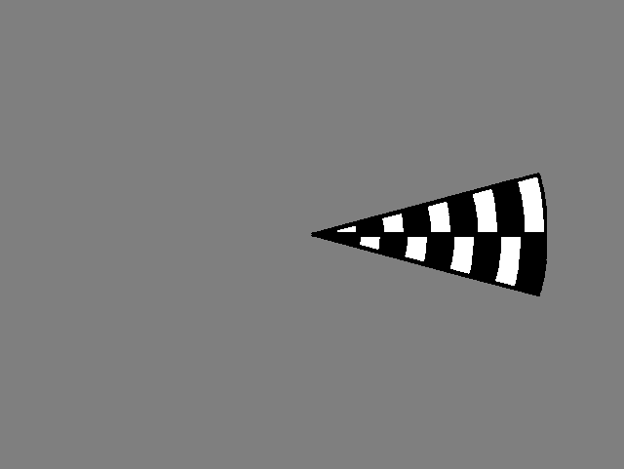
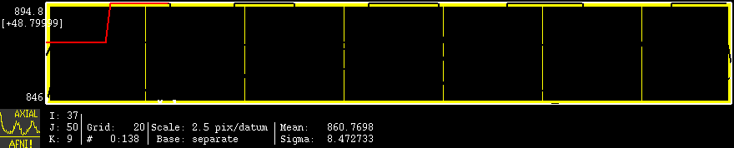
3dsvm tour: example 0
Left vs. Right visual stimulus
3T fmri 31 axial EPI slices, TR/TE = 2000/31 msec, voxel=3.4 X 3.4 X 4 mm).
Randomized block lengths alternating between left and right stimulus.
Stephen LaConte July 22, 2009

Slide 71
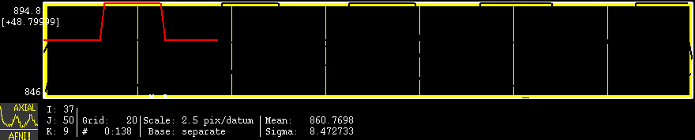
3dsvm tour: example 0
Left vs. Right visual stimulus
3T fmri 31 axial EPI slices, TR/TE = 2000/31 msec, voxel=3.4 X 3.4 X 4 mm).
Randomized block lengths alternating between left and right stimulus.
Stephen LaConte July 22, 2009

Slide 72

3dsvm tour: example 0
Left vs. Right visual stimulus
3T fmri 31 axial EPI slices, TR/TE = 2000/31 msec, voxel=3.4 X 3.4 X 4 mm).
Randomized block lengths alternating between left and right stimulus.
Stephen LaConte July 22, 2009

Slide 73

3dsvm tour: example 0
Left vs. Right visual stimulus
3T fmri 31 axial EPI slices, TR/TE = 2000/31 msec, voxel=3.4 X 3.4 X 4 mm).
Randomized block lengths alternating between left and right stimulus.
Stephen LaConte July 22, 2009

Slide 74

3dsvm tour: example 0
Left vs. Right visual stimulus
3T fmri 31 axial EPI slices, TR/TE = 2000/31 msec, voxel=3.4 X 3.4 X 4 mm).
Randomized block lengths alternating between left and right stimulus.
Stephen LaConte July 22, 2009

Slide 75

3dsvm tour: example 0
Left vs. Right visual stimulus
3T fmri 31 axial EPI slices, TR/TE = 2000/31 msec, voxel=3.4 X 3.4 X 4 mm).
Randomized block lengths alternating between left and right stimulus.
Stephen LaConte July 22, 2009

Slide 76

3dsvm tour: example 0
Left vs. Right visual stimulus
3T fmri 31 axial EPI slices, TR/TE = 2000/31 msec, voxel=3.4 X 3.4 X 4 mm).
Randomized block lengths alternating between left and right stimulus.
Stephen LaConte July 22, 2009

Slide 77

3dsvm tour: example 0
Left vs. Right visual stimulus
3T fmri 31 axial EPI slices, TR/TE = 2000/31 msec, voxel=3.4 X 3.4 X 4 mm).
Randomized block lengths alternating between left and right stimulus.
Stephen LaConte July 22, 2009

Slide 78

3dsvm tour: example 0
Left vs. Right visual stimulus
3T fmri 31 axial EPI slices, TR/TE = 2000/31 msec, voxel=3.4 X 3.4 X 4 mm).
Randomized block lengths alternating between left and right stimulus.
Stephen LaConte July 22, 2009

Slide 79

3dsvm tour: example 0
Left vs. Right visual stimulus
3T fmri 31 axial EPI slices, TR/TE = 2000/31 msec, voxel=3.4 X 3.4 X 4 mm).
Randomized block lengths alternating between left and right stimulus.
Stephen LaConte July 22, 2009

Slide 80
3dsvm tour: example 0
Left vs. Right visual stimulus
3T fmri 31 axial EPI slices, TR/TE = 2000/31 msec, voxel=3.4 X 3.4 X 4 mm).
Randomized block lengths alternating between left and right stimulus.
Stephen LaConte July 22, 2009

Slide 81
3dsvm tour: example 0
Left vs. Right visual stimulus
3T fmri 31 axial EPI slices, TR/TE = 2000/31 msec, voxel=3.4 X 3.4 X 4 mm).
Randomized block lengths alternating between left and right stimulus.
Stephen LaConte July 22, 2009

Slide 82
3dsvm tour: 3dsvm –help examples
Usage:
3dsvm [options]
Examples:
1. Training: basic options require a training run, category (class) labels for each timepoint, and an output model. In general, it usually makes sense to include a mask file to exclude at least non-brain voxels
3dsvm -trainvol run1+orig \
-trainlabels run1_categories.1D \
-mask mask+orig \
-model model_run1
Stephen LaConte July 22, 2009

Slide 83
3dsvm tour: 3dsvm –help examples
Usage:
3dsvm [options]
Examples:
2. Training: obtain model alphas (a_run1.1D) and model weights (fim: run1_fim+orig)
3dsvm -alpha a_run1 \
-trainvol run1+orig \
-trainlabels run1_categories.1D \
-mask mask+orig \
-model model_run1 \
-bucket run1_fim
Stephen LaConte July 22, 2009

Slide 84
3dsvm tour: 3dsvm –help examples
Usage:
3dsvm [options]
Examples:
3. Training: exclude some time points using a censor file
3dsvm -alpha a_run1 \
-trainvol run1+orig \
-trainlabels run1_categories.1D \
-censor censor.1D \
-mask mask+orig \
-model model_run1 \
-bucket run1_fim
Stephen LaConte July 22, 2009

Slide 85
3dsvm tour: 3dsvm –help examples
Usage:
3dsvm [options]
Examples:
4. Training: control svm model complexity (C value)
3dsvm -c 100.0 \
-alpha a_run1 \
-trainvol run1+orig \
-trainlabels run1_categories.1D \
-censor censor.1D \
-mask mask+orig \
-model model_run1
-bucket run1_fim
Stephen LaConte July 22, 2009

Slide 86
3dsvm tour: 3dsvm –help examples
Usage:
3dsvm [options]
Examples:
5. Testing: basic options require a testing run, a model, and an output predictions file
3dsvm -testvol run2+orig \
-model model_run1+orig \
-predictions pred2_model1
Stephen LaConte July 22, 2009

Slide 87
3dsvm tour: 3dsvm –help examples
Usage:
3dsvm [options]
Examples:
6. Testing: compare predictions with 'truth'
3dsvm -testvol run2+orig \
-model model_run1+orig \
-testlabels run2_categories.1D \
-predictions pred2_model1
Stephen LaConte July 22, 2009

Slide 88
3dsvm tour: 3dsvm –help examples
Usage:
3dsvm [options]
Examples:
7. Testing: use -classout to output integer thresholded class predictions (rather than continuous valued output)
3dsvm -classout \
-testvol run2+orig \
-model model_run1+orig \
-testlabels run2_categories.1D \
-predictions pred2_model1
Stephen LaConte July 22, 2009

Slide 89

example 1a
Stephen LaConte July 22, 2009

Slide 90


multi-source interference task
(Bush et al. 2003)
example 1b
Combines sources of cognitive interference
  Stroop, Eriksen, and Simon
Report the identity of the number that is different
Stephen LaConte July 22, 2009

Slide 91
#!/bin/bash
# example by Andrew Fischer
echo === motor ===
echo === align run2 to run1 ===
3dvolreg -prefix blur_vr_r2_to_r1 \
-base 'blur_vr_run1_motor_AFB003+orig[0]'
blur_vr_run2_motor_AFB003+orig
echo === calculate mask for run1 ===
3dAutomask -prefix msk_run1_motor_AFB003+orig blur_vr_run1_motor_AFB003+orig
echo === training run1 ===
3dsvm -a a_run1_motor_AFB003 \
-trainvol blur_vr_run1_motor_AFB003+orig \
-trainlabels motor_labels.1D \
-mask msk_run1_motor_AFB003+orig \
-model model_run1_motor_AFB003 \
-bucket bucket_run1_motor_AFB003
echo === testing run1 ===
3dsvm -testvol blur_vr_r2_to_r1_motor_AFB003+orig \
-testlabels motor_labels.1D \
-model model_run1_motor_AFB003+orig \
-predictions classifier_motor_r2_using_r1_motor_AFB003 > ./motor_classifier_log.txt 2>&1
example 1
Stephen LaConte July 22, 2009

Slide 92




Example Stimulus Frames
example 2
Bimanual coordination task:
Feedback of both the left and right hand performance was provided by a four arc display described in (Klaiman and Karniel, 2006), where button tapping was used to move the inner arches to match the speed of the outer arches.
1:1 – Good Performance
1:1 – Poor Performance
3:2 – Good Performance
3:2 – Poor Performance
Stephen LaConte July 22, 2009

Slide 93






example 2
Group brain maps of the SVM models for the 14 subjects
Distributed pattern common to 1:1 & 3:2 rhythms:
Bil. Precuneus (BA7)
L. (1:1) & Bil. (3:2) postcentral (BA4)
Bil. Lentiform
R. culmen
Distributed pattern during Fixation:
L. cuneus (BA18)
Distributed pattern unique to 1:1 rhythm:
Bil. Precentral/M1 (BA4)
R. inf. Temporal (BA37)
L. sup. Parietal
Distributed pattern unique to 3:2 rhythm:
R. middle frontal (BA6)
L. medial frontal (BA6)
1:1 (red) vs. Fixation (blue)
FDR-corrected; q<0.01
3:2 (red) vs. Fixation (blue)
FDR-corrected; q<0.01
3:2 (red) vs. 1:1 (blue)
p=0.001
1:1 vs. Fixation
(93% Accuracy)
3:2 vs. Fixation
(93% Accuracy)
3:2 vs. 1:1
(77% Accuracy)
Raw classifier output plotted over label files for a relatively accurate subject. The first two TRs have been removed for each transition between stimuli.
Stephen LaConte July 22, 2009

Slide 94
example 2
#!/bin/csh
# example by Prashant Prasad
3dsvm -trainvol volreg_run1_PPA+orig \
-trainlabels LABEL_PPA_1.1D \
-mask automask_run1_PPA+orig \
-bucket bucket_run1_PPA \
-model model_run1_PPA
3dsvm -classout \
-testvol volreg_run2_PPA+orig \
-testlabels LABEL_PPA_2.1D \
-model model_run1_PPA+orig \
-predictions pred_run2_frmRun1_classout
3dsvm -testvol volreg_run2_PPA+orig \
-testlabels LABEL_PPA_2.1D \
-model model_run1_PPA+orig \
-predictions pred_run2_frmRun1
# optional, move bucket files to Tailarach
# @auto_tlrc -base TT_N27+tlrc -input anatomical_PPA+orig
# @auto_tlrc -apar anatomical_PPA_at+tlrc –input bucket_run1_PPA_0_1+orig -dxyz 4
# @auto_tlrc -apar anatomical_PPA_at+tlrc -input bucket_run1_PPA_0_2+orig -dxyz 4
# @auto_tlrc -apar anatomical_PPA_at+tlrc -input bucket_run1_PPA_1_2+orig -dxyz 4
Stephen LaConte July 22, 2009

Slide 95

example 2
#!/bin/csh
# example by Prashant Prasad
3dsvm -trainvol volreg_run1_PPA+orig \
-trainlabels LABEL_PPA_1.1D \
-mask automask_run1_PPA+orig \
-bucket bucket_run1_PPA \
-model model_run1_PPA
3dsvm -classout \
-testvol volreg_run2_PPA+orig \
-testlabels LABEL_PPA_2.1D \
-model model_run1_PPA+orig \
-predictions pred_run2_frmRun1_classout
3dsvm -testvol volreg_run2_PPA+orig \
-testlabels LABEL_PPA_2.1D \
-model model_run1_PPA+orig \
-predictions pred_run2_frmRun1
# optional, move bucket files to Tailarach
# @auto_tlrc -base TT_N27+tlrc -input anatomical_PPA+orig
# @auto_tlrc -apar anatomical_PPA_at+tlrc –input bucket_run1_PPA_0_1+orig -dxyz 4
# @auto_tlrc -apar anatomical_PPA_at+tlrc -input bucket_run1_PPA_0_2+orig -dxyz 4
# @auto_tlrc -apar anatomical_PPA_at+tlrc -input bucket_run1_PPA_1_2+orig -dxyz 4
Stephen LaConte July 22, 2009

Slide 96

#!/bin/csh
# example by Prashant Prasad
3dsvm -trainvol volreg_run1_PPA+orig \
-trainlabels LABEL_PPA_1.1D \
-mask automask_run1_PPA+orig \
-bucket bucket_run1_PPA \
-model model_run1_PPA
3dsvm -classout \
-testvol volreg_run2_PPA+orig \
-testlabels LABEL_PPA_2.1D \
-model model_run1_PPA+orig \
-predictions pred_run2_frmRun1_classout
3dsvm -testvol volreg_run2_PPA+orig \
-testlabels LABEL_PPA_2.1D \
-model model_run1_PPA+orig \
-predictions pred_run2_frmRun1
# optional, move bucket files to Tailarach
# @auto_tlrc -base TT_N27+tlrc -input anatomical_PPA+orig
# @auto_tlrc -apar anatomical_PPA_at+tlrc –input bucket_run1_PPA_0_1+orig -dxyz 4
# @auto_tlrc -apar anatomical_PPA_at+tlrc -input bucket_run1_PPA_0_2+orig -dxyz 4
# @auto_tlrc -apar anatomical_PPA_at+tlrc -input bucket_run1_PPA_1_2+orig -dxyz 4
Stephen LaConte July 22, 2009

Slide 97

example 2
#!/bin/csh
# example by Prashant Prasad
3dsvm -trainvol volreg_run1_PPA+orig \
-trainlabels LABEL_PPA_1.1D \
-mask automask_run1_PPA+orig \
-bucket bucket_run1_PPA \
-model model_run1_PPA
3dsvm -classout \
-testvol volreg_run2_PPA+orig \
-testlabels LABEL_PPA_2.1D \
-model model_run1_PPA+orig \
-predictions pred_run2_frmRun1_classout
3dsvm -testvol volreg_run2_PPA+orig \
-testlabels LABEL_PPA_2.1D \
-model model_run1_PPA+orig \
-predictions pred_run2_frmRun1
# optional, move bucket files to Tailarach
# @auto_tlrc -base TT_N27+tlrc -input anatomical_PPA+orig
# @auto_tlrc -apar anatomical_PPA_at+tlrc –input bucket_run1_PPA_0_1+orig -dxyz 4
# @auto_tlrc -apar anatomical_PPA_at+tlrc -input bucket_run1_PPA_0_2+orig -dxyz 4
# @auto_tlrc -apar anatomical_PPA_at+tlrc -input bucket_run1_PPA_1_2+orig -dxyz 4
Stephen LaConte July 22, 2009

Slide 98
example 2
#!/bin/csh
# example by Prashant Prasad
3dsvm -trainvol volreg_run1_PPA+orig \
-trainlabels LABEL_PPA_1.1D \
-mask automask_run1_PPA+orig \
-bucket bucket_run1_PPA \
-model model_run1_PPA
3dsvm -classout \
-testvol volreg_run2_PPA+orig \
-testlabels LABEL_PPA_2.1D \
-model model_run1_PPA+orig \
-predictions pred_run2_frmRun1_classout
3dsvm -testvol volreg_run2_PPA+orig \
-testlabels LABEL_PPA_2.1D \
-model model_run1_PPA+orig \
-predictions pred_run2_frmRun1
# optional, move bucket files to Tailarach
# @auto_tlrc -base TT_N27+tlrc -input anatomical_PPA+orig
# @auto_tlrc -apar anatomical_PPA_at+tlrc –input bucket_run1_PPA_0_1+orig -dxyz 4
# @auto_tlrc -apar anatomical_PPA_at+tlrc -input bucket_run1_PPA_0_2+orig -dxyz 4
# @auto_tlrc -apar anatomical_PPA_at+tlrc -input bucket_run1_PPA_1_2+orig -dxyz 4
Stephen LaConte July 22, 2009

Slide 99
example 2
#!/bin/csh
# example by Prashant Prasad
3dsvm -trainvol volreg_run1_PPA+orig \
-trainlabels LABEL_PPA_1.1D \
-mask automask_run1_PPA+orig \
-bucket bucket_run1_PPA \
-model model_run1_PPA
3dsvm -classout \
-testvol volreg_run2_PPA+orig \
-testlabels LABEL_PPA_2.1D \
-model model_run1_PPA+orig \
-predictions pred_run2_frmRun1_classout
3dsvm -testvol volreg_run2_PPA+orig \
-testlabels LABEL_PPA_2.1D \
-model model_run1_PPA+orig \
-predictions pred_run2_frmRun1
# optional, move bucket files to Tailarach
# @auto_tlrc -base TT_N27+tlrc -input anatomical_PPA+orig
# @auto_tlrc -apar anatomical_PPA_at+tlrc –input bucket_run1_PPA_0_1+orig -dxyz 4
# @auto_tlrc -apar anatomical_PPA_at+tlrc -input bucket_run1_PPA_0_2+orig -dxyz 4
# @auto_tlrc -apar anatomical_PPA_at+tlrc -input bucket_run1_PPA_1_2+orig -dxyz 4
type = string-attribute name = HISTORY_NOTE count = 933 '[pprasad@awesomo.hnl.bcm.edu: Fri May 8 13:16:13 2009] to3d -epan -prefix to3dbutton_run1_PPA -time:zt 34 308 2000 alt+z2 -assume_dicom_mosaic ../../../../../opt/dicom_data/ExperimentsTABS_PPA/PPA010_20090421/run1_5/00001.dcm ../../../../../opt/dicom_data/ExperimentsTABS_PPA/PPA010_20090421/run1_5/00002.dcm ../../../../../opt/dicom_data/ExperimentsTABS_PPA/PPA010_20090421/run1_5/00003.dcm ... ../../../../../opt/dicom_data/ExperimentsTABS_PPA/PPA010_20090421/run1_5/00307.dcm ../../../../../opt/dicom_data/ExperimentsTABS_PPA/PPA010_20090421/run1_5/00308.dcm\n[pprasad@awesomo.hnl.bcm.edu: Fri May 8 13:16:15 2009] 3dvolreg -Fourier -prefix volreg_button_run1_PPA -dfile volreg_button_run1_PPA.mp -base 0 to3dbutton_run1_PPA+orig\n[slaconte@awesomo.hnl.bcm.edu: Fri Jul 17 04:36:16 2009] 3dsvm -trainvol volreg_run1_PPA+orig -trainlabels LABEL_PPA_1.1D -mask automask_run1_PPA+orig -bucket bucket_run1_PPA -model model_run1_PPA~
Stephen LaConte July 22, 2009

Slide 100
example 2
#!/bin/csh
# example by Prashant Prasad
3dsvm -trainvol volreg_run1_PPA+orig \
-trainlabels LABEL_PPA_1.1D \
-mask automask_run1_PPA+orig \
-bucket bucket_run1_PPA \
-model model_run1_PPA
3dsvm -classout \
-testvol volreg_run2_PPA+orig \
-testlabels LABEL_PPA_2.1D \
-model model_run1_PPA+orig \
-predictions pred_run2_frmRun1_classout
3dsvm -testvol volreg_run2_PPA+orig \
-testlabels LABEL_PPA_2.1D \
-model model_run1_PPA+orig \
-predictions pred_run2_frmRun1
# optional, move bucket files to Tailarach
# @auto_tlrc -base TT_N27+tlrc -input anatomical_PPA+orig
# @auto_tlrc -apar anatomical_PPA_at+tlrc –input bucket_run1_PPA_0_1+orig -dxyz 4
# @auto_tlrc -apar anatomical_PPA_at+tlrc -input bucket_run1_PPA_0_2+orig -dxyz 4
# @auto_tlrc -apar anatomical_PPA_at+tlrc -input bucket_run1_PPA_1_2+orig -dxyz 4
Stephen LaConte July 22, 2009

Slide 101
example 2
#!/bin/csh
# example by Prashant Prasad
3dsvm -trainvol volreg_run1_PPA+orig \
-trainlabels LABEL_PPA_1.1D \
-mask automask_run1_PPA+orig \
-bucket bucket_run1_PPA \
-model model_run1_PPA
3dsvm -classout \
-testvol volreg_run2_PPA+orig \
-testlabels LABEL_PPA_2.1D \
-model model_run1_PPA+orig \
-predictions pred_run2_frmRun1_classout
3dsvm -testvol volreg_run2_PPA+orig \
-testlabels LABEL_PPA_2.1D \
-model model_run1_PPA+orig \
-predictions pred_run2_frmRun1
# optional, move bucket files to Tailarach
# @auto_tlrc -base TT_N27+tlrc -input anatomical_PPA+orig
# @auto_tlrc -apar anatomical_PPA_at+tlrc –input bucket_run1_PPA_0_1+orig -dxyz 4
# @auto_tlrc -apar anatomical_PPA_at+tlrc -input bucket_run1_PPA_0_2+orig -dxyz 4
# @auto_tlrc -apar anatomical_PPA_at+tlrc -input bucket_run1_PPA_1_2+orig -dxyz 4
Stephen LaConte July 22, 2009

Slide 102

#!/bin/csh
# example by Prashant Prasad
3dsvm -trainvol volreg_run1_PPA+orig \
-trainlabels LABEL_PPA_1.1D \
-mask automask_run1_PPA+orig \
-bucket bucket_run1_PPA \
-model model_run1_PPA
3dsvm -classout \
-testvol volreg_run2_PPA+orig \
-testlabels LABEL_PPA_2.1D \
-model model_run1_PPA+orig \
-predictions pred_run2_frmRun1_classout
3dsvm -testvol volreg_run2_PPA+orig \
-testlabels LABEL_PPA_2.1D \
-model model_run1_PPA+orig \
-predictions pred_run2_frmRun1
# optional, move bucket files to Tailarach
# @auto_tlrc -base TT_N27+tlrc -input anatomical_PPA+orig
# @auto_tlrc -apar anatomical_PPA_at+tlrc –input bucket_run1_PPA_0_1+orig -dxyz 4
# @auto_tlrc -apar anatomical_PPA_at+tlrc -input bucket_run1_PPA_0_2+orig -dxyz 4
# @auto_tlrc -apar anatomical_PPA_at+tlrc -input bucket_run1_PPA_1_2+orig -dxyz 4
pred_run2_frmRun1_classount_0_1.1D
Stephen LaConte July 22, 2009

Slide 103

#!/bin/csh
# example by Prashant Prasad
3dsvm -trainvol volreg_run1_PPA+orig \
-trainlabels LABEL_PPA_1.1D \
-mask automask_run1_PPA+orig \
-bucket bucket_run1_PPA \
-model model_run1_PPA
3dsvm -classout \
-testvol volreg_run2_PPA+orig \
-testlabels LABEL_PPA_2.1D \
-model model_run1_PPA+orig \
-predictions pred_run2_frmRun1_classout
3dsvm -testvol volreg_run2_PPA+orig \
-testlabels LABEL_PPA_2.1D \
-model model_run1_PPA+orig \
-predictions pred_run2_frmRun1
# optional, move bucket files to Tailarach
# @auto_tlrc -base TT_N27+tlrc -input anatomical_PPA+orig
# @auto_tlrc -apar anatomical_PPA_at+tlrc –input bucket_run1_PPA_0_1+orig -dxyz 4
# @auto_tlrc -apar anatomical_PPA_at+tlrc -input bucket_run1_PPA_0_2+orig -dxyz 4
# @auto_tlrc -apar anatomical_PPA_at+tlrc -input bucket_run1_PPA_1_2+orig -dxyz 4
pred_run2_frmRun1_classount_0_2.1D
Stephen LaConte July 22, 2009

Slide 104

#!/bin/csh
# example by Prashant Prasad
3dsvm -trainvol volreg_run1_PPA+orig \
-trainlabels LABEL_PPA_1.1D \
-mask automask_run1_PPA+orig \
-bucket bucket_run1_PPA \
-model model_run1_PPA
3dsvm -classout \
-testvol volreg_run2_PPA+orig \
-testlabels LABEL_PPA_2.1D \
-model model_run1_PPA+orig \
-predictions pred_run2_frmRun1_classout
3dsvm -testvol volreg_run2_PPA+orig \
-testlabels LABEL_PPA_2.1D \
-model model_run1_PPA+orig \
-predictions pred_run2_frmRun1
# optional, move bucket files to Tailarach
# @auto_tlrc -base TT_N27+tlrc -input anatomical_PPA+orig
# @auto_tlrc -apar anatomical_PPA_at+tlrc –input bucket_run1_PPA_0_1+orig -dxyz 4
# @auto_tlrc -apar anatomical_PPA_at+tlrc -input bucket_run1_PPA_0_2+orig -dxyz 4
# @auto_tlrc -apar anatomical_PPA_at+tlrc -input bucket_run1_PPA_1_2+orig -dxyz 4
pred_run2_frmRun1_classount_1_2.1D
Stephen LaConte July 22, 2009

Slide 105
#!/bin/csh
# example by Prashant Prasad
3dsvm -trainvol volreg_run1_PPA+orig \
-trainlabels LABEL_PPA_1.1D \
-mask automask_run1_PPA+orig \
-bucket bucket_run1_PPA \
-model model_run1_PPA
3dsvm -classout \
-testvol volreg_run2_PPA+orig \
-testlabels LABEL_PPA_2.1D \
-model model_run1_PPA+orig \
-predictions pred_run2_frmRun1_classout
3dsvm -testvol volreg_run2_PPA+orig \
-testlabels LABEL_PPA_2.1D \
-model model_run1_PPA+orig \
-predictions pred_run2_frmRun1
# optional, move bucket files to Tailarach
# @auto_tlrc -base TT_N27+tlrc -input anatomical_PPA+orig
# @auto_tlrc -apar anatomical_PPA_at+tlrc –input bucket_run1_PPA_0_1+orig -dxyz 4
# @auto_tlrc -apar anatomical_PPA_at+tlrc -input bucket_run1_PPA_0_2+orig -dxyz 4
# @auto_tlrc -apar anatomical_PPA_at+tlrc -input bucket_run1_PPA_1_2+orig -dxyz 4
pred_run2_frmRun1_classount_1_2.1D
Stephen LaConte July 22, 2009

Slide 106

#!/bin/csh
# example by Prashant Prasad
3dsvm -trainvol volreg_run1_PPA+orig \
-trainlabels LABEL_PPA_1.1D \
-mask automask_run1_PPA+orig \
-bucket bucket_run1_PPA \
-model model_run1_PPA
3dsvm -classout \
-testvol volreg_run2_PPA+orig \
-testlabels LABEL_PPA_2.1D \
-model model_run1_PPA+orig \
-predictions pred_run2_frmRun1_classout
3dsvm -testvol volreg_run2_PPA+orig \
-testlabels LABEL_PPA_2.1D \
-model model_run1_PPA+orig \
-predictions pred_run2_frmRun1
# optional, move bucket files to Tailarach
# @auto_tlrc -base TT_N27+tlrc -input anatomical_PPA+orig
# @auto_tlrc -apar anatomical_PPA_at+tlrc –input bucket_run1_PPA_0_1+orig -dxyz 4
# @auto_tlrc -apar anatomical_PPA_at+tlrc -input bucket_run1_PPA_0_2+orig -dxyz 4
# @auto_tlrc -apar anatomical_PPA_at+tlrc -input bucket_run1_PPA_1_2+orig -dxyz 4
pred_run2_frmRun1_classout_overall.1D
Stephen LaConte July 22, 2009

Slide 107

#!/bin/csh
# example by Prashant Prasad
3dsvm -trainvol volreg_run1_PPA+orig \
-trainlabels LABEL_PPA_1.1D \
-mask automask_run1_PPA+orig \
-bucket bucket_run1_PPA \
-model model_run1_PPA
3dsvm -classout \
-testvol volreg_run2_PPA+orig \
-testlabels LABEL_PPA_2.1D \
-model model_run1_PPA+orig \
-predictions pred_run2_frmRun1_classout
3dsvm -testvol volreg_run2_PPA+orig \
-testlabels LABEL_PPA_2.1D \
-model model_run1_PPA+orig \
-predictions pred_run2_frmRun1
# optional, move bucket files to Tailarach
# @auto_tlrc -base TT_N27+tlrc -input anatomical_PPA+orig
# @auto_tlrc -apar anatomical_PPA_at+tlrc –input bucket_run1_PPA_0_1+orig -dxyz 4
# @auto_tlrc -apar anatomical_PPA_at+tlrc -input bucket_run1_PPA_0_2+orig -dxyz 4
# @auto_tlrc -apar anatomical_PPA_at+tlrc -input bucket_run1_PPA_1_2+orig -dxyz 4
pred_run2_frmRun1_0_1.1D
Stephen LaConte July 22, 2009

Slide 108

#!/bin/csh
# example by Prashant Prasad
3dsvm -trainvol volreg_run1_PPA+orig \
-trainlabels LABEL_PPA_1.1D \
-mask automask_run1_PPA+orig \
-bucket bucket_run1_PPA \
-model model_run1_PPA
3dsvm -classout \
-testvol volreg_run2_PPA+orig \
-testlabels LABEL_PPA_2.1D \
-model model_run1_PPA+orig \
-predictions pred_run2_frmRun1_classout
3dsvm -testvol volreg_run2_PPA+orig \
-testlabels LABEL_PPA_2.1D \
-model model_run1_PPA+orig \
-predictions pred_run2_frmRun1
# optional, move bucket files to Tailarach
# @auto_tlrc -base TT_N27+tlrc -input anatomical_PPA+orig
# @auto_tlrc -apar anatomical_PPA_at+tlrc –input bucket_run1_PPA_0_1+orig -dxyz 4
# @auto_tlrc -apar anatomical_PPA_at+tlrc -input bucket_run1_PPA_0_2+orig -dxyz 4
# @auto_tlrc -apar anatomical_PPA_at+tlrc -input bucket_run1_PPA_1_2+orig -dxyz 4
pred_run2_frmRun1_0_2.1D
Stephen LaConte July 22, 2009

Slide 109

#!/bin/csh
# example by Prashant Prasad
3dsvm -trainvol volreg_run1_PPA+orig \
-trainlabels LABEL_PPA_1.1D \
-mask automask_run1_PPA+orig \
-bucket bucket_run1_PPA \
-model model_run1_PPA
3dsvm -classout \
-testvol volreg_run2_PPA+orig \
-testlabels LABEL_PPA_2.1D \
-model model_run1_PPA+orig \
-predictions pred_run2_frmRun1_classout
3dsvm -testvol volreg_run2_PPA+orig \
-testlabels LABEL_PPA_2.1D \
-model model_run1_PPA+orig \
-predictions pred_run2_frmRun1
# optional, move bucket files to Tailarach
# @auto_tlrc -base TT_N27+tlrc -input anatomical_PPA+orig
# @auto_tlrc -apar anatomical_PPA_at+tlrc –input bucket_run1_PPA_0_1+orig -dxyz 4
# @auto_tlrc -apar anatomical_PPA_at+tlrc -input bucket_run1_PPA_0_2+orig -dxyz 4
# @auto_tlrc -apar anatomical_PPA_at+tlrc -input bucket_run1_PPA_1_2+orig -dxyz 4
pred_run2_frmRun1_1_2.1D
Stephen LaConte July 22, 2009

Slide 110
#!/bin/csh
# example by Prashant Prasad
3dsvm -trainvol volreg_run1_PPA+orig \
-trainlabels LABEL_PPA_1.1D \
-mask automask_run1_PPA+orig \
-bucket bucket_run1_PPA \
-model model_run1_PPA
3dsvm -classout \
-testvol volreg_run2_PPA+orig \
-testlabels LABEL_PPA_2.1D \
-model model_run1_PPA+orig \
-predictions pred_run2_frmRun1_classout
3dsvm -testvol volreg_run2_PPA+orig \
-testlabels LABEL_PPA_2.1D \
-model model_run1_PPA+orig \
-predictions pred_run2_frmRun1
# optional, move bucket files to Tailarach
# @auto_tlrc -base TT_N27+tlrc -input anatomical_PPA+orig
# @auto_tlrc -apar anatomical_PPA_at+tlrc –input bucket_run1_PPA_0_1+orig -dxyz 4
# @auto_tlrc -apar anatomical_PPA_at+tlrc -input bucket_run1_PPA_0_2+orig -dxyz 4
# @auto_tlrc -apar anatomical_PPA_at+tlrc -input bucket_run1_PPA_1_2+orig -dxyz 4
pred_run2_frmRun1_1_2.1D
Stephen LaConte July 22, 2009

Slide 111
#!/bin/csh
# example by Prashant Prasad
3dsvm -trainvol volreg_run1_PPA+orig \
-trainlabels LABEL_PPA_1.1D \
-mask automask_run1_PPA+orig \
-bucket bucket_run1_PPA \
-model model_run1_PPA
3dsvm -classout \
-testvol volreg_run2_PPA+orig \
-testlabels LABEL_PPA_2.1D \
-model model_run1_PPA+orig \
-predictions pred_run2_frmRun1_classout
3dsvm -testvol volreg_run2_PPA+orig \
-testlabels LABEL_PPA_2.1D \
-model model_run1_PPA+orig \
-predictions pred_run2_frmRun1
# optional, move bucket files to Tailarach
# @auto_tlrc -base TT_N27+tlrc -input anatomical_PPA+orig
# @auto_tlrc -apar anatomical_PPA_at+tlrc –input bucket_run1_PPA_0_1+orig -dxyz 4
# @auto_tlrc -apar anatomical_PPA_at+tlrc -input bucket_run1_PPA_0_2+orig -dxyz 4
# @auto_tlrc -apar anatomical_PPA_at+tlrc -input bucket_run1_PPA_1_2+orig -dxyz 4
pred_run2_frmRun1_classout.1D
Stephen LaConte July 22, 2009

Slide 112
Acknowledgments
Jeffrey Prescott
Will Curtis
Jason White
Jonathan Lisinski
Andrew Fischer
Prashant Prasad
Ziad Saad
Rick Renolds
Bob Cox
Scott Peltier
Stephen Strother
Vladimir Cherkassky
Thank You!
NINDS R21NS050183, NIDA 1R21DA026086, DoD/US Army W81XWH-08-2-0144,
the Robert and Janice McNair Foundation, and Baylor College of Medicine

