Slide 1
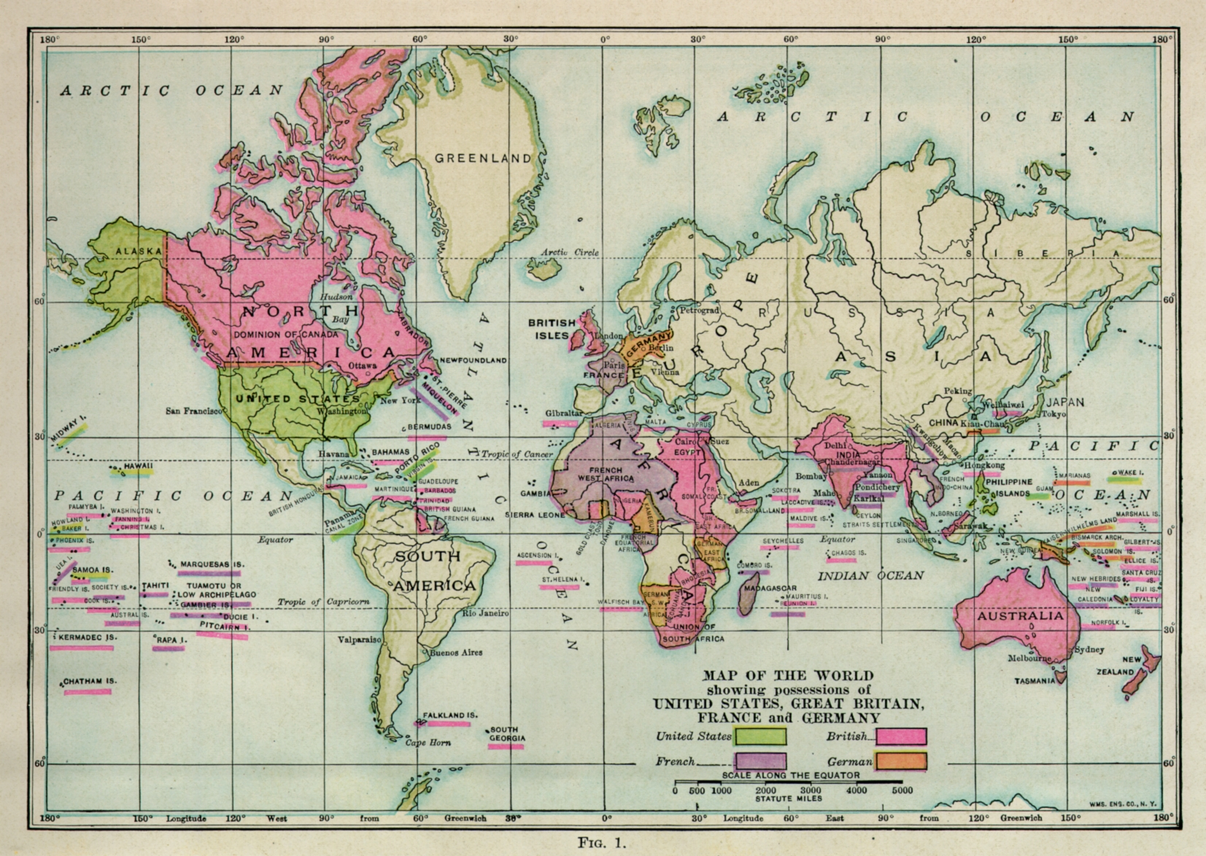
TEMPLATES AND ATLASES

Slide 2
Abbrevs used here
abbrev = abbreviation
AKA = also known as
anat = anatomical
corr = correlation
diff = difference
dset = dataset
e.g. = exempli gratia (= “for example”)
EPI = echo planar image
Ex = example
FOV = field of view
i.e. = id est (= “that is”)
ijk = coordinate indices (integer)
NB = nota bene (= “note well”)
phys = physics or physical
ref = reference
ROI = region of interest
subj = subject
vol = volume
vox = voxel(s)
xyz = physical coordinates (units of mm)

Slide 3
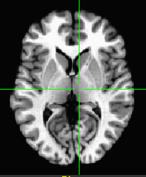
Definitions
Template
A reference dataset (typically whole brain) used for matching shapes, reporting coordinates of results, etc.
Ex: TT_N27+tlrc, MNI_EPI+tlrc, TT_ICBM452+tlrc.
TT_N27+tlrc

Slide 4
Definitions
Template Space
An (x, y, z) coordinate system shared by many datasets in alignment with a template.
Ex: TLRC (Talairach-Tourneaux), MNI, MNI_ANAT, ORIG.
To see what “space” a dset is in, type:
3dinfo -space DSET_NAME

Slide 5
Definitions
A note on AFNI usage of “tlrc”:
The “+tlrc” extension in a dataset’s name is used to denote that the volume in question is in a standardized space; it does not always mean that the standard space in question is the Talairach-Tournoux one, specifically-- it could be MNI, pediatric template, macaque, ...
Hopefully the context makes things clear.
(Typically, there are so many templates for a given space now-- MNI, for example, has several templates-- that one really has to specify the full file name of a template to be able to refer to it unambiguously, anyways.)

Slide 6
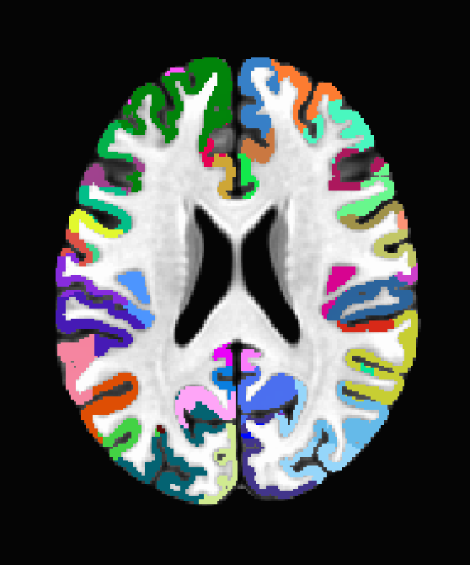
Definitions
Atlas
A dset containing segmentation or parcellation information. It can be considered a “map” of ROIs: each ROI is defined as a set of voxels with a certain integer value (and a string label can be attached to each ROI).
Ex: Brodmann_pijn_afni.nii.gz, my_roidset+orig.
Brodmann_pijn_afni.nii.gz
See more description about templates+atlases (including making your own) on the AFNI website:
https://afni.nimh.nih.gov/pub/dist/doc/htmldoc/template_atlas/framework.html

Slide 7
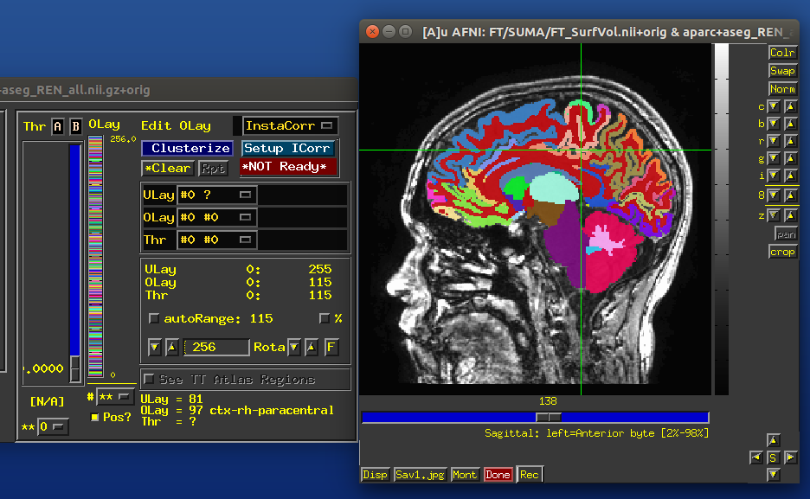
Definitions
Atlas (or general ROI) label in GUI
integer value of ROI
associated string label

Slide 8
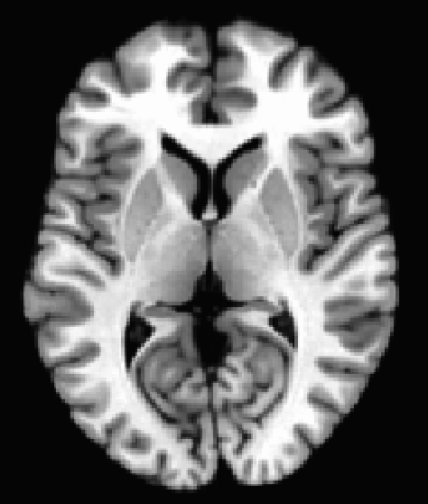
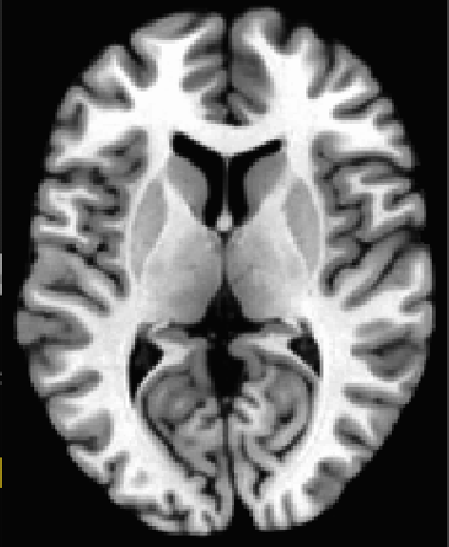
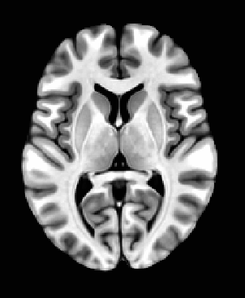
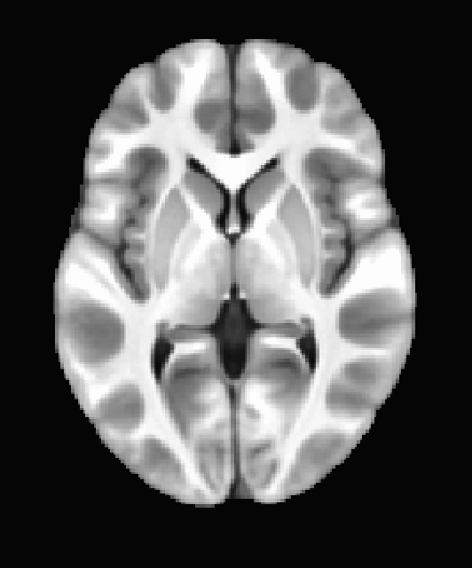
Templates included with AFNI
After default AFNI installation, these templates (and others) would be in ~/abin/:
TT_N27
MNI_CAEZ_N27
MNI152_T1_2009c
Haskins_Peds
What important properties does each dset here have?

Slide 9
Choosing a template
Try to pick a template that...
is similar to the subject group: neonates, pediatric, young adults, elderly, macaque, rabbit...
is of the same modality and coverage as your data sets
has a relevant atlas segmentation

Slide 10
Choosing a template
Try to pick a template that...
is similar to the subject group: neonates, pediatric, young adults, elderly, macaque, rabbit...
is of the same modality and coverage as your data sets
has a relevant atlas segmentation.
You can also make your own template (and maybe an atlas too):
Individual or group template
  Group: average or iterative (discussed more later)
Scripts/commands exist in AFNI
  Ex. Haskins pediatric atlas
    several methods tested
    best approach: iterative nonlinear alignment
      @toMNI_Awarp, @toMNI_Qwarpar
      And soonish make_template_dask.py

Slide 11
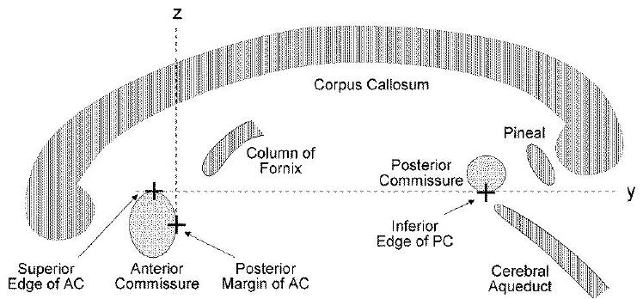

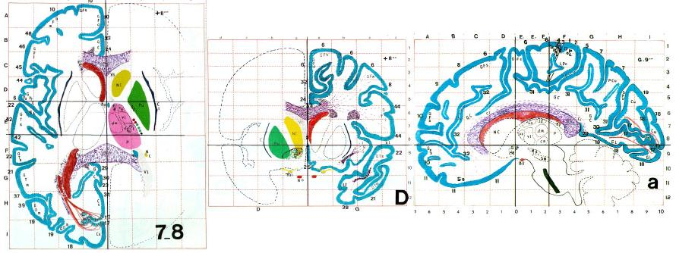
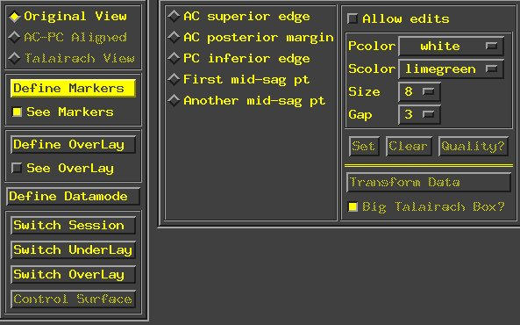
Talairach Templates, Procedures
Jean Talairach and Pierre Tournoux
“Co-Planar Stereotaxic Atlas of the Human Brain”
Thieme Medical Publishers, New York, 1988

Slide 12
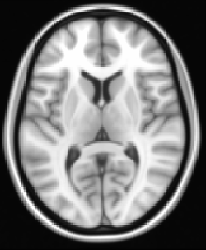
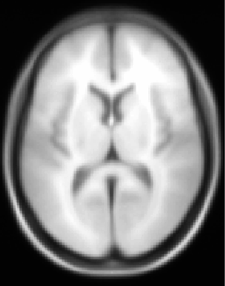
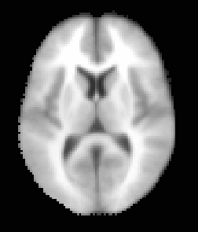
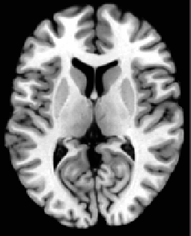
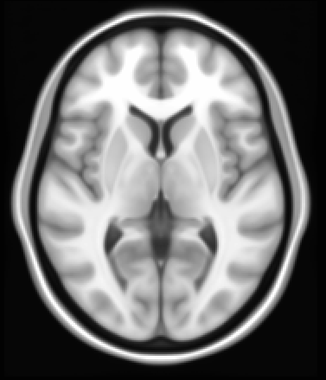
The Many Faces of MNI Templates
MNI_305 -
the first MNI template, (“sort of Talairach AC-PC”) 1992
MNI N27
MNI_caez_N27, “Colin brain”, 1998
MNI_152 (2mm)
MNI cohort of ICBM452, 2001
MNI_2006 asym “6th generation”
(FSL,SPM)
MNI_2006 sym (MNI)
MNI_2009c asymmetric.
Unifized in AFNI.
a,b,c versions, symmetric/asymmetric, different grids
1mm,0.5mm, 2011
+Other MNIs: MNI_ANAT (SPM Anatomy Toolbox), HCP40, HCP900, Mai-MNI,....

Slide 13
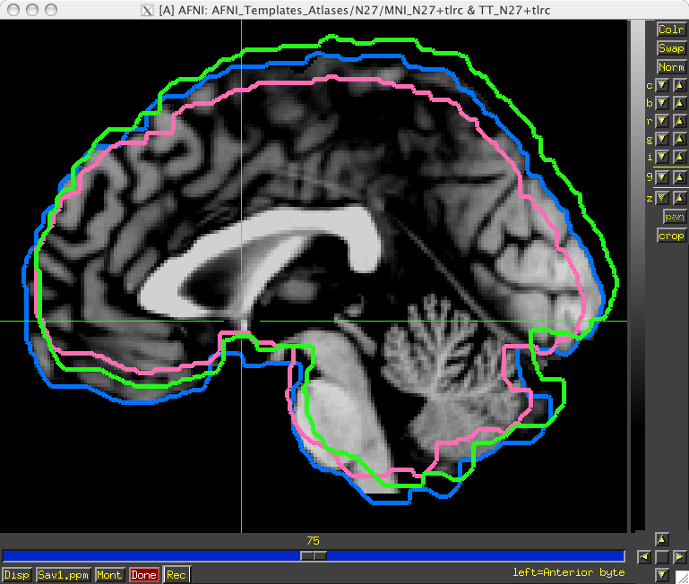
Template spaces differ in origin
TLRC, MNI, and MNI-Anat

Slide 14
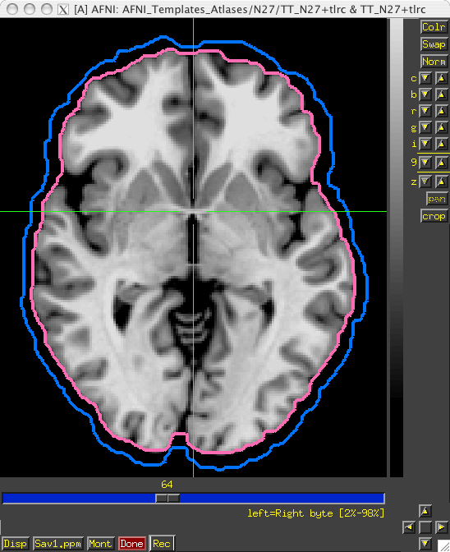
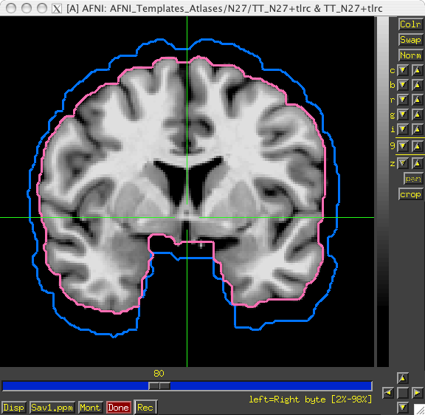
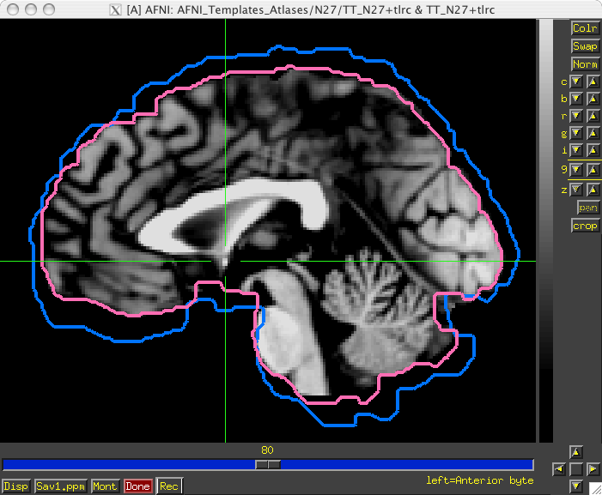
Template spaces differ in size
The MNI brain is larger than the TLRC brain.

Slide 15
From space to space
TLRC, MNI, and MNI-Anat
For going between TLRC and MNI:
Approximate equation
→ used by whereami and 3dWarp
A manual TLRC transformation of MNI
template to TLRC space
→ used by whereami (as precursor to
MNI Anat.), based on N27 template
Multiple space coordinates reported
in whereami output
(AFNI_ATLAS_TEMPLATE_SPACE_LIST)
For going between MNI and MNI Anat (Eickhoff et al., 2005):
MNI + (0, 4, 5) = MNI Anat. (in RAI coordinate system)
Going between TLRC and MNI Anat (as practiced in whereami):
Go from TLRC (TT_N27) to MNI via
manual transform of N27 template
Add ( 0, 4, 5 )
Going between TLRC and MNI:
  Approximate equation
    used by whereami and 3dWarp
  Manual TLRC transformation of MNI template to TLRC space
    used by whereami (as precursor to MNI Anat.), based on N27 template
  Multiple space coordinates reported in whereami output (AFNI_ATLAS_TEMPLATE_SPACE_LIST)
Going between MNI and MNI Anatomical (Eickhoff et al. Neuroimage 25, 2005):
  MNI + ( 0, 4, 5 ) = MNI Anat. (in RAI coordinate system)
Going between TLRC and MNI Anatomical (as practiced in whereami):
  Go from TLRC (TT_N27) to MNI via manual xform of N27 template
  Add ( 0, 4, 5 )

Slide 16
Finding your space
3dinfo -space -prefix *.HEAD *.nii.gz
HaskinsPeds HaskinsPeds_NL_atlas1.01
HaskinsPeds HaskinsPeds_NL_template1.0
MNI_N27 MNI_caez_N27
MNI_N27 MNI_caez_gw_18
MNI_N27 MNI_caez_lr_18
MNI_N27 MNI_caez_ml_18
MNI_N27 MNI_caez_mpm_22
TT_N27 TT_N27
TT_N27 TT_caez_gw_18
TT_N27 TT_caez_lr_18
TT_N27 TT_caez_ml_18
TT_N27 TT_caez_mpm_22
MNI BN_Atlas_246_1mm.nii.gz
MNI_N27 Brodmann.nii.gz
MNI_2009c_asym Brodmann_pijn_afni.nii.gz
MNI_2009c_asym FS.afni.MNI2009c_asym.nii.gz
TT_N27 FS.afni.TTN27.nii.gz
HaskinsPeds HaskinsPeds_NL_template1.0_SSW.nii.gz
MNI_2009c_asym Julich_MNI2009c.nii.gz
MNI_N27 Julich_MNI_N27.nii.gz
MNI_2009c_asym MNI152_2009_template.nii.gz
MNI_2009c_asym MNI152_2009_template_SSW.nii.gz
MNI_2009c_asym MNI_Glasser_HCP_v1.0.nii.gz

Slide 17
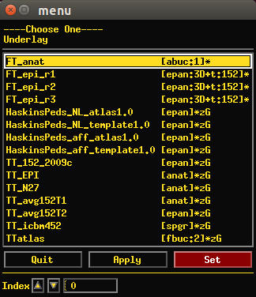
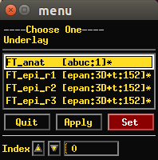
Templates included with AFNI
A helpful note on viewing templates (or any dsets) each time you open up the AFNI GUI, regardless of directory!
Set the AFNI_GLOBAL_SESSION variable in your ~/.afnirc file, e.g.,:
AFNI_GLOBAL_SESSION = /home/nmandela/abin
All dsets there will appear in your “Underlay” or “Overlay” menu in the AFNI GUI.
(Use full path of directory, no “~” or “$HOME”.)
Ex: then open AFNI GUI in some directory, say:
~/AFNI_data6/FT_analysis/FT/
after
before

Slide 18
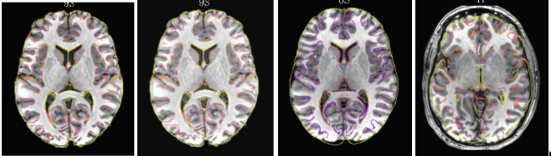
Trading Spaces
How to transform data to a standard template space
sswarper2 – skullstrip and align data to some select standard spaces
@animal_warper - skullstrip, align data to animal template and bring atlas into native space
auto_warp.py -combination affine and nonlinear alignment to a template
@auto_tlrc – affine alignment to a template
Manual talairach
sswarper2/@SSw
AW
@at
manual

Slide 19
Trading Spaces with afni_proc.py
-blocks ... tlrc volreg
-volreg_tlrc_warp
-tlrc_base $tpath/$btemplate (runs @auto_tlrc)
-tlrc_NL_warp (runs auto_warp.py)
For sswarper2 output, add these:
-copy_anat anatSS.${subj}.nii \
-anat_has_skull no \
-tlrc_NL_warp \
-tlrc_NL_warped_dsets \
anatQQ.${subj}.nii \
anatQQ.${subj}.aff12.1D \
anatQQ.${subj}_WARP.nii

Slide 20
Standard spaces
Reasons to use a standard template space:
Compare across subjects and groups easily for every voxel in the brain
Standardize coordinates with others
Know where a voxel is automatically from an atlas
Mostly automated and no specific ROI drawing required
Reasons not to use a standard template space:
Inconsistency among subjects
Inconsistency among groups – elderly versus younger
Use consistent anatomical ROIs with good anatomical knowledge
Lower threshold for multiple comparison adjustments
Methods like DTI require much of the processing to be done in subject space
Surface analysis
Surgical, subject-specific coordinates for TMS, DBS (but can still use template alignment to move atlases to subject space)

Slide 21
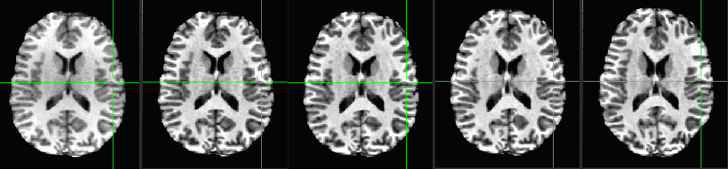
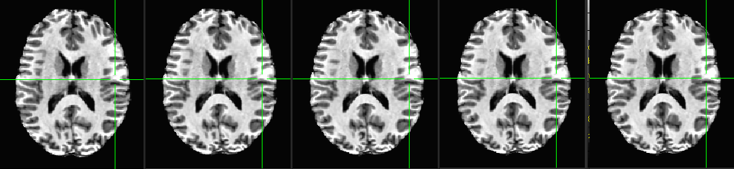
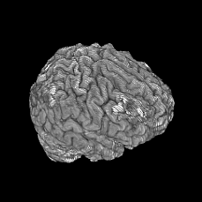
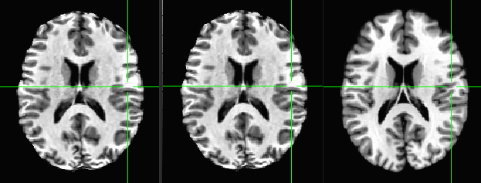
Nonlinear alignment to template
3dQwarp, through multiple levels of refinement →
@auto_tlrc 3dUnifize qw0 qw1 qw2
qw3 qw4 qw5 qw6 qw7
qw8 qw9 TT_N27

Slide 22
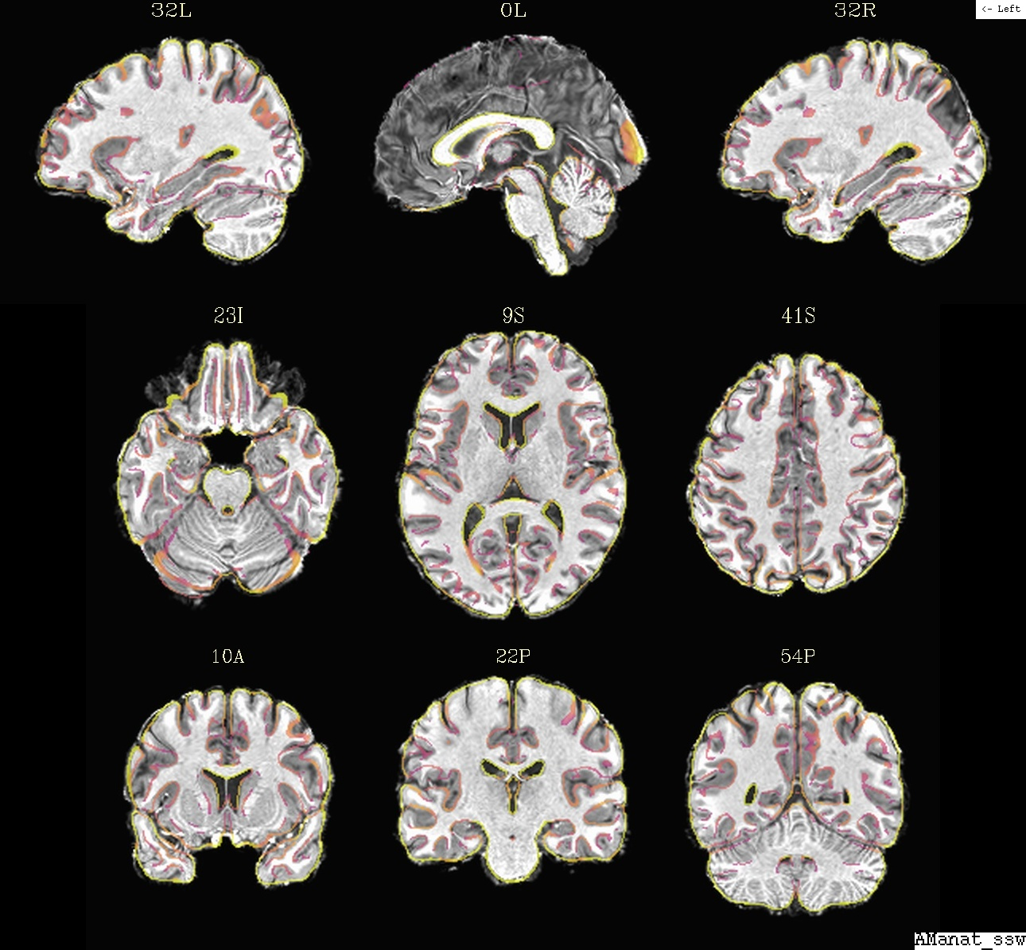
Nonlinear alignment to template
Multiple nonlinear alignment tools in AFNI
3dQwarp: the standard nonlinear workhorse
auto_warp.py: wrapper for alignment functionality, ~simpler syntax
(@auto_tlrc + 3dQwarp together)
Ex: auto_warp.py -base MNI152_T1_2009c+tlrc. \
-suffix _awarp -input strip+orig.
sswarper2: skull stripping and alignment in one-- and bonus automatic QC images
+ sswarper2 uses a multi-volume base; several exist for standard templates already, and more can be made-- see full description for these online:
https://afni.nimh.nih.gov/pub/dist/doc/htmldoc/template_atlas/sswarper_base.html

Slide 23
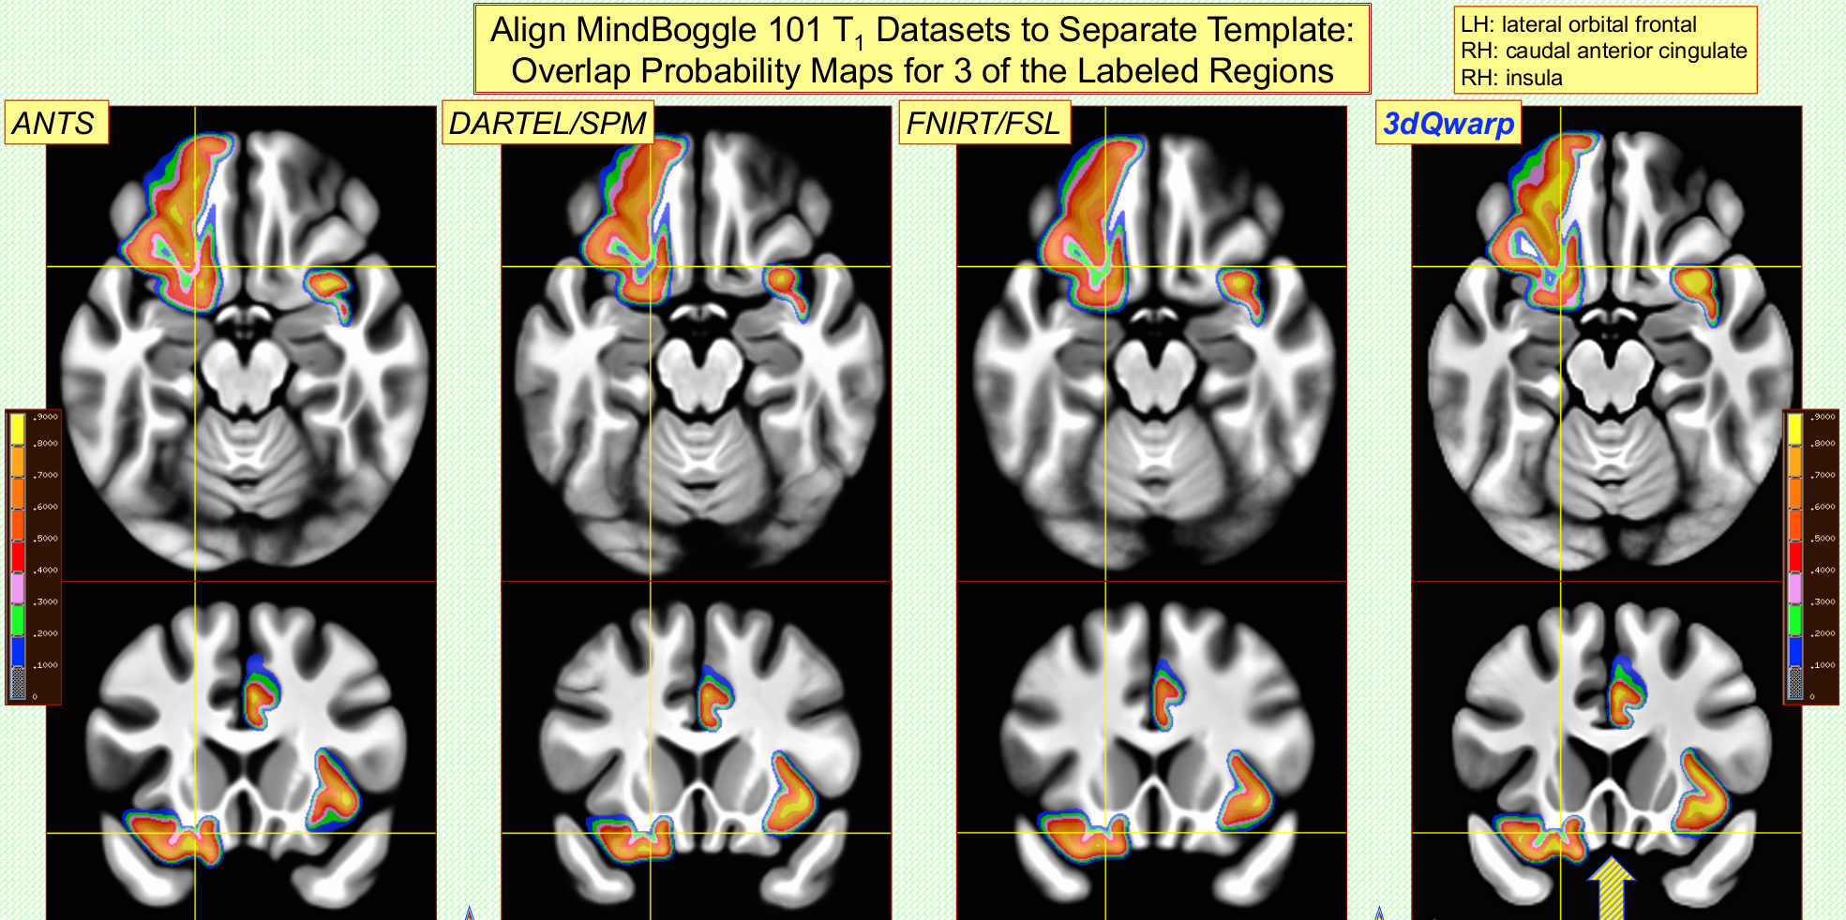
Measuring quality of alignment
Can compare 3dQwarp with other available nonlinear alignment tools
+ For a group of subjects, estimate warp from anat to template
+ Apply warp to labeled ROIs, and measure % overlap in results. (Yellow: >90% overlap)
ANTS, DARTEL and FNIRT run with default settings
(Cox & Glen, 2013, OHBM)

Slide 24
2023 Atlas Overhaul
a new dawn, a new day
Cleaning Up:
Removal of TTatlas+tlrc - Talairach daemon
Removal of other older SPM Anatomy Toolbox atlases, no MNI_ANAT atlases
Adding On:
Addition of Brodmann-Pijnenburg atlases MNI_N27 and MNI_2009d
Addition of JulichBrain atlases for MNI_N27 and MNI_2009c
Addition of FreeSurfer atlases for TT_N27 and MNI_2009c
Making Changes:
Default Atlas for “Show atlas colors”, “Go to atlas location” is Brodmann_Pijn_AFNI (MNI_2009c)
Atlases identified with specific template spaces for MNI - MNI_N27, MNI_2009c.
Atlas versions and description in AFNI header and in NIFTI header
Default atlas search updated
Default template space list for coordinates shown is TLRC, MNI (no MNI_ANAT)

Slide 25
Going where the atlases live
AFNI binary directory for datasets and configuration
AFNI_atlas_spaces.niml describe the distributed atlases
CustomAtlases.niml and SessionAtlases.niml allow for more atlases and templates
Saving the Environment (in .afnirc)
AFNI_ATLAS_LIST "CA_ML_18_MNI,DKD_Desai_MPM"
"ALL"
AFNI_TEMPLATE_SPACE_LIST “MNI,TLRC”
AFNI_ATLAS_COLORS CA_ML_18_MNI
AFNI_SUPP_ATLAS_DIR ~/MyAtlases
AFNI_WHEREAMI_DEC_PLACES 2
AFNI_WHEREAMI_MAX_SEARCH_RAD 3

Slide 26
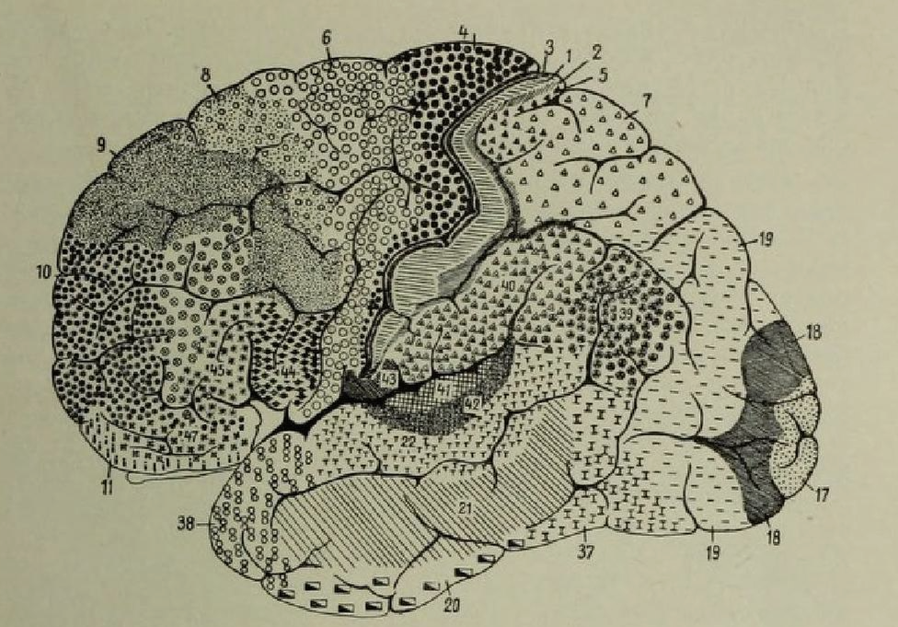
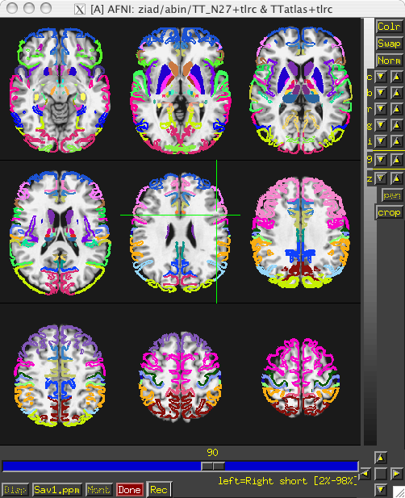
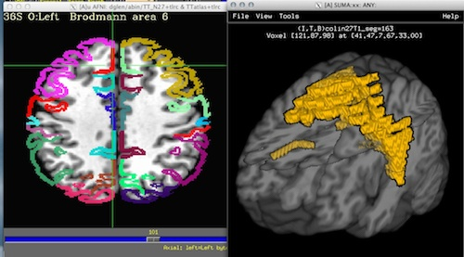
Early Atlases -Talairach Daemon
Brodmann, 1909
Talairach, 1988
Half brain- 5mm slices
No MRI volume
Lancaster, 2000
Removed from AFNI, 2023?

Slide 27
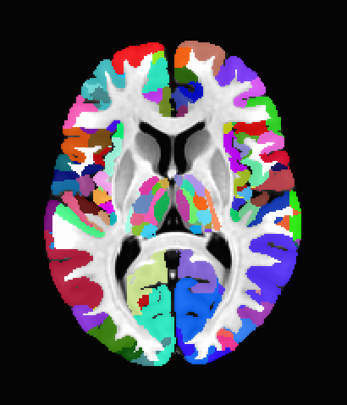
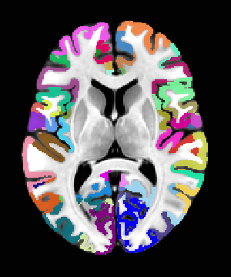
JulichBrain 3.1
(replacing Eickhoff-Zilles, 3.0 atlases)
Cytoarchitectonic, 10 subjects for
414 region MPM (probabilistic available from EBRAINS), cortical and subcortical
MNI_N27, MNI_2009c
(AFNI working with EBRAINS and Julich groups for updates)
Brodmann-Pijnenburg
“Classical atlases” - Heuvel group
MNI_N27
MNI_2009c (AFNI reprojection)

Slide 28
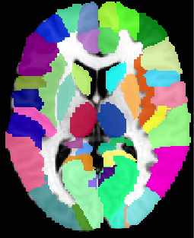
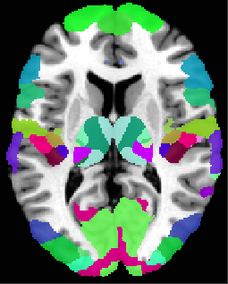
Eickhoff-Zilles Macrolabel (AAL)
MNI_N27 (shifted)
TT_N27 (transformed)
Eickhoff-Zilles MPM 2.2
MNI_N27 (shifted)
TT_N27 (transformed)
10 subject probabilistic atlases also available

Slide 29
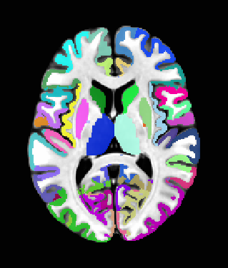
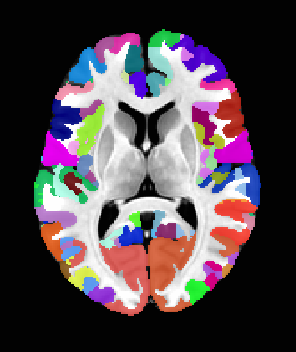
Freesurfer recon-all
Destrieux Gray matter regions
TT_N27
MNI_2009c
HCP Glasser
360 region - FMRI task-based
MNI_2009c - AFNI projection with Megan Robinson, Michael Beauchamp (formerly Baylor)

Slide 30
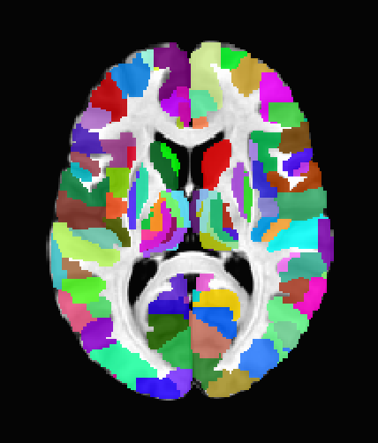
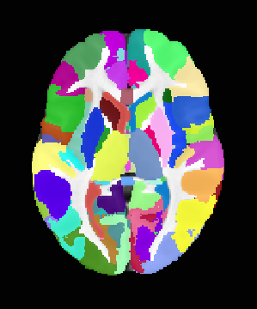
Brainnetome
DTI-based, L. Fan, T. Jiang
HCP-40 (~MNI_2009c)
246 regions
Haskins Pediatric
MNI_2009c
75-subject 10 year old median age (6-13 years)
AFNI-Haskins, P. Molfese

Slide 31
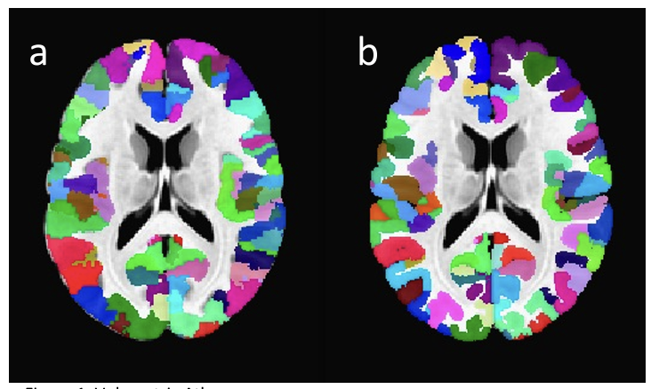
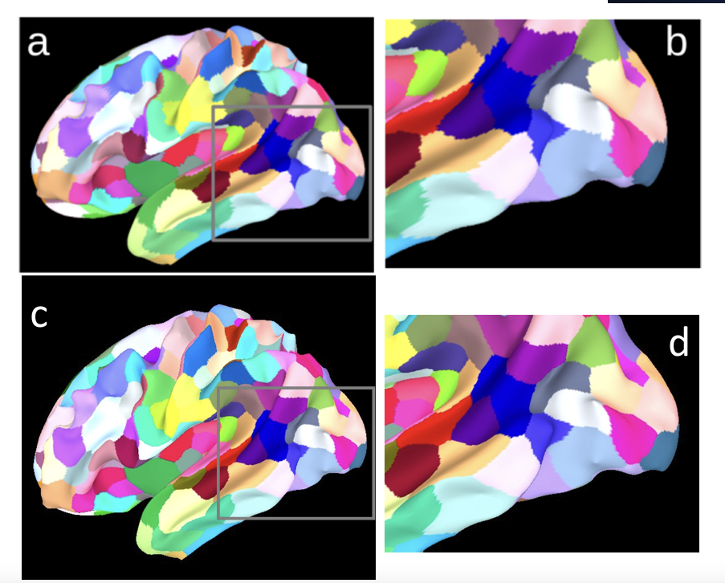
Schaefer-Yeo atlases -available on AFNI website
Resting state based regions of similar sizes labeled by overlap with 7 or 17 resting state networks and anatomical regions.
100 - 1000 regions per atlas
AFNI version
Modally smoothed on surface and projected into MNI_2009c volume
400 region 17-network atlas shown here

Slide 32
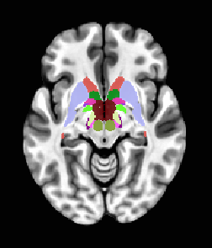
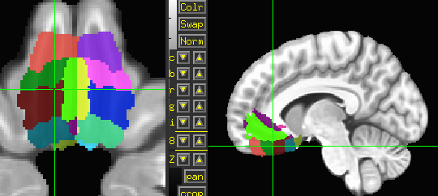
Pauli subcortical atlas
MPM atlas
AFNI version MNI_2009c space
Ventromedial Prefrontral Cortex
(vmPFC, Scott Mackey)
MPM atlas
AFNI version MNI_2009c

Slide 33
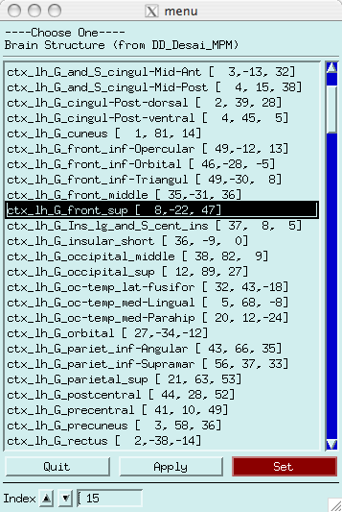
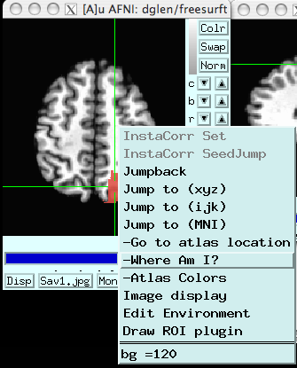
Using atlases in AFNI GUI
Some fun and useful things to do with +tlrc datasets are on the 2D slice viewer.
Ex: can be run in ~/AFNI_data6/afni/
1) Right click to get menu:
  [Go to Atlas Location]
Lets you jump to centroid of regions to current default atlas (set by AFNI_ATLAS_COLORS) Works in +orig, too.

Slide 34
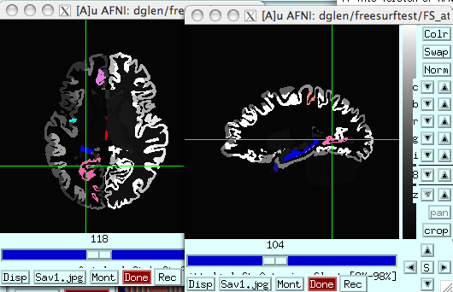
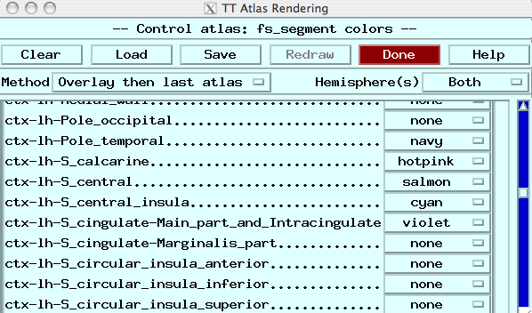
  [Atlas colors]
  Lets you show atlas regions over your own data (works only in +tlrc).

Slide 35
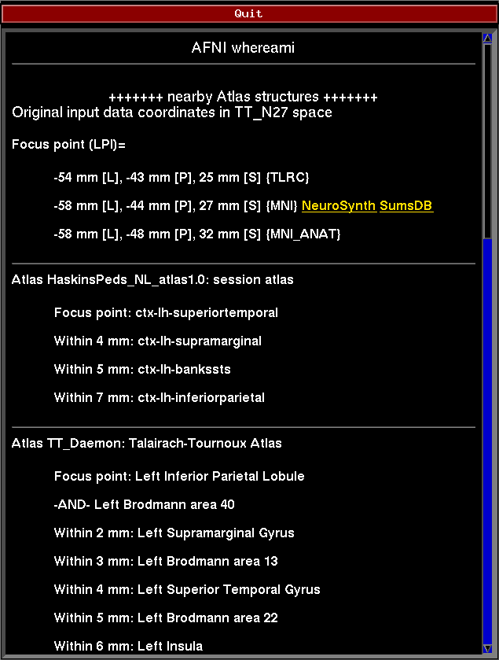
  [Where am I?]
Shows you where you are in various atlases and spaces
(works in +orig too, if you have a transformed parent)
For atlas installation, and much, much more, see help in command line version:
whereami -help

Slide 36
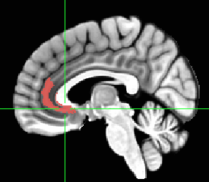





What’s in a name ... or a coordinate?
FS (MNI2009c) rostral anterior cingulate
Brainnetome A24rv_right
HCP Glasser area A24 (red) and area 25 (purple)
Brodmann-Pijnenburg BA24
JulichBrain Area_s24 (sACC)
Ventromedial Prefrontal
Cortex atlas
(Area_s24 (sACC) in cyan)

Slide 37
whereami on the command line
Try these simple examples:
whereami -show_atlases
whereami -space MNI 20 10 5
whereami -show_atlas_code
Citation info and descriptions
Understand coordinate order. Use -lpi or default -rai?
3dinfo -labeltable ~/abin/MNI_caez_ml_18+tlrc.
3dinfo -atlas_points ~/abin/MNI_caez_ml_18+tlrc.

Slide 38

whereami on the command line
whereami can combine usefully with 3dClusterize:
1) 3dClusterize finds cluster volumes, and
2) whereami provides detailed info like overlap with atlas regions
Ex: can be run in ~/AFNI_data6/afni/
# Threshold the index-0 vol (an F-stat) at >9.5 and
# find clusters with >=1000 voxels
3dClusterize -1sided RIGHT 9.5 \
-clust_nvox 1000 -NN 1 \
-inset func_slim+orig -ithr 0 -idat 0 \
> clusts.1D
# Use the center of mass coords in
# cols [1,2,3] to show location according
# to several atlases (TT, MNI, etc.); also
# shows nearby structures
whereami \
-coord_file \
clusts.1D'[1,2,3]' \
-tab | more

Slide 39

whereami on the command line
whereami can also report the overlap of ROIs with atlases
Ex: can be run in ~/AFNI_data6/afni/
# Quick way to make test ROI a sphere at a given location)
echo -14 66 23 > tmp.txt
3dUndump \
-xyz \
-prefix tmproi.nii.gz \
-master anat+tlrc \
-datum byte \
-srad 9.5 \
tmp.txt
# report overlap
whereami \
-omask tmproi.nii.gz

Slide 40
Make your own atlas!
New atlases – easy and fun. Make your own!
  make available in AFNI GUI and whereami and to other user
@AfniEnv -set AFNI_SUPP_ATLAS_DIR ~/MyCustomAtlases/
Then:
@Atlasize -space MNI -dset atlas_for_all.nii \
-lab_file keys.txt 1 0 -atlas_type G
In ~/MyCustomAtlases/ you will now find atlas_for_all.nii along
along with a modified CustomAtlases.niml file.

Slide 41



Make your own template
make_template_dask.py - Dask parallelization - 10, 100 or 1000 subjects on a cluster, server or PC

Slide 42
Preprocessing
(center, skullstrip, unifize)
Nonlinear mean
(resize, unifize/anisosmooth)
Rigid mean
Nonlinear means
Final mean
Affine subjects and mean
Nonlinear warps
Nonlinear warps-
resized
Rigid subjects
Dask Template task graph

Slide 43

Haskins Pediatric Atlas: the templates
Affine Group
Nonlinear Group I –
iterative

Slide 44



ALTERNATIVE ATLAS CREATION TECHNIQUES: ITERATIVE AND TYPICAL METHODS
B
C
Iterative nonlinear alignment to affine template with progressively smaller patch sizes
“Typical”
Brain

Slide 45

Haskins Pediatric Atlas

Slide 46

Indian Brain Template C2: IBT
@Install_IBT

Slide 47










Templates and Atlases across Species in AFNI

Slide 48


Saleem macaque atlas – MRI, surfaces, connections, subcortical regions
@Install_D99_macaque
Marmoset subcortical atlas too!
@Install_SAM_marmoset
@Install_D99_macaque - install templates, atlas and set AFNI variables

Slide 49

Mapping the digital atlas onto different macaques MRI
Alignment with @animal_warper
-feature_size to control for various animal resolution “features” - blurring and neighborhood size for alignment costs
Moves dataset to template space and atlases to native space
Notes:
Atlas and template application
Using five naive macaques, we aligned each macaque's T1 brain MRI to the template created here with a sequence of affine and nonlinear registration steps. An initial affine step proved and approximate scaling. A small amount of nonlinear warping was then used to warp the general brain shape to the template. A brain-only mask from the template was applied to the individual subject brains and the subject was more finely warped to the template by progressively smaller nonlinear warps. This procedure resulted in subject brain data to be registered to the D99 template space. In order to demonstrate the applicability of the atlas to each macaque, the combination of affine and nonlinear transformations were used to warp the atlas segmentation back to each subject's original native space. The results are shown in in figure XXX…
<number>

Slide 50



NMT (NIH Macaque Template)
Group template from 31 macaques (+ surfaces, GM/WM/CSF segmentation)
With CHARM -
6 level cortical hierarchical atlas!
And SARM -
6 level subcortical hierarchical atlas!
@Install_NMT

Slide 51

2018: improved NIH Marmoset Template
@Install_NIH_Marmoset
@Install_NIH_Marmoset
(Liu et al., 2018, SfN)

Slide 52

2020:more improved MBM Marmoset Population Template
MBMv3
@Install_MBM_Marmoset,
MBMv4 - resting state networks included

Slide 53

2024 : Human Subcortical Atlas of the Human Brain
Subcortical regions including thalamus sub-regions, Cerebellum, Brainstem
Defined at 0.5mm with ex-vivo brain, high resolution MAP-MRI, brainstem histology

Slide 54



Rats and Mice
Waxholm Rat Atlas - Papp, et al. - AFNI version
Allen Mouse CCF3 - AFNI version

Slide 55

And Dogs
CornDog - Philippa Johnson at Cornell

Slide 56



Individual Subjects
@SUMA_MakeSpecFS – atlasizes too!
FreeSurfer segmentation
Overlay panel shows structure name. Now FreeSurfer segmentation can also be used in whereami.
Manual segmentation

